Slide 1


Stark broadening from impact theory to simulations
R. STAMM¹
I. HANNACHI², M. MUREINI¹,
L. GODBERT-MOURET¹, M. KOUBITI¹
Y. MARANDET¹, J. ROSATO¹
M. DIMITRIJEVIC³ and Z. SIMIC³
1 Physique des Interactions Ioniques et Moléculaires
Aix-Marseille université / CNRS
2 University Batna 1
3 Astronomical Observatory, Belgrade, Serbia

Slide 2
Outline
Introduction
Different impact models
Beyond impact
Conclusion

Slide 3
Collision and radiation, Lorentz profile
perturber
Atom (emitter)
Light emission (frequency ω₀)
Lorentz model : the perturber cuts the light wave W(t)= exp(iω₀t) as it gets near to the emitter (collision)
Emitter W(t) starts at t=0, ends at t=τ (average time between strong collisions)
Power spectrum I(ω)=W(ω) W*(ω):
Lorentz profile collisionnal broadening
Notes:
Classically, reducing the light lifetime by a sudden collision leads to a lorentz profile All or nothing

Slide 4
Quantum mechanics
Uncertainty principle. An energy level above ground state with energy E and lifetime Δt has uncertainty in energy:
States which are short-lived have large uncertainties in the energy.
This is natural broadening and leads also to a Lorentzian profile
Reducing the lifetime of a state broadens the spectrum of the emitted line
But broadening can be done gradually, each perturbation changing e.g. the phase of the light
dephasing effect
collision

Slide 5
Nonbinary quantum calculation or impact approximation?
Starting point : dipole d of the emitter
The effect of perturbations is a change of the emitted radiation.
This can be measured by the dipole autocorrelation function (DAF) of the emitter
T(t) emitter evolution operator, ρ density matrix
Trace over all possible states of the quantum system emitter plus perturbers
Could be calculated by density functional theory or quantum Monte Carlo methods (density functional method, quantum Monte Carlo)
But for a large range of conditions:
-Collisions are binary
-Collision time is much larger than the time of interest (inverse of line width)
These are the validity conditions of the impact approximation
Notes:
Quick historical review on the work of milan dimitrijevic, and the many interaction we had during our carreres

Slide 6
Outline
Introduction
Different impact models
Beyond impact
Conclusion

Slide 7
Quantum impact for emitter and perturbers
Perturbers as wave packets
Each wave packet is scattered in the interaction potential with the emitter
Started in 1970 (Barnes and Peach, Bely and Griem)
Calculation for isolated lines of ions, with an expression using the optical theorem:
where N is the perturbers density, v their velocity, and σ_{i} and σ_{f} are inelastic cross sections, f_{i} and f_{f} the forward scattering amplitudes in a direction given by θ, ϕ for the initial i and final f states.
New life today for such calculations (Elabidi, Sahal-Bréchot, Dimitrijević), often in agreement with other methods

Slide 8
Isolated lines: efficient semi-empirical model
Makes use again of the expression using the optical theorem
Bethe-Born approximation for evaluating inelastic cross sections
Width expressed with a Gaunt factor (a quantity which measures the probability than an incident electrons changes its kinetic energy )
Numerous calculation performed for isolated ion lines of astrophysical interest
Dimitrijević and Konjević.
Collaboration Belgrade-Marseille
Results allowed many diagnostic applications
Notes:
Take another point of view: simple analytic approach, 1992 ICSLS, organized with the help of Nicalas Konjevic

Slide 9
Classical path approximation, ion lines
Perturbers follow a classical trajectory
Valid if the wave packet remains well localized in space
For isolated lines, the semi classical perturbation method (SCP) has been applied successfully to many kinds of emitters (Dimitrijević, Sahal-Bréchot)
Inspired by all the developments of the quantum theory of collisions (Clebsch-Gordan averages)
Accuracy generally better than 20 to 30% for the width.
Method continuously improved, and interfaced with atomic structure codes
Collaborations: Meudon observatory, ICSLS, since 1980’s

Slide 10
Classical versus quantum impact calculations
Quantum calculations have often been found to predict narrower lines than those of semiclassical models
Semiclassical calculations may be brought closer to quantum widths, e.g. by a refined calculation of the minimum impact parameter allowing the use of a classical path
Surprisingly, quantum widths of Li-like and boron-like ions often show a worse agreement with experiments than semiclassical calculation, thus calling for further calculations and analysis
Collaboration: SLSP

Slide 11
Outline
Introduction
Different impact models
Beyond impact
Conclusion

Slide 12
Beyond
Standard model (impact electrons and static approximation for ions) not validated by accurate hydrogen line profile measurements in arc plasmas (nineteen seventies)
Problems in the line centers, and also in the far wings.
-line wings well reproduced by unified theory
-The observation of the Lyman α line 40 years ago showed that the experimental profile is a factor 2.5 broader than the theoretical line using static ions in arc plasma conditions.
Grützmacher K. ; Wende B. Discrepancies between the Stark–broadening theories of hydrogen and measurements of Lyman α Stark profiles in a dense equilibrium plasma Phys. Rev. A 1977, 16, 243-246.

Slide 13
Alternative Stark broadening models
Ion dynamics models
No analytic solution
Use of stochastic processes:
-model microfield method (MMM), Stehlé, C. Astrophys., Suppl. Ser. 1994, 104, 509-527.
-Frequency fluctuation model, Talin et al. Phys. Rev. A 1995, 51, 1918-1928
These models use statistical properties of the microfield (PDF, <E(0)E(t)>)
-Use of a numerical simulation for the microfield coupled to a numerical integration of the emitter Schrödinger equation
Periodic boundary conditions or recycling boundary conditions

Slide 14
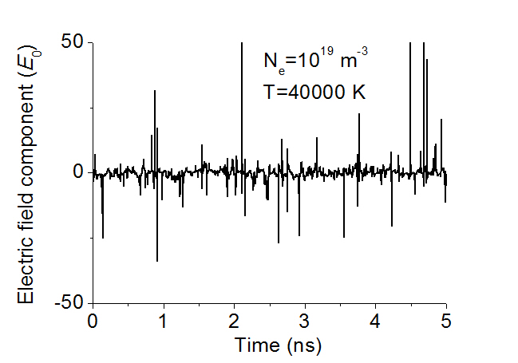
Numerical simulation
One component of the electric field during the time of interest of Lyman α (L_{α})
Binary condition : Weisskopf radius << r₀ , here

Slide 15
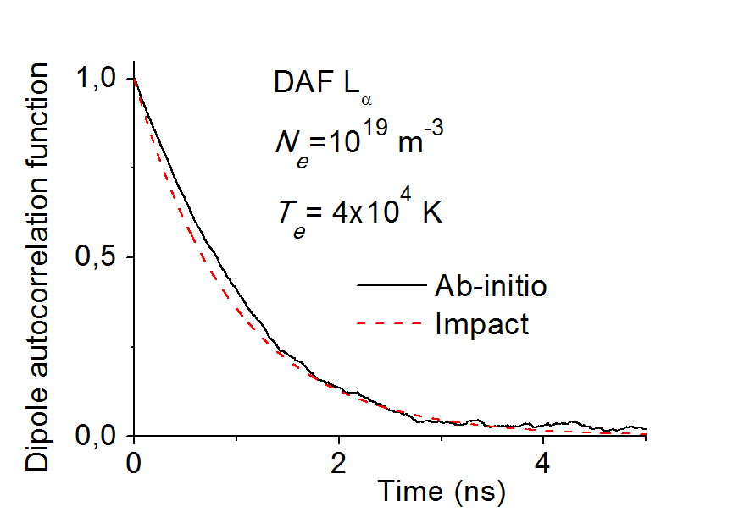
Numerical simulation
Dipole autocorrelation function (DAF) for Lyman α (L_{α})
Integration over 3000 field histories for the Ab-initio numerical simulation

Slide 16
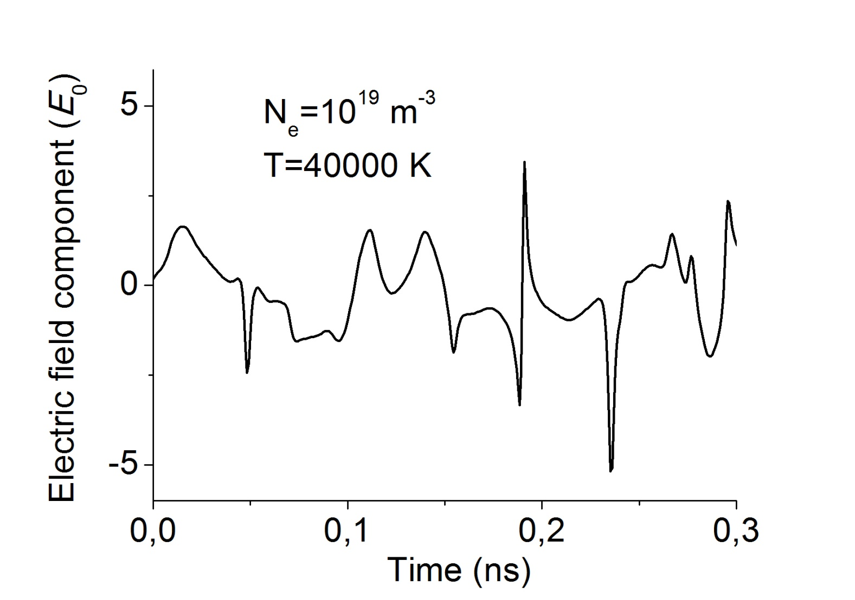
Numerical simulation
One component of the electric field during the time of interest of Balmer β (H_{β})

Slide 17
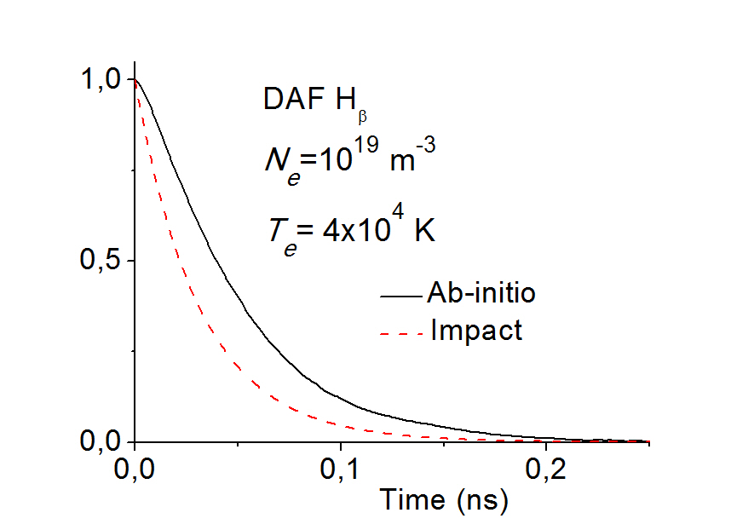
Numerical simulation
Dipole autocorrelation function (DAF) for Balmer β (H_{β})
Integration over 3000 field histories for the Ab-initio numerical simulation

Slide 18
Numerical simulation
In near impact conditions, there is always a background of electric field fluctuations with a magnitude of about E₀ or and a typical time scale longer than the collision time r₀/v_{i}.
Such fluctuations correspond to the sum of electric fields of distant particles.
For hydrogen lines affected by linear Stark effect, it is well known that this effect of weak collisions is dominant in near impact regimes and results from the long range of the Coulomb electric field. (Griem).
Integration over 3000 field histories for the Ab-initio numerical simulation

Slide 19
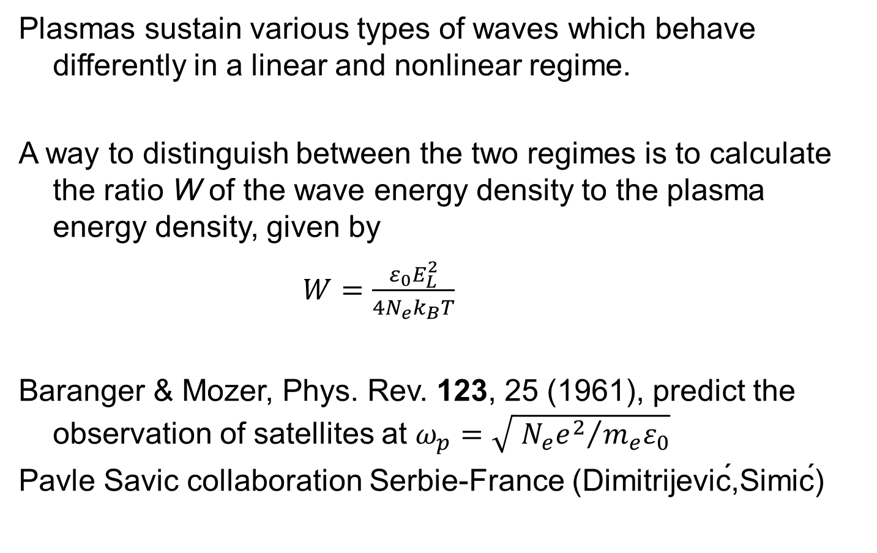
Line shape with Langmuir waves
Plasmas sustain various types of waves which behave differently in a linear and nonlinear regime.
A way to distinguish between the two regimes is to calculate the ratio W of the wave energy density to the plasma energy density, given by
$W=\frac{ε_{0}E_{L}^{2}}{4N_{e}k_{B}T}$
Baranger & Mozer, Phys. Rev. 123, 25 (1961), predict the observation of satellites at $ω_{p}=\sqrt{{{ N}_{e}e^{2}}/{m_{e}ε_{0}}}$
Pavle Savic collaboration Serbie-France (Dimitrijević,Simić)
Notes:
Pay tribute to Baranger who passed away last october

Slide 20
Simulation for linear waves
One electric field history corresponds to one Langmuir wave with a given electric field direction, magnitude and phase
The dipole autocorrelation function (DAF) is obtained after an average over thousand field histories
We integrate the Schrödinger equation retaining the impact broadening of the background plasma, plus the waves
For L_{α}, N_{e}=10¹⁹ m⁻³, T=10⁵ K, and W=0.01 (E_{L}=15 E₀)
Response of the DAF: oscillation with period 2π/ω_{p}, but almost not visible
Notes:
There are observational signatures, Why not in your favorite plasma, if there is an energy source AGN

Slide 21
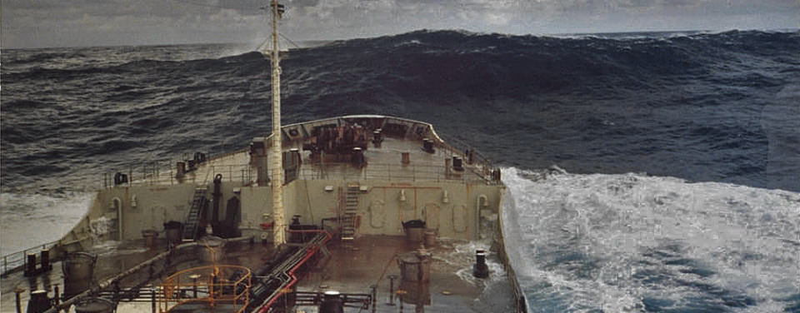
Langmuir rogue waves?
We assume the presence of an external perturbation, e.g. a beam of charged particles
Nonlinear phenomena: coupling of the Langmuir, ion sound and electromagnetic waves
Background of low magnitude Langmuir waves, but a significant fraction of the wave has a larger magnitude (3 times the background wave magnitude, W =0.1)
Rogue waves are a unifying
concept for studying
Localized excitations, which
exceed the strength of
the background structures

Slide 22
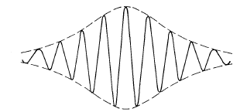
The creation of rogue vagues
Rogue waves in plasma: surface plasma, dusty plasma, electron-positron plasma
-Modeling most often uses the Nonlinear Schrödinger equation
One dimensional solution : stable soliton, e.g. Peregrine soliton
Notes:
Exemple em wave
The wave packet is trapped in that region. Vladimir Zhakarov electrostatic, 1972, E amplitude of the electric field

Slide 23
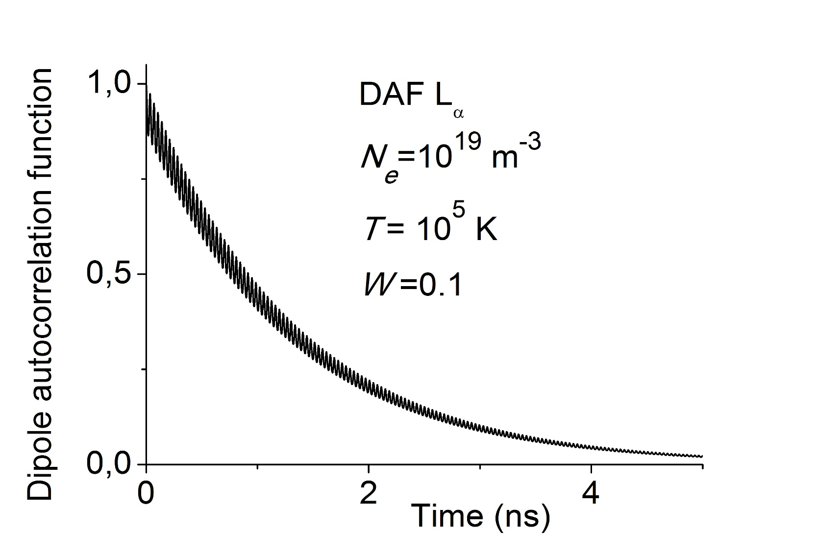
Toy model for Langmuir rogue wave effect on L_{α}
We add in our Langmuir wave simulation the effect of rogue waves with E_{L}=45 E₀ (3 times the magnitude of the linear wave, with W=0.1, Lorentzian envelope soliton)
Notes:
No longer a soliton! How high amplitude rogue wave emerge from noise through the process of modulation instability

Slide 24
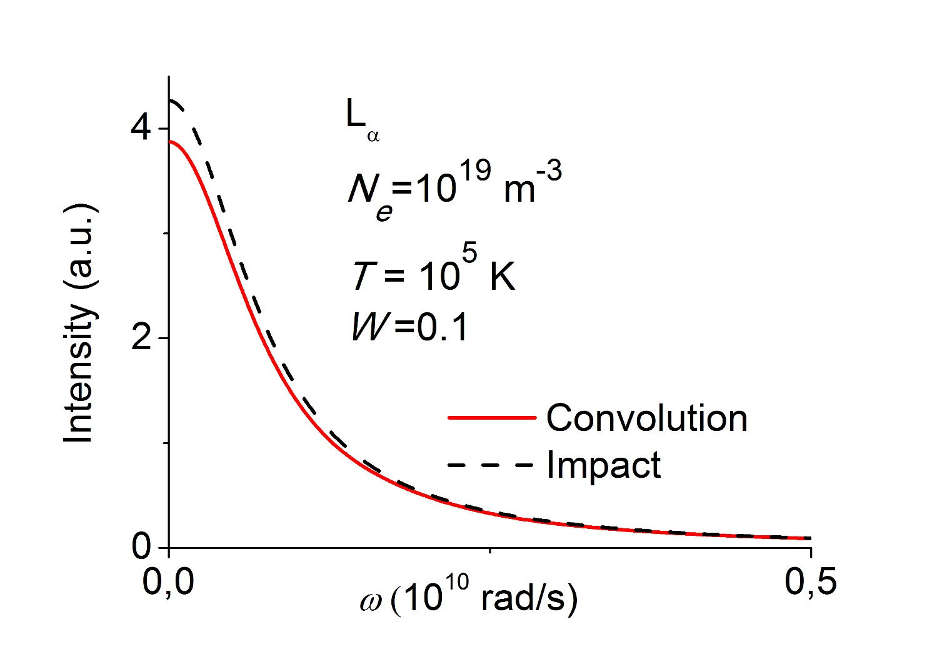
Rogue wave effect on L_{α}
We add in our Langmuir wave simulation the effect of rogue waves
Notes:
No longer a soliton! How high amplitude rogue wave emerge from noise through the process of modulation instability

Slide 25
Summary
-Line shapes can often be described using an impact approximation
-Many different models use the impact approximation
-Ab initio simulations can reproduce the impact profiles
-Impact broadening screens other effects like wave effects
Notes:
The team provides an assistance to the analysis of line shape in various plasmas. . Like in present day tokamaks, spectroscopy will remain an
essential source of information for ITER for a better understanding of ITER edgeplasma 300 line of sight

Slide 26
Collaborations
-Started long time ago with Milan Dimitrijevic
-Collaboration on the Stark broadening formalism
-Collaboration on diagnostics
-Role of SCSLSA: enabled discussions between the different groups and countries
-Many Thanks to Milan and all colleagues
Notes:
The team provides an assistance to the analysis of line shape in various plasmas. . Like in present day tokamaks, spectroscopy will remain an
essential source of information for ITER for a better understanding of ITER edgeplasma 300 line of sight

Slide 27
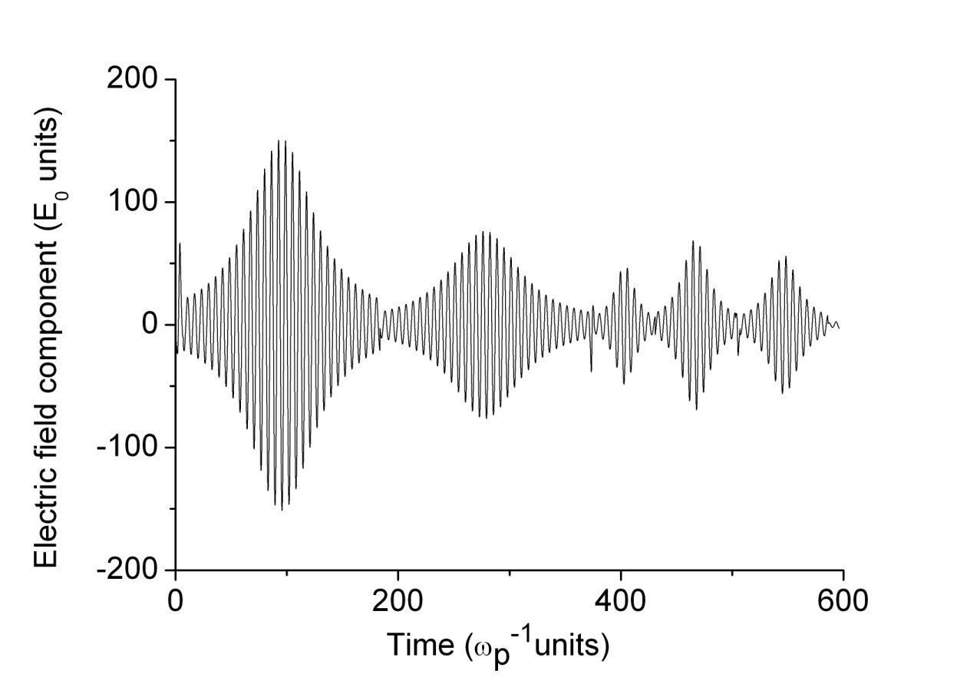
Electric field history
Average peak field 100 E₀, jumping frequency ν=ω_{p}/50
plasma T= 10⁴ K, N_{e}=10¹³ cm⁻³
Lorentzian envelope functions S_{j}(t) with a time width ΔT_{L} 40% of τ

Slide 28
Calculation of the dipole autocorrelation function
D is the emitter dipole, U(t) the evolution operator is obtained by solving the Schrödinger equation
This is done numerically for a history of
The dipole autocorrelation function (DAF) is obtained after an average over all configurations of the turbulent Langmuir field
In the following we average over 10⁴ field histories
Notes:
We observe many atoms on the line of sight

Slide 29
Stark broadening: the line shape
Fourier transform of the dipole autocorrelation function (DAF)
Different calculations are possible
-The single effect of strong Langmuir turbulence (pure Langmuir)
-The effect of equilibrium Stark broadening (pure Stark)
-The result of a convolution of the the two previous (full profile)

Slide 30
Ly_{α} DAF, effect of the envelope shape
ΔT_{L}
τ
Ratio of the Lorentzian half width ΔT_{L} to the duration τ
of a step (here about 50 %)
Notes:
Ratio in percentage kept constant

Slide 31
Static and impact approximations
Two limiting regimes
Static:
Time of interest
Collision time
Only the PDF P(E) is needed
Impact:
Binary collisions
(electrons)

