Slide 1

ASTA Software
An Advanced Spectral Analysis Algorithmic Environment for Emission and Absorption Line Spectra

Slide 2
Hello!
Dr.Dimitrios Tzimeas
Astrophysics Spectroscopy Team
National & Kapodistrian University of Athens, Greece

Slide 3
DACs, BALs & BELs structures
ASTA v1.4 stable release
Multi-component case
study
Narrow Absorption Lines

Slide 4
DACs, BALs & BELs structure
BAL structure in Quasar’s spectra

Slide 5
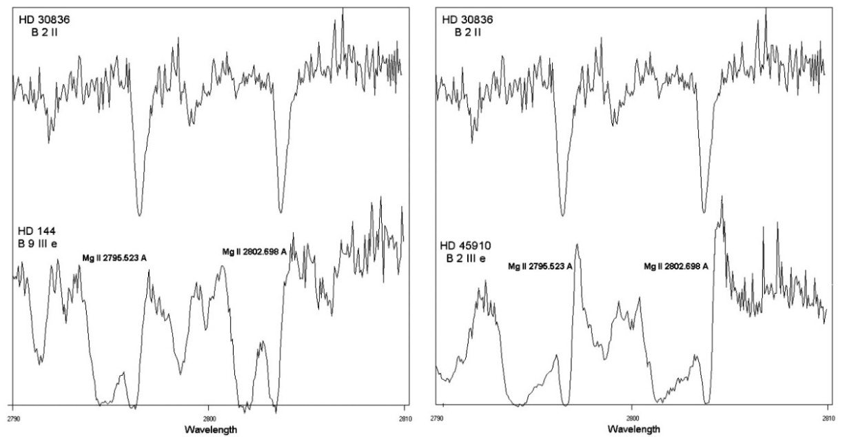
Comparison of the Mg II resonance lines between the spectrum of a normal B star and the spectra of two active Be stars that present complex and peculiar spectral lines. As we can observe the Be stars present some absorption components that do not appear in the spectrum of the normal B star.

Slide 6
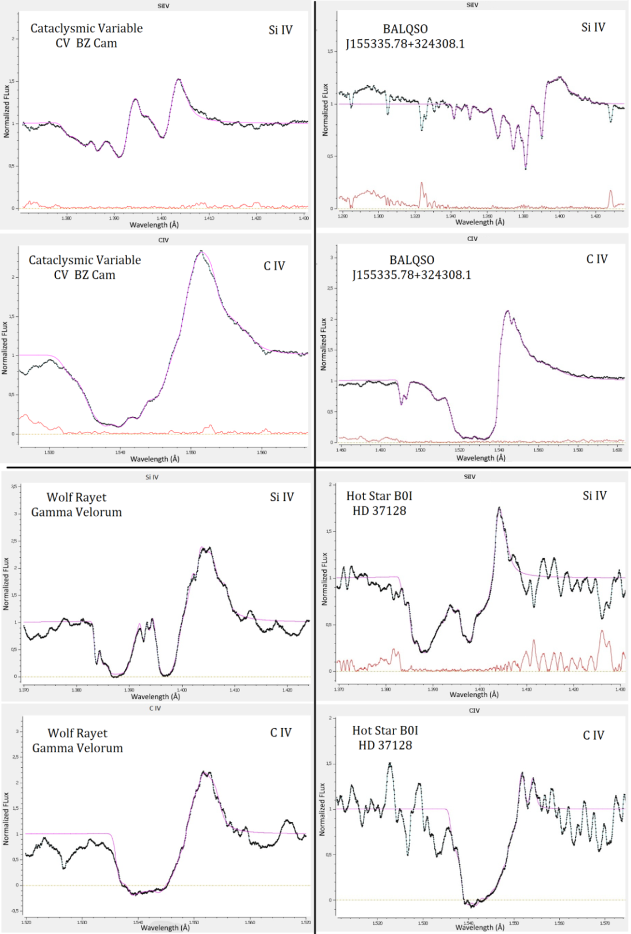
DAC/SAC phenomena and BALs in the spectra of Hot Emission Stars, BAL Quasars, Cataclysmic Variables, Wolf Rayet stars were confirmed both theoretically and observationally.

Slide 7
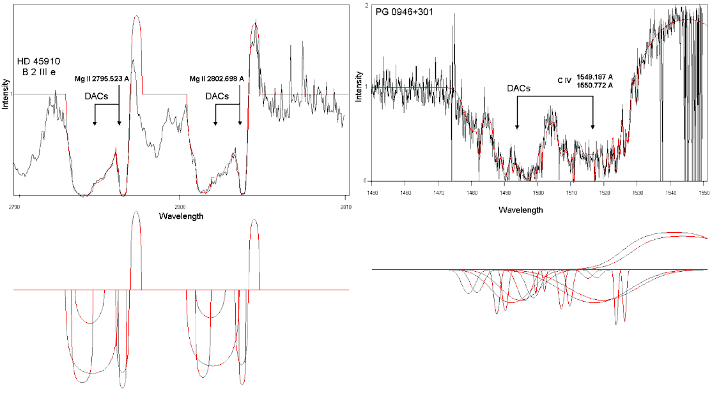
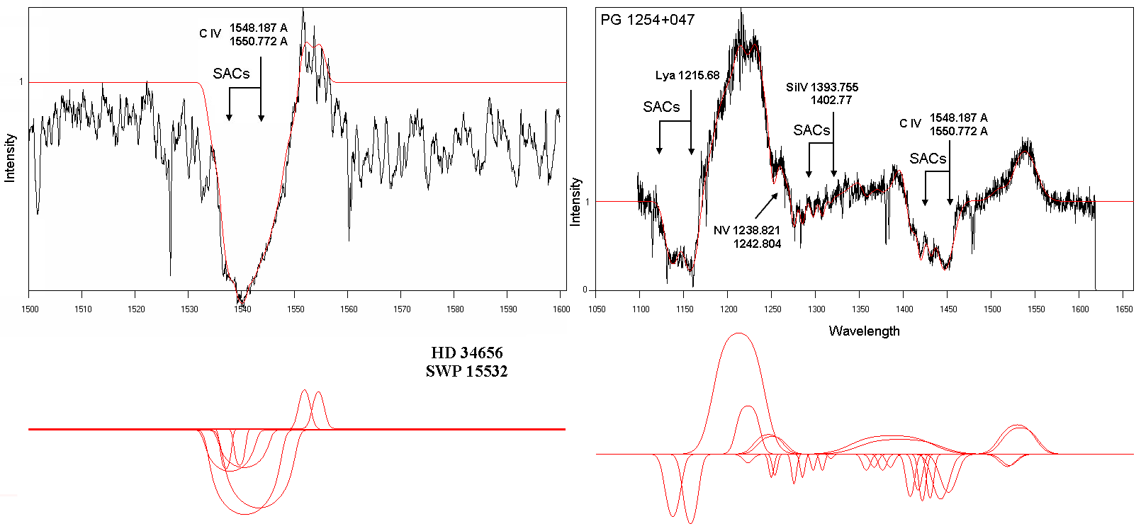
Similarity of DACs phenomenon in Be star’s HD 45910 spectrum (Mg II doublet) and AGNs PG 0946+301spectrum (C IV doublet).
SACs phenomenon in Oe star’s HD 34656 and AGNs PG 1254+047 spectrum (Lya and Si IV and C IV doublets)

Slide 8
Can BALs be simulated and analysed taking into account their complex structure and large widths?

Slide 9
How can Si IV and C IV BALs be analysed? Accepting the point of view that BALs are the synthesis of a series of spectral line components, is there a way to study not only the whole profile but the profiles of each individual component (line function of each individual absorber in the line of sight)?

Slide 10
Which is the interpolation polynomial that describes the whole BAL profile?
In the case of multiple BAL which is the interpolation polynomial that describes the whole absorbing region?

Slide 11
Can the two members of the resonance doublets (f. e Si IV and C IV) be studied independently? Until now the resonance lines (e.g. C IV and Si IV) are treated as one spectral line

Slide 12
ASTA v1.4 stable release
Developing an integrated multicomponent spectral analysis environment

Slide 13
ASTA v1.4 stable release
ASTA alpha testing version
spectrum
DMVL

Slide 14
Apps/ features | GUI | Number of Distributions | DACs/BALs/BELs Analysis within multicomponent model | Parameters | Multi - component fit | Simultaneous fitting of multiple ions with parameters tied | Deblending of Unresolved resonance lines | Unique number of component of DACs/BALs/BELs | Component parameter values uniqueness
SpecView | Yes | 4 (Gauss, Lorentz, Voigt, Logarithmic) | linear/nonlinear curve fitting using mathematical functions | FWHM, Equivalent Width, optical depth, position | limited | No | No | No | No
PROFIT | Yes | 1 (Gauss for emission lines) | linear/nonlinear curve fitting using mathematical functions | FWHM, Equivalent Width, optical depth, position |  | No | No | No | No
DIPSO | No | 2 (Gauss, Triangular) | linear/nonlinear curve fitting using mathematical functions | FWHM, Equivalent Width, optical depth, position | Limited (mainly for emission lines) | No | No | No | No
SPLAT | Yes | --- | linear/nonlinear curve fitting using mathematical functions | FWHM, Equivalent Width, optical depth, position | no | No | No | No | No
IRAF | No/few packages have their own | 3 (Gauss, Lorentz, Voigt) | linear/nonlinear curve fitting using mathematical functions | FWHM, Equivalent Width, optical depth, position | limited | No | No | No | No
IDL | No, user must create one | 3 (Gauss, Lorentz, Voigt) | linear/nonlinear curve fitting using mathematical functions | FWHM, Equivalent Width, optical depth, position | limited | No | No | No | No
ASTA v1.4 | Yes | 5 (Gauss, Lorentz, Voigt, Rotation, Gauss-Rotation) | linear/nonlinear curve fitting using distributions on the basis of the Solution of Radiative Transfer Equation | FWHM, Equivalent Width, optical depth, position, column density | Large parameter space due to GR multi-component analysis model | Yes | Yes | Yes | Yes

Slide 15
BAL/BEL/DAC
Can we analyze, process and curve fit their spectra obtaining the physical properties of the density region?

Slide 16
ASTA analyzes each BAL/BEL/DAC/SAC in its components
GR multi-component model
Interpolation polynomial support
Physical representation of parameter values

Slide 17
ASTA v1.4 stable release workflow
spectrum preparation
import spectrum
curve fitting process
choose element
compute & export
calculate physical parameters
export results, plots and statistical checks calculations
redshift correction/smoothing
focus on area of interest
continuum line
flux normalization
type (absorption/emission)
set distribution parameters
add component line
if curve fitting achieved proceed to next stage
create report

Slide 18
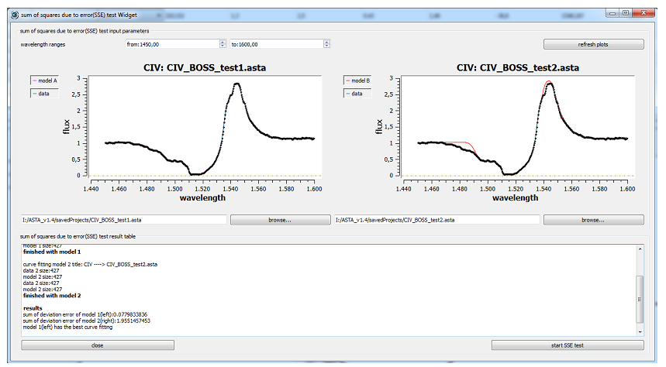
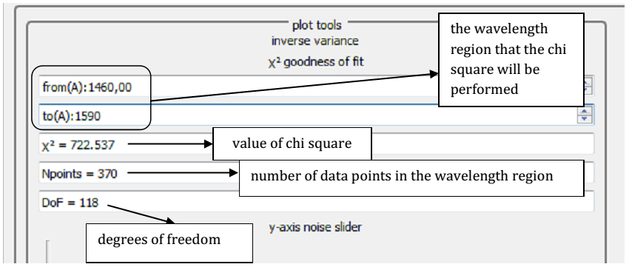
ASTA v1.4 statistical & verification tools
Sum of squares (SSE) test
Pearson chi-square test
F-test
Real-time Chi-square test

Slide 19
The BAL Quasar case
SDSS J114548.38+393746.6

Slide 20
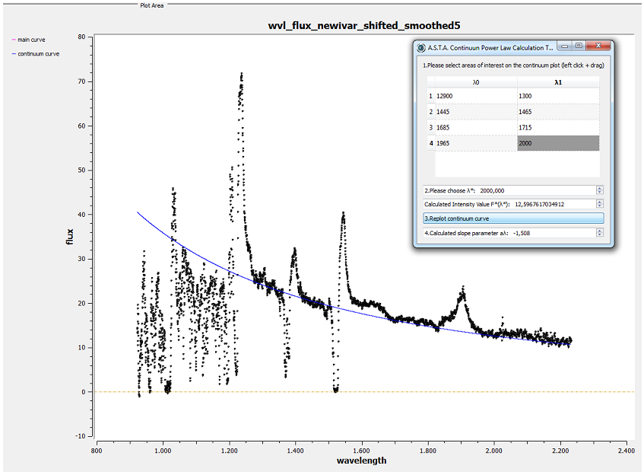
ASTA v1.4 stable release workflow
spectrum preparation
import spectrum
redshift correction/smoothing
focus on area of interest
continuum line
flux normalization
Curve fitting BAL the continuum line of Quasar SDSS J114548.38+393746.6 with power law

Slide 21
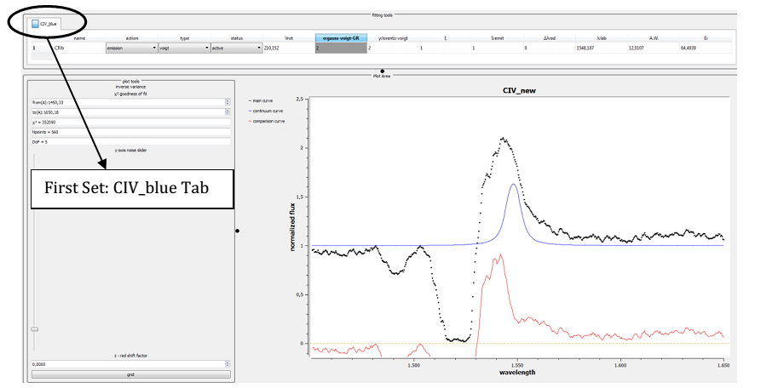
ASTA v1.4 stable release workflow
curve fitting process
choose element
type (absorption/emission)
set distribution parameters
add component line
if curve fitting achieved proceed to next stage
create report
export results, plots and and statistical checks calculations
calculate physical paramaters
compute & export
Initiating the curve fitting process with the first set of components CIV_blue

Slide 22
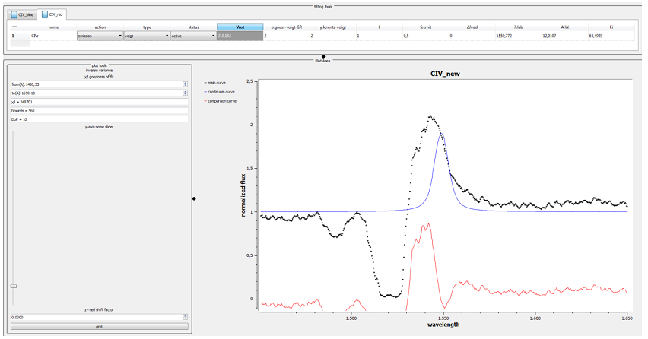
ASTA v1.4 stable release workflow
curve fitting process
choose element
type (absorption/emission)
set distribution parameters
add component line
if curve fitting achieved proceed to next stage
create report
export results, plots and and statistical checks calculations
calculate physical paramaters
compute & export
Adding a second set of components, CIV_red, in BAL Quasar SDSS J114548.38+393746.6

Slide 23
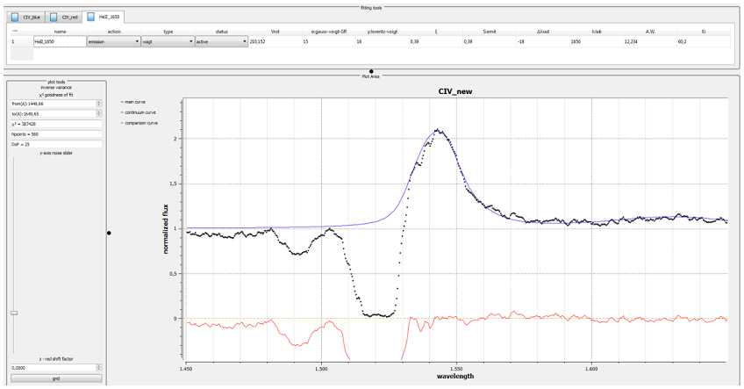
ASTA v1.4 stable release workflow
curve fitting process
choose element
create report
export results, plots and and statistical checks calculations
calculate physical paramaters
compute & export
type (absorption/emission)
set distribution parameters
add component line
if curve fitting achieved proceed to next stage
Fine tuning the emission broad line of BAL Quasar SDSS J114548.38+393746.6

Slide 24
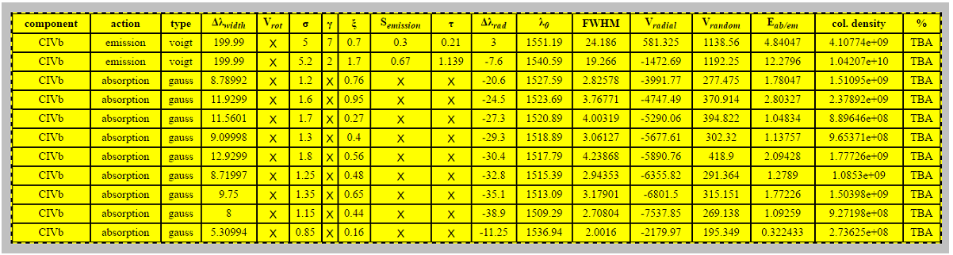
ASTA v1.4 stable release workflow
compute & export
choose element
type (absorption/emission)
set distribution parameters
add component line
if curve fitting achieved proceed to next stage
create report
export results, plots and and statistical checks calculations
calculate physical paramaters
compute & export
Distribution parameters and physical properties of the Quasar SDSS J114548.38+393746.6 best fit

Slide 25
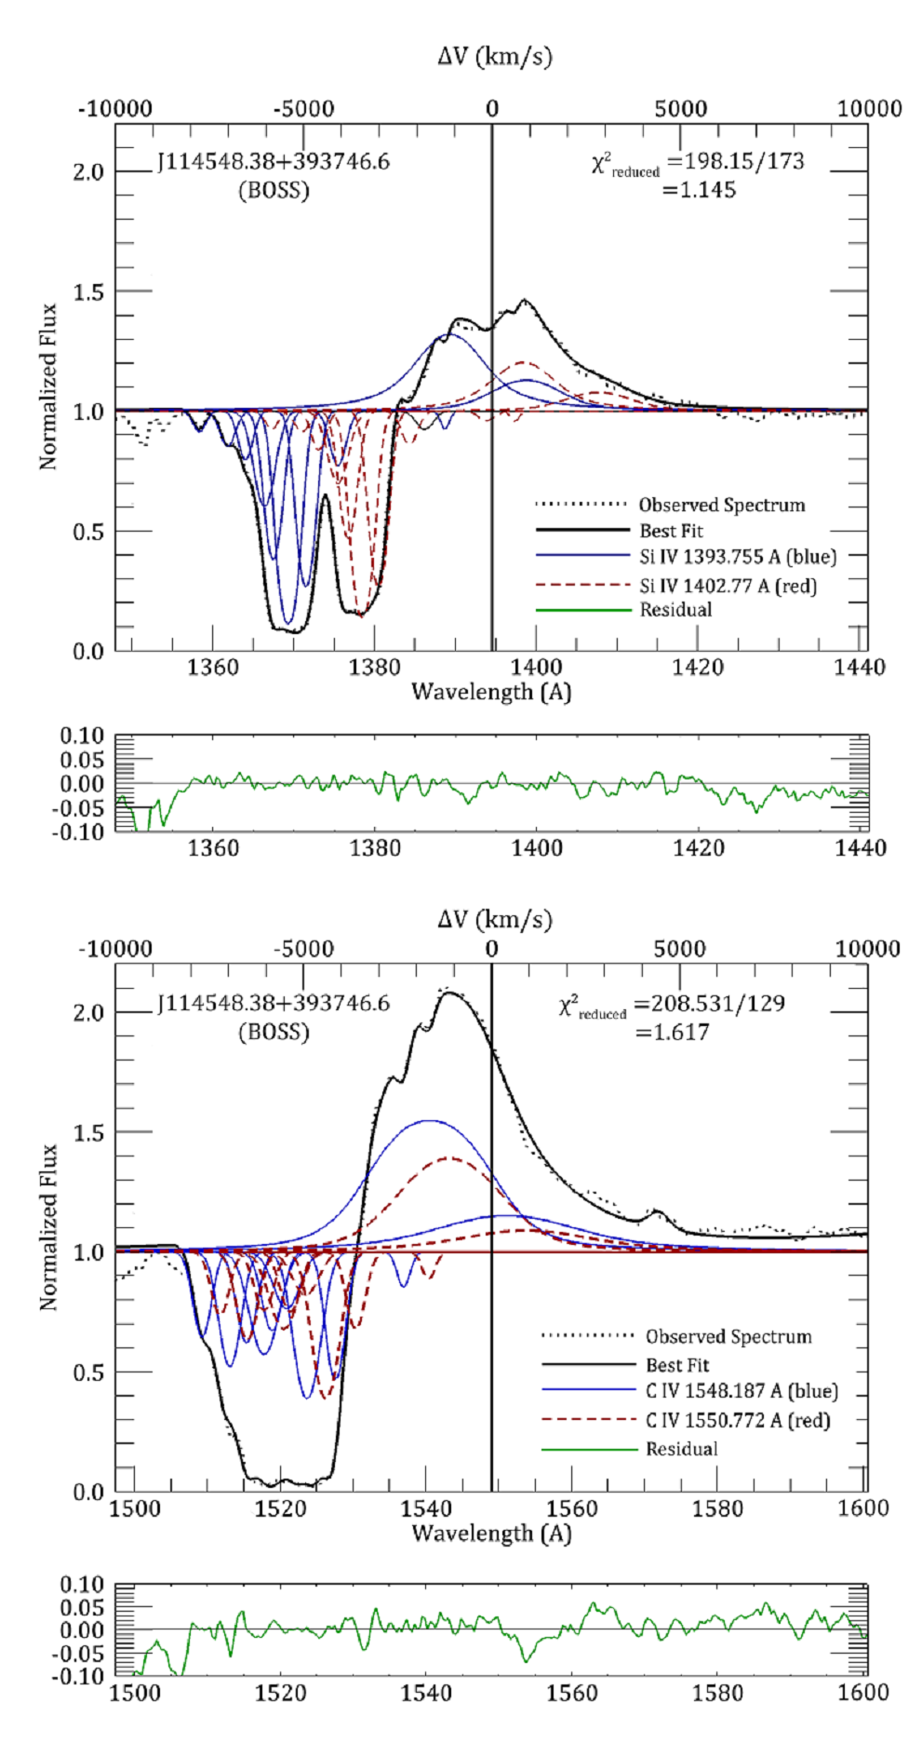
ASTA v1.4 stable release workflow
Best curve fit and the individual components that compose the whole profiles of C IV and Si IV

Slide 26
ASTA v1.4 stable release workflow
spectrum preparation
import spectrum
curve fitting process
choose element
compute & export
calculate physical parameters
export results, plots and statistical checks calculations
redshift correction/smoothing
focus on area of interest
continuum line
flux normalization
type (absorption/emission)
set distribution parameters
add component line
if curve fitting achieved proceed to next stage
create report

Slide 27
Narrow Absorption Lines
the Quasar SDSS J000027.01+030715.5 case study

Slide 28
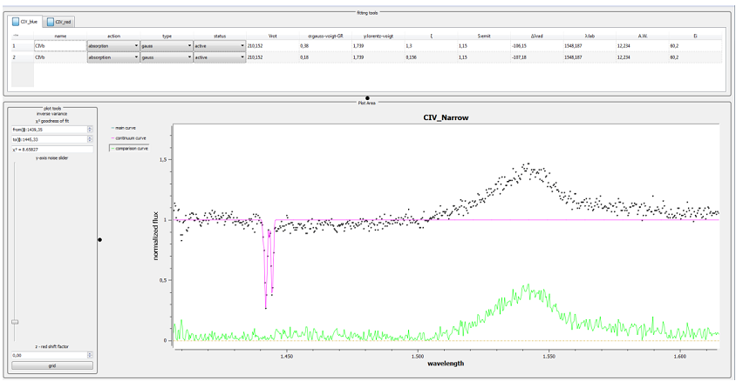

2 component sets
CIV_blue (first Set)
CIV_red line (second Set)
$$x^{2}= 8. 65827$$
degrees of freedom for this fit are 6
(19 data points minus 12 free parameters minus 1)
$$x_{red}^{2} = 8. 65827/6 = 1.443$$

Slide 29
5 distributions
GR multi-component model
Statistics, verification & curve fitting
Two of them new: Rotation and Gauss-Rotation
Physical properties calculation
Pearson chi-square, F-test, SSE test, Realtime chi-square, Gaussian noise, smoothing filters

Slide 30
ASTA v1.4 stable release
Performs multicomponent fitting of complex and asymmetrical spectral lines (DACs, SACs, BALs, and BELs)
Integrates the GR model which ensures the uniqueness of the best fit and the number of individual components used to simulate the complex absorption profiles.
Decomposes complex absorption and emission lines to the individual components they consist of.
Contains the solution of the radiative transfer equation for a complex plasma atmosphere. The atmosphere can be either a number of independent and successive absorbing or emitting density regions of matter in the line of sight or successive shells around the central body emitting the continuum radiation.
Calculates the values of a series of physical parameters such as radial velocities, the FWHM, the optical depth, the equivalent width of the individual components that compose the observed complex emission or absorption profiles
Calculates the line function of every single individual component that contributes to the final profile.
Calculates the interpolation polynomial that can simulate the whole observed emission and absorption profiles.
Ensures the uniqueness of the values of the calculated physical parameters.

Slide 31
ASTA v1.4 stable release has been tested and verified in the case of the most extreme astronomical objects i.e. hot stars, Wolf Rayet (WR) stars, Cataclysmic Variables (CVs) and Broad Absorption Line QSOs (BALQSOs) (Antoniou et al. 2010, 2011a,b, 2014; Danezis et al. 2003, 2007, 2009, 2010; Lyratzi et al. 2007, 2009, 2010, 2011; Stathopoulos et al. 2015).
.

Slide 32
Future work
Towards an Artificial Intelligent core
Focus on Deep learning
+ other optimization and decision making techniques
Regression random forests
Bayesian inference
Variational methods
Gradient descent
Facilitate and automate tedious tasks carried out by end user

Slide 33
Thanks!
Any questions?
You can find me at dtzimeas@phys.uoa.gr
ASTA v1.4 documentation and download:
www. spectroscopyteam.edu.gr

