Slide 1
Timescale variation of the components that form the C IV and Si IV DACs in the UV spectrum of the O-star HD 93521
Dr. Antonios Antoniou
In collaboration with
Prof. E. Danezis, Dr. E. Lyratzi, D. Stathopoulos (MSc.) and Dr. Dimitrios Tzimeas
National and Kapodistrian University of Athens, Faculty of Physics,
Department of Astrophysics, Astronomy and Mechanics

Slide 2
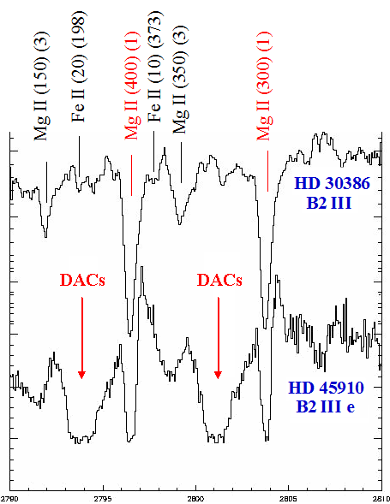
Studding the Hot Emission Stars (O and B stars, T_{eff} ≥10,000 K) we can sometimes detect independent absorption components blueshifted from the corresponding emission lines. We call these absorption spectral lines, Discrete Absorption Components (DACs) (*)
(*) Underhill 1975, Henrichs 1984, Underhill & Fahey 1984, Bates & Halliwell 1986, Grady et al. 1987, Lamers et al. 1988, Waldron et al. 1992, 1994, Cranmer & Owocki 1996, Rivinius et al. 1997, Kaper et al. 1996, 1997, 1999, Markova 2000, Cranmer et al. 2000.

Slide 3
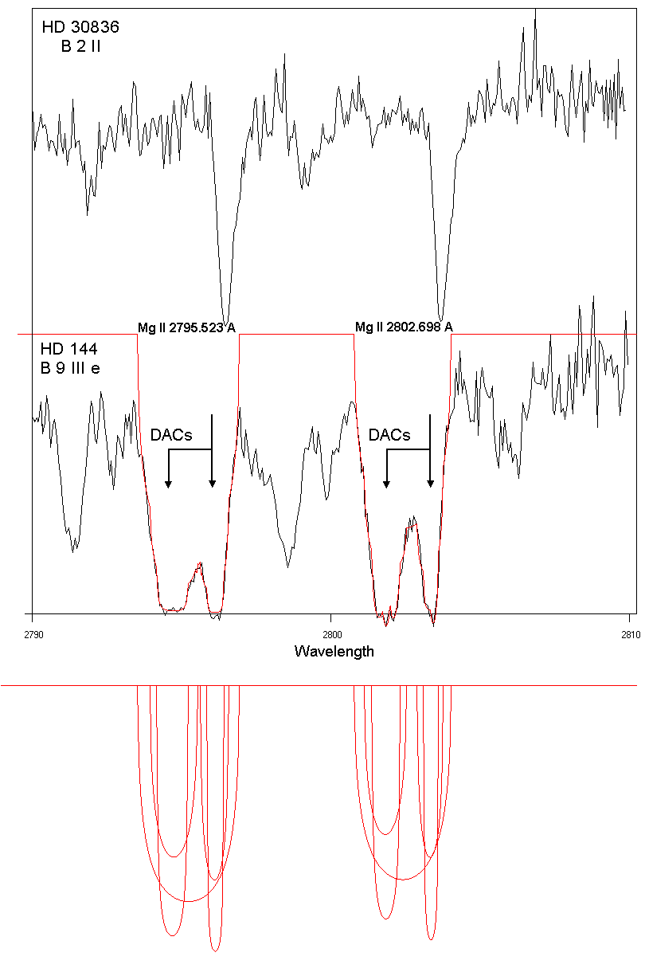
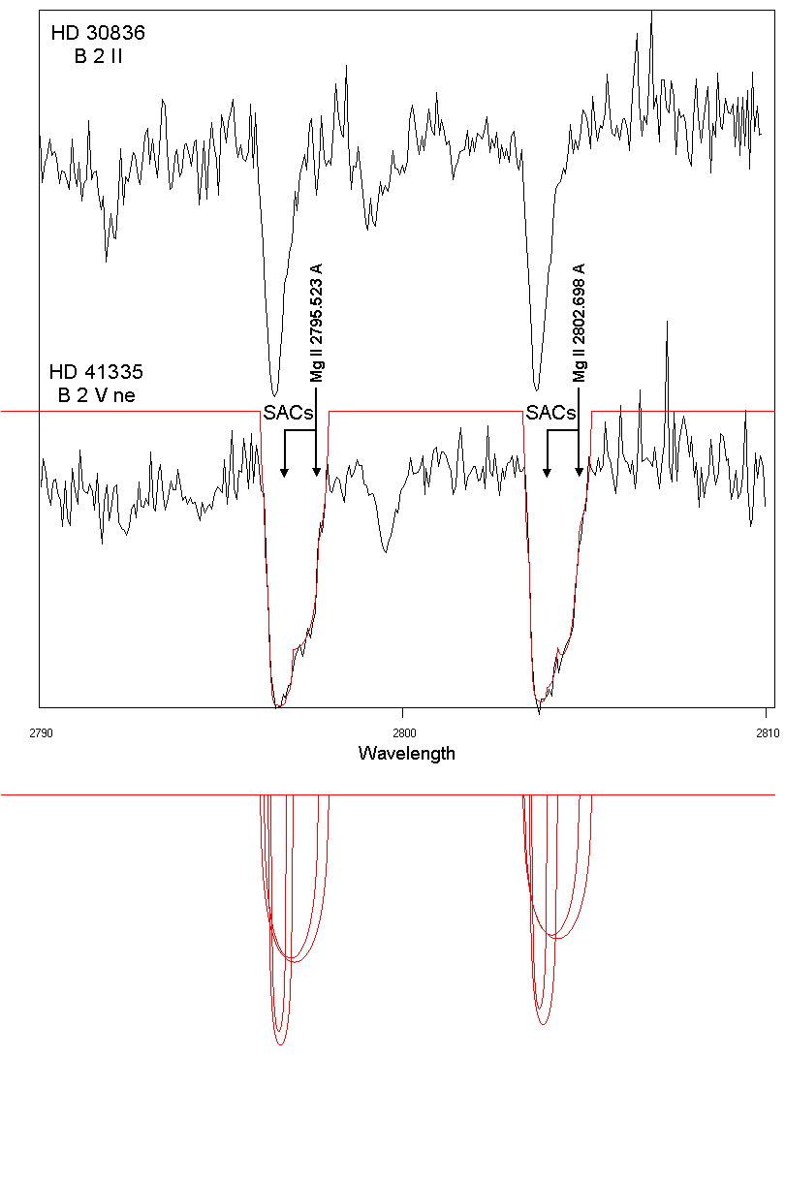
However, DACs are spectral lines of the same ion and the same wavelength as the main spectral line, shifted at different Δλ, as they are created in different density regions which rotate and move radially with different velocities (*). Another problem is that DACs have very complex profiles that we can not theoretically reproduce with a known distribution, such as Gaussian, Voigt, or Lorenzian. In order to explain this complex line profiles we proposed the phenomenon of SACs (Satellite Absorption Components) ( **).
(*) Danezis 1983, 1987, Danezis et al. 1991, 2003, Lyratzi & Danezis 2004.
( **) Danezis et al. 2003, 2007a, Lyratzi & Danezis 2004, Lyratzi et al. 2007a

Slide 4
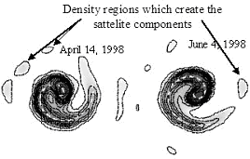
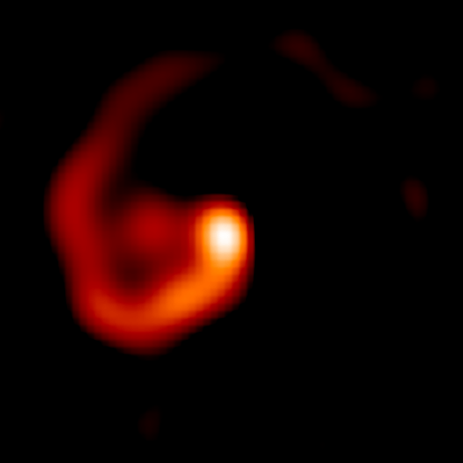
According to this phenomenon, a DAC is not a single absorption line, but a synthesis of classical absorption components of the same spectral line of an ion (SACs). These spectral components are created in independent densities regions inside the violent stellar wind surrounding Hot Emission Stars.
Wolf-Rayet star (WR 104), 8000 ly, O-star, Keck Telescope

Slide 5
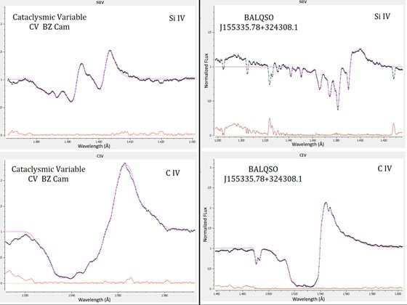
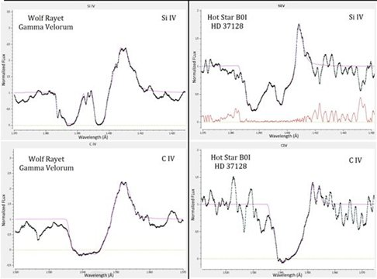
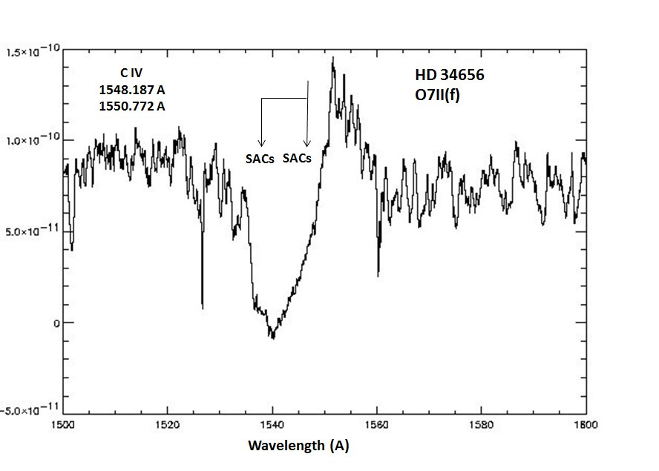
It is interesting to point out that we can detect DACs and SACs phenomena in the case of other type of stars as for example in Wolf Rayet, Cataclysmic Variables as well as in Quasars (*).
(*) Stathopoulos et. al. 2016, Stathopoulos et. al. 2017

Slide 6
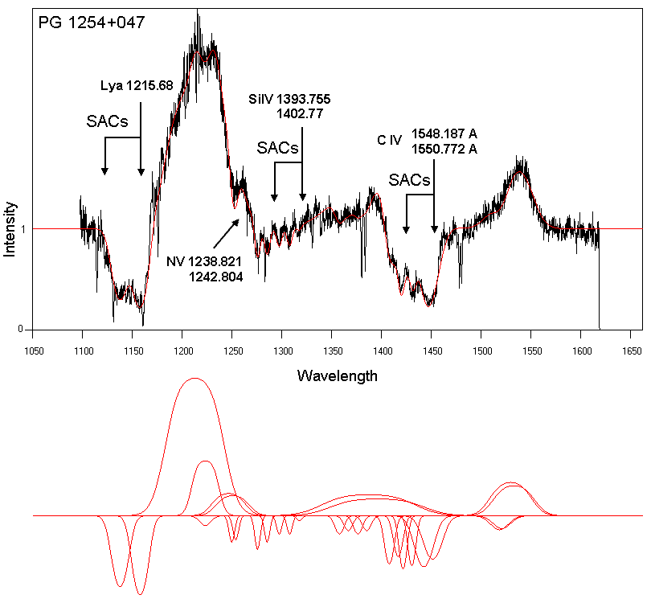
In this figures we can see the SACs phenomenon in the spectrum of the AGN PG 1254+047
(Stathopoulos et. al. 2016, Stathopoulos et. al. 2017 ).

Slide 7
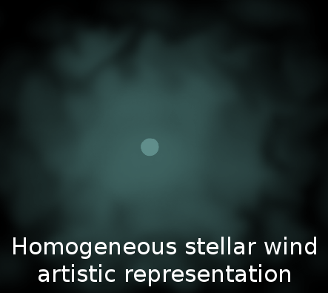
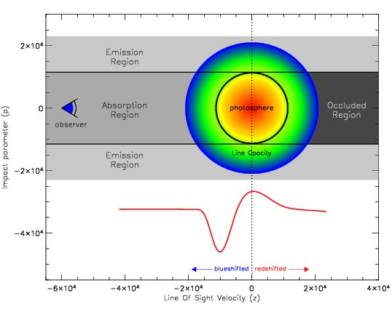
The origin of DACs/SACs. From wind models to «clumping» structure
1. Winds: As we know the winds of O and B stars have been observed in UV spectra, through the P-Cygni profile and they are changing in time scales from several days up to hours (*).
(*) e.g. Henrichs (1984), Prinja & Howarth (1986), Prinja et al. 1987, Henrichs et al. 1988

Slide 8
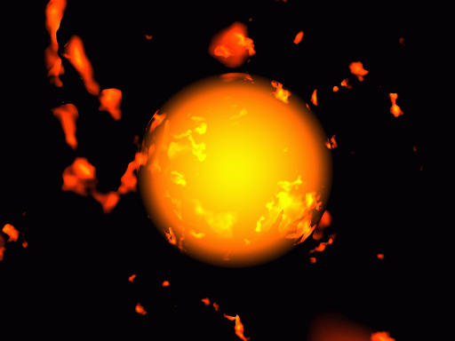
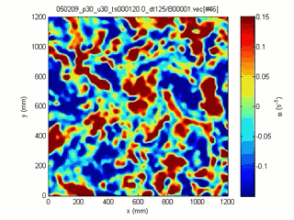
2. Flow instabilities: However, the models of normal winds could not interpret the structure of the areas in which DACs and SACs are created. Many researchers (*) suggested that the observed variability of mass outflows indicates instabilities of the winds of hot stars, the so called “flow instabilities”. These instabilities would disrupt the smooth outflow destroying the balance between the forces.
(*) e.g. Lucy (1984), Owocki & Rybicki, (1984, 1985, 1986), Lucy & Solomon (1970), MacGregor et al (1979), Carlberg (1980), and Lucy (1984), Lucy & White (1980)

Slide 9
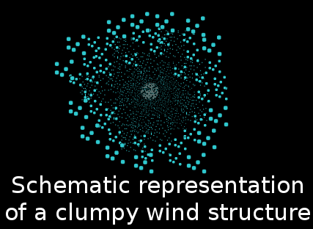
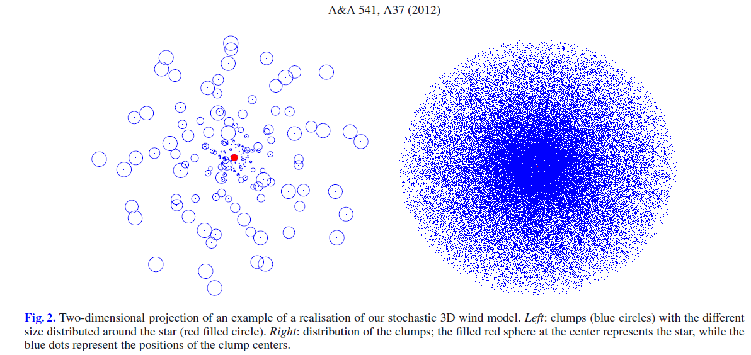
Surlan et al. 2012, A&A 541, A37

Slide 10
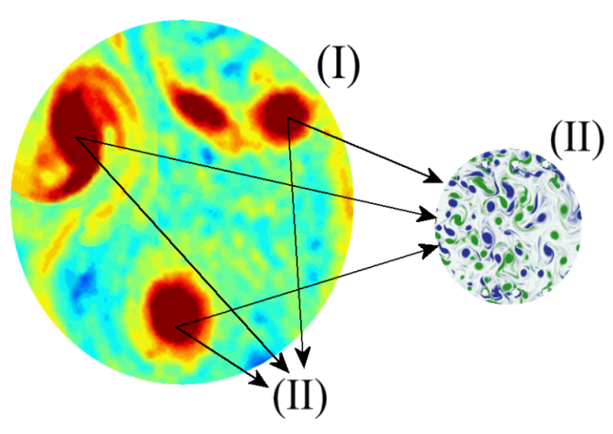
Our theoretical ad hoc proposed models for DAC/SAC Regions (*)
3. Independent and individual clouds: All the above lead us to the conclusion that in the inner regions of the stellar atmosphere (from the photosphere to the first regions of the disk) of the stars that present DACs or SACs, the plasma is ejected violently and it does not have the form of smooth stellar wind, for as long as the phenomenon lasts.
During the phenomenon, in the regions where the DACs or SACs are created, the majority of plasma is distributed in the density regions of spherical symmetry around the star or around their own centers.
Density regions (I) that form the Discrete Absorption Components (DACs) and SAC regions (II) that form the DACs regions (I).
(*) Stathopoulos, D., Danezis, E., Lyratzi, E., Antoniou, A.; Tzimeas: Multicomponent Analysis of the UV Si IV and C IV Broad Absorption Troughs in BALQSO Spectra: The Examples of J01225 + 1339 and J02287 + 0002D. 2015, JApA, 36, 495

Slide 11
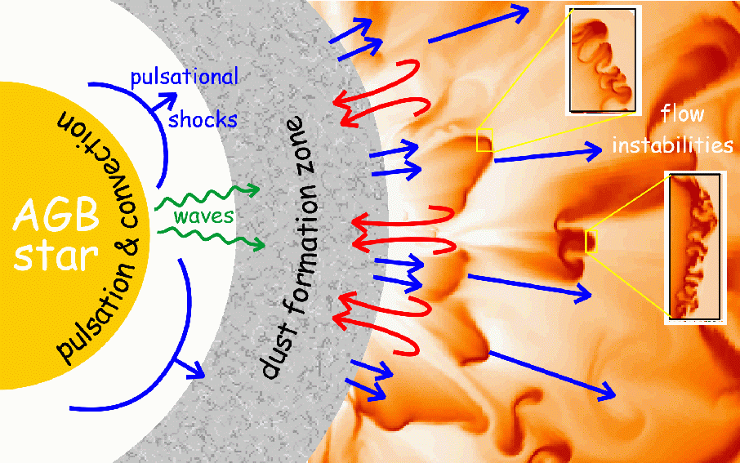
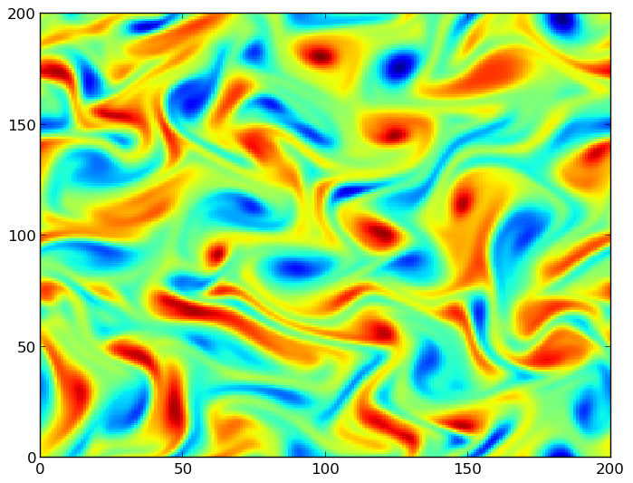
…Independent and individual clouds: These density regions were created as a result of the violent mass ejection during the period of the emission phenomenon (i.g. in Be and Oe stars). The ejected matter takes the form of stellar wind as it goes away from the turbulent medium of the inner atmospheric layers of hot emission stars.

Slide 12
All the above give rise to some questions:
1. Can DACs be simulated and analyzed taking into account their complex structure and large widths?
2. How can Si IV and C IV DACs be analyzed?
3. Accepting the point of view that DACs are the synthesis of a series of spectral line components, is there a way to study not only the whole profile but the profiles of each individual component (line function of each individual absorber in the line of sight)?
4. Which is the interpolation polynomial that describes the whole DAC profile?
5. In the case of multiple DAC which is the interpolation polynomial that describes the whole absorbing region?
6. Can the two members of the resonance doublets (f. e Si IV and C IV) be studied independently? Until now the resonance doublets (f. e C IV and Si IV) are considered one spectral line.
In order to answer in this set of questions we use GR model (*) which incorporates all the previously mentioned characteristics
(*) Danezis, E., Nikolaidis, D. , Lyratzi, E., Antoniou, A. Popovic, L.C., Dimitrijevic, M., PASJ, 2007

Slide 13
The main idea of our work
Why is variability important?
The fact that Si IV and C IV DACs exhibit variability in individual components, rather than showing variability of the whole absorption trough, indicates strongly that DACs are the synthesis of individual components produced by substructures-inhomogeneities inside the stellar wind (*).
In this work using the GR-model we can study the time scale variations of each Satellite Absorption Component (SAC) and not just the variability of the whole peculiar spectral shape (DAC).
(*) Henrichs,1984; Prinja & Howarth, 1986; Prinja et al., 1987; Henrichs et al., 1988
Prinja, 1990; Balona, ​​1992; Fullerton et al., 1996

Slide 14
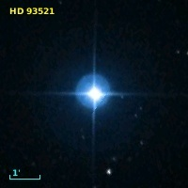
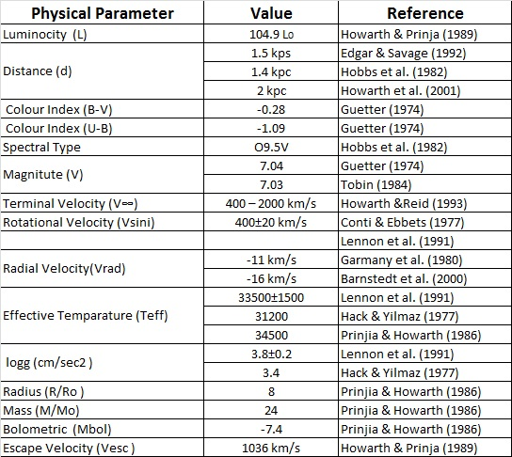
Our research
In this application we analyze the C IV (λλ 1548.155, 1550.774 Å) and Si IV (λλ 1393.755, 1402.77 Å) absorption troughs in the O-star HD93521, in four different periods in a time interval of 16 years, to the individual components (SACs) they consists of.
Name Date
SWP 05621 25 June 1979
SWP 34788 20 November 1988
SWP 50360 24 March 1993
SWP 54037 3 April 1995

Slide 15
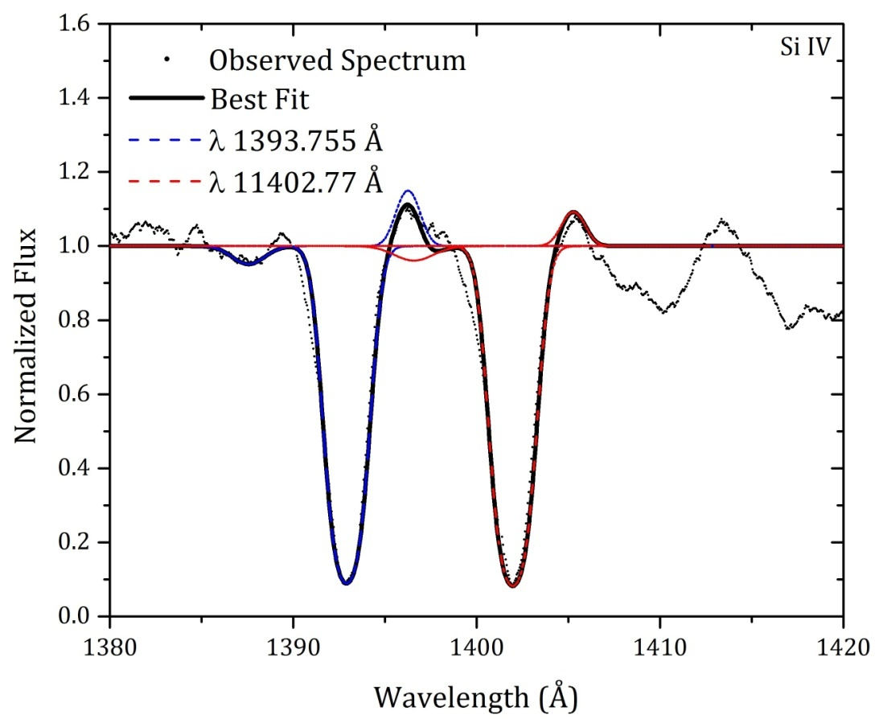
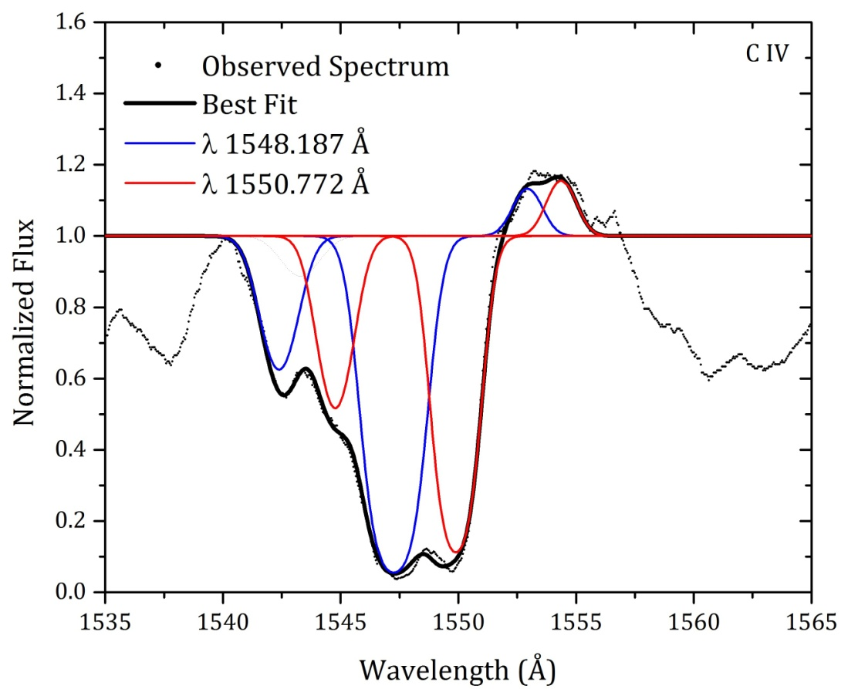
The best fit process
In this figure one can see the C IV and Si IV doublet of the HD 93521 and its best fit. The best fit has been obtained using two absorption components.
The spectrum has been taken on March 24th 1993 by the camera SWP50360

Slide 16
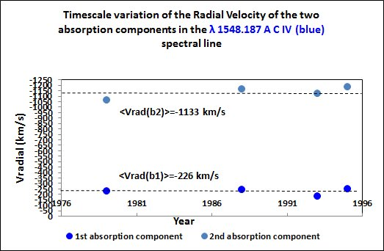
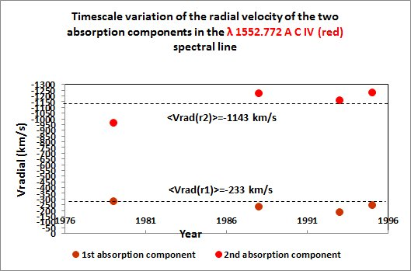
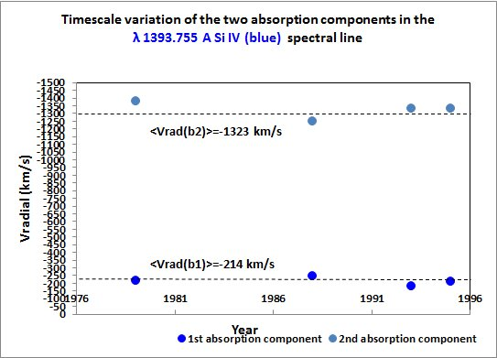
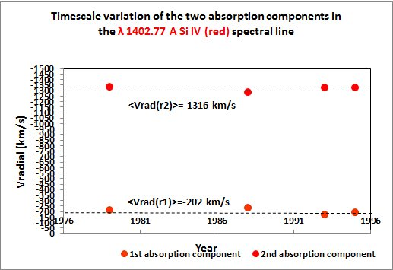
In the following figures we show the timescale variation of the radial velocities of the two absorption components in the blue C IV and Si IV spectral line as well as the variation of the radial velocities in the red C IV and Si IV spectral line.
The C IV variability (Radial Velocities)
The Si IV variability (Radial Velocities)
It is important to note that the large difference between the two values indicate the independence of the absorption clouds.

Slide 17
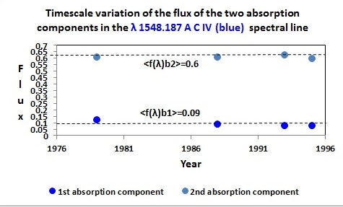
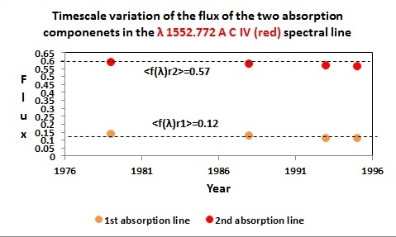
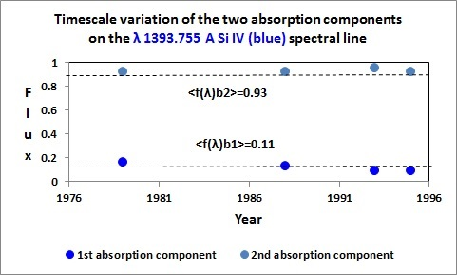
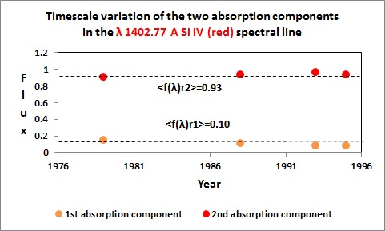
In the following figures we present the timescale variation of the line flux
$$f\left(λ_{0}\right)=\exp\left(−τ_{0}\right)$$
at the line center of the 1st and 2nd absorption components in the C IV and Si IV resonance spectral lines.
The C IV variability (Flux)
The Si IV variability (Flux)
As in the case of the radial velocities, the large difference between the two mean values indicates once again the independence of the absorption clouds.

Slide 18
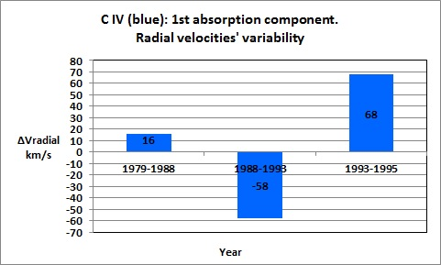
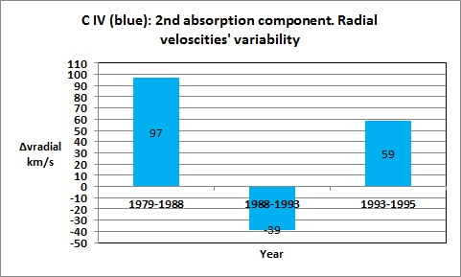
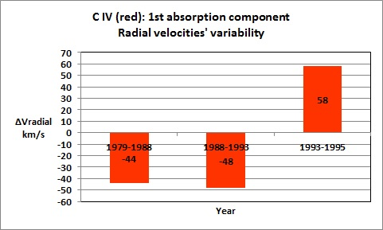
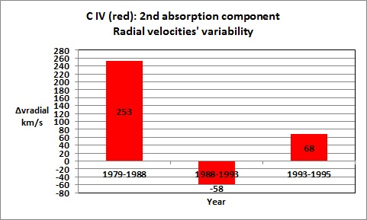
The C IV region
In the following figures we show the variability of the radial velocities of the two absorption components in the blue C IV spectral line , as well as the variability of the radial velocities in the red C IV spectral line.

Slide 19
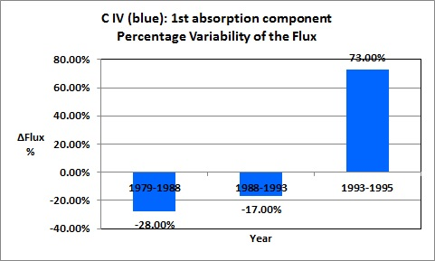
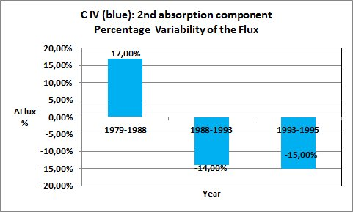
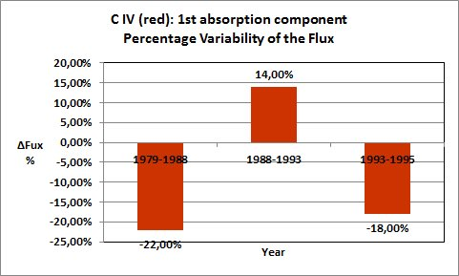
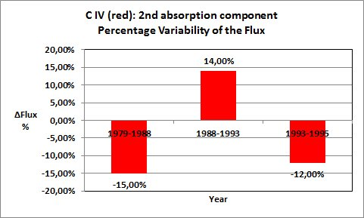
The C IV region
In the following figures we present the percentage variability of the Fluxes at the center of the two absorption components in the blue C IV spectral line , as well as the percentage variability of the Fluxes in the red C IV spectral line.

Slide 20
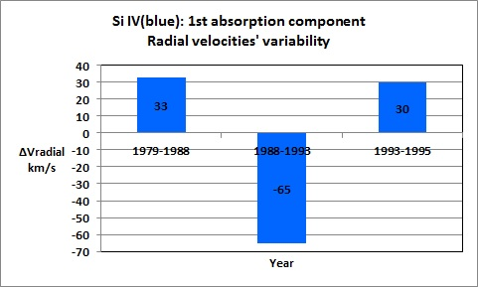
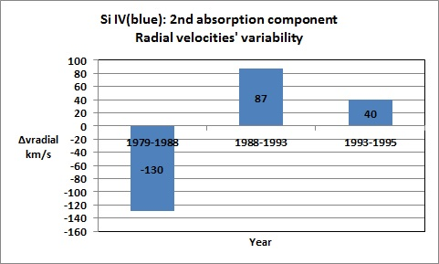
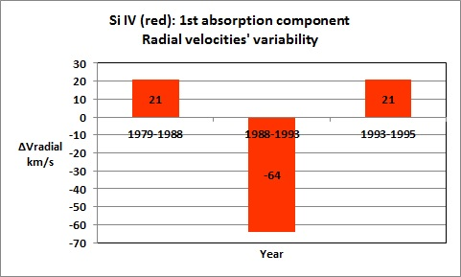
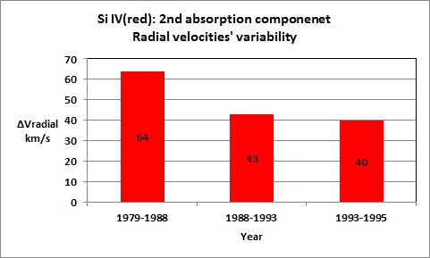
The Si IV region
In the following figures we show the variability of the radial velocities of the two absorption components in the blue Si IV spectral line , as well as the variability of the radial velocities in the red Si IV spectral line.

Slide 21
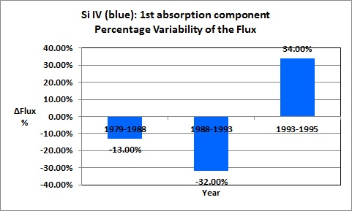
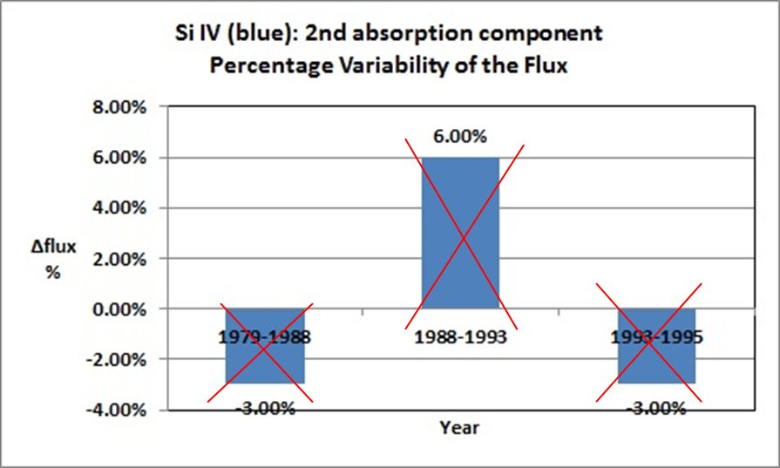
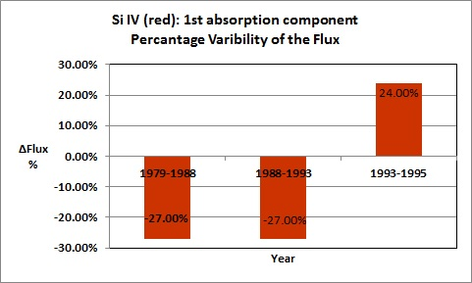
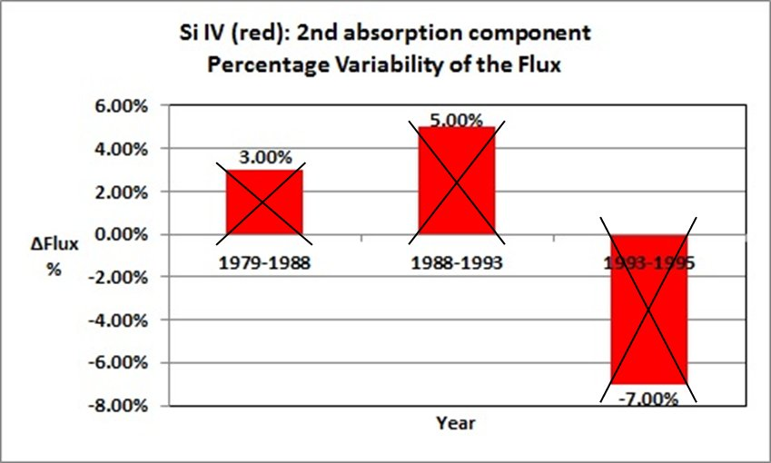
The Si IV region
In the following figures we present the percentage variability of the Fluxes at the center of the two absorption components in the blue Si IV spectral line , as well as the percentage variability of the Fluxes in the red Si IV spectral line.

Slide 22
Results and Discussion
A first note:
Due to the strict criteria (Stathopoulos et al. 2015) we apply during the fitting process, we are able not only to distinguish the individual components that compose the final profile but also calculate the values of the physical parameters of each individual component. Thus we are able to compare individual components between different epochs and investigate the variability of individual structures in the outflow.
According to these criteria, we detected that both of the C IV resonance spectral lines, as well as both of the Si IV resonance spectral lines, consist of two independent and individual Satellite Absorption Components (SACs).

Slide 23
Results and Discussion
Answer to the basic question that was the goal of our study
As we have mentioned, the time scale variability of some parameters, such, e.g., the radial velocities or the fluxes at the center of the absorption components gives us an additional strong evidence for the existence of the individual clouds which create the whole DAC absorption troughs (*). These changes were confirmed and this result is a first confirmation of the "clumping" structure of the Oe star HD 93521 environment.
(*) Henrichs,1984; Prinja & Howarth, 1986; Prinja et al., 1987; Henrichs et al., 1988
Prinja, 1990; Balona, ​​1992; Fullerton et al., 1996

Slide 24
Results and Discussion
This analysis, as well as the analysis presented by Dimitrios Stathopoulos is based on the Software ASTA which will be presented in the afternoon session by Dimitrios Tzimeas.
ASTA Software An Advanced Spectral Analysis Algorithmic Environment for Emission and Absorption Line Spectra

Slide 25
Thank you very much for your attention
A. Antoniou, E. Danezis, E. Lyratzi, D. Stathopoulos and D. Tzimeas

Slide 26
Error Analysis (Radial Velocities)
The uncertainty range of the radial velocities
In order to compare the calculated radial velocities of the clouds which create the SACs between two spectra of different epochs, we take into account that in the IUE stars’ spectra two closed points have a distance of about 0.05 Angstrom, which corresponds to a velocity of 10 km/s. Specifically, in the C IV spectral line corresponds to 9.8 km/s and in the Si IV spectral line correspond to 11.06 km/s. This means that the uncertainty range of the velocity is V± 10 km/s. Thus, values of the velocities greater than 10 km/s can be considered as variation, while values lower than 10 km/s are in the error range.

Slide 27
Error Analysis (Flux)
The uncertainty range of the flux
In order to compare the fitted components between two spectra of different epochs, we define a measurement of the deviation between two components, in units of σ using the following equation:
$$N_{σ}(λ)=\frac{f_{2}−f_{1}}{\sqrt{σ_{1}^{2}+σ_{2}^{2}}}$$
where$f_{1}, f_{2}$ are the fluxes of the components under comparison that are calculated through the proposed model and $σ_{1}, σ_{2}$ are the uncertainties in each flux (both $σ_{1}$ and $σ_{2}$ include observational errors and uncertainties from the fitting process). We identify variable components of SACs troughs to be where an absorption component is detected with $N_{σ}≥0.1$ or $N_{σ}≤−0.1$ in the core of the component.

