Slide 1


ELECTRON SCATTERING DATA AND COLLISIONAL DATABASES
NEEDED FOR UNDERSTANDING PROCESSES IN COMAS
Bratislav Marinković and Branko Tomčik
Institute of Physics Belgrade
11th Serbian Conf. Spectral Line Shapes in Astrophysics, Šabac, 24.08.2017

Slide 2


Slide 3
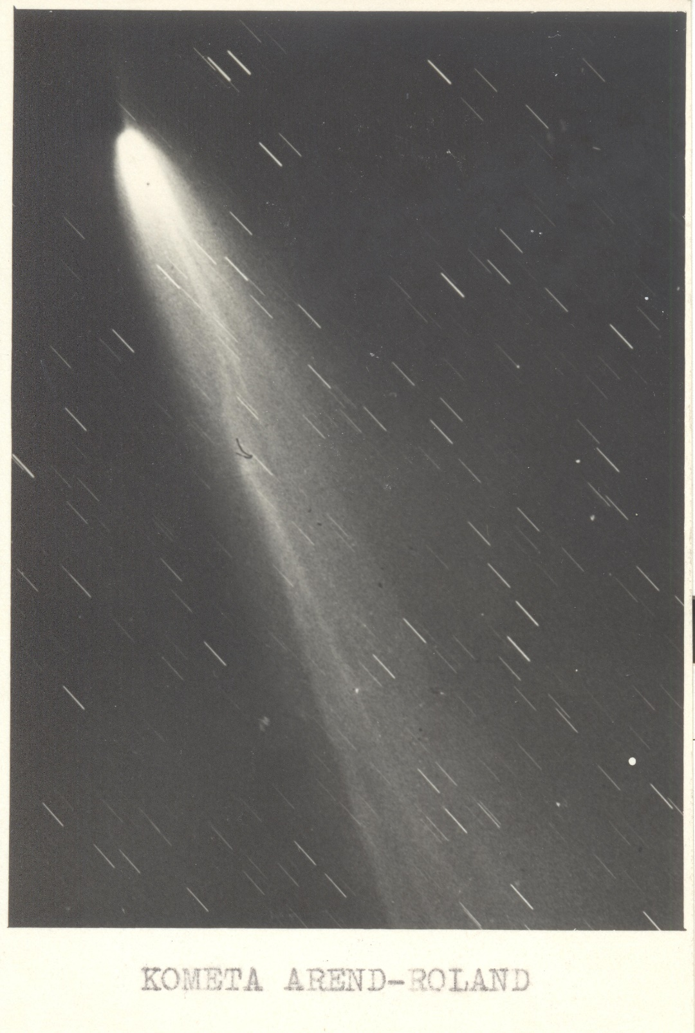
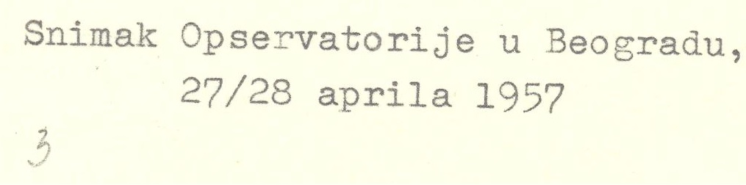
Comet Arend–Roland was discovered on November 8, 1956, by Belgian astronomers Sylvain Arend and Georges Roland on photographic plates. As the eighth comet found in 1956, it was named Arend–Roland 1956h after its discoverers. Wikipedia
C/1956 R1 (Arend–Roland)
Discovered: 1956
Inclination: 119.94°
Orbits: Sun
Last perihelion: April 8, 1957
Discoverers: Sylvain Arend, Georges Roland
AOB
27/28 April 1957

Slide 4
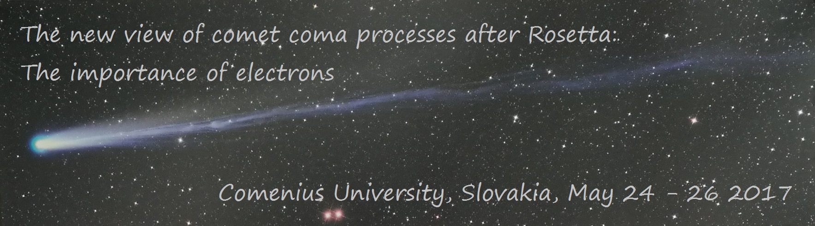

ELECTRON SCATTERING DATA AND ROSETTA MISSION
Bratislav Marinković

Slide 5
Outline
Motivation
About Rosetta mission
67P/Churyumov–Gerasimenko Comet
Objectives; Instruments
Observations
Role of electrons
Electron scattering data needs
Cross sections in BEAMDB database
Belgrade e-RACP IS (electron Research in Atomic Collisional Physics Information System)

Slide 6
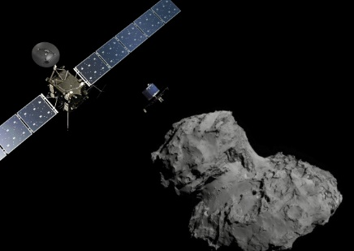
Rosetta mission
Approved in Nov. 1993 by ESA
Launch date: 2 March 2004
Mission phase: At Comet 67P/Churyumov-Gerasimenko
The spacecraft arrived at the comet on 6 August 2014. Since then, the spacecraft has been orbiting the comet.
Lander delivery 12 Nov. 2014
Mission end: September 2016
Artist's impression of Rosetta and Philae at the comet. Credit: ESA/ATG medialab; Comet image: ESA/Rosetta/NavCam

Slide 7
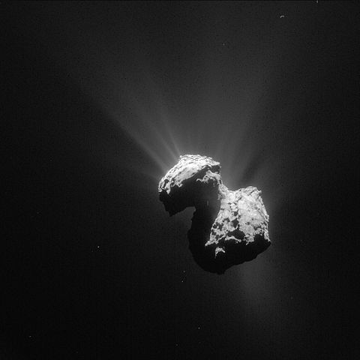
67P/Churyumov–Gerasimenko Comet
Jupiter-family comet, originally from the Kuiper belt
Current orbital period of 6.45 years
Rotation period of approximately 12.4 hours
Maximum velocity 38 km/s
Orbital period: 2,398 days
Discovered: September 20, 1969
Mean density: 0.533 ± 0.006 g/cm³
Discoverers: Klim Churyumov, Svetlana Gerasimenko
By ESA/Rosetta/NAVCAM, CC BY-SA IGO 3.0, CC BY-SA 3.0-igo,
https://commons.wikimedia.org/w/index.php?curid=41733207

Slide 8

Objectives
To study the origin of comets
Relationship between cometary and interstellar material
Implications with regard to the origin of the Solar System

Slide 9
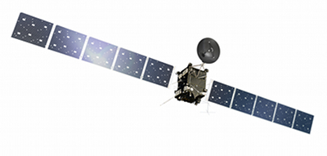
INSTRUMENTS - THE ROSETTA ORBITER
(11 SCIENCE INSTRUMENT PACKAGES)
ALICE - Ultraviolet Imaging Spectrometer
COSIMA - Cometary Secondary Ion Mass Analyser
OSIRIS - Optical, Spectroscopic, and Infrared Remote Imaging System
VIRTIS - Visible and Infrared Thermal Imaging Spectrometer
The Rosetta orbiter
Credit: ESA/ATG medialab.

Slide 10
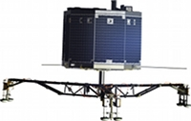
INSTRUMENTS - THE ROSETTA LANDER
(10 SCIENCE INSTRUMENT PACKAGES)
APXS - Alpha Proton X-ray Spectrometer
ÇIVA and ROLIS Panoramic and microscopic imaging system
PTOLEMY Evolved Gas Analyser
The Philae lander
Credit: ESA/ATG medialab.
http://sci.esa.int/rosetta/47366-fact-sheet/

Slide 11
Observations - OSIRIS
Optical imager OSIRIS WAC (wide-angle camera) narrowband filters 200 – 700 nm
Bodewits et al. Astron. J, 152, 130 (2016) [15pp]

Slide 12
Direction to the Sun is upward
On the right side of the nucleus “ghosts” are caused by internal reflections from optical elements
Left - model image of the comet nucleus
Continuum-subtracted images acquired with the OH, NH, NH2, [O I], and CN filters
Long exposure UV375 filter image
Bodewits et al.
Astron. J, 152, 130 (2016) [15pp]

Slide 13
Observations - IES
Rosettaʼs Ion and Electron Sensor (IES; Clark et al. 2015) the large population of suprathermal electrons observed.
Electron velocity distribution functions. Representative VDF for the evolution from a solar wind-like VDF (blue curve) to accelerated VDFs (black and green curves). A generalized Gaussian (Eq. (1)) is used to fit the non-Maxwellian suprathermal distribution. At high electron velocities, the distribution resembles a Maxwellian part and then a power-law dependence (purple and cyan curves).
Clark et al. A&A 583, A24 (2015) [6pp]

Slide 14
Inconsistencies in results if one assumes standard cometary physics and chemistry:
1. Column densities and production rates derived from OSIRIS images are much higher than those measured by other instruments on board Rosetta
Assuming photodissociation of H2O as the main source of formation and prompt emission by atomic oxygen, and photodissociation and subsequent fluorescent excitation of OH, CN, and NH emission, Bodewits et al. derived column densities and calculated global production rates using the standard Haser model
2. Two water photolysis products, OH and [O I]. Water production rates derived from OH seem larger than those derived from [O I], by a factor of 6 in January and by a factor of 30 in July.
3. All production rates drop significantly between 2015 March and June, much larger than the diurnal variation of the total water production and not consistent with the observed trend of increasing production rates with decreasing heliocentric distance.
The photo-dissociation and fluorescence are not the dominant processes resulting in the OH, [O I], CN, and NH emission observed in the inner coma. Instead, the fragments might be fragments from different parent species and/or formed by other processes.

Slide 15
e/H₂O
Summary of the recommended electron collision cross sections for H2O. Cross sections smaller than 10E-18 cm2 are not shown.
Itikawa and Mason, J. Phys. Chem. Ref. Data, 34, 1-22 (2005).

Slide 16
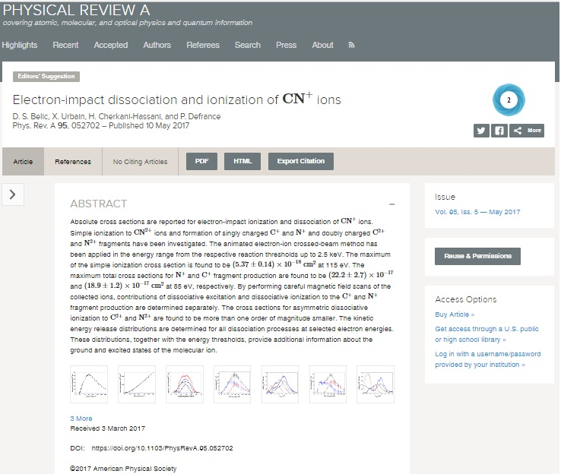
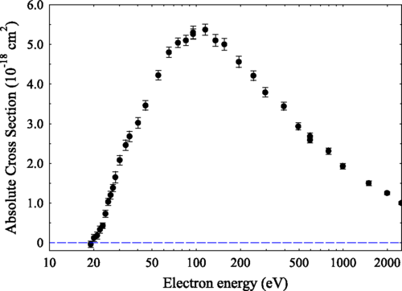
e/CN⁺ Belic et al. PRA 95, 052702 (2017).
Absolute cross sections for electron-impact simple ionization of CN⁺

Slide 17
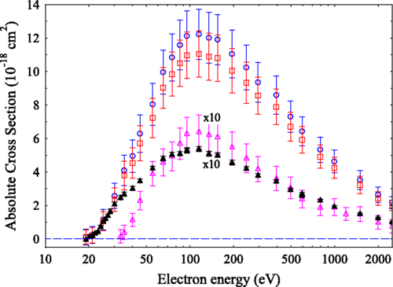
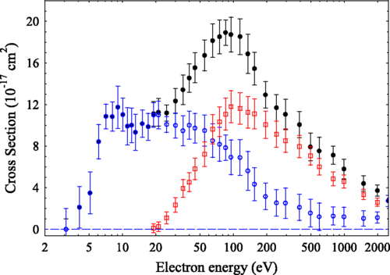
e/CN⁺ Belic et al. PRA 95, 052702 (2017).
Absolute cross sections for CN⁺ fragment production versus electron energy: total cross sections (solid circles), dissociative excitation contribution (open circles), and dissociative ionization (squares)
Absolute cross sections for C⁺ fragment production versus electron energy: total cross sections (solid circles), dissociative excitation contribution (open circles), and dissociative ionization (squares)

Slide 18
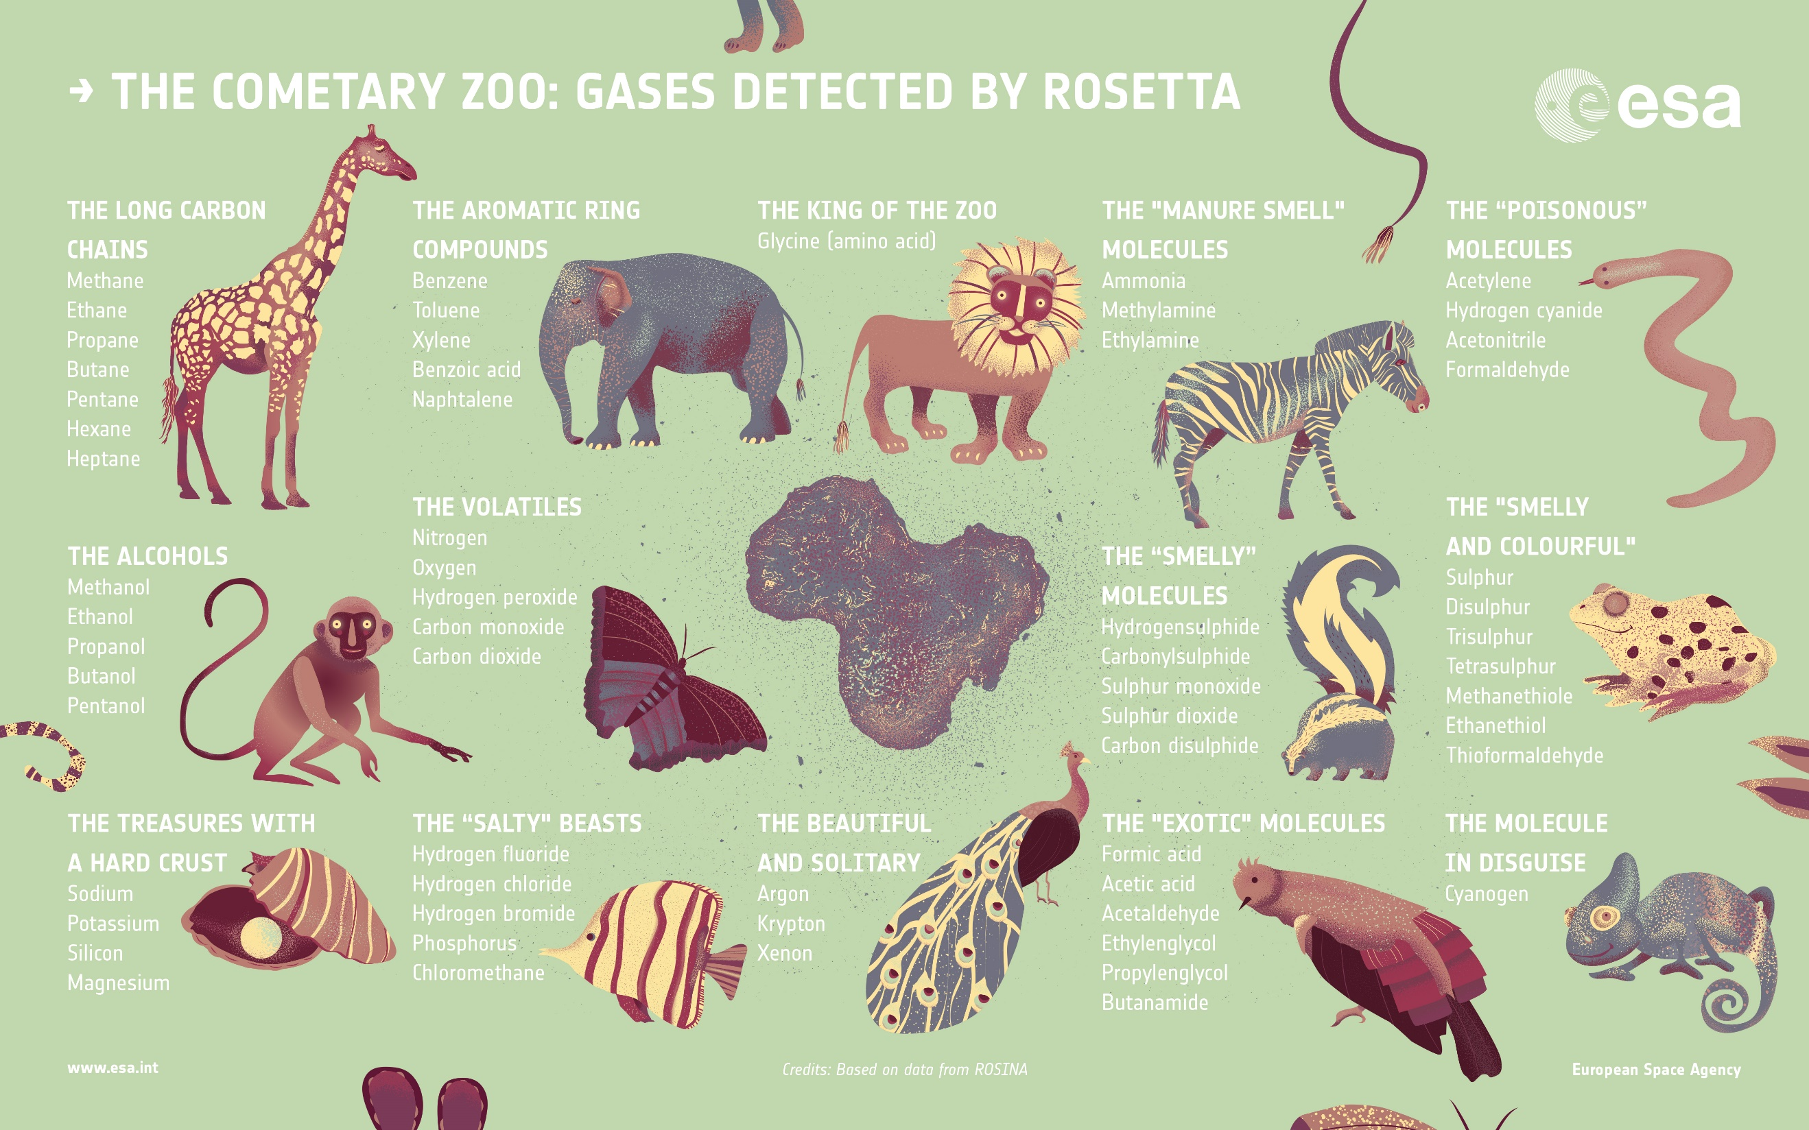

Slide 19
Outline
Motivation
About Rosetta mission
67P/Churyumov–Gerasimenko Comet
Objectives; Instruments
Observations
Role of electrons
Electron scattering data needs
Cross sections in BEAMDB database
Belgrade e-RACP IS (electron Research in Atomic Collisional Physics Information System)

Slide 20
Present Databases
Numerical
The NIST Reference on Constants, Units, and Uncertainty
Energy levels, wavelengths and transition probabilities of atoms and ions, http://physics.nist.gov/cgi-bin/AtData/main_asd
Wavelength, energy level, oscillator strength, opacity, and photoionization cross sections, http://astro.u-strasbg.fr/TOP.html
Collisional data: NIFS, NIST, ALADDIN, http://www-amdis.iaea.org/aladdin.html
Bibliographic
Atomic Transition Probability Bibliographyics Database, http://physics.nist.gov/PhysRefData/Fvalbib/html/reffrm0.html
Various processes for atoms, ions and molecules (structure, photonic collisions, electron collisions, atomic and molecular collisions,
http://gaphyor.lpgp.u-psud.fr/

Slide 21

Present Databases
Search engines
GENIE - A General Internet Search Engine for Atomic Data, http://www-amdis.iaea.org/GENIE/
DANSE - Atomic and Molecular Bibliographic Data Search Engine - ICAMDATA –International Conference on Atomic and Molecular Data
On-line computing
Electron Impact Cross Section Calculations Using The Average Approximation, http://www-amdis.iaea.org/AAEXCITE
Effective ionization and recombination rate coefficients, http://www-amdis.iaea.org/RATES /
Institute of Physics,
University of Belgrade

Slide 22
Present Scattering Databases
LXCat
An open access web site for collecting, displaying and downloading ELECtron SCATtering cross sections and swarm parameters
L. C. Pitchford et al. Chem. Phys. 398, 148 (2012)
Plas.Proc.&Polym.14 1600098 (2017).
Institute of Physics,
University of Belgrade

Slide 23

Belgrade databases and IS
Belgrade e-RACP IS (electron - Research in
Atomic Collisional Physics Information System)
  V. Cvjetkovic, B. P. Marinkovic, V. Bocvarski, M. Bilbija and V. Petrovic, “Information system aided research in atomic physics”, Proc. of the Fifth Gen. Conf. of Balkan Physical Union BPU-5, Vrnajcka Banja, Serbia and Montenegro, August 25 – 29, (2003), Eds. S. Jokic, I. Milosevic, A. Balaz and Z. Nikolic, (Belgrade: Serbian Physical Society) CD-ROM Abstract SO04 – 003, pp. 245 – 250.
  V. M. Cvjetković, B. P. Marinković, and D. Šević, “Information System in Atomic Collision Physics”, in Advances and Innovations in Systems, Computing Sciences and Software Engineering, Ed. Khaled Elleithy, Springer, Dordrecht, The Netherlands (2007) pp. 485-490. DOI: 10.1007/978-1-4020-6264-3_84 http://www.springerlink.com/content/l717769328240l34
  B. P. Marinković, “Progress on Belgrade e-RACP data base and information system”, Proc. Workshop on Nano-IBCT data base development, February 24 - 26, (2012) Vienna, Austria, Session Oral Presentation.

Slide 24
Belgrade databases and IS
LCAP@IPB e/Mol database - BEAMDB
  S Denifl, G Garcia, B A Huber, B P Marinković, N Mason, J Postler, H Rabus, G Rixon, A V Solov’yov, E Suraud, and A V Yakubovich, “Radiation damage of biomolecules (RADAM) database development: current status”, Journal of Physics: Conference Series 438 012016 (2013).
  doi:10.1088/1742-6596/438/1/012016
  Bratislav P. Marinković, Veljko Vujčić, Gennady Sushko, Dušan. Vudragović, Dara B. Marinković, Stefan Đorđević, Stefan Ivanović, Milutin Nešić, Darko Jevremović, Andrey V Solov’yov and Nigel J. Mason, “Development of Collisional Data Base for Elementary Processes of Electron Scattering by Atoms and Molecules”, Nucl. Instrum. Meth. B 354, 90-95 (2015). doi:10.1016/j.nimb.2014.12.039
  M L Dubernet et al., “The virtual atomic and molecular data centre (VAMDC) consortium”, J. Phys. B: At. Mol. Opt. Phys. 49, 074003 (2016). [18 pp].
  doi: 10.1088/0953-4075/49/7/074003 Special Issue on Atomic and Molecular Data for Astrophysics
  B P Marinković, D. Jevremović, V. A. Srećković, V. Vujčić, Lj. M. Ignjatović, M. S. Dimitrijević and N. J. Mason, “BEAMDB and MolD – databases for atomic and molecular collisional and radiative processes: Belgrade nodes of VAMDC”, Eur. Phys. J. D 71, 158 (2017) [9pp] doi: 10.1140/epjd/e2017-70814-6

Slide 25
LCAP@IPB e/Mol database - BEAMDB
UML (Unified Modelling Language) diagram

Slide 26
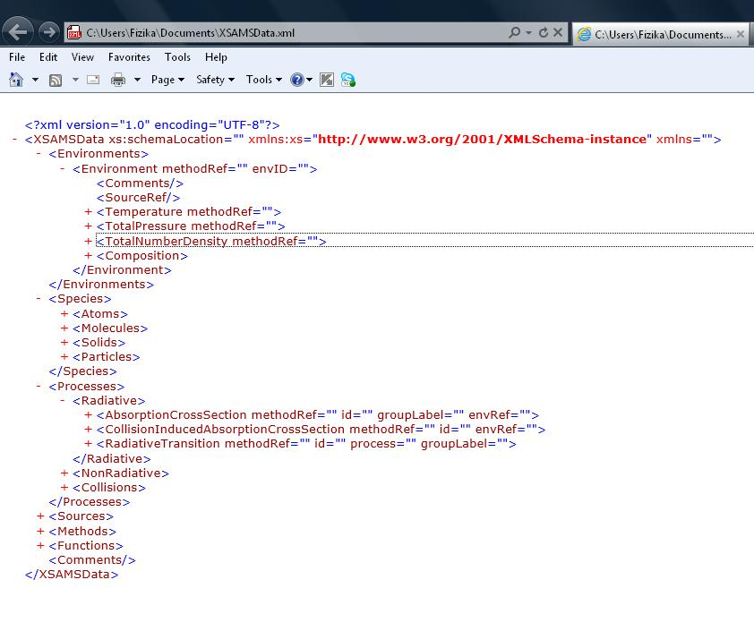
LCAP@IPB e/Mol database - BEAMDB
Sample output represented in XSAMS format

Slide 27
LCAP@IPB e/Mol database - BEAMDB

Slide 28
LCAP@IPB e/Mol database - BEAMDB

Slide 29
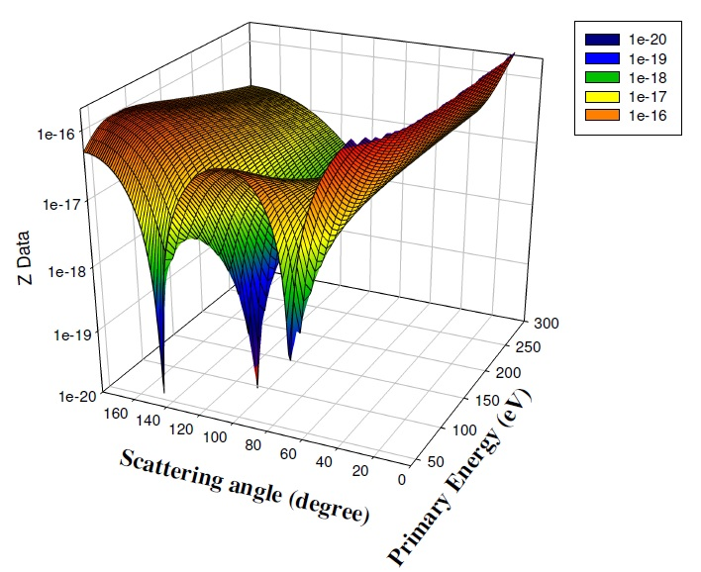
LCAP@IPB e/Mol database - BEAMDB
Elastic el.
scattering
DCS(E_{o},θ)
surface

Slide 30
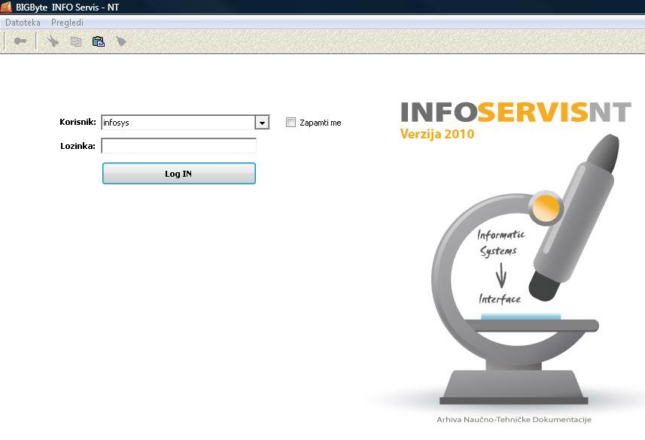
Belgrade e-RACP IS

Slide 31
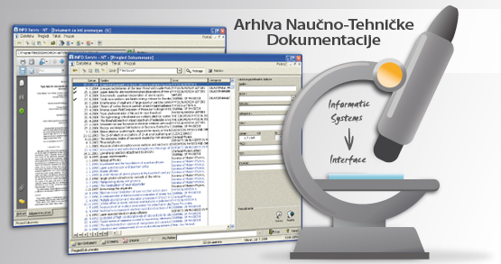

Belgrade e-RACP IS
Goals to be achieved?
Keep the bibliography of the Lab.
List the results of the projects
Keep the internal documents
Digitalization of own archive documents
Systematize the literature on specific topics
No duplication or multiple retrievals
Archive of old papers
Survey of existing data
Larger visibility of own data
Institute of Physics,
University of Belgrade

Slide 32
Basic idea of Belgrade e-RACP IS
Tool for researchers (plan & organize the research, source of data, survey of literature)
Process model and Data model
Expert Decomposition of the Article (EDA)
Selective and efficient data retrieval
Evaluation of data sets and applied methods
Institute of Physics,
University of Belgrade

Slide 33
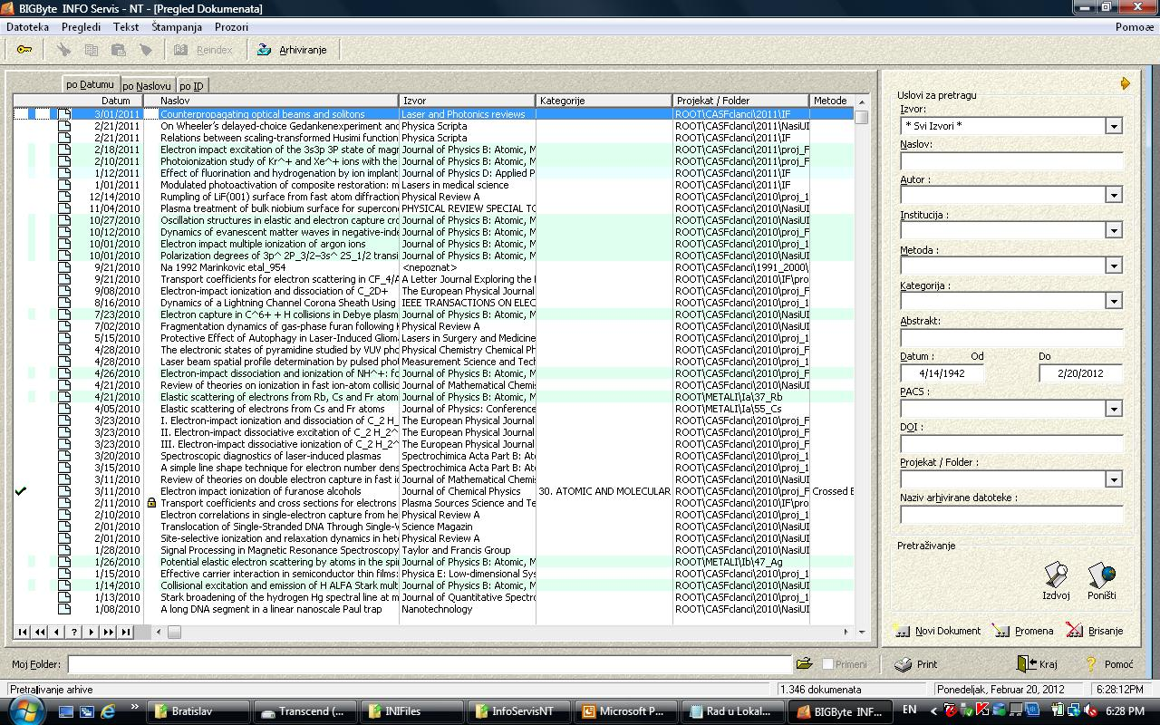
Belgrade e-RACP IS
Institute of Physics,
University of Belgrade
33

Slide 34
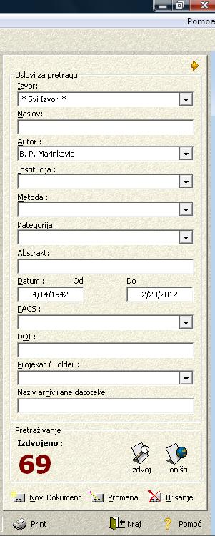
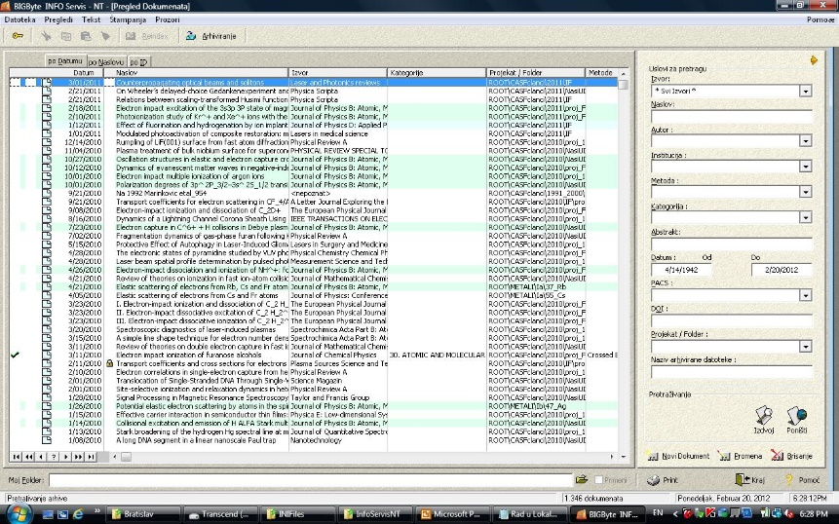
Selective and efficient data retrieval
Source
Author
Institution
Method
Abstract
Date From… To…
PACS
DOI
Project/Folder
Archived file
Institute of Physics,
University of Belgrade

Slide 35
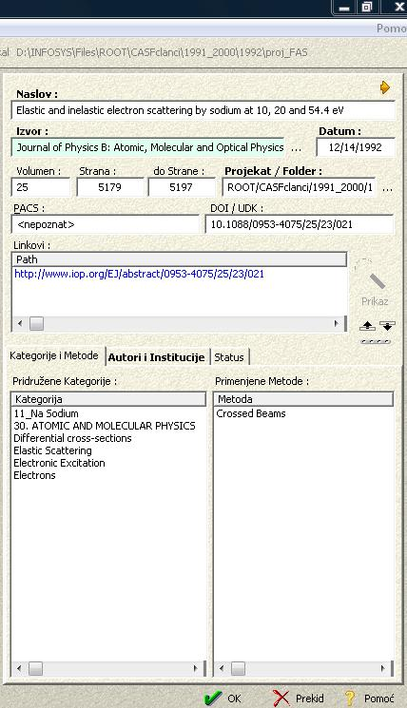
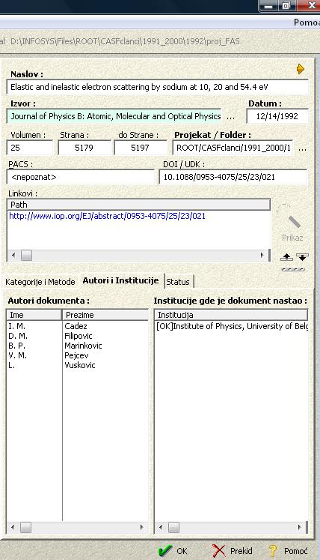
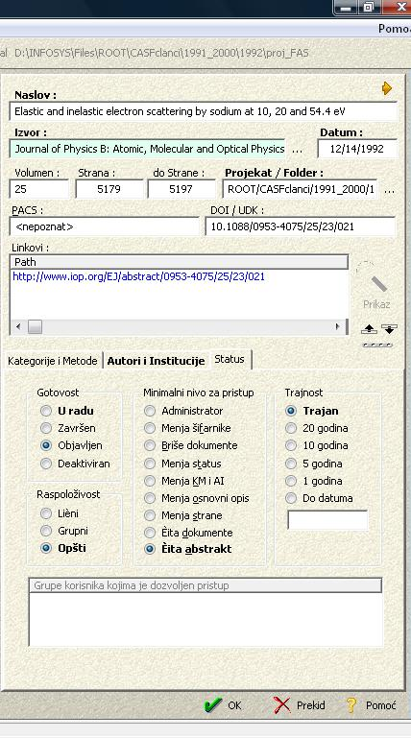
Expert Decomposition of the Article (EDA)
Categories and Methods
Authors and Institutions
Status
Institute of Physics,
University of Belgrade

Slide 36
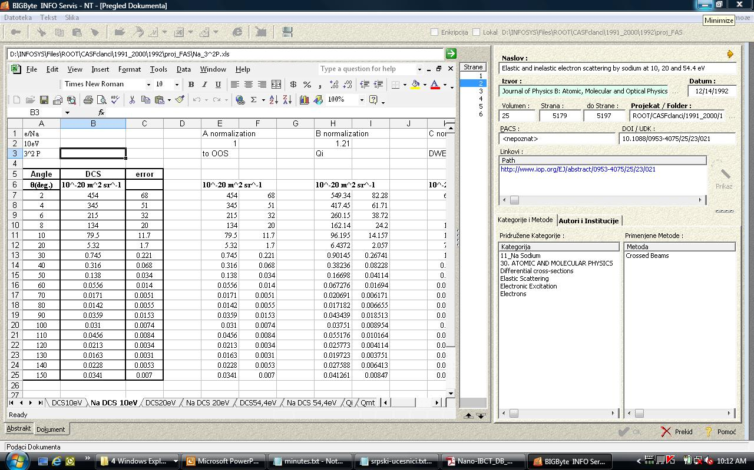
Belgrade e-RACP IS
Institute of Physics,
University of Belgrade

Slide 37
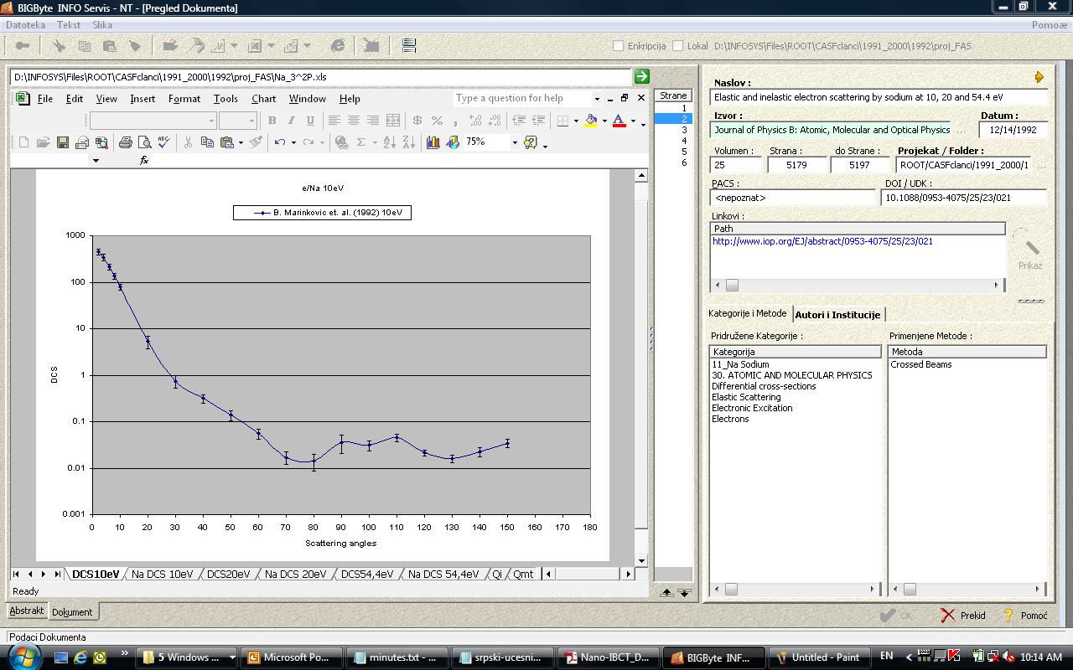
Belgrade e-RACP IS
Institute of Physics,
University of Belgrade

Slide 38
IS main characteristics
No limits on expansion to other areas of research or different type of data
No need for the whole document in the underlying database
Requires considerable human work for document decomposition
Institute of Physics,
University of Belgrade

Slide 39
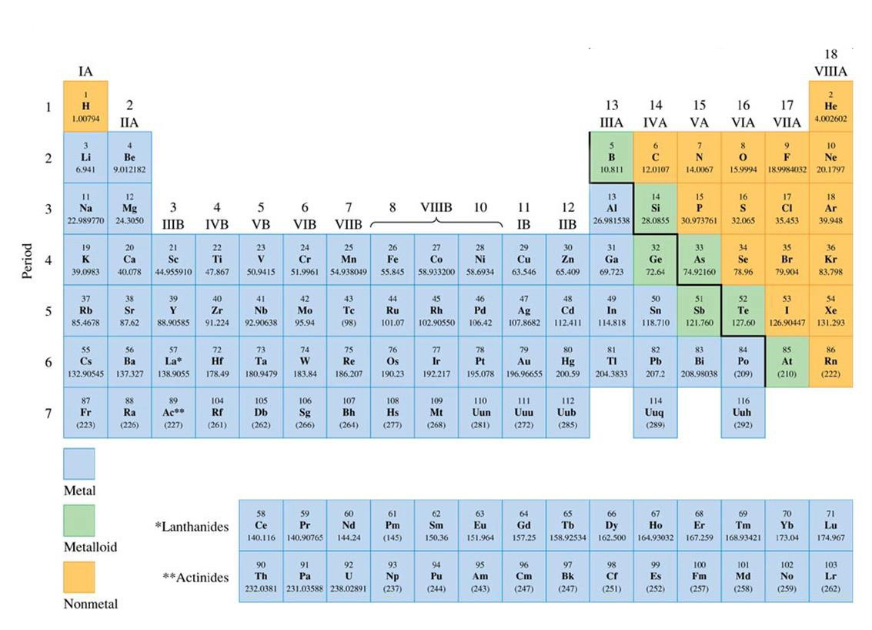
















Periodic Table of Elements

Slide 41
Conclusions
Electron and particle scattering data (not only photo-processes data) are needed to better understand processes in astrophysical observations
VAMDC as a distributed databases with a common portal is a powerful aid
Settling the Information System in a specific field of research (like the field of Atomic Collision Physics) could be very useful for each Lab or research group
Need for improved accuracy of CS measurements and smaller error bars – consistency of data.
Still we need refinements in theoretical approaches to the electron scattering problem.
Work with more complex systems (larger biomolecules, molecules being precursors for FEBID-focused electron beam induced deposition, radio-sensitizers, drugs, chelators, bio-chemically active compounds…) is challenging task ahead
Urgent need for settling the panel for critical assessment of e/Mol data and normalization procedures
Institute of Physics,
University of Belgrade

Slide 42
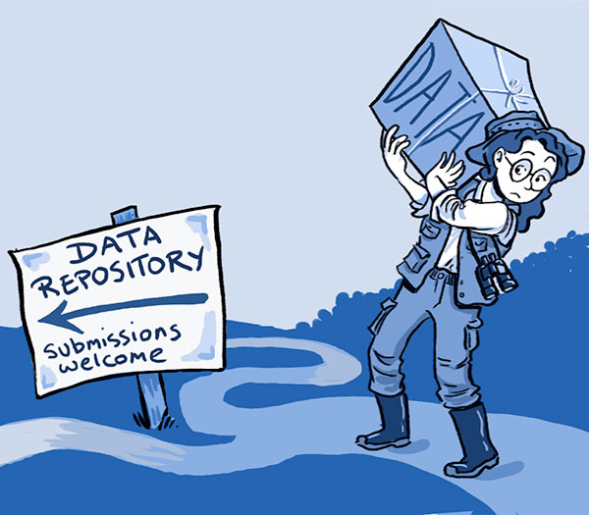
Instead of acknowledging all people who has been working on databases

Slide 43


Financing bodies and International collaborations
Fundamental Research Program:
Project # OI 171020
“Physics of collisions and photo processes in atomic, (bio)molecular and nano-sized systems”
Special thanks to Milan Dimitrijevic
He is Serbian representative in VAMDC consortium
Nanoscale Insights into Ion Beam Cancer Therapy, nanoIBCT Action MP1002

