Slide 1
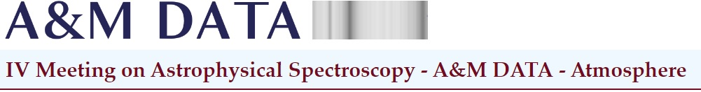

Statistics of Management Committee Members from Serbia in COST Actions
Zoran Mijić, COST National Coordinator (CNC)
Bratislav Marinković, COST Committee of Senior Officials (CSO)
Fruška Gora, 31th May 2022

Slide 2
Information on Action Extensions due to force majeure
On 25 April 2022, the Executive Board granted the possibility to apply for a maximum 6-month extension with budget
The following cohorts were affected by the pandemic: CA171xx,CA181xx and CA182xx
A communication to the Actions Chairs was sent on 26 April 2022
This will provide the necessary support for the Actions to achieve their planned objectives and impact and compensate for the difficulties encountered during the pandemic
Questions, please contact Action Science Officer

Slide 3
Information on the 70 new Actions 30/05/2022:
16% of main proposers are early-career investigator
44% of main proposers are women
71% of the proposals feature participants from industry/SMEs
19% of main proposers come from an Inclusiveness Target Country ( ITC)
As an indicator of multidisciplinarity of the new Actions, 47% of all Actions cover at least two OECD (Organisation for Economic Co-operation and Development) fields of science and technology, while 11% cover at least three fields.
Serbia
Main proposer: 1 (2,5%)
Secondary proposers: 52 (71,4%)
Total: 53 (75,7%)
CA21153 – “Network for implementing multiomics approaches in atherosclerotic cardiovascular disease prevention and research”
dr Mion Sopić, Faculty of Pharmacy, University of Belgrade

Slide 4
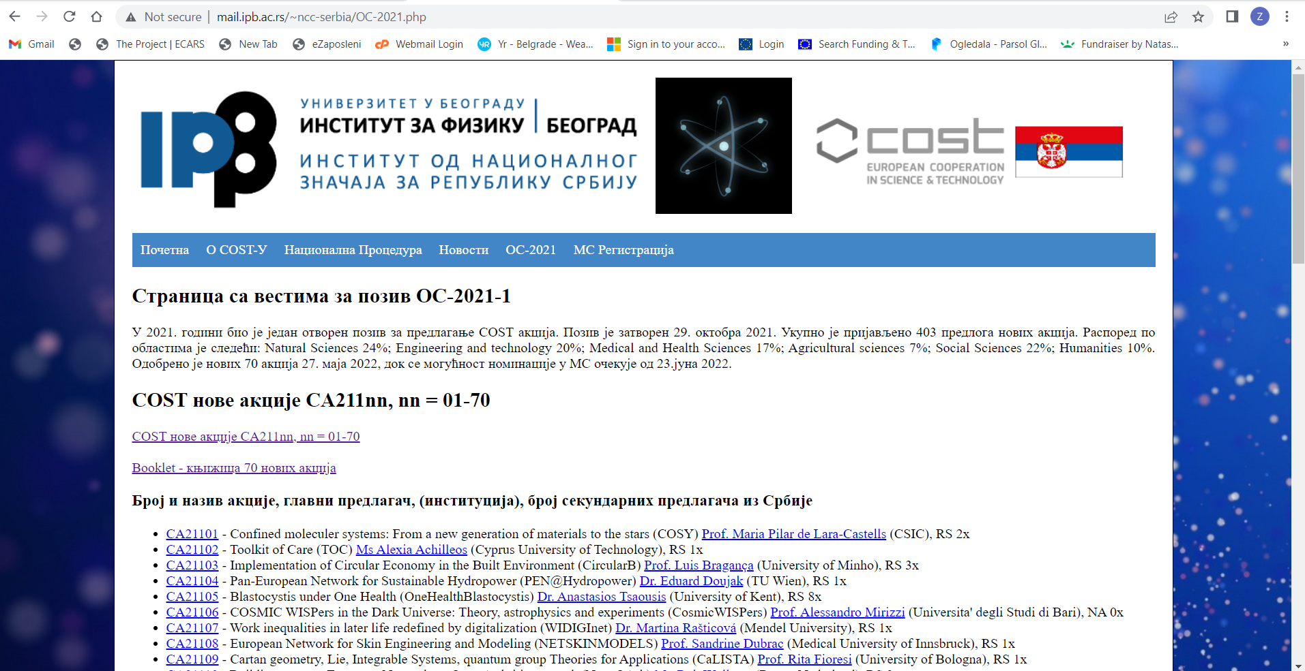
http://mail.ipb.ac.rs/~ncc-serbia/OC-2021.php

Slide 5
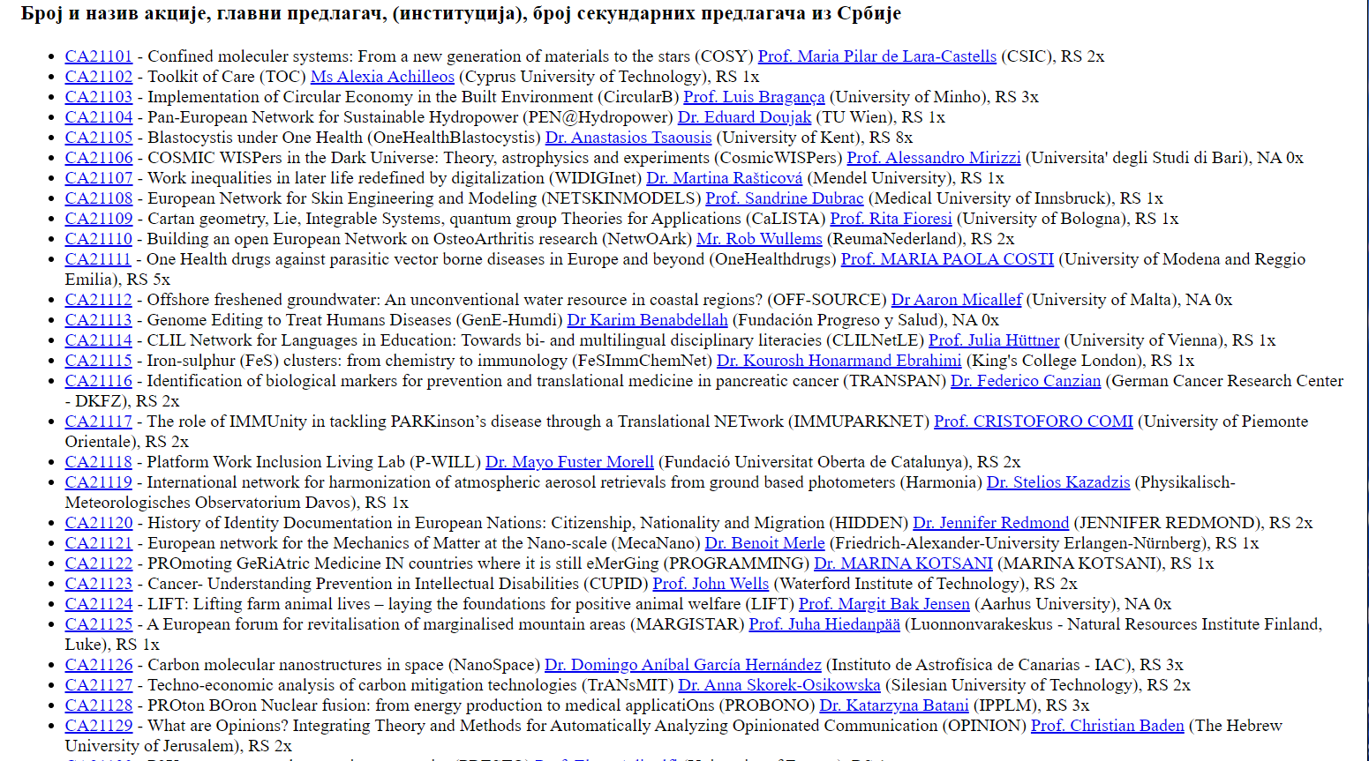

Slide 7
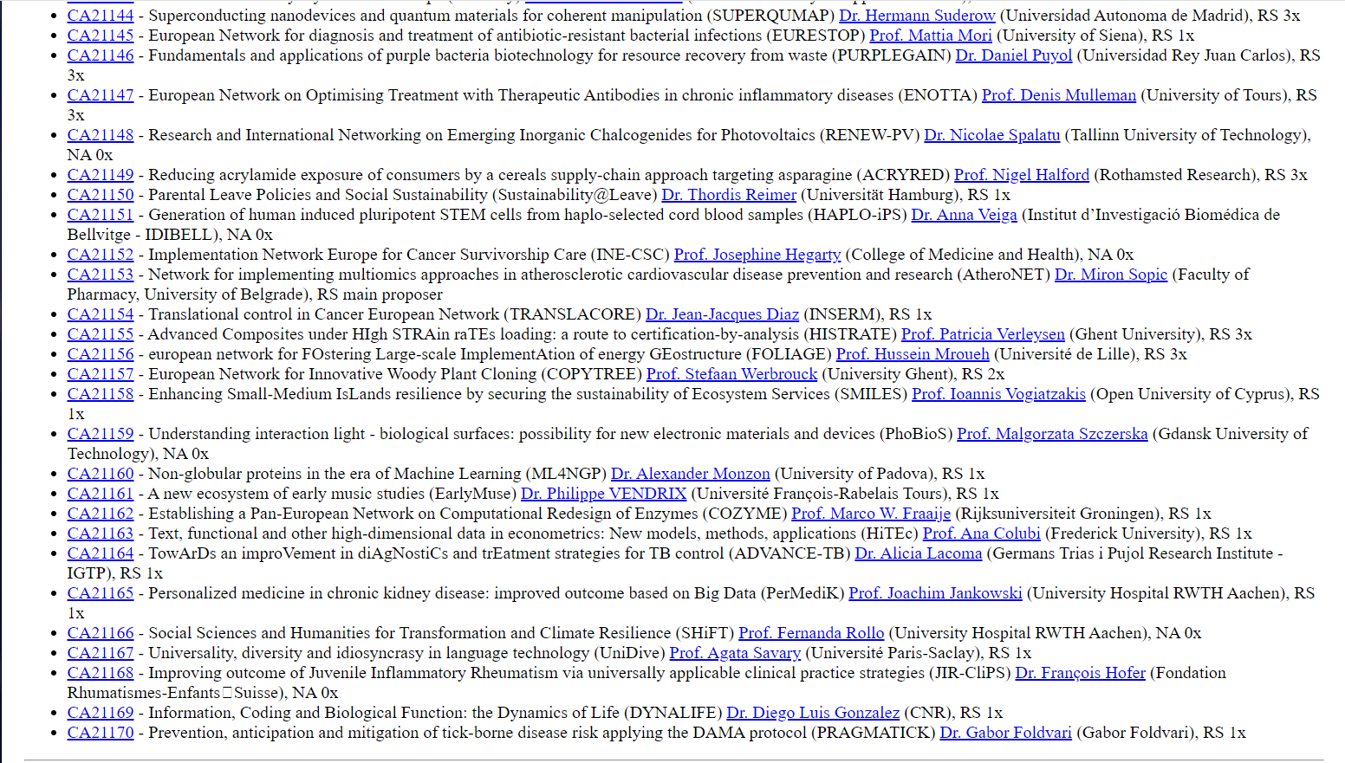

Slide 8

National procedure – MC nomination

Slide 9
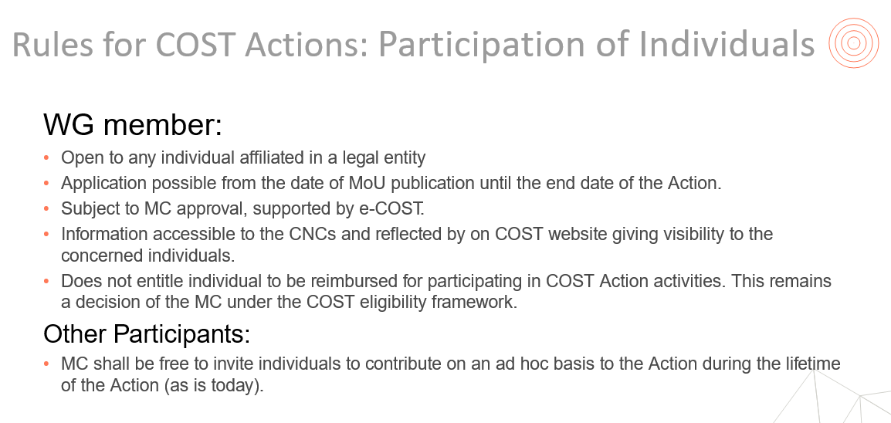

Slide 10
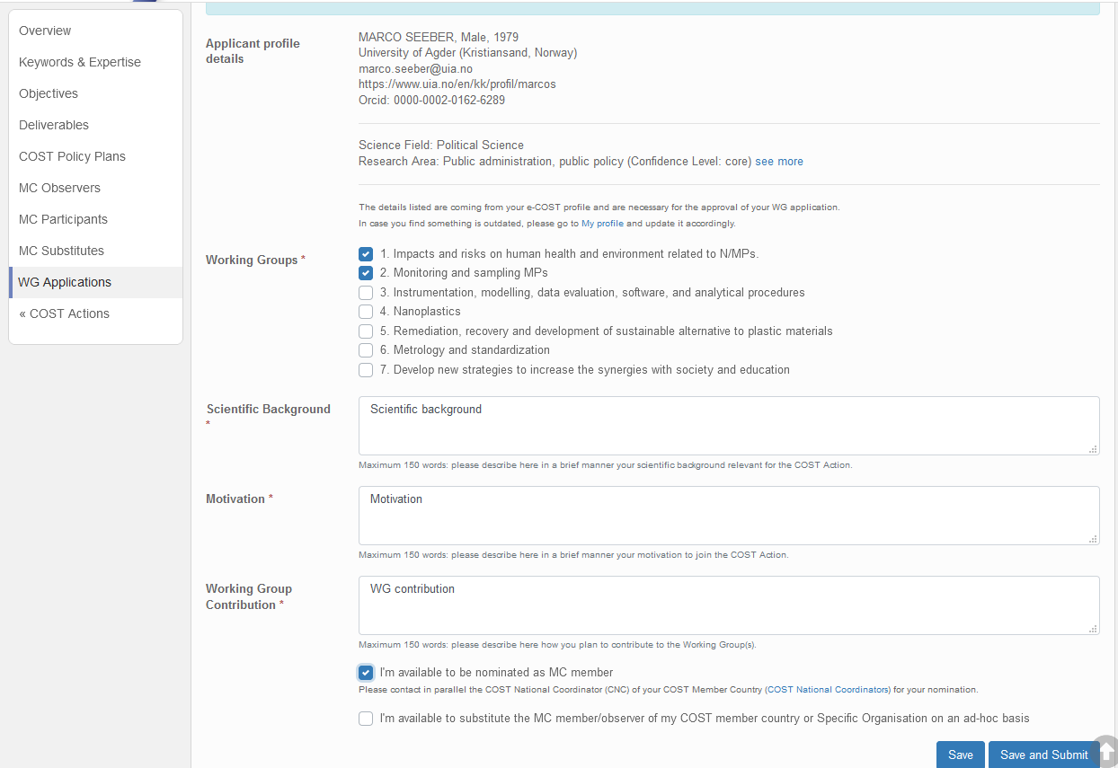

Slide 11
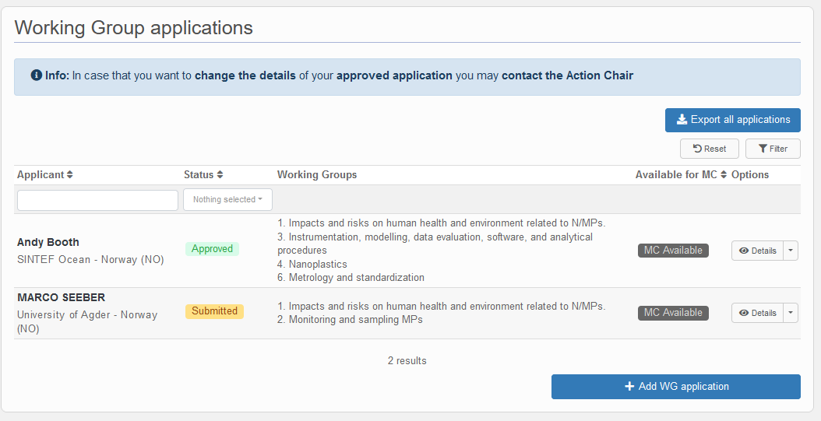

Slide 12
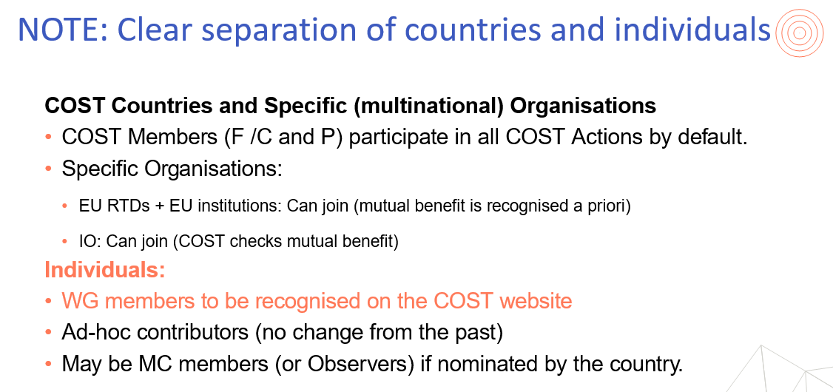

Slide 13
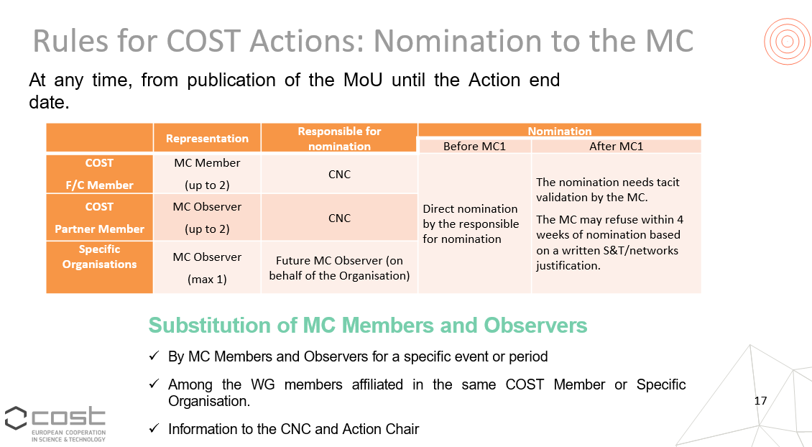

Slide 14
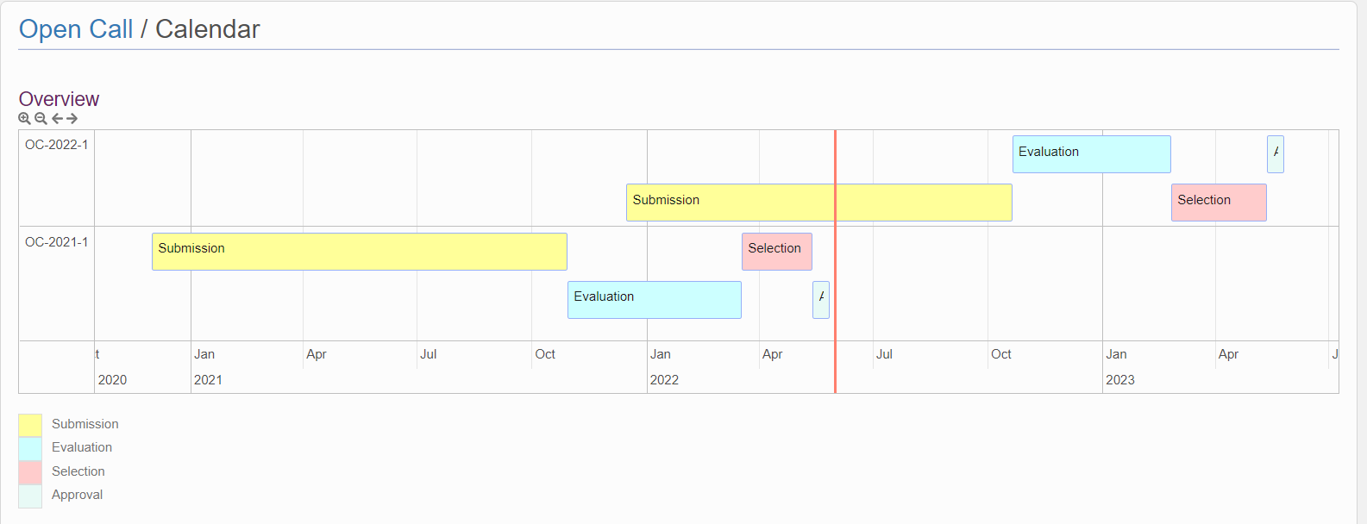
Update on the oc-2022-1

Slide 15
Changes for OC-2022-1
Horizon 2020 → Horizon Europe
  List of ITCs : Luxembourg out, Greece in
  List of COST Full Member Countries
  Georgia and Ukraine added
  Changes in terminology :
      ECI (up to 8 years from the date they obtained their PhD) → YRI (under the age of 40)
  Anonymity :
    Clear examples of eligible statements in Applicant’s Guidelines
    No exceptions anymore
  Changes in the TA
Notes:
Were inputs only coming from EB, or also from CSO /SC/CNC ? Now there is access for nNCs to leadership positions, observer status is no longer applied to NNCs and third states

Slide 16
Take-home message OC-2022-1
New Technical Annex template
  Do not use the old version (resubmissions !)
  or proposal will be declared ineligible
No longer any exceptions to anonymity criterion
  Apply anonymity to all proposers and their institutions
  No direct or indirect reference to people and/or their institutions involved
  in the Network of Proposers
  Names should neither be explicitly mentioned nor potentially identifiable
  Some examples mentioned in Applicant’s Guidelines on what is eligible

Slide 17
Statistics on MC nominations and country activity

Slide 18
Nomination of proposers (I)

Slide 19
Nomination of non-proposers (I)

Slide 20
MC delegates in multiple Actions

Slide 21
Percentage of female MC delegates

Slide 22
Mobilisation of young researchers

Slide 23
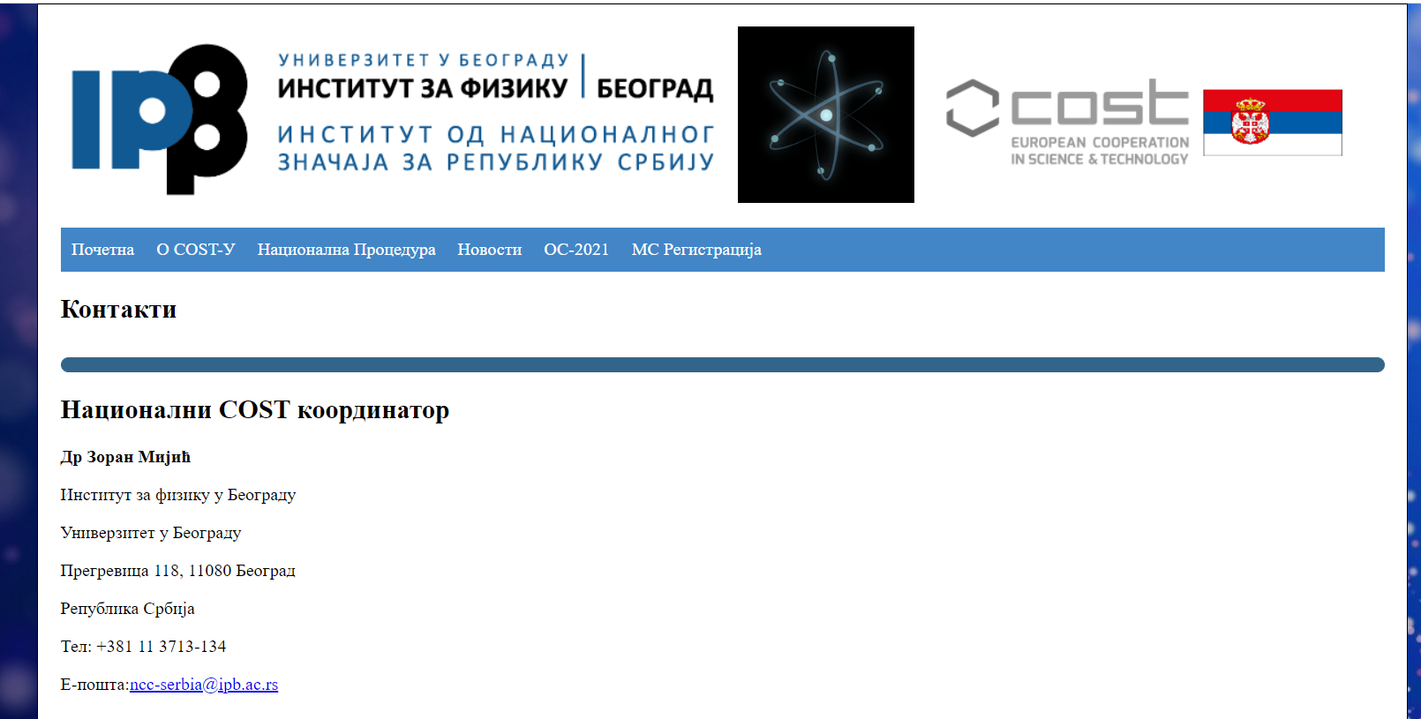

Slide 24
COST Info Day
addressed to the
Western Balkan Countries
Draft agenda
SAVE the DATE
20 June 2022
09:30 – 12:30 CET
Online via Teams

