Slide 1



Review of atmospheric aerosol optical properties profiling and lidar station activities in Serbia
Zoran Mijić, Maja Kuzmanoski, Luka Ilić, Aleksander Kovačević, Darko Vasiljević
Institute of Physics Belgrade, University of Belgrade, Serbia

Slide 2
Atmospheric aerosols
Atmospheric aerosol affects climate through the direct (scattering and absorption both solar and terrestrial radiation) and indirect effects (modification of cloud through aerosol-cloud interaction)
Due to their short lifetime and the large spatial-temporal variability, it is necessary to establish a climatology of the aerosol distribution.
Regulatory monitoring ground-based networks do not provide an adequate information of spatial coverage
Remote sensing of atmospheric aerosols from space-borne sensors provides opportunity to achieve long-term continuous characterization of aerosols

Slide 3
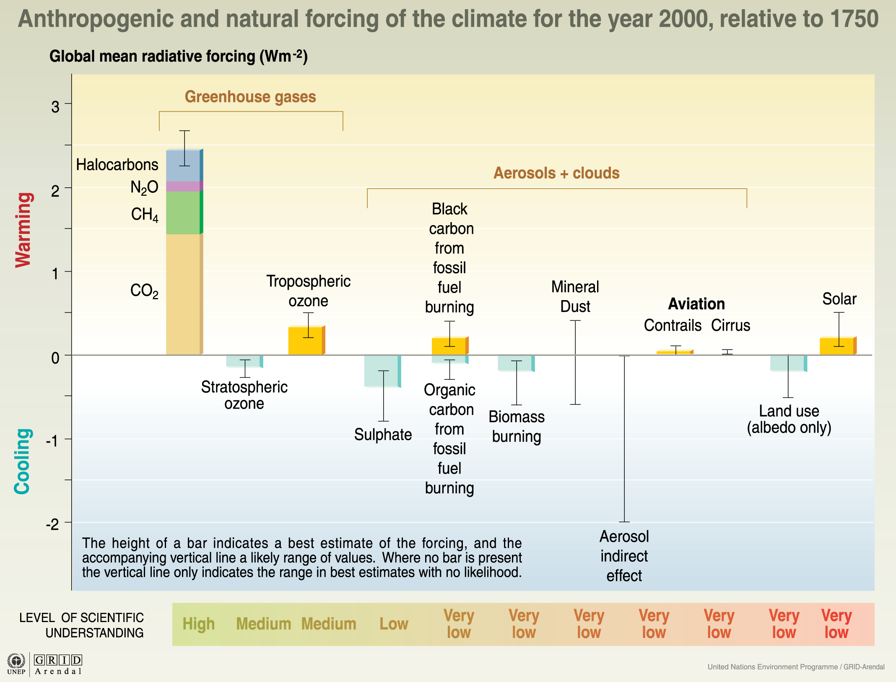
Radiative forcing

Slide 4
The rationale for ground-based
aerosol profiling
Long-range transport occurs at elevated layer decoupled from ground
4 – Dimensional space-time distribution of aerosols
Detection of long-term man-made trends in the concentration of aerosols related to climate change
Better qunatification of pollution sources and their atmospheric pathways to sensitive downwind receptors
Direct observations of plumes from major events such as forest fires, dust storms and volcanic eruptions
Improved regional forecast of both weather and air quality

Slide 5
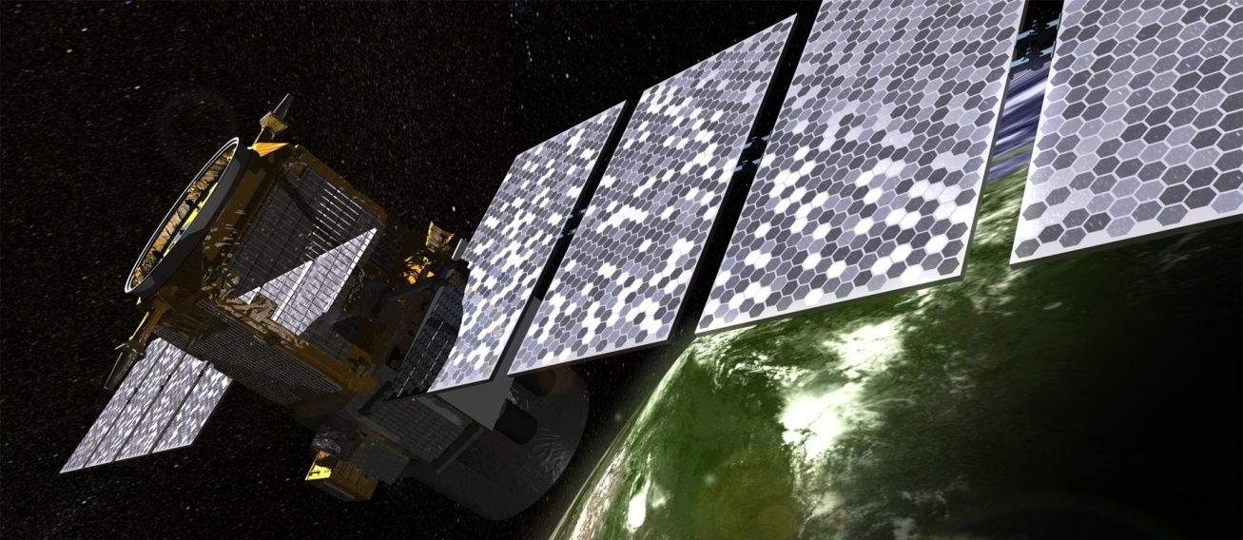
Integrated approach
CALIPSO (Cloud and Aerosol LIdar Pathfinder for
Spaceborn Observation)
ground-level in-situ measurements
ground-based remote sensing, space-borne observations
advance modelling

Slide 6


DREAM model
DREAM – Dust REgional Atmospheric Model
DREAM simulates all major processes of the atmospheric dust cycle (Nickovic et al., 2001)
Barselona Supercomputing Center
http://www.bsc.es/earth-sciences/mineral-dust-forecast-system/
South East European Virtual Climate Change Center, Belgrade
http://www.seevccc.rs/

Slide 7
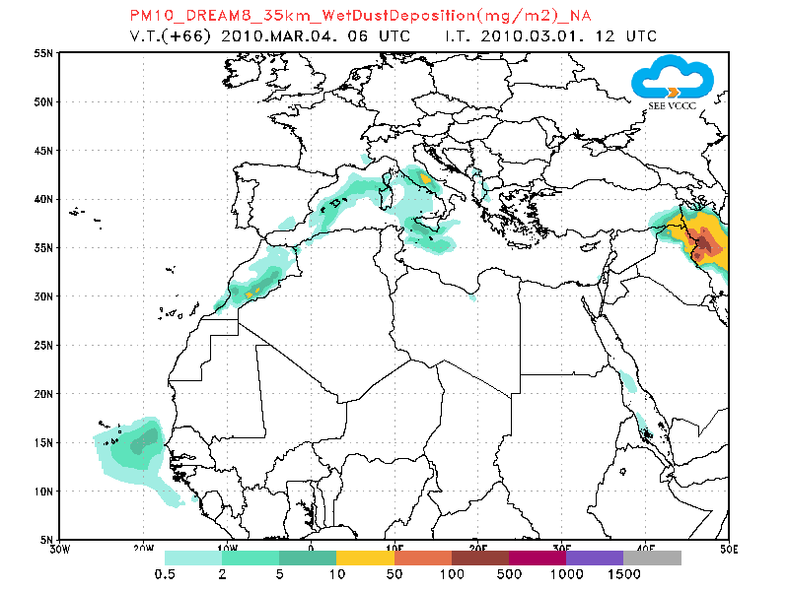
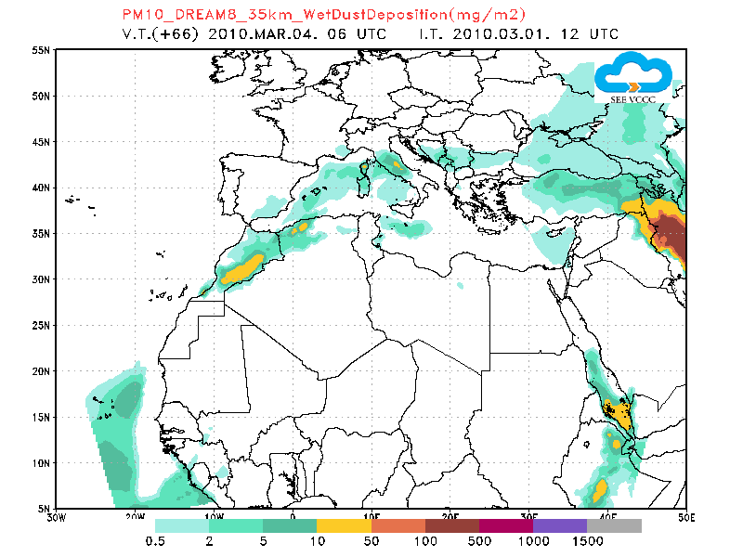
Case of yellow snow observed at the Kopaonik ski resort in Serbia
04 March 2010
WET DEPOSITION
WET DEPOSITION
NO ASSIMILATION
ASSIMILATION
Nickovic et al. Second GALION workshop, WMO, Geneva, 2010.
Notes:
To increase performance of numerical atmospheric dust model forecasts and to improve our understanding of the atmospheric underlying dust process, incorporation of available observed information on dust into modelling systems is required. Well established techniques used for atmospheric data assimilation in numerical weather prediction systems could be applicable for assimilation of observed aerosol parameters as well. Assimilation method is based on the Newtonian relaxation using background dust concentration of the DREAM dust model and target ﬁelds of ECMWF dust analysis that includes the Moderate Resolution Imaging Spectro-radiometer (MODIS) aerosol objective analysis
Pejanovic G., Nickovic S., Petkovic S., Vukovic A., Djurdjevic V., Vujadinovic M., Dacic M., 2012: “Dust operational forecast system with assimilation of dust analysed data”, Regional Conference on Dust and Dust Storms, Kuwait, 20-22 November 2012. Poster can be found

Slide 8
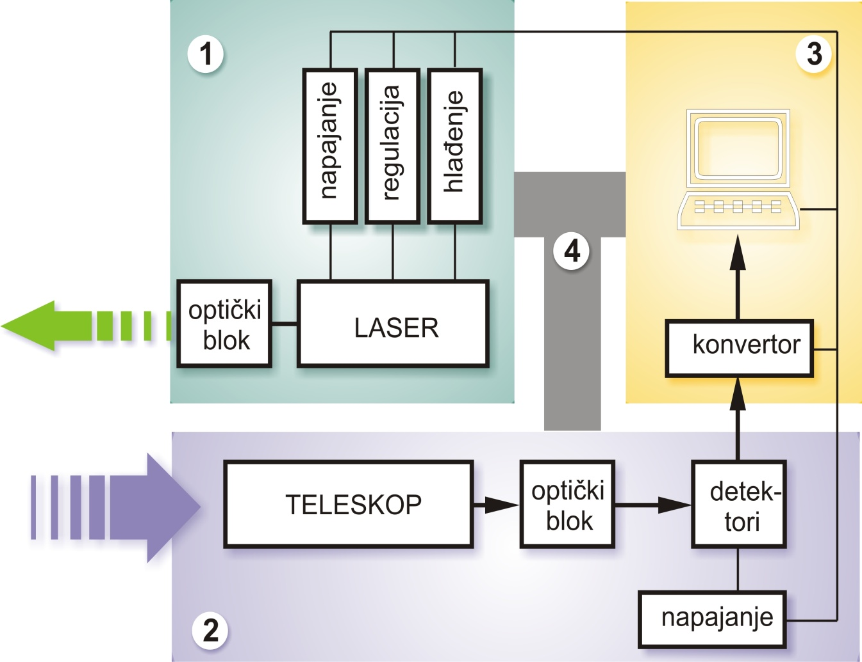
LIDAR -
Ligth Detection And Ranging
Supply
Cooling
Regulation
Atmosphere
OPTICS
Convertor
OPTICS
DETE-
CTOR
POW. SUPPLY

Slide 9
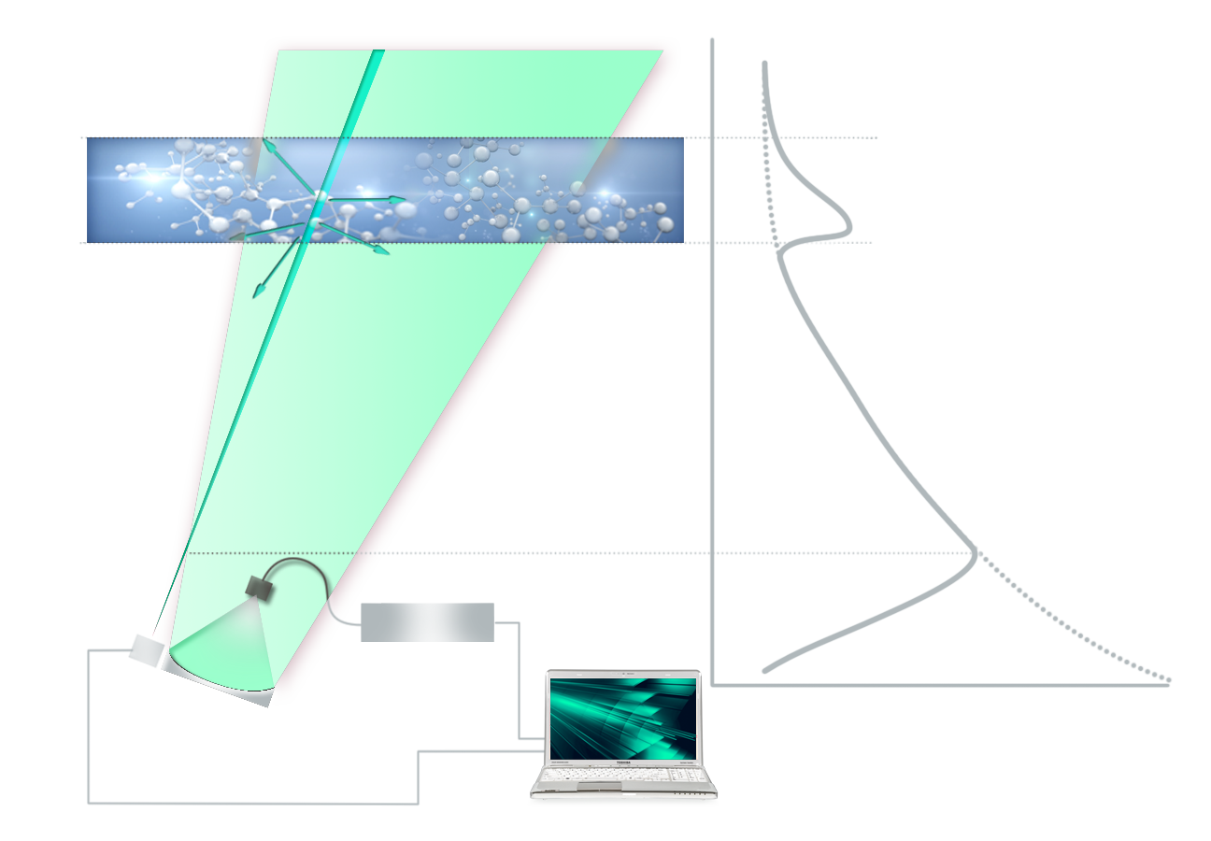
The major parts of LIDAR system and characteristic signal response
Laser beam
Aerosol layer
Theorethical curve for clean atmopsphere
Measurement
Scattering on aerosol
Telescope field of view
Heigh
Scattering on air molecules
TRANSMITER Laser
Entrance of the beam into the telescope field of view
Detector
Analysis
RECIEVER
Telescope
Power of scatter irradiance

Slide 10
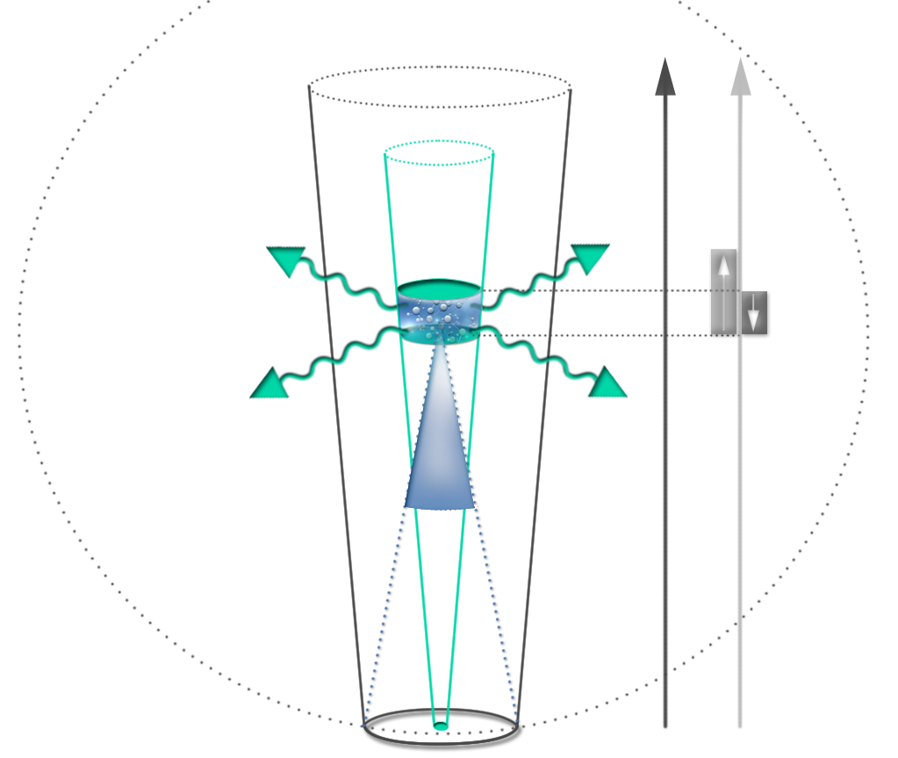
Basic LIDAR equation - illustration
Reciever field of view
Heigh
Time
P(λ,r) – signal detected
P₀(λ,r) – emitted laser power
β (λ,r) – backscatter coefficients
α (λ,r) – extinction coefficients
C – system constant
Laser beam
ΔR
Effective
pulse length
Scattering volume
ΔR=cτ/2
τ - laser pulse duration
C - speed of light
Perception angle
Telescope area

Slide 11
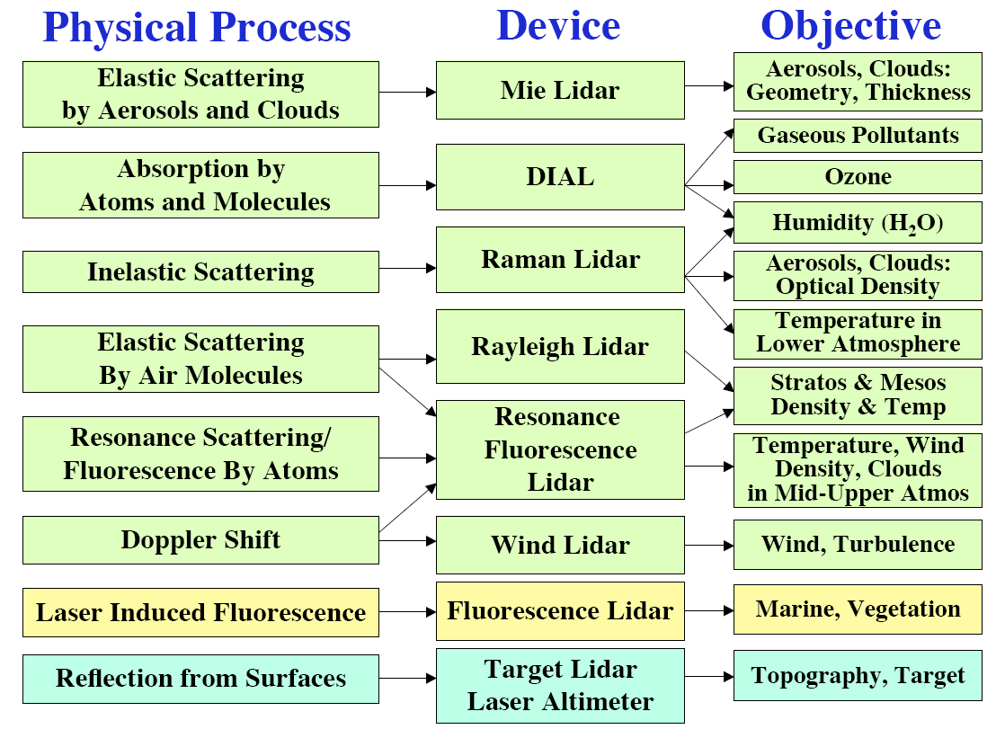

Slide 12
Aerosol parameter that can be derived from LIDAR observation
Parameter | Basic LIDAR type
Range corrected signal (colour plots of aerosol distribuiton) | BL
Aerosol backscatterf coefficient | BL
PBL depth | BL
Aerosol extinction coefficient | RL or HSRL
Angstrom exponent | MLR
Aerosol type dicrimination (dust, antrophogenic) | BL+DL
Aerosol microphysical properties (volume and survace conc, refractive index) | MLR
Single scattering albedo | MRL
Aerosol type determination (dust, maritime, fire smoke, urban haze) | MRL+DL

Slide 13
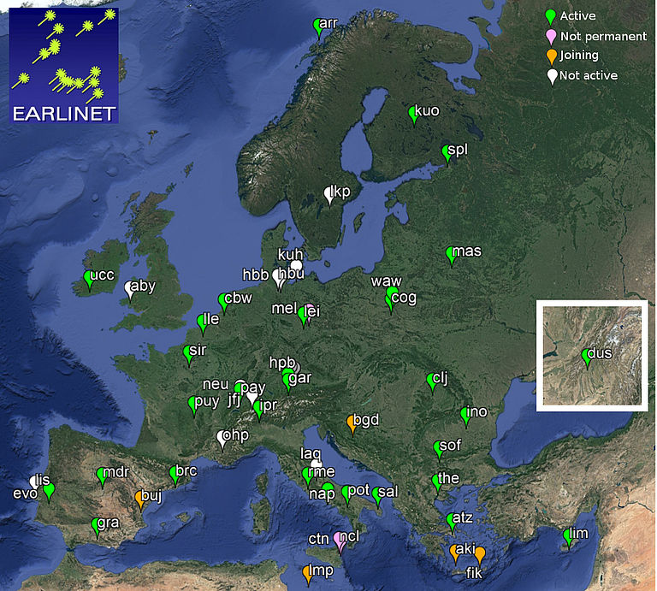
European Aerosol Research
Lidar Network - EARLINET
31 lidar stations
- multiwavelength Raman lidar stations
backscatter (355, 532 and 1064 nm) extinction (355 and 532 nm)
depolarization ratio (355 and 532 nm)
Raman lidar stations
Comprehensive, quantitative, and statistically significant data base
Continental and long-term scale
www.earlinet.org

Slide 14
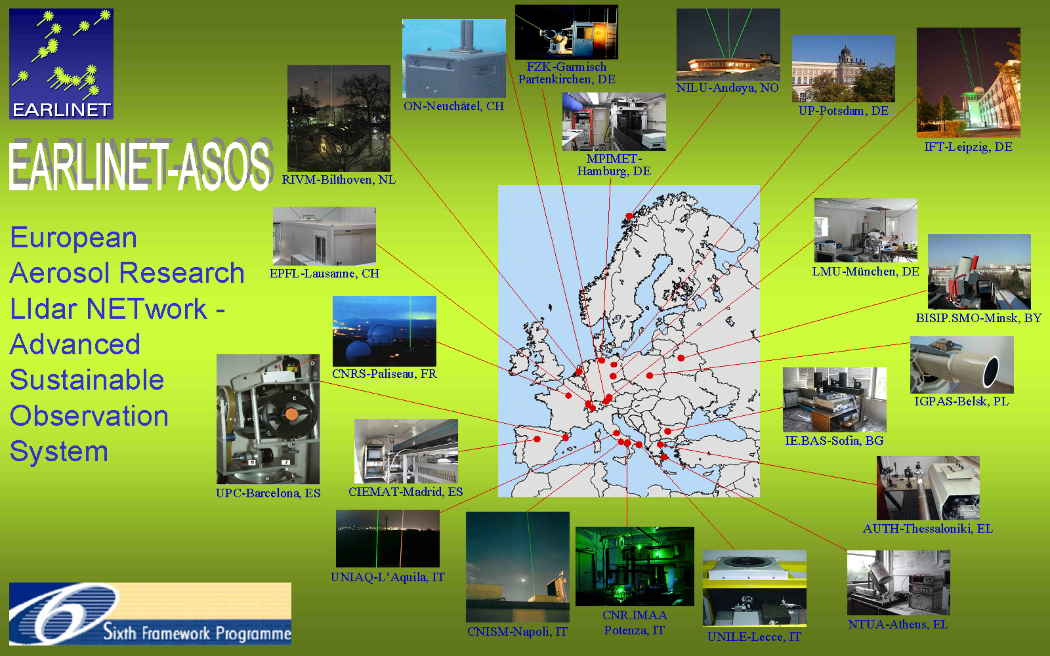
EARLINET-ASOS

Slide 15
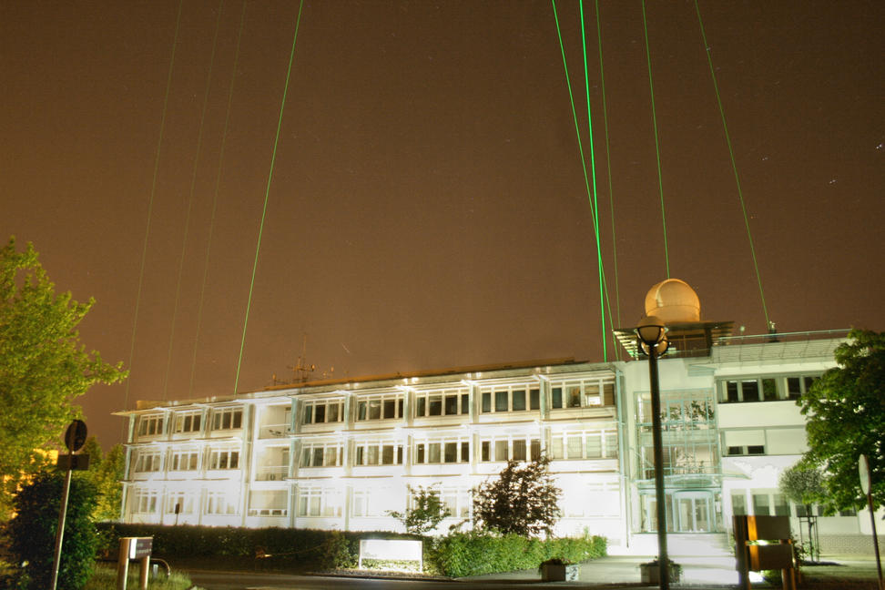
Intercomparison, Leipzig, 2009

Slide 16
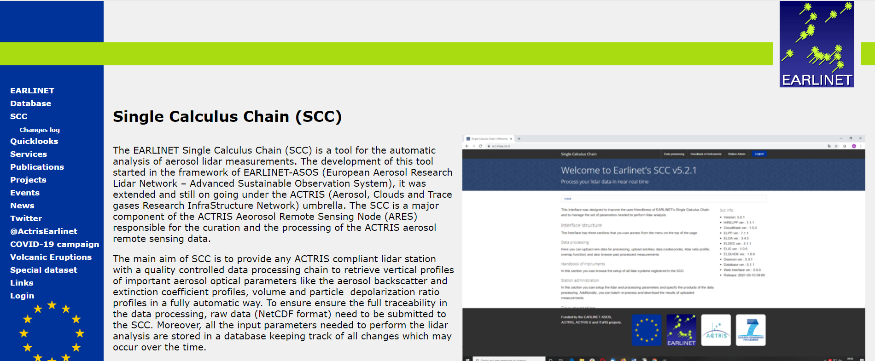
Single Calculus Chain (SCC)
https://www.earlinet.org/index.php?id=281

Slide 17
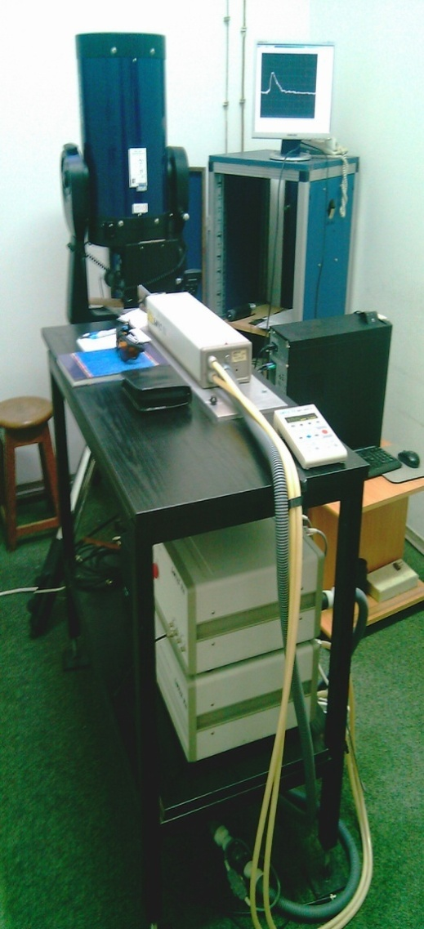
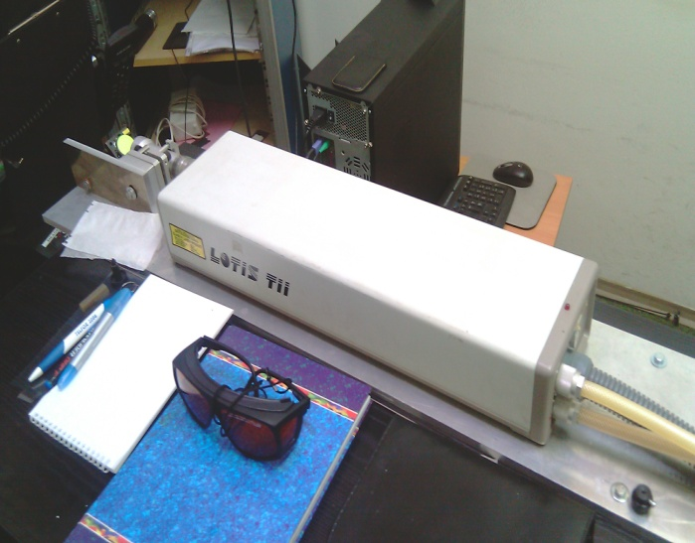
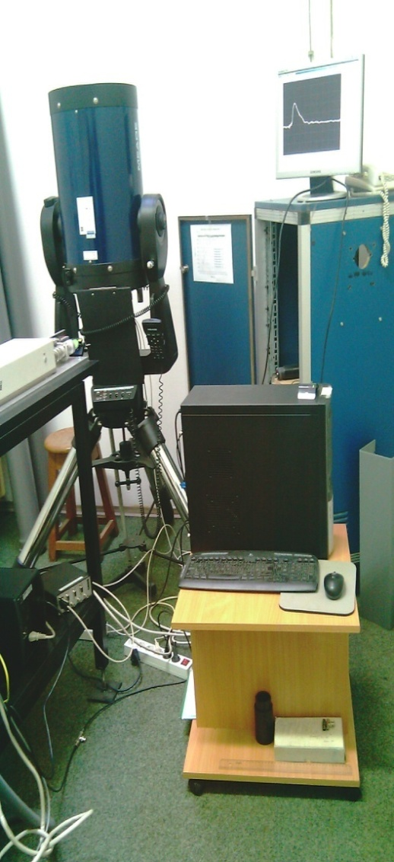
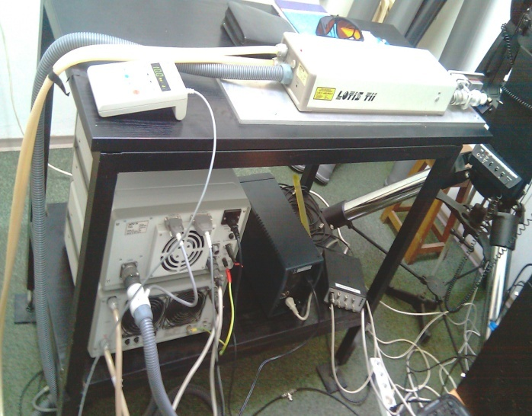
Backscatter LIDAR
IPB, Belgrade 2008.

Slide 18
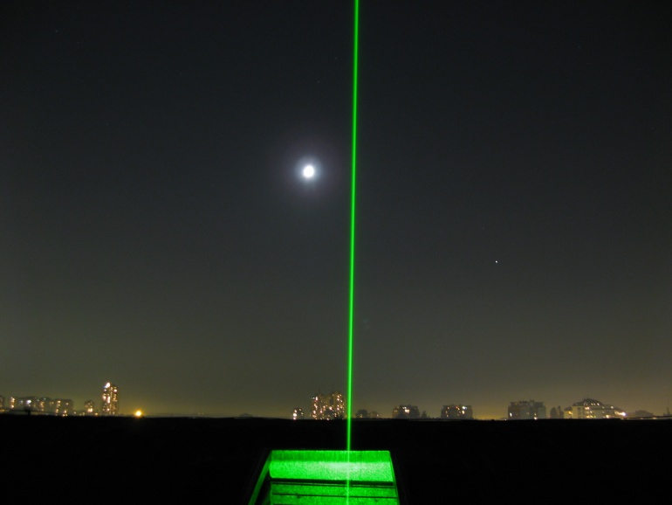
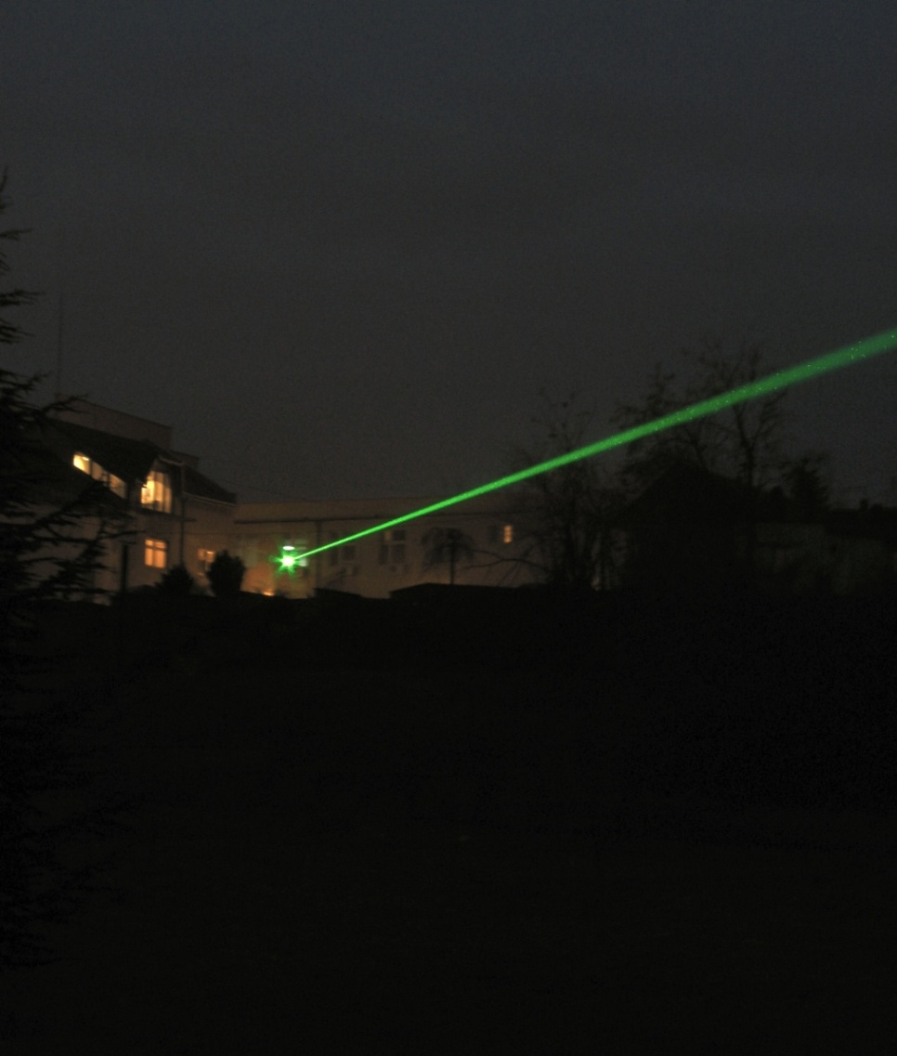
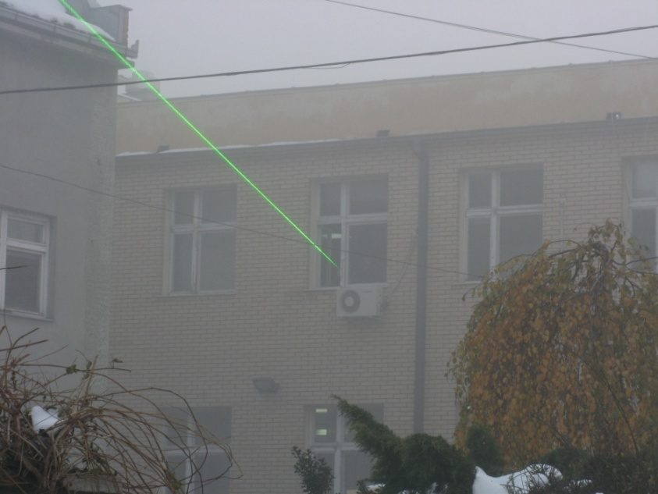
Backscatter LIDAR
IPB, Belgrade 2012.

Slide 19
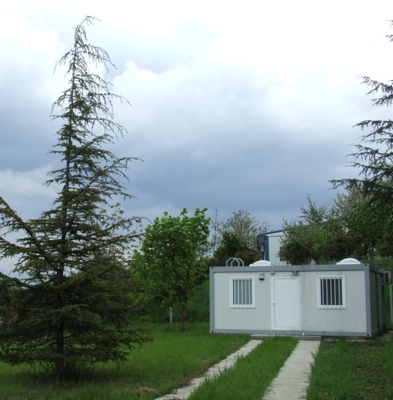
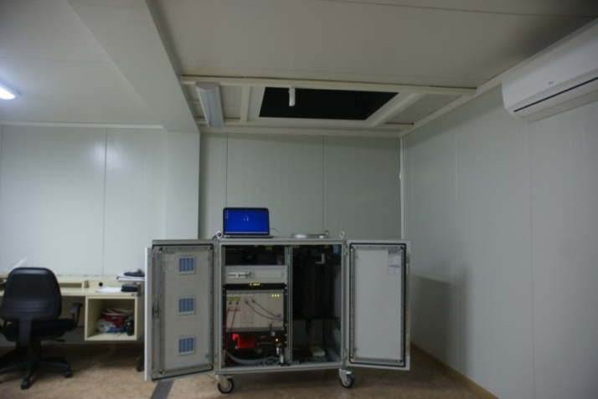
Raman Lidar Belgrade
Station coordinates: 44.856 N, 20.391 E, 89 m

Slide 20
Aerosols, Clouds and Trace gases
Research Infrastructure
ACTRIS
Ground-based stations to understand past,
present and predict future evolution of the atmosphere

Slide 21
COVID-19 NRT lidar measurement campaign, May 2020
ACTRIS initiative
  Aerosol in situ + aerosol remote sensing + modelling
  Additional: reactive trace gases in situ + clouds
Expected outputs:
  Weekly reports → dissemination via websites (ACTRIS, EARLINET), national networks, Copernicus, ESA, EUMETSAT
  Campaign report → combined with others, to IAC
  Publications → e.g. Aerosol and Air Quality Research
Other reasons
  Community effort → community building
  Optimization of the CARS-ARES-NFs workflows

Slide 22
Scope of the campaign
This campaign was organized as part of the ACTRIS initiative for studying the changes in the atmosphere during the COVID-19 lockdown. Two types of data will be issued:
● Near-real-time data, partially quality-assured – to allow fast analysis of the status of the atmosphere. This data was used to provide weekly reports to ACTRIS. No centralized QC on data products is performed. Quicklooks and reports will be made public,
● Re-analysis data, fully quality-assured – to identify possible changes compared to similar periods in previous years. This data will be used to perform extended studies referring to the COVID-19 impact on the atmosphere.

Slide 23
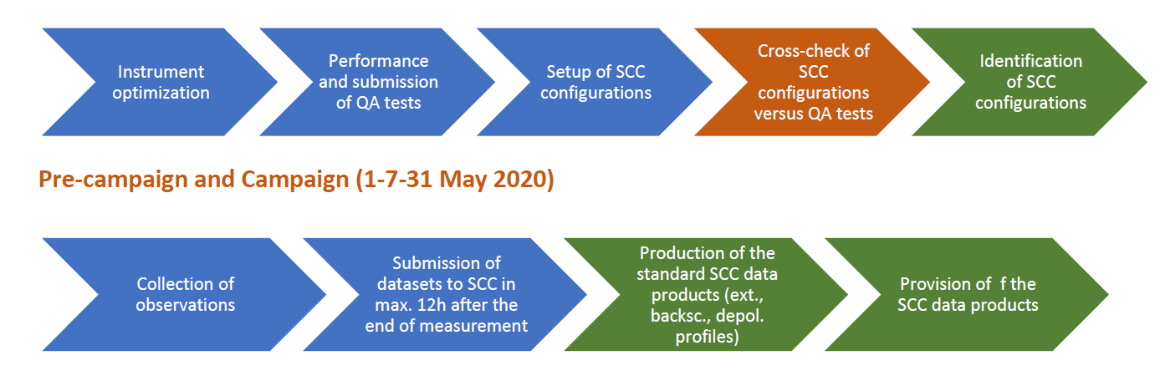
Campaign workflow
Preparations (26-30 April 2020)

Slide 24
Measurement schedule and QA
Lidar stations should perform measurements each day, as often as possible. At minimum, the following time intervals must be covered:
● 2h continuous measurements at noon, after the full development of
the PBL
● 2h continuous measurements at nighttime conditions, allowing good
Raman measurements
QA
Dark measurements of the analogue channels:
The telecover measurements
A Rayleigh-fit measurement is necessary to verify the far-range alignment of the laser
The polarization calibration measurements

Slide 25
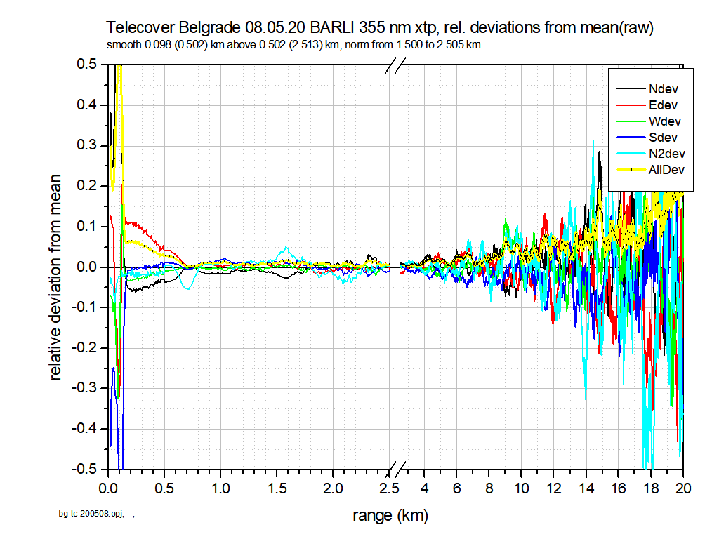

Slide 26
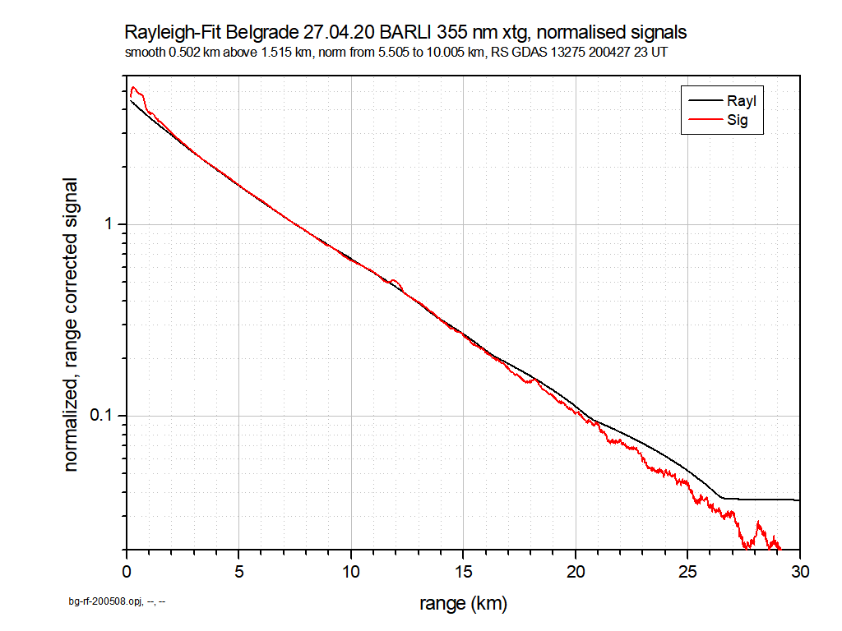
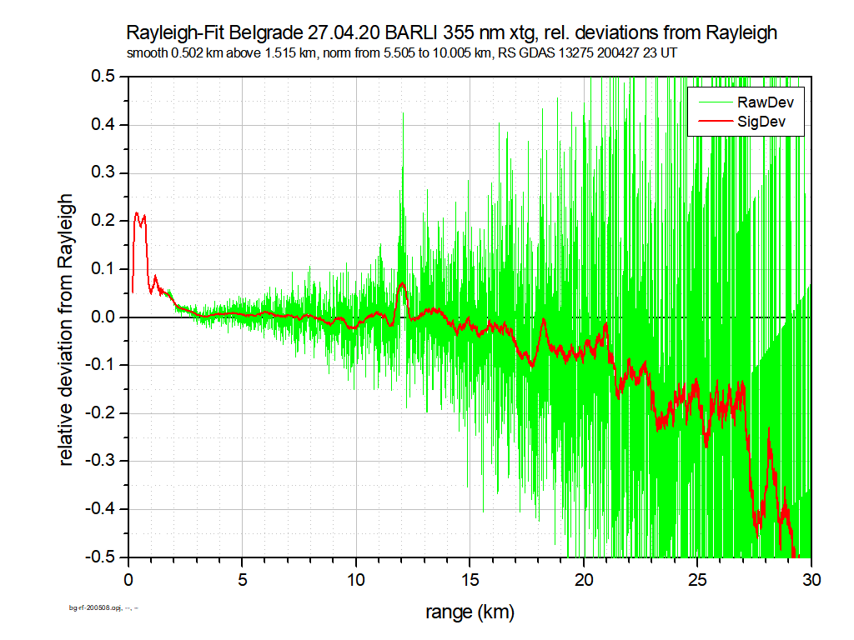
Belgrade, QA measurement

Slide 27
Data products and availability
The SCC products will be made available in NRT through the THREDDS server.
Lidar quicklooks available at: https://quicklooks.earlinet.org/
Aerosol optical products
● Particle elastic backscatter profiles (daytime measurements)
● Raman backscatter and extinction profiles (nighttime measurements).
● Particle/volume depolarization ratio profiles (if applicable).

Slide 28
Data processing
For the purpose of this experiment, the use of the SCC was mandatory. Only data processed by the SCC will be used in the study.
Lidar data should be pushed to the SCC in max. 12 h after the end of each measurement – Near real time (NRT)
Datasets should be submitted in packages of 2h profiles.

Slide 29
Lidar stations providing measurements of the aerosol profiles in Jan.-May. 2020
Location | Coordinates
Athens | 37.9600 N, 23.7800 E, 212 m
Barcelona | 41.3930 N, 2.1200 E, 115 m
Belsk | 51.8300 N, 20.7800 E, 180 m
Bucharest | 44.3480 N, 26.0290 E, 93 m
Clermont-Ferrand | 45.7610 N, 3.1110 E, 420 m
Evora | 38.5678 N, -7.9115 E, 293 m
Granada | 37.1640 N, -3.6050 E, 680 m
Kuopio | 62.7333 N, 27.5500 E, 190 m
Lecce | 40.3330 N, 18.1000 E, 30 m
Leipzig | 51.3527 N, 12.4339 E, 125 m
Lille | 50.6117 N, 3.1417 E, 60 m
Limassol | 34.6700 N, 33.0400 E, 10 m
Hohenpeissenberg | 47.8019 N, 11.0119 E, 974 m
Palaiseau | 48.7130 N, 2.2080 E, 156 m
Potenza | 40.6000 N, 15.7200 E, 760 m
Roma-Tor Vergata | 41.8330 N, 12.6500 E, 110 m
Sofia | 42.6500 N, 23.3800 E, 550 m
Thessaloniki | 40.6300 N, 22.9500 E, 50 m
Warsaw | 52.2100 N, 20.9800 E, 112 m
Antikythera | 35.8600 N, 23.3100 E, 193 m
Belgrade | 44.8557 N, 20.3913 E, 89 m
a) in yellow, stations measuring 2 times per day; b) in red, stations providing quasi-continuous observations. In general, no measurements are performed during precipitation and presence of low clouds.

Slide 30
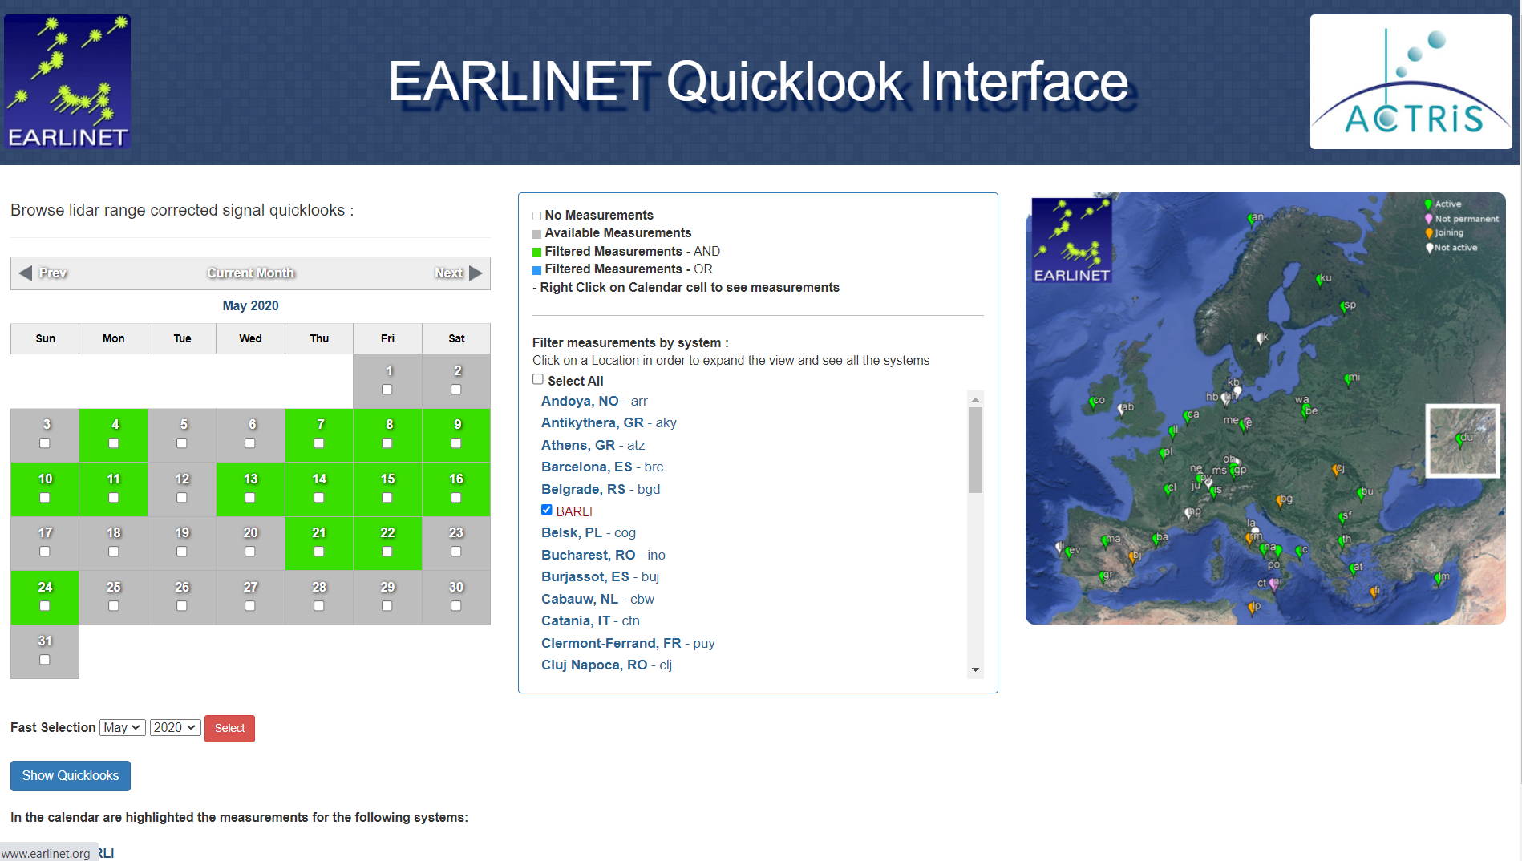
Fruska Gora, Serbia, 2022

Slide 31
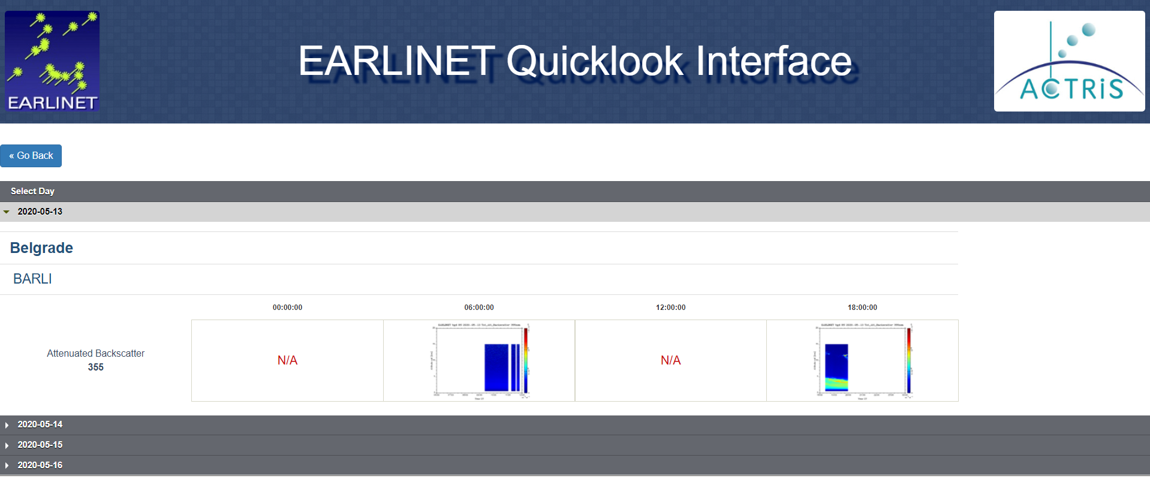

Slide 32
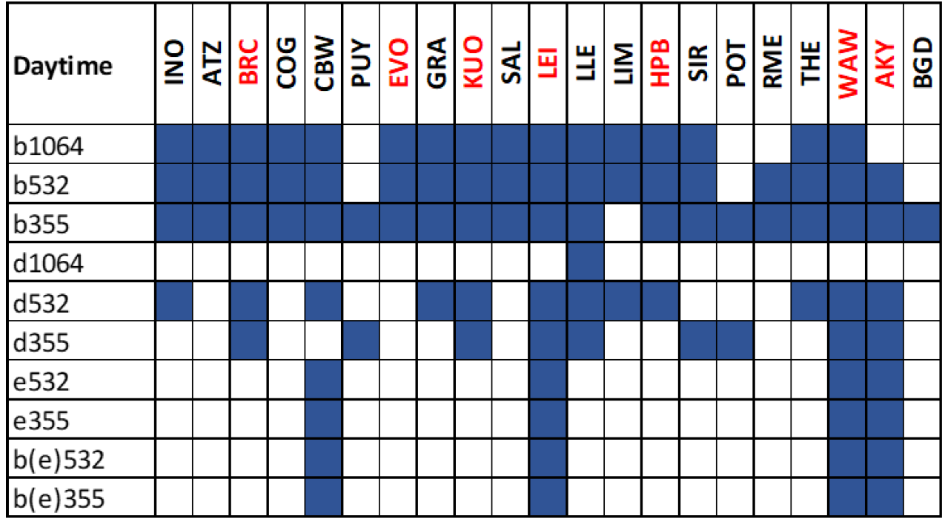
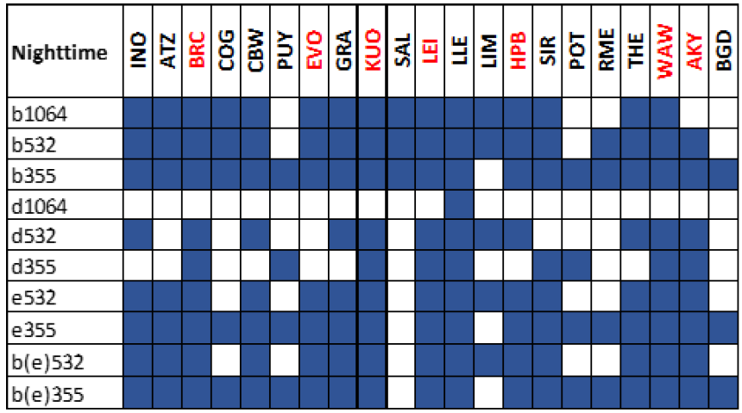
Specific data products
Data products calculated for each station during daytime and nighttime; in red, stations providing quasi-continuous measurements.

Slide 33
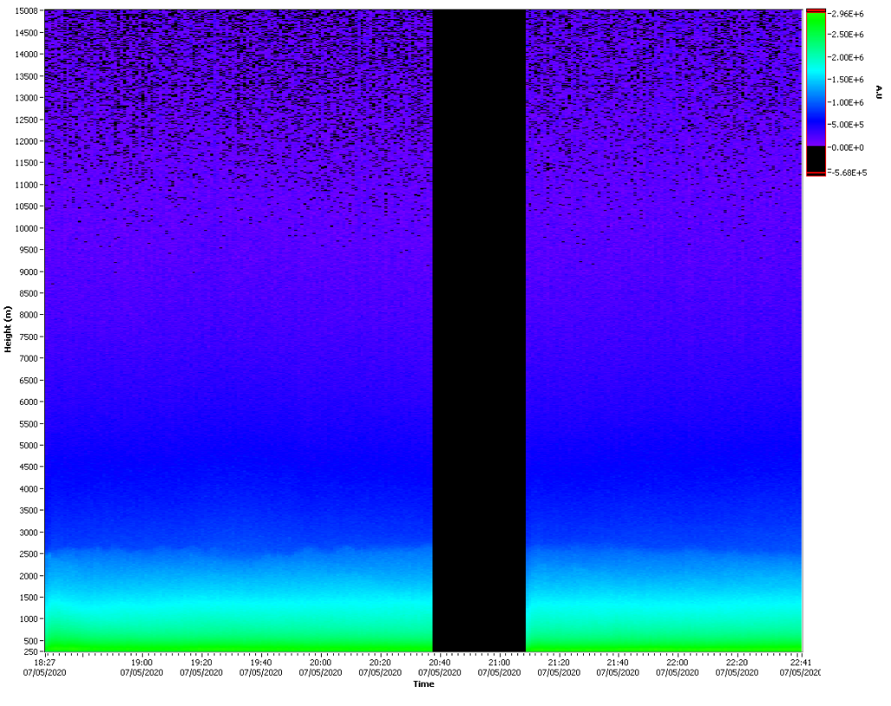
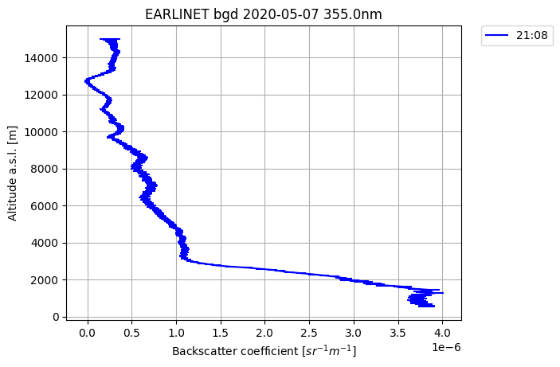
Example – Belgrade measurement

Slide 34
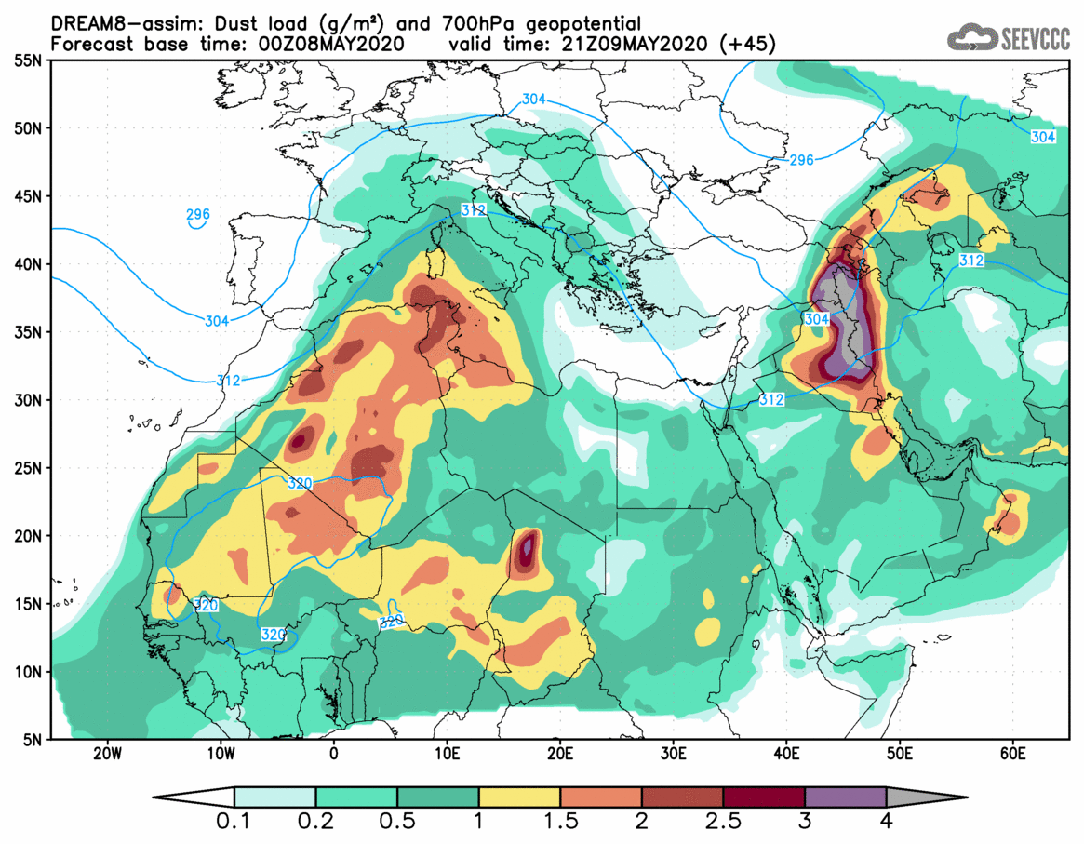
Example – Dust intrusion

Slide 35
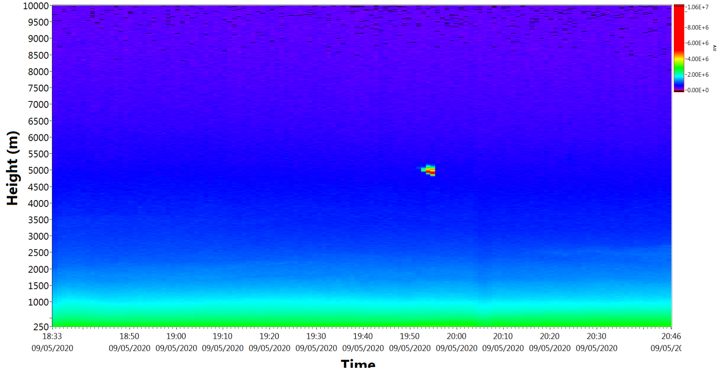
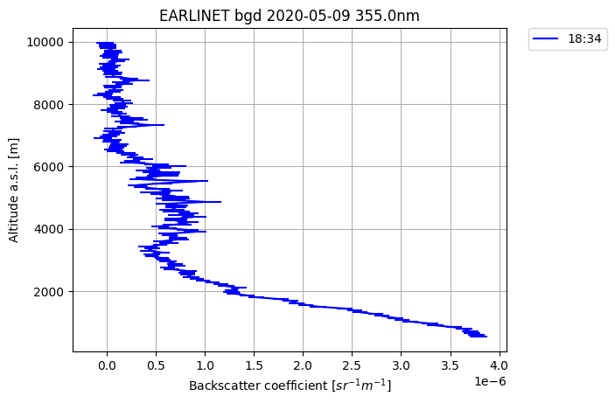
Dust intrusion

Slide 36
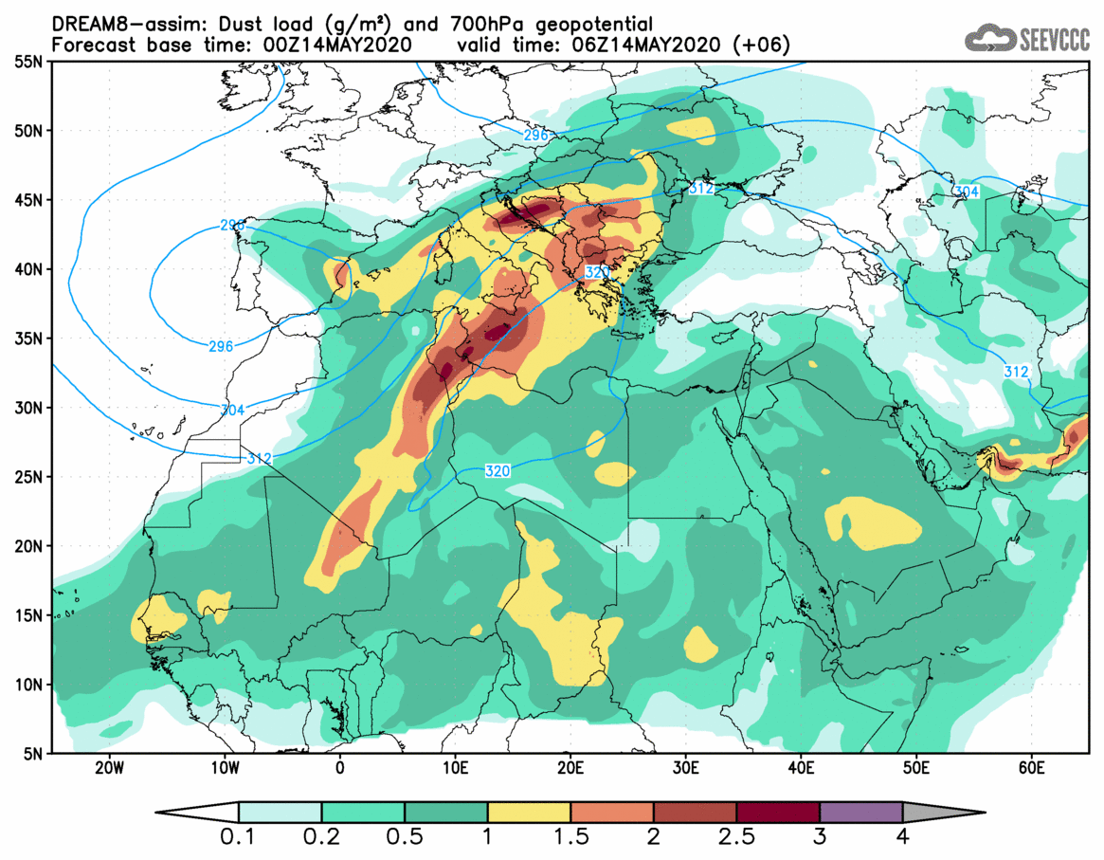
Dust intrusion

Slide 37
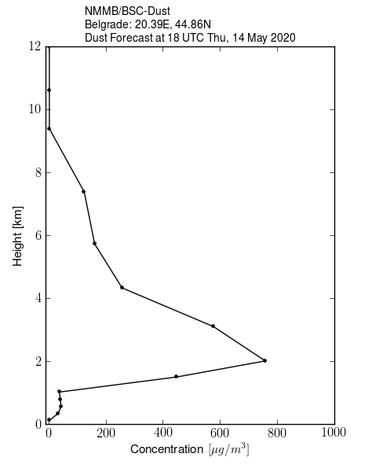
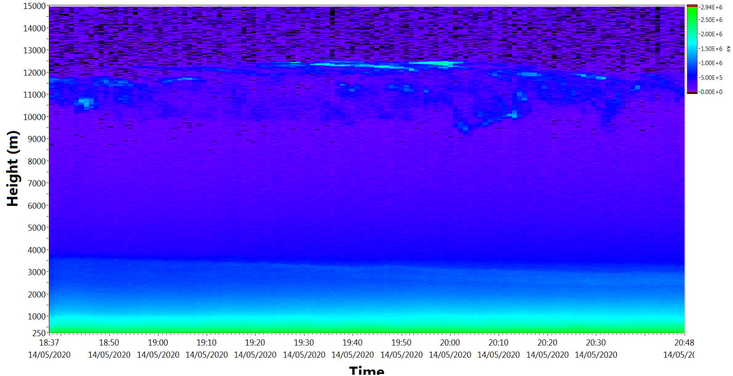
Dust intrusion

Slide 38
Measurement statistics
Out of the 1302 scheduled observations, 693 were performed, representing 53%.

Slide 39
Data products statistics
From a total number of 4125 data products which could be calculated by the SCC from the performed measurements,
3473 were actually obtained, representing 84%.
Fruska Gora, Serbia, 2022

Slide 40
Monthly mean values of the aerosol backscatter coefficient (532 nm)
High troposphere (left panel) and low troposphere (right panel) during daytime

Slide 41
Monthly mean values of the aerosol backscatter coefficient (532 nm)
High troposphere (left panel) and low troposphere (right panel) during nighttime

Slide 42
Optical products at European scale
Time evolution of the aerosol backscatter coefficient (532 nm) in the low and high troposphere, as difference to the climatological values; average for all stations for Jan.-May 2020

Slide 43
Percentage difference vs climatological values for the aerosol backscatter coefficient (532 nm) in the low troposphere; weekly average for all stations for Jan.-May 2020. Blue error bars report the weekly variability observed in 2020, gray vertical bars show the 15-year monthly variability over Europe

Slide 44
Scientific focus: Impact of the
lock-down on the troposphere
Is there a visible effect in the atmospheric column?
  A shallower development of the PBL?
  Less aerosol concentration means smaller optical properties in the vertical?
  In large cities, how to separate the regional contribution for focusing only on the local, urban one?
  Difference coastal/inland sites.
Comparison with satellite (operational satellite mainly): to show what lidar can do and what is not visible from satellite.
Aerosol typing (this is interesting both for comparison before during and after the lockdown but also for other kind of analysis respect to the epidemiological crisis),
Synergy with near-surface, clouds, etc. -

Slide 45
Conclusion
The aerosol backscatter coefficient is a proxy for the aerosol concentration, however a more quantitative analysis must be made to consolidate the conclusions
Beyond the scientific goals of this analysis, the actions organized by EARLINET/ACTRIS (NRT delivery of the data and fast analysis of the data products) proved that aerosol lidars are useful for providing information not only for climatological purposes, but also in emergency situations.

Slide 46
Temporal evolution of PBL, Solar eclipse,
March 20, 2015
Temporal evolution of PBL (blue line) and elevated aerosol layers (red dots). Colormaps represent the lidar RCS at 355 nm on March 20, 2015. White vertical lines indicate beginning, maximum and end of the eclipse. Box plot shows the median, first and third quartiles and 5th and 95th percentiles of PBL heights in March for period 2006–2015.
Ilić et al., 2018, J. Atmos. Sol.-Terr. Phys.

Slide 47
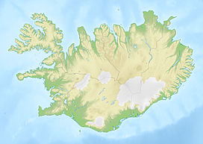
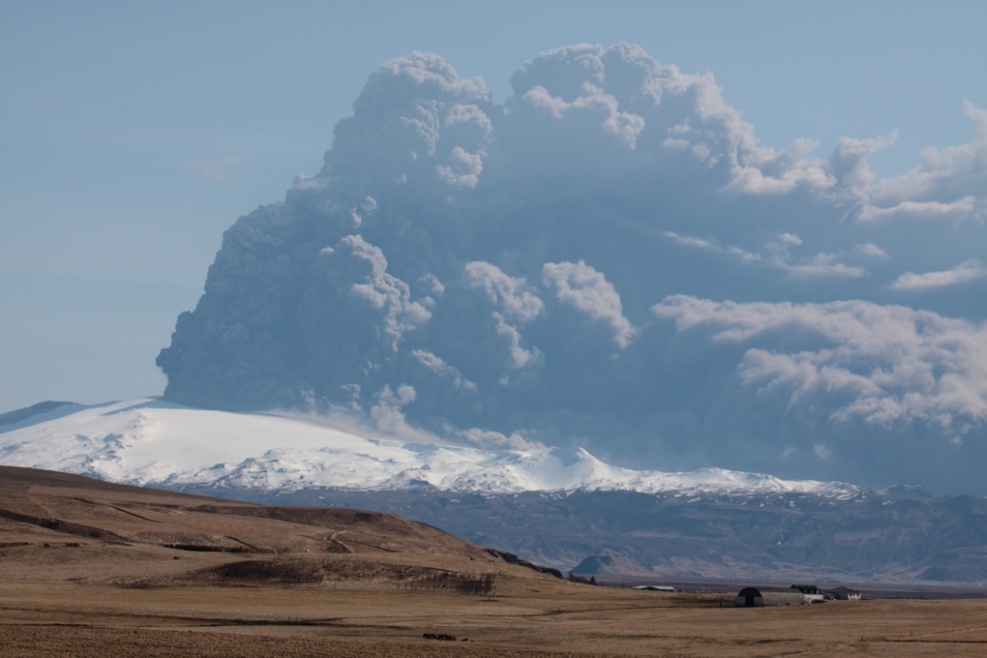
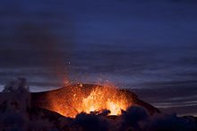
Eyjafjallajökull, April, 2010.
Eyjafjallajökull

Slide 48
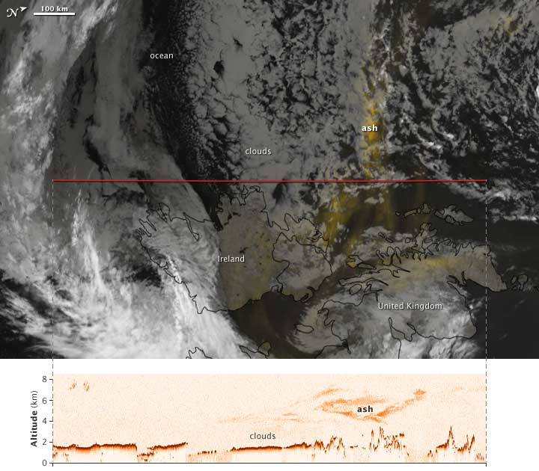
Eyjafjallajökull MODIS – CALIPSO
16. Maj, 2010.

Slide 49
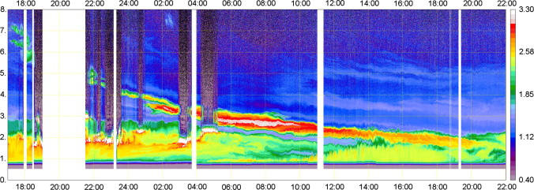
Volcanic eruption - Eyjafjallajökull
Volcanic ash
MULIS: 16 April 17 UTC - 17 April 2010, 22 UTC, Maisach.

Slide 50
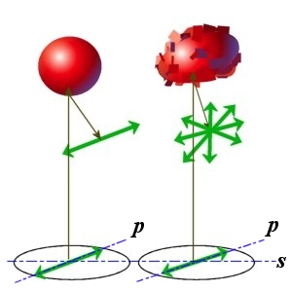
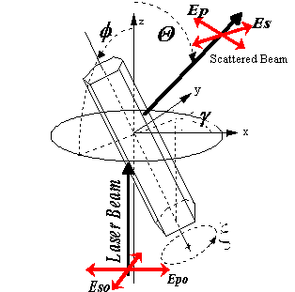
Depolarization
Aerosol typing
Rasejani snop
Laserski snop

Slide 51
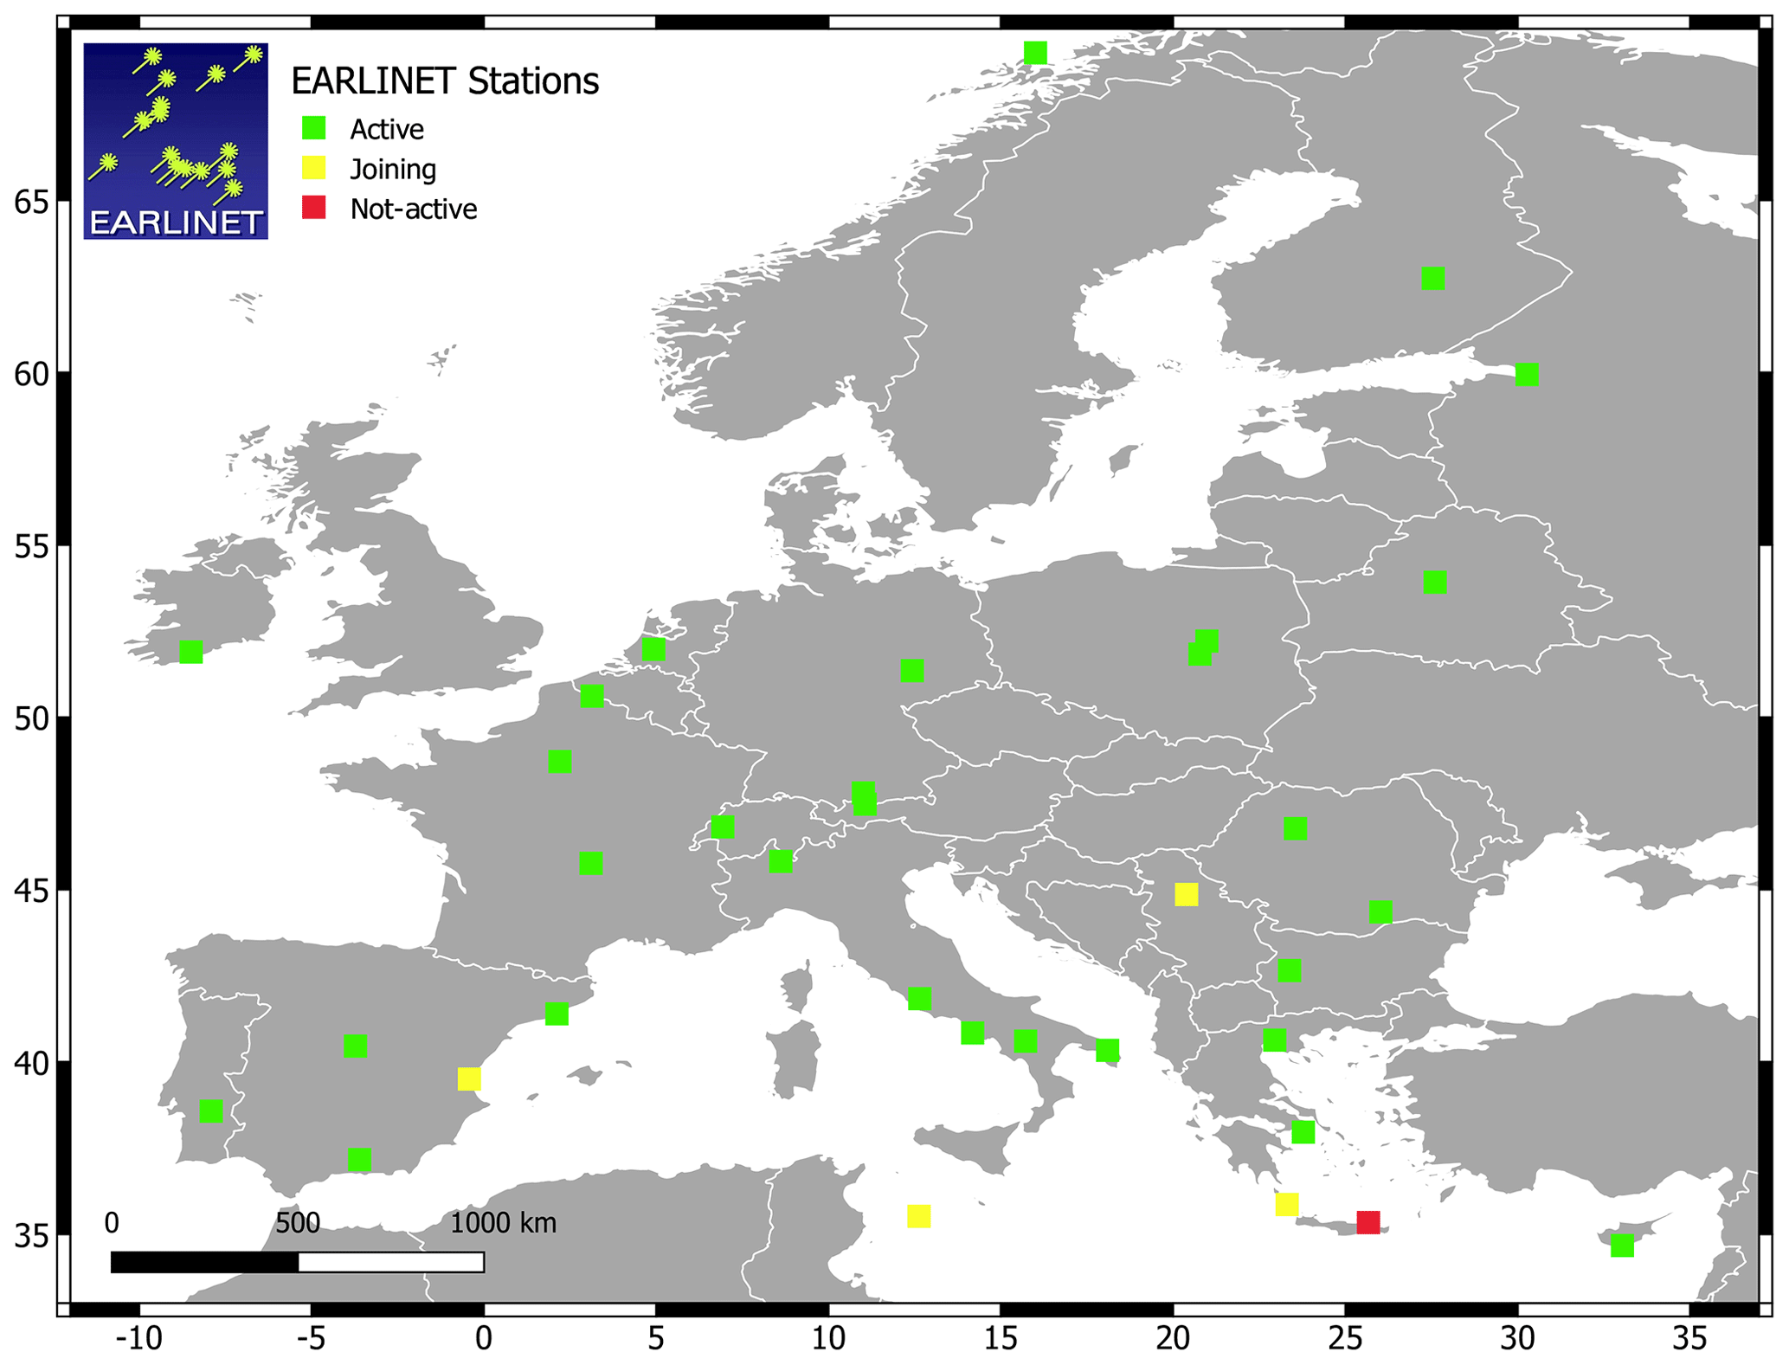
EUNADICS-AV exercise
The application of the EWS and the timely delivery of the EARLINET data were tested in real time during the EUNADICS-AV exercise, in which EARLINET stations performed synchronous measurements.
The EUNADICS-AV
demonstration exercise
in March 2019,

Slide 52
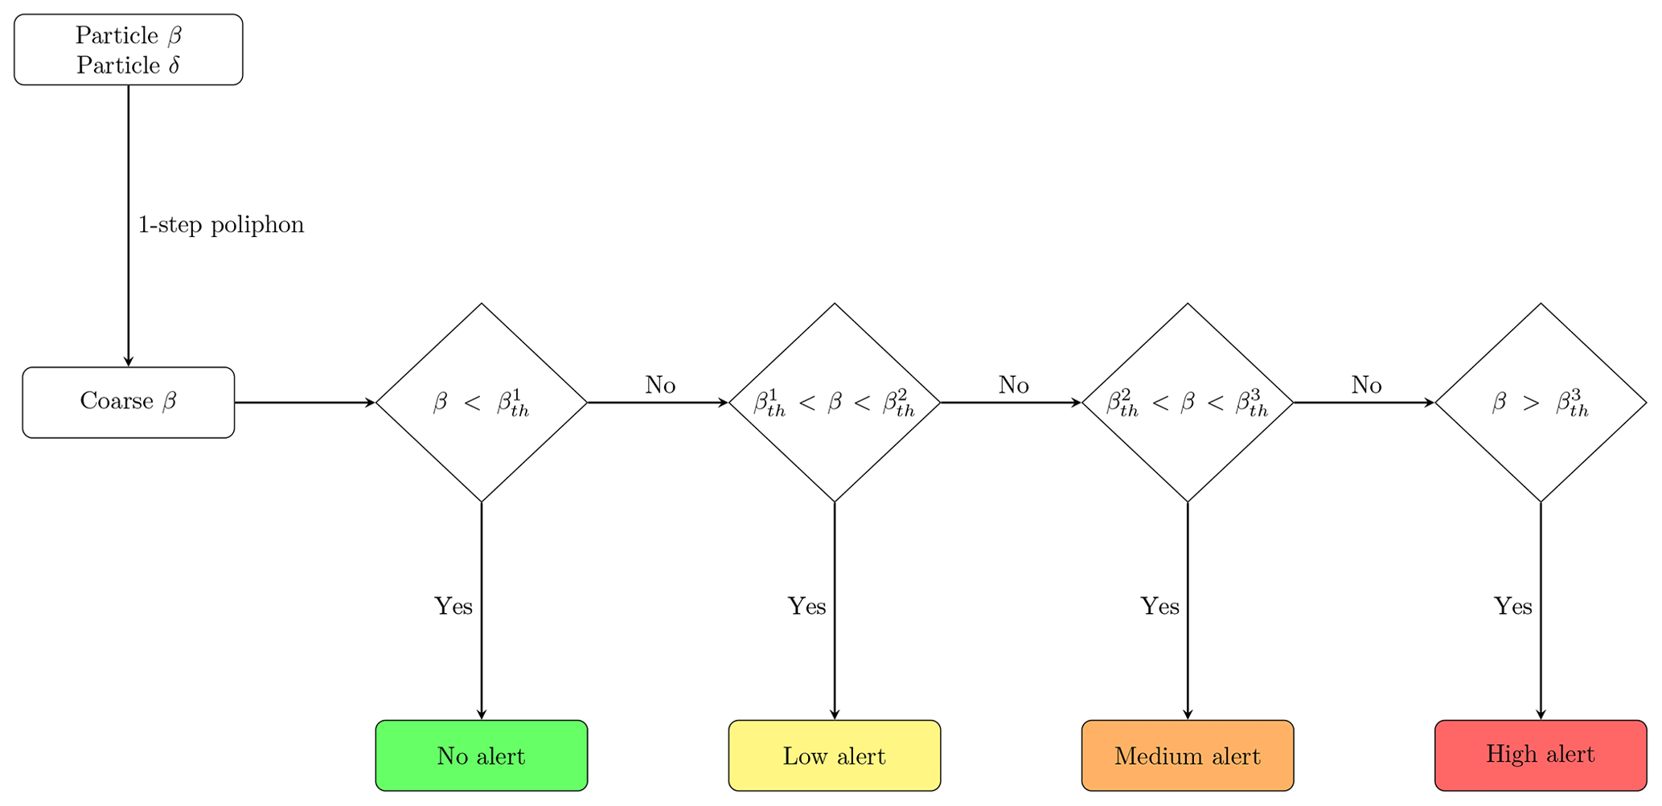
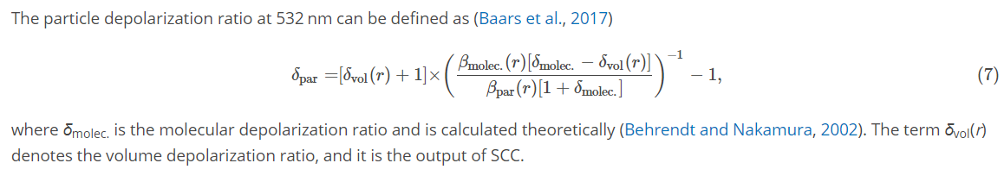
EUNADICS-AV exercise

Slide 53
EUNADICS-AV exercise
The raw lidar data were streamed and processed in less than 30 min from the measurement, enabling the timely delivery of the lidar data and the tailored product when possible.
The demonstration exercise was the first occasion in which the proposed methodology was tested in NRT, and the obtained results suggest that the network could actively support stakeholders in decision-making during an aviation crisis.
Papagiannopoulos, N., D'Amico, G., at. Al., 2020, An EARLINET early warning system for atmospheric aerosol aviation hazards, Atmos. Chem. Phys., 20, 10775–10789,

Slide 54
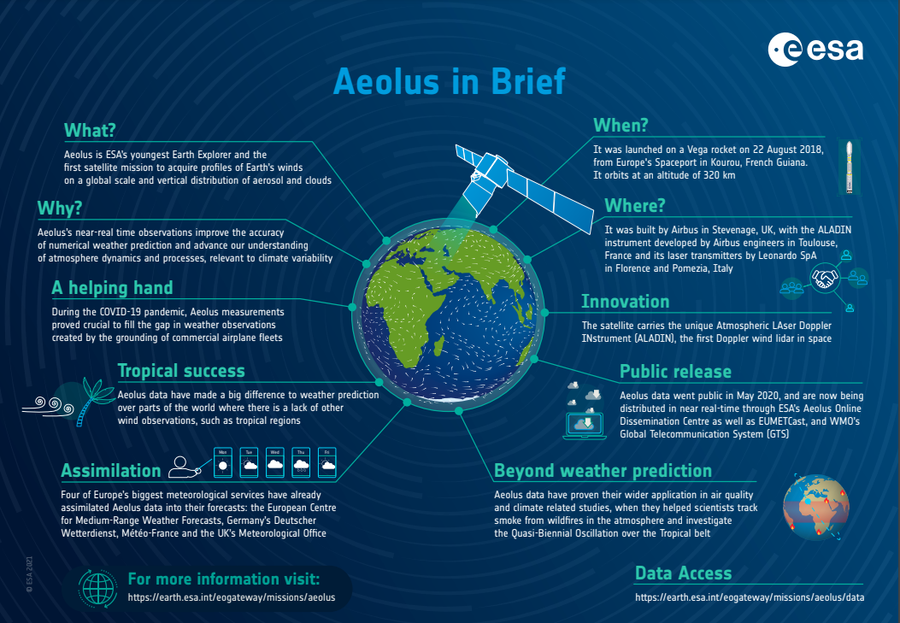
AEOLUS

Slide 55



Thank you
and
ACTRIS
SEEVCCC

