Slide 1
Slavica Malinović-Milićević
Clear-sky spectral UV radiation modeling
Geographical Institute “Jovan Cvijić”
Serbian Academy of Sciences and Arts
Belgrade, Serbia

Slide 2
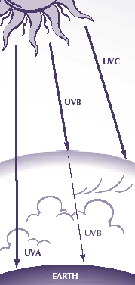
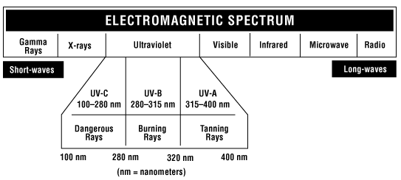
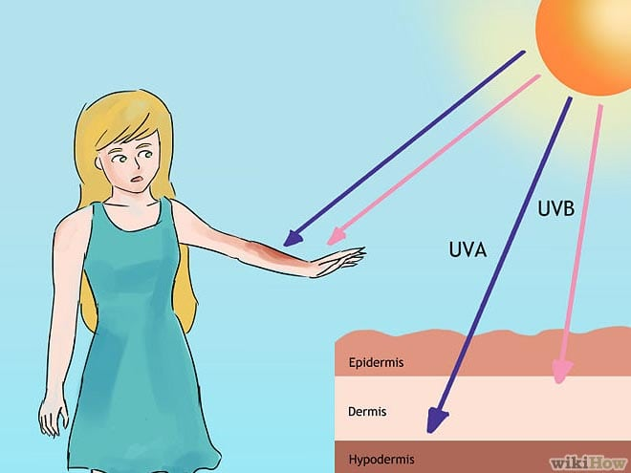
Ultraviolet (UV) radiation
UVC 100-290 nm
UVB 290-315nm
UVA 315-400 nm
https://www.ccohs.ca/
MAIN FACTORS AFFECTING UV RADIATION:
Cloud cover
Stratospheric Ozone
Atmospheric aerosols type and content
Surface albedo
Altitude
https://treatcancer.com/
1974 - chlorofluorocarbon (CFC) gases destroy ozone layer
1984 - springtime Antarctic ozone hole is discovered
1977 - an increased incidence in skin cancer is noticed in USA
Late 1970th – beginning of measurements
1987 - Montreal Protocol – global agreement designed to phase out the use and production of substances that were known to deplete ozone in the stratosphere

Slide 3
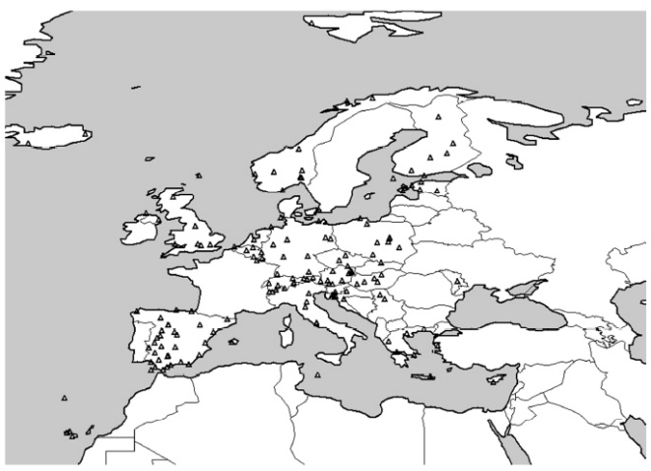
Measurements of the UV radiation
Europe
25 countries
160 monitoring sites
Ground-based
late 1970s Australia and USA
global network - a random mixture of national measurement schemes
no standardized instrument
WOUDC
Main types of radiometers
Spectrophotometers- intensity of radiation per wavelength
Narrowband Radiometers-narrow part of the spectrum
Dosimeters - integrated UV doses
Broadband UV Radiometers (biometers)-total UV irradiance over a certain wavelength range, UVA, UVB or erythemally-weighted UV radiation
UV Index monitoring sites in Europe which deliver online values
Schmalwieser et al. 2017, Photochem. Photobiol. Sci.
Satellite-based
NASA
Total Ozone Mapping Spectrometer (TOMS)
Ozone Monitoring Instrument (OMI)
ESA
Global Ozone Monitoring Experiment (GOME), SCIAMACHY, GOME2

Slide 4
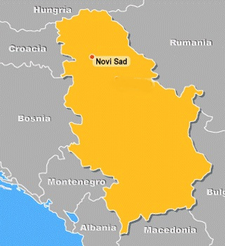
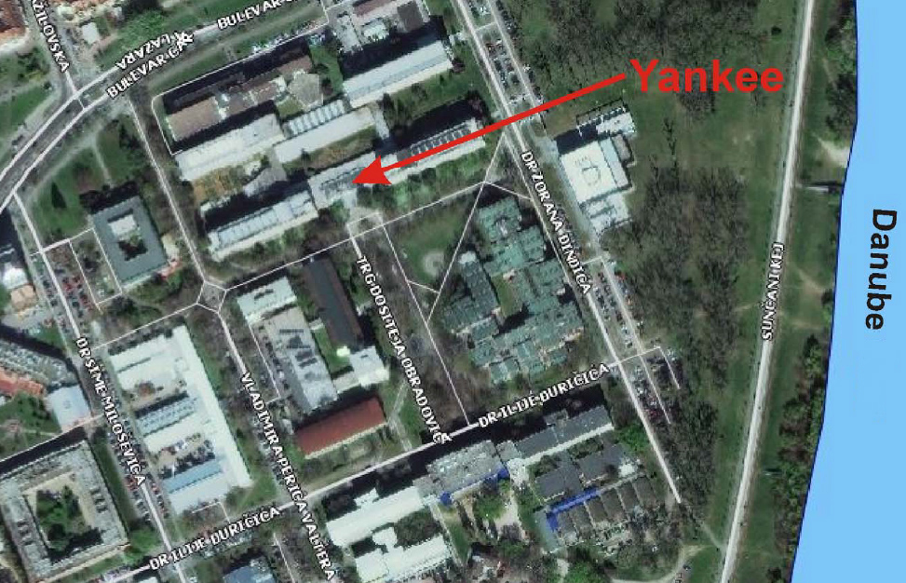
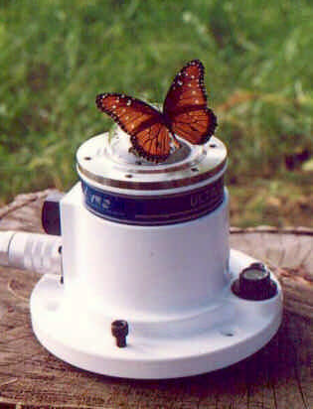
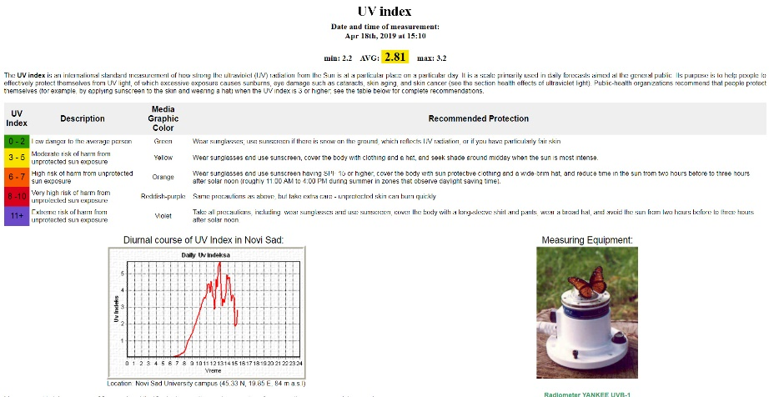
UV measurements in Novi Sad
Start - 2003
Yankee Environmental System
(YES) UVB-1 pyranometer
https://www.df.uns.ac.rs
About UV index
Presentation
by colors
Recommended protection
Graphical
presentation

Slide 5
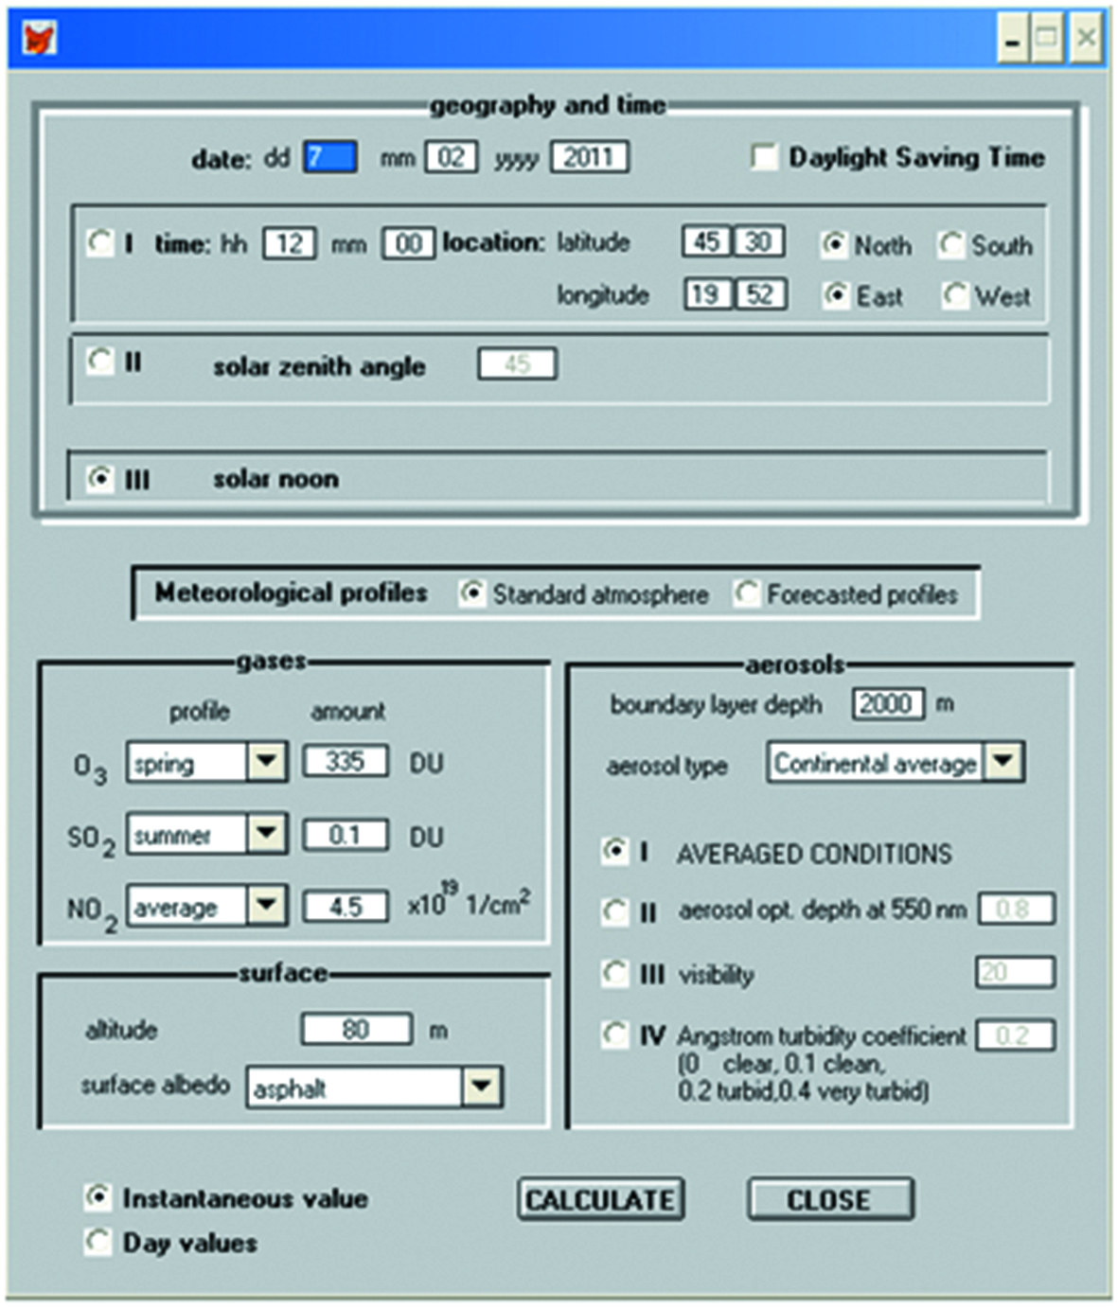
NEOPLANTA parametric model
Malinović, 2003, M.S. thesis
Malinović et al. 2006, Journal of Applied Meteorology and Climatology
Malinović-Milićević and Mihailović, 2011, Atmospheric Research
Malinović -Milićević et al. 2018, International Journal of Climatology
Input parameters
geographical coordinates and time (or SZA)
Amount of gases
Altitude
Surface albedo
Aerosols type and amount
Optional – forecasted meteorological profile
Incorporated in the model
vertical gas profiles
extinction cross-sections of gases
extra-terrestrial solar irradiance
aerosol optical properties for 10 different aerosol types
spectral albedo for nine different ground surface types
Output parametrs
spectral direct, diffuse, and global UV irradiance
spectral optical depth and spectral transmittance for each component
the erythemally weighted UV irradiance
UV index

Slide 6
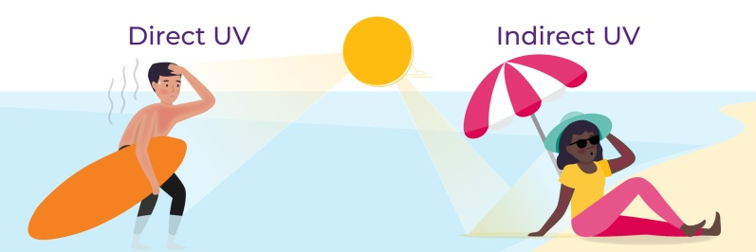



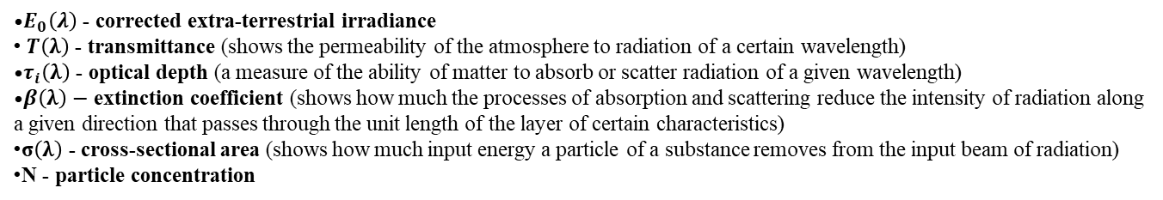


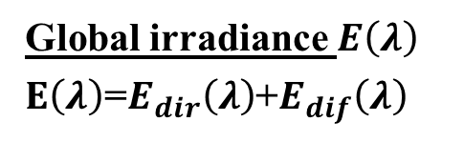


UV irradiance calculation
Global irradiance $E\left(λ\right)$
$E\left(λ\right)$=$E_{dir}\left(λ\right)$+$E_{dif}\left(λ\right)$
Direct irradiance $E_{dir}\left(λ\right)$
https://www.cancer.nsw.gov.au/
$$E_{dir}\left(λ\right)=E_{0}\left(λ\right)T\left(λ\right)$$
Extraterestrial solar irradiance
$$E_{0}\left(λ\right)=E_{∞}\left(λ\right)Dcos\left(λ\right)$$
$T\left(λ\right)$=$T_{O_{3}}\left(λ\right)T_{{SO}_{2}}\left(λ\right)T_{{NO}_{2}}\left(λ\right)T_{a}\left(λ\right)$ $T_{r}\left(λ\right)$
Sun-Earth distance correction factor
$$T_{i}\left(λ\right)=exp\left[−τ_{i} (λ)\right]$$
$$τ_{i}\left(λ\right)=β(λ)s$$
Day angle
$β(λ)$=σ$\left(λ\right)N$
$E_{0}\left(λ\right)$ - corrected extra-terrestrial irradiance
$T\left(λ\right)$ - transmittance (shows the permeability of the atmosphere to radiation of a certain wavelength)
$τ_{i}\left(λ\right)$ - optical depth (a measure of the ability of matter to absorb or scatter radiation of a given wavelength)
$β\left(λ\right)−$extinction coefficient (shows how much the processes of absorption and scattering reduce the intensity of radiation along a given direction that passes through the unit length of the layer of certain characteristics)
σ$\left(λ\right)$ - cross-sectional area (shows how much input energy a particle of a substance removes from the input beam of radiation)
N - particle concentration
Notes:
I₀ Extraterrestrial irradiance
T_{aa} transmittance for aerosol absorption
T_{as} transmittance for aerosol scattering
D_{s} aerosol forward scattering fraction
r_{g} ground albedo
r_{s} sky reflectivity

Slide 7



Direct irradiance $E_{dir}\left(λ\right)$
Gases O₃, SO₂, NO₂
$β(λ)$=σ$\left(λ\right)N$
cross-sectional are σ$\left(λ\right)$determined in the laboratory for five different temperatures
N is calculated by combining vertical profiles and total gases amount.
Air molecules
Rayleigh extinction cross section of an air molecule
anisotropic correction factor
real part of refraction index
air molecule density
equation of state
N_{r} is the number of molecules m⁻³ under standard conditions (2.547 x10²⁵ m⁻³)
A_{n} Avogadro's constant=6.02257x1023 mol⁻¹
M_{v} molecular weight of air of 28.964 gmol⁻¹
Aerosols
Optical Properties of Aerosols and Clouds (OPAC); 10 different aerosol mixtures in boundary layer; vertical distribution of particles by an exponential profile
h height above the surface; Z height scale describing the slope of the profile; Ni the concentration of molecules at sea level
amount of aerosols in the a boundary layer
use of datasets supplied with the Averaged values of the amount of aerosols given by OPAC
2. Aerosol optical depth at 550 nm - searches the value of the corresponding optical depth in the OPAC input data set and calculates the corresponding extinction coefficient by linear interpolation
3. Visibility V
Koschmieder eq.
meteorological range
4. Angstrom turbidity coefficient (B)
Dependence of extinction on wavelength
approximate values of B (Iqbal, 1983)
(0.0 no aerosols; 0.1 clear; 0.2 turbid; 0.4 very turbid)

Slide 8
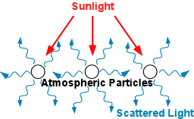



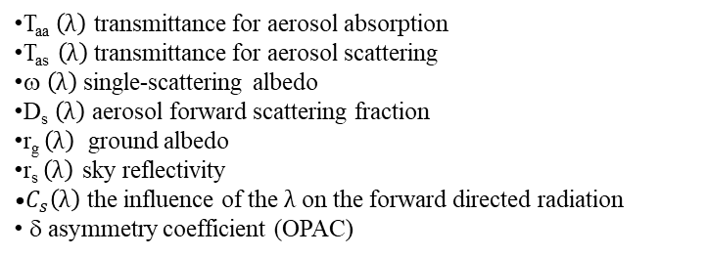
Diffuse irradiance $E_{dif}\left(λ\right)$
Simplified approach:
photons that are not directly transmitted or absorbed are scattered in all directions and that the downward part of the diffuse radiation
can be predicted
use the same transmittance functions used to calculate direct radiation
modified set of equations from the Bird and Riordan (1986) spectral model
$E_{dif}\left(λ\right)$= $E_{ray}\left(λ\right)$+ $E_{aer}\left(λ\right)$+ $E_{ref}\left(λ\right)$
$E_{ray}\left(λ\right)$= $E_{0}\left(λ\right)T_{O_{3}}\left(λ\right)T_{{SO}_{2}}\left(λ\right)T_{{NO}_{2}}\left(λ\right)T_{a_{a}}\left(λ\right)\left(1−T_{r}^{0.95}\left(λ\right)\right)0.5$
$E_{aer}\left(λ\right)$= $E_{0}\left(λ\right)T_{O_{3}}\left(λ\right)T_{{SO}_{2}}\left(λ\right)T_{{NO}_{2}}\left(λ\right)T_{a_{a}}{\left(λ\right)T}_{r}^{1.5}\left(λ\right)\left(1−T_{as}^{}\left(λ\right)\right)$ $D_{s}$ $\left(λ\right)$
Source: https://socratic.org/
T_{aa} $\left(λ\right)$ transmittance for aerosol absorption
T_{as} $\left(λ\right)$transmittance for aerosol scattering
ω $\left(λ\right)$single-scattering albedo
D_{s} $\left(λ\right)$ aerosol forward scattering fraction
r_{g} $\left(λ\right)$ ground albedo
r_{s} $\left(λ\right)$ sky reflectivity
$C_{s}\left(λ\right)$ the influence of the $λ$ on the forward directed radiation
δ asymmetry coefficient (OPAC)
$E_{ref}\left(λ\right)$=$\frac{\left(E_{dir}\left(λ\right)+E_{ray}\left(λ\right)+E_{aer}\left(λ\right)\right)r_{s}\left(λ\right)r_{g}{\left(λ\right)C}_{s}\left(λ\right)}{1−r_{s}\left(λ\right)r_{g}\left(λ\right)}$
Notes:
I₀ Extraterrestrial irradiance
T_{aa} transmittance for aerosol absorption
T_{as} transmittance for aerosol scattering
D_{s} aerosol forward scattering fraction
r_{g} ground albedo
r_{s} sky reflectivity

Slide 9
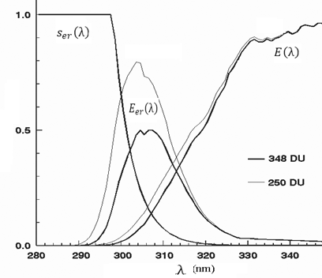
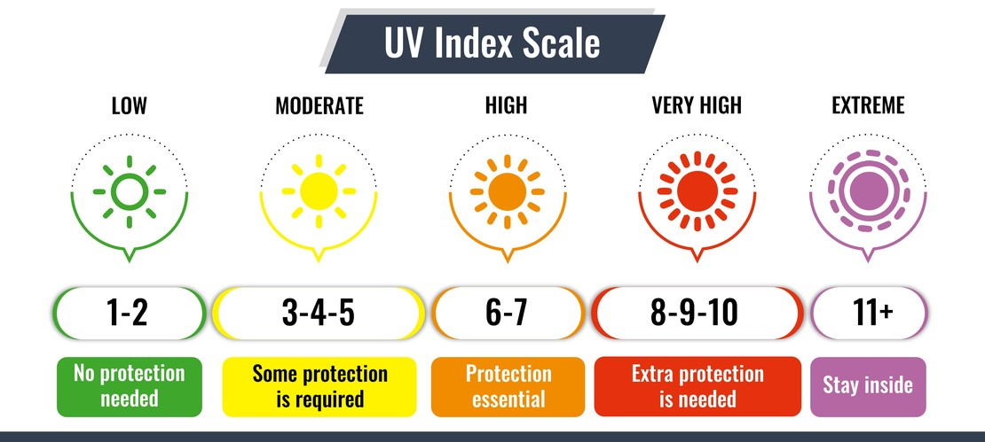
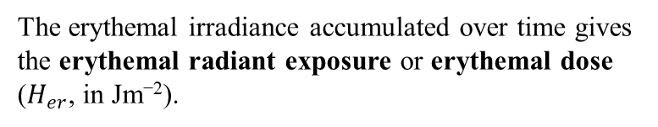

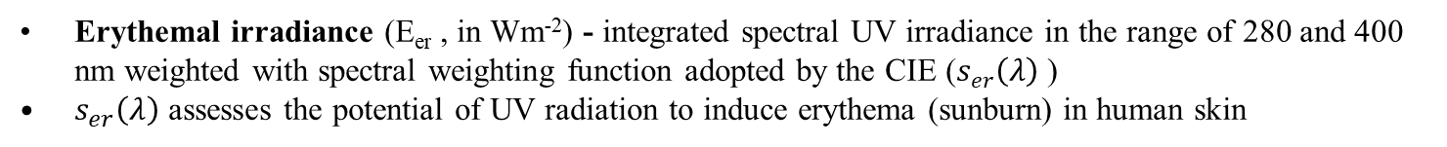

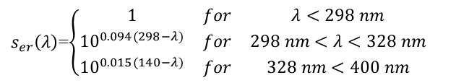
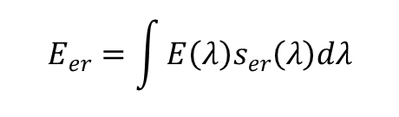
Erythemal irradiance and UV index
Erythemal irradiance (E_{er} , in Wm⁻²) - integrated spectral UV irradiance in the range of 280 and 400 nm weighted with spectral weighting function adopted by the CIE ($s_{er}\left(λ\right)$ )
$s_{er}\left(λ\right)$ assesses the potential of UV radiation to induce erythema (sunburn) in human skin
$$E_{er}=\int{E\left(λ\right)s_{er}\left(λ\right)dλ}$$
$s_{er}\left(λ\right)$=$\left\{\begin{matrix}1 & for & λ<298 nm \\ {10}^{0.094(298−λ)} & for & 298 nm<λ<328 nm \\ {10}^{0.015(140−λ)} & for & 328 nm<400 nm\end{matrix}\right.$
global UV radiation at the ground - 6% is UV-B
erythemal UV radiation at the ground - 83% is UV-B
E_{er} is usually expressed as unit-less quantity UV index (UVI)
$$UVI=k_{er}E_{er}$$
$$k_{er}=40 m^{2}W^{−1}$$
The erythemal irradiance accumulated over time gives the erythemal radiant exposure or erythemal dose ($H_{er}$, in Jm⁻²).
Source: https://www.uvindextoday.com/

Slide 11
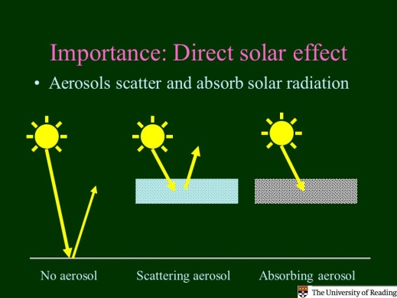
NEOPLANTA model
sensitivity tests
Aerosols
The magnitude of the effect of aerosols on the amount of radiation on the surface is very variable and depends on the number of particles and their physical and chemical characteristics.
sulfate and some organic aerosol particles scatter UV radiation
mineral dust and soot absorb UV radiation
Difference of UVI = 5%
Urban air – more soot; soot absorbs UV radiation; result – UV attenuation
At the same optical depth urban aerosol type will reduce the radiation more due to the smaller contribution of diffuse radiation scattered on the aerosols
 | B=0.1 (clean) | B=0.2 (turbid) | B=0.4 (very turbid)
UV – B | 1.362 | 1.146 | 0.896
UV – A | 47.955 | 42.341 | 36.216
E_{er} | 0.174 | 0.147 | 0.116
UVI | 6.941 | 5.866 | 4.620

Slide 12
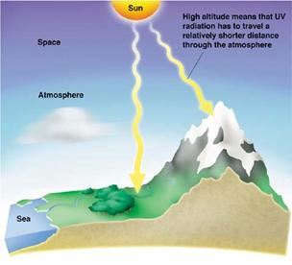
NEOPLANTA model
sensitivity tests
Altitude
UV radiation increases
on average 5-8% for every 1000 m of altitude
Source:https://azskincancerinstitute.org/
increase with height was higher in the first 1000 m due to the higher share of diffuse radiation in the total UV radiation

Slide 13
NEOPLANTA model
sensitivity tests
the contribution of direct and diffuse UV radiation

Slide 15
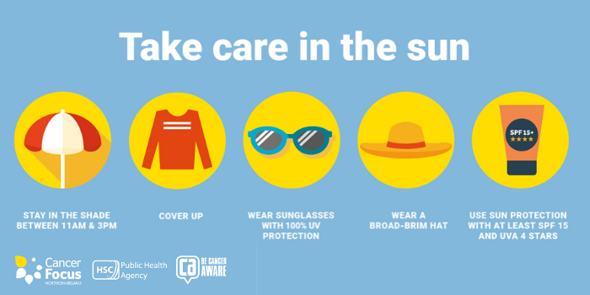
Thank you for your attention
https://careinthesun.org/

Slide 16
Атмосферски гасови који апсорбују зрачење у UV делу спектра
Гасови | (nm) | Производи
N₂ | < 100
O₂ | < 245 | 2O
O₃ | 180-350 | O+O₂
H₂O | < 210 | OH+O
H₂O₂ (хидроген пероксид) | < 350 | 2OH
NO₂ | < 600 | NO+O
HNO₂ (азотаста киселина) | < 400 | NO+HO₂
HNO₃ (азотна киселина.) | < 330 | NO+OH
H₂CO (формалдехид) | 250-360 | H₂+CO
SO₂ | < 340 | SO+O
CFCl₃ (хлорофлорокарбонат) | <230 | CFCl₂+Cl

Slide 17
Фактор корекције за различиту облачност и типове облака
 | Облачност (осмине)
Тип облака | 0-2 | 3-4 | 5-6 | 7-8
Високи | 1 | 1 | 1 | 0.9
Средњи | 1 | 1 | 0.8 | 0.5
Ниски | 1 | 0.8 | 0.5 | 0.2

Slide 18
Стратосферски озон
Реакције стварања О₃
Реакције уништења О₃
(рекомбинација)
Водоникови радикали
Халохени угљеници
Азотни радикали

Slide 19
Удео рефлектованог зрачења у укупном у загађеном градском ваздуху
Албедо у UV области за различите врсте подлоге

Slide 20
Утицај различитих типова подлоге на вредност UV индекса и удео дифузног зрачења у укупном

Slide 21
Попречни пресеци расејања озона на различитим температурама

Slide 22
Албедо једноструког расејања и коефицијент асиметрије

Slide 23
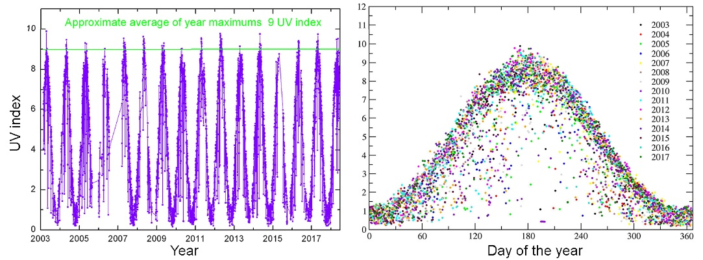
High levels (≥ 6 UVI) April-September
Very high levels (≥ 8 UVI) May-August
UV measurements in Novi Sad

