Slide 1
Gravity satellite missions measurement data for atmospheric density estimation
Ljiljana M. Brajović and Miodrag Malović

Slide 2
Gravity satellite missions measurement data are primarily intended for use in the estimation of an accurate model of Earth’s gravity field.
Precision accelerometers on the satellites extend the ability to monitor non-gravitational forces acting on them continuously.
One of these forces, atmospheric drag, can be derived as an additional result of gravity field modeling data based on the orbit track positions evaluation and the precise accelerometer measurements, so it can be used for atmospheric mass density determination especially thermosphere .
One of the examples is thermospheric mass density determination using neutral mass spectrometers on earlier satellite missions. Measurement of the Earth’s far ultraviolet (FUV) dayglow spectra is also used to infer number density proﬁles of N₂, O, and O₂Combination of accelerometers measurements and those spectroscopic data is the foundation of widely used empirical models of thermospheric mass density.

Slide 3
Gravity satellite missions
At the beginning of the last decade of the twentieth century, the determination of the Earth’s gravity field—based on classical directional, distance and Doppler observations of a large number of passive satellites in near-Earth spacehad reached its natural limits, and the conditions for realizing already imagined scientific-technical concepts for new specialized gravity satellite mission were not fulfilled .
Concepts were
to choose the orbit altitudes as close as possible to the Earth surface , between 250 and 500 km
to use almost circular orbits with polar or near-polar inclination of the orbital plane for global and even coverage of the Earth with ground tracks.
to determine an uninterrupted, three-dimensional and global position of the near-Earth satellite by means of orbit tracking from the high orbiting system of navigation satellites (high-low concept)
to record continuously the non-gravitational forces acting on the satellites with precision accelerometers
the additional amplification of the gravitational field signal either by a differential distance measurement between satellites in low Earth orbit (low-low concept) or the in-situ measurement of gravitational gradients using a gravitational gradiometer at low orbit altitude.

Slide 4
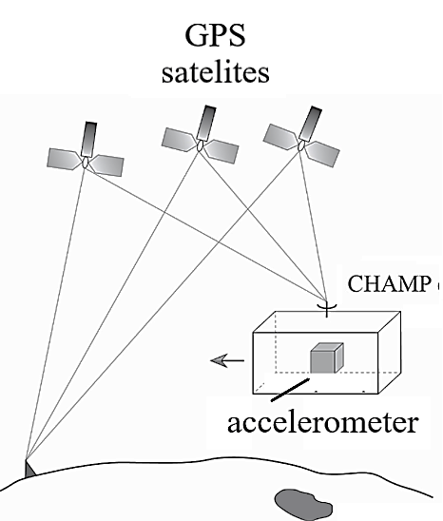
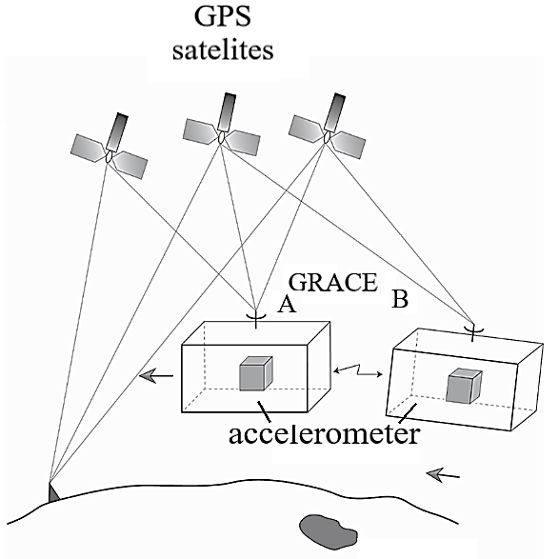
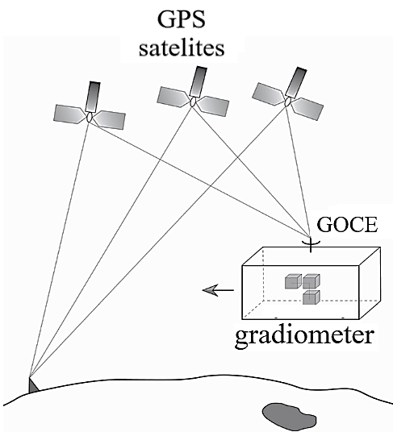
- The first successful flight of GPS receiver on TOPEX/POSEIDON satellite mission at 1992 the has established the new way of the orbit determination of low-flying satellites.
In june 1996 was realized the first flight of the French GRADIO/ASTRE space-qualified precise accelerometer on the STS78 shuttle mission .
These were the possibilities for the realization of specialized gravitational field missions

Slide 5
CHAMP
(CHAllenging Minisatellite Payload satellite mission)
- established by German Research Center GFZ and launch in 2000 and finished in 2010
Mission goals:
1. to significantly improve determination of the long-wave components of the Earth’s gravity and geomagnetic field using innovative instrumentation on board the satellite
2. the use of the on-board GPS instrumentation for the first operational use of radio occultation technology for remote sensing of the atmosphere and ionosphere
Orbit:
At launch, polar (orbit inclination i = 87.3° ), almost circular (orbit eccentricity e = 0.004 ) orbit at an altitude of 454 km
Due to increased deceleration and to prolonge mission duration in some periods the several orbital manoeuvres (raising) were done and orbit became circular (frozen orbit)
After 10 years flight altitude was 260 km

Slide 6
Instruments :
GPS sistem - two-frequency GPS receiver for measuring the exact position and frequency and providing uniform time reference
Accelerometer - The electrostatic accelerometer STAR provided information on the accelerations of the non-gravitational surface forces. (a measurement range of ±10⁻⁴ m/s² and exhibits a resolution of better than 3·10⁻⁹ m/s² for the y- and z-axes and 3·10⁻⁸ m/s² for the x-axis, within the measurement bandwidth from 10⁻⁴Hz to 10⁻¹ Hz.
A highly autonomous control and data processing system -enable safe operation up to 12 h without contact to ground stations. The data was stored in a mass memory with a capacity of 1.2 Gigabit and sent to the receiving stations in Weilheim, Neustrelitz and Ny Alesund during overflights.
Digital ion drift meter, Overhauser and fluxgate magnetometer -for electric and magnetic field recovery
Laser retro reflector - enables orbit control
Four stellar sensor systems – for determination of orientation in space
Data - Operational and scientific data was collected on board of almost continuously (approx. 98 per cent) every second and all measured quantities were provided with a uniform and accurate (< 1 ms) time stamp.
- A special scientific data system was developed for decoding raw sensor data sent by CHAMP in the data operating system SOS and converted into calibrated physical measurement data together with data from the laser and GPS ground station networks. This was the basis for the derivation of the scientific standard products of different processing stages for the gravitational field, magnetic field and atmosphere in the processing system SDS. (accelerometer (ACC) data files and rapid science orbit (RSO) ACC -file records values of satellite mass, acceleration, and quaternions, every 10 s. RSO - position and velocity of CHAMP in the conventional terrestrial system (CTS) recorded every 30 s, with accuracy of centimeter level
.

Slide 7
GRACE
(Gravity Recovery And Climate Experiment)
- Specifically designed to measure the temporal variations of the Earth’s gravitational field.
- Satellites Launch was in 2002 and mission was finished in 2015
Mission goals :
1. Monitoring globally integrated mass changes in the geosphere, which are
associated with climate-relevant processes, over a measurement period of several years.
To map the global gravitational field with unprecedented accuracy over a spatial range of 400 to 40,000 km every 30 days.
2. Using of GPS radio occultation measurements to obtain density and
temperature profiles in the upper atmosphere.
Structure :
The GRACE mission consisted of two identical satellites orbiting the Earth at a distance of 220±50 km in the same orbit, initially at an altitude of about 500 km, and connected by a high-precision microwave ranging system with two different frequency signals of 24 GHz (K-band) and 32 GHz (Ka-band) that were physical measurement data together with data from the laser and GPS ground transmitted and received between the satellites. The relative distance is measured with the 1μm accuracy.

Slide 8
Because of the differential character of the measurement, much finer structures can be resolved with the twin configuration than from the orbital disturbances of a single satellite.
Instruments on satellites :
Inter-satellite microwave K band ranging system HAIRS - for continuous measurement of the distance between the satelites (low-low SST)
GPS receivers - two-frequency GPS receivers of the for measuring the exact position and frequency and providing uniform time reference
Accelerometer – three axis Electrostatic Super-STAR accelerometer, as improved version of STAR provided information on the accelerations of the non-gravitational surface forces with sampling period of 1s. Precision was 10⁻¹⁰ m/s²
Laser retro reflector - enables orbit control
Two stellar sensor systems – for determination of orientation in space
Data
Level 1B Format Record files can been downloaded from the GRACE Information System
and Data Center (ISDC) website, (ACC_1B files, accelerometers dat, sampling rate 1s), Star Camera Assembly (SCA_1B files-quaternions ) 5 s sampling time),POD of GRACE (GNV_1B files ,position and velocity at 5 s intervals. Time series of monthly gravity fields are available in the versions RL01 to RL06.

Slide 9
GOCE
(Gravity and steady-state Ocean Circulation Explorer)
- Gravitational gradiometry is the measurement of gradients of the three components of the gravitational vector, or in other words, of second derivatives of the gravitational potential.
- Satellites Launch was in 2009 and mission was finished in 2013
Mission objectives
To measure the global Earth’s gravitational field with accuracy of 1 millionth of the Earth’s gravity (= 1milliGal) or a geoid height accuracy of 1 to 2 cm and to resolve spatial structures of the Earth’s gravitational field up to a spatial extent of about 100 km half wavelength.
Orbit: At launch, polar (orbit inclination i = 96.7° ), quasi-circular sun-synchronized (satelllite remains facing the sun during the whole mission by a slow gyroscopic movement) in space) at altitude 255 km (lowering in four steps to 224 km)
GOCE is the first "drag-free" mission , i.e. the satellite moves in free fall around the Earth, Non-gravitational forces are compensated using very sensitive ion thrusters.

Slide 10
Instruments on satellite
Triaxial gravitational gradiometer : for three axiala gravity gradients measurements
Spaceborne geodetic GPS receiver two-frequency GPS receivers of the for measuring the exact position
Laser reflector enables orbit control
Three star-sensors determination of orientation in space
Ion engines Compensation for air resistance
Data :
Orbits: SST PSO 2 (sub-products: SST PKI 2 [kinematic orbits],SST PCV 2 [variance-covariance information of orbit positions],or alternatively SST PRD 2 [reduced-dynamic orbits]).
Gravity gradients in the gradiometer reference frame (GRF) and attitude: EGG NOM 2.
Non-gravitational (“common mode”) accelerations: EGG CCD 1B.
Models for temporal gravity field reduction, such as ephemeris of Sun and Moon, ocean tide models, correction coefficients for non-tidal temporal variation signals (SST AUX 2), and for Earth’s rotation (AUX IERS

Slide 11
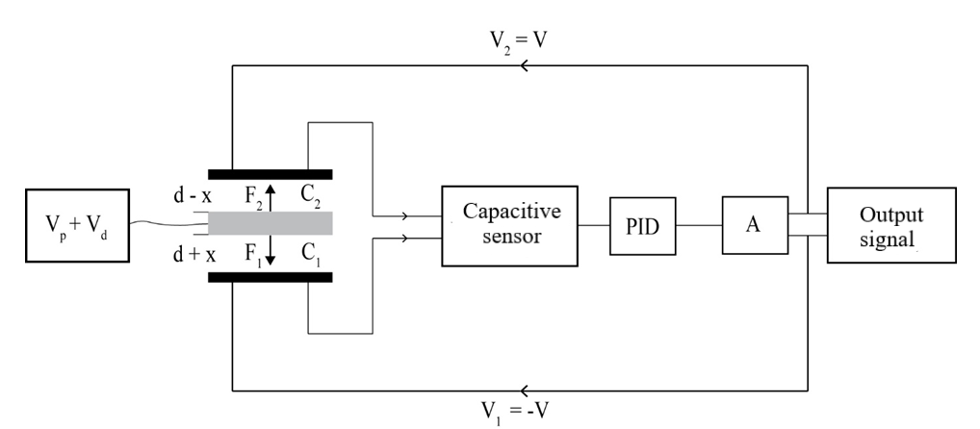
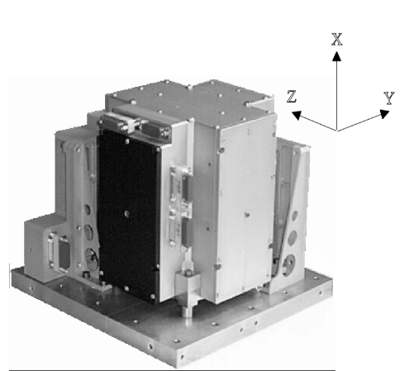
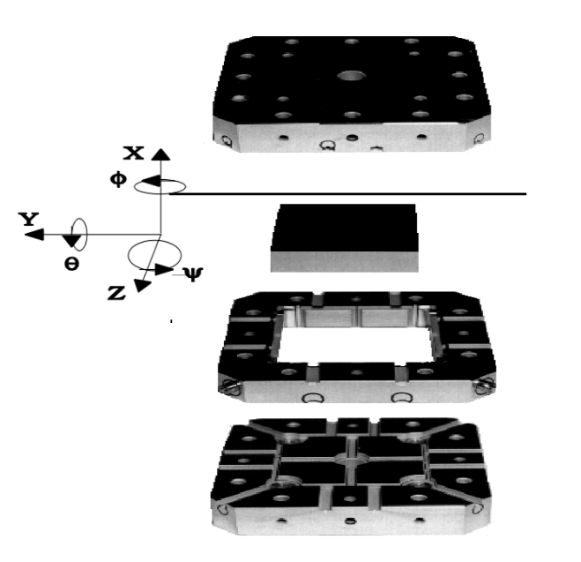
Electro-static capacitive (servo- controlled) sensor principle
A proof mass connected to a bias V_{p}+V_{d} voltage is kept levitated in the centre of capacitor by applying control voltages V₁=V i V₂=-V on its plates. Capacitive sensor detects the moving of proof mass due to gravity field change , and close loop regulating system changes the control voltage V to keep proof mass at its constant levitating position . Control voltage is proportional to the proof mass acceleration. Three–axis accelerometer have three pairs of mutual orthogonal capacitor plates., and 8 electrodes for measuring three axial , a three rotational components.

Slide 12
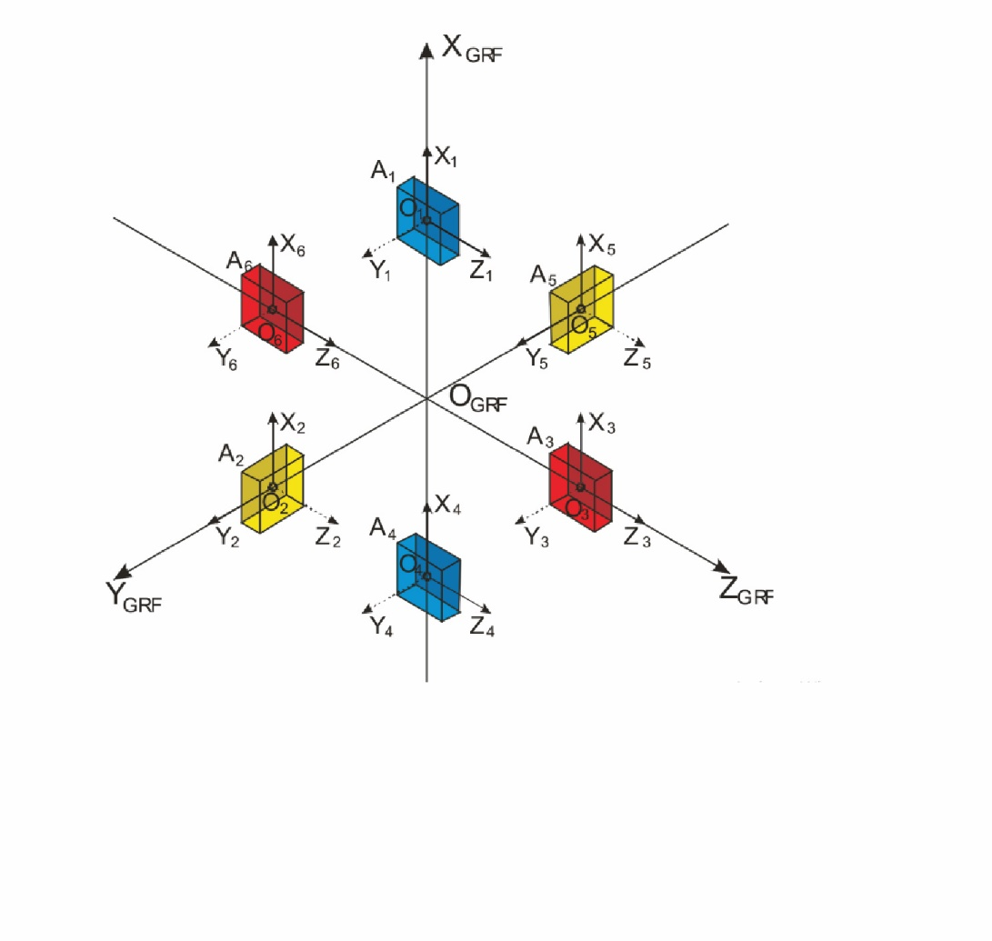
Electrostatic gravity gradiometer (EGG)
The EGG consists of three orthogonal pairs of capacitive accelerometers mounted on the ultra-stable carbon–carbon honeycomb support structure. Two accelerometers of the same pair are mounted at 50 cm distance to each other and form a gradiometric arm aligned along one axis
The requirements for the gradiometer are : The accelerations measured by each accelerometer within a band-limited frequency range of 5–100 mHz can be as small as one part in 10¹³ of the gravitational attraction experienced on Earth.
The GOCE accelerometers are therefore about 100 times more sensitive than any accelerometers previously flown,such as SuperSTAR on GRACE
Essentially the four gradiometer components Vxx , Vyy , Vzz, and Vxz are resolvable with high precision.

Slide 13
The acceleration observed by a single acceleromete
r - the position vector of the accelerometer origin in the GRF.
- angular velocities
anon non-conservative forces
In the differential mode
fundamental equation of the gradiometer

Slide 14
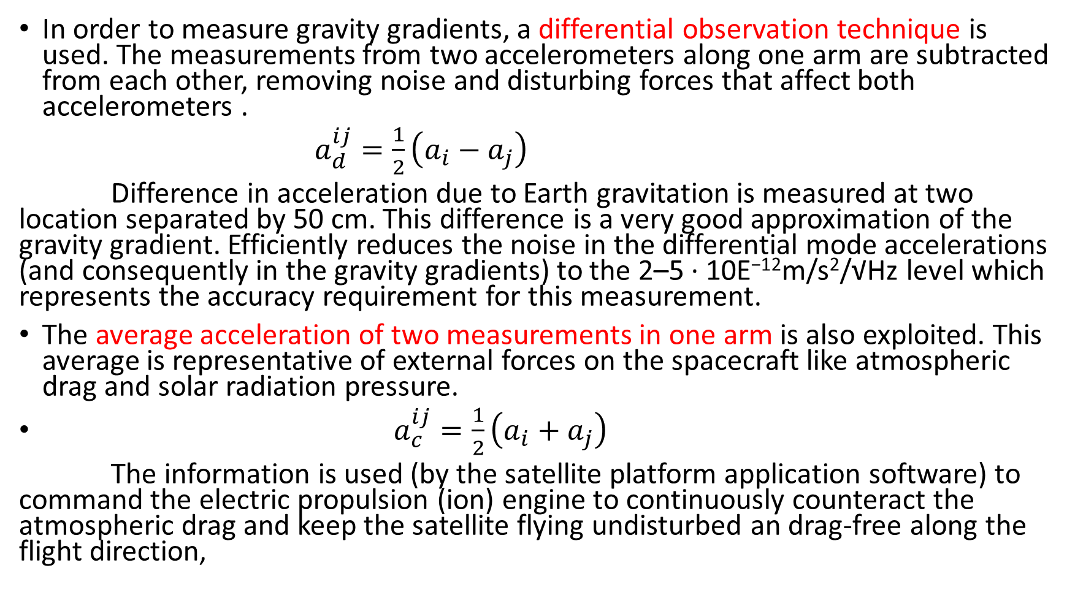
In order to measure gravity gradients, a differential observation technique is used. The measurements from two accelerometers along one arm are subtracted from each other, removing noise and disturbing forces that affect both accelerometers .
$a_{d}^{ij}=\frac{1}{2}\left(a_{i}−a_{j}\right)$
Difference in acceleration due to Earth gravitation is measured at two location separated by 50 cm. This difference is a very good approximation of the gravity gradient. Efficiently reduces the noise in the differential mode accelerations (and consequently in the gravity gradients) to the 2–5 · 10E⁻¹²m/s²/√Hz level which represents the accuracy requirement for this measurement.
The average acceleration of two measurements in one arm is also exploited. This average is representative of external forces on the spacecraft like atmospheric drag and solar radiation pressure.
$a_{c}^{ij}=\frac{1}{2}\left(a_{i}+a_{j}\right)$
The information is used (by the satellite platform application software) to command the electric propulsion (ion) engine to continuously counteract the atmospheric drag and keep the satellite flying undisturbed an drag-free along the flight direction,

Slide 15
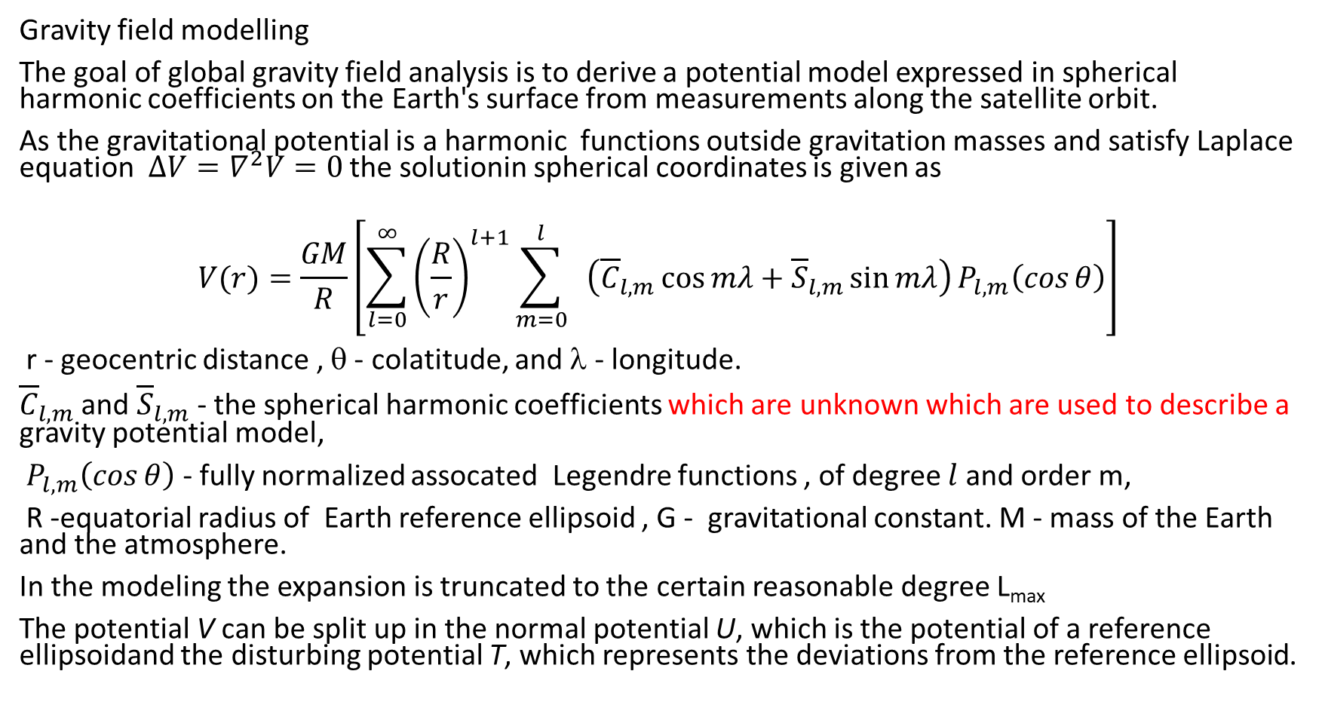
Gravity field modelling
The goal of global gravity field analysis is to derive a potential model expressed in spherical harmonic coefficients on the Earth's surface from measurements along the satellite orbit.
As the gravitational potential is a harmonic functions outside gravitation masses and satisfy Laplace equation $∆V=∇^{2}V=0$ the solutionin spherical coordinates is given as
$$V(r)=\frac{GM}{R}\left[\sum_{l=0}^{∞}{{\left(\frac{R}{r}\right)}^{l+1}\sum_{m=0}^{l}{ \left({\overline{C}}_{l,m}\cos{mλ}+{\overline{S}}_{l,m}\sin{mλ}\right)}P_{l,m}\left(\cos{θ}\right)}\right]$$
r - geocentric distance , θ - colatitude, and λ - longitude.
${\overline{C}}_{l,m}$ and ${\overline{S}}_{l,m}$ - the spherical harmonic coefficients which are unknown which are used to describe a gravity potential model,
$P_{l,m}\left(\cos{θ}\right)$ - fully normalized assocated Legendre functions , of degree $l$and order m,
R -equatorial radius of Earth reference ellipsoid , G - gravitational constant. M - mass of the Earth and the atmosphere.
In the modeling the expansion is truncated to the certain reasonable degree L_{max}
The potential V can be split up in the normal potential U, which is the potential of a reference ellipsoidand the disturbing potential T, which represents the deviations from the reference ellipsoid.

Slide 16
Modelling is two step procedure
The first step - a linear relation between the observations and functionals of the potential is derived.
The second step - the point values along the orbit have to be transformed into a global model on the Earth's surface.
The first step
1) In case of high-low satellite-to-satellite tracking (hl SST) the main observation is the GPS tracking from a LEO satellite.
Precise orbit determination (POD)
- dynamic reduced method: based on the integration of accelerations which are computed from physical models and some statistical parameters
kinematic POD: kinematic geometric technique which is purely based on observations (mainly GPS) and uses no a priory models to describe the motion of the satellite. (need numerical differentiation)
2) In case of gravity gradiometer measurements (GGT)
Satellite Gravity Gradiometry (SGG) observes components of the tensor of second derivatives of the gravity potential in the satellite fixed coordinate frame. They are already functionals of the potential and do not need to be linearized. Nevertheless they are subject to several data processing steps and a frame transformation.

Slide 17
Energy Balance Approach .
The Energy Balance Approach is a method to derive a time series of disturbing potential T values from the satellite orbit based on the Law of Energy Conservation. The POD data are used to derive velocities and acceleration as first and second derivatives of satellite position to the Earth.
Terms
1-Static gravity field (integral the orbit is path independent).
2. Normal potential
3-Centrifugal acceleration
4- Surface forces (non-conservative, measured by the onboard accelerometers have to be integrated along the orbit and the resulting quantity has to be used as correction)
5-Temporal variations and tides (can be computed from models)

Slide 18
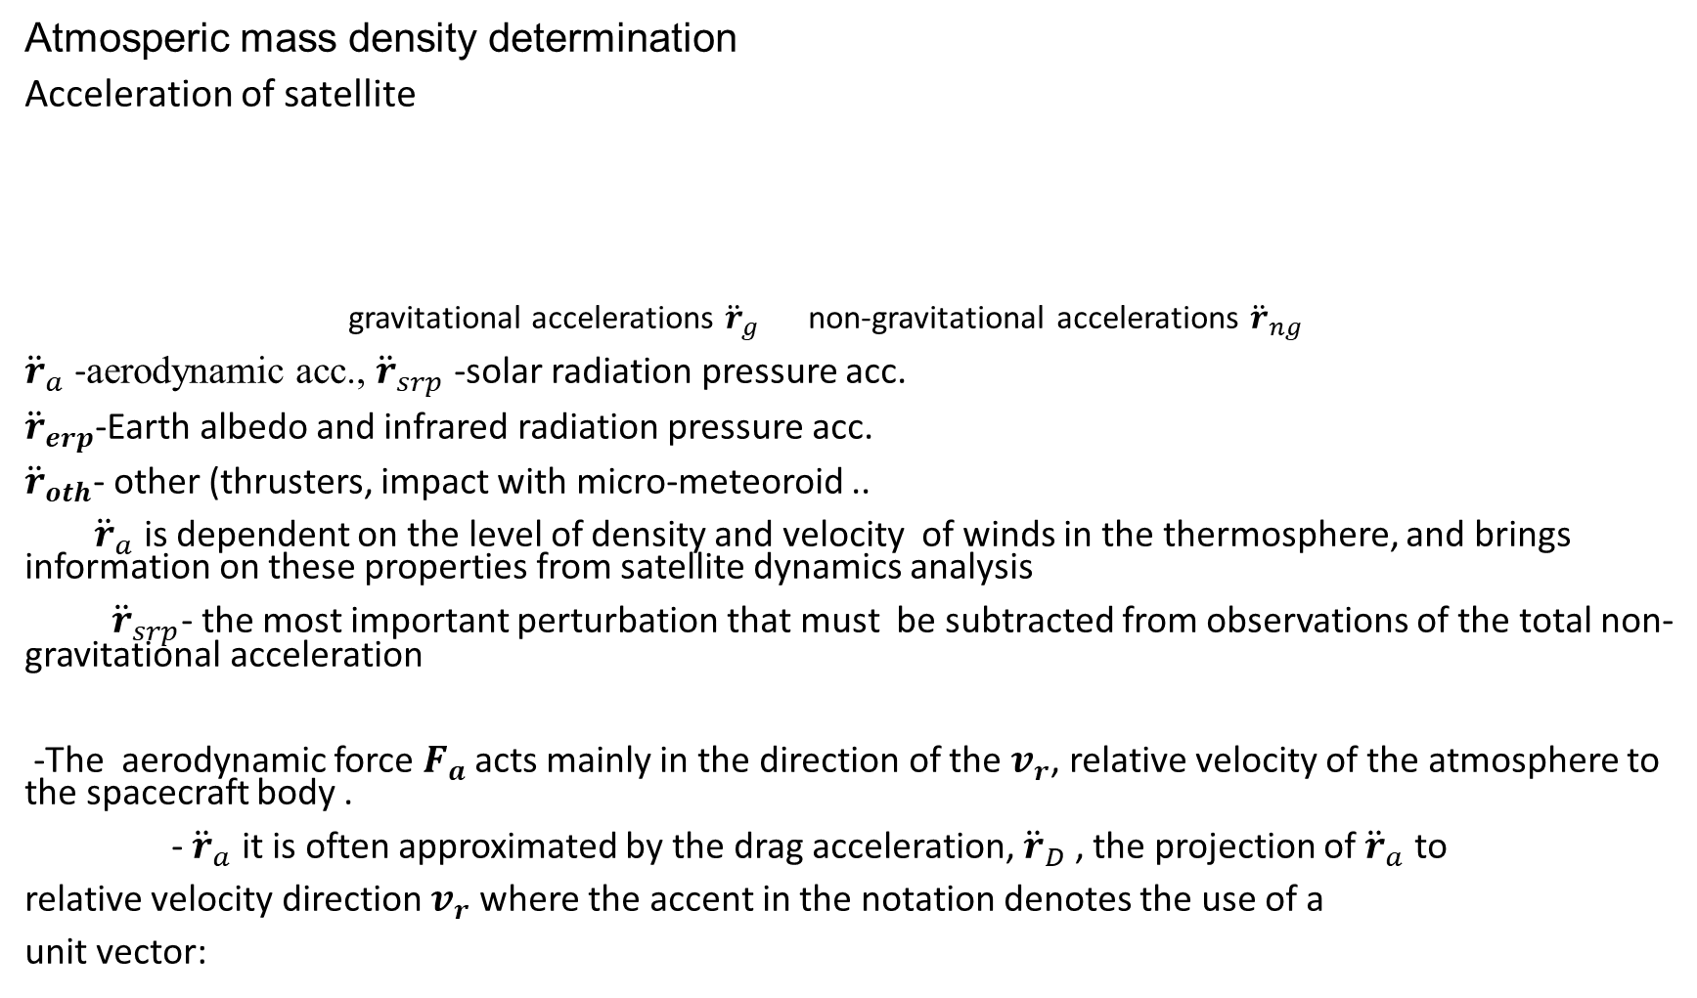
Atmosperic mass density determination
Acceleration of satellite
gravitational accelerations ${\ddot{r}}_{g}$ non-gravitational accelerations ${\ddot{r}}_{ng}$
${\ddot{r}}_{a}$ -aerodynamic acc., ${\ddot{r}}_{srp}$ -solar radiation pressure acc.
${\ddot{r}}_{erp}$-Earth albedo and infrared radiation pressure acc.
${\ddot{r}}_{oth}$- other (thrusters, impact with micro-meteoroid ..
${\ddot{r}}_{a}$ is dependent on the level of density and velocity of winds in the thermosphere, and brings information on these properties from satellite dynamics analysis
${\ddot{r}}_{srp}$- the most important perturbation that must be subtracted from observations of the total non-gravitational acceleration
-The aerodynamic force $F_{a}$acts mainly in the direction of the $v_{r}$, relative velocity of the atmosphere to the spacecraft body .
- ${\ddot{r}}_{a}$ it is often approximated by the drag acceleration, ${\ddot{r}}_{D}$ , the projection of ${\ddot{r}}_{a}$ to
relative velocity direction $v_{r}$ where the accent in the notation denotes the use of a
unit vector:

Slide 19
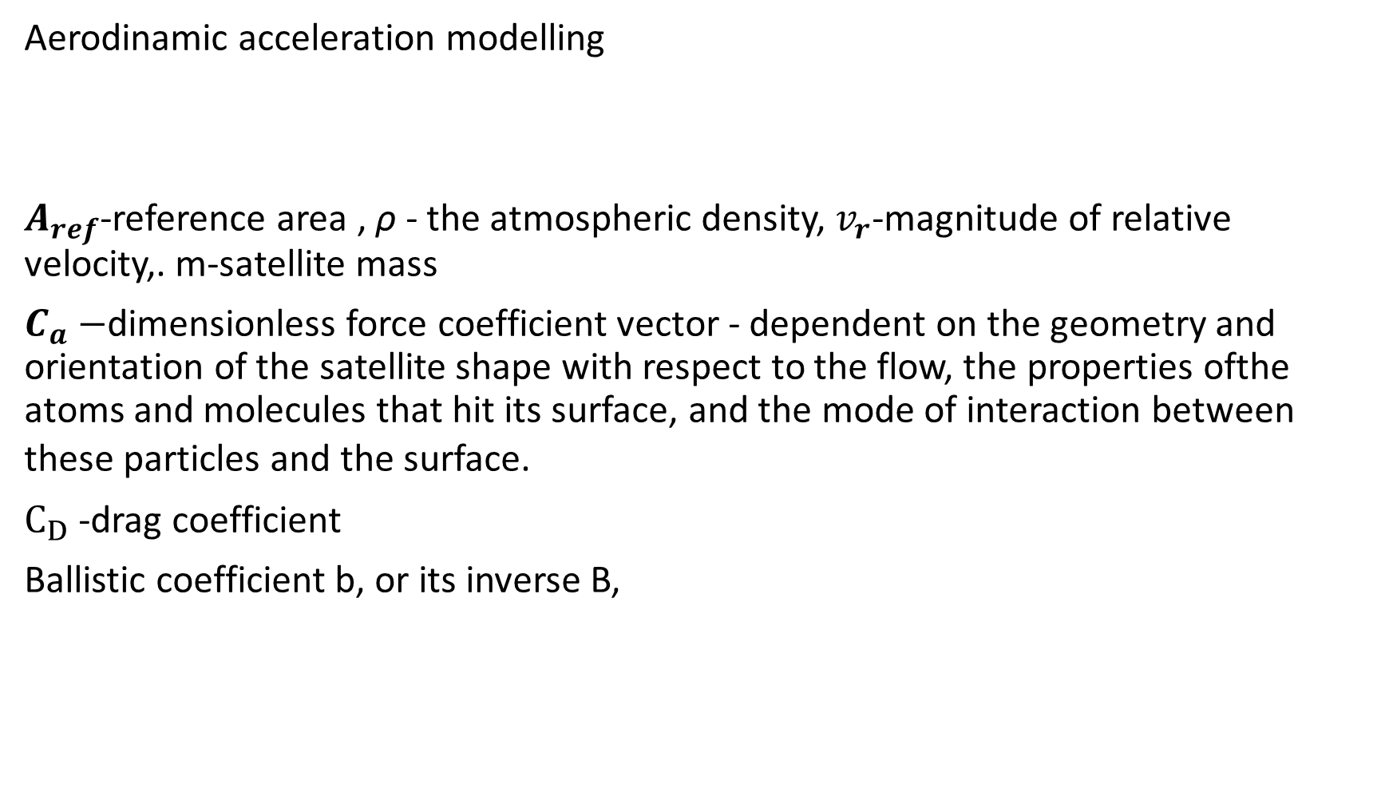
Aerodinamic acceleration modelling
$A_{ref}$-reference area , ρ - the atmospheric density, $v_{r}$-magnitude of relative velocity,. m-satellite mass
$C_{a}−$dimensionless force coefficient vector - dependent on the geometry and orientation of the satellite shape with respect to the flow, the properties ofthe atoms and molecules that hit its surface, and the mode of interaction between these particles and the surface.
$C_{D}$ -drag coefficient
Ballistic coefficient b, or its inverse B,

Slide 20
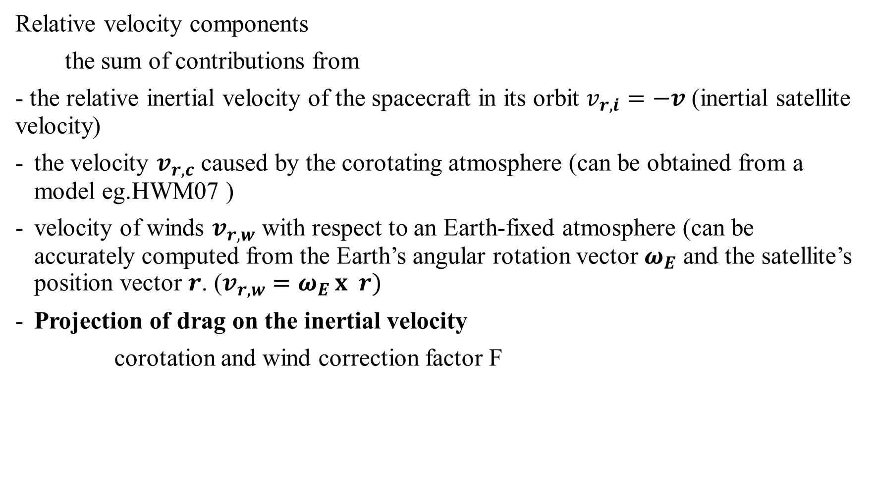
Relative velocity components
the sum of contributions from
- the relative inertial velocity of the spacecraft in its orbit $v_{r,i}=−v$ (inertial satellite velocity)
the velocity $v_{r,c}$ caused by the corotating atmosphere (can be obtained from a model eg.HWM07 )
velocity of winds $v_{r,w}$ with respect to an Earth-fixed atmosphere (can be accurately computed from the Earth’s angular rotation vector $ω_{E}$ and the satellite’s position vector $r$. ($v_{r,w}=ω_{E }x r)$
Projection of drag on the inertial velocity
corotation and wind correction factor F

Slide 21
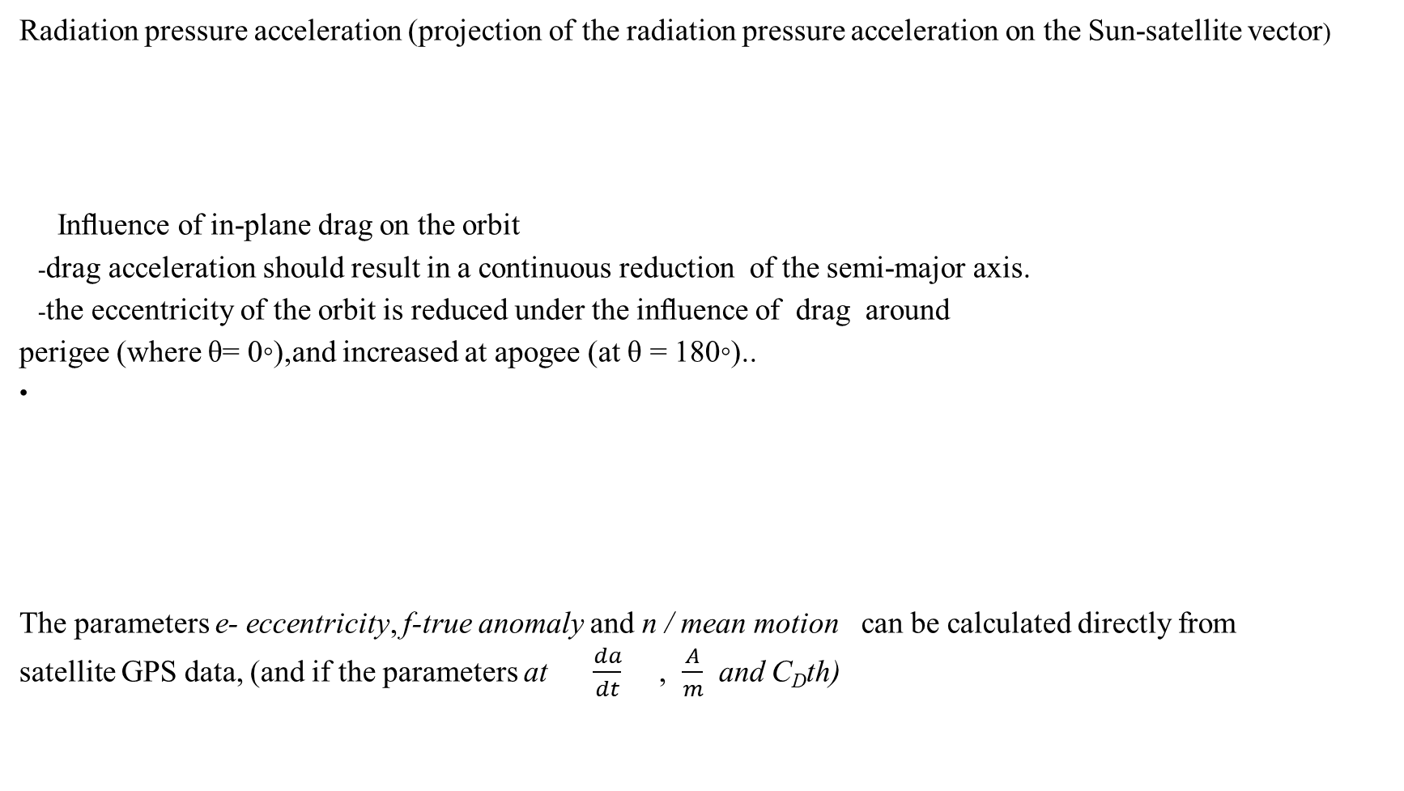
Radiation pressure acceleration (projection of the radiation pressure acceleration on the Sun-satellite vector)
Inﬂuence of in-plane drag on the orbit
-drag acceleration should result in a continuous reduction of the semi-major axis.
-the eccentricity of the orbit is reduced under the inﬂuence of drag around
perigee (where θ= 0◦),and increased at apogee (at θ = 180◦)..
The parameters e- eccentricity, f-true anomaly and n / mean motion can be calculated directly from
satellite GPS data, (and if the parameters at $\frac{da}{dt}$ , $\frac{A}{m}$ and C_{D}th)

Slide 22
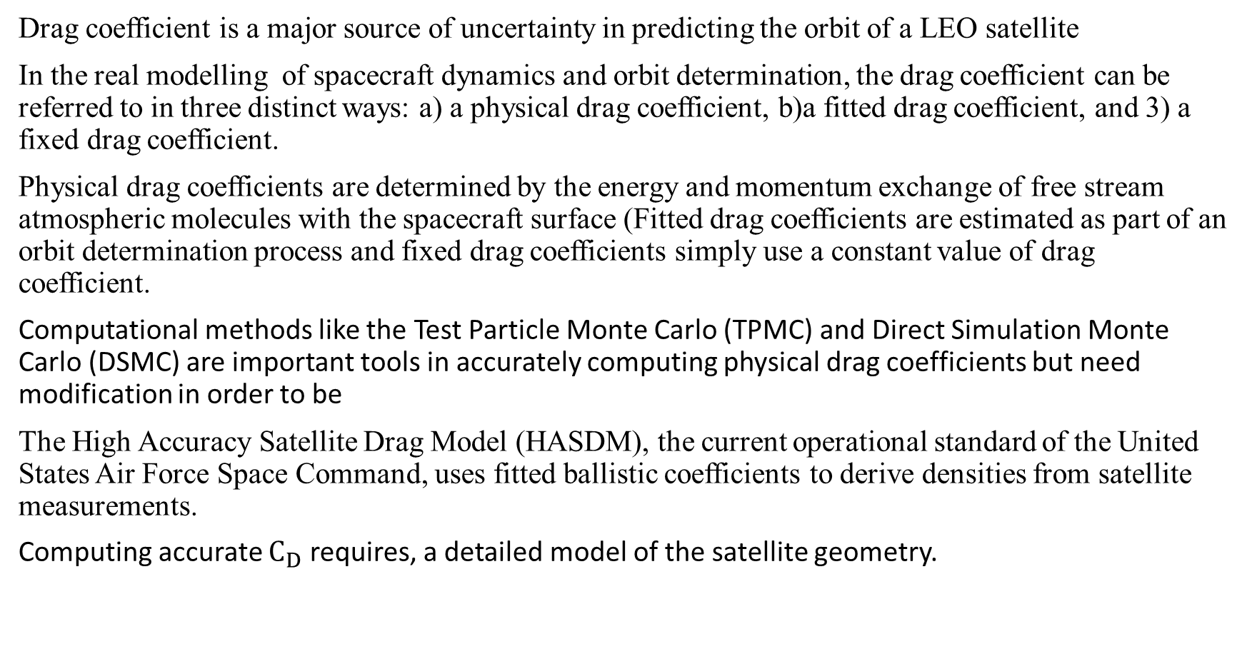
Drag coefficient is a major source of uncertainty in predicting the orbit of a LEO satellite
In the real modelling of spacecraft dynamics and orbit determination, the drag coefficient can be referred to in three distinct ways: a) a physical drag coefficient, b)a fitted drag coefficient, and 3) a fixed drag coefficient.
Physical drag coefficients are determined by the energy and momentum exchange of free stream atmospheric molecules with the spacecraft surface (Fitted drag coefficients are estimated as part of an orbit determination process and fixed drag coefficients simply use a constant value of drag coefficient.
Computational methods like the Test Particle Monte Carlo (TPMC) and Direct Simulation Monte Carlo (DSMC) are important tools in accurately computing physical drag coefficients but need modification in order to be
The High Accuracy Satellite Drag Model (HASDM), the current operational standard of the United States Air Force Space Command, uses fitted ballistic coefficients to derive densities from satellite measurements.
Computing accurate $C_{D}$ requires, a detailed model of the satellite geometry.

Slide 23
The Global Ultraviolet Imager (GUVI)
- GUVI is on board the NASA Thermosphere Ionosphere Mesosphere Energy and
Dynamics (TIMED) satellite that was launched on 7 December2001 into a 630 km circular orbit with an inclination of 74.1°
- Its measurement mode consisted of imaging the FUV dayglow from both the Earth limb and disk in the wavelength range from 115 to 180 nm.
-Scan mirror swept the 14 pixel fields of view every 15 s, from 510km tangent height to 110 km (downward by 80° to nadir (0°) and across the disk by another 60°. In December 2007 the scan mirror failed, GUVI only operates in the spectral stare mode at about 47° from nadir.
-Five spectral bands are imaged simultaneously
-Few types of recalculation and recalibration data are made
- Very good corellation with CHAMP mass density data is described in the literature

Slide 24
-NRLMSISE-00 is an empirical, global model of the Earth’s atmosphere, from ground to space,
-NRLMSISE-00 model provides altitude profiles of temperature T(z), number densities of species (He,O, N2, O2, Ar, H, N) in equilibrium at the temperature T(z), total mass density ρ(z), and the number density of a high altitude‘‘anomalous oxygen’’ component of total mass density that is not in thermal equilibrium at T(z).
It is the standard for international space research. A primary use is to aid predictions of satellite orbital decay due to atmospheric drag.
This model of atmospheric composition, temperature, and total mass density includes the following:
- drag data based on orbit determination;
- more recent accelerometer data sets;
- new temperature data derived from incoherent scatter radar observations;
-observations of (O2) by the Solar Maximum Mission (SMM), based on solar UV occultation.
The earlier models of this type MSIS-86 and MSISE-90 are based on Mass Spectrometer and Incoherent Scatter Radar measurements.

Slide 25
Neutral mass spectrometer (NMS)
The data about thermospheric composition from 1960^{s} until 1983 are mostly collected from in situ measurements by neutral mass spectrometers from Atmospheric Explorer (AE)and Dynamic Explorer (DE)series of satellite missions.
The mass spectrometer on DE, a quadrupole, measured the abundances of neutral species in the region 300-500 km These measurements are used with other simultaneous oin the earth's atmosphere
Observations on Dynamics Explorer to study the physical processes involved in the interactions of the magnetosphere-ionosphere-atmosphere system. The number densities of atomic oxygen O, molecular nitrogen N, helium He, argon Ar, and possibly atomic nitrogen N, were measured to an accuracy of about ± 15%, over the specified altitude range, with a temporal resolution of one second.
There was a problem with detection of atomic oxygen , because incoming O can react with instrument surface to form O₂

Slide 26
SWARM
The satellites in autumn 2013. Technically, this mission’s expected lifetime duration was four years
The Swarm constellation consists of three identical satellites named Alpha, Bravo, and Charlie (A, B and Cnear–polar LEO. Two are flying side–by–side around about 450 km altitude, whereas a third satellite is orbiting about 530 km altitude.
The goal is creating a highly detailed survey of the Earth's geomagnetic field and its temporal evolution as well as the electric field in the atmosphere, by using a satellite constellation that carries sophisticated magnetometers and other instruments.
The satellites have on board global positioning systems (GPS) and accelerometers. These satellites provide a unique sampling for both the local solar time and universal time. The resolution of Swarm accelerometers is better than the CHAMP STAR accelerometer by 3 nm/s2 and below 10 nm/s2 for a noise level
The Swarm Satellite Constellation Application and Research Facility (SCARF) has been formed for the relevant Swarm observations like the derivations of density and wind in the thermosphere
The Swarm Level 2 processing system (L2PS) is governed the SCARF and both are accountable for Level 2 data products.

Slide 27
CASPA-ADM mission
(Cold Atom Space PAyload Atmospheric Drag Mission)
- The objective is to develop a mission concept for observing thermospheric mass density with an accelerometer based on Cold Atom Interferometry (CAI) as a technology demonstrator.
- CAI relies on cooling a vapor of atoms in a vacuum chamber close to absolute zero temperature using lasers and using the properties of the atoms to form a matter-wave interferometer that is extremely sensitive to accelerations
- the advantage - acceleration measurements are not affected by biases or scale factors and not need recalibration

Slide 28
Instruments and their accuracy
CAI accelerometer Signal range 0.03–11.8 μm/s2
for measure non-gravitational acceleration Noise level 0.01 μm/s²/ sqrt(Hz)
GPS receiver Multi-frequency measurements
Geolocation of measurements 12 + channels
Validation of CAI measurements Code and carrier phase observations
Neutral mass spectrometer Mass range 4–32 amu
Atmospheric composition and temperature Composition 10%
Temperature 3%
Mass density Goal: 1% Threshold: 5%
Star cameras Accuracy 50″)
Orientation of measurements/aerodynamic coeff.
Correction for effects due to measuring in rotating frame
Ram wind sensor Range < 2000 m/s
Measure in-track wind Accuracy 40 m/s (1 σ)
Alignment with relative velocity direction within ± 12°

