Slide 1
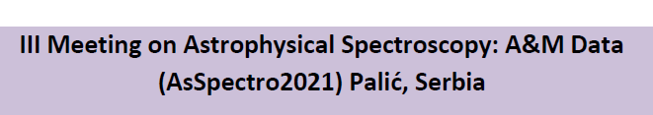

Slide 2
Stark broadening parameters of the singly ionized sulfur S II ion
Walid F. Mahmoudi¹, Lamia Abu El Maati^{2,3}, Sahar G. Tawfik^{3,4}, Fatemah H. Alkallas⁴, Nabil Ben Nessib⁵, Sylvie Sahal-Bréchot⁶, Milan S. Dimitrijević^{6,7}
  ¹Department of physics, Faculty of Science of Bizerte, University of Carthage, Tunisia
  ²Department of physics, Science College, Benha University, Benha, Egypt
  ³Department of Physics, College of Science, Princess Nourah bint Abdulrahman University, Riyadh, Po Box 84428, Saudi Arabia
  ⁴Physics Department, Faculty of Science, Alexandria University, Alexandria, Egypt
  ⁵Department of Physics and Astronomy, College of Sciences, King Saud University,
  PO Box 2455, Riyadh 11451, Saudi Arabia
  ⁶Sorbonne Université, Observatoire de Paris, Université PSL, CNRS, LERMA, F-92190 Meudon, France
  ⁷Astronomical Observatory, Volgina 7, 11060 Belgrade 38, Serbia

Slide 3
Outline
Why S II?
Precedent works.
Our Calculations.

Slide 4
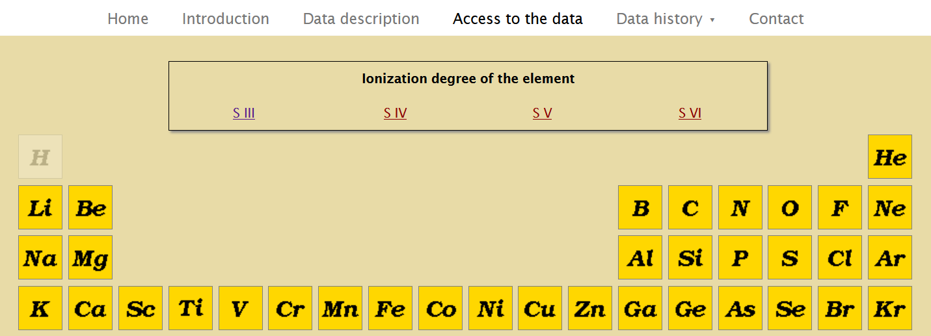
Why S II?

Slide 5
Precedent works:
The theoretical comparison will be mostly with the values of experimental measured by Djeniže et al. (1990), Hong et al. (1993) and Kobilarov et al. (1990) and theoretical values calculated by Milovanović (2007).
Djeniže, S., Srećković, A., Platiša, M., Konjević, N., Labat, J. and Purić, J., Phys. Rev. A 42, 2379 (1990).
Hong, D. and Fleurier, C., Spectral line Shapes, edited by Stamm, R. and Talin, B., Nova Science, Commak, NY, 7, 123 (1993).
Kobilarov, N. and Konjević, N., Phys. Rev. A 41, 6023 (1990).
Milovanović, N. and Dimitrijević, M. S., AIP conference proceedings, 938, 258, (2007).

Slide 6
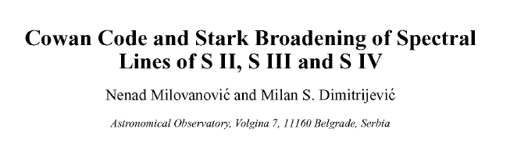
Precedent works:
Milovanović, N. and Dimitrijević, M. S., AIP conference proceedings, 938, 258, (2007).
We present Stark broadening parameters (widths) of 5 multiplets of S II, 3 multiplets
of S III and 2 spectral lines of S IV calculated using modified semi- empirical approach (MSB).
Needed atomic data (energy levels) have been calculated ab initio using Cowan code. Comparison of energy levels of S II, S III and SIV calculated by Cowan code and energy levels taken from NIST atomic spectra database is given.

Slide 7
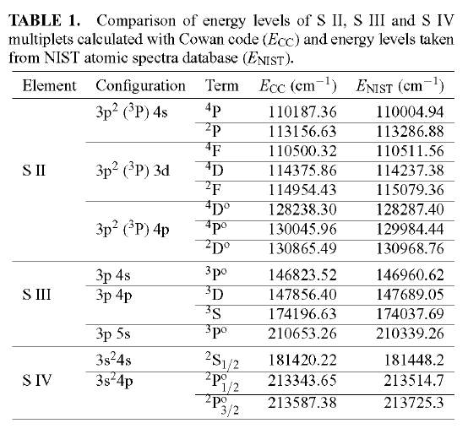
Precedent works:

Slide 8
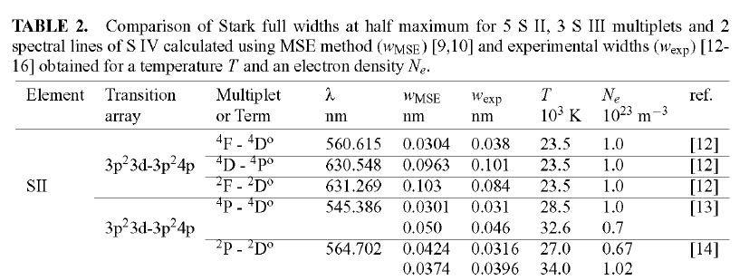
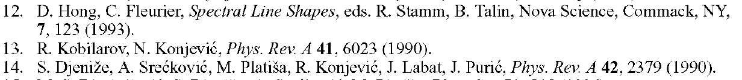
Precedent works:

Slide 9
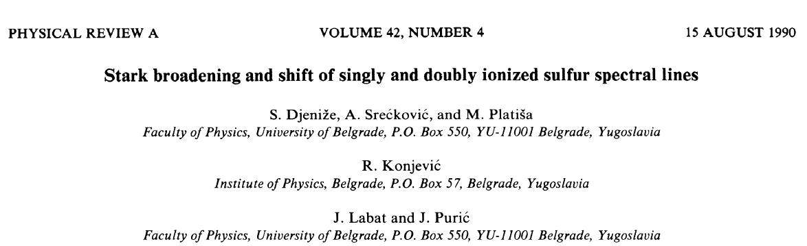
Precedent works:

Slide 10
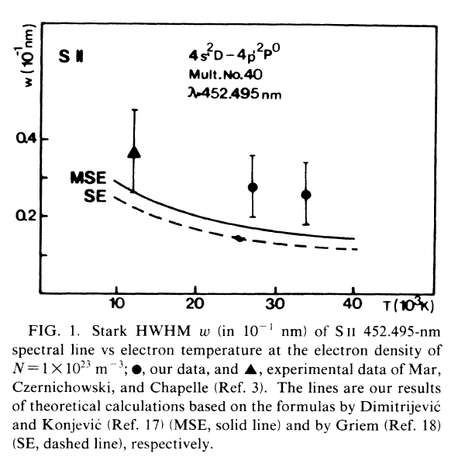
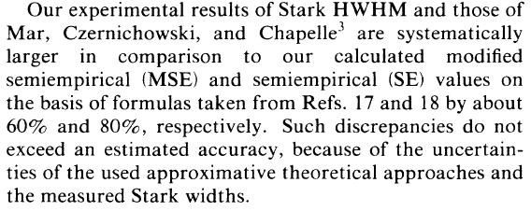

Slide 11
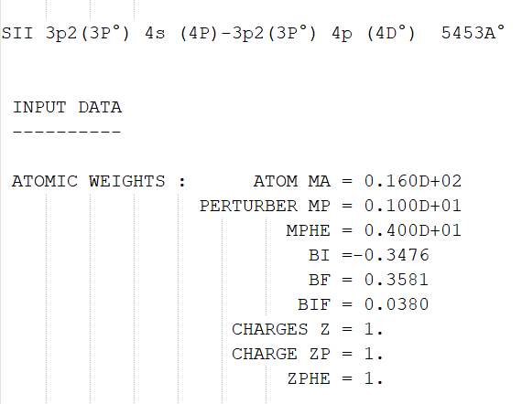
Our calculations:

Slide 12
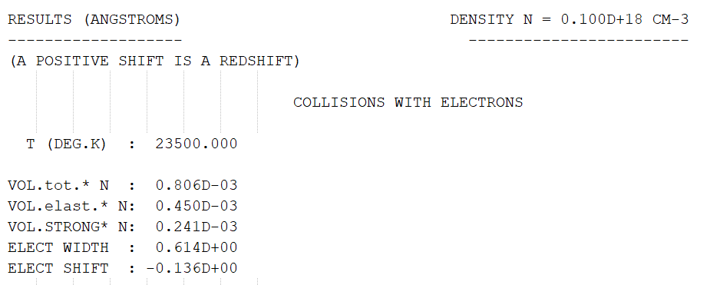
Our calculations:

Slide 13
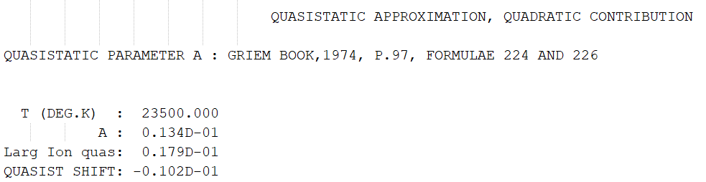
Our calculations:

Slide 14
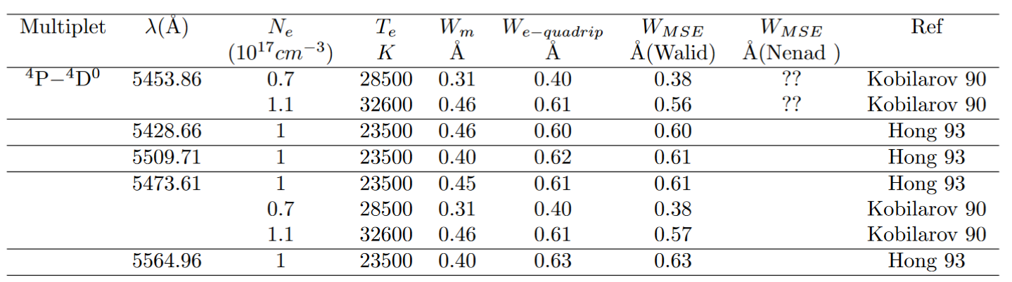
Our calculations:

Slide 15
Thank you for your attention

