Slide 2
Atomic structure of the doubly ionized titanium Ti III ion
Lamia Abu El Maati^{1,2}, Walid F. Mahmoudi³, Sahar G. Tawfik^{2,4},
Fatemah H. Alkallas⁴, Nabil Ben Nessib⁵, Milan S. Dimitrijević^{6,7}
¹Department of physics, Science College, Benha University, Benha, Egypt
²Department of Physics, College of Science, Princess Nourah bint Abdulrahman University, Riyadh, Po Box 84428, Saudi Arabia
³Department of physics, Faculty of Science of Bizerte, University of Carthage, Tunisia
⁴Physics Department, Faculty of Science, Alexandria University, Alexandria, Egypt
⁵Department of Physics and Astronomy, College of Sciences, King Saud University, PO Box 2455, Riyadh 11451, Saudi Arabia
⁶Astronomical Observatory, Volgina 7, 11060 Belgrade 38, Serbia
⁷Sorbonne Université, Observatoire de Paris, Université PSL, CNRS, LERMA, F-92190 Meudon, France

Slide 3
Outline
Why the Ti III?
Precedent works.
Methods to calculate the atomic structure parameters of the Ti III ion.
Our calculations on atomic structure of Ti III.

Slide 4
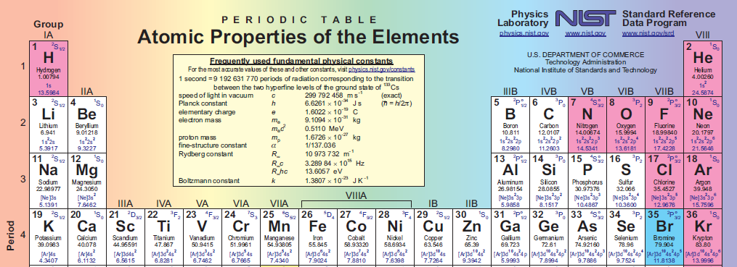
Why Ti III?

Slide 5
Why Ti III?
Alkallas, F. H., Abu El Maati, L. A., Ben Nessib, N., & Dimitrijević, M. S. (2021). Energy levels of the singly ionized titanium: Ti II ion. Astronomische Nachrichten.
Tankosić, D., Popović, L. Č., & Dimitrijević, M. S. (2001). Electron-impact Stark broadening parameters for Ti II and Ti III spectral lines. Atomic Data and Nuclear Data Tables, 77(2), 277-310.
Sitnova, T. M., Mashonkina, L. I., & Ryabchikova, T. A. (2016). A non-local thermodynamical equilibrium line formation for neutral and singly ionized titanium in model atmospheres of reference A–K stars. Monthly Notices of the Royal Astronomical Society, 461(1), 1000-1011.

Slide 6
Precedent works
The most important theoretical work on neutral and ionized titanium is done in 1979 by Corliss, C., & Sugar, J. (Energy levels of titanium, Ti I through Ti XXII). In this last work, the authors compiled critically the energy levels, term designations, experimental g values and ionization energies. Also are given, the percentages of the two leading components of the eigenvectors of the levels.
Corliss, C., & Sugar, J. (1979). Energy levels of titanium, Ti I through Ti XXII. Journal of Physical and Chemical Reference Data, 8(1), 1-62.

Slide 7
Precedent works
Zhang, T. Y., Zheng, N. W., & Ma, D. X. (2009). Theoretical calculations of transition probabilities and oscillator strengths for Ti III and Ti IV. International Journal of Quantum Chemistry, 109(2), 145-159.

Slide 8
Precedent works
El-maaref, A. A., Samak, Z., Allam, S. H., & El-Sherbini, T. M. (2015). Oscillator strengths and E1 radiative rates for Ca-like titanium, Ti III. Int. J. New. Hor. Phys, 2(1), 25-31.
Raassen, A. J. J., & Uylings, P. H. M. (1997). Orthogonal operator calculation of E1, M1 and E2 transition probabilities in Ti III and V IV. Astronomy and Astrophysics Supplement Series, 123(1), 147-158.
Roberts, J. R., Andersen, T., & Sørensen, G. (1973). Determination of atomic lifetimes and absolute oscillator strengths for neutral and ionized titanium. Nuclear Instruments and Methods, 110, 119-125.
Roberts, J. R., Voigt, P. A., & Czernichowski, A. (1975). Experimentally Determined Absolute Oscillator Strengths of Ti I, Ti II, and Ti III. The Astrophysical Journal, 197, 791-798.

Slide 9
Methods to calculate the atomic structure parameters of the Ti III ion
The methodology used in this work is by using three methods of calculating atomic structure of Ti III:
The first method is the pseudo-Relativistic Hartree-Fock (HFR) method using the Cowan (CW) atomic structure code (ab initio and semi-empirical calculations).
The second method is the Thomas-Fermi-Dirac-Amaldi (TFDA) method by using the AUTOSTRUCTURE (AS) atomic structure code we used also ab initio calculations and using the LEC which mean Level Energy Corrections fitting by NIST atomic data.
The third method is the Configuration Interaction with Slater wave-functions using the CIV3 atomic structure code.

Slide 10
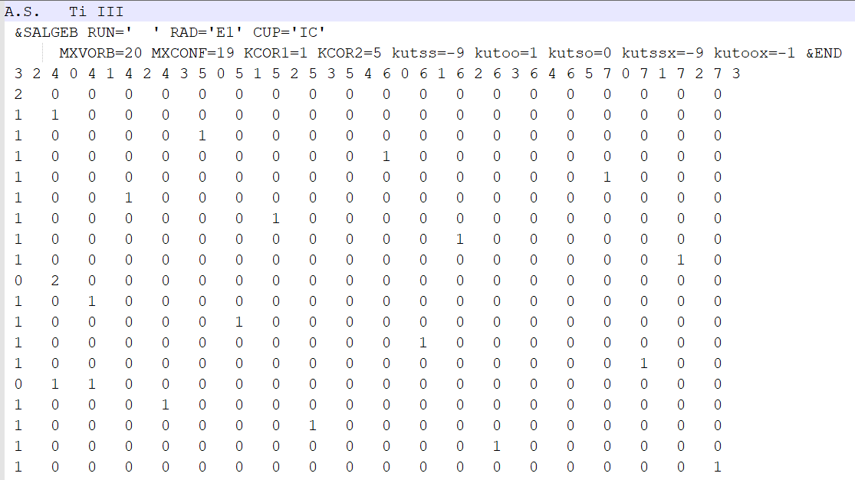
Our calculations on atomic structure of Ti III

Slide 11
Our calculations on atomic structure of Ti III

Slide 12
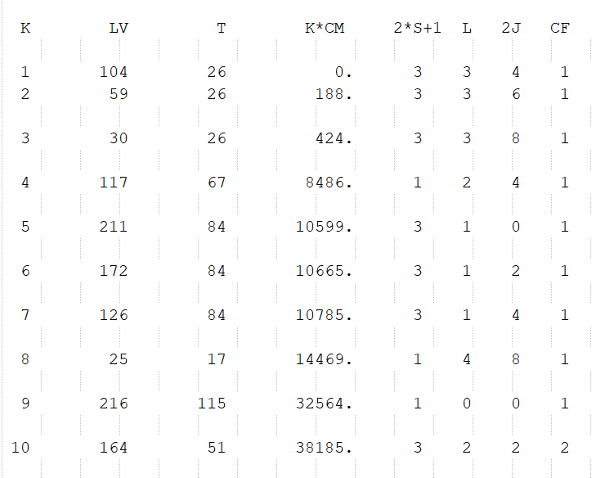
Our calculations on atomic structure of Ti III

Slide 13
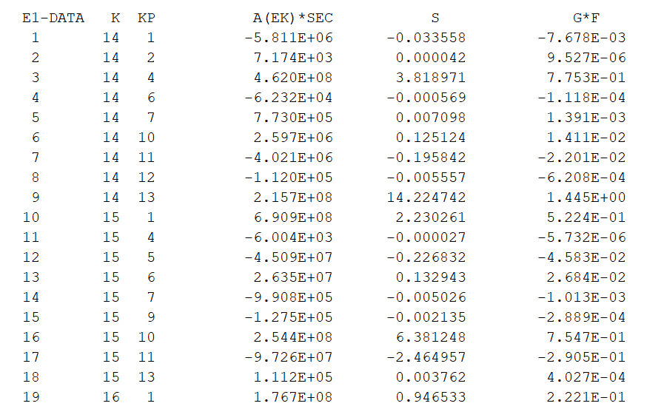
Our calculations on atomic structure of Ti III

Slide 14
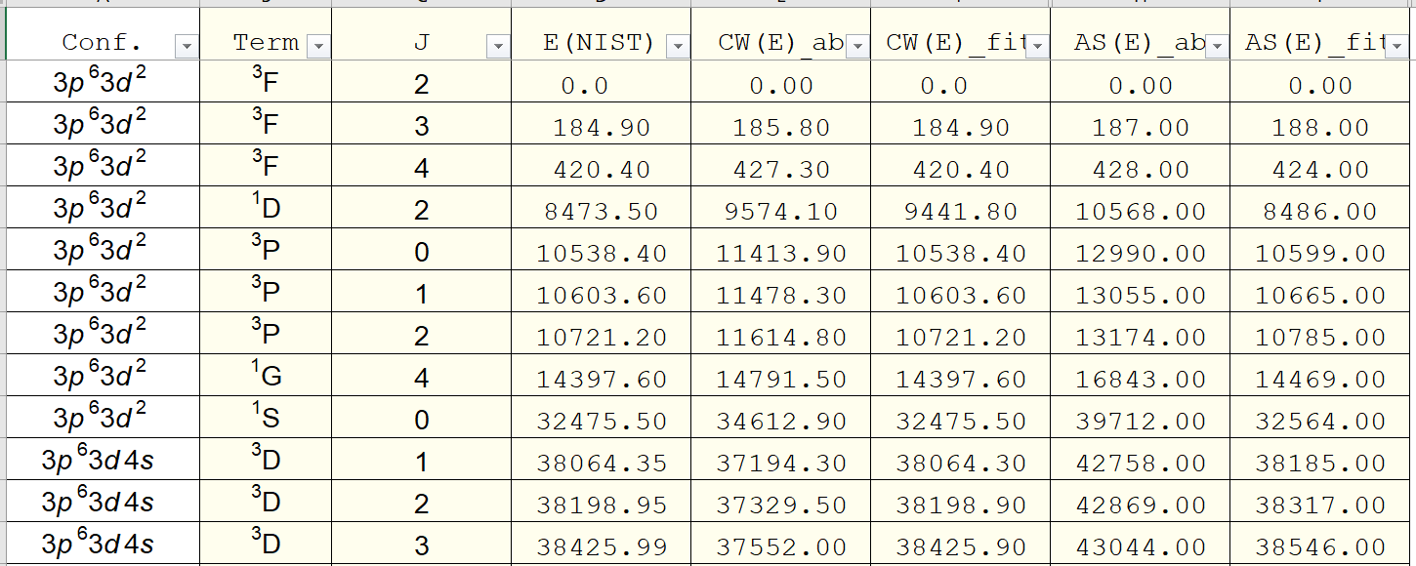
Our calculations on atomic structure of Ti III

Slide 15
Thank you for your attention

