Slide 1
Deducing stellar parameters from modeled spectra
Darko Jevremović
Astronomical Observatory Belgrade
Palić, December 8 2021

Slide 2
Together with
Dušan Nikezić
Veljko Vujčić
Miodrag Malović
Dušan Topalović
And few more

Slide 3
OUTLINE
Phoenix
Modeled spectra
Statistical methods
Future work

Slide 4
Phoenix
Started in late ‘80s early ‘90s Heidelberg
Haushchildt and Allard (RT and EOS)
Baron joined in ‘93
General stellar atmosphere code
Most of physics included
Heavily involved late ‘90 early to end 2000’s

Slide 5
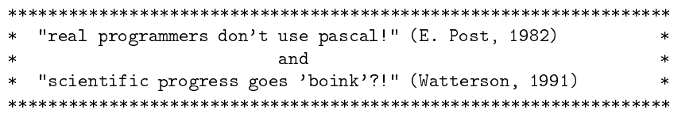
Phoenix

Slide 6
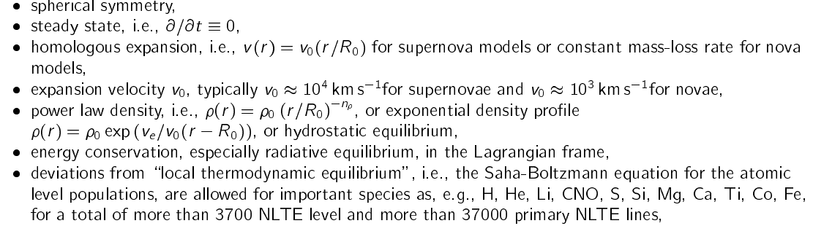
Phoenix physics

Slide 7
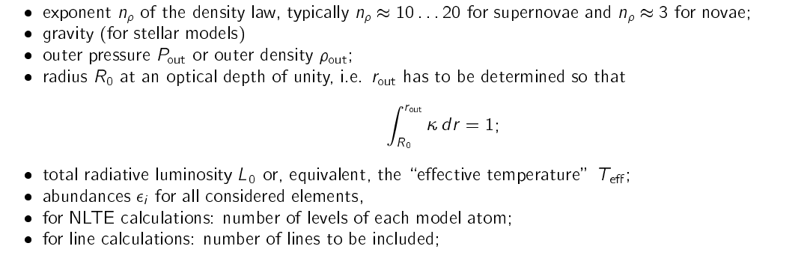
Phoenix most important model parameters

Slide 8
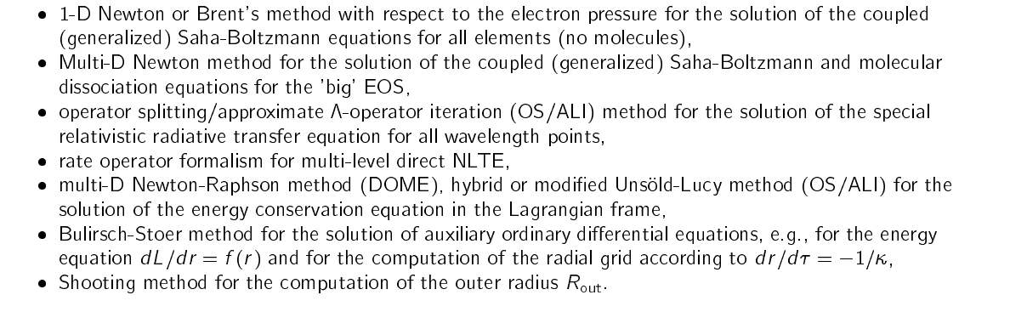
Phoenix numerical methods

Slide 9
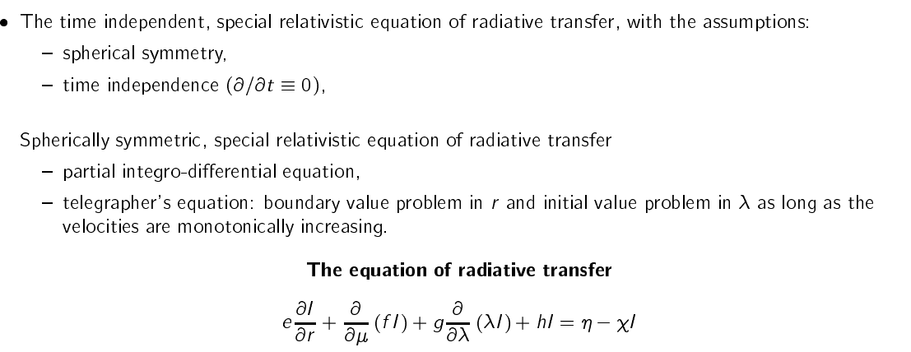
Phoenix numerical methods

Slide 10
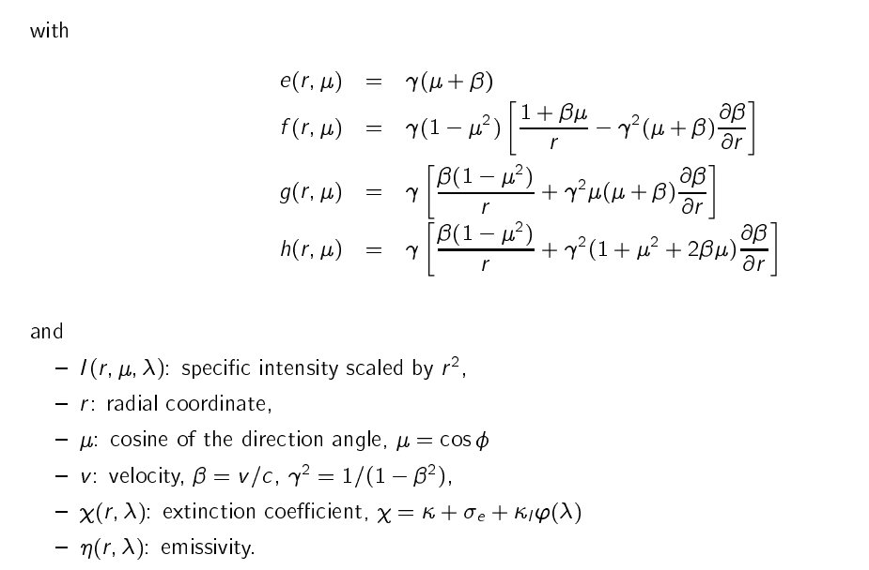
Phoenix numerical methods

Slide 11
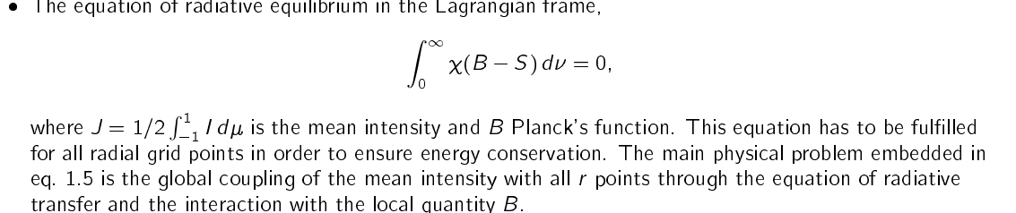
Phoenix model equations

Slide 12
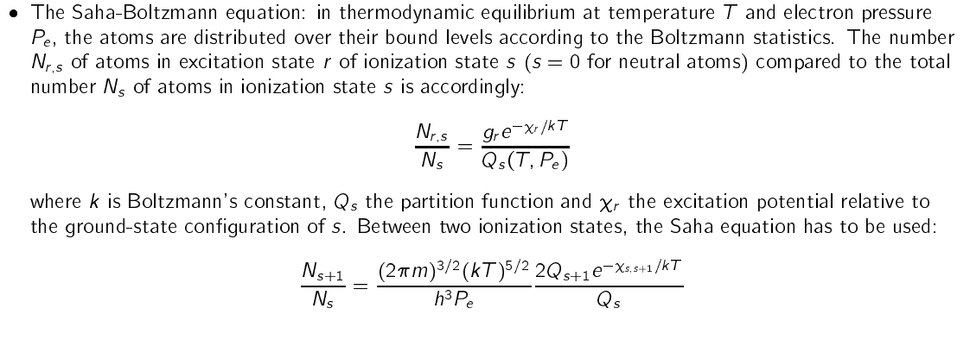
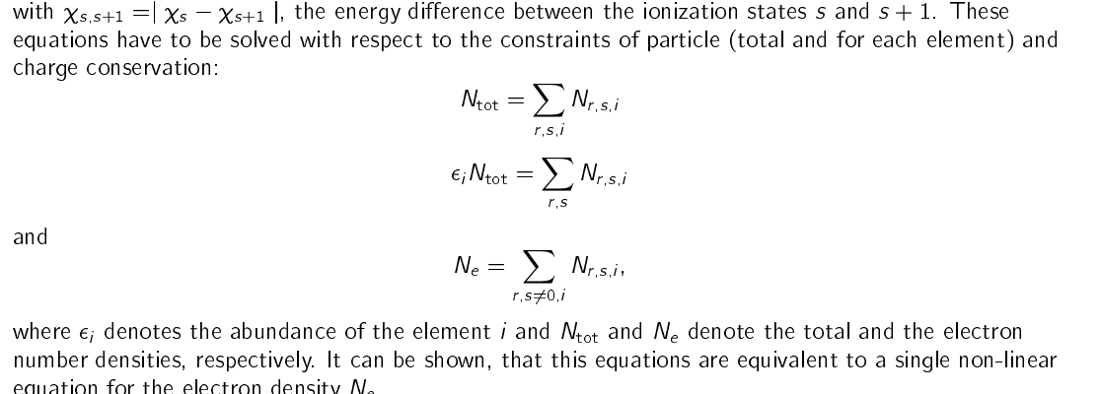
Phoenix model equations

Slide 13
Phoenix models
Dotter et al. 2008
Grid of models built for stellar evolution
Earlier models i.e. NextGen
Boundary conditions for DSEC
Obtained color indexes and used for detemination of age of stellar clusters

Slide 14
Phoenix models
Several thousands models
Test of integrity and capacity of OU cluster
Wide range of parameters
No detailed analysis of generated spectra

Slide 15
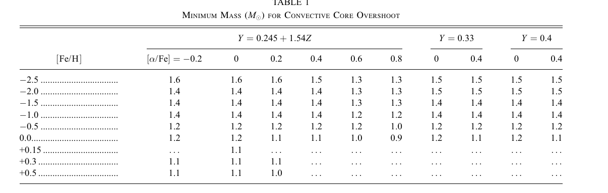
Phoenix models

Slide 16
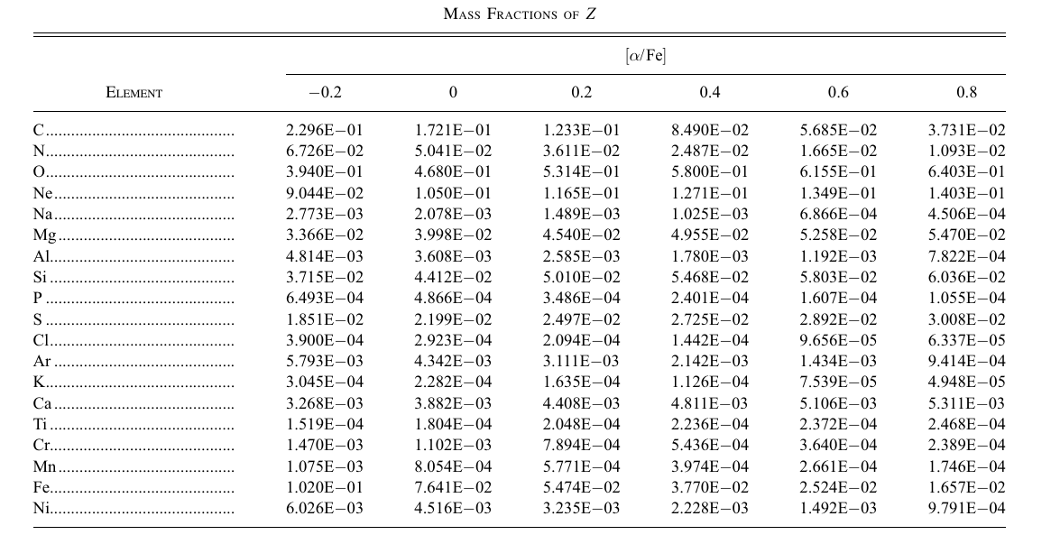
Phoenix models

Slide 17
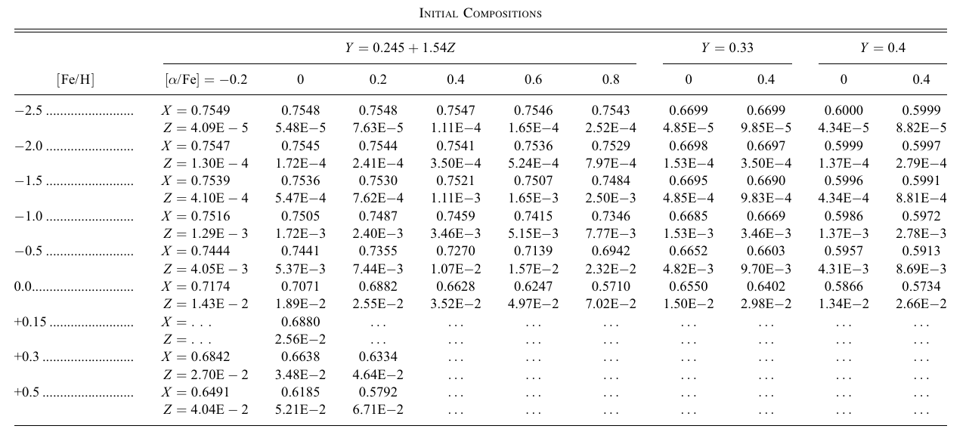
Phoenix models

Slide 18
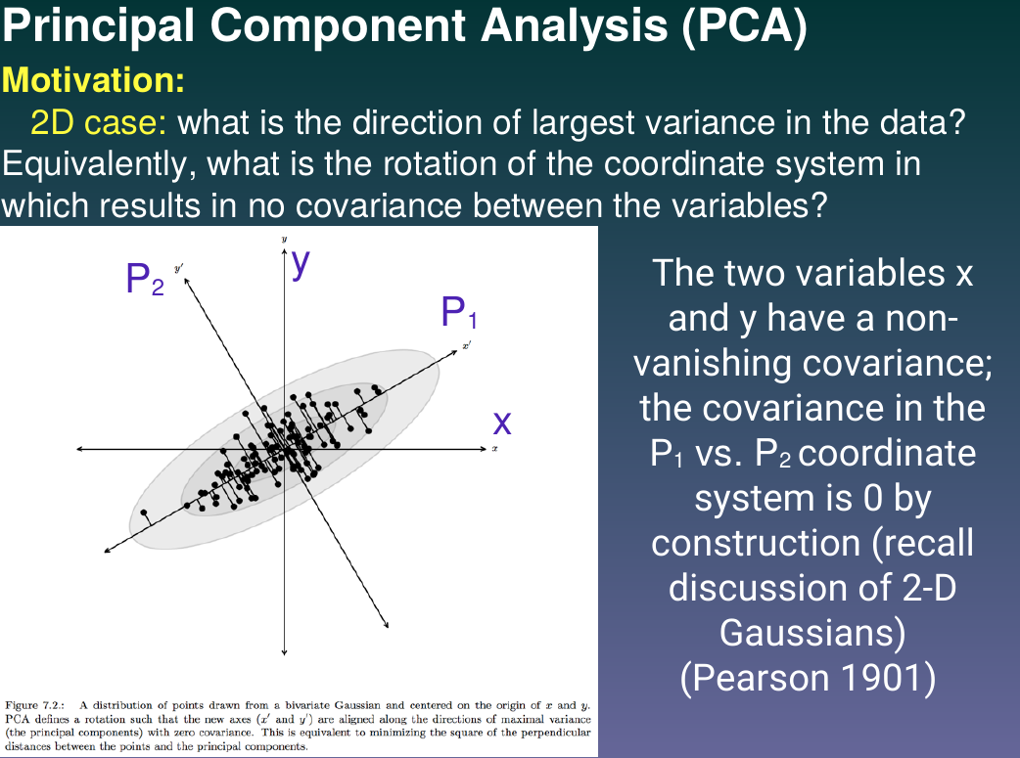
PCA

Slide 19
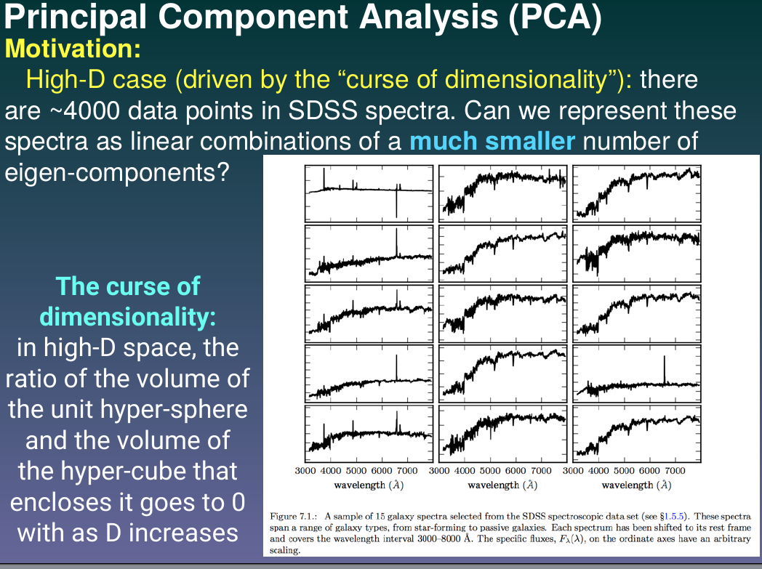
PCA

Slide 20
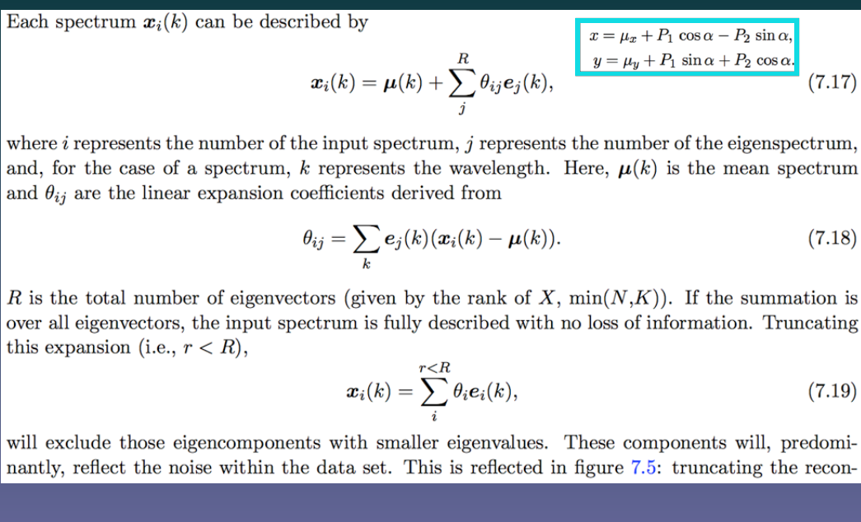
PCA

Slide 21
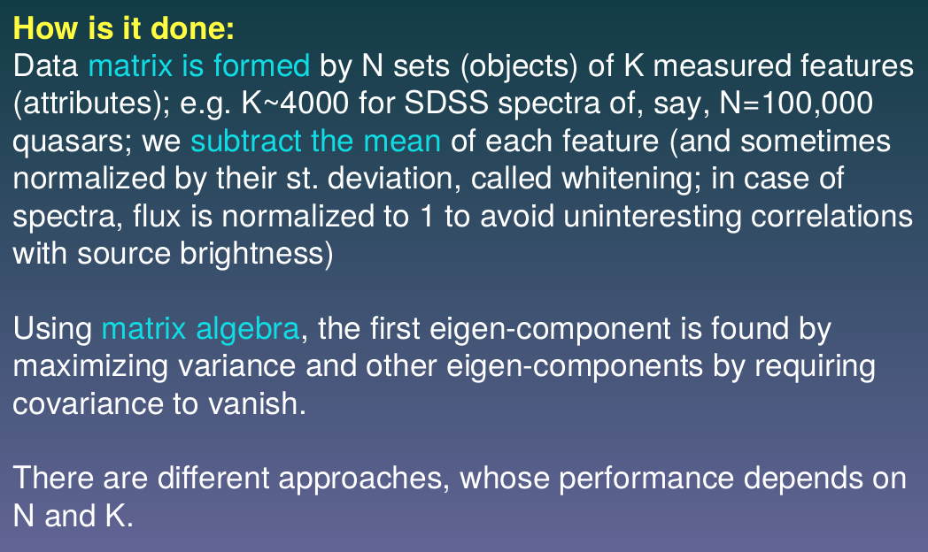
PCA

Slide 22
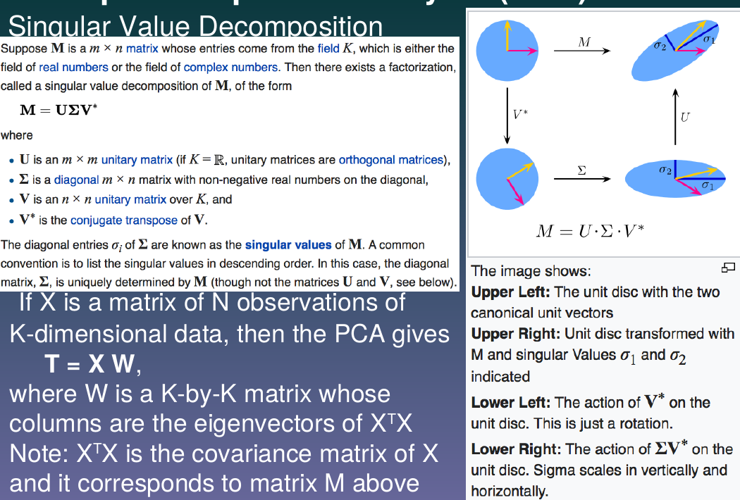
PCA

Slide 23
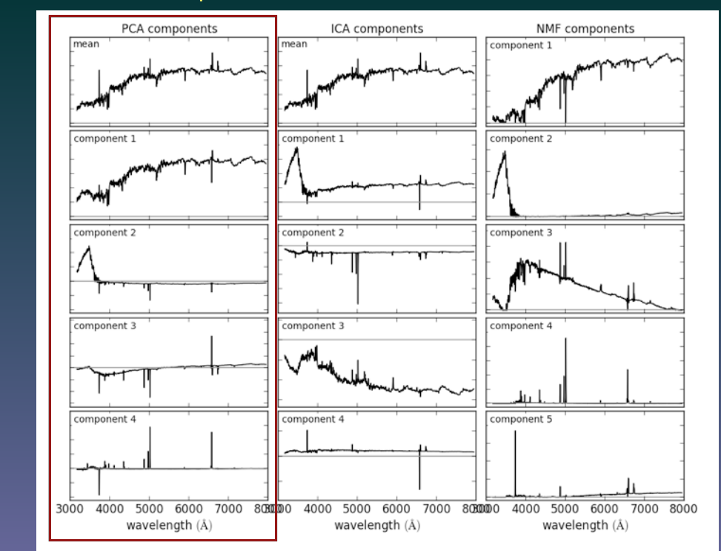
PCA

Slide 24
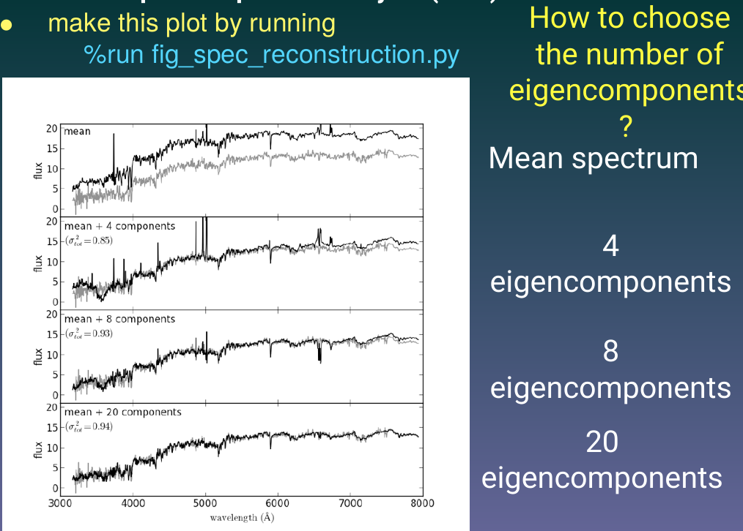
PCA

Slide 25
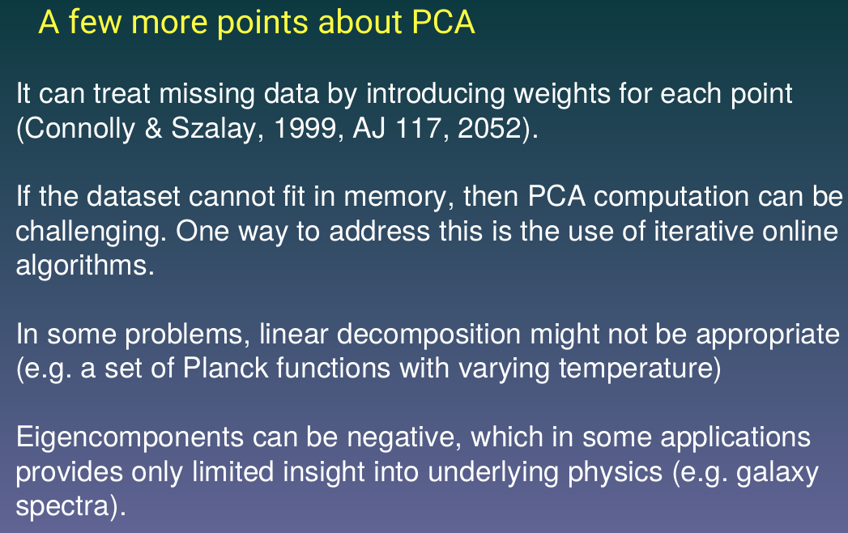
PCA

Slide 26
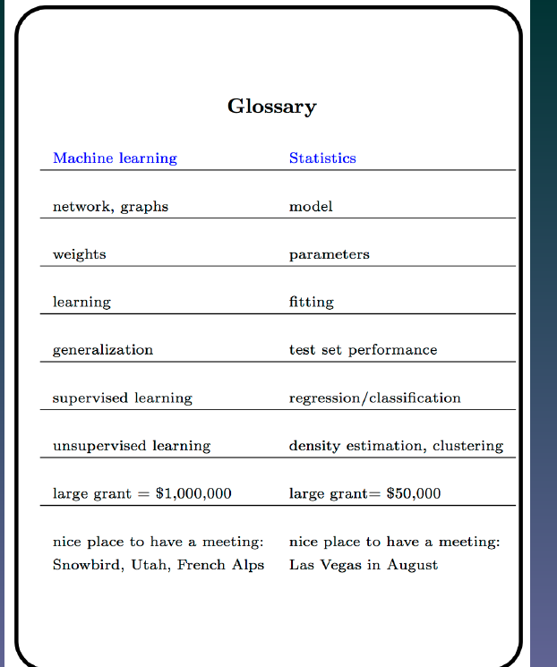
PCA

Slide 27
Future (now) work
Apply PCA, LLE to calculated spectra
Try to identify significant components in decomposition ofcalculated spectra and correlate them to physical parameters
Deduct physical parameters (known)
Apply our system of classification to observed spectra from different sources

Slide 28
PCA

Slide 29
Few words of caution
I am not an expert on writing proposals nor on EU funding
Nic Walton and I are preparing EU funding session at LSST@Europe2 in June… - fliers around
It takes lot of effort to write good proposal
success rate relatively small
There are some agencies who professionally write proposals
There are some Universities who have their offices in Brussels doing anything you need for the success of proposals (from lobbying, finding you the calls to writing proposals
I do not cover regional programs...

Slide 31
H2020
80 B Euro EU Commission flagship program for Research and innovation
MSCA
  ITN
  RISE
  COFUND
LEIT
  SPACE
  ICT
FET
INFRASTRUCTURE
Mainly 2017 calls but LOOK AHEAD toward 2018-2020

Slide 32
MSCA
Maria Sklodowska-Curie Actions
  ITN – Innovative Training Network
    10 Jan 2017 budget 430M
  IF – not for us
  RISE – Research and Innovation Staff Exchange
    05 April 2017 80M
  COFUND of regional national and international programmes
    28 Sep 2017 80M

Slide 33
MSCA ITN
10 Jan 2017 budget 430M
Objective: The Innovative Training Networks (ITN) aim to train a new generation of creative, entrepreneurial and innovative early-stage researchers, able to face current and future challenges and to convert knowledge and ideas into products and services for economic and social benefit
ITN will raise excellence and structure research and doctoral training, extending the traditional academic research training setting, incorporating the elements of Open Science and equipping researchers with the right combination of research-related and transferable competences. It will provide enhanced career perspectives in both the academic and non-academic sectors through international, interdisciplinary and intersectoral mobility combined with an innovation-oriented mind-set.

Slide 34
MSCA ITN
Three types of training networks
  European Training Network (my favorite) 370M
  European Industrial Doctorates 28M
  European Joint Doctorates 32M
Easily connected to BSE
We have something to offer!!!

Slide 35
MSCA ITN
Main Impact - research level
  Increased set of skills, both research-related and transferable ones, leading to improved employability and career prospects both in and outside academia (leading in the longer-term to more successful careers)
  Increase, in the longer-term, in higher impact R&I output, more knowledge and ideas converted into products and services
  Greater contribution, in the longer term, to the knowledge-based economy and society
Main Impact - organization level
  Enhanced cooperation and better transfer of knowledge between sectors and disciplines
  Improvement in the quality of training programmes
  Creation of new networks and enhanced quality of existing ones
  Boosting R&I capacity among participating organisations
  Increased internationalization of participating organisations

Slide 36
MSCA ITN
Main Impact – system level
  Increase in international, interdisciplinary and intersectoral mobility of researchers in Europe
  More structured and innovative doctoral training, enhanced implementation of the European Charter and Code and the EU Principles for Innovative Doctoral Training
  Stronger links between the European Research Area (ERA) and the European Higher Education Area (EHEA), notably through supporting the knowledge triangle between research, innovation and education
  Improvement in the working and employment conditions for doctoral candidates in Europe
  Increased societal and economic relevance of European higher education
  Strengthening Europe's human capital base in R&I with a new generation of more entrepreneurial and highly-skilled early career researchers
  Increase in Europe's attractiveness as a leading research destination, accompanied by a rise in the numbers of talented researchers retained and attracted from abroad
  Better quality research and innovation contributing to Europe's competitiveness and growth

Slide 37
MSCA RISE
RISE – Research and Innovation Staff Exchange
05 April2017 80M
Objective: The RISE scheme will promote international and inter-sector collaboration through research and innovation staff exchanges, and sharing of knowledge and ideas from research to market (and vice-versa).
The scheme fosters a shared culture of research and innovation that welcomes and rewards creativity and entrepreneurship and helps to turn creative ideas into innovative products, services or processes.
Scope: RISE involves organisations from the academic and non-academic sectors (in particular SMEs), based in Europe (EU Member States and Associated Countries) and outside Europe (third countries).
Support is provided for the development of partnerships in the form of a joint research and innovation project. This is aimed at knowledge sharing via international as well as intersectoral mobility, based on secondments of research and innovation staff (exchanges) with an in-built return mechanism.

Slide 38
MSCA COFUND
COFUND – Co-funding of regional, national and international programmes
  05 April2017 80M
  Objective: The COFUND scheme aims to stimulate regional, national or international programmes to foster excellence in researchers' training, mobility and career development, spreading the best practices of Marie Skłodowska-Curie actions. This will be achieved by co-funding new or existing regional, national, and international programmes to open up to, and provide for, international, intersectoral and interdisciplinary research training, as well as transnational and cross-sectoral mobility of researchers at all stages of their career.
  Scope: Each proposal funded under the COFUND scheme shall have a sole beneficiary that will be responsible for the availability of the necessary matching funds to execute the proposal.

Slide 39
MSCA COFUND
COFUND – two schemes
  Doctoral programs 30M
  Fellowship programs 50M

Slide 40
LEIT
Leadership in enabling and industrial technologies
Key Enabling Technologies (KETS)
  micro-and nano-electronics, nanotechnologies, advanced materials, advanced manufacturing and processing, biotechnology and photonics, enabling innovation in all key industrial sectors. Advanced manufacturing in particular is considered as a cross-cutting issue, underpinning innovation.
ICT
Space

Slide 41
LEIT-ICT
WP 130+ pages of calls
ICT 39 calls
Big Data Public Private Partnerships - ICT-14-2016-2017 – ICT-18-2016-2017
Ground-breaking Horizon Prize on Big Data technologies 2017

Slide 42
LEIT-ICT
ICT-14-2016-2017: Big Data PPP: cross-sectorial and cross-lingual data integration and Experimentation
ICT-15-2016-2017: Big Data PPP: Large Scale Pilot actions in sectors best benefitting from data-driven innovation
ICT-16-2017: Big data PPP: research addressing main technology challenges of the data Economy
ICT-17-2016-2017: Big data PPP: Support, industrial skills, benchmarking and evaluation
ICT-18-2016: Big data PPP: privacy-preserving big data technologies

Slide 43
LEIT-SPACE
Earth Observations EO
Competitivnes of European Space Sector: Technology and Science
Application in Satellite Navigation – Galileo-2017
Many other actions (TOC)

Slide 44
LEIT-SPACE
EO-2-2017 EO Big Data Shift March 1 2017 – 7.5M ESA will not participate!
Two main strands of activities are expected to be addressed: (i) the evolution of the Copernicus data infrastructure; and (ii) the adaptation of big data technologies to Copernicus user scenarios (i.e. data discovery and analytics to store and extract informati
on).Proposals should take into account needs emerging from ongoing linked actions within Copernicus including the dissemination platform; access to data and the Collaborative Ground Segment. To that end an information document will be made available as part of the general
call package.

Slide 45
LEIT-SPACE
EO-2-2017 EO Big Data Shift
Expected Impact:
Make access to the Copernicus data and information easy and user friendly through scalable dissemination and exploitation platforms based on international standards;
Foster the establishment of interoperable access facilities to all EU Member States; Link the Copernicus interoperable data with the EU Open Data Portal, as appropriate Implement sustainable industrial solutions to meet the Big Data challenges;
Provide user community tools within the dissemination platforms including bestpractices;
Ensure resilience of the overall dissemination and exploitation system.
Optimise the use of Copernicus data by non-traditional user communities to meetsocietal challenges.

Slide 46
FET
Future and Emerging Technologies activities help to create in Europe a fertile ground for responsible and dynamic multi-disciplinary collaborations on future and emerging technologies and for kick-starting new European research and innovation eco-systems around them. These will be the seeds for future industrial leadership and for tackling society's grand challenges in new ways.
FET focuses on research beyond what is known, accepted or widely adopted and supports novel and visionary thinking to open promising paths towards radically new technological possibilities. In particular, FET funds interdisciplinary collaborations that seek genuine cross-fertilisation and deep synergies between the broadest range of advanced sciences (including the life sciences, social sciences and humanities) and cutting-edge engineering disciplines.

Slide 47
FET
FET has three main lines of activity:
FET Open supports the early-stages of the science and technology research and innovation around new ideas towards radically new future technologies. It also funds coordination and support activities for such high-risk forward looking research to prosper in Europe.
FET Proactive addresses promising directions for research on future technologies in order to build up a European critical mass of knowledge and excellence around them.
FET Flagships are science-driven, large-scale, multidisciplinary research initiatives oriented towards a unifying goal, aiming at transformational impacts with substantial benefits for European competitiveness and for society.

Slide 48
FET
FETHPC three calls:
FETHPC-01-2016: Co-design of HPC systems and applications 27 Sep 2016 41M
FETHPC-02-2017: Transition to Exascale Computing 26 Sep 2017 40M
FETHPC-03-2017: Exascale HPC ecosystem development 26 Sep 2017 4M (CSA)

Slide 49
FET
FETHPC-02-2017: Transition to Exascale Computing
  High productivity programming environments for exascale
  Exascale system software and management
  Exascale I/O and storage in the presence of multiple tiers of data storage
  Supercomputing for Extreme Data and emerging HPC use modes
  Mathematics and algorithms for extreme scale HPC systems and applications working with extreme data

Slide 50
INFRASTRUCTURES
Including e-infrastructures
EINFRA21-2016 20Sep 26M Research and Innovation Actions for e-Infrastructure prototypes:
  Universal discoverability of data objects and provenance
  Computing e-infrastructure with extreme large datasets

Slide 51
Look ahead
Timeline for space (similar to others)
Position papers due on April 22!!!
2016
  Stakeholder consultation/Advisory groups (Q1/Q2)
  Consultation of Member States (Q2/Q3)
  Strategic Programming Document (Q3)
  Start of drafting of WPs (Q4)
2017
  Consultation PC configurations on WPs drafts (Q1-Q3)
  Adoption of the WP 2018-20 (Q4) (should incorporate the results of the Horizon 2020 Interim evaluation)
2018
  Adoption of financing decision for 2019 (Q2)
2019
  Adoption of financing decision for 2020 (Q2)

Slide 52
Conclusion
There is plenty of funding opportunities
We should concentrate on few we feel the best (strongest) about
Hope this summary helps!

