Slide 1
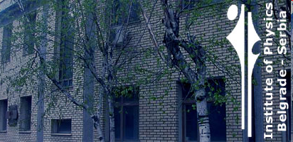
VLF DATA ACQUISITION AND CENTRAL DATABASE STORING
VLADIMIR A. SREĆKOVIĆ¹, D. ŠULIĆ², A. NINA¹,
A. A. MIHAJLOV¹, and LJ. M. IGNJATOVIĆ¹
¹Institute of Physics, P.O.Box 57, Pregrevica 118, Belgrade, Serbia
² Faculty of Ecology and Environmental Protection, Belgrade

Slide 2
Outline
The collaborators
(In this short talk I will present the work of VLF Belgrade group and present our members together
with all collaborators .)
The ionosphere and VLF waves
(Short introduction about ionosphere and VLF waves. Above all , talk about D region of the ionosphere
and VLF waves.)
The AWESOME receivers
(Present the characteristics of AWESOME receivers, network and present our part in it.)
The AWESOME CENTRAL DATABASE
(Few words about the AWESOME central database (Stanford database). Present status and perspectives
of collaboration.) (Atmospheric Weather Electromagnetic System for Observation Modeling and Education)
Scientific applications of VLF
(At the end, I will talk about Scientific applications of VLF and its importance. Here above all we have
in mind detection of the stellar events: the solar flares, CME, GRB, and analysis of the ionosphere response,
and modeling .)

Slide 3
The collaborators:
Belgrade VLF group:
(Belgrade VLF group started working by installing the first station (AbsPAl) in 2003 at the Institute of physics. We have many members from different institutions.)
D. Šulić, Faculty of Ecology and Environmental Protection
A. A. Mihajlov, V.A. Srećković, A. Nina and LJ. M. Ignjatović
Institute of Physics, P.O.Box 57, Pregrevica 118, Belgrade, Serbia
A.Kolarski, Institute for Geophysics, Batajnički drum 8, 11000 Belgrade, Serbia
- V. Čadež, Astronomical Observatory, Volgina 7, 11060 Belgrade, Serbia
D. Grubor, University of Belgrade, Faculty of Mining and Geology, Physics Cathedra, Belgrade,
-----------------------------------------------
V. Žigman, University of Nova Gorica, Vipavska 13, SI-5000 Nova Gorica, Slovenia ,
and manu collaborators (and colleagues) all over world:, colleagues from Stanford, India, Brazil, Tunis.
- We take part in the activities within COST ES0803 action
- We are members of a Stanford/AWESOME Collaboration for Global VLF Research, sponsored by NASA
- We are members of the Joint Bilateral project: BISLOSR/10–11–038.
- We are members of the projects III 44002, 176002 and 176004.

Slide 4
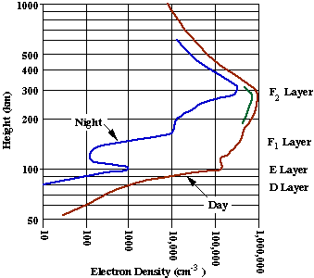
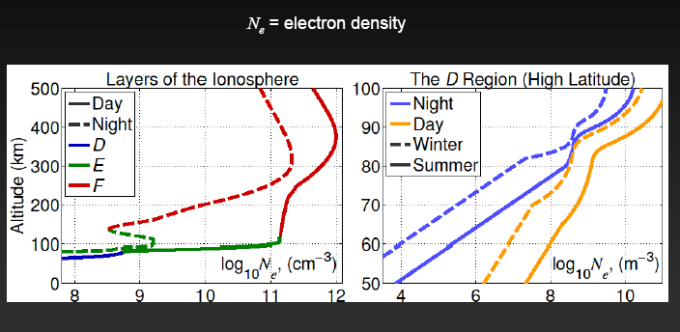
The Ionosphere and VLF waves
- Characteristics of the ionosphere and their changes are very
important for life and human activity on the Earth. There are
numerous studies about influences of ionospheric disturbances
on operation of powerful energetic systems, navigation and remote
radio communication systems, the atmospheric weather, the human
health and the state of the entire biosphere.
- Methods of investigation of the ionospheric vertical structure
are diverse and depend on the applied measuring techniques.

Slide 5
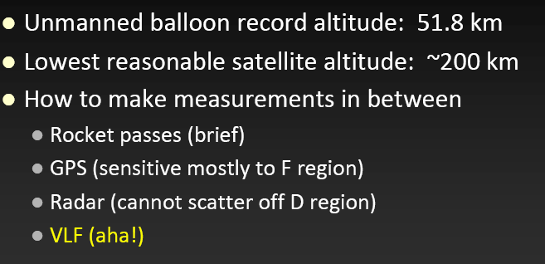
Studying the Ionosphere, techniques, D region
There are few traditional techniques for studying the Ionosphere
We are interested in the investigations of the D region.

Slide 6
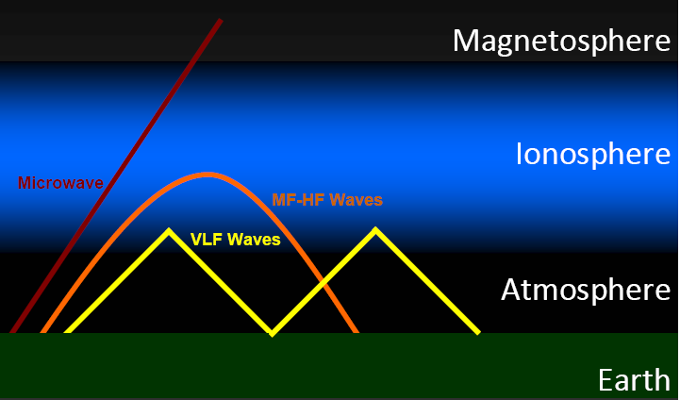
- on this slide you can see how the different waves behave as they pass through the ionosphere.
- VLF 3 kHz to 30 kHz , wavelengths from 10 to 100 kilometres
- MF 300 kHz to 3 MHz
HF 3 MHz to 30 MHz
Microwave 300 MHz (0.3 GHz) and 300 GHz
Good thing about it is that VLF waves reflects on the D region and give us information about that ionosphere layer.
By analyzing the amplitude and phase time variations of very low frequency (VLF) radio waves emitted by many transmitters and recorded by the receivers in real time we can map that layer.

Slide 7
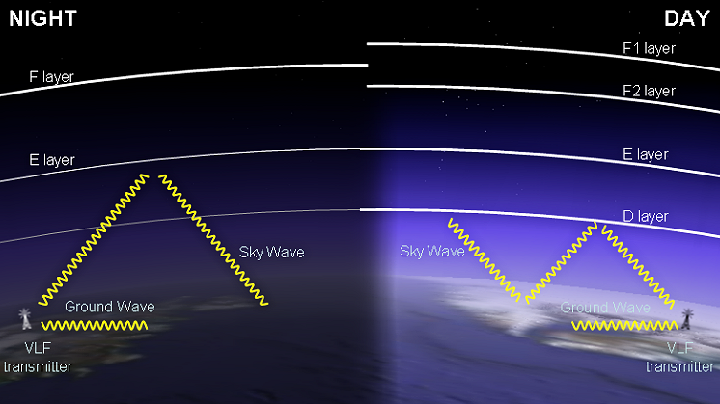
On this slide you can see how the VLF waves behave at night and day. D region almost disappears
at night (due to the deficiency of ionization). Later I will discuss about signal i.e. amplitude and phase behavior
at night and day.

Slide 8

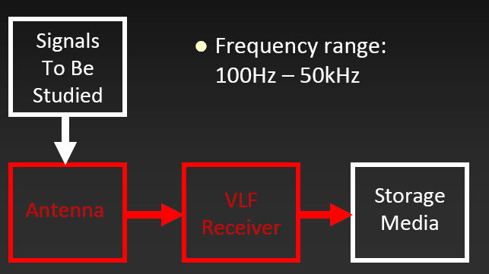
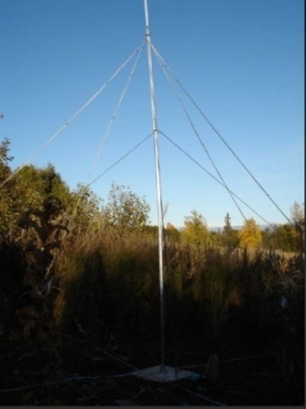
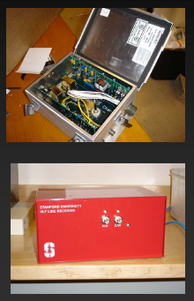
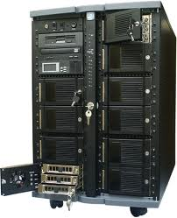
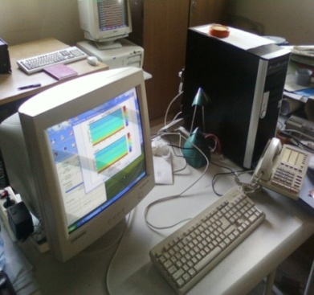
+
- Monitor (or VLF receiver) consists of a VLF antenna (small, medium or large: from few meters to
several tens of meters) , preamplifier box, and a line receiver box. This equipment is connected to
PC and Storage media. VLF data can be recorded locally and transmit to a central database.

Slide 9
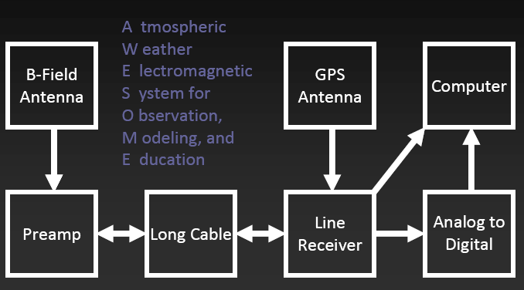
This is a detailed scheme

Slide 10

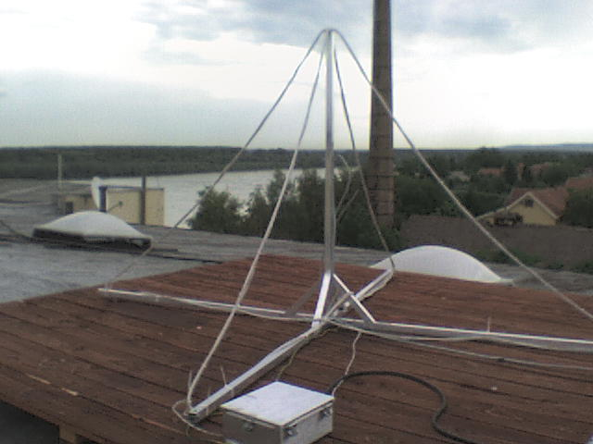
Belgrade
talk about data from AWESOME receiver because we are part of networks and databases, and
we share data.
Medium large. This receiver is install 2008 at the Institute of physics and we are part of the
Stanford network. We have Abspal antenna receiver too but not in the network.
  Daytime: monitor solar activity
  Nighttime: GRB, monitor atmospheric phenomena (e.g. lightning)

Slide 11

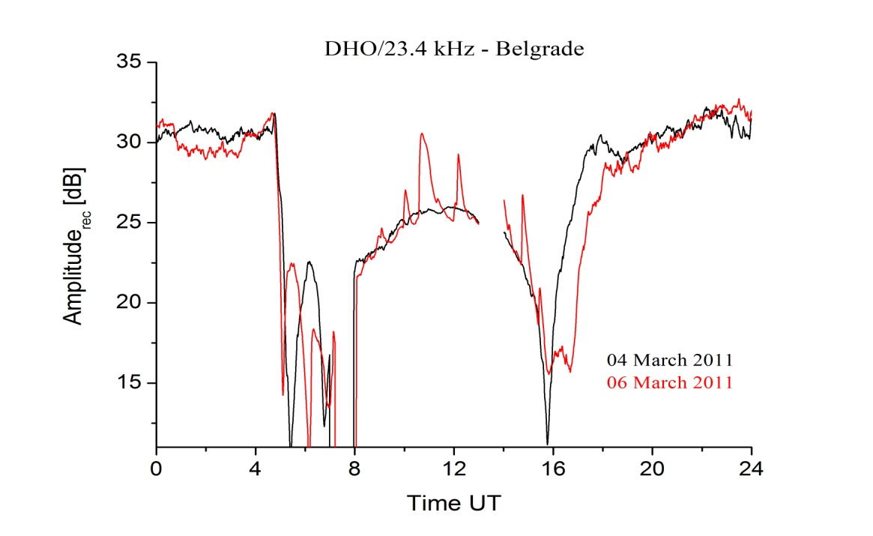
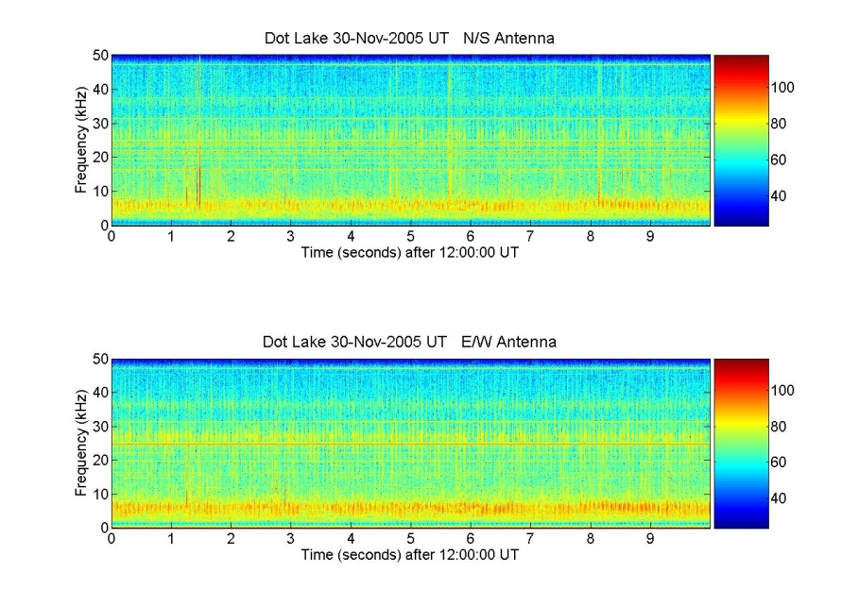
Data
- There are two types of
recordings made by
AWESOME
2 Narrowband
Several Gbyte of data in one day (1 GB 1 h) (depends low-res or hi-res).
The second type of data is called narrowband. This simply involves taking the amplitude and phase, separately, of a single narrow frequency range, specified in the software, and usually corresponding to the frequency of a VLF transmitter. Such data is generally saved in two different resolutions, hi-res (50 Hz), and low-res (1 Hz). Narrowband data takes up a much smaller amount of room, ~1GB per hour, per transmitter. Low-res can be use for some kind of observations (for phenomena that take longer )and high res are better for other.
1. Broadband
Several Gbyte in one hour.
Broadband saves the waveform
received from antenna exactly as it was digitized, at the full 100 kHz sampling rate. It thus includes information at all
frequencies between the systems cutoffs (300 Hz – 47 kHz). Broadband data is very large, however, taking up 10 GB per hour.
spectrogram

Slide 12

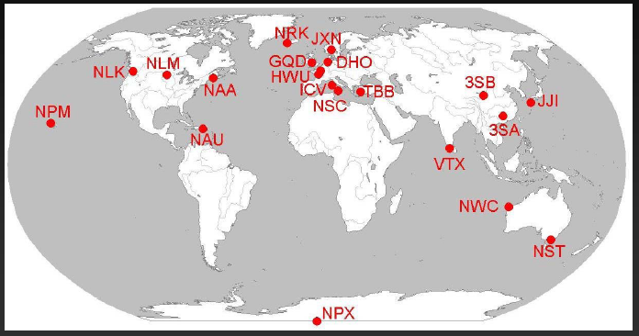
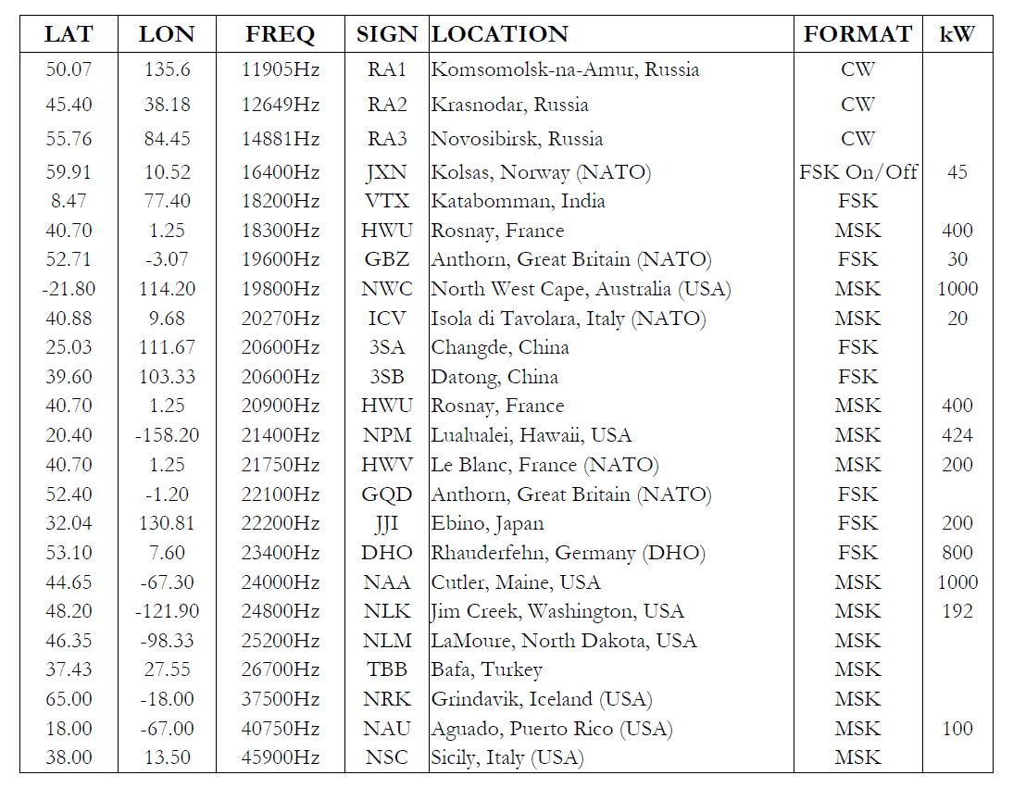
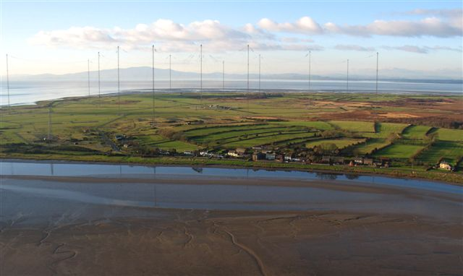
- Transmitters are all over the world (~there are approx. 20 Transm. stations ). Every transmitters transmit at fix frequency. For example Anthorn with code name GQD transmit at 19.6 kHz.

Slide 13

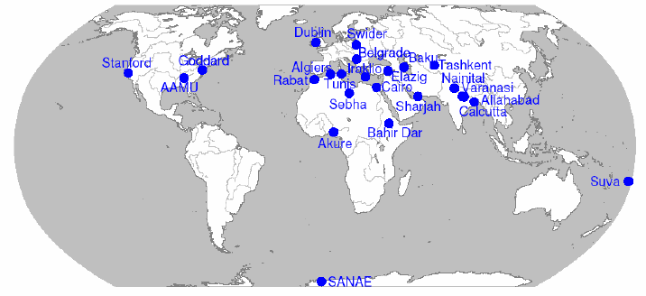
Network
AWESOME receiver all over the world.
Since 2008, Belgrade station is included in the international program AWESOME
(Atmospheric Weather Electromagnetic System for Observation Modeling and Education)
in cooperation with Space Telecommunication and Radioscience Laboratory,
Stanford University, Stanford, California 94305, http:/www-star.stanford.edu/~vlf/.

Slide 14

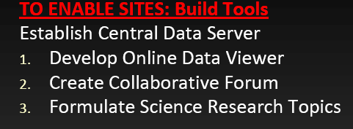
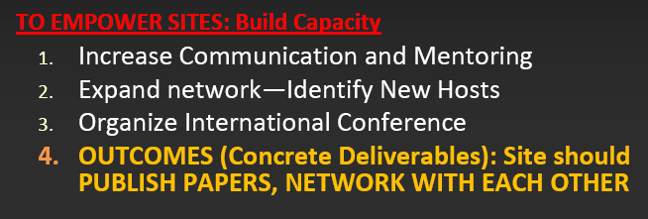
Member of AWESOME network, advantages
Member of AWESOME network, and its advantages .
We can store our data, use data from other AWESOME receivers (in some situations are crucial to
know data from different direction or site for analizing some phenomena.)
We can attend workshops and conferences (Tunis, Dubai, India…) and extend collaborations .

Slide 15
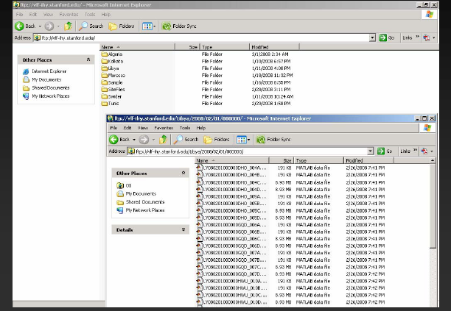
Central Data Server
- In Stanford: Central Data Server
- We transmit data via net in real time to central server.
Problems: limited flow of data through the net. A solution to get and install our local
data server and to communicate with central server

Slide 16

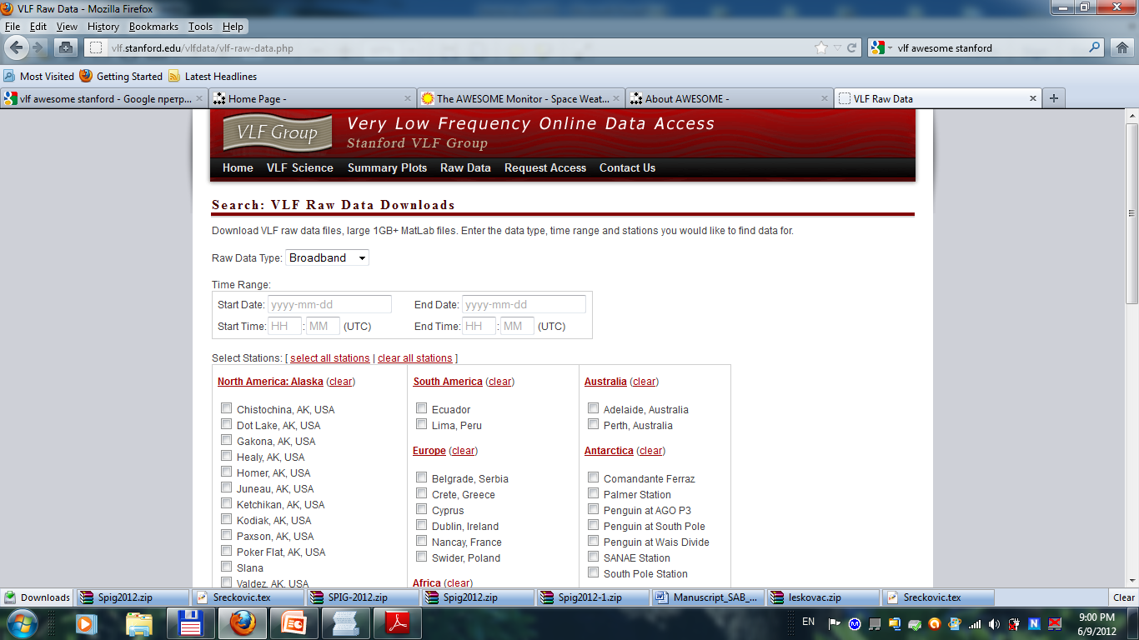
graphic query,
- You can download data to use later.
- Online data query on the address www.stanford.edu/
- Online query: Fill with needed data: transmitter stations, receiver, year, month, hour, etc.
- You can see Belgrade receiver station.

Slide 17

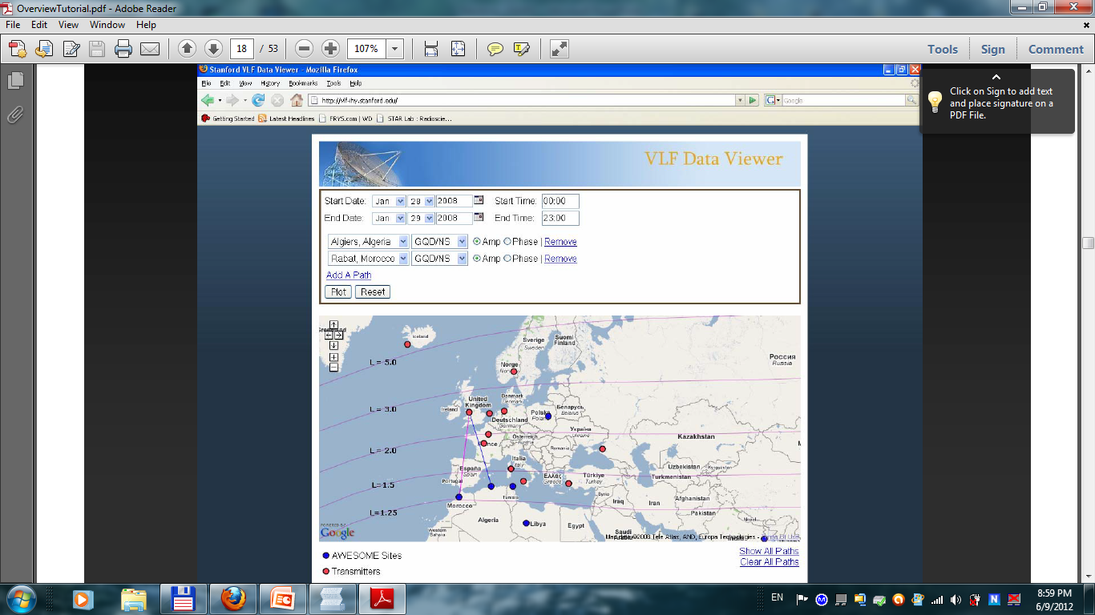
- Here , You can see snapshot of online data with aplitude and phase graphs.
- Fill with needed data: transmitter stations, receiver , year, month, hour etc.

Slide 18
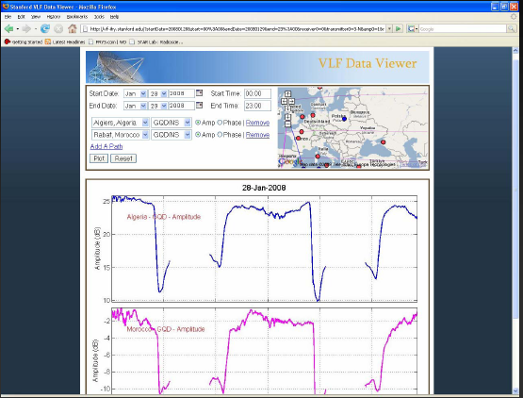
Here You can see snapshot of online data viewer.
You can choose VLF amplitude (phase) , Algire receiver station, transmitter is
GQD (19.6kHz). from jan. 28 2008-jan 29 2008.

Slide 19
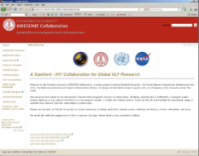




Stanford Tutorials and forum for data usage
- In our community we have:
- Every year different member (diff. country) is organizing workshop with Stanford group
(Tunis, Dubai, India).
- Teach how to use the online data queries. We attend International workshops (with data
exercises and scientific program).
- Talk about modernization of the system.

Slide 20

- Scientific application of VLF is that we can monotonously monitor various kind of stellar and terrestrial perturbations (detection) and analyze the ionosphere respond to it so that we can model it. Here is the example of the quiet day and below is example of active day (with lot of perturbations). We can (AWESOME) monitor a lot of various events, Solar flares (X,M,C and even B) class. GRS-s, Solar eclipse, CME
Quiet Day
NLK 24.8 kHz
Active Day
-here is nighttime with higher signal, (because D-region almost disappear ), sunset and sunrise with sudden change form (because of formation and disappearance of D region) , daytime with lower signal (due to the D region existence ).

Slide 21


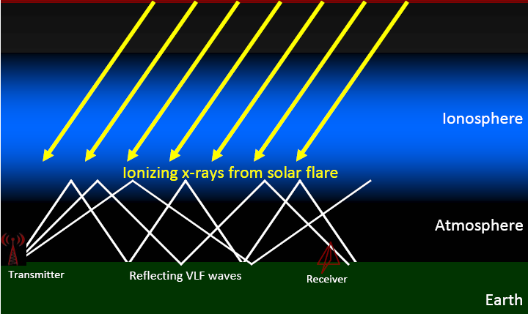
Strong solar flares penetrate to lower ionospheric region, cause transient changes
- study the influence of solar flares on electron concentration in the terrestrial ionospheric
D-region by analyzing the amplitude and phase time variations of very low frequency (VLF)
radio waves emitted by transmitters (all over the world) and recorded by the AWESOME receiver
in Belgrade (Serbia) in real time.
- Different magnitudes of solar flares were found to influence the VLF signal
amplitude in the Earth-ionosphere waveguide in such specific ways, that
their GOES (soft X-ray flux) class (C, M, X) can be classified from the response
of the ionosphere (Grubor et al. 2005).

Slide 22
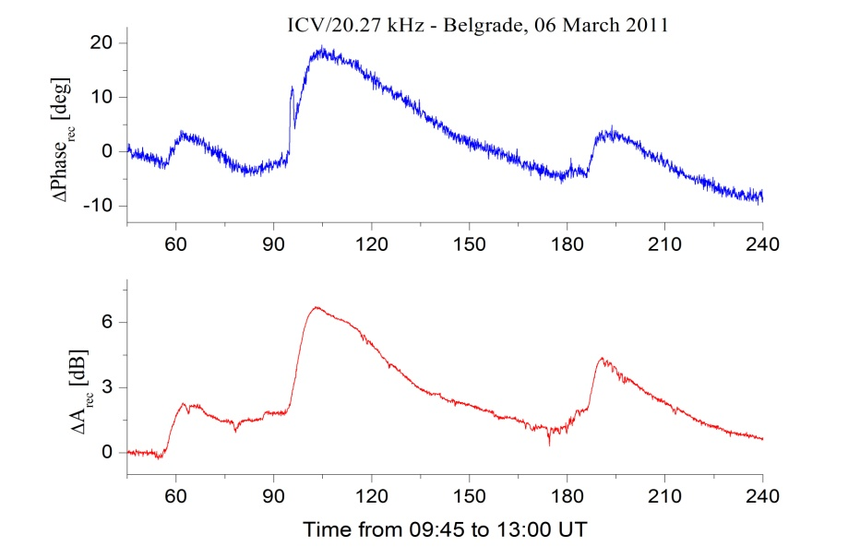
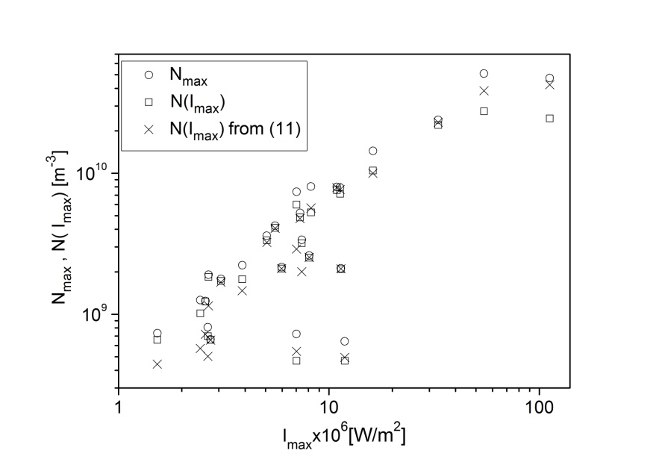
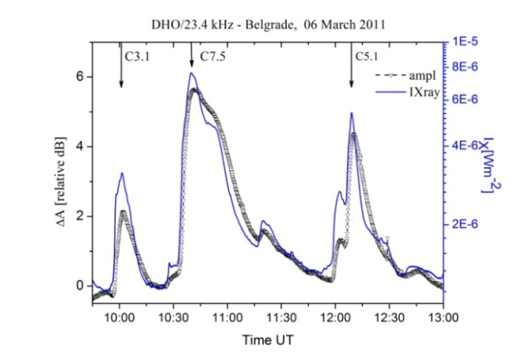
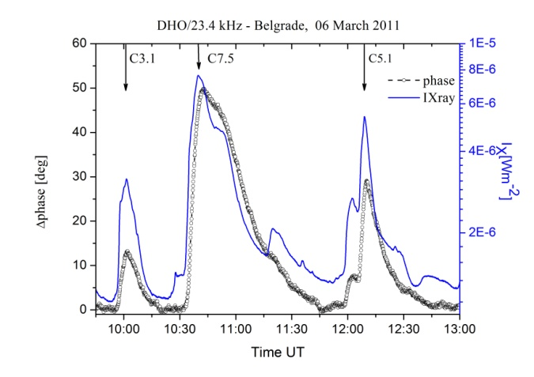
Solar flares
D-region electron density
Calculaste electron concentration in the
terrestrial ionospheric D-region by analyzing
the amplitude and phase time variations of
VLF.
X-ray Solar activity
(from spaceweather.com)
Fig.
a) Time variation of X-ray irradiance measured by GOES-15 satellite (solid lines),
and observed perturbations of DHO signal amplitude (triangles) during Solar flares: C3.1 (10:01 UT);
C7.5 (10:40 UT) and C5.1 (12:09 UT) on 06 March 2011.
b) Time variation of observed DHO signal phase delay (circles) for the same day and period from 09:45 - 13:00 UT.
Zero values correspond to amplitude and phase delay recorded in non-perturbed plasma in the D – region.
- Signals, i.e. curves are almost identical.

Slide 23
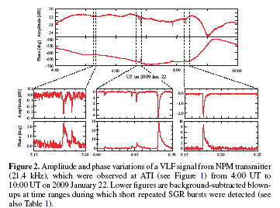
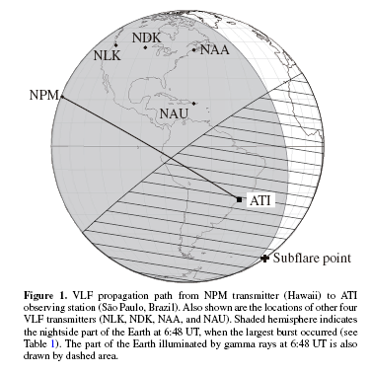
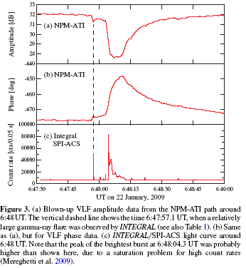
GRB
2 –Here is the example of the positive detection of ionospheric
disturbances caused by short repeated gamma-ray bursts from the
magnetar SGR J1550−5418. Very low frequency (VLF) radio wave
data obtained by Tanaka and coworkers (The ApJL, 721, L24 2010)
clearly show sudden amplitude and phase changes at the
corresponding times of eight soft gamma-ray repeater bursts.
1 - In summary, they claim that Earth’s ionosphere can be used as a
very large gamma-ray detector and the VLF observations provide us with a new method to monitor high-energy
astrophysical phenomena.

Slide 24
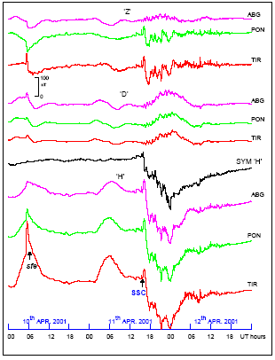
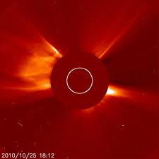
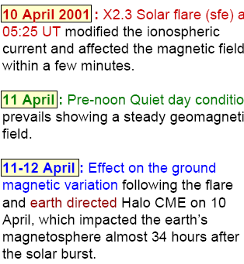
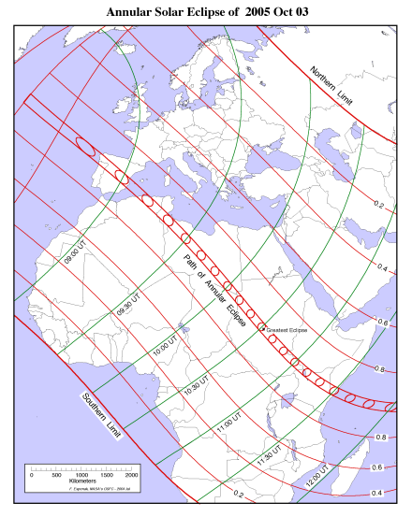
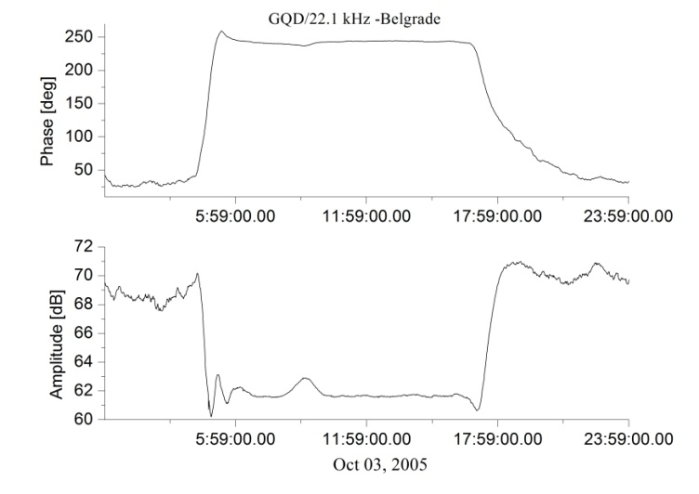
- Coronal Mass Ejection – (CMEs mass motions) are fundamental for Space Weather prediction can be detected and analized with VLF.
-Solar eclipse can be detected and analized with VLF.
Time UT | Amplitude [dB] | Phase [deg] | Reflection height [km] | β [km⁻¹] | Elec. density at reflection height
07:30 | 61.36 | 240 | 74 | 0.30 | 2.18E+08
09:09 | 62.90 | 237 | 75 | 0.31 | 1.86E+08
10:30 | 61.57 | 243 | 74 | 0.30 | 2.18E+08

Slide 25
After analyzing all these perturbations we can calculate the
electron concentration (in this layer of ionosphere) before and after these
changes and also to model ionization and recombination coefficients.
- Refs our papers.
- Nina A,Cadez Vladimir M,Sreckovic Vladimir A,Sulic Desanka M (2012)
Altitude distribution of electron concentration in ionospheric D-region in presence of
time-varying solar radiation flux, NIMB, vol. 279, br. , str. 110-113
- Nina A,Cadez Vladimir M,Sulic Desanka M,Sreckovic Vladimir A,Zigman V (2012)
Effective electron recombination coefficient in ionospheric D-region during the relaxation
regime after solar flare from February 18, 2011, NIMB, vol. 279, br. , str. 106-109
- Grubor D.,Sulic D.,Zigman V (2008)
Classification of X-ray solar flares regarding their effects on the lower ionosphere electron density
profile, ANNALES GEOPHYSICAE, vol. 26, br. 7, str. 1731-1740
Zigman V,Grubor Davorka,Sulic Desanka M (2007)
D-region electron density evaluated from VLF amplitude time delay during X-ray solar flares,
JOURNAL OF ATMOSPHERIC AND SOLAR-TERRESTRIAL PHYSI, vol. 69, br. 7, str. 775-792

Slide 26

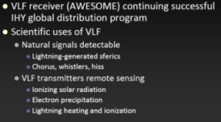
VLF observations provide us with a new method to monitor high-energy transient phenomena of astrophysical importance.
Evidentially Very Low Frequency waves are diagnostic tool.
Future plans: acquire and install new receiver and data local server

Slide 27
Thank you for your attention

