Slide 1
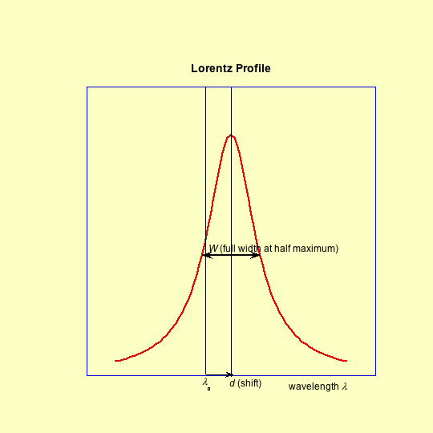
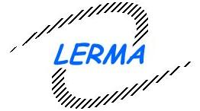

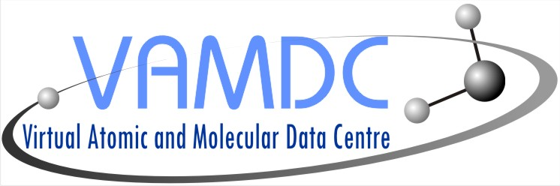
The STARK-B database for spectral line broadening by collisions with charged particles in the framework of the
European project VAMDC
(Virtual Atomic and Molecular Data Center)
S. Sahal-Bréchot
Observatoire de Paris, LERMA CNRS UMR 8112, France
http://www.vamdc.org
http://stark-b.obspm.fr

Slide 2
STARK-B
Database for "Stark" widths and shifts of isolated spectral lines of atoms and ions, due to collisions with electrons and ions in a plasmahttp://stark-b.obspm.fr
Calculated widths and shifts: more than 150 pubs (1984-2011)
SCP theory updated and operated
by M.S. Dimitrijević and S. Sahal-Bréchot and colleagues
Technical development:
Paris Observatory, LERMA, by N. Moreau, engineer
  the database has been opened since September 2008: 99% of the existing data are currently implemented
It is a part of the atomic and molecular databases of the Paris Observatory
Link (and mirror site in progress) to SerVO - Serbian Virtual Observatory
http://servo.aob.rs/~darko/
It is a part of VAMDC- Virtual Atomic and Molecular Data Centre
it follows the standards of VAMDC and Virtual Observatories
(Europe: IVOA International Virtual Observatory Alliance)
http://www.vamdc.org
http://www.ivoa.net
2

Slide 3
STARK-B widths and shifts of isolated spectral lines of atoms and ions, due to collisions with electrons and ions in a plasma
Overlapping lines and departures from impact approximation are outside the scope of STARK-B
Stark broadening of spectral lines can be applied to many subjects
Astrophysics
Laboratory plasmas
Industrial plasmas
Ionization degree ≥ 1%
Moderately hot to very hot plasmas (5 10³ to ∼10⁶ K)
Moderate electron density (10¹³ to 10²² cm⁻³ )

Slide 4
Diagnostics and Modelling in Astrophysics:
Understanding of the evolution of stars
Thanks to considerable developments of
  Ground based and space-born missions
  Increased sensitivity (S/N) and spectral resolution
  Powerful computers
Interpretation of the faint observed spectrum :
faint objects, faint lines (trace elements)
  Line intensities + line profiles
  Continuum
  Spectroscopic diagnostics:
    Temperatures
    pressure
    Abundances
    Chemical stratification of the atmosphere
    Modelling of atmospheres
    Synthetic spectra: a great number of lines of a same element are required
    Radiative transfer
Stellar interiors studies and Asterosimology
  opacities: a great number of lines oh higly ionized elements are required
  Nuclear processes: formation of elements, chemical enrichment

Slide 5
Diagnostics and Modelling in Astrophysics:
Understanding of the evolution of stars
Thanks to considerable developments of
  Ground based and space-born missions
  Increased sensitivity (S/N) and spectral resolution
  Powerful computers
Interpretation of the faint observed spectrum :
faint objects, faint lines (trace elements)
  Line intensities + line profiles
  Continuum
  Spectroscopic diagnostics:
    Temperatures
    pressure
    Abundances
    Chemical stratification of the atmosphere
    Modelling of atmospheres
    Synthetic spectra: a great number of lines of a same element are required
    Radiative transfer
Stellar interiors studies and Asterosimology
  opacities: a great number of lines oh higly ionized elements are required
  Nuclear processes: formation of elements, chemical enrichment

Slide 6
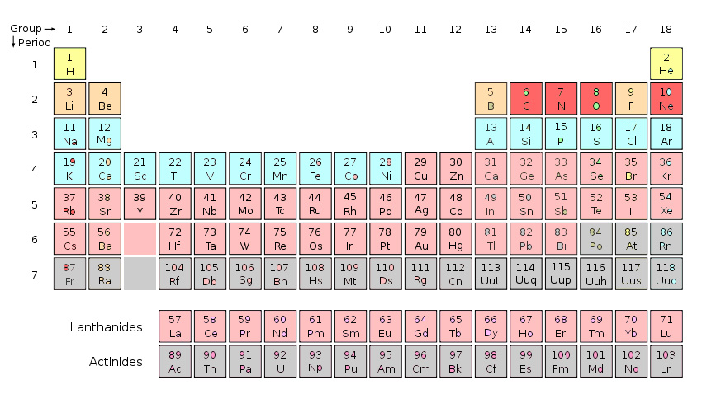
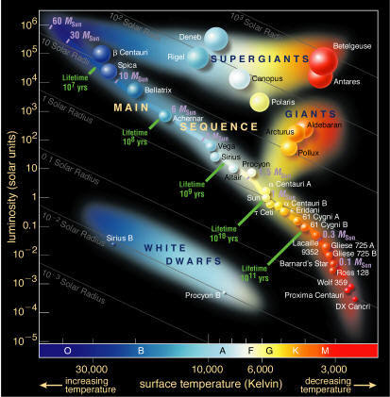
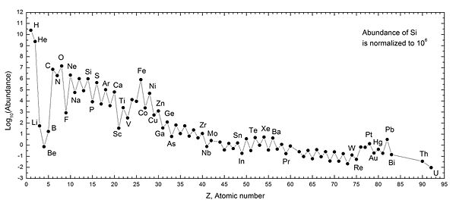
Diagnostics and Modelling in Astrophysics:
Understanding of the evolution of stars
Thanks to considerable developments of
  Ground based and space-born missions
  Increased sensitivity (S/N) and spectral resolution
  Powerful computers
Interpretation of the faint observed spectrum :
faint objects, faint lines (trace elements)
  Line intensities + line profiles
  Continuum
  Spectroscopic diagnostics:
    Temperatures
    pressure
    Abundances
    Chemical stratification of the atmosphere
    Modelling of atmospheres
    Synthetic spectra: a great number of lines of a same element are required
    Radiative transfer
Stellar interiors studies and Asterosimology
  opacities: a great number of lines oh higly ionized elements are required
  Nuclear processes: formation of elements, chemical enrichment
Sun abundances

Slide 7
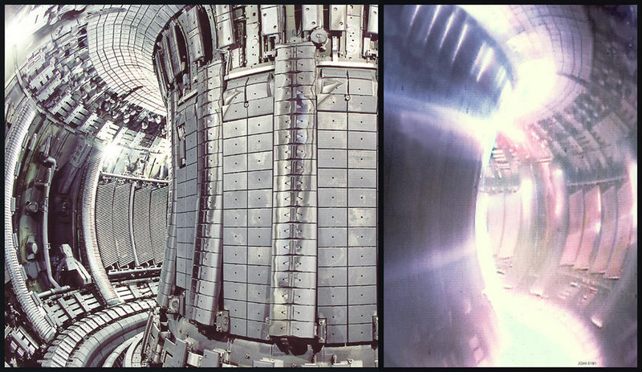
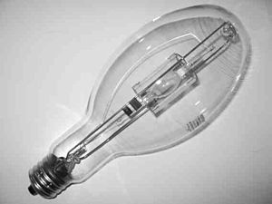
Diagnostics and Modelling in
Laboratory and Industrial plasmas
Thanks to developments and needs (devices an research)
  Magnetic confinement fusion: moderately dense and hot plasmas (e.g. ITER)
  Inertial confinement fusion (laser fusion, ion-beam fusion): dense and very hot plasmas
  Low temperatures plasmas
  Lighting discharges
Analysis and interpretation of the spectrum in fusion devices and Tokamaks
  Light elements in the divertor and edge plasma regions
  Importance of Tin, Tungsten, and Aluminium
  (Al-pellet Ablation Plasmas in Large Helical Device)
    Temperatures
    Pressure
Progress in low-energy light sources
Discharge lamps and lighting :
optimisation of performances
cold light from hot atoms and molecules
(white light 3000-5000K, discharge up to 45000K),
high electron density (strong and broad emission in the visible spectrum
Fluorescent lamps: improving efficacity (phosphors)
  Rare earth elements Dy, Ho, Ce: excellent radiation sources
  HID (High Intensity Discharge): MH (Metal Halide) lamps, e.g. Dy I₃, In I, ZnI3
  (LED light-emitting diodes)

Slide 8
STARK-B data:
Basic approximations (theory and calculations)
Impact approximation
  Collisions between radiators and perturbers
  act independently and are additive
ρ_{typ}/v << ΔT i.e. ρ_{typ}<< N^{-1/3}
Complete collision approximation
➔ line broadening theory becomes
an application of the theory of collisions
The atom has no time to emit or absorb a photon during the collision process, the collision is not broken off.
Isolated lines
  Neighbouring levels do not overlap
i’
i
i’
  ➔ Lorentz profile; S-matrix, cross-sections
f’
f
LS coupling: fine (hyperfine) structure
can be neglected during the collision
(S or I : no time to rotate)
➔The fine structure (hyperfine) components have the
same width and the same shift, thet of the multiplet
f’
High densities:
➔Debye screening effect
8

Slide 9
STARK-B
Methods of calculations of the data
1. The scattering S-matrix
SCP: Semi-Classical : atom = quantum description (atomic structure),
        perturber= particle moving on a classical path
+ Perturbation theory (2nd order)
  (Sahal-Bréchot, A&A1970 and further papers, 6-8 basic papers)
    unitarity and symmetrization of the S-matrix, adequate cut-offs
    hyperbolae for ion-electron and ion-ion (1970),
    complex atoms (1974), very complex (2008)
    Feshbach resonances for ion-electron collisions (1977)
    Updated and operated with MS. Dimitrijević (1984 and after)
    accuracy: 20%, sometimes better, sometimes worse
MSE: Modified Semi-Empirical : atom = simplified quantum description Dimitrijević and colleagues, JQSRT1980 and further A&A papers)

Slide 10
STARK-B
Methods of calculations of the data
2 - The atomic structure
  NIST atomic data
  VALD (Vienna Atomic Line Database)
  Coulomb approximation with quantum defect (Bates & Damgaard 1949)
  TOPbase : R-matrix in LS coupling
  Cowan code : HFS multi-conf with exchange and relativistic effects (by perturbations)
  SUPERSTRUCTURE : scaled Thomas-Fermi-Dirac-Amaldi potential + relativistic effects (Breit-Pauli)

Slide 11
STARK-B
Methods of calculations of the data
3. Calculations leading to a great number of data
  Atomic structure coupled to the S-matrix calculation:
  Many widths and shifts for a set of several temperatures and densities in a same run
  Ab initio calculations: no external data insertion
    SST + SCP: data for 100 lines and more in a same run
    Cowan code + SCP : in progress (case of Pb IV, more than 100 lines in a same run)
  Coupling to atomic structure databases:
    TopBase : data for 150 lines in a same run
    VALD: data for more than 1000 lines in a same run (case of CII for white dwarfs)

Slide 12
STARK-B:
Elements (atoms and ions) currently inserted
Ag I,
Al I, Al III, Al XI
Ar I, Ar II, Ar II, Ar VIII
Au I
B II, B III
Ba I, Ba II
Be I, Be II, Be III
Br I
C II, C III, C IV, C V
Ca I, Ca II, Ca V, Ca IX, Ca X
Cd I, Cd II
Cl I, Cl VII
Cr I, Cr II
Cu I
F I, F II, F III ,F IV, F V, F VI, F VII
Fe II
Ga I
Ge I
He I
Hg II
I I
In II, In III
K I, K VIII, K IX
Kr I, Kr II, Kr VIII
Li I, Li II
Mg I, Mg II, Mg XI
Mn II
N I, N II, N III, N IV, N V
Na I, Na X
Ne I, Ne II, Ne II, Ne III, Ne IV, Ne V, Ne VIII
Ni II
O I, O II, O III (in progress), O IV, O V, O VI; O VII
P IV, P V
Pb IV
Pd I
Rb I
S III, S IV, S V, S VI
Sc III, Sc X, Sc XI
Se I
Si I, Si II, Si IV, Si V, Si VI, Si XI, Si XII, Si XIII
Sr I
Te I
Ti IV, Ti XII, Ti XIII
Tl III
V V, V XIII
Y III
Zn I
C II in progress (150 lines, 4 temperatures, 3 densities)

Slide 13
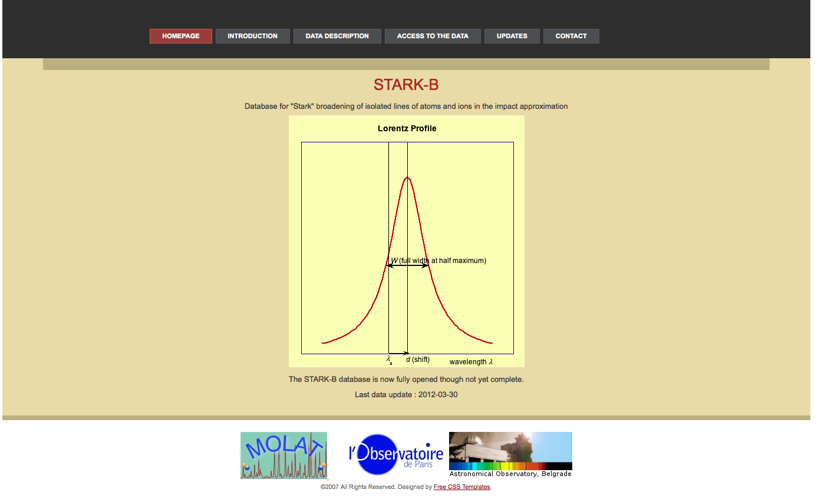
STARK-B http://stark-b.obspm.fr

Slide 14
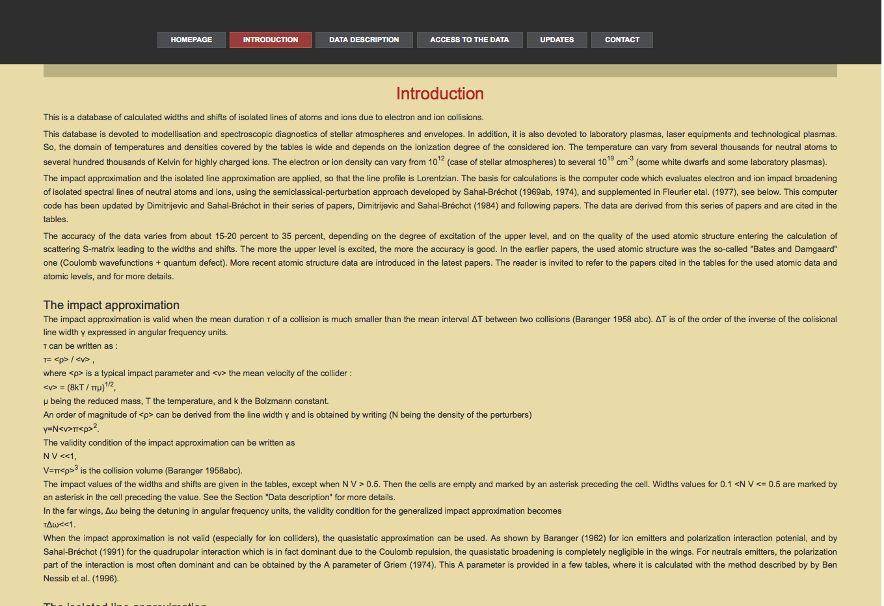

Slide 15
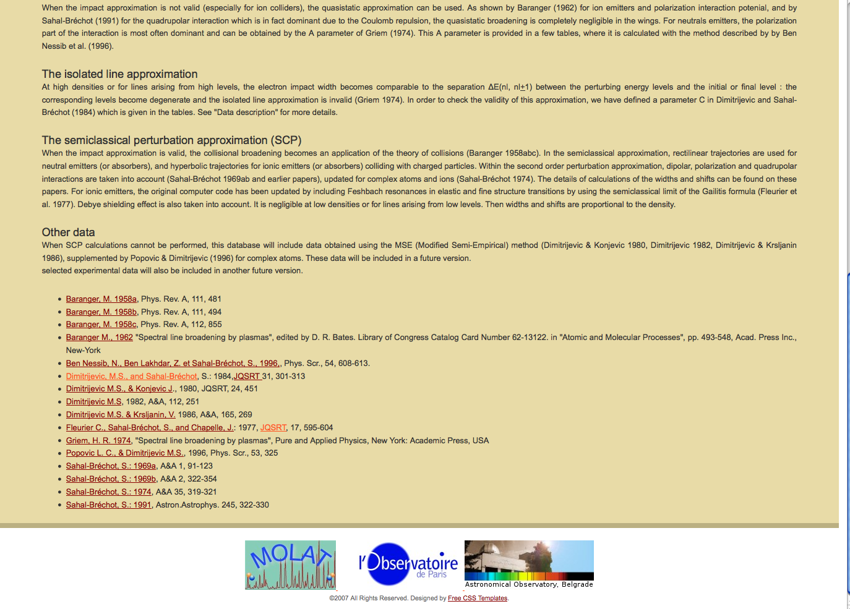

Slide 16
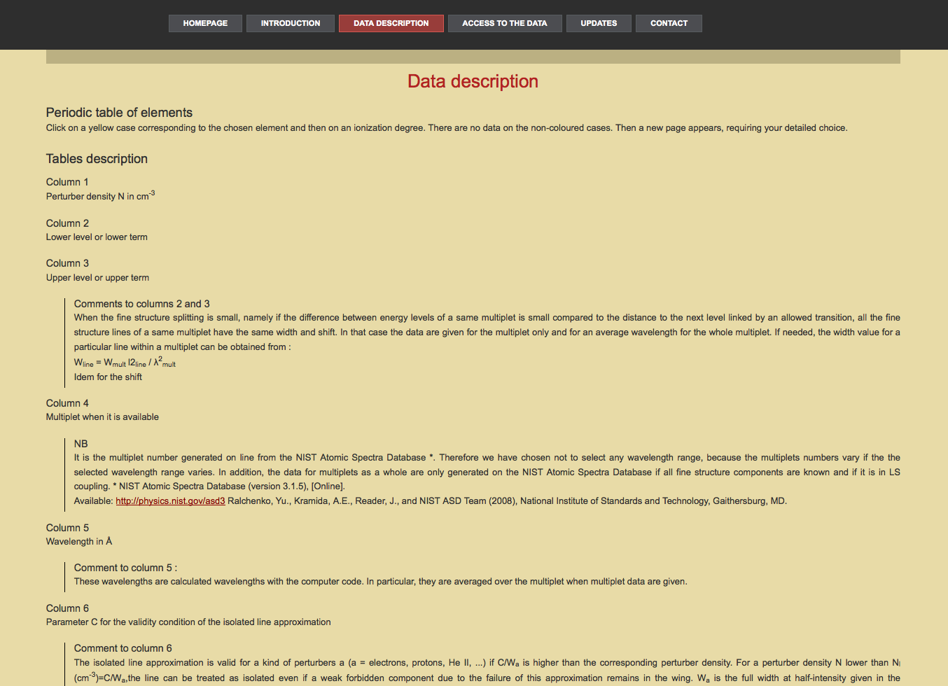

Slide 17
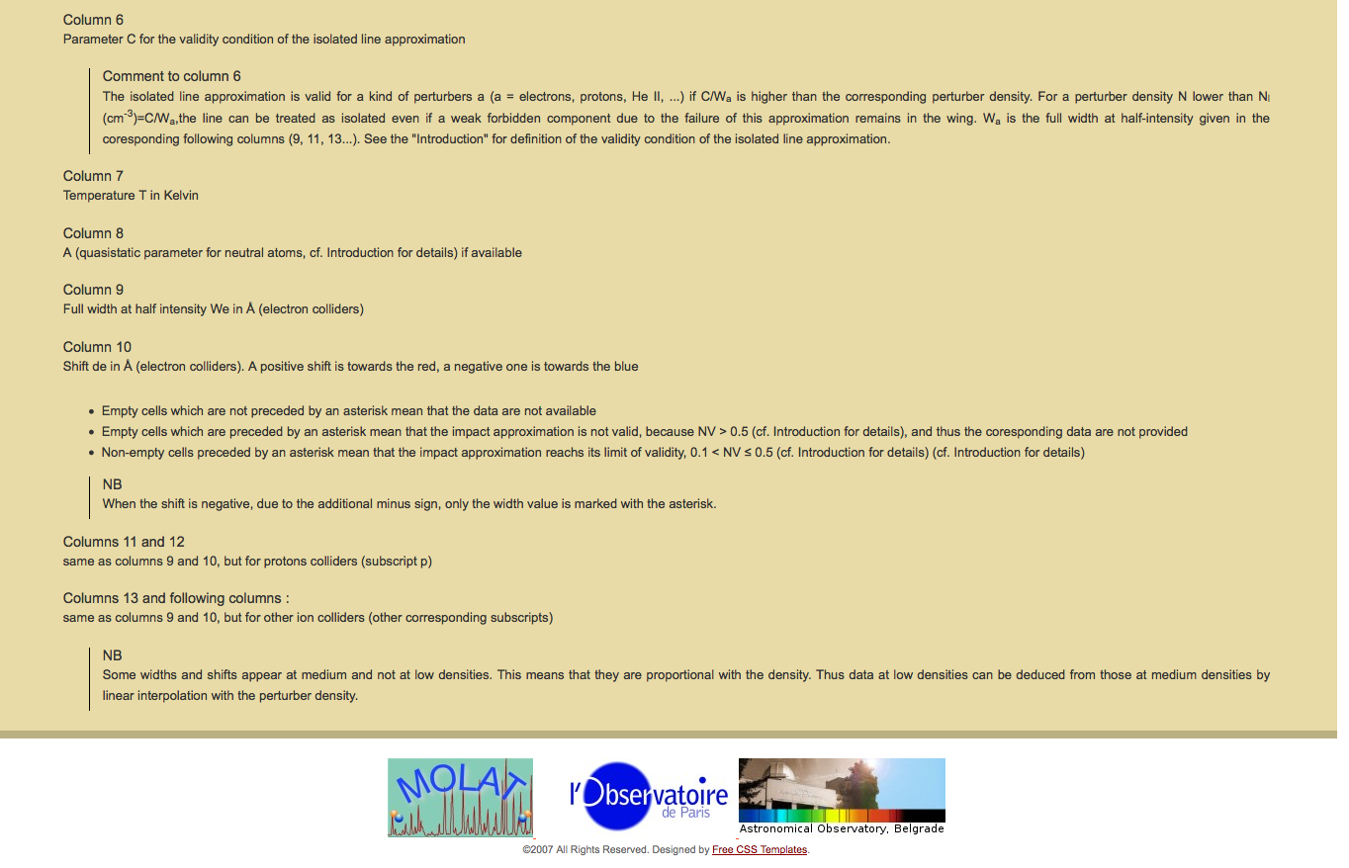

Slide 18
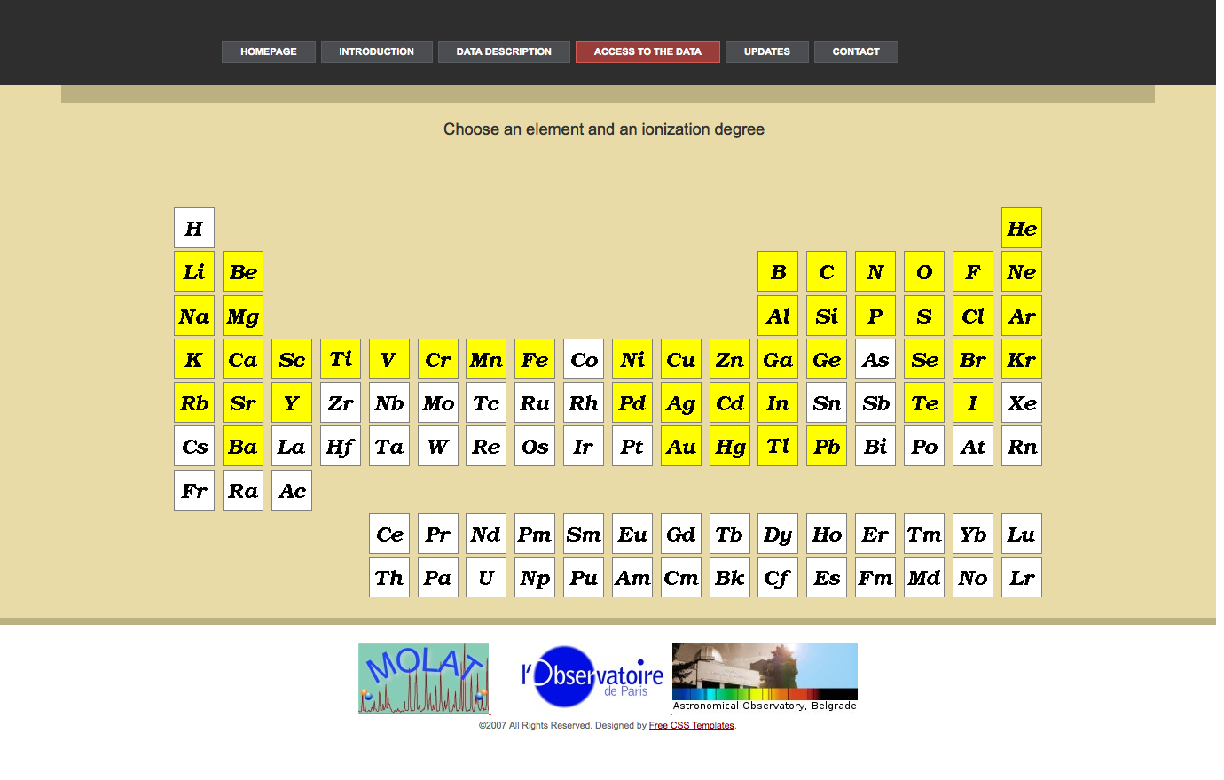

Slide 19
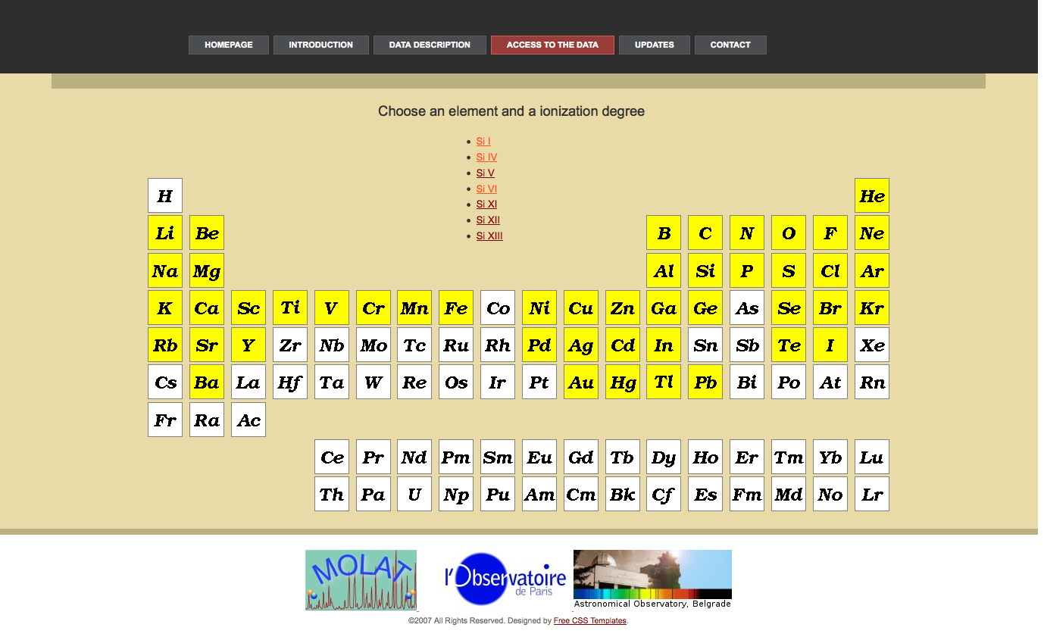

Slide 20
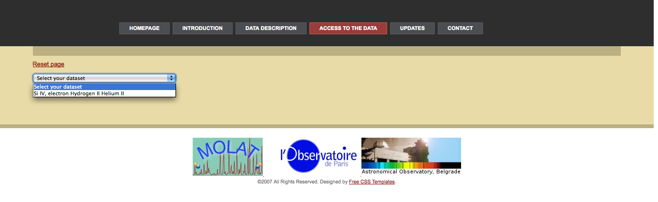
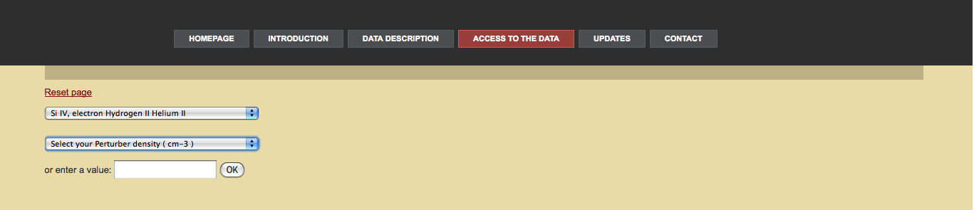

Slide 21
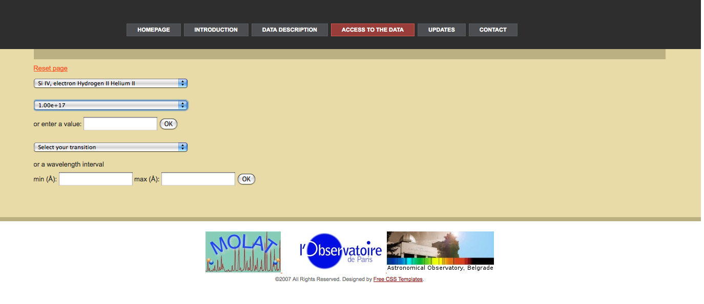

Slide 22
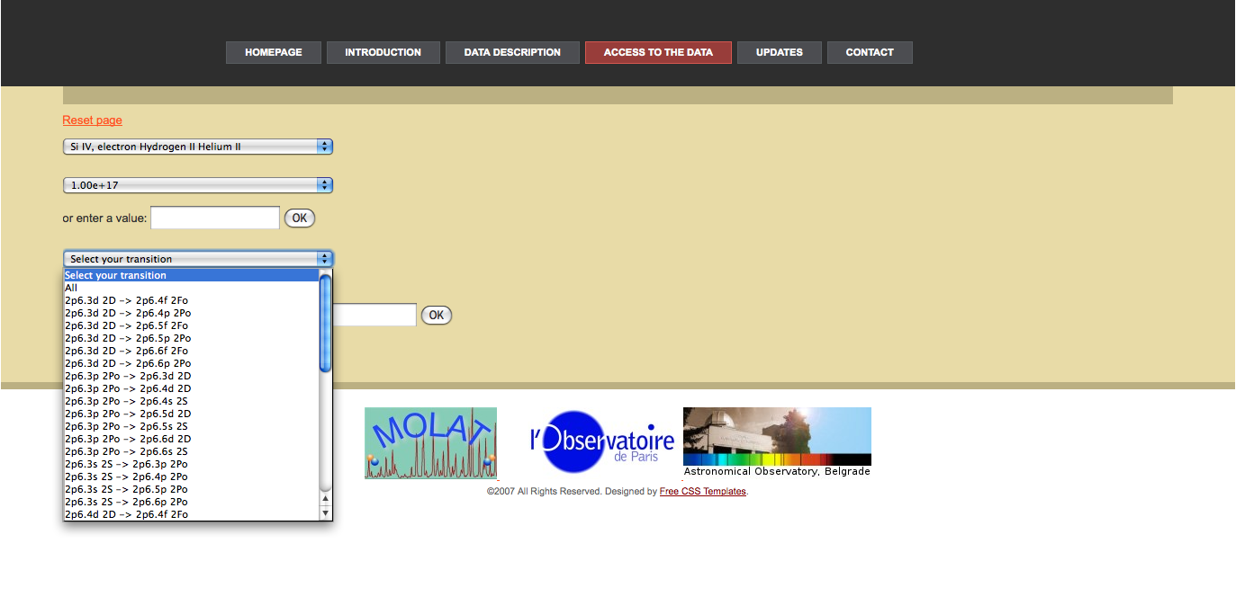

Slide 23
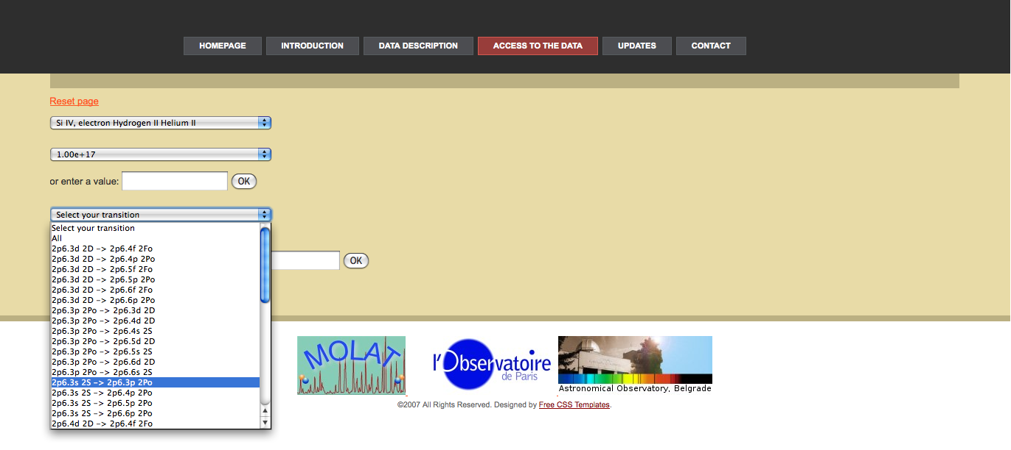

Slide 24
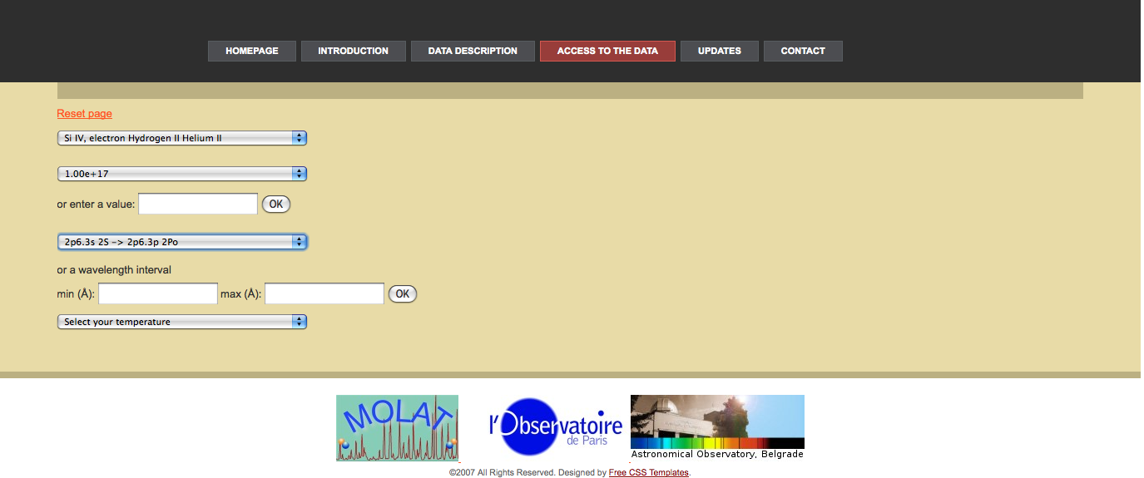

Slide 25
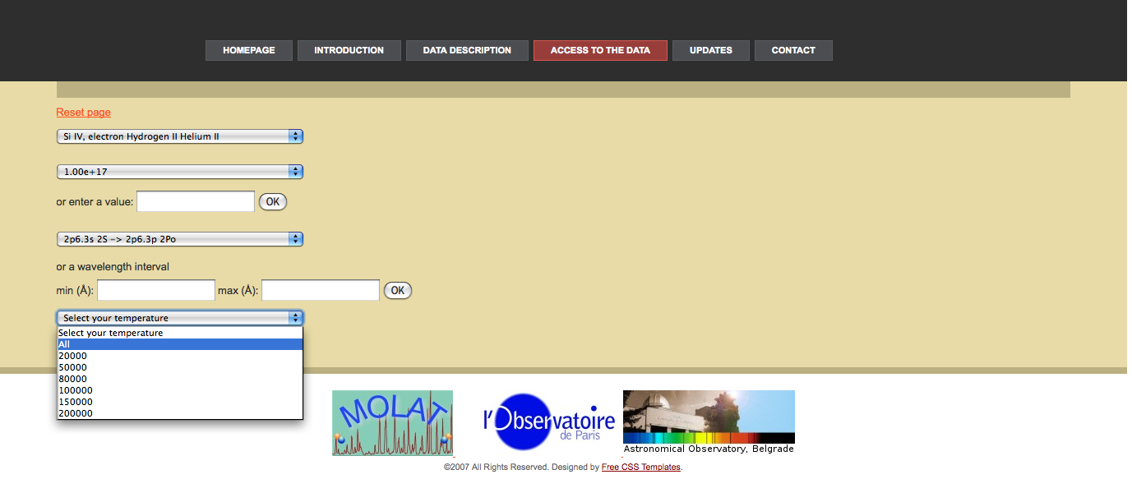

Slide 26
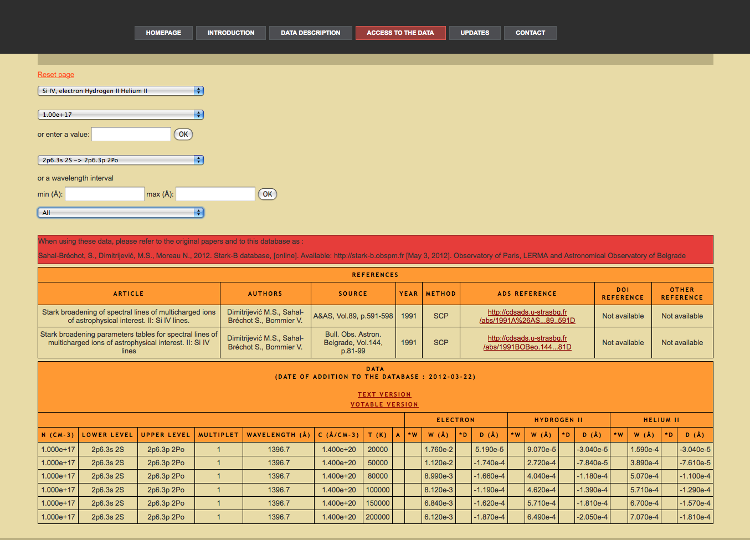

Slide 27
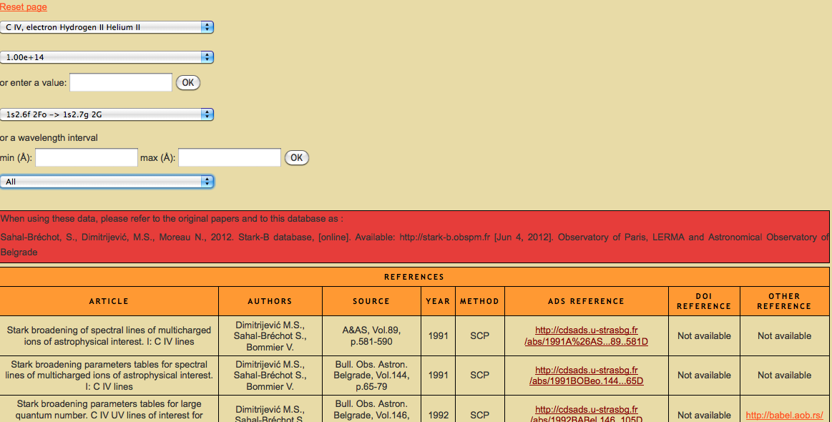
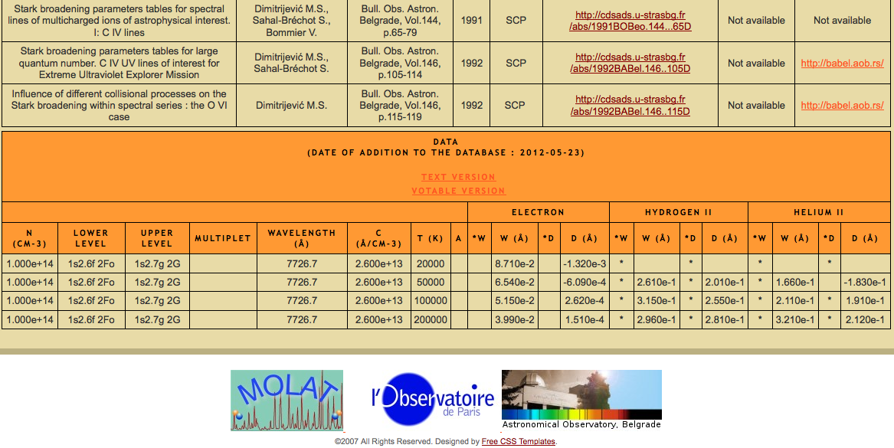

Slide 28
STARK-B: Next steps
Insertion of MSE data
Insertion of little “applets” on line for users:
  Fitting along temperatures (for astrophysics)
  extrapolation or interpolation (regularities and systematic trends)
    along principal quantum numbers,
    charge of the radiating ions (isoelectronic sequences),
    homologous ions,
    charge of the ion collider
Future:
  SCP code on line: STARK-C project
      Insertion of quantum data in intermediate coupling: SST + DW
      especially adapted to highly charged ions and resonance lines (Sahal-Bréchot with Elabidi & Ben Nessib (2004 and after, an also with Dubau and Cornille 2007 and after )

Slide 29
VAMDC project
Virtual Atomic and Molecular Data Center
European project FP7 "Research Infrastructures
summer 2009 - end of 2012
Interoperable e-Infrastructure
for exchange of atomic and molecular data
15 administrative partners: 24 teams
from 6 European Union member states,
Serbia, Russian Federation and Venezuela
strong coupling
to the users (astrochemistry, atmospheric physics, plasmas)
scientists and engineers from the ICT community (Information and Communication Technologies)
used to deal with deploying interoperable e-infrastructure
e.g. Europlanet IDIS
IVOA (International Virtual Observatory Alliance)
Members: Euro-VO , AstroGrid…
http://www.vamdc.org
http://www.vamdc.eu

Slide 30
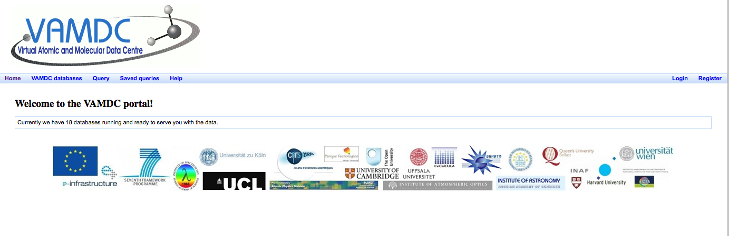
VAMDC: portal user
http://portal.vamdc.org/vamdc_portal_test/home.seam

Slide 31
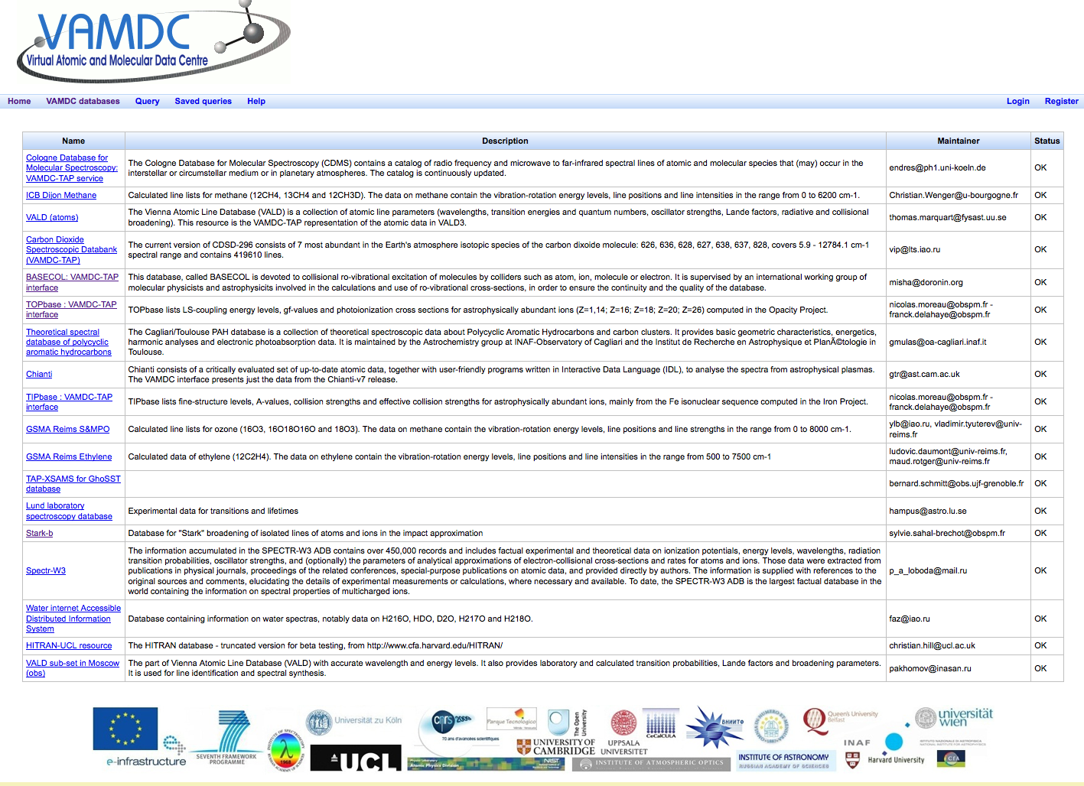

Slide 32
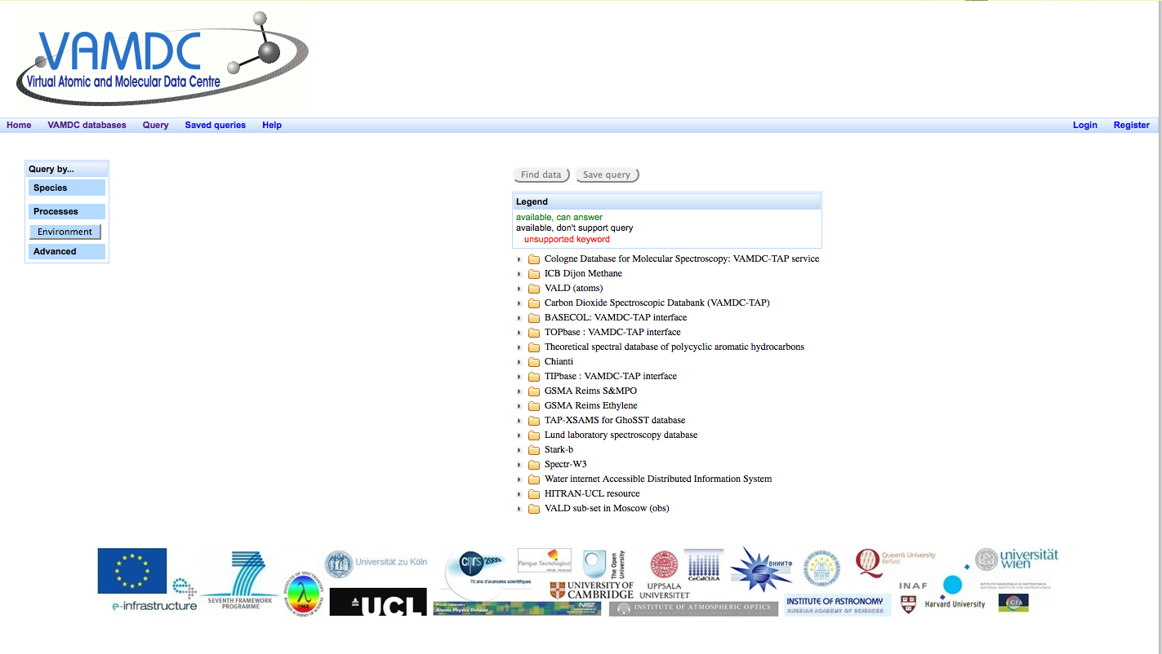
Query

Slide 33
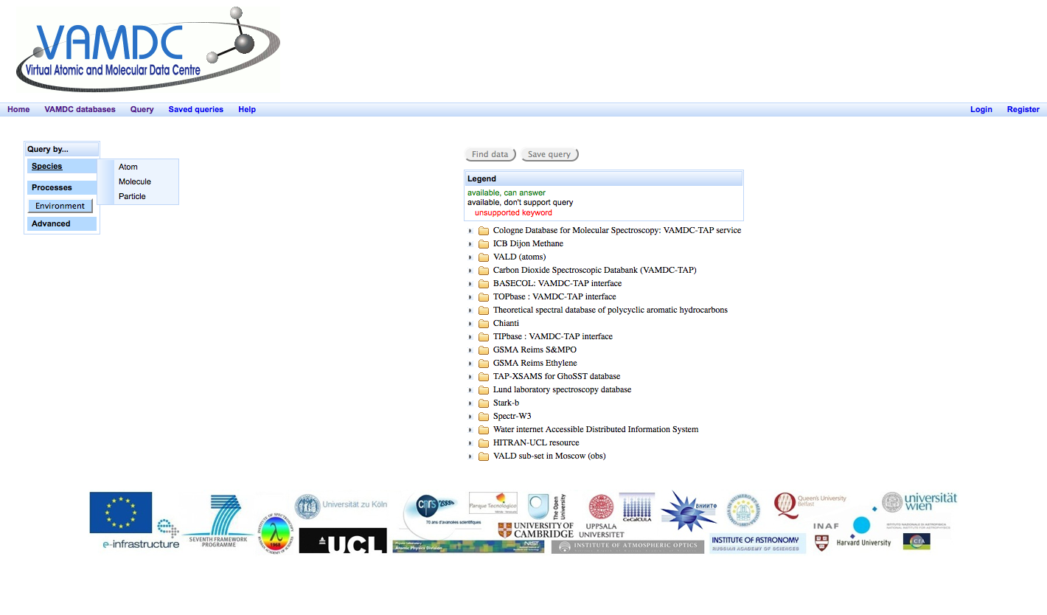
Query by species

Slide 34
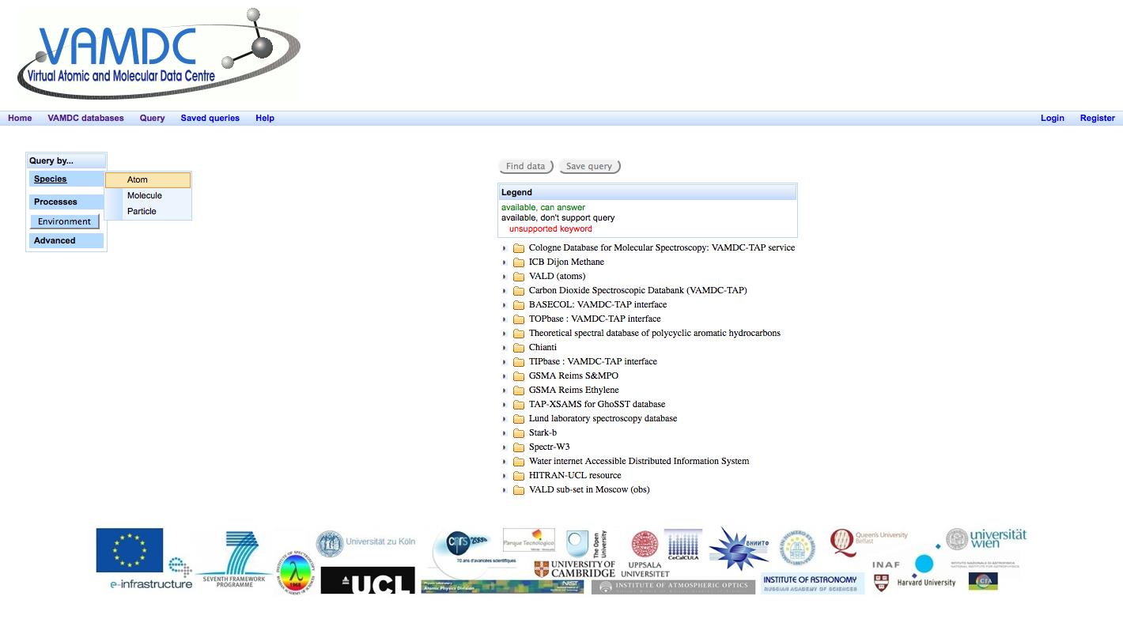
Query by species: atom

Slide 35
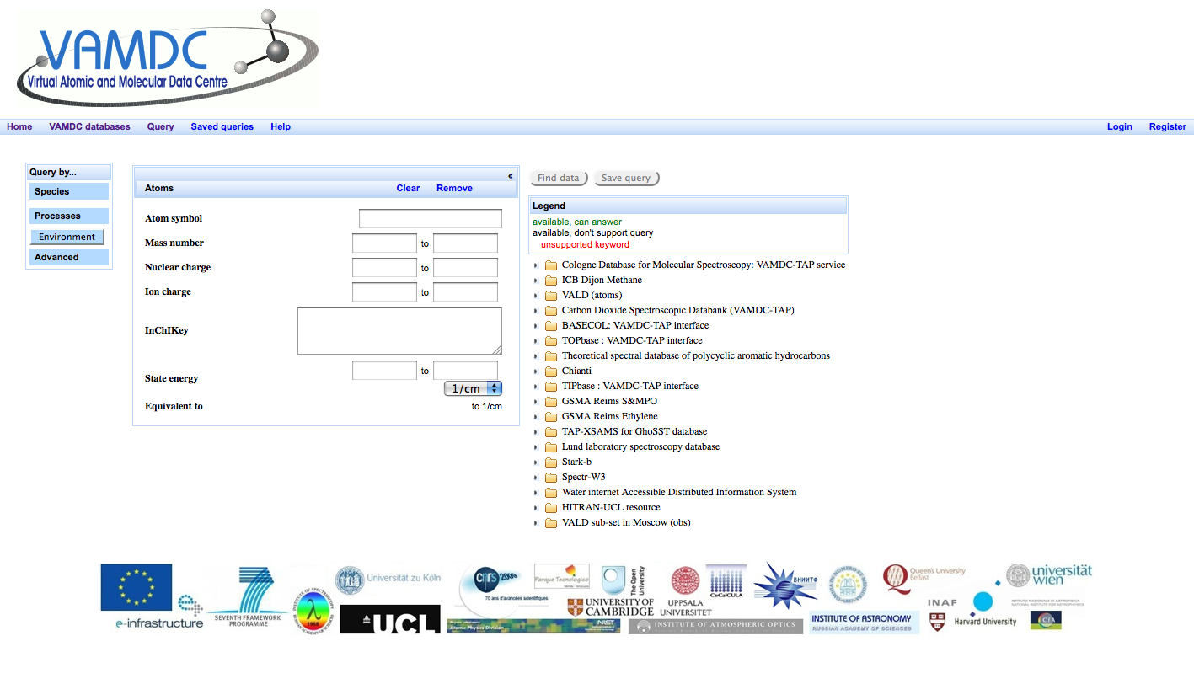
Query by species: atom (following)

Slide 36
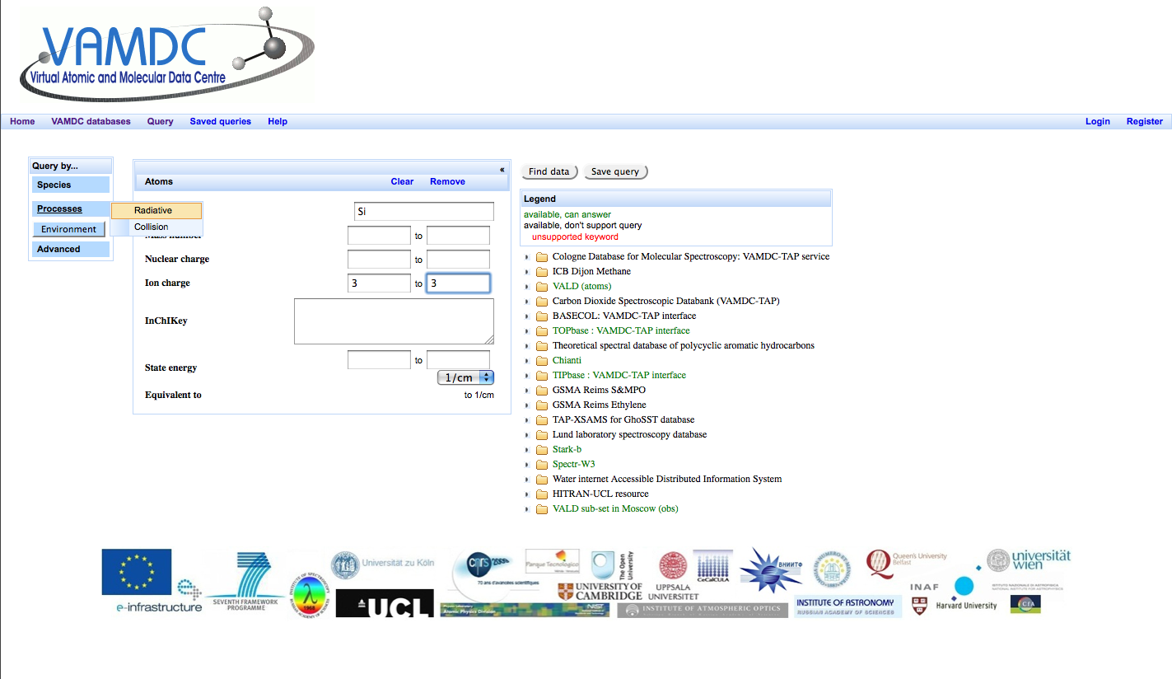
Query by species: atom, processes

Slide 37
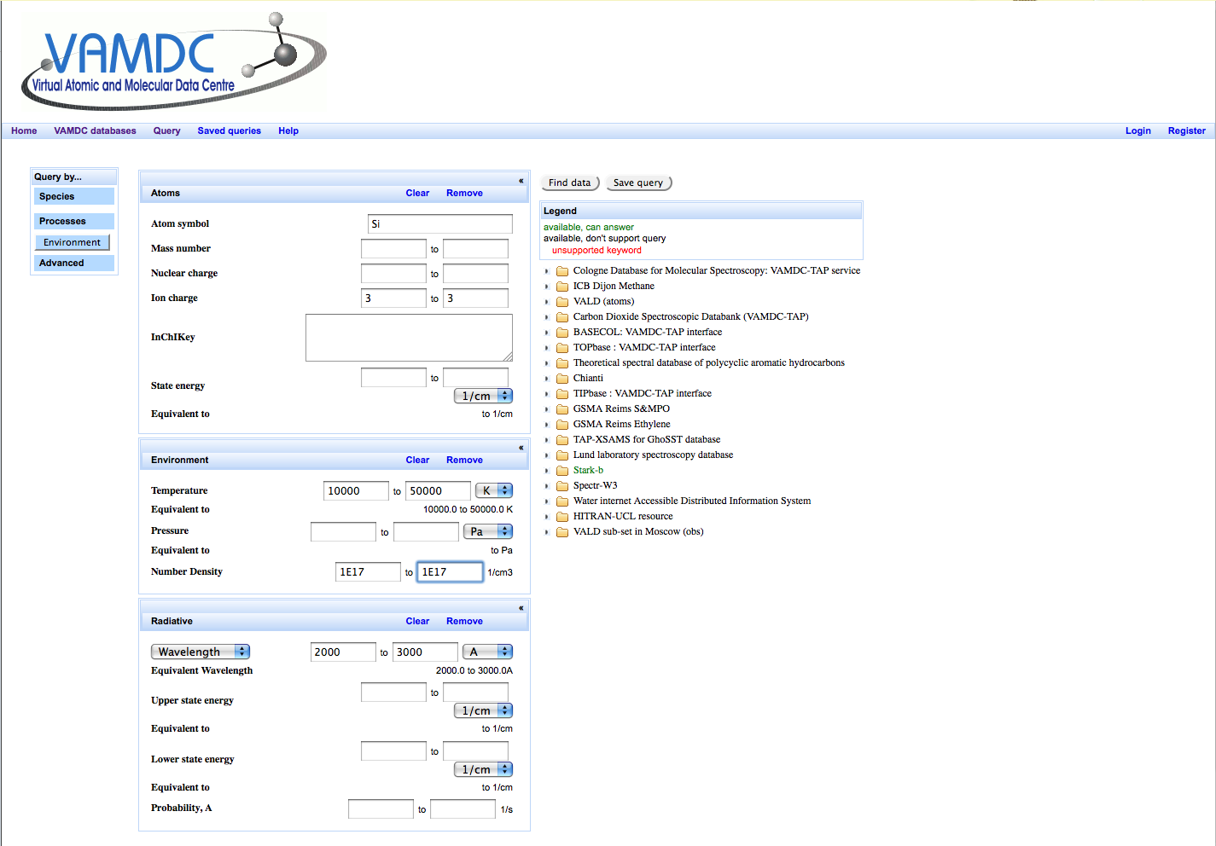
Query by species: atom, processes (following)

Slide 38
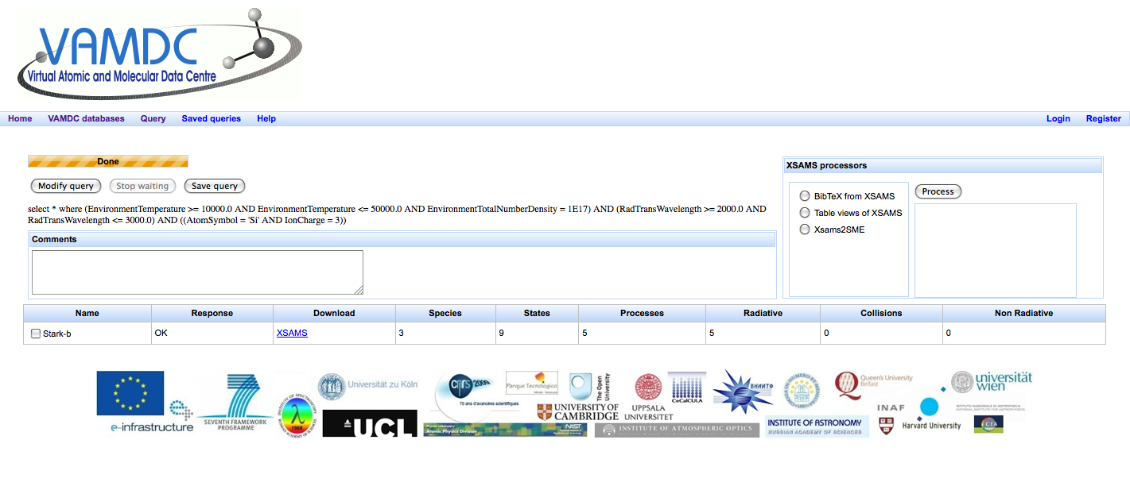
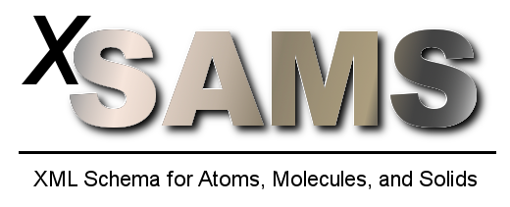

Query : result, click on download
Xsams: XML Schema for Atoms, Molecules and Solids
XML: Extensible Markup Language
Xsams2SME: converts XML document into the CSV-format wanted by Spectroscopy Made Easy (SME)
Notes:
XML : Extensible Markup Language, « langage de balisage extensible ») mettre en forme des documents grâce à des balises (markup) faciliter l'échange automatisé de contenus complexes (arbres, texte riche…) entre systèmes d'informations hétérogènes (interopérabilité).
XSAMS: XML-based standard for exchange of atomic, molecular, and particle-solid-interaction data was proposed at the IAEA

Slide 39
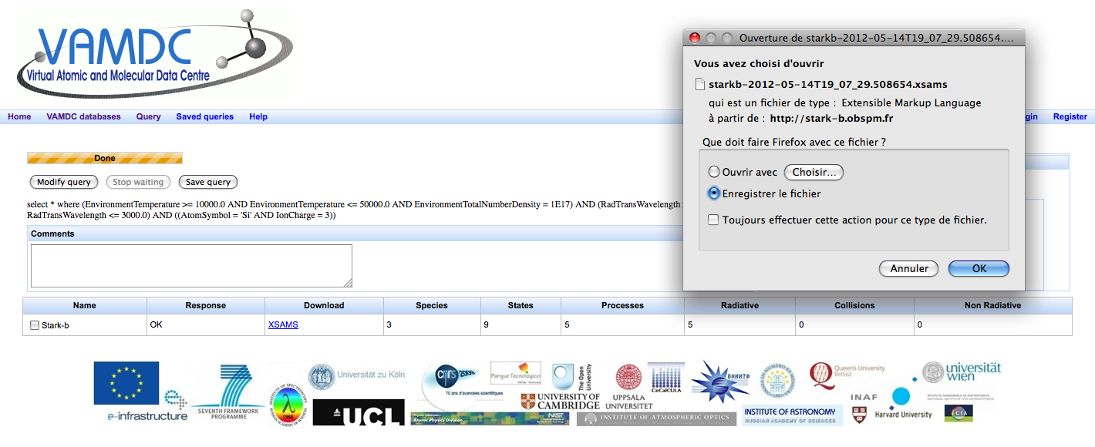
Result of the download: code in XML language for users
Xsams
XML Schema for Atoms, Molecules and Solids

Slide 40
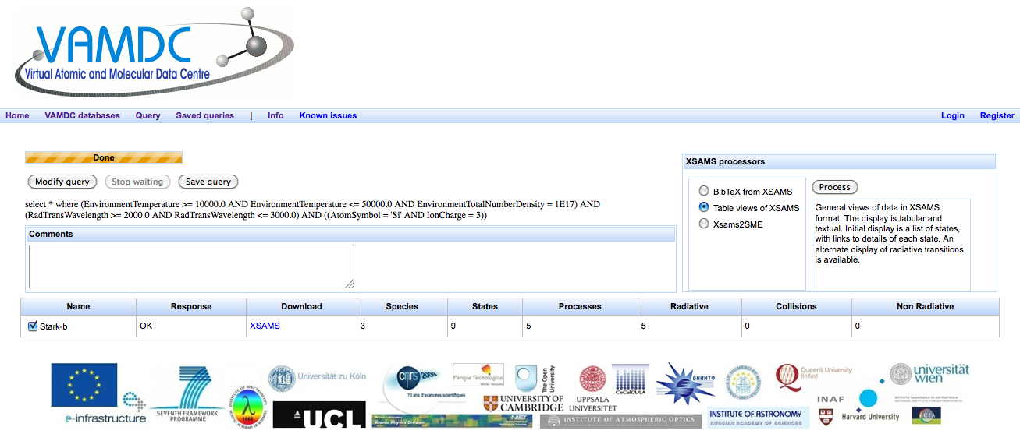
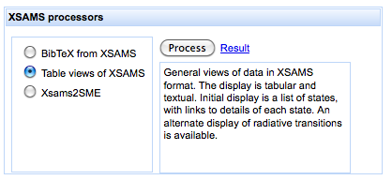

Slide 41
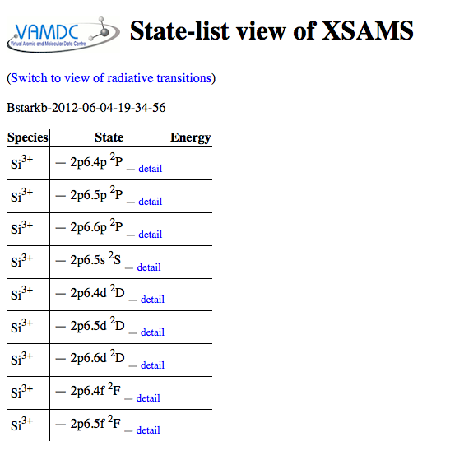

Slide 42
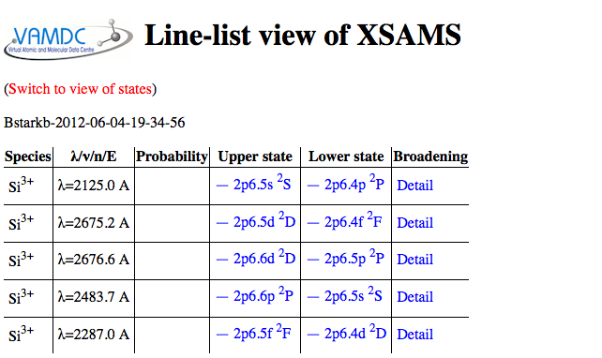

Slide 43
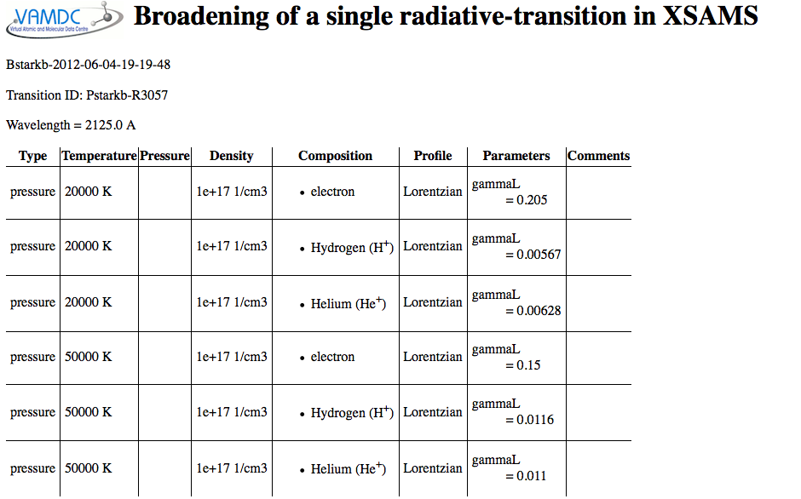

Slide 44
Thank you for your attention

