Slide 1
Atomic and molecular data for Active Galactic Nuclei
– Fe II lines and Balmer continuum
Jelena Kovačević
Astronomical Observatory Belgrade

Slide 2
Outline:
Active Galactic Nuclei (AGN): basic properties
Some examples of use of atomic databases in AGN investigation
2.1 Construction of the Fe II template
2.2 Calculation of Balmer continuum
Conclusions

Slide 3
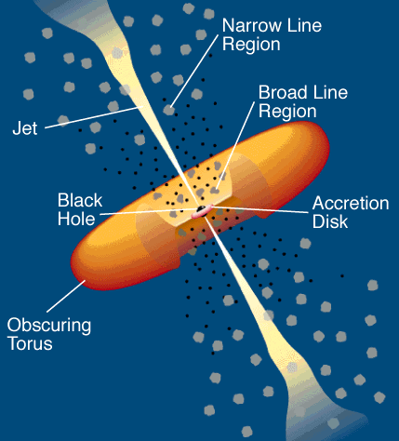
1. Active Galactic Nuclei (AGN): basic properties
Standard Unification Model:
blasar
Sy 1,
QSO 1
Sy 2,
QSO 2

Slide 4
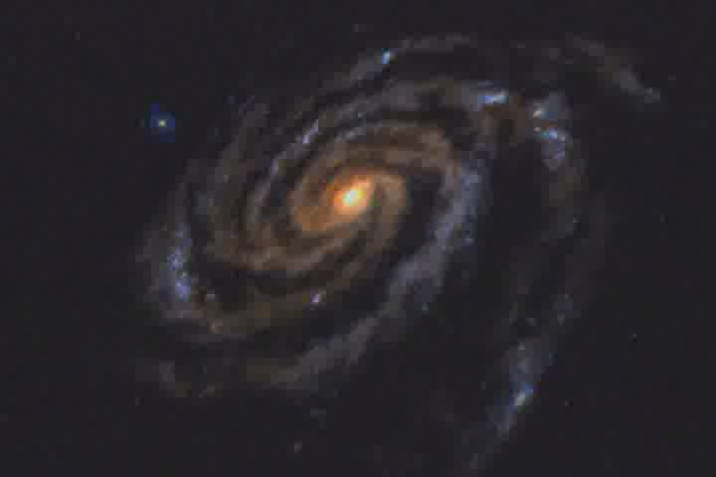

Slide 5
2.1 Construction of the Fe II template
Why Fe II lines are interesting?
Unknown mechanism of excitation!
(observed Fe II emission cannot be well
explained by standard photoionization
models!)
Unknown place of Fe II emission
region in AGN structure!
3. Some unexplained correlations between
Fe II lines and some other spectral
properties: what is the physics behind?
Hβ
Fe II (λλ4400 -5500 Å)
intensity
wavelength (A)
wavelength (A)
We need a good Fe II template in order to:
1. answer to these questions,
2. investigate Hβ and [O III] lines which overlap
with Fe II;

Slide 6
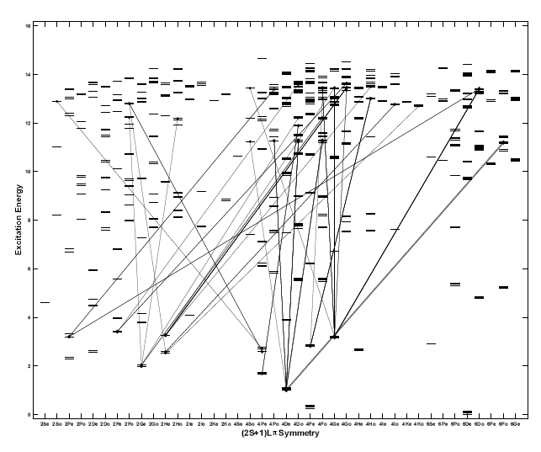
2.1 Construction of the Fe II template
Why the construction of iron template is difficult?
empirical template
complex Fe II ion: many transitions,
difficult identification of the lines!
theoretical template
unknown mechanism of excitation of all Fe II
lines. Except the photoionization, there are
probably some additional mechanisms:
continuum flourescence (Philips 1978, 1979)
collisional excitation (Joly 1981, 1987, 1991)
self- flourescence among Fe II transitions
(Netzer & Wills 1983)
flourescent excitation by the Lyα and Lyβ lines
(Penston 1988, Verner et al. 1999)
Difficult calculation of their
relative intensities!
intensity
Sigut & Pradhan, 2003
wavelength (A)
wavelength (A)

Slide 7
2.1 Construction of the Fe II template
To investigate the Fe II emission, we made an Fe II template, taking into account following:
(a) majority of Fe II multiplets dominant in λλ4400 -5500 Å range, have one of three specific lower terms of their transitions: 3d⁶ (³F2)4s ⁴F,
3d⁵ 4s² ⁶S or 3d⁶ (³G)4s ⁴G (hereinafter F, S and G groups of lines),
(b) beside these lines there are also lines whose origin is not well known, and probably originate from higher levels

Slide 8
2.1 Construction of the Fe II template
The constructed Fe II template consists of:
35 lines, which describe 75% of Fe II emission in λλ4400 -5500 Å range, and belong to F, S or G groups.
The relative intensities of lines within one line group are calculated using the formula:
15 lines, which probably originate from higher levels, and make about 25% of the Fe II emission. Their relative intensities are taken from I Zw 1 object (I Zw 1 group).

Slide 9
2.1 Construction of the Fe II template
This was difficult because:
difference in wavelengths of the
same lines in different sources,
significant difference between
values of oscillator strengths for
the same line in different sources.
Wavelengths (λ), oscillator strengths (f),
statistical weights (g), energies of upper
level of transition (E), obtained from:
Fuhr et al. 1981
Giridhar & Ferro 1995
NIST Atomic Spectra Database
Kurucz 1990
Iron Project, Hummer 1993

Slide 10
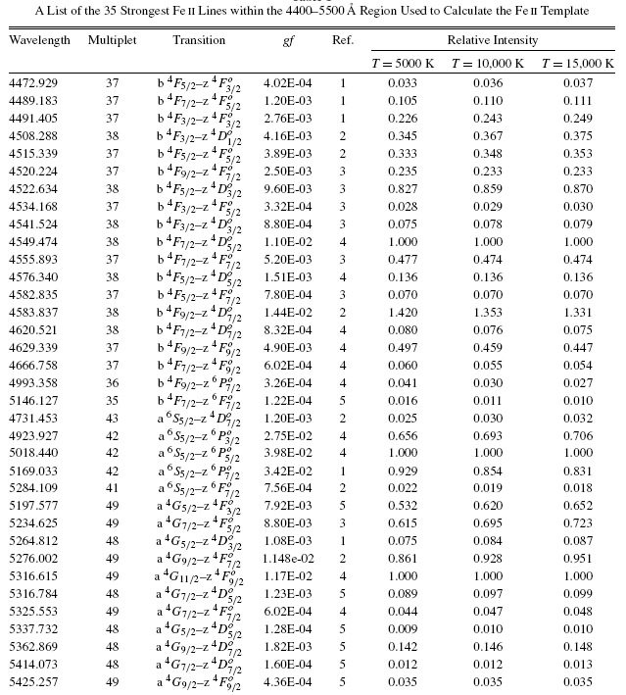
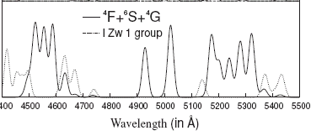
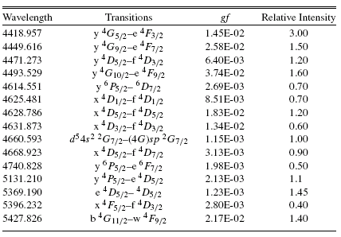
2.1 Construction of the Fe II template

Slide 11
2.1 Construction of the Fe II template
The template is described with 7 free parameters:
- 4 parameters of intensity - for Fe II lines from F, S and G line groups and for I Zw 1 group,
- one parameter of the width and one of the shift (since we assume that all iron lines have the same width and shift),
- excitation temperature;

Slide 12
Kovačević et al. 2010
Kovačević et al. 2010
Veron-Cetty et al. 2004
This template enables very good fit, specially in the cases where there is a big discrepancy between the intensities of the red and the blue iron shelf (F and G line groups).
Veron-Cetty et al. 2004
Bruhweiler and Verner 2008
Bruhweiler and Verner 2008

Slide 13
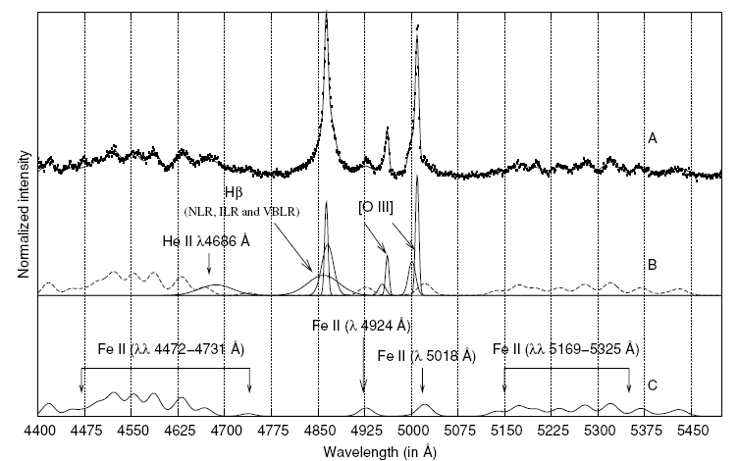
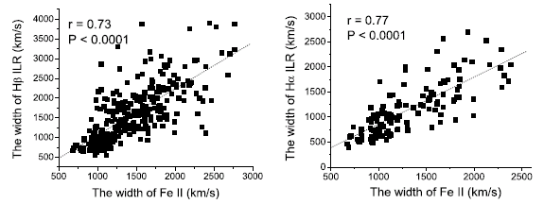
2.1 Construction of the Fe II line template
This Fe II template enabled a precise fit of Fe II lines, and investigation of
different parts of Fe II shelf (F, S, G).
We found:
that Fe II lines probably originate
from Intermediate Line Region in AGN.
2. Different behavior of different parts of
Iron shelf, which is signature of some physical
processes:
logL_{con} F/G and F/S
FWHM Hβ F/G, F/S, G/S
Published in
Kovačević et al. 2010, ApJS, 189, 15.

Slide 14



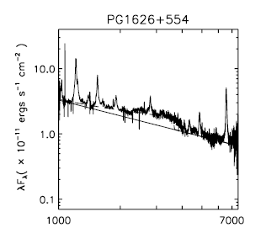

2.2 Calculation of Balmer continuum
to investigate UV part of spectra:
1 step: determination of the UV pseudocontinuum in the sample!
Not easy because:
1. complex shape of UV pseudocontinuum:
Power low + Balmer continuum (Grandi 1982)
2. Our sample contains spectra within spectral range: 2900 A – 5500 A (SDSS)
(only two continuum windows : ~4200 A and ~5100A! Complex shape of UV pseudocontinuum cannot be fitted well!
Tsuzuki et al. 2006

Slide 15
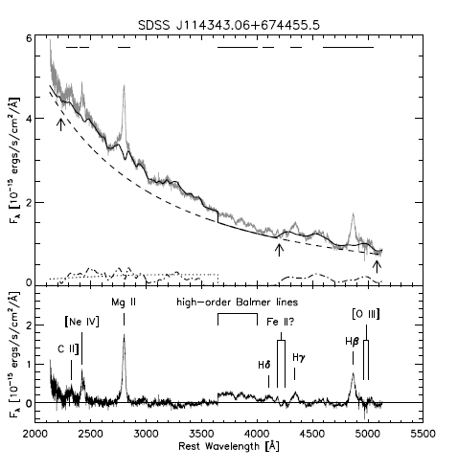
2.2 Calculation of Balmer continuum
Tsuzuki et al. 2006,
Sameshima et al. 2010
Sameshima et al. 2010

Slide 16

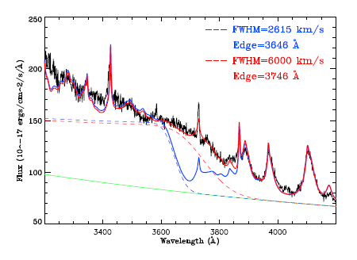
2.2 Calculation of Balmer continuum
Jin et al. 2012
Convolving Balmer continuum
equation with Gaussian
(FWHM Gaussian = FWHM broad Hβ)

Slide 17

Our model of Balmer continuum
We try to make model which:
- we could use for fitting spectra within 2900 A – 5500 A range (with two continuum windows). It could be done by reducing number of free parameters: calculating the intensity of Balmer continuum!
- we try to make good fit near Balmer edge (3646 A)!
Our model consists of:
Power law + Balmer continuum (λ<3646A) + high order Balmer lines (n=3-400),
(λ>3646A)
They are fitted by one Gaussian with the same width and shift as Hγ.
-The relative intensites for Balmer lines with n<50 are taken from the paper: Storey and Hummer 1995, where line emissivities, effective recombination coefficients, opacity factors, recombination coefficients, etc. are calculated for hydrogenic ions (z<9, n<50)
- No data for 50<n<400!
- Relative intensities for 50<n<400
are calculated using approximate
formula:
≈1

Slide 18
Examples of fit:

Slide 19
Conclusions:
The calculated optical iron template enables detailed investigation of Fe II lines in AGN spectra, which are telling us about AGN physics and geometry.
Model with high order Balmer lines n=3-400, for λ>3646A, improve the fit near Balmer edge, and enables the calculation of the intensity of Balmer continuum. This is specially important in case of using luminosity at 3000 A, for calculation of black hole mass.
The data basis with large and complete atomic data may help a lot in analysis of AGN spectra, and understanding of AGN nature.
Thank you for your attention!

