Slide 1
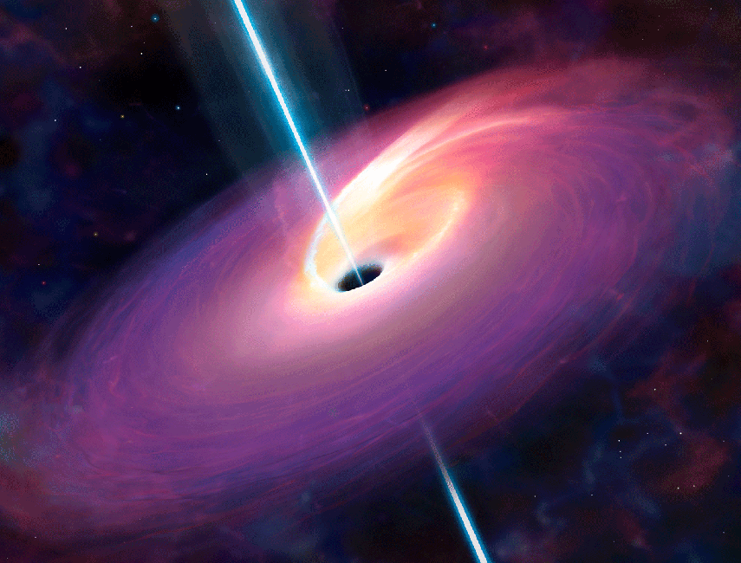
Growth of Black Hole Masses on Cosmological Time scales
W.Kollatschny, Zetzl , Z.Alvi

Slide 2
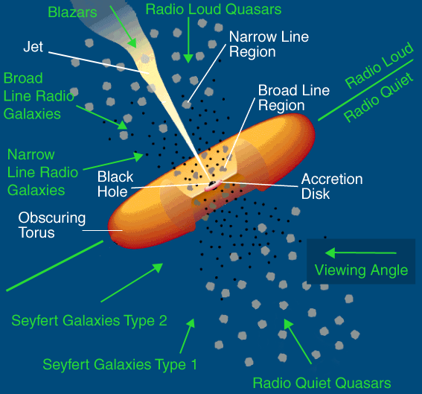
Introduction
Information about the Structure and the Kinematics of the inner most region surrounding an AGN can be revealed by analyzing the broad emission line profiles in the spectra.
The shape and the width of the emission line profiles from AGN depends on a number of parameters such as
  Velocity Fields
  Geometrical structure of the line emitting gas
  Obscuration effects
  The Anisotropy/Isotropy of the emission line
  The superposition of emission lines from different regions etc

Slide 3
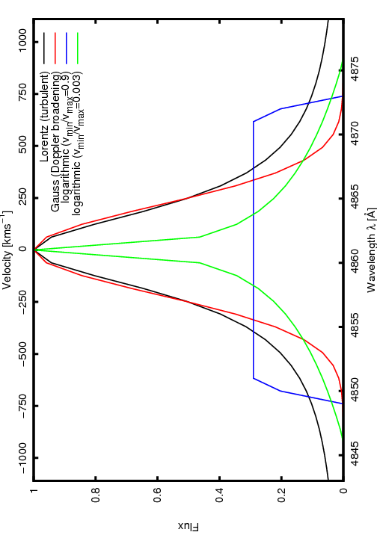
Emission line Profiles
The emission line profiles as dipicted from various kinematical and dynamical models, emitted in the BLR region of AGN are as follows:
  Gaussian Profiles due to Doppler motions
  Lorentzian Profiles due to Turbulent motions
  Exponential profiles due to Electron scattering
  Logarithmic profiles due to Inflow/Outflow motions
Lorentzian and Guassian profiles are the most accepted profiles which are thought to be emitted intrinsically.
Rotational broadening of emission line profiles is the dominant broadening mechanism as shown previously in (ref: paper I W.kollatschny).
Emission line profiles resulting from different kinematic models for the BLR in AGN.Profiles are scaled to the FWHM=500km/sec

Slide 4
Analysis of Emission line Profiles
The investigation of the profile shapes of the UV/Optical broad emission lines in AGN shows that
Lorentzian profiles and the rotational broadening are the two basic components causing the line profile shapes.
To each specific emission line belongs an intrinsic turbulent velocity.The turbulent velocity range from 500 km/sec(Hβ) to 5000 km/sec(lyα+Nvλ1240)
The correct intrinsic rotational velocities can be obtained by taking into consideraton the effect of turbulence.
The correction factors for getting the intrinsic FWHM from the Observed FWHM of different emission lines caused by rotation only have been already calculated and presented in the paper(Ref).
Ref:The shape of broad line profiles in AGN by W.kollatschny,M.Zetzl

Slide 5
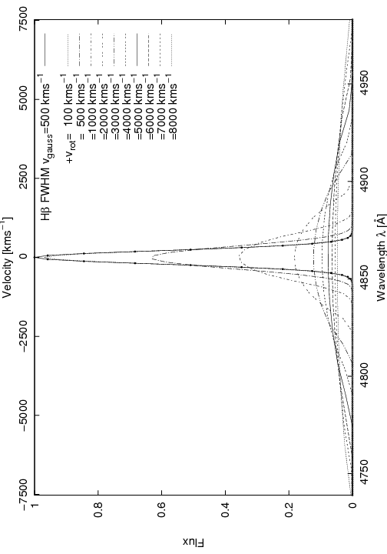
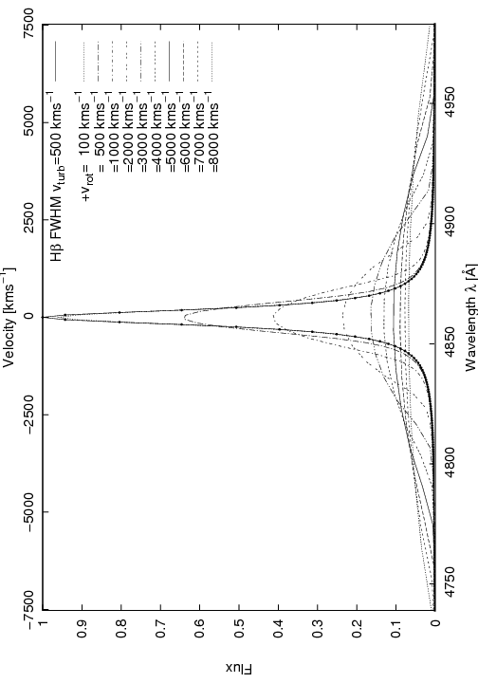
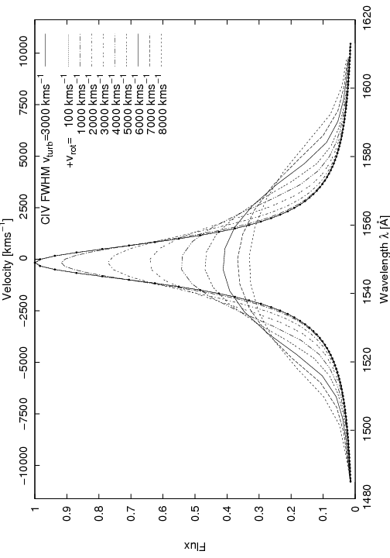
Modeling of observed line profile relations
Rotational line broadening of a Guassian Hβ profile
(v_{turb} = 500 km/s). Theoretical modeling
Rotational line broadening of Lorentzian Hβ profile
(v_{turb} = 500 km/s). Theoretical modeling
Rotational line broadening of Lorentzian CIVλ1550 profile
(v_{turb} = 3000 km/s). Theoretical modeling

Slide 6
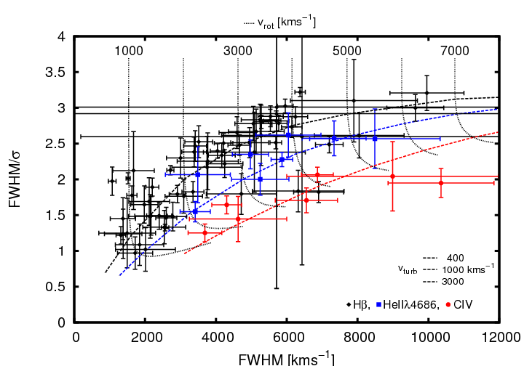
Observed and modeled Hβ, HeII and CIV line-width ratios FWHM/σ versus linewidth FWHM
Theoretical modeling by rotational broadening of Lorentzian Profiles

Slide 7


The mass of the Black holes is calculated by using the following mass scaling relationships referred in(M.Vetergaard 2003):
The black hole (BH) mass equation based on optical data:
The black hole(BH) mass equation relevant for UV data:

Slide 8
Work Progress
SDSS Objects | Z=0±0.1 | Z=1.9±2.1 | Z=3.9±4.1
No of Spectras | 110 | 440 | 56
Total: 606
Using IRAF as a tool for measuring the observed FWHM and continuum luminosity for calculating BH masses.
Later on will apply the correction factors to get the intrinsic FWHM of the observed line width caused by rotation only in order to calculate the correct Black hole masses(i-e after removing the effects due to turbulence).

Slide 9
Object ID | FWHM | Redshift | Flux@5100A | Distance of the source | Luminosity | Log MBH/Msun
 | Km/sec | Z | erg /cm2/sec | D MPC | erg/sec
52138-386 | 2958.52363 | 6.16E-02 | 2.95E-12 | 246.4 | 2.14E+43 | 7.173423368
52138-386 | 2958.52363 | 6.32E-02 | 2.95E-12 | 252.8 | 2.25E+43 | 7.18901428
52138-386 | 2958.52363 | 6.00E-02 | 2.95E-12 | 240 | 2.03E+43 | 7.157422121
51994-394 | 4607.53086 | 9.31E-02 | 1.36E-12 | 372.4 | 2.26E+43 | 7.574289417
51994-394 | 4607.53086 | 9.47E-02 | 1.36E-12 | 378.8 | 2.33E+43 | 7.584649834
51994-394 | 4607.53086 | 9.15E-02 | 1.36E-12 | 366 | 2.18E+43 | 7.563749395
52378-458 | 3337.76146 | 9.91E-02 | 2.55E-12 | 396.4 | 4.80E+43 | 7.523778555
52378-458 | 3337.76146 | 1.00E-01 | 2.55E-12 | 401.2 | 4.92E+43 | 7.531096745
52378-458 | 3337.76146 | 9.79E-02 | 2.55E-12 | 391.6 | 4.68E+43 | 7.516371207
5264-447 | 2762.45231 | 7.34E-02 | 1.89E-12 | 293.6 | 1.95E+43 | 7.085601127
5264-447 | 2762.45231 | 7.49E-02 | 1.89E-12 | 299.6 | 2.03E+43 | 7.097901188
5264-447 | 2762.45231 | 7.19E-02 | 1.89E-12 | 287.6 | 1.87E+43 | 7.07304709
52709-149 | 3182.67251 | 9.38E-02 | 5.03E-12 | 375.2 | 8.46E+43 | 7.654887075
52709-149 | 3182.67251 | 9.51E-02 | 5.03E-12 | 380.4 | 8.70E+43 | 7.663255825
52709-149 | 3182.67251 | 9.25E-02 | 5.03E-12 | 370 | 8.23E+43 | 7.646401527
54507-376 | 2900.39141 | 8.41E-02 | 5.09E-12 | 336.4 | 6.89E+43 | 7.51161838
54507-376 | 2900.39141 | 8.63E-02 | 5.09E-12 | 345.2 | 7.25E+43 | 7.5273191
54507-376 | 2900.39141 | 8.19E-02 | 5.09E-12 | 327.6 | 6.53E+43 | 7.495501448
54208-373 | 3509.22951 | 3.38E-02 | 7.38E-12 | 135.2 | 1.61E+43 | 7.235956154
54208-373 | 3509.22951 | 3.54E-02 | 7.38E-12 | 141.6 | 1.77E+43 | 7.26407734
54208-373 | 3509.22951 | 3.22E-02 | 7.38E-12 | 128.8 | 1.46E+43 | 7.206470993
53730-254 | 4346.42123 | 5.70E-02 | 1.85E-12 | 228 | 1.15E+43 | 7.319144317
53730-254 | 4346.42123 | 5.84E-02 | 1.85E-12 | 233.6 | 1.21E+43 | 7.333897505
53730-254 | 4346.42123 | 5.56E-02 | 1.85E-12 | 222.4 | 1.10E+43 | 7.304024227
52646-60 | 5265.54044 | 7.27E-02 | 2.77E-12 | 290.8 | 2.80E+43 | 7.755779113
52646-60 | 5265.54044 | 7.45E-02 | 2.77E-12 | 298 | 2.94E+43 | 7.77064972
52646-60 | 5265.54044 | 7.09E-02 | 2.77E-12 | 283.6 | 2.66E+43 | 7.740535667
52427-186 | 4095.13425 | 0.0714 | 2.08E-12 | 285.6 | 2.03E+43 | 7.440269481
52427-186 | 4095.13425 | 0.0729 | 2.08E-12 | 291.6 | 2.12E+43 | 7.452910525
52427-186 | 4095.13425 | 0.0699 | 2.08E-12 | 279.6 | 1.95E+43 | 7.427360031
53475-490 | 5831.0699 | 9.63E-02 | 4.14E-12 | 385.2 | 7.34E+43 | 8.137534171
53475-490 | 5831.0699 | 9.87E-02 | 4.14E-12 | 394.8 | 7.71E+43 | 8.152501383
53475-490 | 5831.0699 | 9.39E-02 | 4.14E-12 | 375.6 | 6.98E+43 | 8.122189199
52283-487 | 4970.28745 | 2.36E-02 | 8.22E-12 | 94.4 | 8.77E+42 | 7.35269774
52283-487 | 4970.28745 | 2.53E-02 | 8.22E-12 | 101.2 | 1.01E+43 | 7.394989666
52283-487 | 4970.28745 | 2.19E-02 | 8.22E-12 | 87.6 | 7.55E+42 | 7.307242697

Slide 10
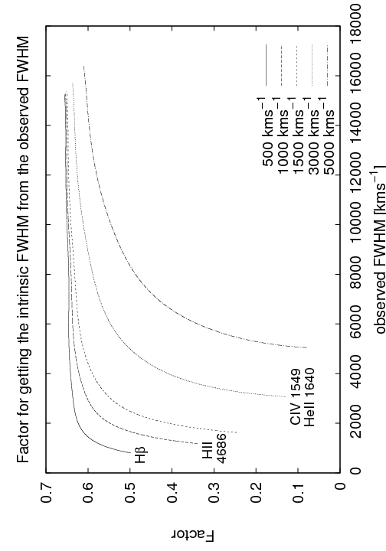
Expected Result:
The finally calulated BH Masses using corrected FWHM are a factor 2 -10 or more lower than to the ones not corrected for the effect of turbulence.
FWHM correction factor for different Emission lines

Slide 11
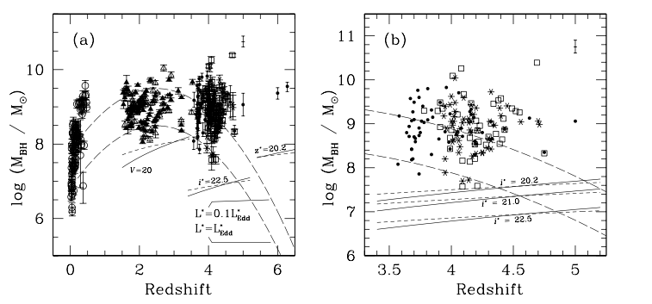
Expected Result
Distribution of MBH with Redshift ref(M.Vestergaard 2003)
The finally calulated BH Masses using corrected FWHM are a factor 2 -10 or more lower
than to the ones not corrected for the effect of turbulence.

Slide 12
Reasoning
Narrow CIVλ1549 lines are rare (~2%) compared with narrow Hβ (~20%)(Baskin & Laor, 2005)
Different mass scaling relations are needed for the CIVλ1549 and Hβ line (Vestergaard 2006).
The use of the CIVλ1549 line gives considerably different BH masses compared to Hβ (Netzer et al., 2007).
By using `Accretion Disk Theory` we can explain the geometrical structure of accretion disk knowing the corresponding turbulent and rotational velocities.
→ fast rotating broad line AGN: geometrically thin accretion disk
→ slow rotating narrow line AGN: geometrically thick accretion disk

