Slide 1
WFPDB - UPGRADING CATALOGUE OF WIDE-FIELD PLATE ARCHIVES
AND RECENT DEVELOPMENT
D. Kalaglarski, K. Tsvetkova, M. Tsvetkov
Institute of Mathematics and Informatics,
Bulgarian Academy of Sciences
Sofia, 02.07.2014

Slide 2
WFPDB meta-model

Slide 3
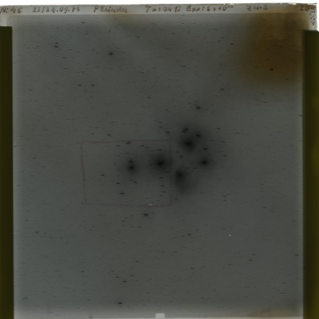
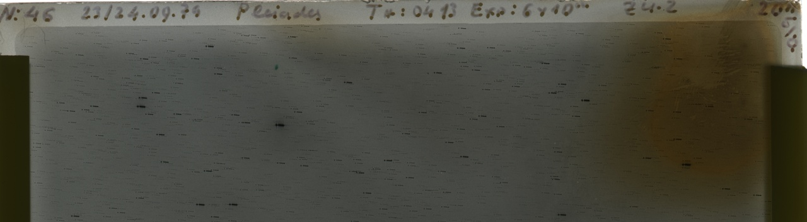
Wide-Field Plate Archive
A collection of astrophysical wide-field plates, which are:
  Obtained via a single instrument at a definite location (observatory).
  Currently stored at a single location.
CWFPA represents description of archival attributes (archive meta-data) in a defined format / schema.

Slide 4
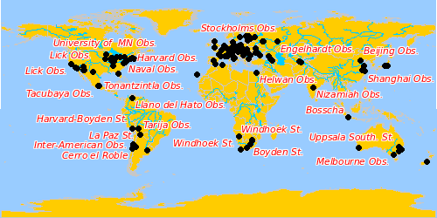
Data in CWFPA
The Catalogue of Wide-Field Plate Archives (CWFPA) currently contains description of 495 archives from 163 observatories.
Description and recent version available at address: http://www.wfpdb.org/catalogue.html
Observatory geographical location, visualized by AstroWeb:

Slide 5
CWFPA archive attributes
Archive ID.
Instrument properties description (instrument type, aperture, etc.).
Observatory of instrument operation (name, country, geographical location).
Archive location.
Astronomer in charge.
Etc.

Slide 6
Archive attribute changes in v7.0
Archive code (coded as 1,2,3,…) – needed when parts of archive plates are stored in different observatories.
Site code (coded as a,b,c,..) – needed when the instrument operated at different locations.
These codes complement the WFPDB instrument identifier (<observatory name><instrument aperture><suffix>, e.g. HAR020A) to form the unique identifier of the archive.
Examples:
  HAR020A archive was made when the telescope operated in Cambridge, Arequipa, Bloemfontein, so Site code of a, b, c, etc. is applied.
  ROZ050 archive plates are located at 3 locations: Sofia, Rozhen, Brussels, so Arch code of 1, 2, 3 is applied.

Slide 7
Import of CWFPA to the on-line system
Import is done via a custom tool to the DBMS.
Representation in the on-line system:
  List of all WFPDB archives: http:/wfpdb.org/search/search.cgi?service=listofarchives&type=all
  List of archives with (at least some) plates already included in the WFPDB: http:/wfpdb.org/search/search.cgi?service=listofarchives&type=active
  Details for an individual archive: available via links.

Slide 8
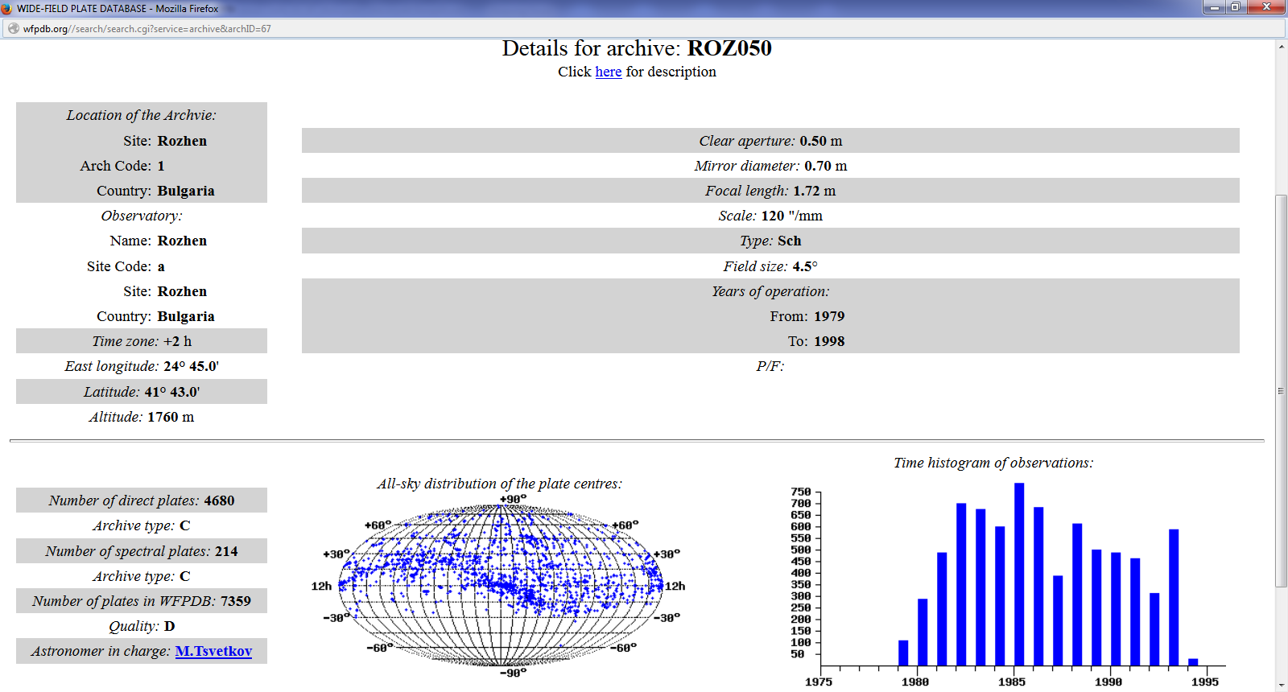
Recent development in the WFPDB on-line access system
Interoperability with AstroWeb: AstroWeb uses the same exact data-set as the WFPDB search system.
Time histogram of observations for an archive (built on-the-fly):

Slide 9
THANK YOU!

