Slide 1
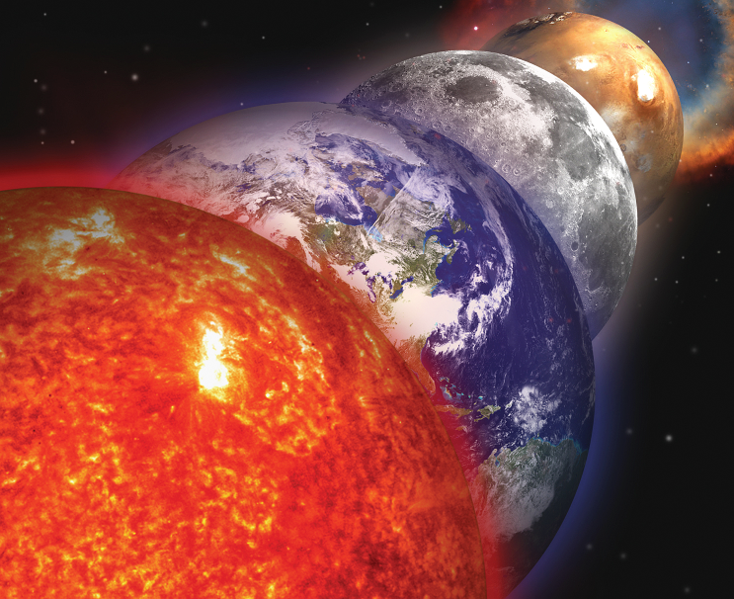
Millennial cycles of mean sea level and
Earth rotation excited by insolation
variations due to orbital harmonics
Yavor Chapanov¹, Jan Vondrák², Cyril Ron²
¹National Institute of Geophysics, Geodesy and Geography – Bulgarian Academy of Sciences
²Astronomical Institute – Academy of Sciences of Czech Republic

Slide 2
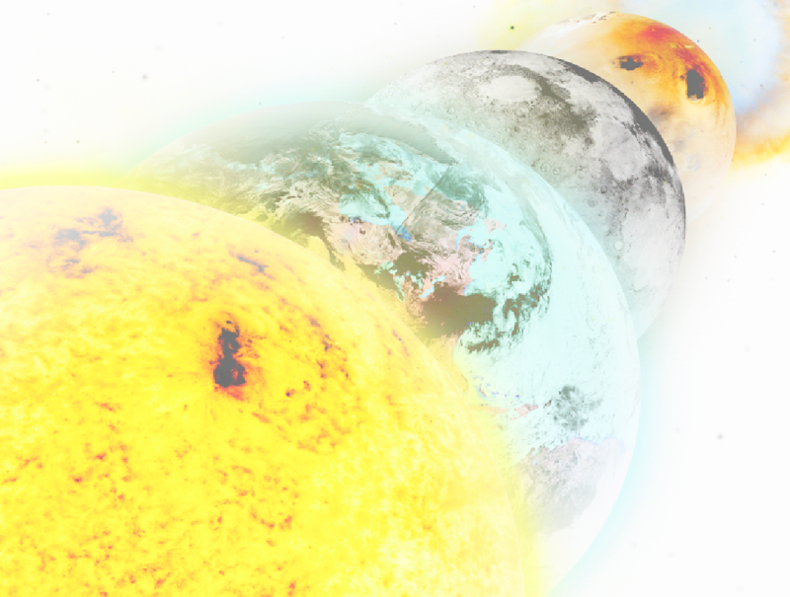
OBJECTIVES
Determination of the common millennial cycles of the Earth rotation and climate variations
Separation of millennial climatic and solar cycles
USED DATA
Wolf’s numbers for the last 11400 years
Total solar Irradiance TSI for the last 9300 years
Mean sea level time series:13Ka-83Ka BP; 380Ka and 800Ka BP
Laskar’s solution for the Earth orbital elements 1Ma BP
METHODS
Fourier approximation + Method of Least Squares
FFT spectrograms
Correlation and regression analysis
RESULTS
Significant correlation between the MSL variations and summer insolation at 65deg. latitude for period bands 21-25Ka; 18.6-19.6Ka; 11.3-11.8Ka; 7.5-7.8Ka; 5.9-6.0Ka; 2.25-2.3Ka.
linear models of climate influence on MSL variations and possibility of separation between the climate and solar millennial cycles.

Slide 3
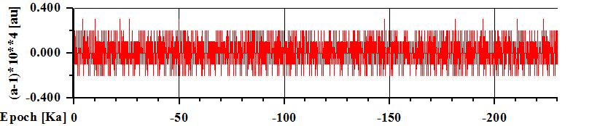
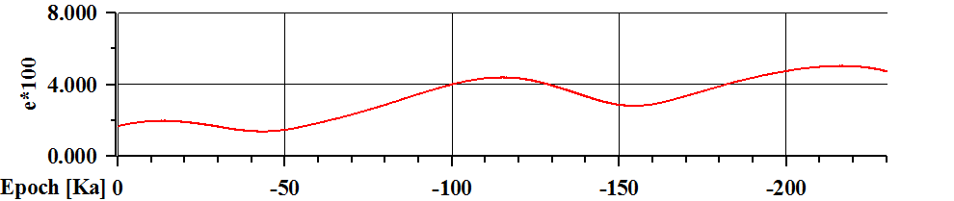
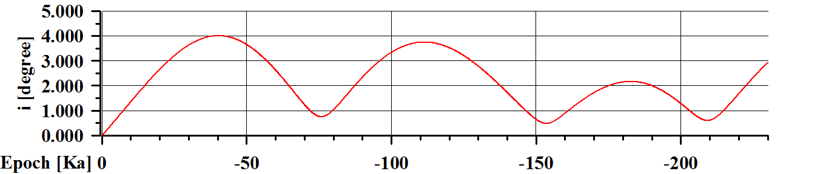
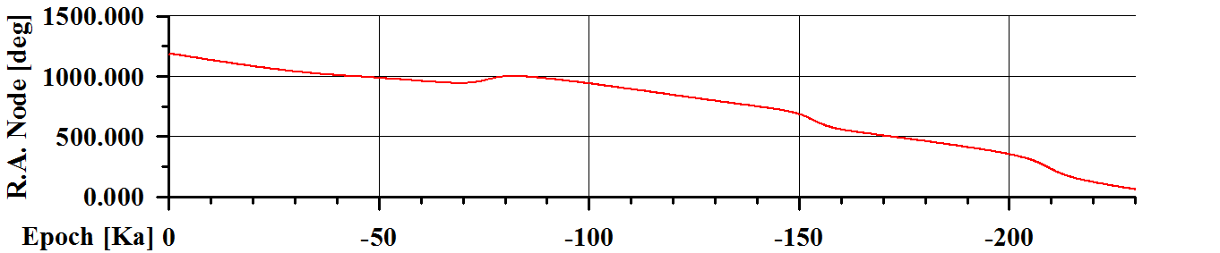
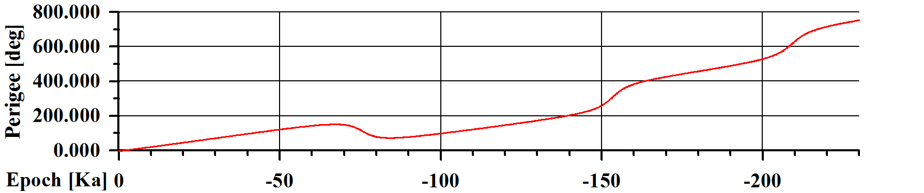
DATA
Earth
Keplerian
Elements

Slide 4
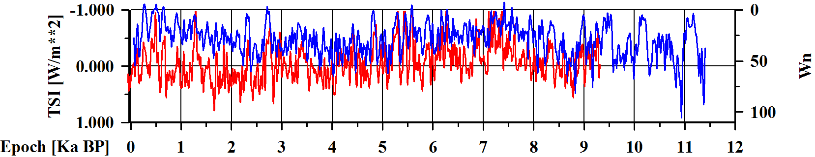
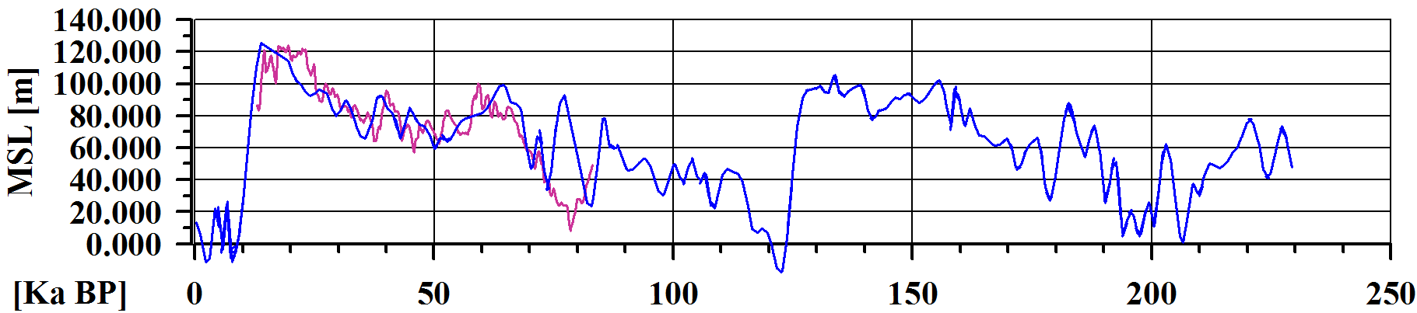
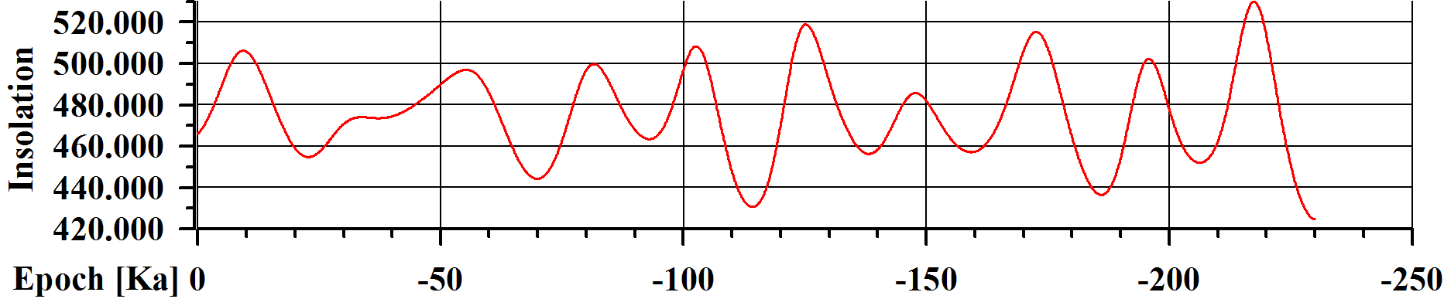
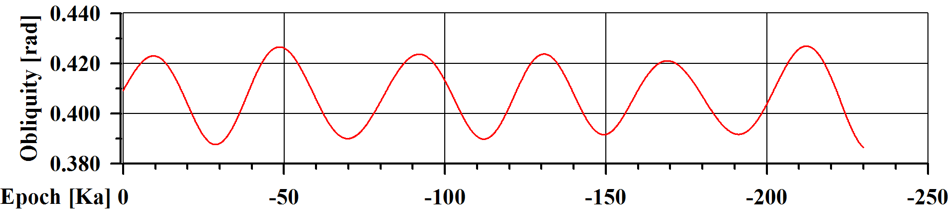
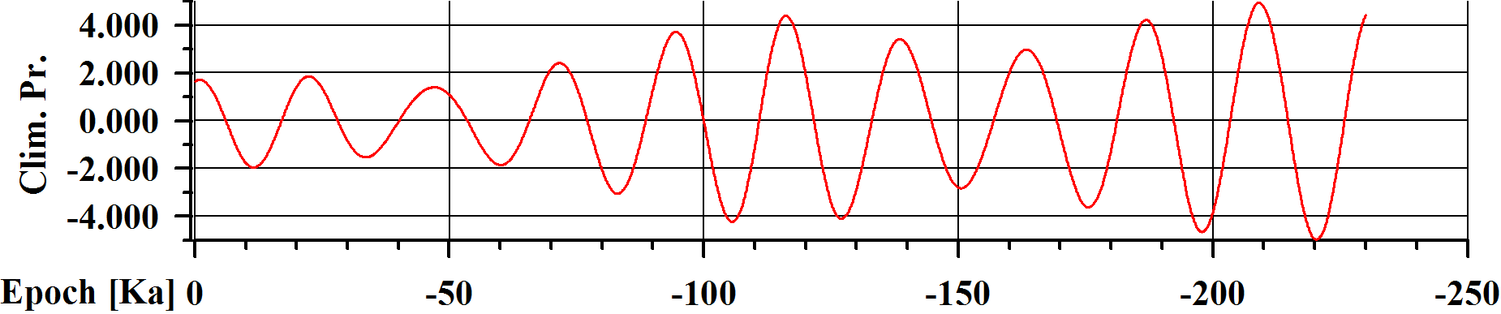
DATA
Wolf’s numb.
TSI
MSL
Insolation
Obliquity
Climatic
precession

Slide 5
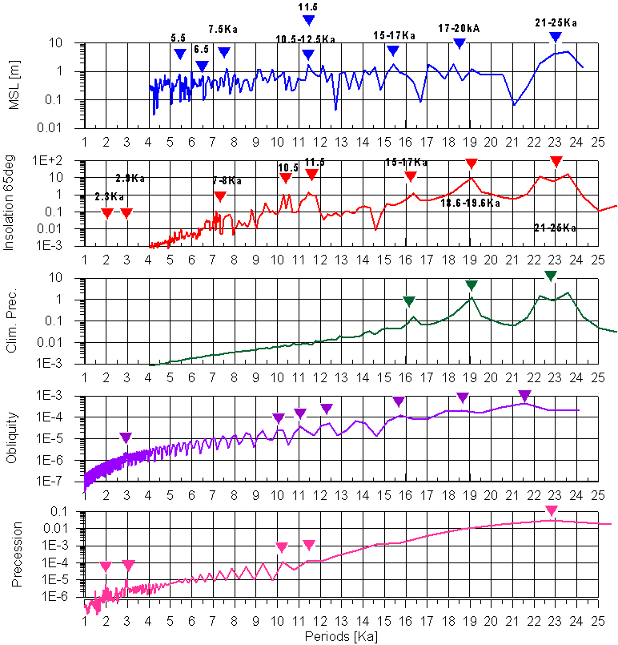
SPECTRA
MSL
Insolation
Precession
Obliquity
Climatic origin of 11.5Ka
Climatic origin of 11.5Ka

Slide 6
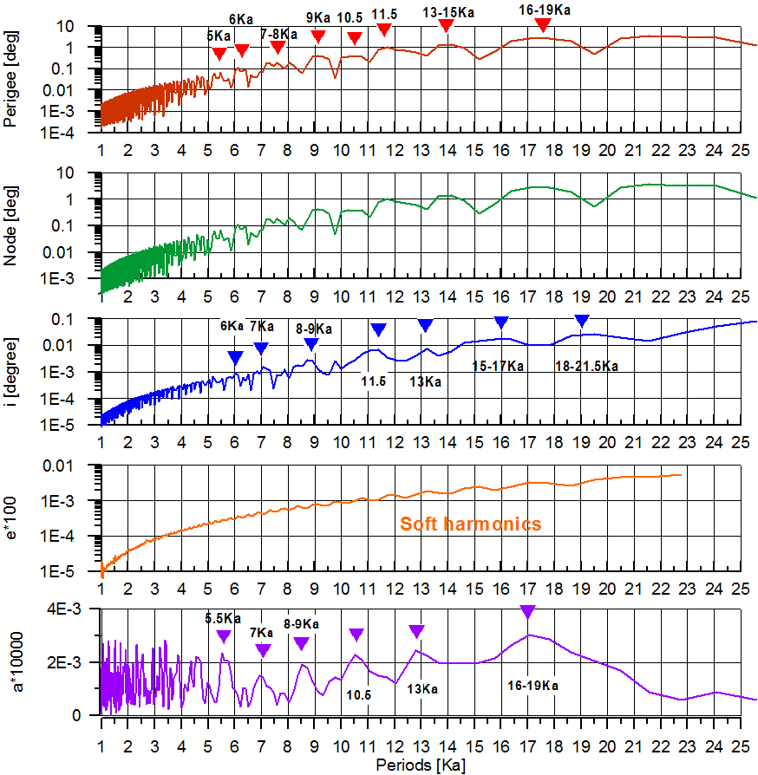
SPECTRA
Climatic origin of 11.5Ka
Earth
Keplerian
Elements
Climatic origin of 11.5Ka?

Slide 7
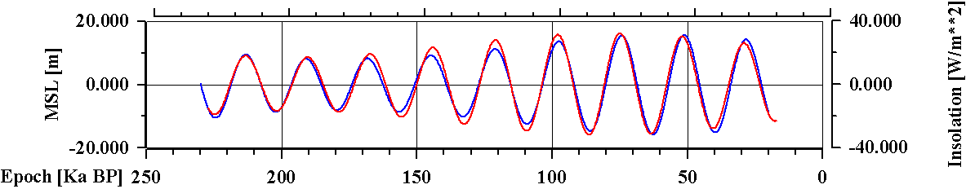
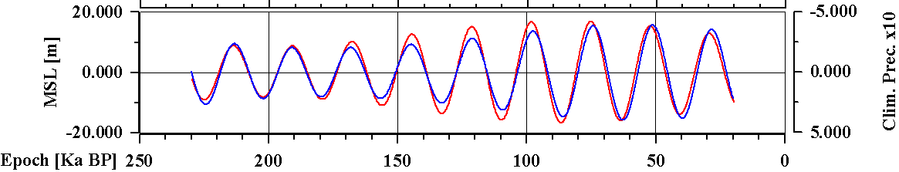
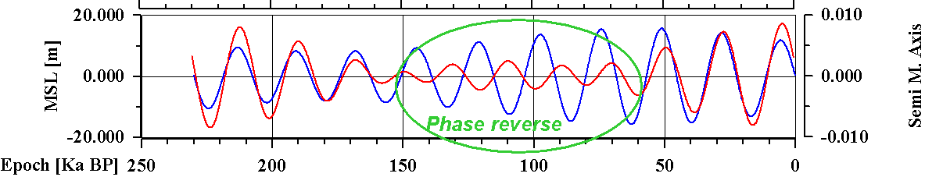
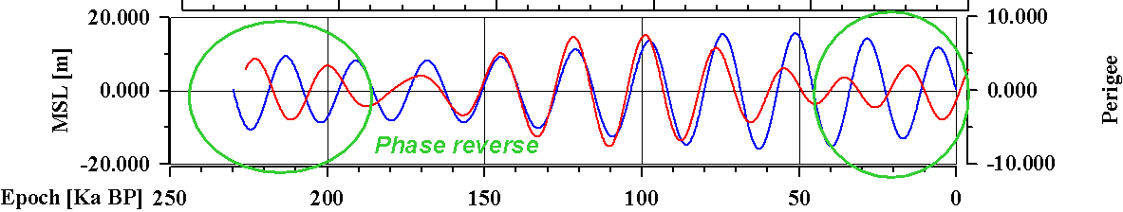
COMPARISON
Excellent matching of MSL and insolation and climatic precession; time delay 1-3Ka
Partial correlation between MSL and keplerian elements with phase reverses
Band
21-25 Ka

Slide 8
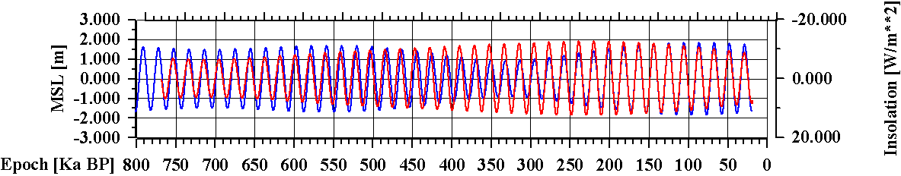
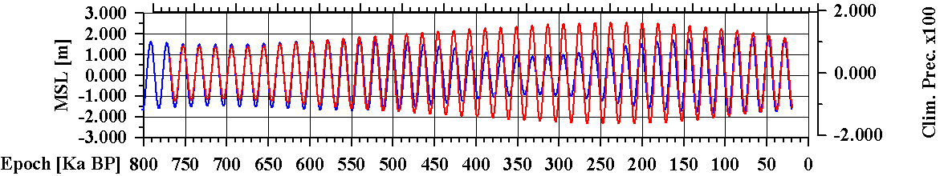
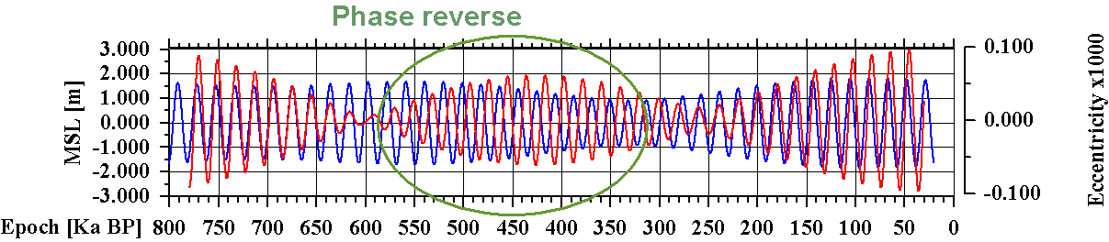
Band
18.6-19.6Ka
COMPARISON
Good agreement between MSL and insolation and climatic precession
Partial correlation between MSL and keplerian elements with phase reverses

Slide 9
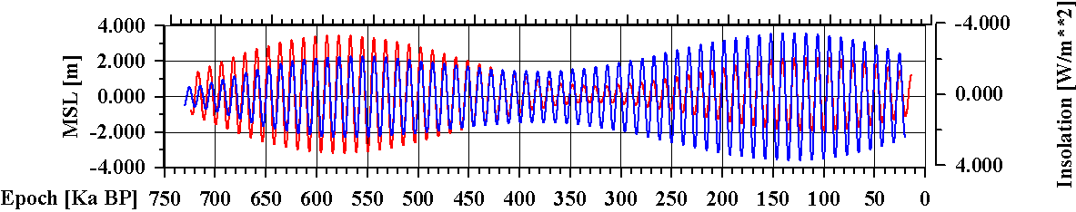
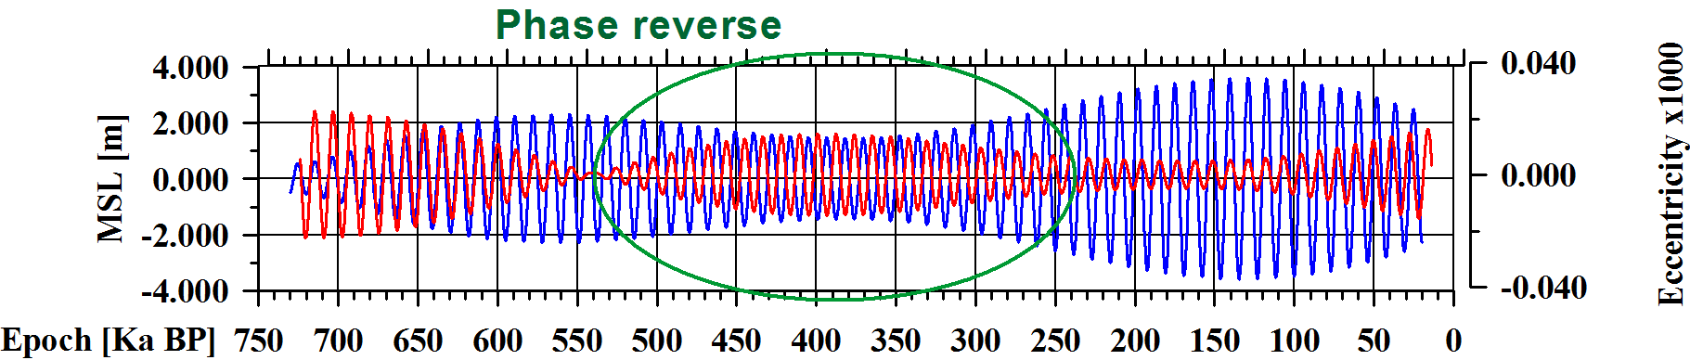
Band 11.3-11.8Ka
11500-year solar cycle
Solar cycles
Good agreement between MSL and insolation
The climatic variations due to orbital harmonics (half precession period )
are the main origin of 11.5Ka oscillations
Partial correlation between MSL and keplerian elements with phase reverses

Slide 10
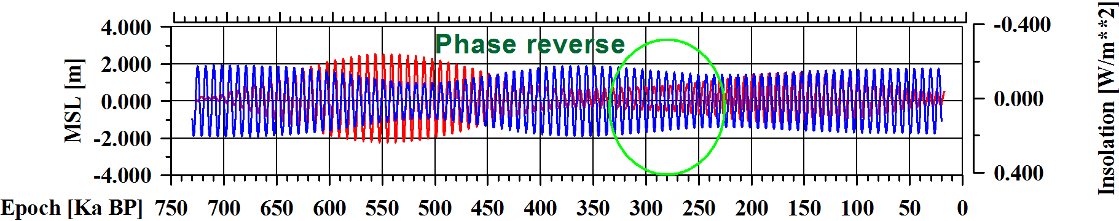
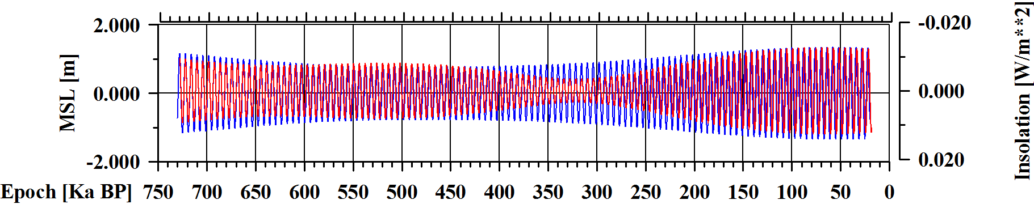
Band 7.5-7.8Ka
Solar cycles
Good agreement between MSL and insolation + short phase reverse
The reported 6000-year solar cycle is not clearly visible in paleo MSL data due to strong
climatic disturbances, but its signatures in phase and frequency deviation exist
Band 5.9-6.0Ka
Good agreement between MSL and insolation, small frequency deviation

Slide 11
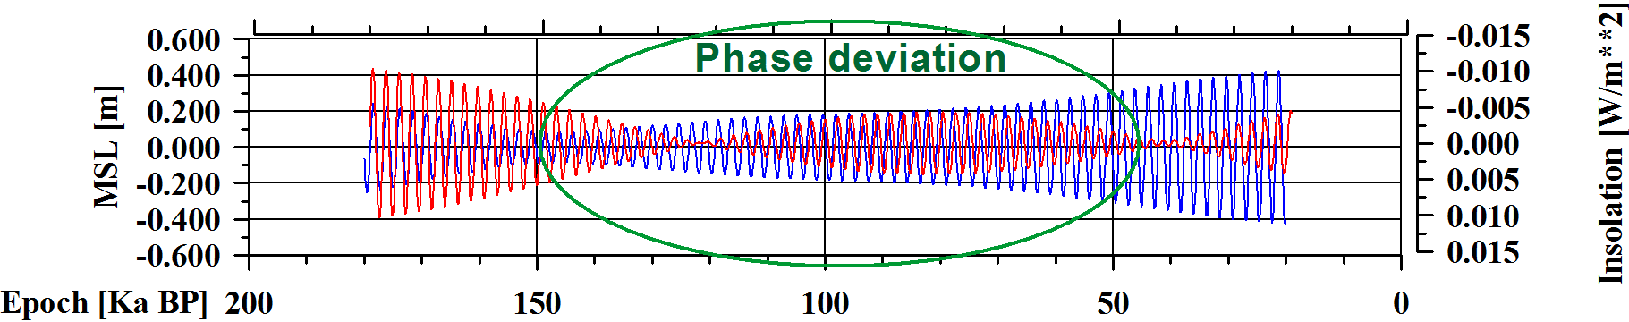
Solar cycles
Band 2.25-2.3Ka
2300-year Hallstatt solar cycle
Correlation between MSL and insolation + significant phase and amplitude deviations
The correlation between MSL and insolation in band 2.25-2.3Ka is strongly disturbed by
The Hallstatt 2300-year solar cycle and corresponding TSI variations, leading to significant phase and amplitude deviations of MSL oscillations.

Slide 12
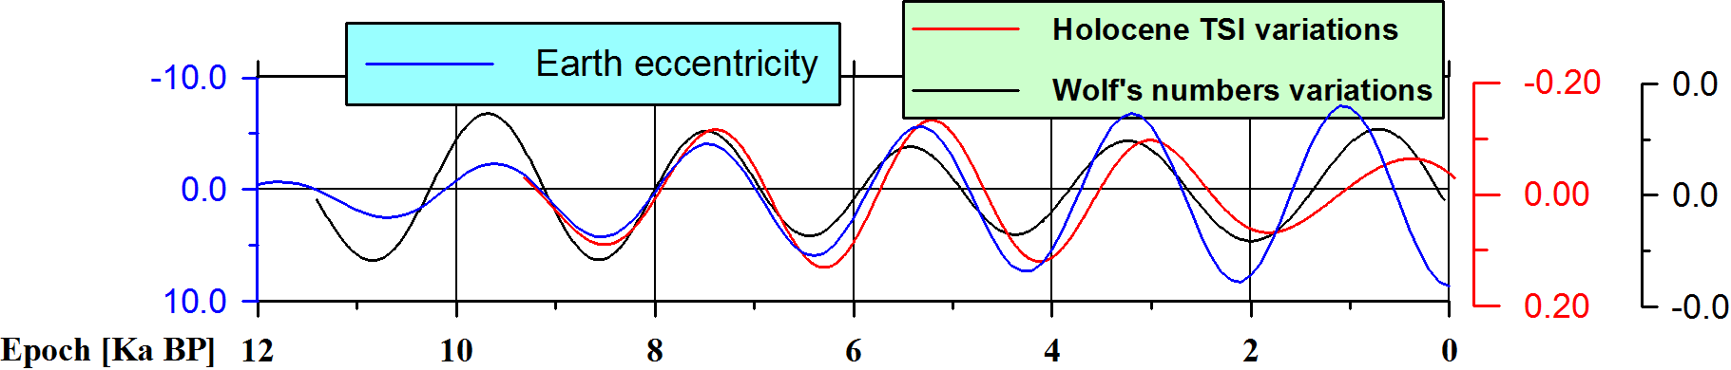
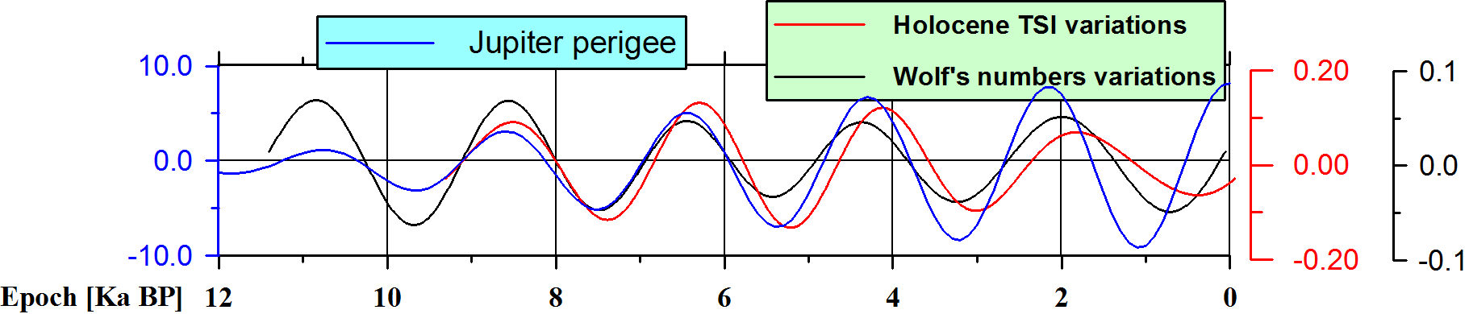
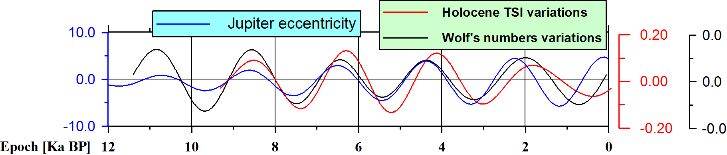
Band 2.0-2.3Ka
2300-year Hallstatt solar cycle
Solar cycles
Some planetary orbital elements are synchronized in band 2.0-2.3Ka and highly correlated with the TSI and Wn Indices during the Holocene – possible signature of planetary origin of the solar activity.

Slide 13
CONCLUSIONS
Significant correlation exists between the MSL variations and Orbital Indices for period bands 21-25Ka; 18.6-19.6Ka; 11.3-11.8Ka; 7.5-7.8Ka; 5.9-6.0Ka; 2.25-2.3Ka. The best correlation is achieved when the index of mean July insolation at 65 degrees North latitude is chosen.
It is possible to create linear regression models of climate influence on MSL in order to separate the climate and solar millennial cycles. The phase, frequency and amplitude deviations exist in some frequency bands (with periods around 2.3Ka, 6Ka and 11.5Ka) between identical MSL and climate orbital indices oscillations. Such discrepancy appears as a signature of additional power source of excitation of millennial MSL variations, like 2300-year Hallstatt cycle of solar activity. An other possible millennial cycle of solar activity is with period from the band 13-17Ka, where no satisfactory correlation between the MSL and North summer insolation exists.
Synchronized oscillations with periods 2.0-2.3Ka exist between orbital elements of Solar system planets and Hallstatt cycles during the Holocene, so they point out to possible signature of planetary origin of the solar activity.

Slide 14
Thank you for atention!

