Slide 1
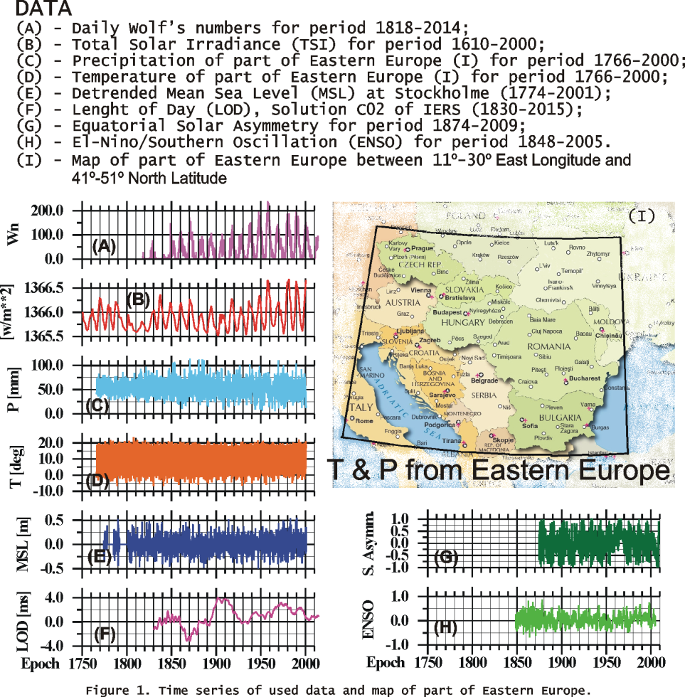
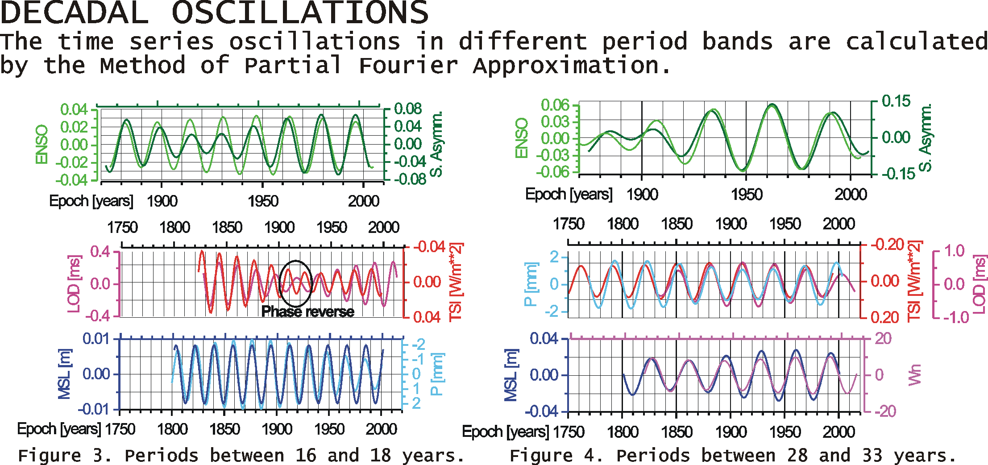
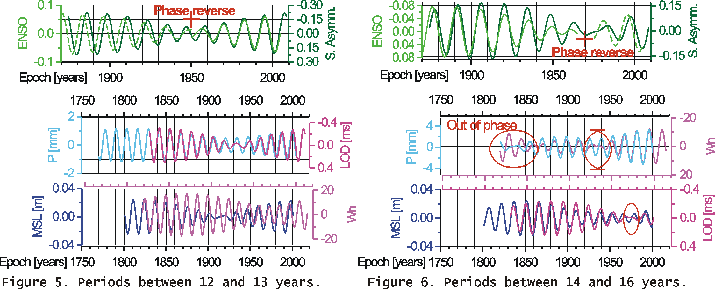
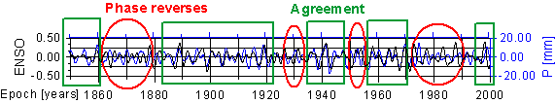

    SOLAR INFLUENCE ON SUBDECADAL VARIATIONS OF EARTH ROTATION, MSL AND CLIMATE, DERIVED BY HARMONICS OF HALE, JOSE, DE VRIES AND SUESS CYCLES
    YAVOR CHAPANOV, CYRIL RON, JAN VONDRAK
A lot of subdecadal and decadal harmonics due to
the shapes of solar cycles.
Common cycles with periods 1-9, 12-19 and 23-33 years
in various Earth time series.
Major effect of equatorial solar asymmetry on ENSO;
TSI and precipitation on LOD;
Wolf’s numbers on mean sea level
Common solar origin of ENSO and
European climate variations

