Slide 1

EARTH ORIENTATION PARAMETERS AND GRAVITY VARIATIONS DETERMINED FROM LAGEOS 1 AND LAGEOS 2 DATA FOR THE PERIOD 1984 – 2011
X SERBIAN-BULGARIAN ASTRONOMICAL CONFERENCE 30 MAY - 3 JUNE, 2016, BELGRADE, SERBIA
Chapanov Ya.¹, Georgiev I.¹
¹National Institute of Geophysics, Geodesy and Geography, BAS, Bulgaria

Slide 2

X SERBIAN-BULGARIAN ASTRONOMICAL CONFERENCE 30 MAY - 3 JUNE, 2016, BELGRADE, SERBIA
OBJECTIVES
Processing of SLR data
USED DATA
Satellite Lageos 1 laser ranging: April 1984 – December 2011;
Satellite Lageos 2 laser ranging: January 1993 – December 2011
    ITRF2000; solution C04 of IERS
METHODS
Program SLRP Version 4.2 (Satellite Laser Ranging Processing);
Method of Least Squares
RESULTS
Estimates of 740 global parameters and
More than 45,000 arc parameters

Slide 3
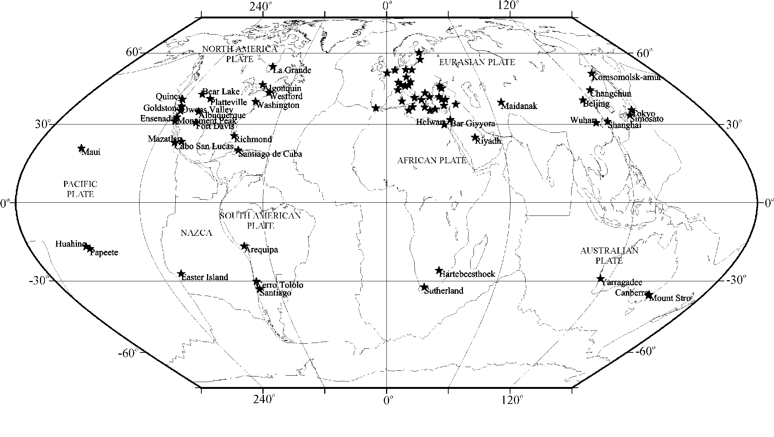
X SERBIAN-BULGARIAN ASTRONOMICAL CONFERENCE 30 MAY - 3 JUNE, 2016, BELGRADE, SERBIA
SLR data
LASER RANGING
Lageos1 : April 1984 – December 2011
Lageos2 : January 1993 - December 2011
2,265,568 three minutes normal points
Fig. 1. The set of SLR tracking stations.

Slide 4
X SERBIAN-BULGARIAN ASTRONOMICAL CONFERENCE 30 MAY - 3 JUNE, 2016, BELGRADE, SERBIA
Program SLRP Version 4.2
Celestial reference frame:
Nature: Definition of the orientation: | dynamical - Lageos 1 and Lageos 2 by fixing each month the last day UTC-UT1 values at IERS Bulletin B.
Terrestrial reference frame: | SSC ITRF2000
Velocity of light: | 299 792 458 m/s
GM | 3.986004418 10¹⁴ m³/s² in two bodies problem 3.986004415 10¹⁴ m³/s², a=6 378 136.3 m, as a scale parameter in the JGM3 geopotential model
Permanent tidal correction: | applied
Definition of origin: | geocentric
Definition of orientation: | Free network, restriction 1m of the latitude of Haleakala (7210) and longitude and latitude of Greenbelt (7105) and Matera (7939) at their ITRF2000 values
Reference epoch: | 2000.0
Tectonic plate model: | ITRF2000 velocity field
Constraint for time evolution: | Free network, restriction 1m/a of the ITRF2000 rates for Haleakala (7210) and Greenbelt (7105)
Earth orientation: | IERS-C04
A priori precession-nutation model: | IAU(2000) and dX and dY corrections from IERS C04
Short period tidal variations in x, y, UT1: | Daily and semi-daily tidal variations, Ray's model
Coordinate systems, constants and models

Slide 5
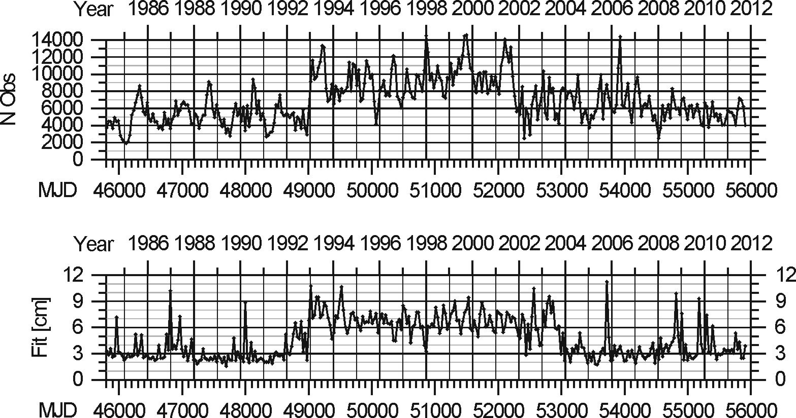
X SERBIAN-BULGARIAN ASTRONOMICAL CONFERENCE 30 MAY - 3 JUNE, 2016, BELGRADE, SERBIA
Program SLRP Version 4.2
Estimated parameters
Unknowns - 46180
Observations - 2292315
Bad observations - 182110
<10%
Dynamical frame: | orbital state vector every month; along track acceleration twice per arc; solar radiation pressure coefficient twice per arc;
Terrestrial frame: | X0, Y0, Z0, XDOT, YDOT, ZDOT;
Earth orientation: | x, y, UT1 every day;
Others: | geogravitational parameter GM0; selected set of 10 geopotential harmonics, including C₂₀; selected ocean loading parameters; station’s range biases (fixing 7939); station’s time biases (fixing 7939).
Monthly number of
observations (N_{obs})
and orbital fit

Slide 6
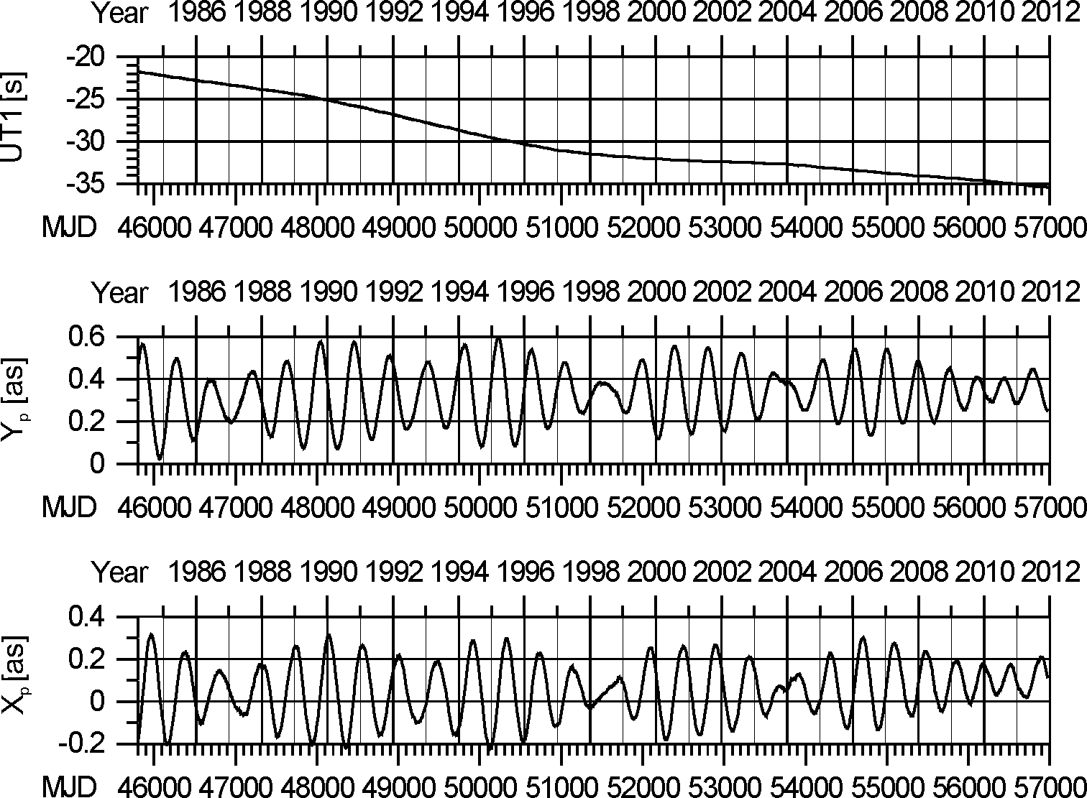
X SERBIAN-BULGARIAN ASTRONOMICAL CONFERENCE 30 MAY - 3 JUNE, 2016, BELGRADE, SERBIA
EOP estimation
EOP - C04 of IERS

Slide 7
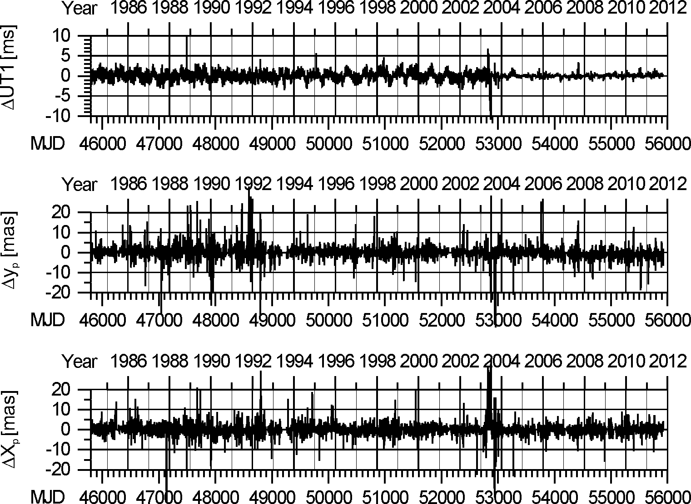
X SERBIAN-BULGARIAN ASTRONOMICAL CONFERENCE 30 MAY - 3 JUNE, 2016, BELGRADE, SERBIA
EOP estimation
Corrections of a priory values of Universal Time and pole coordinates
Possible unmodeled seasonal signals in UT1 series

Slide 8
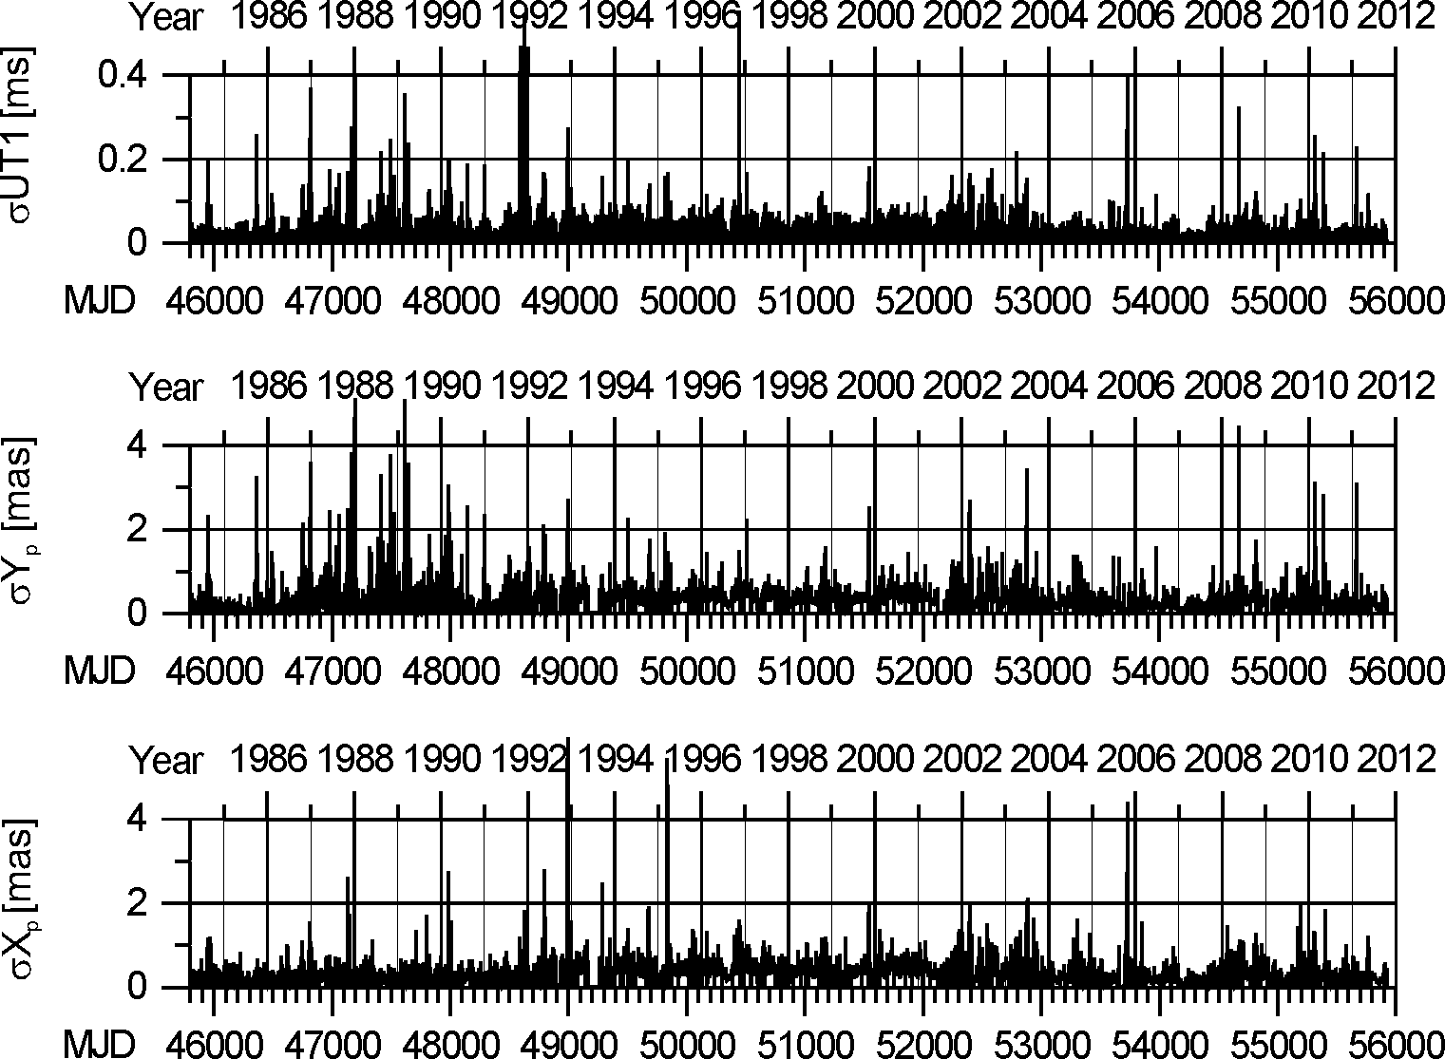
X SERBIAN-BULGARIAN ASTRONOMICAL CONFERENCE 30 MAY - 3 JUNE, 2016, BELGRADE, SERBIA
EOP estimation
Errors of Universal Time UT1 and pole coordinates X_{p} and Y_{p} from the SLRP solution

Slide 9
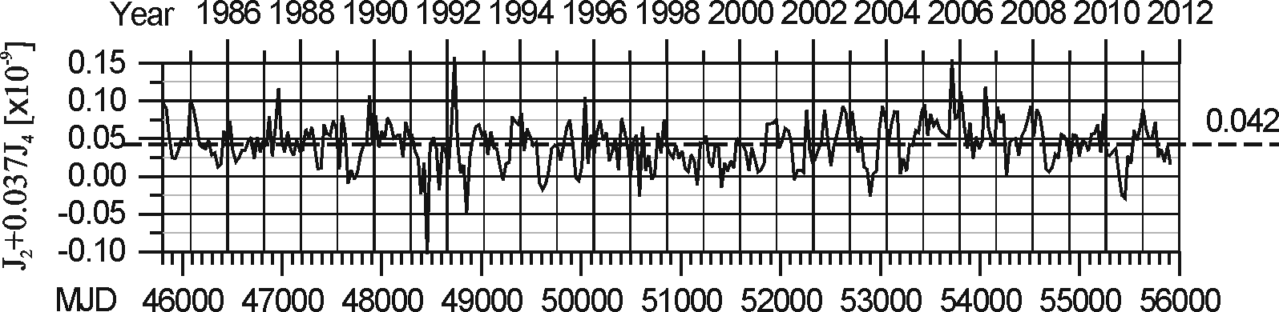
X SERBIAN-BULGARIAN ASTRONOMICAL CONFERENCE 30 MAY - 3 JUNE, 2016, BELGRADE, SERBIA
Time variations of gravity coefficients
The estimation of combination J₂ + 0.037 J₄ stabilizes the common solution
The rate of the obtained drift of the combination J₂ + 0.037 J₄ is:
−1.2 ×10⁻¹²a⁻¹ for the period 1984-1999;
+0.7 ×10⁻¹¹a⁻¹ for the period 1999-2006;
−0.5 ×10⁻¹¹a⁻¹ for the period 2006-2012.

Slide 10
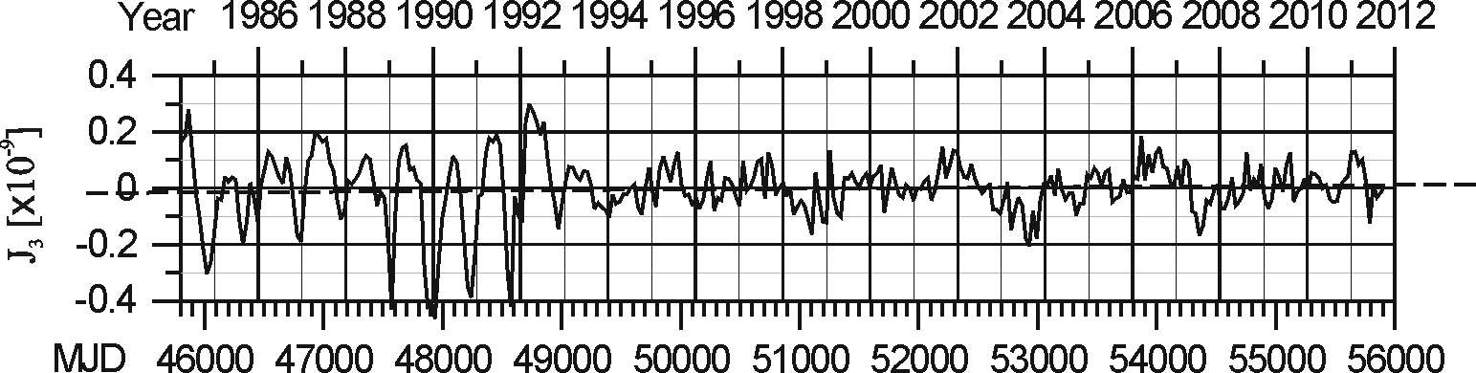
X SERBIAN-BULGARIAN ASTRONOMICAL CONFERENCE 30 MAY - 3 JUNE, 2016, BELGRADE, SERBIA
Time variations of gravity coefficients
Coefficient J₃
The secular rate of J₃ coefficient is:
+0.9×10⁻¹²a⁻¹ for the whole period and
+0.8×10⁻¹²a⁻¹ after 1993.

Slide 11
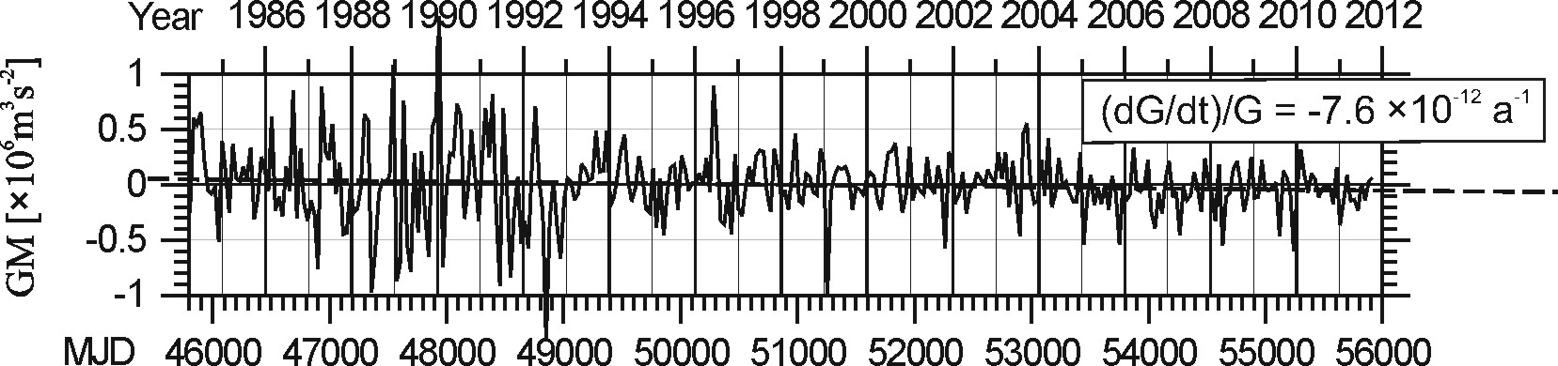
X SERBIAN-BULGARIAN ASTRONOMICAL CONFERENCE 30 MAY - 3 JUNE, 2016, BELGRADE, SERBIA
Time variations of gravity coefficients
Coefficient GM (Geogravity “constant”)
The secular drift of the GM time series is presented by the linear trend of the data, whose inclination is equal to −3.0 ×10⁻⁶ (km³s⁻²)a⁻¹. According this trend, we may calculate the relative secular decrease of the gravity constant
(dG/dt)/G = – 7.6 ×10⁻¹² a⁻¹,
which agrees with some theoretically values within the interval 4⋅10⁻¹³÷2⋅10⁻¹¹a⁻¹ (Weinberg, 1972).

Slide 12
X SERBIAN-BULGARIAN ASTRONOMICAL CONFERENCE 30 MAY - 3 JUNE, 2016, BELGRADE, SERBIA
CONCLUSIONS
The Version 4.2 of SLRP program contains possibilities to investigate the dynamics of the Earth and its interaction with the atmosphere and oceans. The possibility for multiple satellite data analysis over 3 decades is of special importance for the result quality.
We can draw the following conclusions about the obtained results and their analysis:
−The rms of the global solution (7.9cm) indicates the high quality of the obtained solution. The orbital fit is within 1 to 5 cm for a great part of the monthly solutions;
−The use of satellites with different orbit inclinations stabilizes the solution and decreases the error influence on the estimates of a part of the unknowns. That is developed mainly in the estimation of the even zonal harmonics of the gravity potential.
−The estimation of EOP for each day gives a possibility to investigate the short periodic variations in the pole motion and the Universal Time UT1.
The processing of Lageos 1 and Lageos 2 laser ranging data by the program SLRP version 4.2 yields 26-year time series of various global and local geodynamical parameters and improves the values of some important geogravity coefficients. The secular decrease of the coefficients J₂ and J₄ of the even zonal harmonics of the Earth gravitational potential is confirmed. The secular changes of the earth gravity potential coefficients are obtained by the estimation of the linear drift of the change of the combination composed by the even coefficients J₂ + 0.037J₄, and of the change of the coefficient J₃. The rate of the obtained drifts of the combination J₂ + 0.037 J₄ are −1.2 ×10⁻¹²a⁻¹ for the period 1984-1999; +0.7 ×10⁻¹¹a⁻¹ for the period 1999-2006; and −0.5 ×10⁻¹¹a⁻¹ for the period 2006-2012.
The secular drift of the coefficient J₃ determined by the observations of Lageos 1 and Lageos 2 satellites is +0.9×10⁻¹²a⁻¹ for the whole period and +0.8×10⁻¹²a⁻¹ after 1993.
The rate of the secular change of the product GM between the gravity constant G and the Earth’s mass M is −3.0 ×10⁻⁶ (km³s⁻²)a⁻¹. According this trend, the relative secular decrease of the gravity constant (dG/dt)/G is – 7.6 ×10⁻¹² a⁻¹, which is below the upper theoretical boundary of the secular drift of the gravity constant G.

Slide 13
X SERBIAN-BULGARIAN ASTRONOMICAL CONFERENCE 30 MAY - 3 JUNE, 2016, BELGRADE, SERBIA
Thank you for
your atention!

