Slide 1

IONOSPHERIC PERTURBATIONS INDUCED BY
SOLAR X-RAY FLARES
Aleksandra Nina

Slide 2
Prof. Vladimir Čadež
Prof. Luka Popović
Dr Vladimir Srećković
Prof. Saša Simić
STUDENTS
Mr Jovan Bajčetić – PhD dissertation
Mr Miljana Todorović Drakul – PhD dissertation
Ana Djulaković – master thesis
Tatjana Novaković – final exam
Dušan Raičević – final exam

Slide 3
Contents
Introduction:
  Ionosphere, D-region
  D-region monitoring and modelling
  Influences on D-region
Solar X-ray flares:
  Influence on different ionospheric regions
  Comparison of disturbances in D-region and upper regions
  Influence on telecommunication signals
Comparison of X and γ radiation influence on the ionosphere
Applications of the low ionospheric monitoring in the natural disasters prediction
Summary

Slide 4
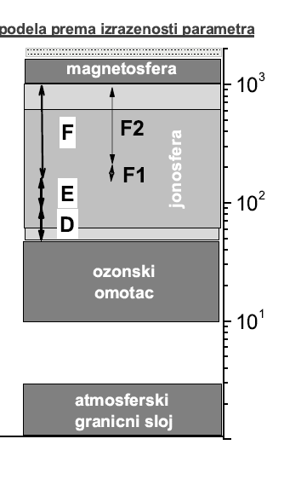
Introduction- ionosphere
magnetosphere
Solar X-ray flare
ionosphere
ozone
layer
PARAMETERS THAT DESCRIBE IONOSPHERE
Electron density
TEC
boundary layer

Slide 5
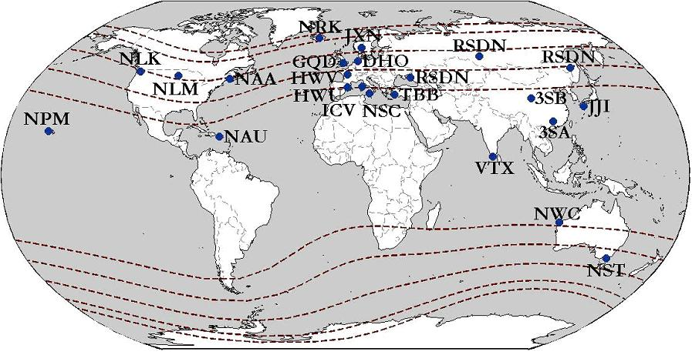
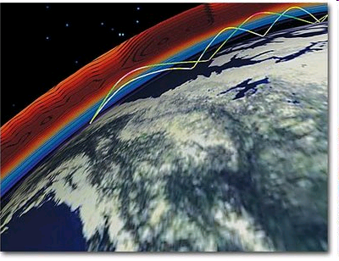
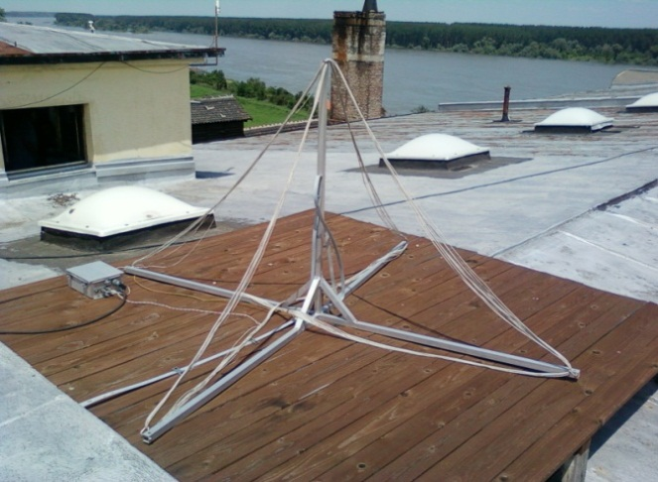
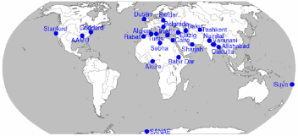
Introduction –low ionospheric monitoring by VLF/LF signals
FREQUENCY DOMAIN
3 kHz – 30 kHz - VLF
30 kHz – 300 kHz - LF
VLF SIGNAL PROPAGATION
Earth – ionosphere waveguide
GLOBAL SETTINGS
-transmitters
-receivers
it allows the analyses of large part of D-region and detection of local perturbations
CONTINUOUS SENDING AND RECEIVING OF SIGNALS -
it allows detections of unperiodical perturbations
BELGRADE VLF RECEIVER STATION
AbsPAL
AWESOME
5

Slide 6
Observations
Solar X-flare - May 5th, 2010
X radiation intensity I
registered by the National Oceanic and Atmospheric Administration (NOAA)
satellite GOES-14
D - region monitoring:
23.4kHz VLF signal emitted by the DHO transmitter in Rhauderfehn (Germany) and received in Belgrade (Serbia)

Slide 7
Electron density modeling
Wait’s model of ionosphere:
reflection height H’(t)
sharpness β(t)
NUMERICAL PROCEDURE FOR WHITE PARAMETERS CALCULATION:
A. Nina, PhD dissertation, 2014
Numerical program for simulation of the VLF/LF signal propagation: Long-Wave Propagation Capability (LWPC) - USA National Oceanic and Atmospheric Administration (NOAA) – Ferguson, 1998
The procedure is based on finding the combination of input Wait’s parameters that gives the best matching of the recorded and modelled signal amplitude and phase changes (Grubor et al., 2008)

Slide 8
Solar X-ray flares influence on different ionospheric regions

Slide 9
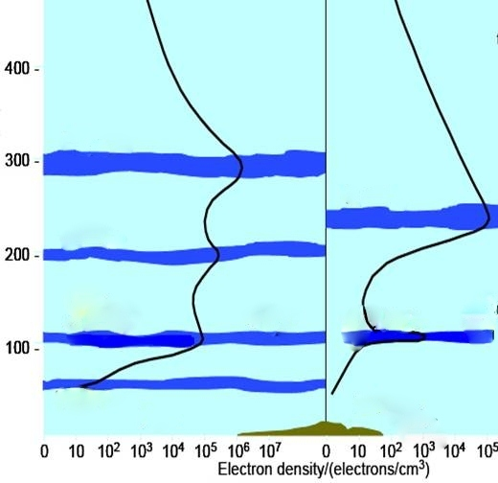
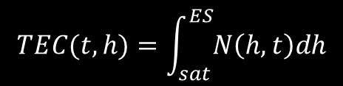
$$TEC(t,h)=\int_{sat}^{ES}{N\left(h,t\right)dh}$$
F
the column electron number density defined as the number of free electrons in a column of unit cross section extending from the satellite to the ground .
E
D

Slide 10
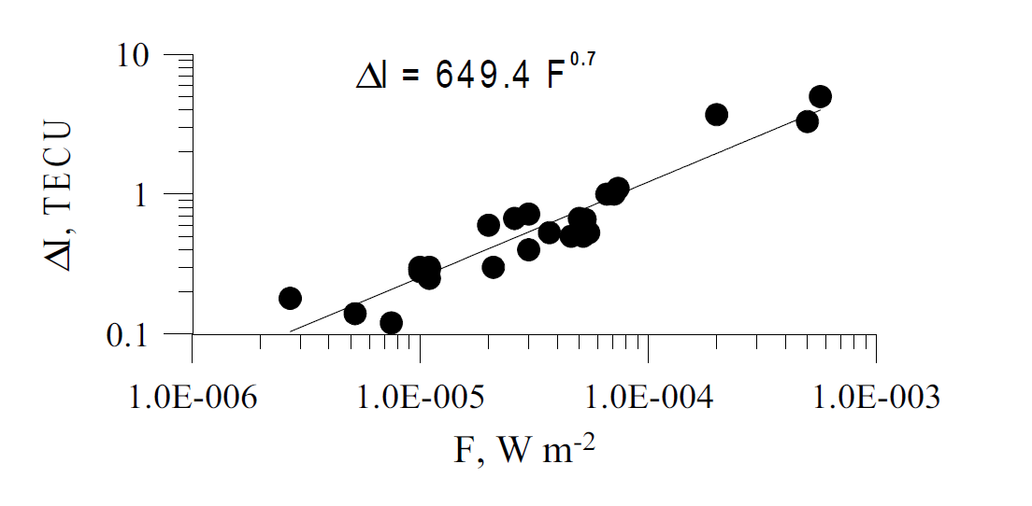
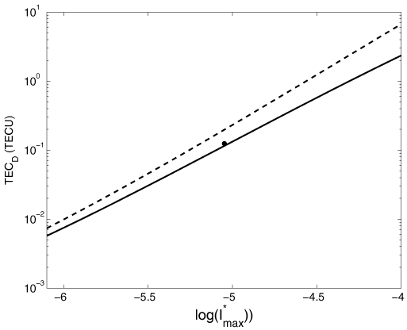
Ionospheric effects of the solar flares as deduced
from global GPS network data
L.A. Leonovich, A.T. Altynsev, V.V. Grechnev, E. L. Afraimovich
ΔTEC (TECU)
I (W/m²)
D-REGION
Dependencies of TEC_{D} in the times of X-ray intensity maxima of C and M classes are events calculated from data given in Grubor et al. 2008 (solid line) and Thomson et al. 2005 (dash line) as a function of I∗_{max} = I_{max}/I₀, where I₀ = 1 W/m²
ΔTECD (TECU)

Slide 11
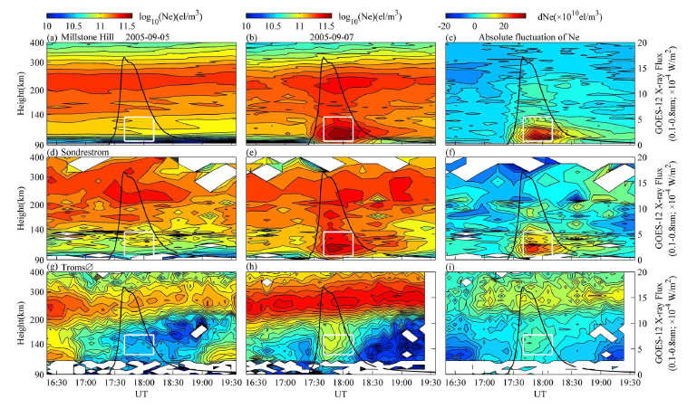
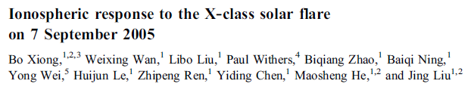
Large X-ray flare

Slide 12
Comparison of disturbances in
D-region and in upper regions

Slide 13
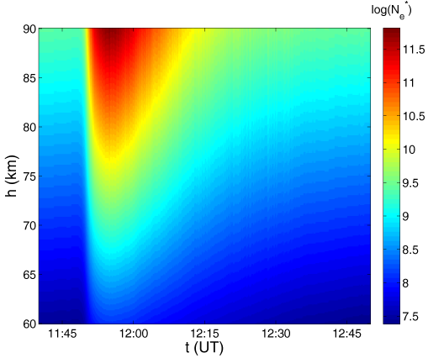

Slide 14
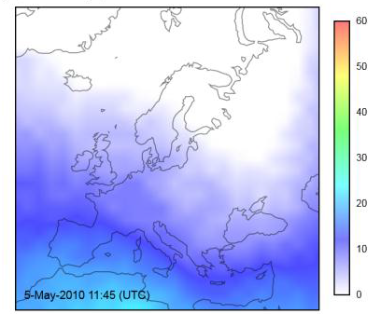
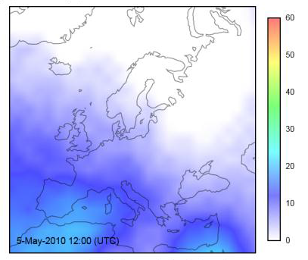
http://www.bath.ac.uk/eleceng/invert/iono/rti.html

Slide 16
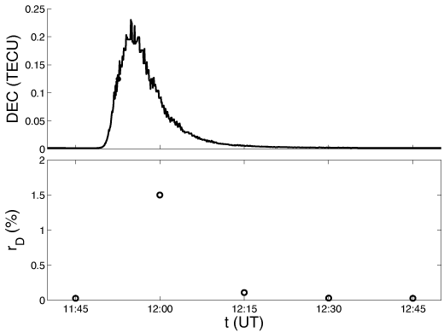

Slide 17

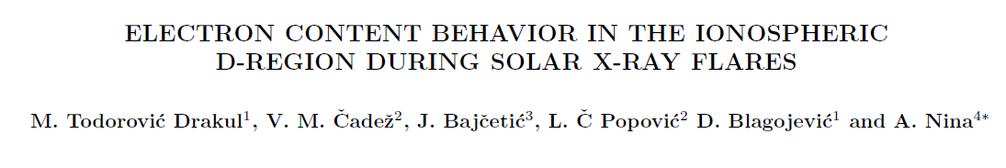

Slide 18
Influence on telecommunication signals

Slide 19
Radio signal propagation

Slide 20
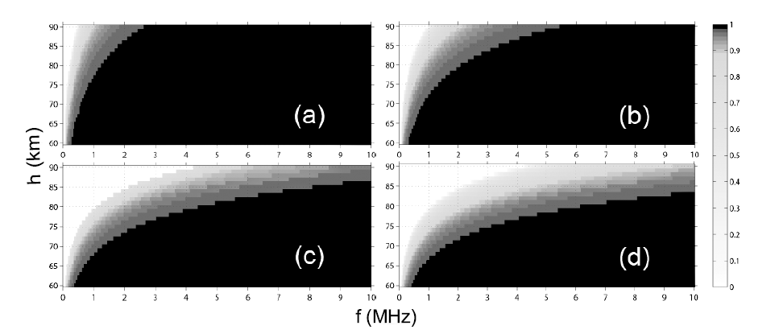
Radio signal propagation
The real part of refraction index nR = Re[n(h; f)] for different D-region altitudes h and signal frequencies f at: (a) time just before the X-flare starts, (b) time when I in the P regime has the same value as when f0 reaches maximum, (c) time of I maximum, and (d) time of f0 maximum. The white areas correspond to domains where waves cannot propagate.

Slide 21
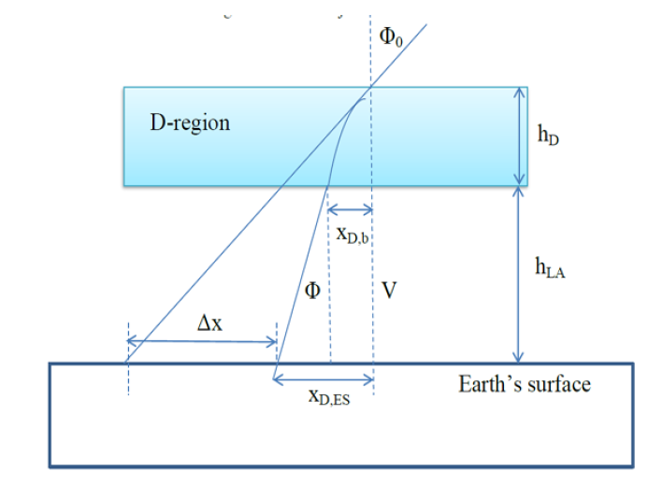
GNSS signals

Slide 22
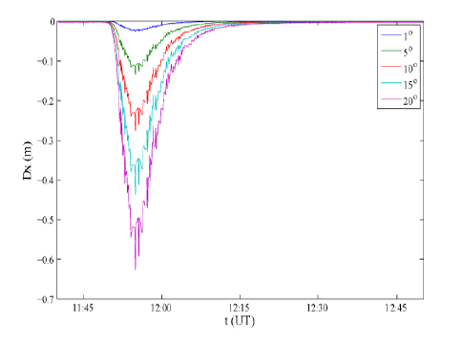
GNSS signals

Slide 23
Comparison of X and γ radiation influences on ionosphere
23

Slide 24
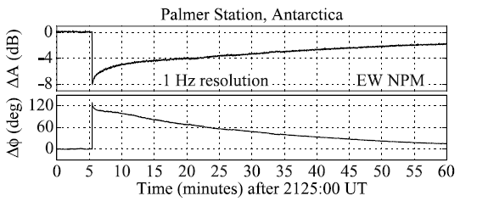
SID induced by other radiation – γ-ray bursts
Long-term SIDs
Massive disturbance of the daytime lower ionosphere by the giant
γ-ray flare from magnetar SGR 1806–20
U. S. Inan,1 N. G. Lehtinen,1 R. C. Moore,1 K. Hurley,2 S. Boggs,2 D. M. Smith,3
and G. J. Fishman4
GEOPHYSICAL RESEARCH LETTERS, VOL. 34, L08103, doi:10.1029/2006GL029145, 2007

Slide 25
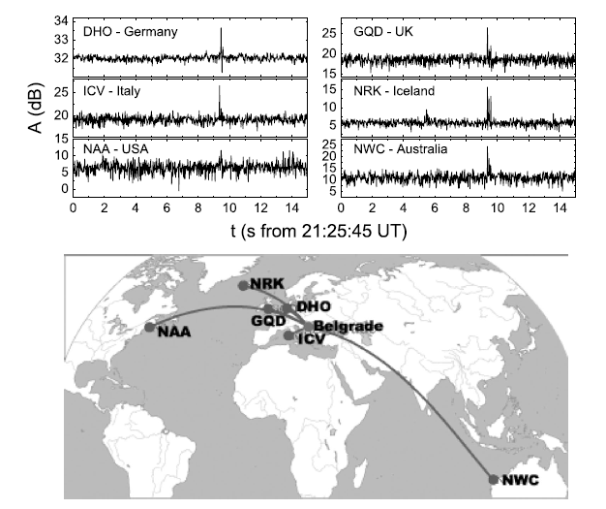
SID induced by other radiation – γ-ray bursts
Short-term SIDs

Slide 26
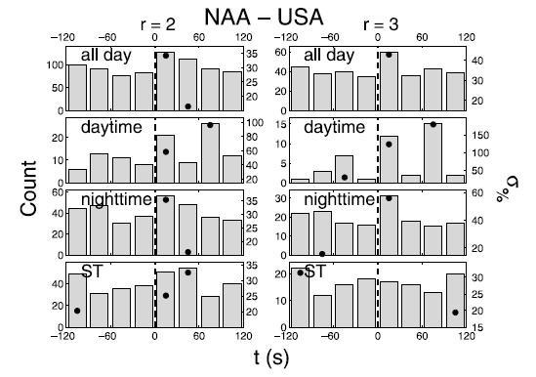
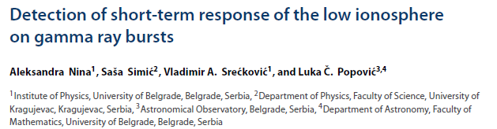

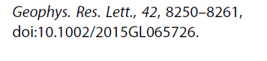

Slide 27
Applications of
low ionospheric monitoring in
natural disasters prediction
27

Slide 28
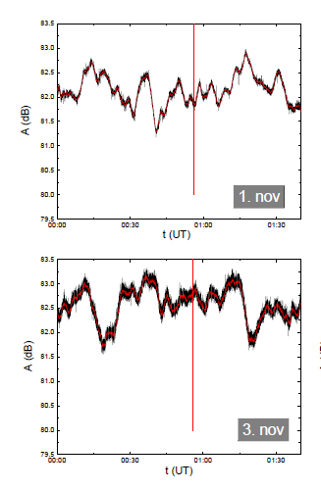
Earthquakes

Slide 29
COST Action TIDES
Alesksandra Nina
Luka Popović
Srdjan Mitrović
Jovan Bajčetić
Milenko Andrić
Slobodan Simić
Saša Simić
Ana Djulaković

Slide 30
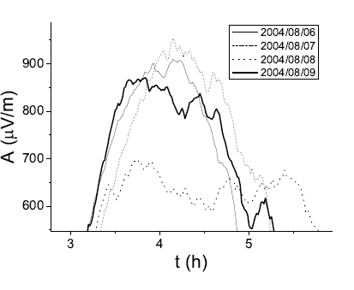
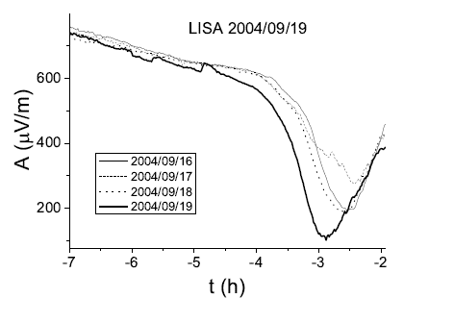
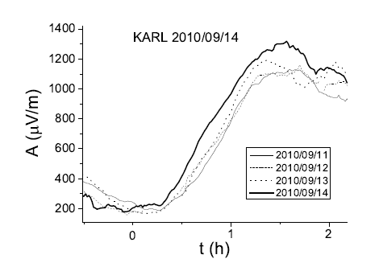
Tropical depressions before hurricanes
Type I
Type II
Type III

Slide 31
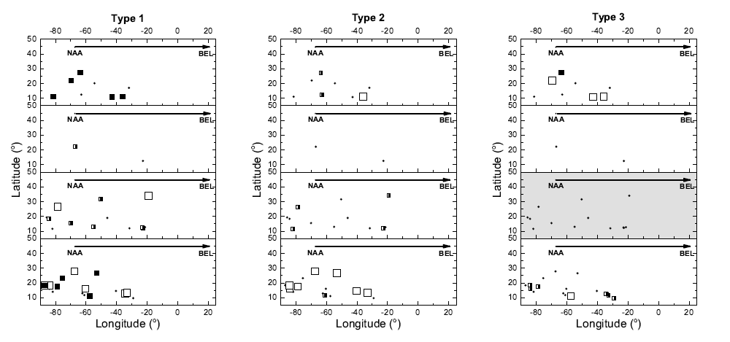
TP I are indicated by black squares, in TP II by open squares and in TP III
by half black squares. The grey panel in the right graph is mark because the considered time period do not include time when Type 3 appears.

Slide 32
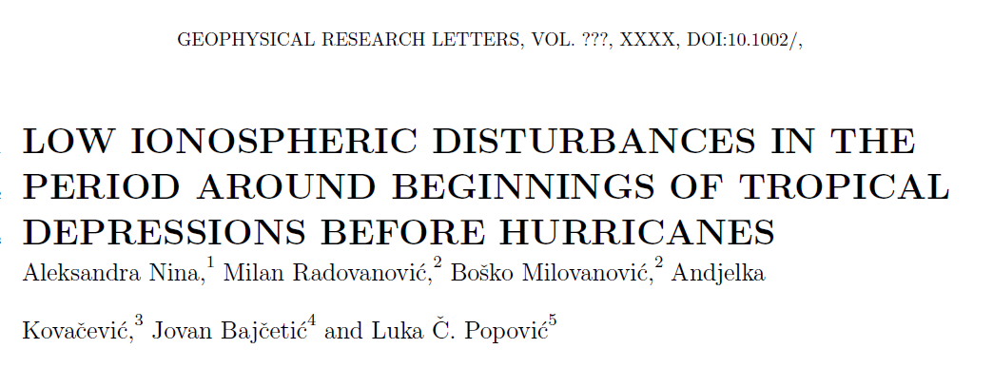

Slide 33
Summary
Solar
Solar X-ray flares:
  Influence on different ionospheric regions
  Comparison of disturbances in D-region and upper regions
  Influence on telecommunication signals
Comparison of X and γ radiation on ionosphere
Applications of the low ionospheric monitoring in the natural disasters prediction

Slide 34
Хвала на пажњи!
Благодаря за вашето внимание!
34
34

