Slide 1



INVESTIGATION OF SUB-PC AGN REGIONS AND GRAVITATIONAL LENSES WITH OPTICAL SPECTROPOLARIMETRIC METHOD
Victor L. Afanasiev & Luka. Č. Popović
X SBAC, Beograd
30. 05-03.06.2016

Slide 2
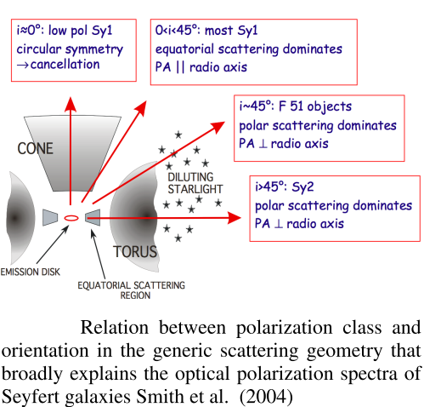
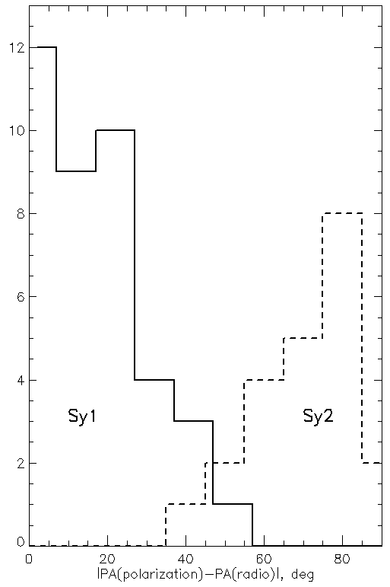
Polarization of AGNs - a simple (UNIFIED) model
Orientation is important !
Notes:
In this slide, we show simplified representation of the
polarization in the AGN. Seyfert galaxies of type 1 and 2
show the different direction of the polarization plane.
Let me just note, that in reality, the situation is far more complex.

Slide 3
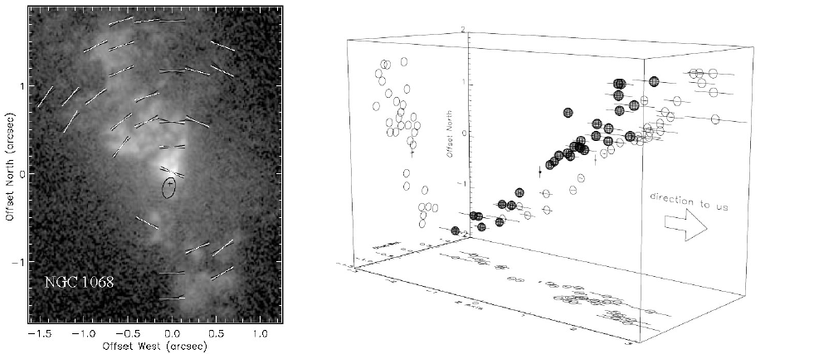
Scattering clouds in NGC 1068 (Sy2)
Capetti et al. 1995 Kishimoto et al. 1999
Phase function of Thomson scattering
Spatial distribution of polarized flux
Assuming optically thin matter
3D image of the scattering clouds
In polarized light is visible broad Hα: Sy2 =>Sy1 !

Slide 4
Polarization AGN – INSIDE OR OUTSIDE ?
INSIDE (scale < 1pc)
polarization of radiation in the field of a rotating black hole
radiation transfer in optically thick accretion disk
(electron scattering)
synchrotron radiation of the jet
OUTSIDE (scale> 1pc)
scattering in optically thick gas-dust torus
scattering in optically thin gas cone ionization
SCALE IS IMPORTANT !

Slide 5


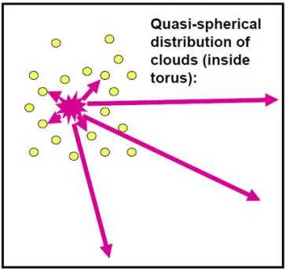
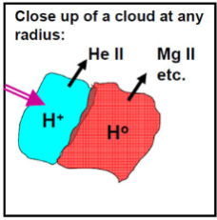
Polarization in BLR & continuum
i ~ 0°, scattering ~ 0 (E ⊥), view direct to accretion disc (E ⎜⎜) and jet (E ⊥)
i <45°, equatorial scattering> 0, (E ⎜⎜)
jet (E⊥)
i ~ 90, polar scattering> 0 (E⊥), “hidden” BLR in polarized ligth
Dusty torus, size~ 10¹⁸cm
Polarization in continuum
radiative transfer in the AD
Synchrotron radiation in jet
scattering by gas-dust torus
Polarization in lines
scattering by gas-dust torus
radiative transfer in the BLR
BLR, size~10¹⁷cm
BH, M~10⁸M . R_{g}~10¹³cm
Accretion disk size~ 10¹⁵cm (E||)
Notes:
This slide shows the scenario for the onset of polarization
of radiation near the center of AGN at different scales - from the size
of the accretion disk (less than one hundredth of a parsec) to torus or
polar outflow (about the size of a few parsecs). Even for the closest
active galaxies, this corresponds to an angular size less than one arc second.
In ground based observations, the observed polarization is a result
of polarization vector addition, coming from a variety of mechanisms.
For example, in the area of the accretion disk, where the
gas is very hot, the polarization arises from the Thomson scattering
(where the plane of polarization is parallel to the axis of the disk), but the
presence of relativistic electrons and magnetic field produce polarized
synchrotron radiation with the polarization plane of approximately
perpendicular to axis – depending from pitch angle.
Resulting polarization vector is not strictly parallel to the axis of the disk.
The situation with the polarization in the BLR is even more complicated.
Due to of the cloud structure in this area the polarization does not occur,
and the observed polarization is produced by radiation scattering on the
matter outside the BLR.

Slide 6
Spectropolarimetric observations:
Motivations
To study variability in polarized spectra (continuum and broad lines) of Type 1 AGNs
To measure the dimension and clarify the nature of the polarization region (e.g. is the continuum polarized in the BLR)
Methods
To observe and measure the linear polarization (Stokes parameters) in spectra of radio quiet AGN with low spectral resolution covering a wide spectral range in several epochs
To performe echo-mapping (reverberation) in order to find the dimensions of polarization region and compare it with the BLR dimension
Instrument
6-m telescope + SCORPIO, spectral coverage 4000-8000 AA
Different type analyzer – Savart plate, Single and Double Wollaston prisms
Spectral resolution 5-40AA,
Precision measurement of the polarization 0.1-0.3%
Notes:
The choice between the different scenarios of radiation polarization in AGN
can be made only based on observations.
Motivations.
-To study variability in polarized spectra (continuum and broad lines) of
Type 1 AGNs.
-To measure the dimension and clarify the nature of the polarization region
(for example is the continuum polarized in the BLR).
Methods.
-To observe and measure the linear polarization (Stokes parameters) in
spectra of radio quiet AGN with low spectral resolution covering a wide
spectral range in several epochs .
-To performe echo mapping (reverberation) in order to find the dimensions
of polarization region and compare it with the BLR dimension.
Instrument.
-6-meter telescope + SCORPIO spectrograph , spectral coverage 4000-8000 Angstroms
-Different type analyzer - Savart plate, Single and Double Wollaston prisms
-Spectral resolution 5-40 Angstroms.
-Precision measurement of the polarization .1 - .3% .

Slide 7
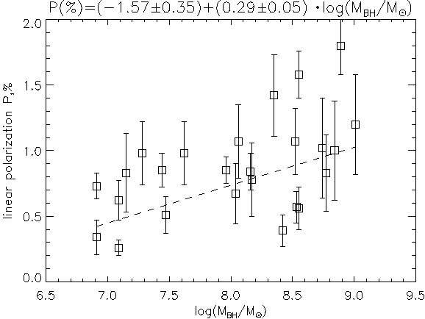
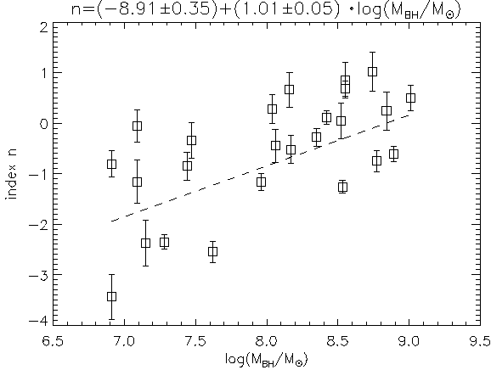
Polarization in continuum. Observation
(Afanasiev et all., Astronomy Letters., 2011, v.37,p.307
Observed in the continuum polarization is formed on a small scale
The polarization caused by the Thomson scattering does not depend on the wavelength
Observed wavelength dependent polarization as Ρ ∝ λ^{n}
The reason - Faraday rotation in the magnetic field AD on the photon mean free path (Gnedin & Silant’ev, 1997)
Extrapolation of the magnetic field in the disc gives an estimate of the magnetic field on the event horizon of about one thousand gauss

Slide 8
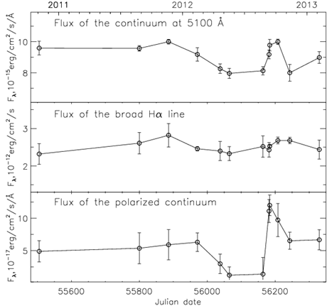
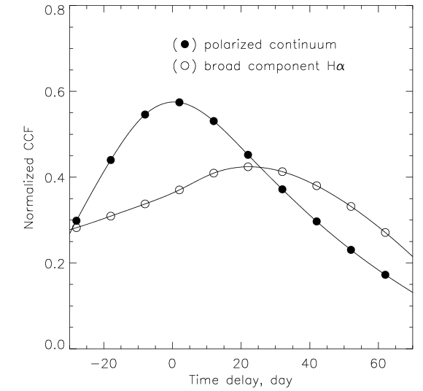
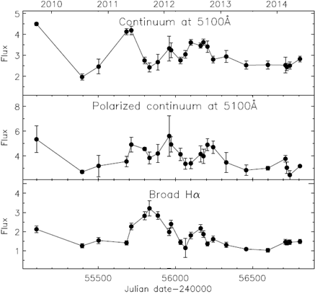
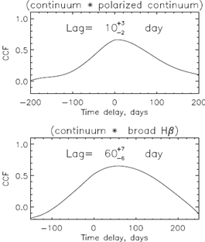
Polarization in continuum. Variability
Seyfert galaxy Mkn 6 (Sy1.5)
spectropolarimetric monitoring (12 epoch) in 2010-2014
size of the polarized continuum about 2 light days (0.002 pc)
BLR size from reverberation broad Hα about 22 light days (~0.02 pc)
Afanasiev et al., 2014, MNRAS, v.440, p.519
Radio-galaxy 3C390.3 (Sy1)
spectropolarimetric monitoring (23 epoch) in 2009-2015
size of the polarized continuum about 10 light days (0.01 pc)
BLR size from reverberation on broad Hβ about 60 light(~0.06 pc), and about 140 days on broad Hα (~0.06 pc)
Afanasiev et al., 2015, MNRAS, v.448, p.276
Region of polarized continuum less on order BLR !

Slide 9
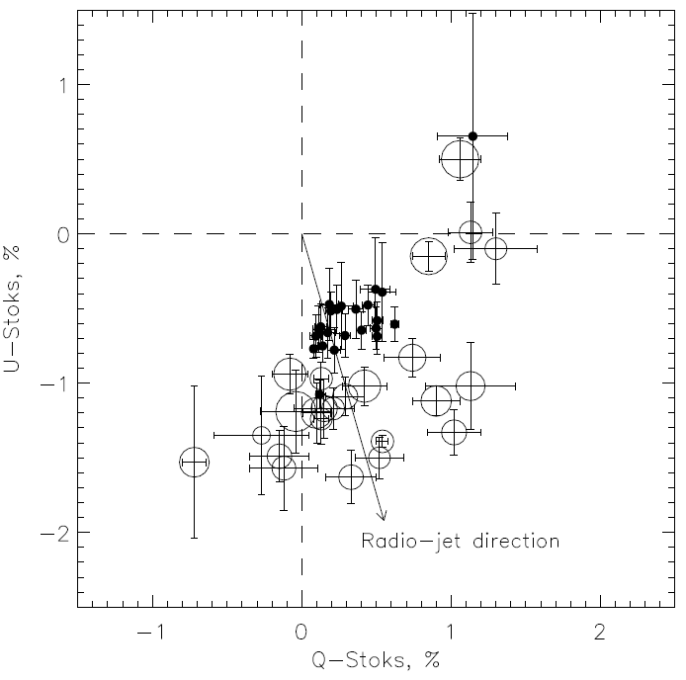
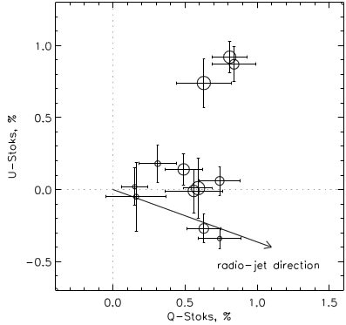
Polarization in continuum : disk+jet?
3C390.3
Mkn 6
disk jet obs
disk jet obs
Polarization in the disk ⇒ radiative transfer in the AD ($\vec{E}$|| axis)
Polarization in the jet ⇒ synchrotron radiation in the variable Jet ( $\vec{E} \text{⊥}$ axis)
The observed polarization in the continuum – the result of the vector addition disk and jet polarization

Slide 10
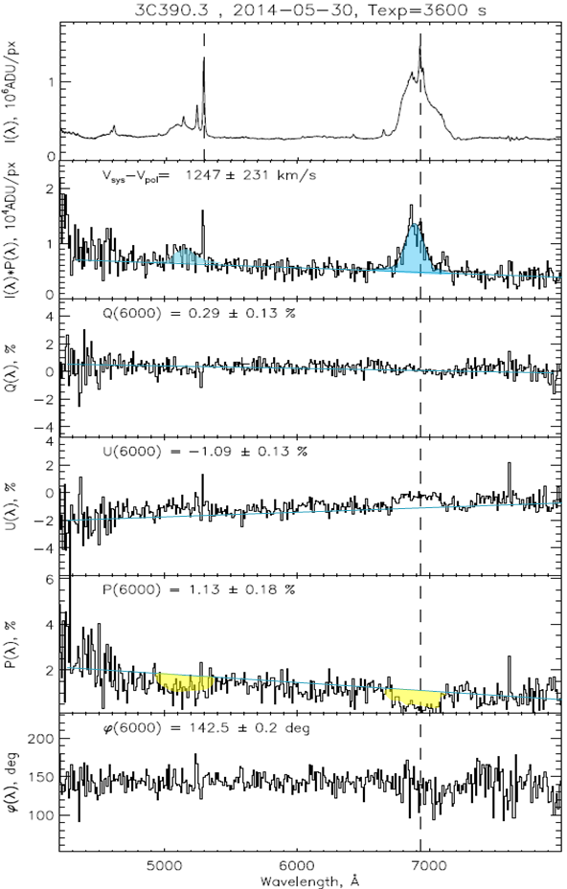
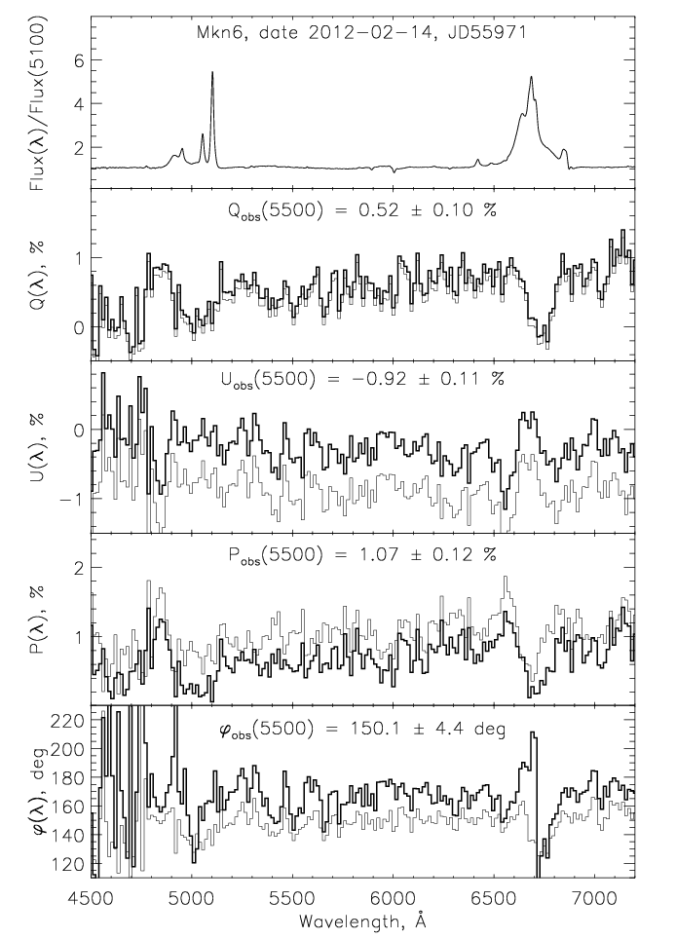
Spectropolarimetry Mkn6 и 3С390.3
3C390.3 2009-2015 (23 epoch)
Mkn 6 2009-2015 (12 epoch)

Slide 11
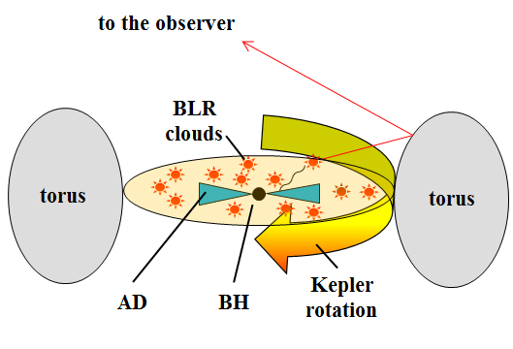
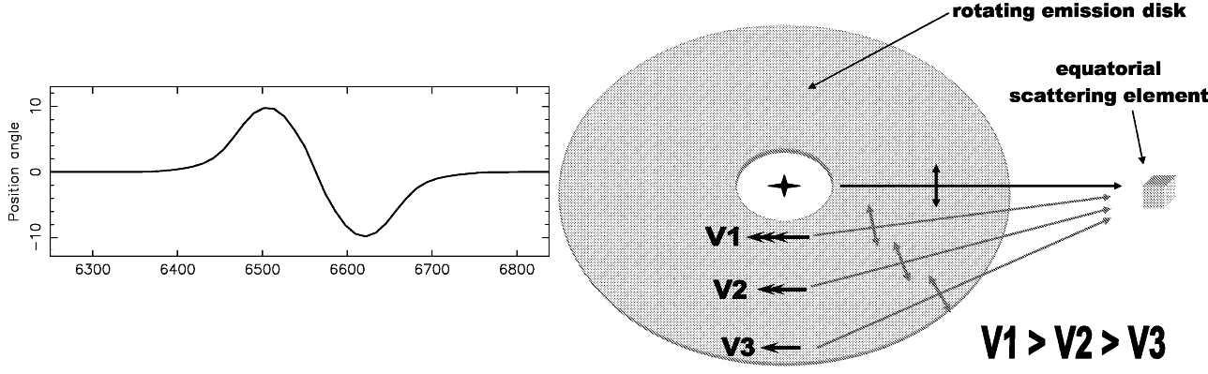
Polarization in broad lines
Broad lines region BLR:
Mist of clouds with N~10⁸÷10¹² cm⁻³
Size BLR ~ 0.1-1 pc , ε~0.001
Equatorial scattering
Smith J.E. at al., 2005, MNRAS, 359, 846

Slide 12
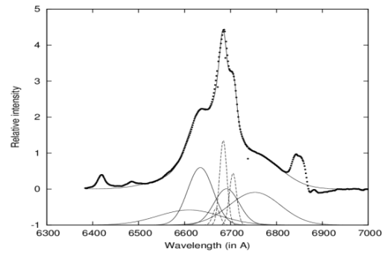
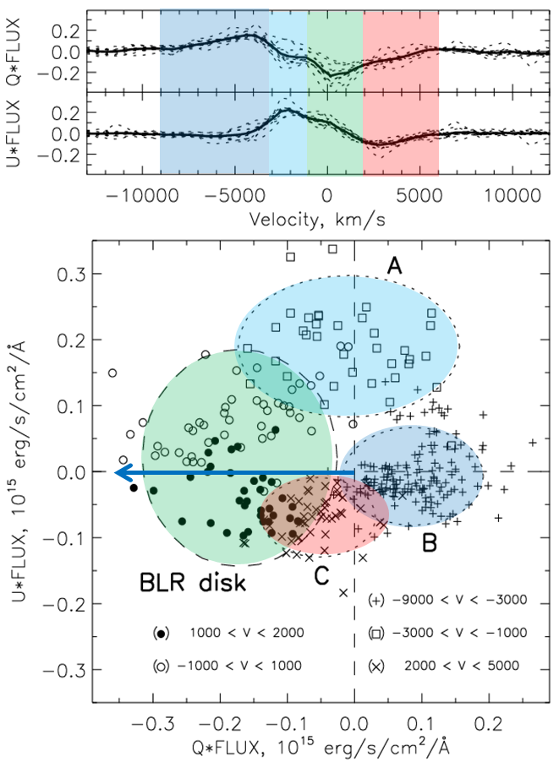
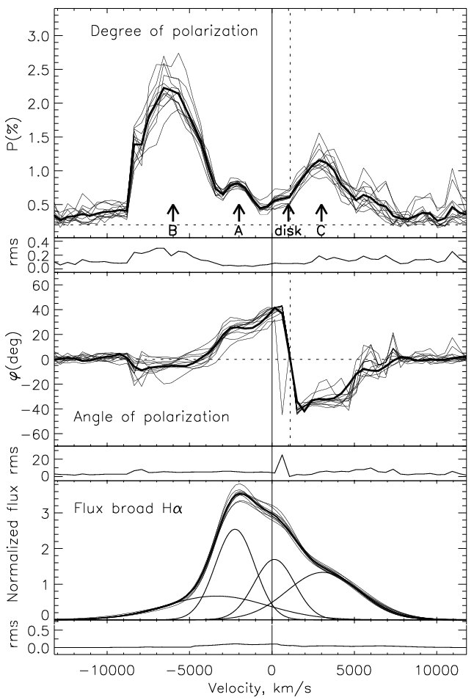
Scattering region in broad Hα Mkn6
rotating BLR disk has an average degree of polarization of ~ 0.5% and shows the change in the angle of the plane of polarization within ± 40° relative to the direction of the disk axis (PA~170°)
Component A, apparently, is probably the outflow at the velocity of -2000 km/s with a polarization ~ 0.6% and the angle of the plane of polarization ~ 45°; This component is clearly visible in the profile of the broad lines and changes with time
For the first time in polarized light detected by the outflow (jet?) of the velocity - 6000 km / s with the degree of polarization > 2% and the angle of the plane of polarization about 90°
Afanasiev, Popović, Shapovalova et al., 2014, MNRAS, v.440, p.519

Slide 13
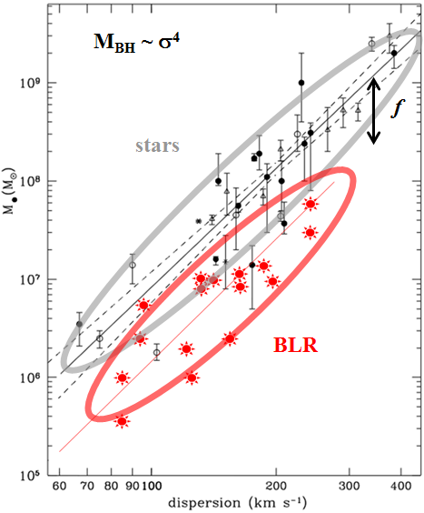

BLR - an indication of the BH in AGN
The size of the BLR is measured at time delay τ of variability flux broad Hα relative to the continuum R_{BLR} = сτ
Line width V is estimated from the observed width V=Vobs/sini, where i - unknown angle of inclination BLR disk to the line of sight
PROBLEMS: f - depends on the BLR geometry (may be very complex – disc, outflows, inflows -combination of these) It is believed that the area of broad line (BLR) in active galactic nuclei (AGN) are virialized.
virial relation
$M_{BH}$=$f\frac{cτ V^{2}}{G}$
This assumption cannot be directly verified because the BLRs are spatially unresolved
f ≈ 5.5
Onken at al., 2004, ApJ, 615, 651
Notes:
The most common AGN spectra appear to be consistent with nearly face-on disk structures, having an inclination of i < 20°.

Slide 14
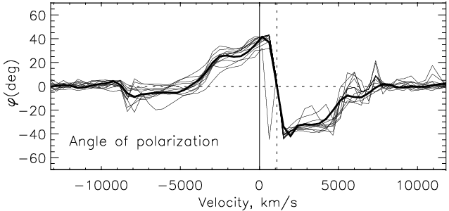



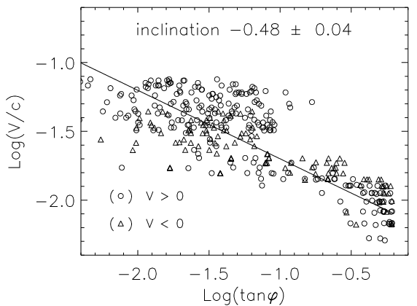
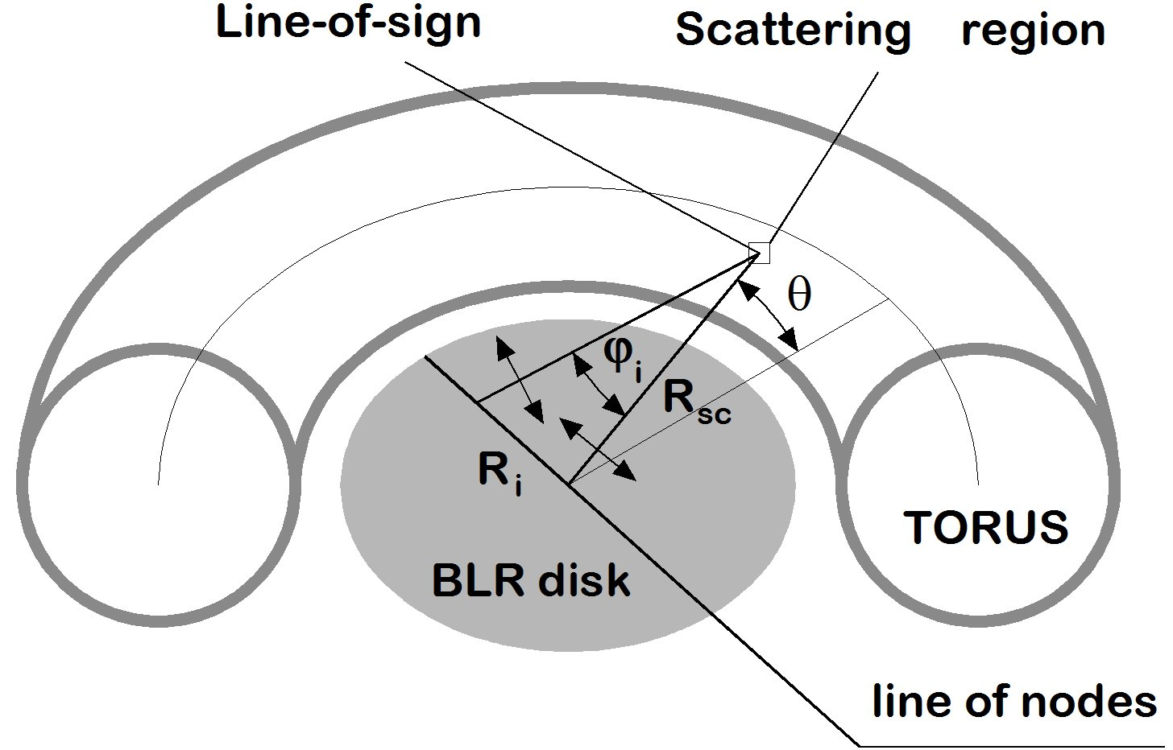
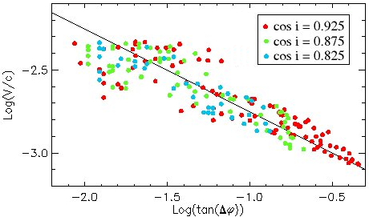
Rotation of the plane of polarization in the BLR
Monte Carlo simulation
Estimation M_{BH} does not depend of the inclination BLR
Notes:
method does not depend on the angle of inclination of the disc to the line of sight of only the angle subtended by the thickness of the dust from the center of the torus

Slide 15
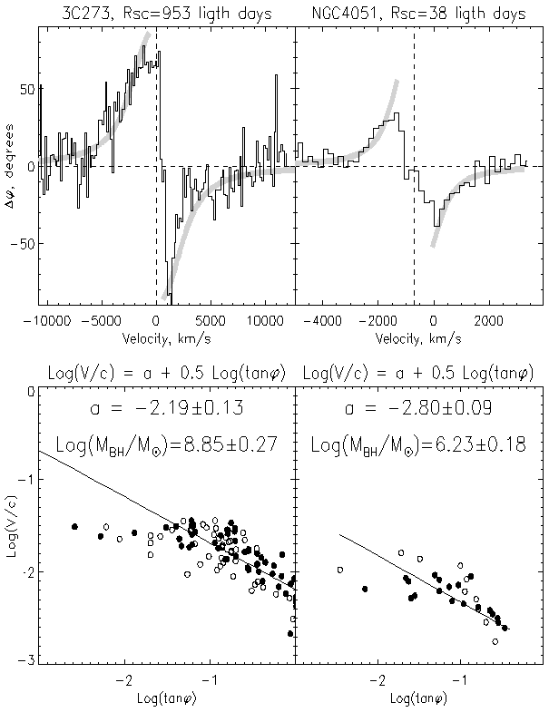
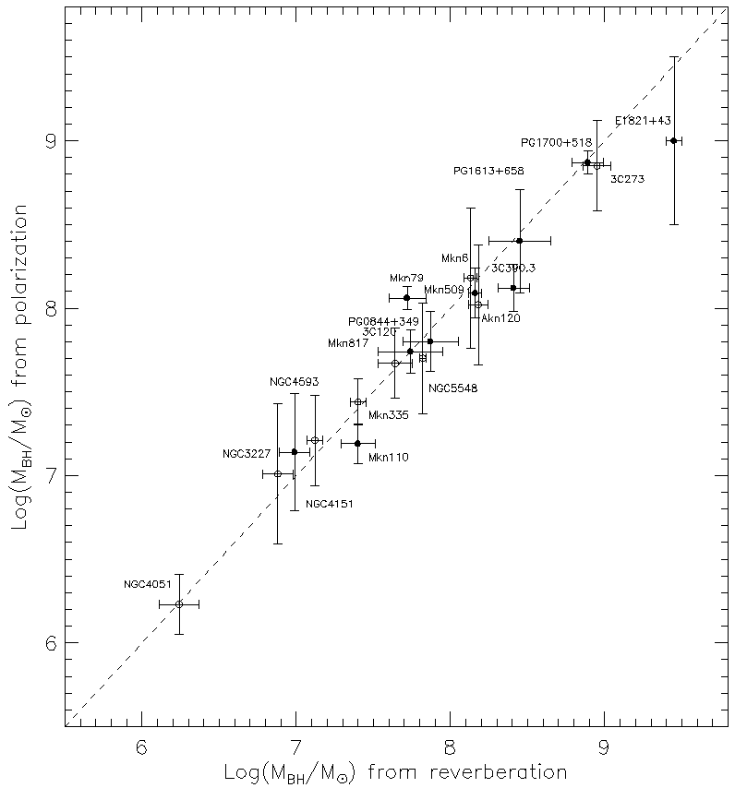
BH masses by polarization in broad line Нα
Observation at 6-m telecope sample SyG with equatorial scattering in Hα
Afanasiev & Popović, 2015, ApJL, v.800, p.L35

Slide 16
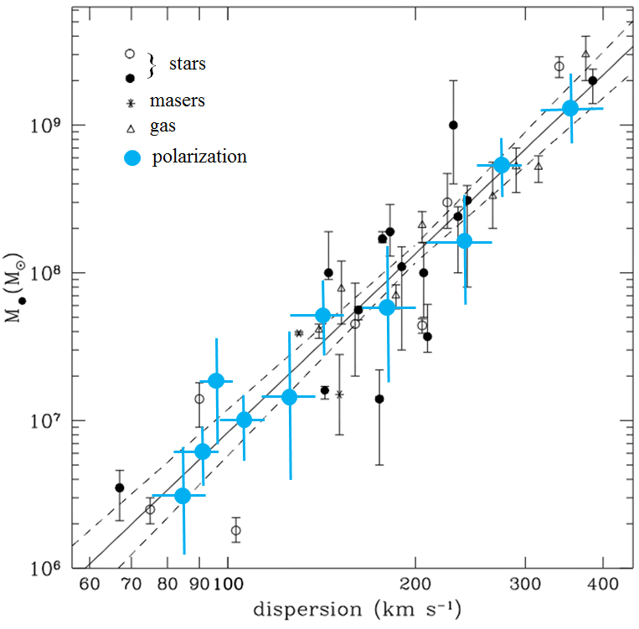
BH masses by polarization in broad line Нα
Observation at 6-m telecope sample SyG with equatorial scattering in Hα
Afanasiev & Popović, 2015, ApJL, v.800, p.L35

Slide 17
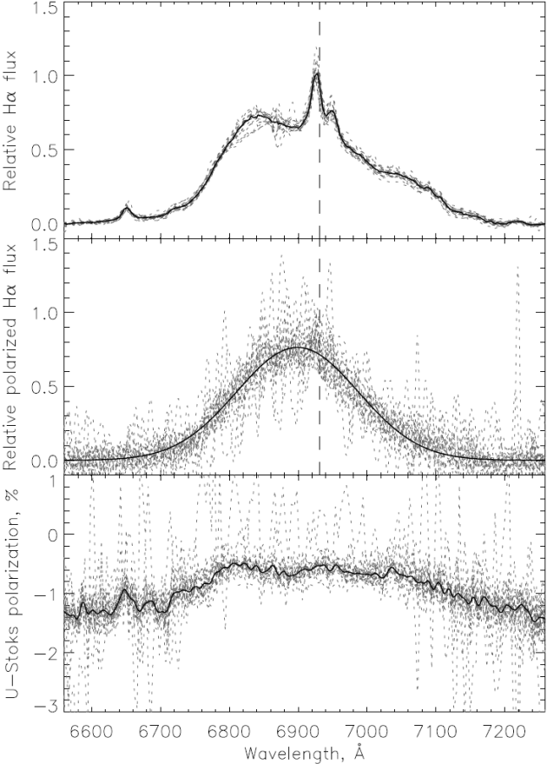
Depolarization in broad line Hα в 3С390.3
i~20°
Конус ионизации (NLR)
Радио джет (VLBI)
Гало BLR
Оптический джет
Газово-пылевой тор
диск BLR
AD
BH
Depolarization polarized flux of accretion disk because of the “mist” halo BLR clouds in the direction of the disk axis with PA~152° => -U (PA=135°)
The halo of clouds in Hα, extends along an axis at velocity -1200 км/с
Notes:
This slide shows the average according to our observations profile broad H alpha in normal light,
polarized broad H alpha and the magnitude of the depolarization in the Stokes parameter U.
Negative values ​​of the Stokes parameter give us direction 135 degrees, which is
within the error close to the direction of the jet PA ~ 152 degrees.
Note that for our monitoring can not be seen significant changes in the
shape of profiles H alpha.
Width polarized blue shifted Halpha about 7000 kilometers per second,
which is two times smaller than the width of the line in normal light.
This indicates that the depolarization occurs at the edge of the BLR and
possibly connected with the interior regions of the torus, which move along
the axis of the galaxy to the observer.

Slide 18
Depolarization in broad line Hα в 3С390.3
i~20°
Radio jet (VLBI)
Halo BLR
Optical jet
Gas and dust torus
BLR disk
BH
AD
The observed properties of an 3C390.3
Size of torus (from UV-calibration)
Radio-jet (VLBI) 1-10 pc
Size of BLR (Hα) ~ 0.12 pc
Outflow in halo of BLR -1200 km/s, size ~ 0.08 pc
Variable optical jet, size <0.01 pc
Size of accretion disk <0.01 pc
M_{BH} ~ 3⋅10⁸ M
Depolarization polarized flux of accretion disk because of the “mist” halo BLR clouds in the direction of the disk axis with PA~152° => -U (PA=135°)
The halo of clouds in Hα, extends along an axis at velocity -1200 км/с
Notes:
This slide shows the average according to our observations profile broad H alpha in normal light,
polarized broad H alpha and the magnitude of the depolarization in the Stokes parameter U.
Negative values ​​of the Stokes parameter give us direction 135 degrees, which is
within the error close to the direction of the jet PA ~ 152 degrees.
Note that for our monitoring can not be seen significant changes in the
shape of profiles H alpha.
Width polarized blue shifted Halpha about 7000 kilometers per second,
which is two times smaller than the width of the line in normal light.
This indicates that the depolarization occurs at the edge of the BLR and
possibly connected with the interior regions of the torus, which move along
the axis of the galaxy to the observer.

Slide 19
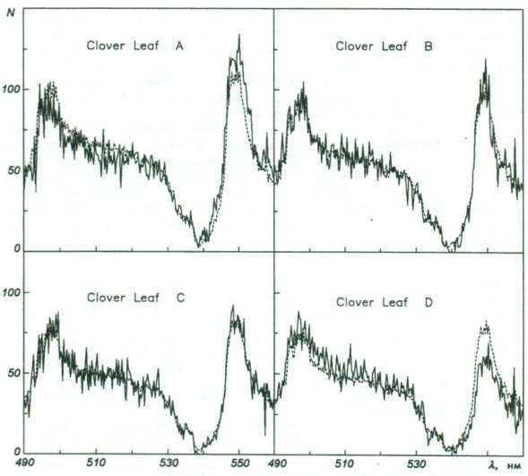
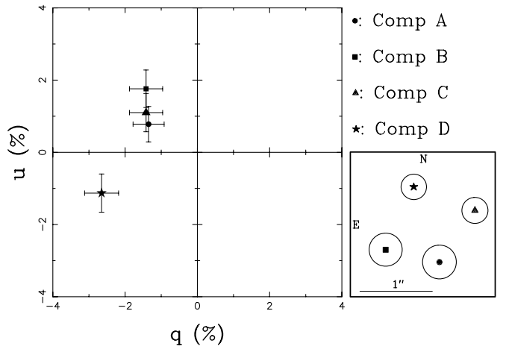
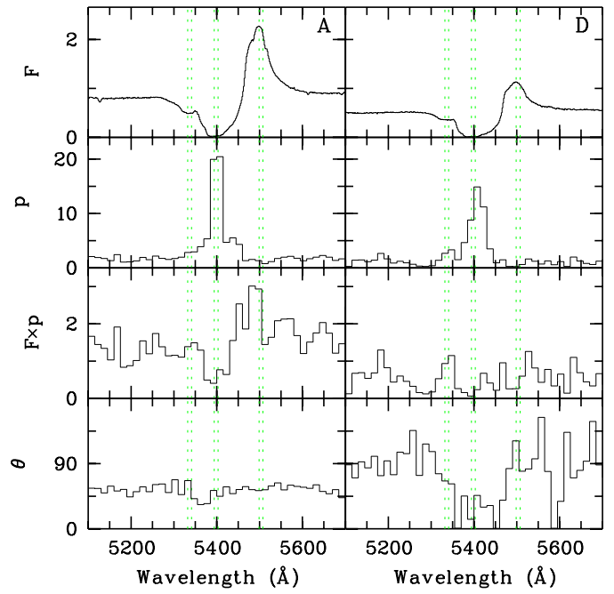
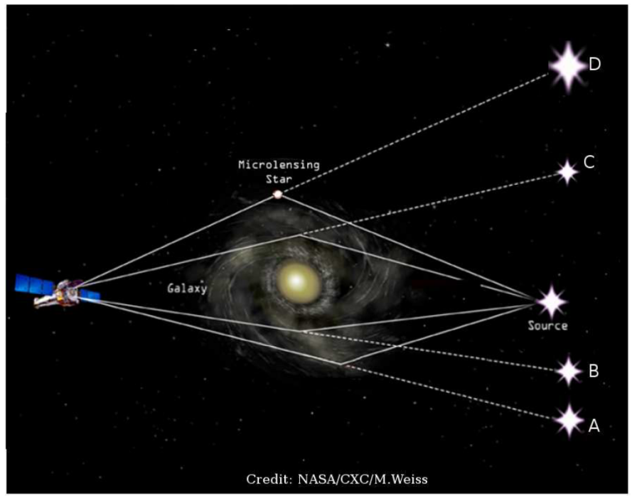
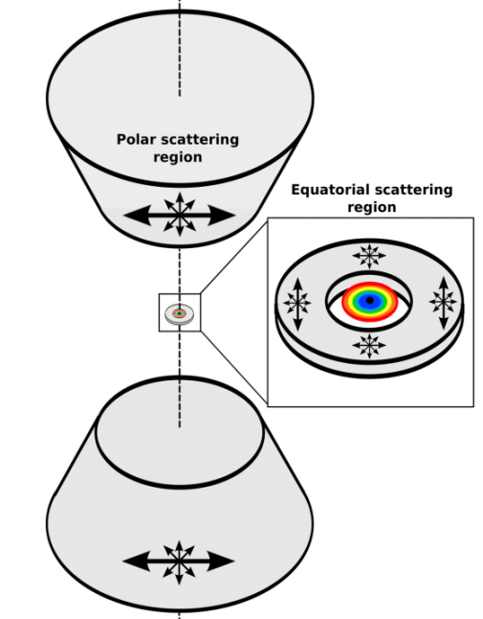
The polarization of gravitational lenses
Polarization and microlensing in the lensed quasar H1413+117(Clover Leaf):
6-m + IFU MPFS (Afanasiev et al., 1993) HST+F555W (Chae et al., 2001) VLT+FORS (Hutsemekers et al., 2015)
The effect of microlensing on the polarization unveils the presence of two continuum sources polarized roughly perpendicularly
P~ 10% θ~35°
P~ 3% θ~115°

Slide 20
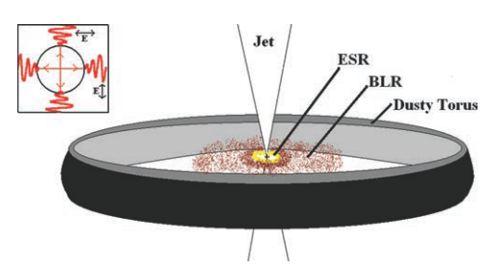
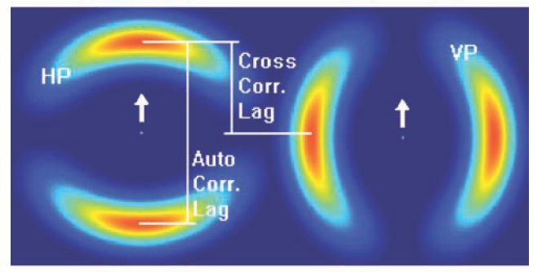
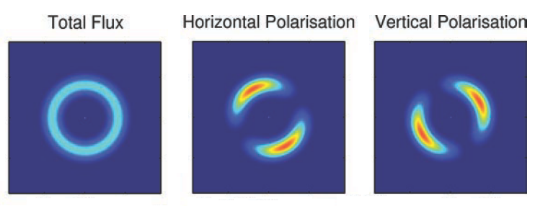
The polarization of gravitational lenses
Prediction polarization in Einstein-Chwolson Ring:
Kedziora at al. 2011,MNRAS, v.415, p.1409

Slide 21

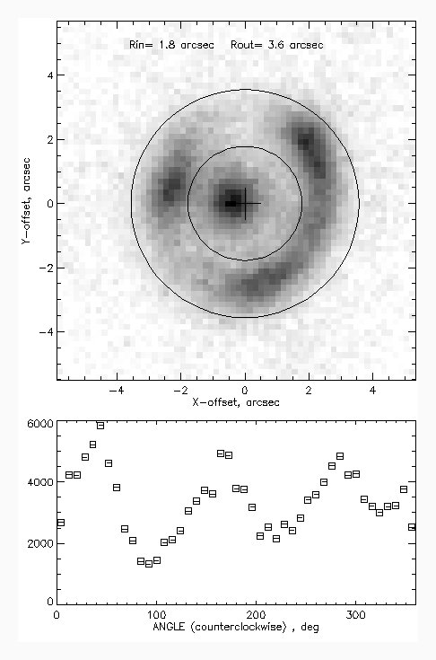
Detection polarization in gravitational lenze J0143+1607
6-m + SCORPIO-2 + polaroid, 3х1800 sec, filter V, θ≈0.9″
SDSS g≈19.5
-60°
0°
+60°
A
B
C

Slide 22
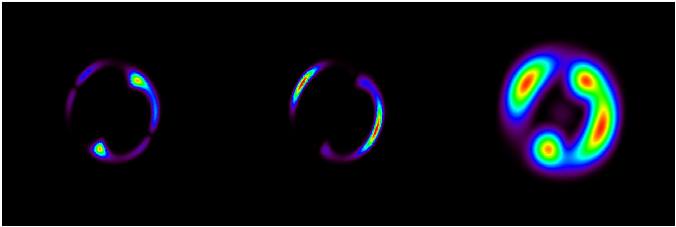
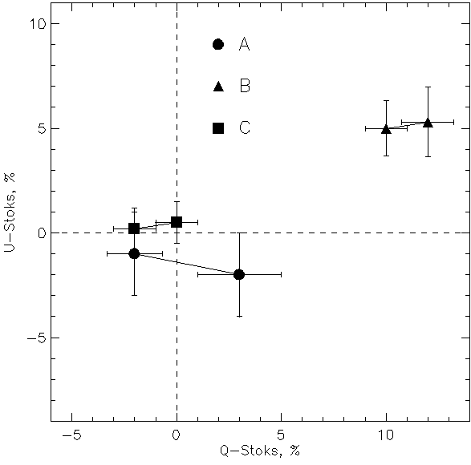
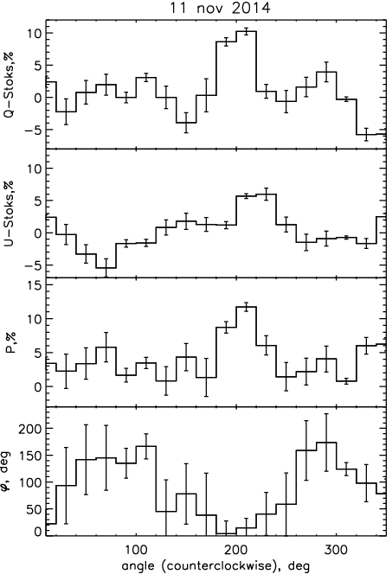
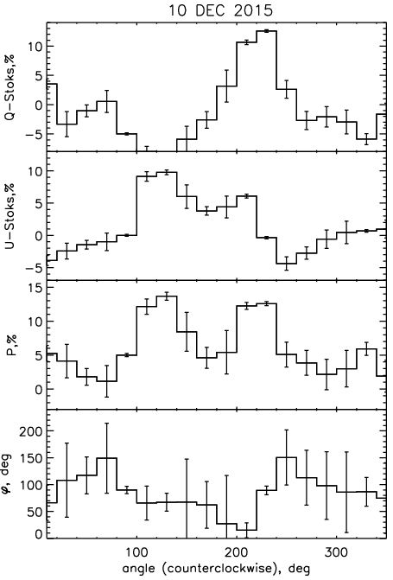
Detection polarization in gravitational lenze J0143+1607
6-m + SCORPIO-2 + polaroid, 3х1800 sec, filter V, θ≈0.9″
Vertical Horizontal Total
-60°
0°
+60°
A
B
C

Slide 23
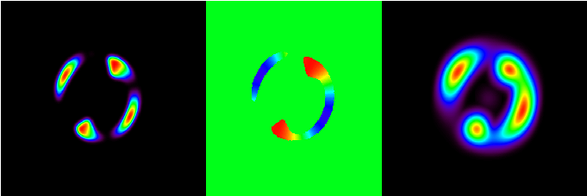
Detection polarization in gravitational lenze J0143+1607
6-m + SCORPIO-2 + polaroid, 3х1800 sec, filter V, θ≈0.9″
Degree polarization Anlge polarization Total flux
-60°
0°
+60°
A
B
C

Slide 24
Conclusion
Polarimetry methods allow to share different
the field of formation of the polarized radiation:
Polarized continuum indicates the direction of the plane of polarization along the axis of the disk and the size of the field is less than 0.01 parsecs, which is much smaller than the BLR. The observed variable polarization is the result of the vector addition of the accretion disk and jet polarization.
Polarization in the broad emission lines, probably due to scattering at the inner parts of the torus of gas and dust, and the dependence of the angle of the polarization plane of the BLR clouds speed allows to determine the nature of the motion at distances less than 0.05-0.1 parsecs that for most objects is less than 10⁻³ seconds of arc.
An analysis of the Stokes vector components allows you to divide the circular and radial movement along the axis of the disk BLR.

Slide 25

Thank you for your attention!

