Slide 1

The correlations between spectral properties in the spectra of
AGNs type 1
Jelena Kovačević¹, Luka Č. Popović¹, Milan S. Dimitrijević¹, Payaswini Saikia¹
¹ Astronomical Observatory Belgrade, Serbia

Slide 2
Outline:
Correlations between spectral AGN properties – a tool to investigate the AGN nature
The sample and analysis
Fe II template construction
Balmer continuum model
Contribution of starbursts to spectra of AGN type 1
Conclusions

Slide 3

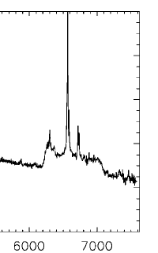
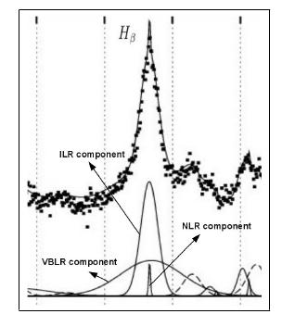
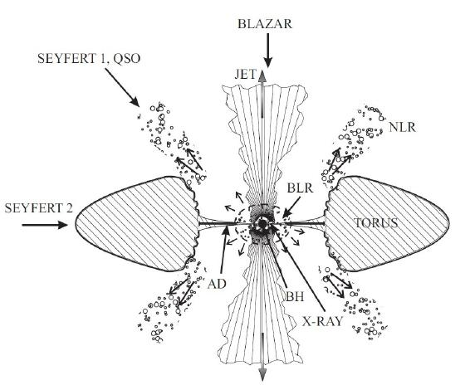
1. Correlations between spectral parameters – tools for descovering AGN nature
Emission lines: complex profiles!
Different components of emission lines are coming from different layers of emission regions.
Each component (represented as Gaussian) reflects the physical and kinematical properties of emission region where it arises.
Correlations between properties of different lines lead to better insight in the AGN structure, and kinematical and physical properties of gas in AGNs.
Hα
SDSS J0942+0900
Jovanović & Popović, 2009

Slide 4
2. The sample and analysis
We obtain ~330 spectra from SDSS DR7 database, using SQL with criteria:
S/N > 20
Good quality of pixels
z< 0.7 and zConf > 0.95
Small contibution of stellar component: ЕW CaK 3934, Mg 5177, Hδ < 1Å
Presence of [O III] and broad Hβ (EW [O III] and EW Hβ > 0)

Slide 5
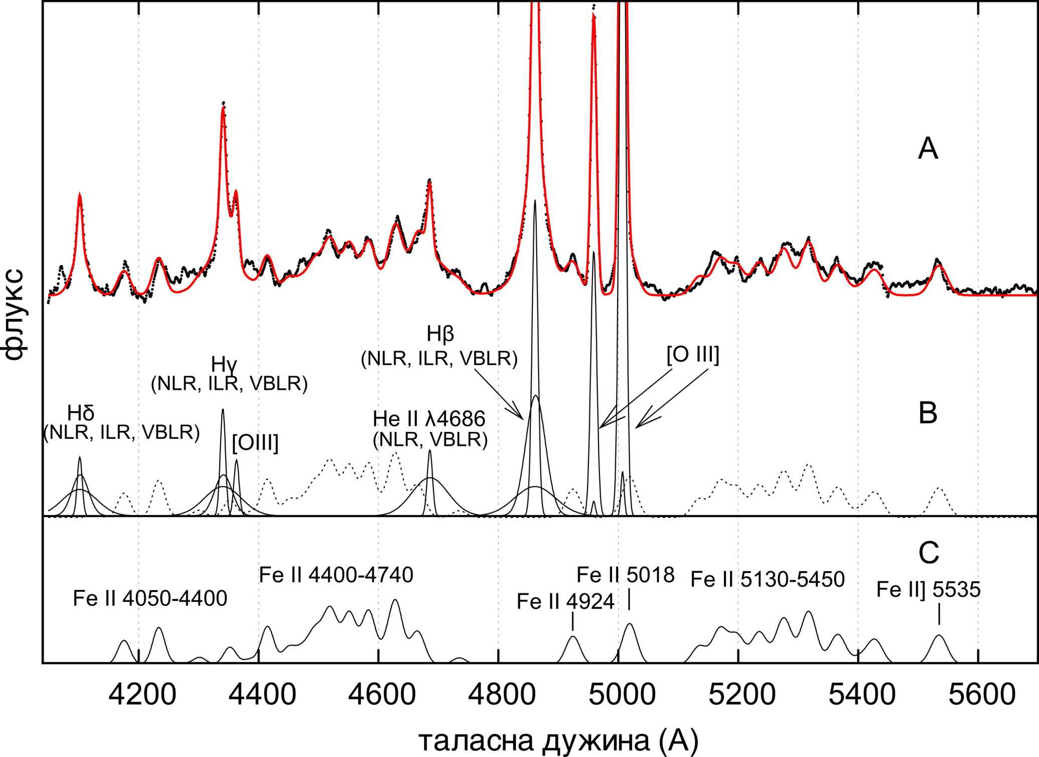
Kovačević et al. 2010,
Shapovalova et al. 2012
Relative intensity
Wavelength (Å)

Slide 6
2.1 Difficult identification of Fe II lines
complex Fe II ion: produces huge number of Fe II lines in UV, optical and IR;
Sigut & Pradhan 2003:
827 energy levels,
23 000 transitions!
(data from Iron Project,
Hummer 1993)
energy

Slide 7
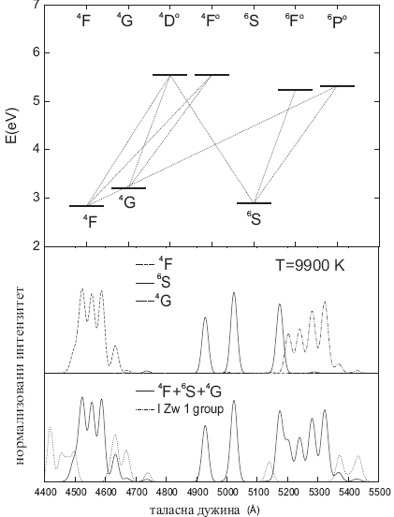
2.2 The Fe II (4400-5500 A) template
Kovačević et al. 2010. ApJS, 189, 15.
Lover terms of Fe II transitions:
(1) 3d⁶ (³F2)4s ⁴F F group (19 lines)
(2) 3d⁵ 4s² ⁶S S group (5 lines)
(3) 3d⁶ (³G)4s ⁴G G group (11 lines)
(4) 15 lines, which probably originate from higher levels. Their relative intensities are taken from I Zw 1 object (I Zw 1 group).
All Fe II lines have the same widths and shifts, and their relative intensities are calculated as:
f – oscillator strength, g – statistical weight, E – energy of upper level of transition, T – excitation temperature, k – Boltzmann constant

Slide 8
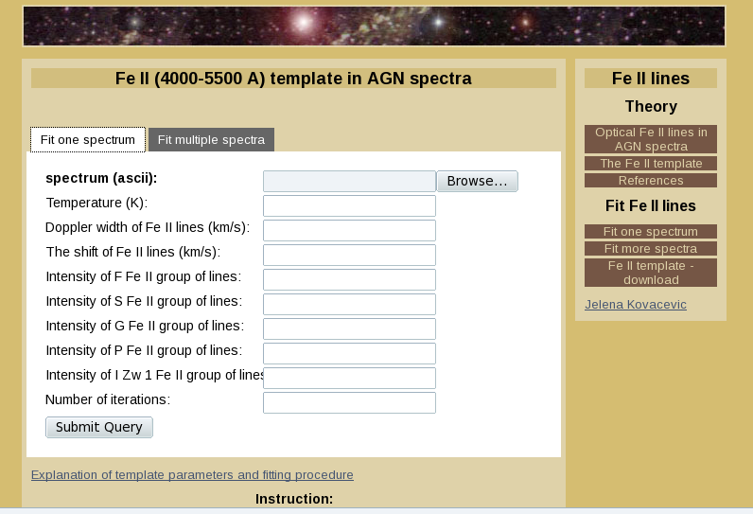
Kovačević et al. 2010
Serbian Virtul Obaservatory: http://servo.aob.rs/FeII_AGN/
Kovačević et al. 2010
Veron-Cetty et al. 2004
Veron-Cetty et al. 2004
Bruhweiler and Verner 2008
Bruhweiler and Verner 2008

Slide 9



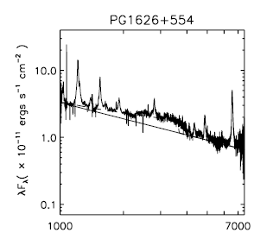

3.1 Balmer continuum
determination of the UV pseudocontinuum in the sample
Not easy because of complex shape of UV pseudocontinuum:
Power low + Balmer continuum (Grandi 1982)
Tsuzuki et al. 2006

Slide 10
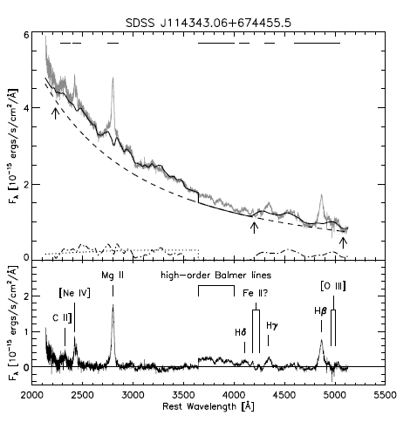
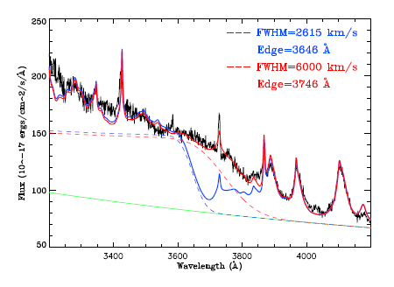

Balmer continuum fitting: Problems
Tsuzuki et al. 2006,
Sameshima et al. 2010
Jin et al. 2012
Sameshima et al. 2010
Convolving Balmer continuum
equation with Gaussian
(FWHM Gaussian = FWHM broad Hβ)

Slide 11

Our model of Balmer continuum
We try to make model which:
- we could use for fitting spectra within 2900 A – 5500 A range (with two continuum windows). It could be done by reducing number of free parameters: calculating the intensity of Balmer continuum!
- we try to make good fit near Balmer edge (3646 A)!
Our model consists of:
Power law + Balmer continuum (λ<3646A) + high order Balmer lines (n=3-400),
(λ>3646A)
They are fitted by one Gaussian with the same width and shift as Hγ.
The relative intensites for Balmer lines with n<50 are taken from the paper: Storey and Hummer 1995.
Relative intensities for 50<n<400 are calculated using approximate formula:
≈1

Slide 12
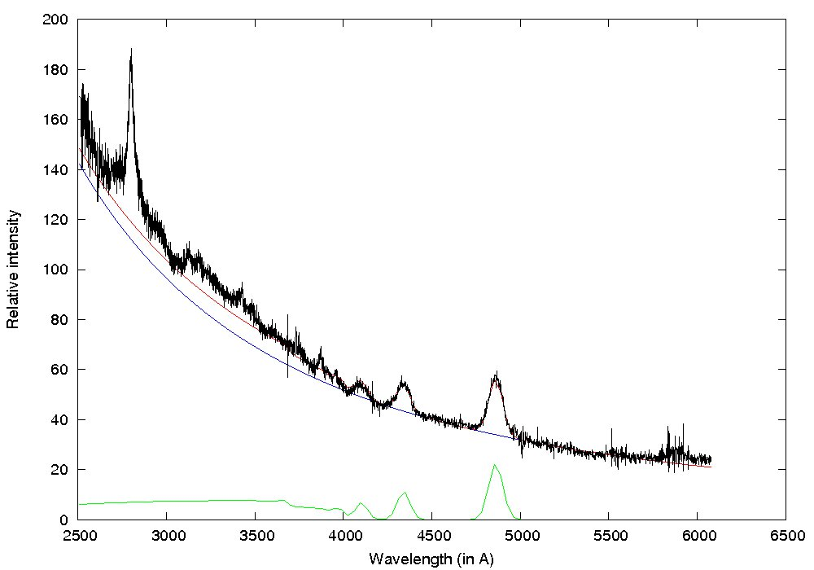
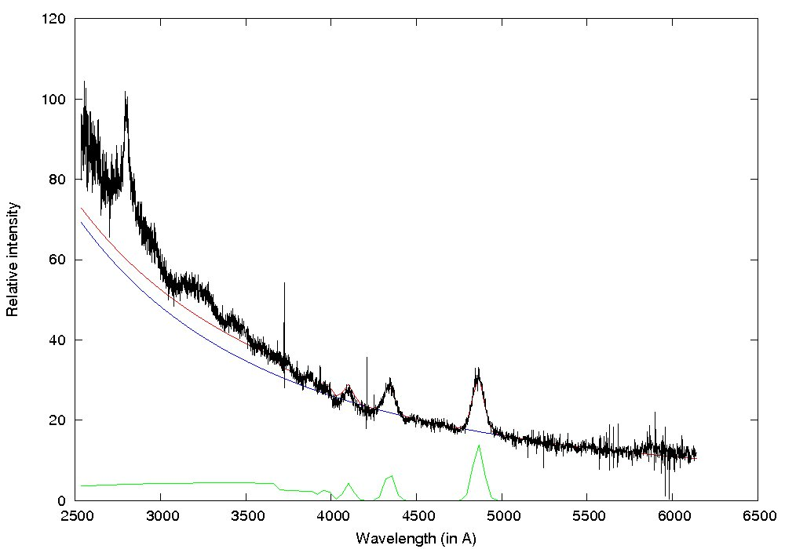
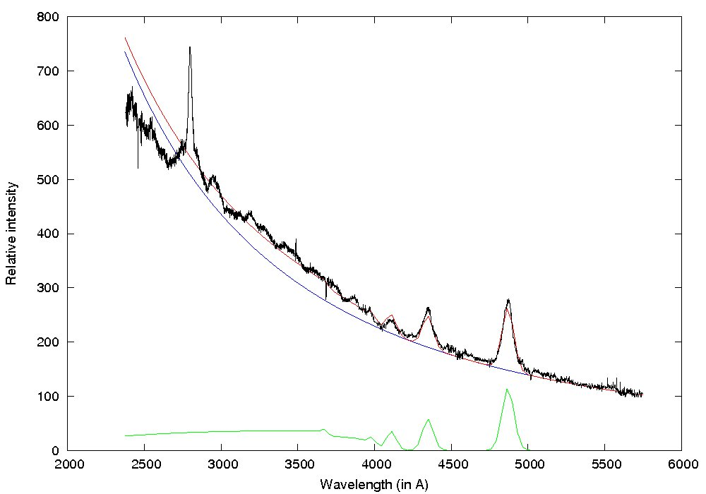
Examples of fit:
Good fit in 65% of spectra
from the sample
Fit is not good in 35% of spectra

Slide 13
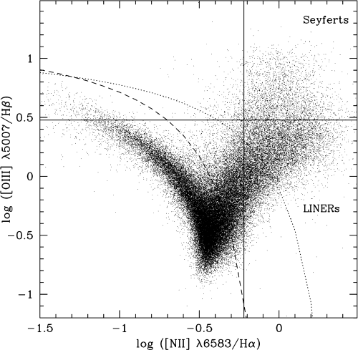
Division of the sample by different source of ionization:
4. Results
4.3 Contribution of starbursts to AGN spectra: the broad line AGNs
- Some indications that AGN+starbursts could coexist in one phase of evolution (Wang & Wei 2006, 2008,
Mao et al. 2009 ).
- NLSy 1: Starburst contribution in narrow lines (Mao et al. 2009)
Diagnostic BPT diagram (Baldwin, Philips Terlevich 1981)
We adopt division:
R ≶ log([O III]5007/Hβ)
Kewley et al. 2001, ApJ, 556, 121
Kauffmann et al. 2003, MNRAS,
346, 1055
AGN
H II

Slide 14
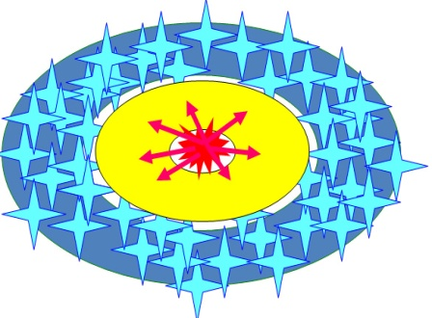
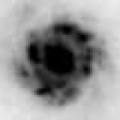
4. Results
4.3 Contribution of starbursts to AGN spectra: AGNs type 1!
R = log([O III]5007/Hβ NLR)
R > 0.5
“pure AGN”
207 objects
R < 0.5
”AGN+ starburst”
95 objects
Mrk 493, HST

Slide 15

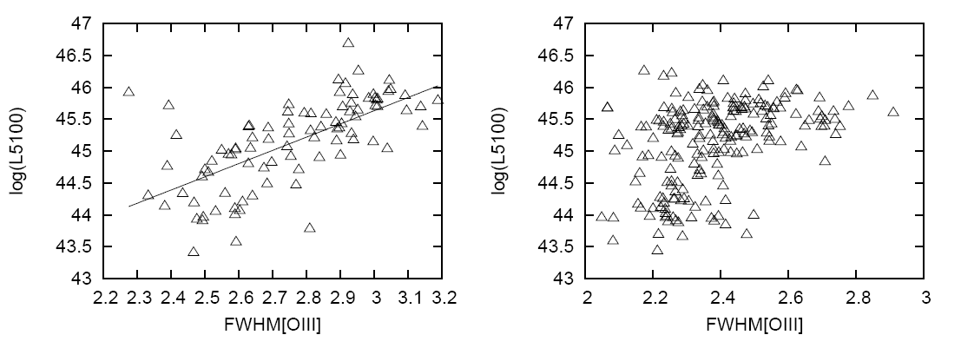
3.4 Division of the sample according the different source of ionization
We try to check is this division criteria correct: R =
Brungardt 1988 observed the correlation between L_{cont} and FWHM [O III] for starbursts.
R < 0.5
“starburst+AGN” subsample
R > 0.5
“pure AGN” subsample
Popović, L. Č., Kovačević, J.,
2011, ApJ, 738, 68.
log
log
Confirmation of criteria:
R=
Popović, L. Č. & Kovačević, J.,
2011, ApJ, 738, 68.

Slide 16

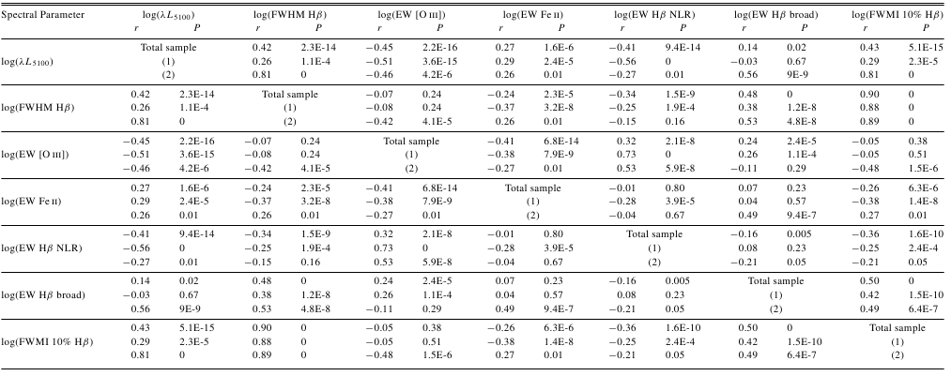
4. Results:
4.1 Differences between spectral properties of “pure AGN” and “starburst+AGN” subsample (R= )
Popović, L. Č. & Kovačević, J.,
2011, ApJ, 738, 68.

Slide 17
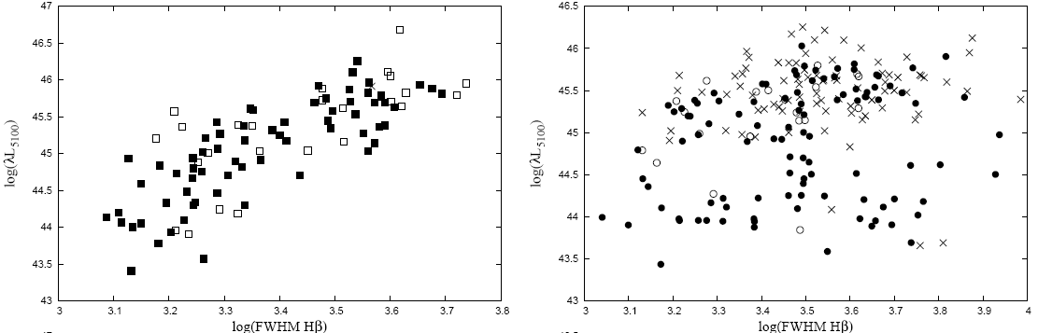


4. Results:
Differences between spectral properties of “pure AGN” and “starburst+AGN” subsample
“starburst+AGN”
“pure AGN”
r=0.81
P=1E-16
r=0.26
P=1E-4
Popović, L. Č., & Kovačević, J.,
2011, ApJ, 738, 68.

Slide 18
4. Results:
4.1 Differences between spectral properties of “pure AGN” and “starburst+AGN” subsample – Baldwin effect!
Stronger in
“pure AGN”
subsample
L_{cont} EW [O III] EW Hβ NLR
L_{cont} EW Hβ broad
Only in
“AGN+starburst”
subsample
Influence of starbursts to Baldwin effect correlations!

Slide 19
Conclusions:
The calculated optical iron template (4000 -5500 Å) gives very good fit of Fe II lines and enables detailed investigation of Fe II lines in AGN spectra.
Model with high order Balmer lines n=3-400, for λ>3646A, improve the fit near Balmer edge, and enables the calculation of the intensity of Balmer continuum. This is specially important in case of using luminosity at 3000 A, for calculation of black hole mass.
The presence of starbursts nearby AGNs, i.e. influence of additional source of ionization to AGN emission regions, reflects in some significantly different correlations between spectral properties. Possible influence of starbursts to emission of broad lines? (in that case – problem with measuring of black hole mass!)
The Baldwin effect correlations depend on dominant source of ionization in a sample (accretion disc or starburst?).
Thank you for your attention

