Slide 1

Photo-ionization in the ionospheric D region induced by the solar Ly-α line emission
Aleksandra Nina and Vladimir Čadež
Institute of Physics, Belgrade, Serbia
Astronomical Observatory, Belgrade, Serbia

Slide 2
Contens
Introduction:
- D region
- external influences
- monitoring
Determination of Ly-alpha photo-ionization rate using changes in electron density dynamic caused by solar X flares:
- theoretical study of electron density dynamic
- determining procedures for values that form this equation from observed data
- our method for calculation Ly-α photoionization rate in D region from obtained data

Slide 3
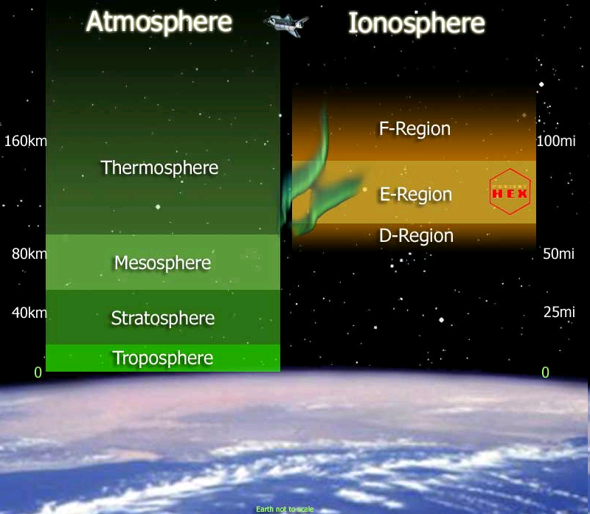
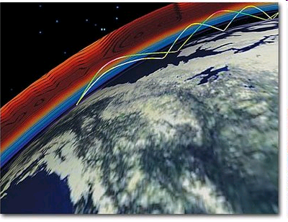
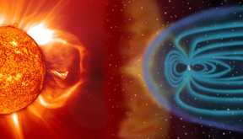
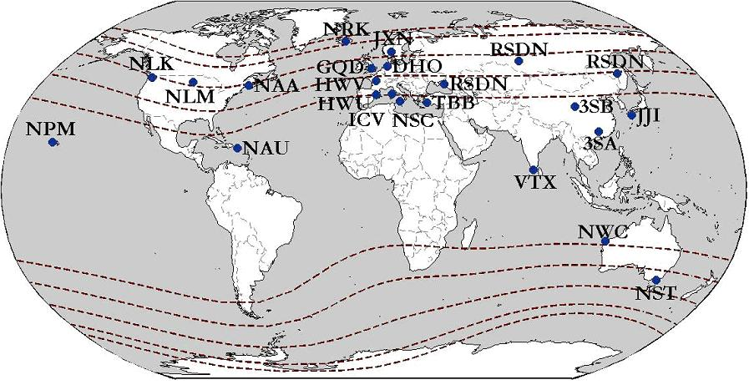
Introduction
The lowest ionospheric layer – D region
Influences: from the space and Earth
source of ionization during
daily unperturbed period
Ly-α radiation
The most
important
source of sudden ionization
Solar flare
method for low ionosphere
monitoring
VLF
radio siglals
- continual emission and monitoring
large analyzed space

Slide 4


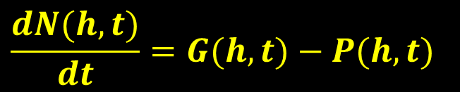

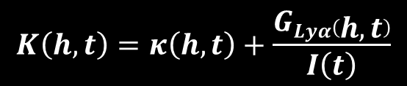



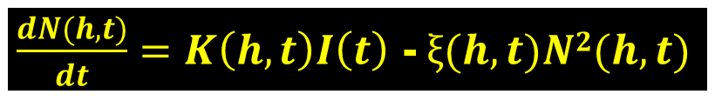


Electron density dynamic
– finding of useful form
$$\frac{dN(h,t)}{dt}=G(h,t)−P(h,t)$$
GENERAL FORM
$$⇩$$
FORM WHICH HAS VALUES
THAT WE CAN OBTAIN FROM
OBSERVATIONS AND MODELING
AND FROM WHICH
WE CAN CALACULATE
PHOTO-IONIZATION RATE
INDUCED BY LY-α RADIOATION
Electron-ion recombination
Ion – ion recombination
Ly-α
Cosmic
X
$$=ξ(h,t)N2(h,t)$$
Three body recombination
$$G0(h)$$
$$GX(h,t)$$
$\frac{dN(h,t)}{dt}=K\left(h,t\right)I\left(t\right)$ -$ξ(h,t)N2(h,t)$
$$≈G_{Lyα}(h)$$
$$=κ\left(h,t\right)I(t)$$
$$G\left(h,t\right)=G_{Lyα}\left(h\right)+κ\left(h,t\right)I\left(t\right)$$
$$G\left(h,t\right)=K\left(h,t\right)I\left(t\right)$$
$$K\left(h,t\right)=κ\left(h,t\right)+\frac{GLyα\left(h,t\right)}{I\left(t\right)}$$

Slide 5

1. Directly used observed data
2. Modelling of observed data
3. Theoretical calculations
$\frac{dN(h,t)}{dt}=K\left(h,t\right)I\left(t\right)$ -$ξ(h,t)N2(h,t)$

Slide 6
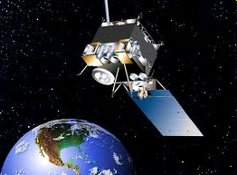

Intensity of X radiation
$\frac{dN(h,t)}{dt}=K\left(h,t\right)I\left(t\right)$ -$ξ(h,t)N2(h,t)$
GOES-15 satellite
May 5th, 2010

Slide 7
1. Directly used observed data
2. Modelling of observed data
3. Theoretical calculations
$\frac{dN(h,t)}{dt}=K\left(h,t\right)I\left(t\right)$ -$ξ(h,t)N2(h,t)$

Slide 8
Electron density determination
Wait’s model of ionosphere:
reflection height H’(t)
sharpness β(t)
Numerical program for simulation of the VLF signal propagation: Long-Wave Propagation Capability (LWPC) - USA National Oceanic and Atmospheric Administration (NOAA)
Recorded signal
amplitude
and phase

Slide 9
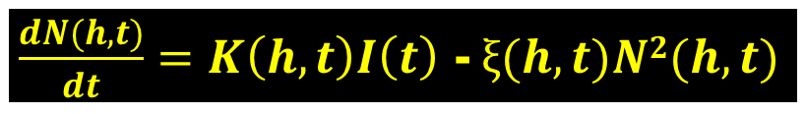
$\frac{dN(h,t)}{dt}=K\left(h,t\right)I\left(t\right)$ -$ξ(h,t)N2(h,t)$

Slide 10
1. Directly used observed data
2. Modelling of observed data
3. Theoretical calculations
$\frac{dN(h,t)}{dt}=K\left(h,t\right)I\left(t\right)$ -$ξ(h,t)N2(h,t)$

Slide 11


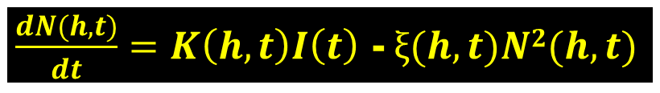

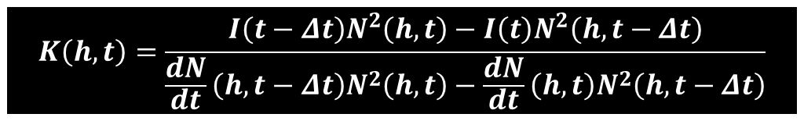
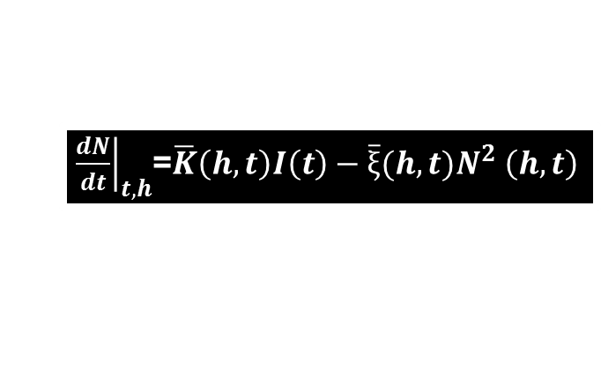
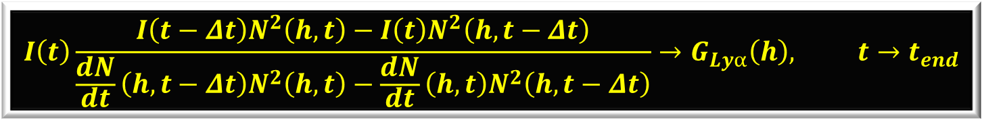
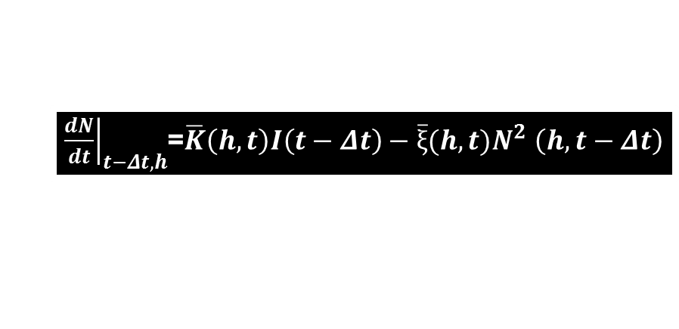

.
$\frac{dN(h,t)}{dt}=K\left(h,t\right)I\left(t\right)$ -$ξ(h,t)N2(h,t)$
Period before the end of
ionospheric perturbations
Approximations:
$$K(h,t−Δt)≈K(h,t)≡\overline{K}(h,t)$$
$$ξ(h,t−Δt)≈ξ(h,t)≡\overline{ξ} (h,t)$$
Set of two
algebraic
equations:
${\left.\frac{dN}{dt}\right|}_{t−Δt,h}$=$\overline{K}\left(h,t\right)I\left(t−Δt\right)−\overline{ξ}(h,t)N^{2}$ $\left(h,t−Δt\right)$
${\left.\frac{dN}{dt}\right|}_{t,h}$=$\overline{K}\left(h,t\right)I\left(t\right)−\overline{ξ}(h,t)N^{2}$ $\left(h,t\right)$
$$K\left(h,t\right)=\frac{I\left(t−Δt\right)N^{2}\left(h,t\right)−I\left(t\right)N^{2}\left(h,t−Δt\right)}{\frac{dN}{dt}\left(h,t−Δt\right)N^{2}\left(h,t\right)−\frac{dN}{dt}\left(h,t\right)N^{2}\left(h,t−Δt\right)}$$
$$G\left(h,t\right)=K\left(h,t\right)I\left(t\right)$$
Approximation:
$$G\left(h,t→t_{end}\right)≈G_{Lyα}\left(h\right)$$
$$I\left(t\right)\frac{I\left(t−Δt\right)N^{2}\left(h,t\right)−I\left(t\right)N^{2}\left(h,t−Δt\right)}{\frac{dN}{dt}\left(h,t−Δt\right)N^{2}\left(h,t\right)−\frac{dN}{dt}\left(h,t\right)N^{2}\left(h,t−Δt\right)}→G_{Lyα}\left(h\right), t→t_{end}$$

Slide 12
Photo-ionization rate induced by the Ly-α line emission in the ionospheric D region

Slide 13
Summary
It is presented the theoretical study about influence of Ly-α radiation to terrestrial low ionosphere.
We describe the determining procedures for values that form equation for electron density dynamics during solar X flares.
We present theoretical method for calculation Ly-α photo-ionization rate from this equation.
The obtained values are in agreement with existing data.

Slide 14
Thank you for your attention!

