Slide 1
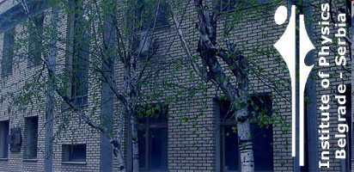
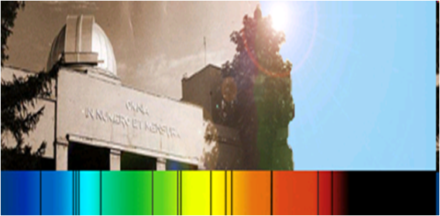
ABSORPTION QUASI-MOLECULAR BANDS AS FACTORS OF THE SOLAR PHOTOSPHERE OPACITY ABOVE SUNSPOTS
V. A. SREĆKOVIĆ¹, A. A. MIHAJLOV¹, LJ. M. IGNJATOVIĆ¹,
M. S. DIMITRIJEVIĆ² and A. METROPOULOS³
¹Institute of Physics, P.O.Box 57, Pregrevica 118, Belgrade, Serbia
²Astronomical Observatory, Volgina 7, 11060 Belgrade, Serbia
³Theoretical and Physical Chemistry Institute, NHRF, Athens, Greece
vlada@ipb.ac.rs

Slide 2
INTRODUCTION
The aim of this research is to show that the radiative processes in strongly non-symmetric ion-atom collisions could influence on the opacity of the sunspot atmosphere (photosphere) in UV region.
- Within this work the H+X ⁺ ion-atom systems are taken in to account, where X is the atom of one of the metal (Mg, Ca, Na, Si and Al),.
-Here, the non-symmetric radiative processes are considered under the conditions characterizing the umbral model
(Maltby et al. (1986)), which gives the possibility to perform all needed calculations and determined the corresponding
spectral absorption coefficients. The needed characteristics of the corresponding molecular ions, i.e. molecular potential curves and dipole matrix elements, have been determined.
- The examined processes generate rather wide quasi-molecular absorption bands in the UV and VUV regions, whose intensity could be comparable with the intensity of known symmetric ion-atom absorption processes and with the contribution of the concurrent electron-atom processes (H⁻ continuum), some metal ph.
- The presented results suggest that the non-symmetric ion-atom absorption processes have to be further examined and consequently could be included in standard models of the sunspot atmosphere.

Slide 3
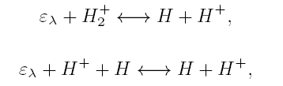
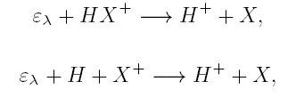

The result obtained recently in Mihajlov et al. (2013) during the study of the role of some strongly non-symmetric ion-atom absorption
processes in the atmosphere of the quiet Sun was the main motivation for this investigation.
Short intro about
quiet Sun
In connection with this fact let us remind that in Mihajlov et al. (2013) two groups of the ion-atom absorption processes, symmetric and strongly non-symmetric, were considered together in connection with the optical characteristics of the quiet solar atmosphere.
The first group included the processes of the molecular ion photo-dissociation and absorption charge exchange in the ion-atom collisions in the hydrogen case, namely
(1)
(2)
Within the second group in the center of the attention were the following processes of the photodissociation and absorption charge
exchange and photoassociation in the ion-atom collisions
(3)
(4)
(5)
where X and X⁺ are the atom and ion of one of some metals in the ground states, and HX⁺ and (HX⁺)∗ are the molecular ions in the electronic states which are asymptotically correlated with the states of the ion-atom systems H + X⁺ and H⁺+X respectively.
-The possible partners in these processes are determined by the used solar atmosphere model. In Mihajlov et al. (2013) the processes (3) - (5) were studied within the standard non-LTE (local thermodynamical equilibrium) model C for the quiet solar atmosphere from Vernazza et al. (1981), since only this model provided all relevant data (in the tabular form) needed for the performed calculations. In accordance with chosen model these processes in Mihajlov et al. (2013) were considered in the cases
X =Mg, Si and Al (without Fe).

Slide 4
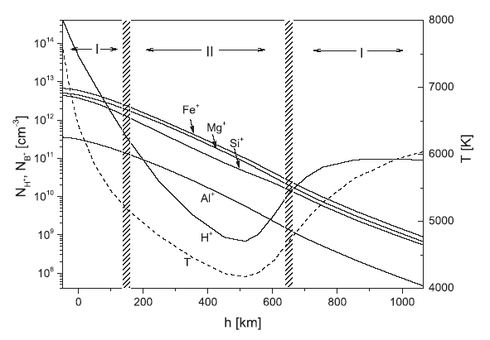

Main idea is this picture
symmetric
non-symmetric
Namely, in accordance with the tables from Vernazza et al. (1981) this behaviour, as well as the behaviour of the temperature T and the ion H⁺ density, within the solar photosphere can be illustrated by the Fig. 1, where h is the height of the considered layer with the respect to the chosen referent one.
From Fig. 1 one can see that in part I the ion H⁺ density dominates with the respect to all metal ion B⁺ densities, which means that within these parts it is expected that the efficiency of the symmetric processes (1) and (2) is more greater than the one of the non-symmetric processes (3)–(5). However, from the same figure one can see also that:
– in the part II, i.e. in the neighbourhood of the temperature minimum, each of the ion B⁺ densities is greater than the ion H⁺ density;
– the width of the part II is close to the total width of the parts denoted with I.
From here it follows that, in the principle, the contribution of the non-symmetric processes (3)–(5) to the solar atmosphere opacity
can be comparable to the one of the symmetric processes (1) and (2), since in the both non-symmetric and symmetric cases as the neutral partner the same atom H appears, and that symmetric and nonsymmetric ion–atom radiative processes together could be treated
as a serious partner to the above-mentioned concurrent processes in the whole solar photosphere.

Slide 5

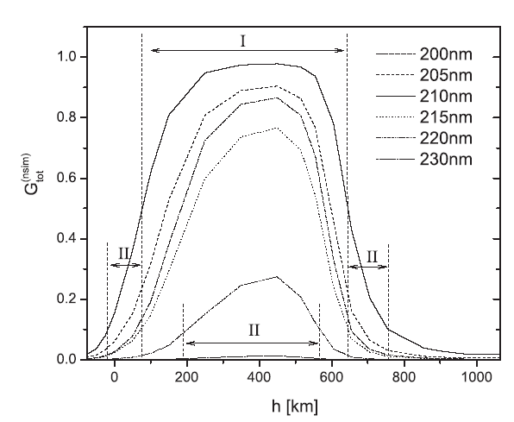


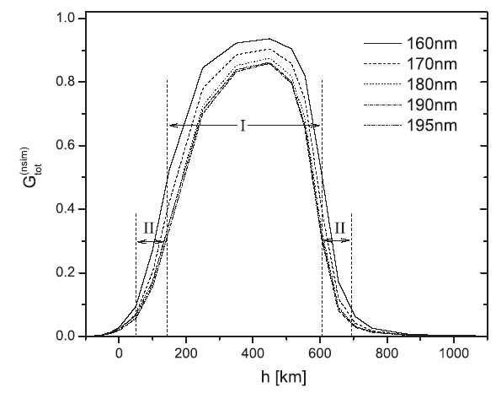
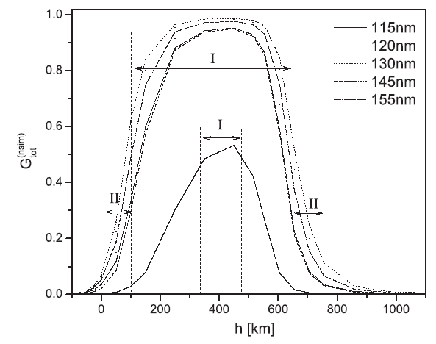
Calculations were done for the 1),2),3):
1) The partial spectral absorption coefficients for the non-symmetric ion-atom processes
2) The total spectral absorption coefficient
Al, without Fe
because of the absent of the
data about the needed
characteristics of the molecular
ions HFe⁺ and (HFe⁺)∗.
3) Relative efficiency (fraction, ratio)
κ_{ia;sim}(λ) characterize the
contribution of the symmetric
ion–atom absorption processes
(1) and (2).
κ_{ia;nsim}(λ) characterize the
contribution of the non-symmetric
ion–atom absorption processes
(3) - (5).
As it was expected from fig. with abundances
The calculated values of G^{(nsim)}_{tot} (λ) as function of h, for the chosen set of λ, are presented in Figs. From these figures one can see that around the mentioned temperature minimum (T ≤ 5000 K, 150 ≤ h ≤ 705 km) the contribution of non-symmetric processes (3)–(5) is dominant in respect to the symmetric processes (1) and (2). Such region of the non-symmetric processes domination is denoted in these figures as the region ‘I’. Apart of that, Figs. show that within the rest of the considered region of h there are significant parts where the relative contribution of the nonsymmetric processes is close to or at least comparable with the contribution of the symmetric ones. In the same figures these parts are denoted as regions ‘II’.

Slide 6
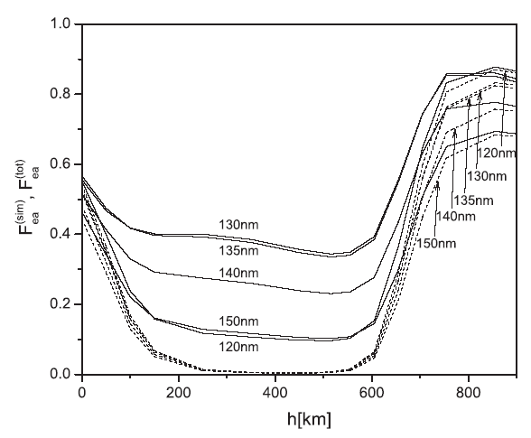



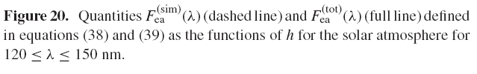

Calculations were done for the 4),5):
4) Relative efficiency
5) Relative efficiency
Κ_{ea}(λ) :efficiency of concurrent processes as the ion H⁻ photo-detachment
and the electron–hydrogen atom inverse ‘bremsstrahlung’ (H⁻ continuum).
Κ_{ei}(λ)
This figure shows that the inclusion in the consideration of the non-symmetric processes (3)–(5) causes the significant increases of the total efficiency of the ion–atom absorption processes, particularly in the neighborhood of the solar atmosphere temperature minimum, where it become close to the efficiency of the H⁻ continuum.
The main result obtained in Mihajlov et al. (2013) is the establishing of the following fact in the case of the quiet Sun:
- the absorption of the electromagnetic (EM) radiation in far- UV and EUV regions, which is caused by all symmetric and strongly non-symmetric ion-atom radiative processes (1) - (5), in the significant part of the solar photosphere in the neighborhood of the temperature minimum is more larger than the absorption which is caused only by the symmetric processes (1) - (2).
- As the result we have that in the case of the quiet Sun the ion-atom processes (1) - (5) together become now a serious concurrent to other relevant absorption processes in far-UV and EUV regions not only out of the neighborhood of the temperature minimum (see Mihajlovet al. (2007)), but within the whole solar photosphere. Of course, this results is significant and for atmospheres of other solar or near solar type stars.

Slide 7
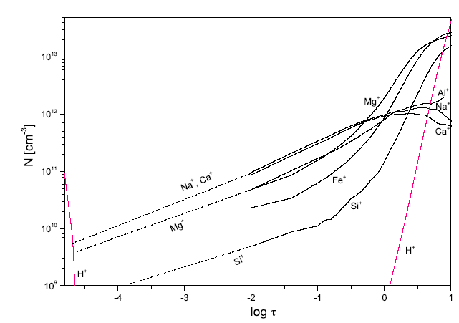
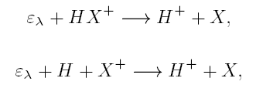

preliminary
Sunspot
The result obtained recently in Mihajlov et al. (2013) during the study of the role of some strongly non-symmetric ion-atom absorption processes in the atmosphere of the quiet Sun was the main motivation for this investigation.
Just the mentioned result was the stimulation to consider the situation in the sunspots, particularly with regard of the fact that sunspots
are important parts of the same solar atmosphere. Namely, since within the sunspots the temperature is significantly smaller than in
the rest of the solar photosphere the significance of the already known symmetric processes (1) - (2) have to be practically negligible
there with respect to the concurrent electron-atom (H⁻ and H + free electron) absorption processes. Consequently, the strongly
non-symmetric ion-atom processes (3) - (5) with the relevant metal atoms could obtained a very important roll.
In order to examine such possibility in this work the sunspot model M from Maltby et al. (1986) is used. This choice is caused, by the fact
that by now only this model, among all other models presented in the journal articles, provides all relevant data (tabulated) which are needed
for the performed calculations. In accordance with the chosen model the processes (3) - (5) with X =Na, Ca, Mg, Si and Al are taken
into account in this work. The case X = Fe, which is also allowable by the used model, is not considered here because of the absent of the
data about the needed characteristics of the molecular ions HFe⁺ and (HFe⁺)∗.
This Figure shows: the densities of the metal ion components (Na⁺, Ca⁺, etc.), ions H⁺. From this Fig. one can see that it is useful indeed
to examine the really roll the mentioned non-symmetric processes within the chosen sunspot model (all metal ion X⁺ densities dominates with the respect to ion H⁺ density). For that purpose we will determine here the corresponding spectral characteristic of the absorption processes (3) - (5) as the functions of λ, T and the relevant particle densities, for the conditions which correspond to the used sunspot model M.
(3)
(4)
(5)
Photo-dissociation and absorption charge exchange
and photo-association in the ion-atom collisions

Slide 8
All theoretical data which are needed for that purpose are given in next part:
- The relevant characteristics of the molecular ions HX⁺ and (HX⁺)∗, i.e. the corresponding potential curves and dipole matrix elements as the functions of internuclear distance.
- The mean thermal spectral cross-sections for the photo-dissociation processes (3) the spectral rate coefficients for the processes (4) and (5) of the absorption charge exchange and photo-association, as well as the spectral rate coefficients characterizing all these
processes with given X together, as functions of λ and T are presented;
- In the last part, are given the expressions for the total spectral absorption coefficients, characterizing the efficiency of the processes (3) - (5) and (1) and (2) with all chosen X together, as the functions of λ, T and h.
- Finally, the values of the parameters which characterize the relative efficiency of the strongly non-symmetric processes (3) - (5) with the respect to: the total contribution of all (symmetric and non-symmetric) ion-atom processes (1)-(5) and the concurrent electron-atom absorption processes, are also presented in Section 3.
Sheme
potential curves and dipole matrix elements
spectral cross-sections and spectral rate coefficients
parameters which characterize the relative efficiency of the considered processes
Partial,total spectral absorption coefficients
Abundances densities of all species H⁺, X⁺,…

Slide 9
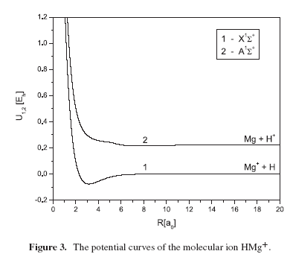
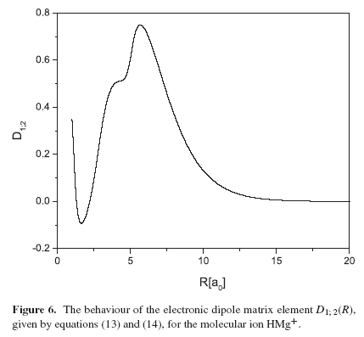
The molecular ion characteristics:
The potential curves of the molecular ions and dipole matrix elements
The mentioned molecular ion HX⁺ characteristic for the cases X = Mg, Si, Ca, Na and Al are presented in next Fig’s.
For the molecular ions in the cases X = Ca, Mg, Si and Al all calculations were done here using the MOLPRO package of programs (MOLPRO 2006). Our colleagues from Greece has done most of the work on this.
For other molecular ions, in the cases X = Na, (Li) the corresponding potential curves and the values of the dipole matrix element are calculated here on the bases of the method which is described in details in Ignjatovic & Mihajlov (2005). In the significant part this method is analogous to the well-known method of the pseudopotential in the solid state physics Heine (1970).

Slide 10
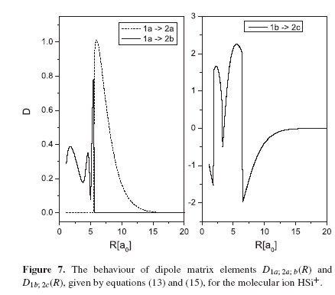
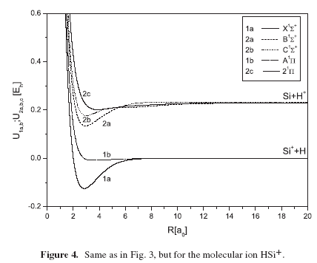
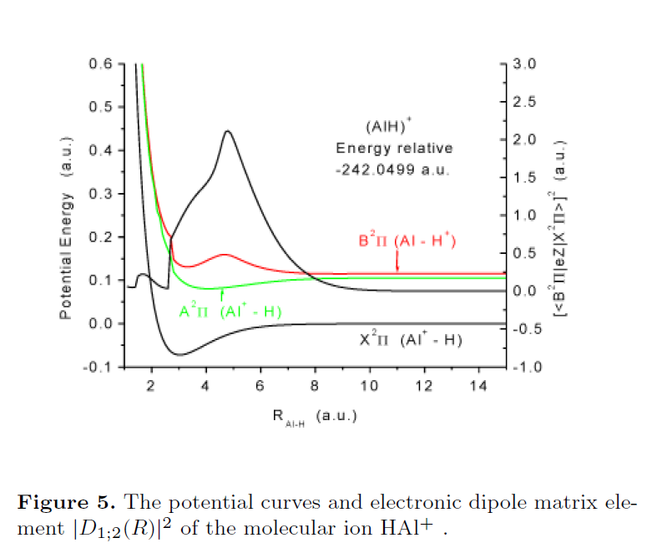
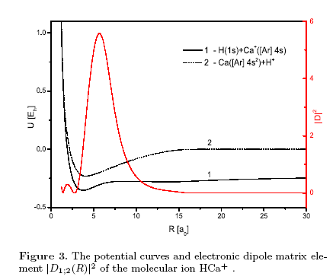

Slide 11
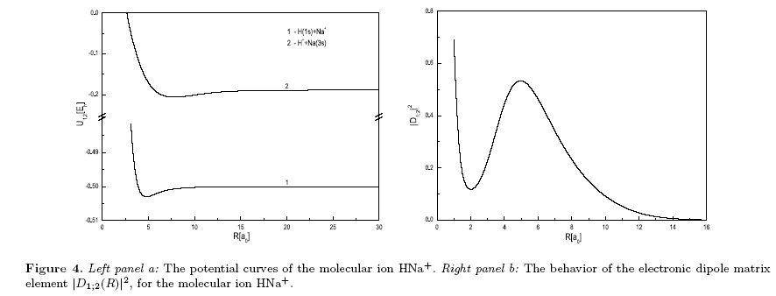
The case X = Fe, which is also allowable by the used model, is not considered here because of the absent of the data about the needed characteristics of the molecular ions HFe⁺ and (HFe⁺)∗. Let us remind that density amount of Fe⁺ is non-negligible.
Because of that we have as the task for the nearest future to find the data about the relevant characteristics of the molecular ion HFe⁺, since the data from Maltby et al. (1981) make possible to further perform all needed calculations. (find in the future molecular ion characteristics for other metals with minor concentration).

Slide 12

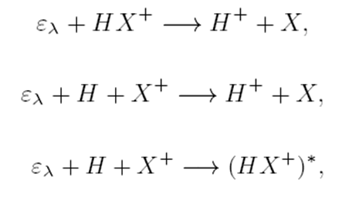

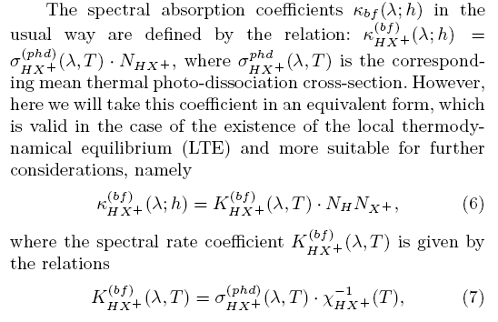


The spectral coefficients
Expressions for:
The partial spectral absorption coefficients
for the non-symmetric ion-atom processes
The efficiency of bf-, ff- and fb-absorption canals together for one of the considered metal species X is characterized by the partial absorption coefficient HX ⁺(λ; h) which is defined by the relation
where the basic absorption coefficients κ_{HX+}^{(bf,ff,fb)} (λ) are
a)
By calculating the rate coeff. for all metals and
summing we can get total spectral abs. coef

Slide 13
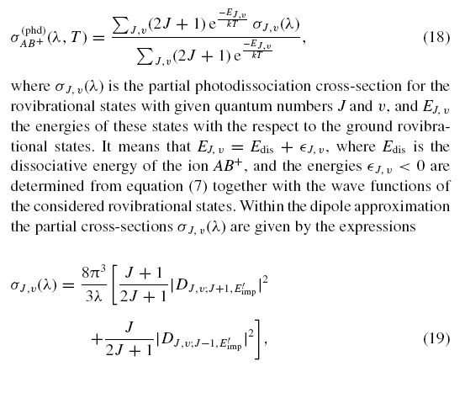


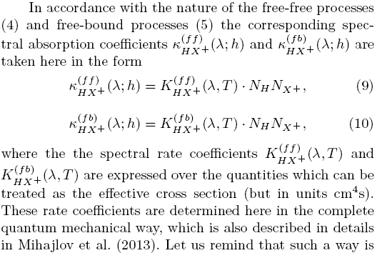

b),c)

Slide 14
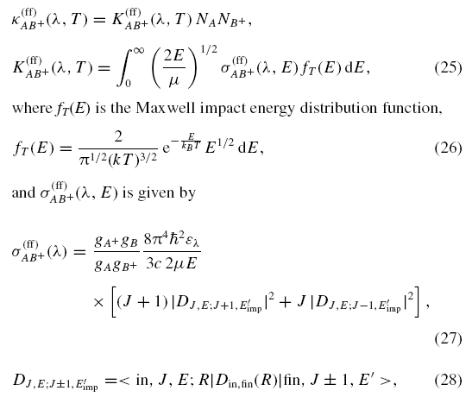
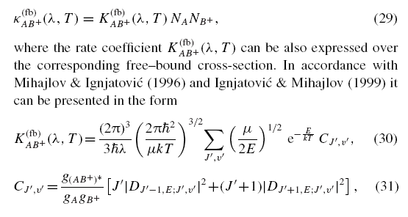
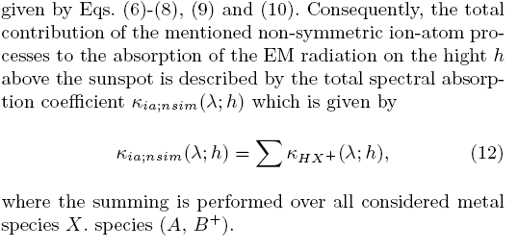
a)+b)+c)=>
Sum over all considered
metal species

Slide 15
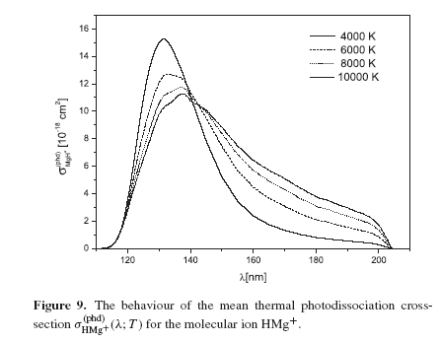
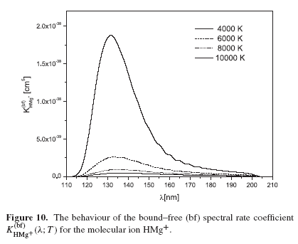
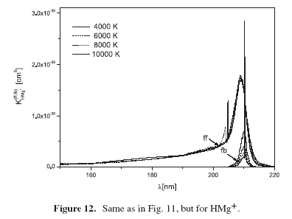
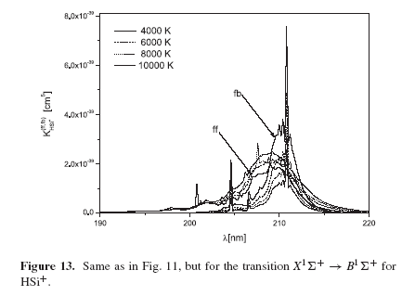
Spectral rate coefficients
K

Slide 16
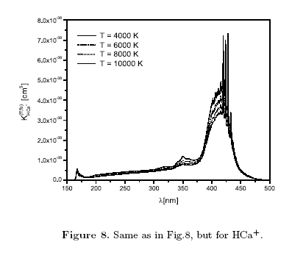
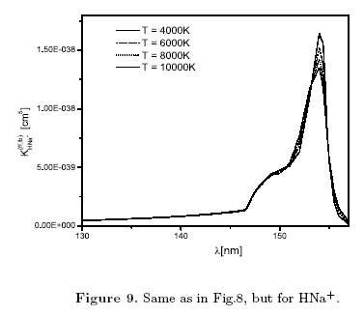
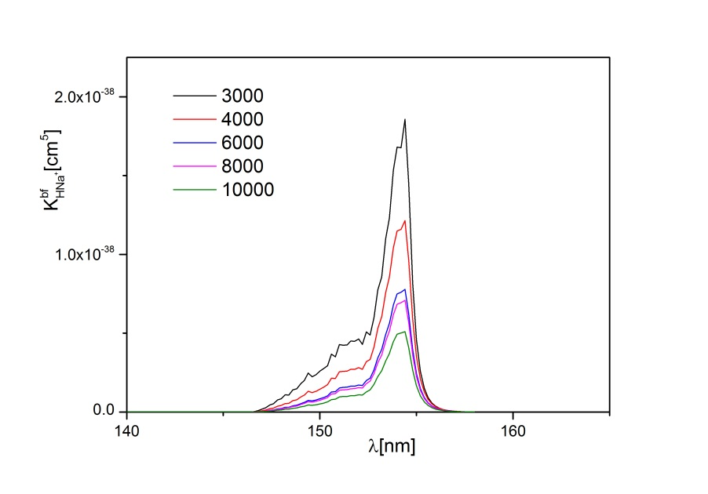
It can be observed that for lower temperatures K is greater. T manje kod pega sto je dobro za nas
We are still working on K_{Ca}^{(bf)} , K_{Al}^{(bf)}

Slide 17
All partial rate coefficients (separately presented) as a function of λ at T=6000K = spectral absorption coeff. for N_{H} = 1 and N_{X+} = 1

Slide 18
spectral absorption coefficients
The results of the calculation of spectral absorption coefficients as a function of h for different λ are presented in Figs which cover the part of UV region.
Increasing with
increasing the wavelength

Slide 19

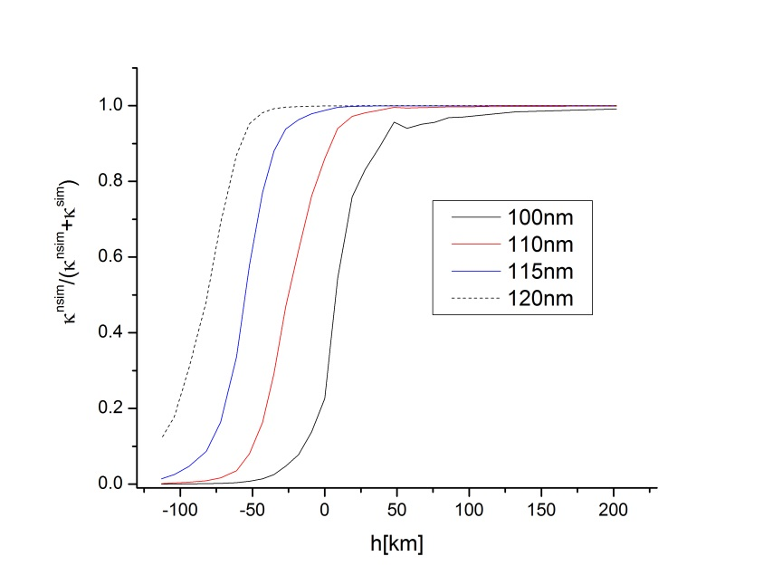
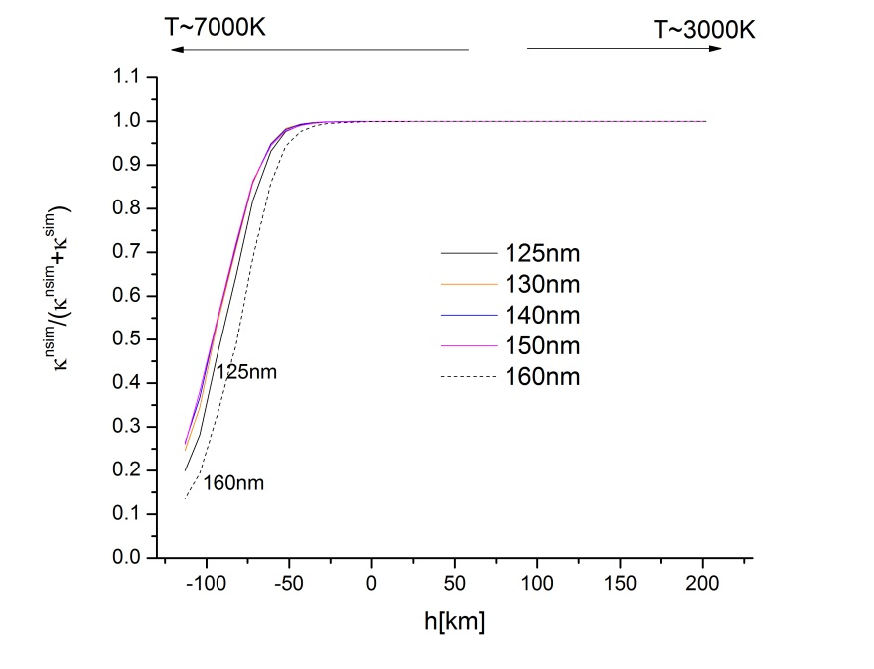
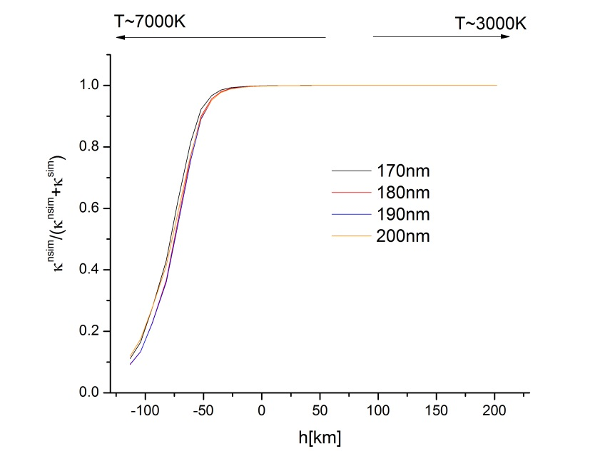
Relative efficiency (fraction, ratio)
This pictures shows what we expected looking into slide with the abundances of H⁺ and X⁺. Namely, since within the sunspots the temperature is significantly smaller than in the rest of the solar photosphere the importance of the already known symmetric processes (1) - (2) have to be practically negligible there with respect to the here investigated strongly non-symmetric ion-atom processes (3) - (5) .

Slide 20

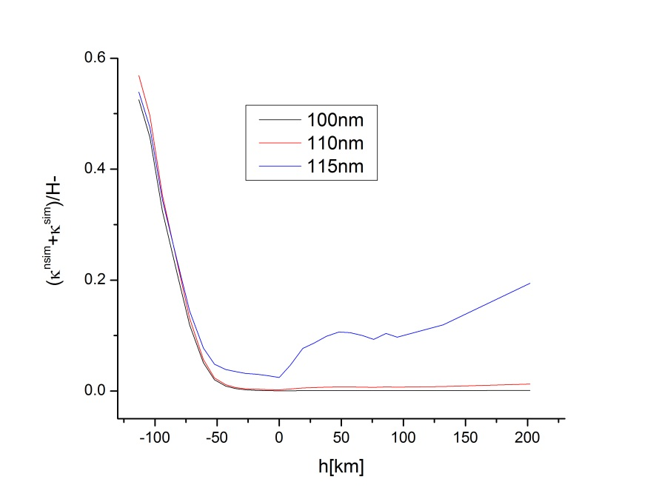
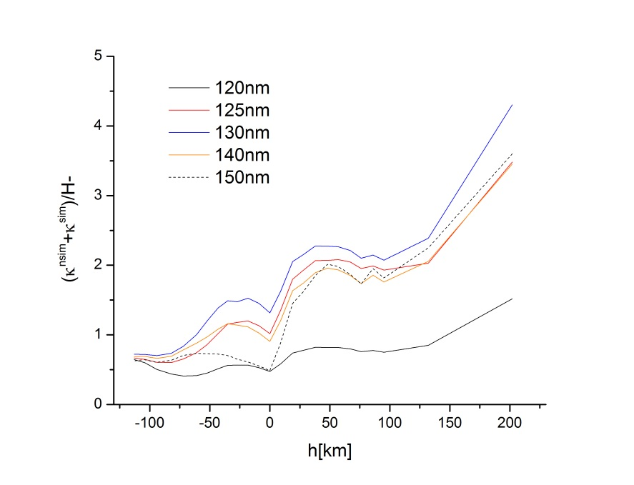
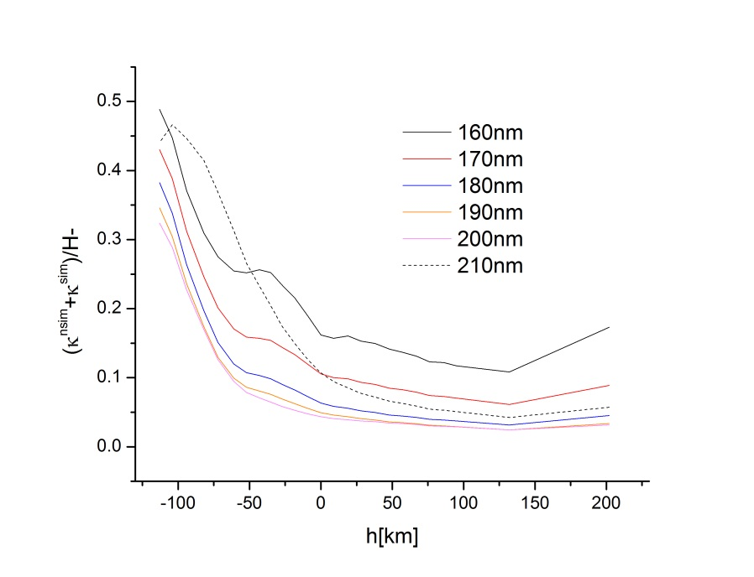
Relative efficiency (fraction, ratio )
In order to additionally show the importance of the non-symmetric processes (3)-(5) here, it was performed the comparison of the efficiencies of the ion-atom absorption processes and the efficiency of such concurrent processes H⁻ continuum.
Wishart (1979)
One can see that efficiency of the ion–atom absorption processes(mainly due to the non-symmetric proc.), particularly in the neighborhood of the solar atmosphere temperature minimum, become close to the efficiency of the H− continuum or even greater (120nm < λ < 150nm) .

Slide 21
Atom absorption
-preliminary results for absorption ion atom non-symmetric processes.
to do more calculations for few cases.
for now(in this stage of calculations) our processes are one among several dominant.
Not lowest not the dominant (means metal photo ionization).

Slide 22

Conclusion
The examined processes generate rather wide quasi-molecular absorption bands in the UV
and VUV regions, whose intensity could be comparable with the intensity of known
symmetric ion-atom absorption processes and with the contribution of the concurrent
(H⁻ continuum, some metal ph).
The presented results suggest that the non-symmetric ion-atom absorption processes
have to be further examined and consequently could be included in standard models
of the sunspot atmosphere.

Slide 23
The Team
Institute of physics
Prof A. Mihajlov
Prof Lj. Ignjatovic
AOB
Prof M. Dimitrijevic

Slide 24
References
Fontenla, J.M., Curdt, W., Haberreiter, M., Harder, J., & Tian, H. 2009, ApJ, 707, 482
Ignjatovic, L.M. & Mihajlov, A.A. 2005, Phys. Rev. A.,72, 022715
Mihajlov, A. A.; Ignjatović, Lj. M.; Srećković, V. A.; Dimitrijević, M. S.; Metropoulos, A.
MNRAS, Vol. 431, Issue 1, p.589-599 (2013).
Mihajlov, A. A.; Srećković, V. A.; Ignjatović, L. J. M.; Dimitrijević, M. S.; Metropoulos, A.
JPCS, Volume 397, Issue 1, article id. 012054 (2012)
Vernazza, J., Avrett, E., & Loser, R. 1981, ApJS, 45, 635

Slide 25
Thank you

