Slide 1
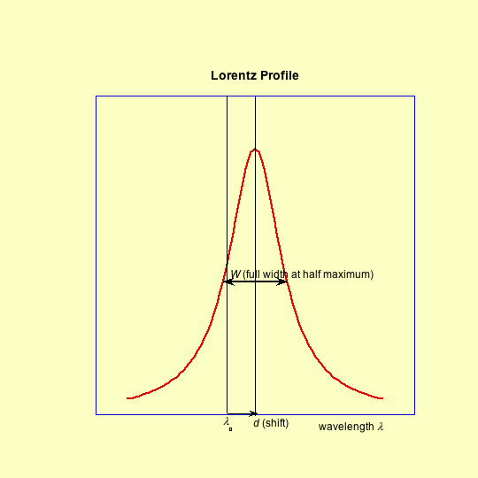
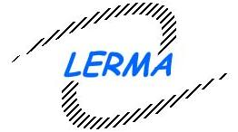



The STARK-B database as a resource for “STARK” widths and shifts data:
State of advancement and program of development in the framework of the
European Consortium VAMDC
(Virtual Atomic and Molecular Data Center)
S. Sahal-Bréchot⁽¹⁾, M.S. Dimitrijević^{(2,1)}, N. Moreau⁽¹⁾,
and N. Ben Nessib⁽³⁾
(1) Observatoire de Paris, LERMA CNRS UMR 8112, France
(2) Astronomical Observatory, Volgina 7, 11060 Belgrade 38, Serbia
(3) Department of Physics and Astronomy, College of Science, King Saud University. Riyadh 11451, Saudi Arabia
http://www.vamdc.org
http://stark-b.obspm.fr

Slide 2
STARK-B broadening and shift of isolated spectral lines of atoms and ions, by collisions with electrons and ions in a plasma
Overlapping lines and departures from impact approximation are outside the scope of STARK-B
Stark broadening of spectral lines can be applied to many subjects
Ionization degree ≥ 1%
Moderately hot to very hot plasmas (2.5 10³ to ∼6 10⁶ K)
Moderate electron density (10¹⁰ to 10²³ cm⁻³ )
Astrophysics
Laboratory plasmas
Technological plasmas

Slide 3
Diagnostics and Modelling in Astrophysics:
Understanding of the evolution of stars
Thanks to considerable developments of
  Ground based and space-born missions
  Increased sensitivity (S/N) and spectral resolution
  Powerful computers
Interpretation of the faint observed spectrum :
faint objects, faint lines (trace elements)
  Line intensities + line profiles
  Continuum
  Spectroscopic diagnostics:
    Temperatures
    pressure
    Abundances
    Chemical stratification of the atmosphere
    Modelling of atmospheres
    Synthetic spectra: a great number of lines of a same element are required
    Radiative transfer
Stellar interiors studies and Asterosimology
  opacities: a great number of lines of higly ionized elements are required
  Nuclear processes: formation of elements, chemical enrichment

Slide 4
Diagnostics and Modelling in Astrophysics:
Understanding of the evolution of stars
Thanks to considerable developments of
  Ground based and space-born missions
  Increased sensitivity (S/N) and spectral resolution
  Powerful computers
Interpretation of the faint observed spectrum :
faint objects, faint lines (trace elements)
  Line intensities + line profiles
  Continuum
  Spectroscopic diagnostics:
    Temperatures
    pressure
    Abundances
    Chemical stratification of the atmosphere
    Modelling of atmospheres
    Synthetic spectra: a great number of lines of a same element are required
    Radiative transfer
Stellar interiors studies and Asterosimology
  opacities: a great number of lines of higly ionized elements are required
  Nuclear processes: formation of elements, chemical enrichment

Slide 5
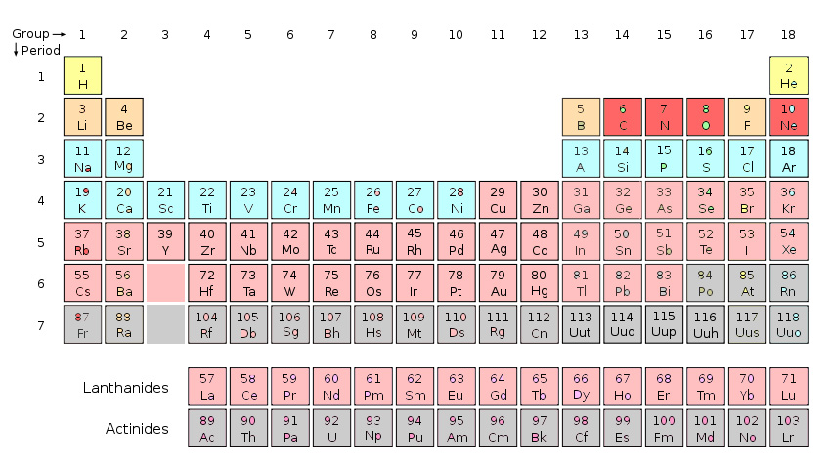
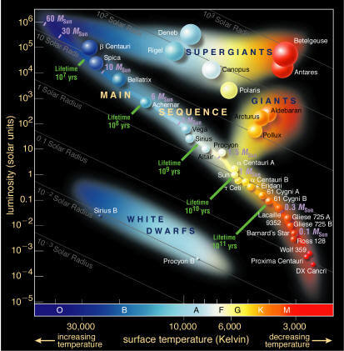
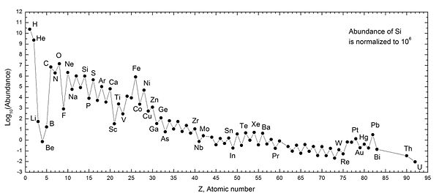
Diagnostics and Modelling in Astrophysics:
Understanding of the evolution of stars
Thanks to considerable developments of
  Ground based and space-born missions
  Increased sensitivity (S/N) and spectral resolution
  Powerful computers
Interpretation of the faint observed spectrum :
faint objects, faint lines (trace elements)
  Line intensities + line profiles
  Continuum
  Spectroscopic diagnostics:
    Temperatures
    pressure
    Abundances
    Chemical stratification of the atmosphere
    Modelling of atmospheres
    Synthetic spectra: a great number of lines of a same element are required
    Radiative transfer
Stellar interiors studies and Asterosimology
  opacities: a great number of lines of higly ionized elements are required
  Nuclear processes: formation of elements, chemical enrichment
Sun abundances

Slide 6
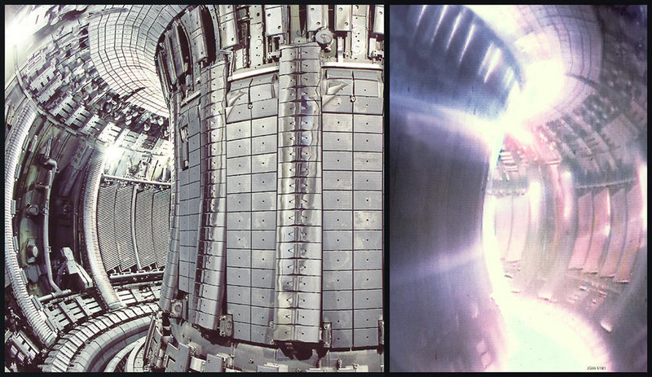
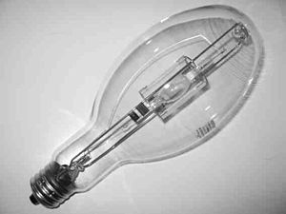
Diagnostics and Modelling in
Laboratory and Technological plasmas
Thanks to developments and needs (devices an research)
  Magnetic confinement fusion: moderately dense and hot plasmas
  Inertial confinement fusion (laser fusion, ion-beam fusion): dense and very hot plasmas
  Low temperatures plasmas
  Lighting discharges
Analysis and interpretation of the spectrum in fusion devices
  Light elements in the divertor and edge plasma regions
  Importance of Tin, Tungsten and impurities
    Temperatures
    Pressure
Progress in low-energy light sources
Discharge lamps and lighting :
optimisation of performances
cold light from hot atoms and molecules
(white light 3000-5000K, discharge up to 45000K),
high electron density (strong and broad emission in the visible spectrum
Fluorescent lamps: improving efficacity (phosphors)
  Rare earth elements Dy, Ho, Ce: excellent radiation sources
  HID (High Intensity Discharge): MH (Metal Halide) lamps, e.g. Dy I₃, In I, ZnI3
  (LED light-emitting diodes)
Notes:
Fusion devices: Impurities are important for modfying th electronic density, and then Stark parameters of elements having a low ionization potential are important for initial stae diagnostics

Slide 7
STARK-B
Database for "Stark" broadening of isolated lines of atoms and ions in the impact approximation http://stark-b.obspm.fr
Calculated widths and shifts: more than 150 pubs (1984-2011)
SCP theory updated and operated
by M.S. Dimitrijević and S. Sahal-Bréchot and colleagues
STARK B is currently developed at Paris Observatory
  the database has been opened since September 2008:
  It is a part of the atomic and molecular databases of the Paris Observatory
Link to SerVO - Serbian Virtual Observatory
http://servo.aob.rs/~darko/
It is node of VAMDC- Virtual Atomic and Molecular Data Centre
it follows the standards of VAMDC and Virtual Observatories
(Europe: IVOA International Virtual Observatory Alliance)
http://www.vamdc.org
http://www.ivoa.net
7

Slide 8
STARK-B data:
Basic approximations (theory and calculations)
Impact approximation
  Collisions between radiators and perturbers
  act independently and are additive
τ ≈ ρ_{typ}/v << ΔT i.e. ρ_{typ}<< N^{-1/3}
Complete collision approximation
➔ line broadening theory becomes
an application of the theory of collisions
The atom has no time to emit or absorb a photon during the collision process, the collision is not broken off.
Isolated lines
  Neighbouring levels do not overlap
i’
i
i’
  ➔ Lorentz profile; S-matrix, cross-sections
f’
f
LS coupling: fine (hyperfine) structure
can be neglected during the collision
(S or I : no time to rotate)
➔The fine structure (hyperfine) components have the
same width and the same shift, that of the multiplet
f’
High densities:
➔Debye screening effect
8

Slide 9
STARK-B data: need to calculate S-matrix and cross-sections
i’
i
i’
f’
f
f’
9

Slide 10
STARK-B data: need to calculate and cross-sections for the width
With the T matrix: T=1-S, and using T*T= 2 Re (T)
(2 l+1) π/κ² = 2 π ρ dρ
i’
i
i’
f’
f
f’
σ is the cross-section for a given velocity:
P is the transition probability for a given impact parameter ρ (or a given orbital angular momentum l)
10

Slide 11
STARK-B
Methods of calculations of the data
1 - The atomic structure
(wave functions, levels and line strengths)
  Coulomb approximation with quantum defect (Bates & Damgaard 1949) with levels taken from tables
  NIST atomic data: levels and line strengths
  VALD (Vienna Atomic Line Database of levels and line strengths)
  TOPbase (R-matrix in LS coupling)
  Cowan code (HFS multi-conf with exchange and relativistic effects by perturbations)
  SUPERSTRUCTURE (scaled Thomas-Fermi-Dirac-Amaldi potential + relativistic effects by perturbations(Breit-Pauli))

Slide 12
STARK-B
Methods of calculations of the data
2. The scattering S-matrix and the cross-sections
SCP: Semi-Classical : atom = quantum description (atomic structure),
        perturber= particle moving on a classical path
+ Perturbation theory (2nd order)
  (Sahal-Bréchot (SSB), A&A1970 and further papers, 6-8 basic papers)
    unitarity and symmetrization of the S-matrix, adequate cut-offs
    hyperbolae for ion-electron and ion-ion (SSB 1970),
    complex atoms (SSB 1974), very complex (Mahmoudi, Ben Nessib & SSB 2008)
    Feshbach resonances for ion-electron collisions (Fleurier, SSB 1977)
    Updated and operated with MS. Dimitrijević (1984 and after)
    accuracy: 20%, sometimes better, sometimes worse
MSE: Modified Semi-Empirical : atom = simplified quantum description Dimitrijević and colleagues, JQSRT1980 and further A&A papers)

Slide 13
STARK-B
Methods of calculations of the data
3. Calculations leading to a great number of data
  Atomic structure coupled to the S-matrix calculation:
  Many widths and shifts for a set of several temperatures and densities in a same run
  Ab initio calculations: no external data insertion
  Coupling to atomic structure codes and databases:
  data for 100-150 lines and more in a same run
  TopBase + SCP
  SST + SCP
  Cowan code + SCP
    Coupling to VALD: data for more than 1000 lines in a same run

Slide 14
2012: SCP data inserted for 114 neutral and ionized atoms
(more than 150 publications)
Ag I,
Al I, Al III, Al XI
Ar I, Ar II, Ar VIII
Au I
B II, B III
Ba I, Ba II
Be I, Be II, Be III
Br I
C II, C III, C IV, C V
Ca I, Ca II, Ca V, Ca IX, Ca X
Cd I, Cd II
Cl I, Cl VII
Cr I, Cr II,+ Cr II (MNRAS,2013 , new results to be inserted)
Cu I
F I, F II, F III ,F IV, F V, F VI, F VII
Fe II
Ga I
Ge I
He I
Hg II
I I
In II, In III
K I, K VIII, K IX
Kr I, Kr II, Kr VIII
Li I, Li II
Mg I, Mg II, Mg XI
Mn II
N I, N II, N III, N IV, N V
Na I, Na X
Ne I, Ne II, Ne II, Ne III, Ne IV, Ne V, Ne VIII
Ni II
O I, O II, O III , O IV, O V, O VI; O VII
P IV, P V
Pb IV,+ Pb IV (MNRAS, 2013, new results to be inserted)
Pd I
Rb I
S III, S IV, S V, S VI
Sc III, Sc X, Sc XI
Se I
Si I, Si II, Si IV, Si IV, Si V, Si VI, Si XI, Si XII, Si XIII
Sr I
Te I
Ti IV, Ti XII, Ti XIII
Tl III
V V, V XIII
Y III
Zn I

Slide 15
2013: New step for insertion of widths and shifts data: the MSE (Modified Semi Empirical) method
Convenient when the knowledge of the atomic structure is incomplete
(lack of levels and/or line strengths: case of complex neutral and ionized atoms)
Dimitrijević and colleagues, JQSRT1980 and further papers
➞ atom: simplified quantum description
1- Cf. Griem (Phys. Rev.1968): SE (Semi-Empirical) method
Elastic contribution taken into account by extending the inelastic cross-sections under the threshold
Cross-sections calculated with an effective Gaunt factor g (Van Regemorter ApJ 1962)
2- MSE: Separation between Δn=0 and Δn≠0
Perturbing levels lumped together for Δn≠0, → use of oscillator strengths sum rules
g revisited, and convenient for ions with Z>1
accuracy of the method: 30-50%

Slide 16
2013: MSE data to be inserted:
90 neutral and ionized atoms
(about 50 publications)
Ag II
Al III, Al V
Ar II, Ar III, Ar IV
As II, As III
Au II
B III, B IV
Ba II
Be III
Bi II, Bi III
Br II
C III, C IV, C V
Ca II
Cd II
Cl III, Cl IV, Cl VI
Co II
Cu III, Cu IV
Eu II, Eu III
F III, F V, F VI
Fe II
Ga II, Ga III
Ge III, Ge IV
I II
Kr II, Kr III
La II, La III
Mg II, Mg III, Mg IV
Mn II
N II, N III, N IV, N VI
Na III, Na VI
Nd II
Ne III, Ne IV, Ne V, Ne VI
O II, O III, O IV, O V
P III, P IV, P VI
Pt II
Ra II
S II, S III, S IV
Sb II
Sc II
Se III
Si II, Si III, Si IV, Si V, Si VI
Sn III
Sr II, Sr III
Ti II, Ti III
V II, V III, V IV
Xe II
Y II
Zn II, Zn III,
Zr II

Slide 17
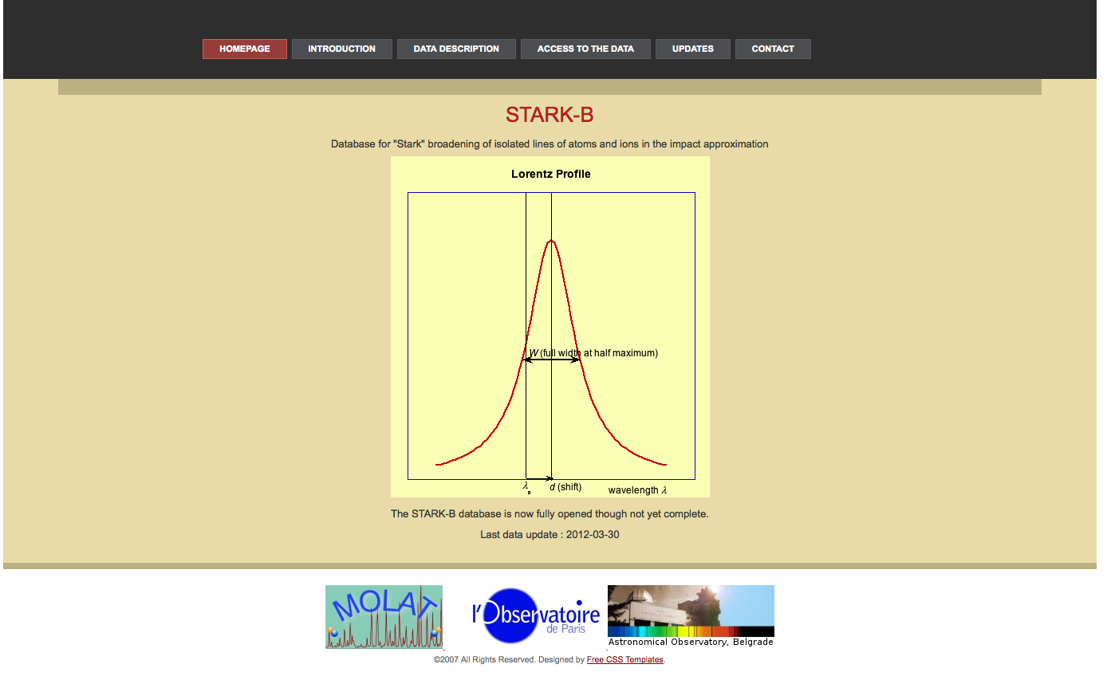
STARK-B http://stark-b.obspm.fr

Slide 18
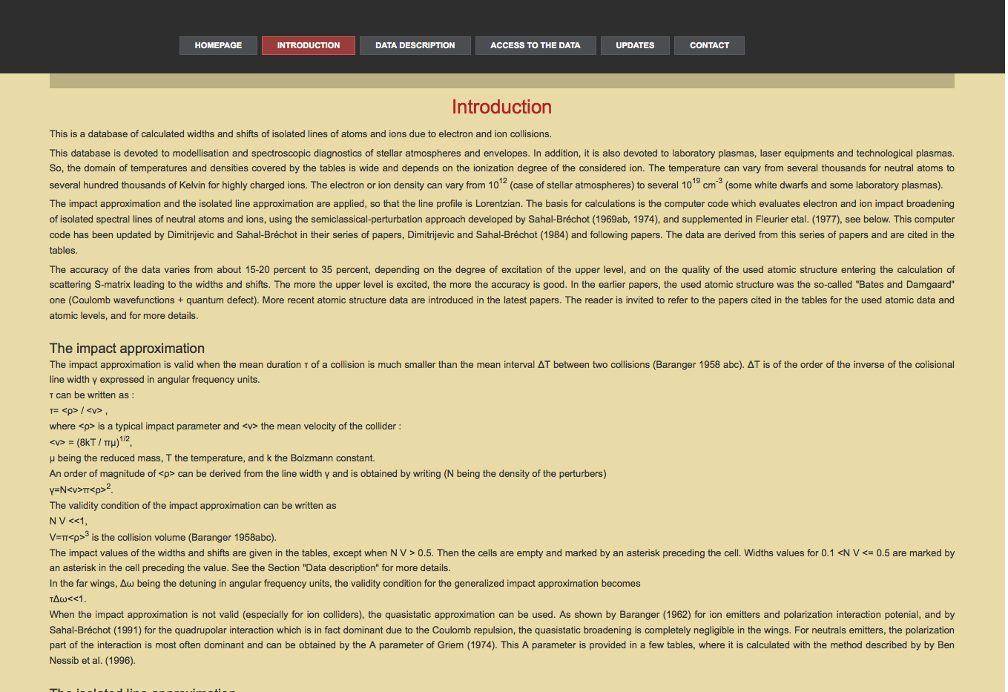

Slide 19
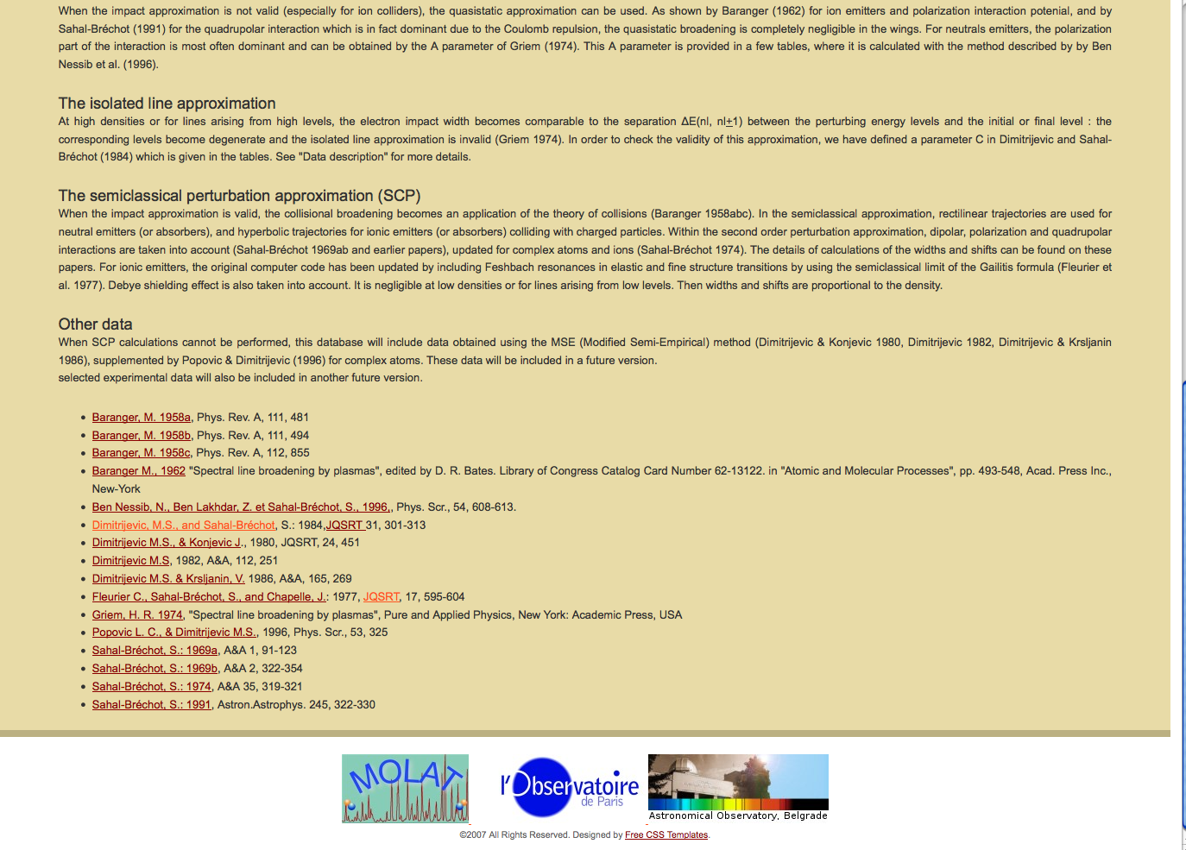

Slide 20
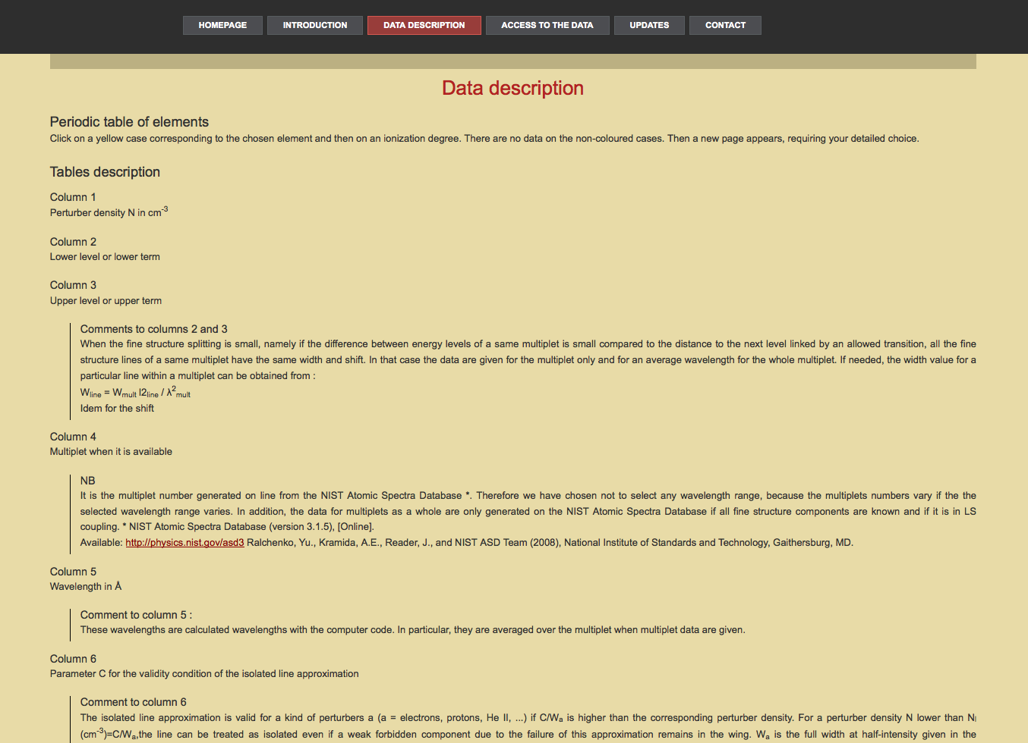

Slide 21
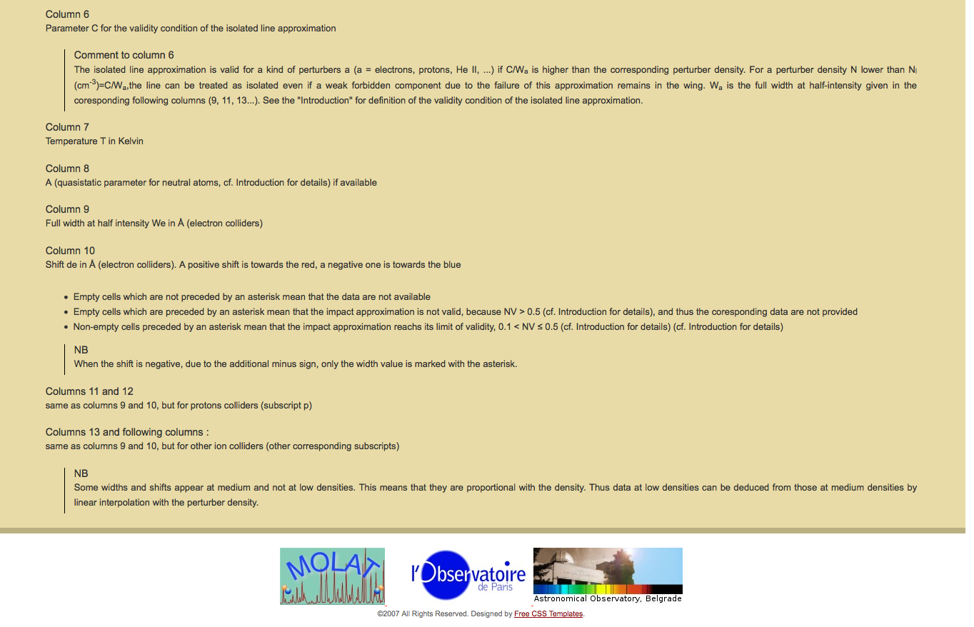

Slide 22
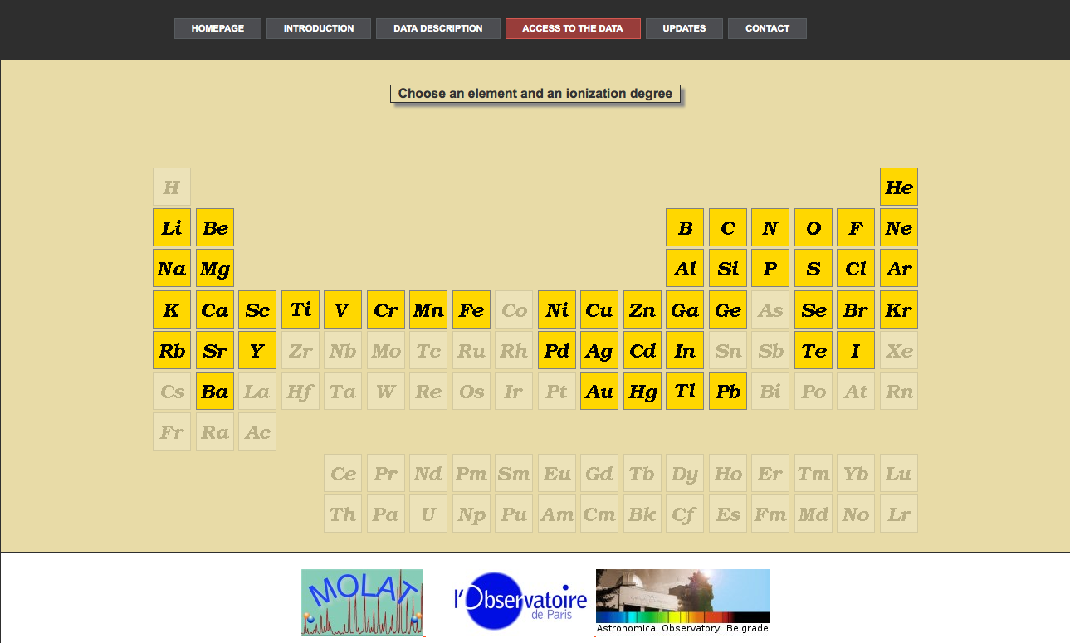

Slide 23
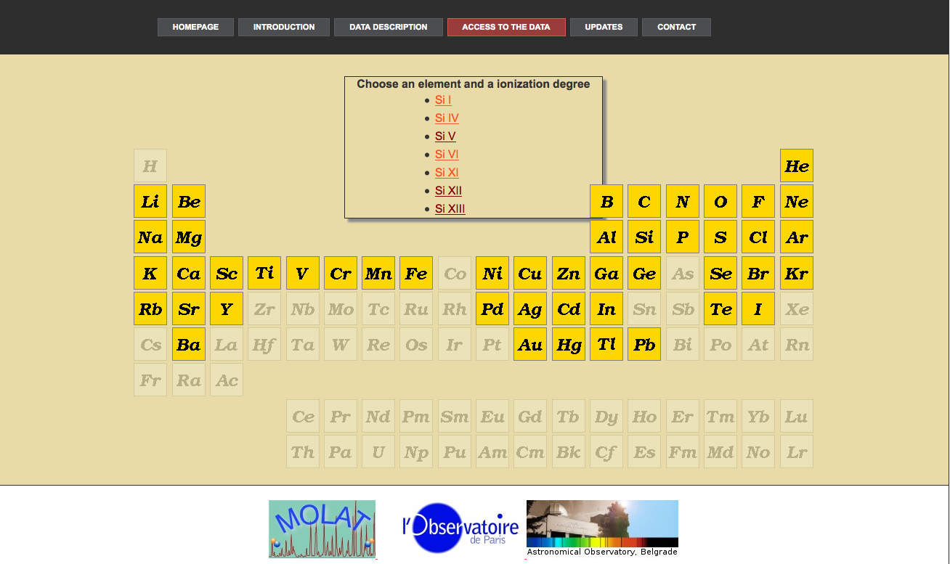

Slide 24
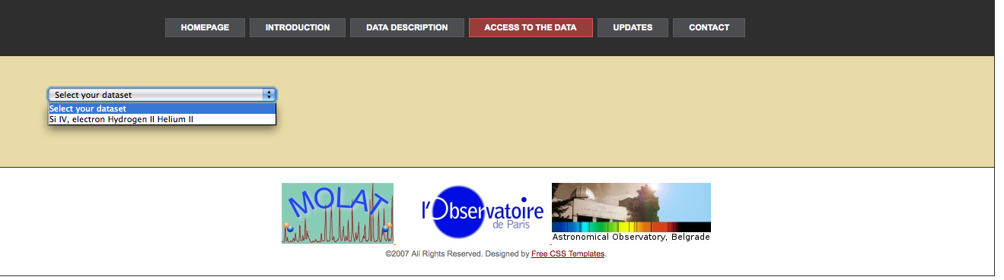
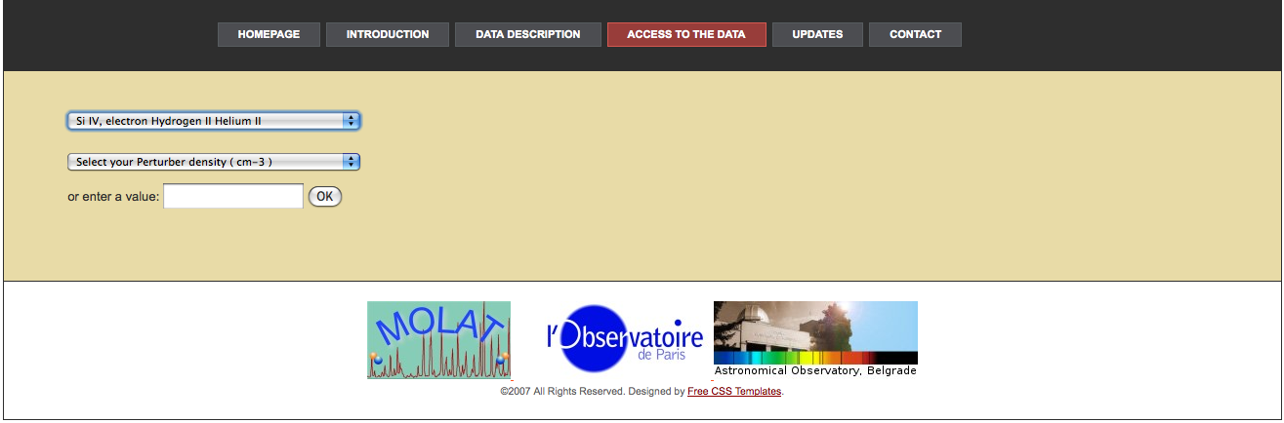

Slide 25
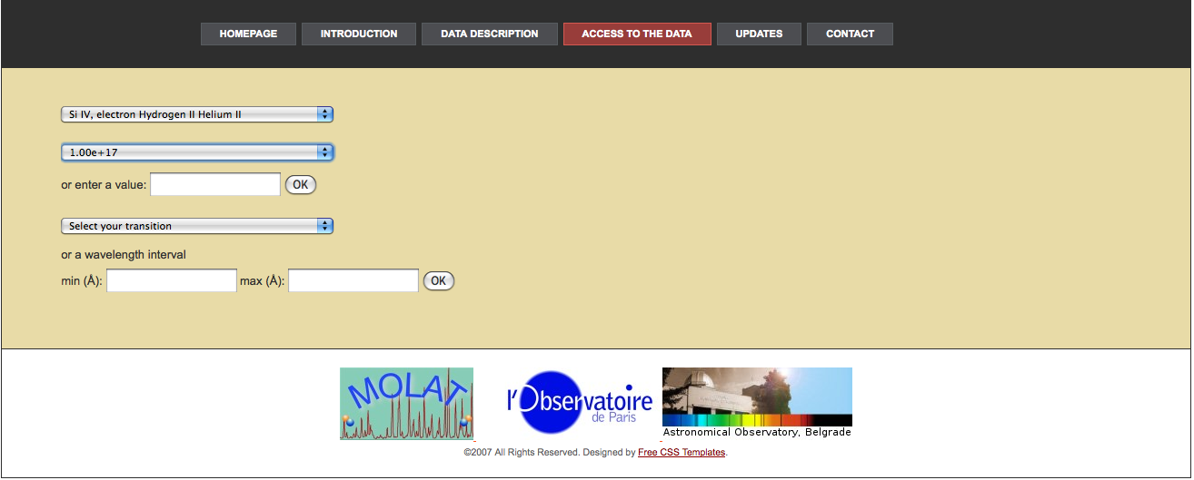

Slide 26
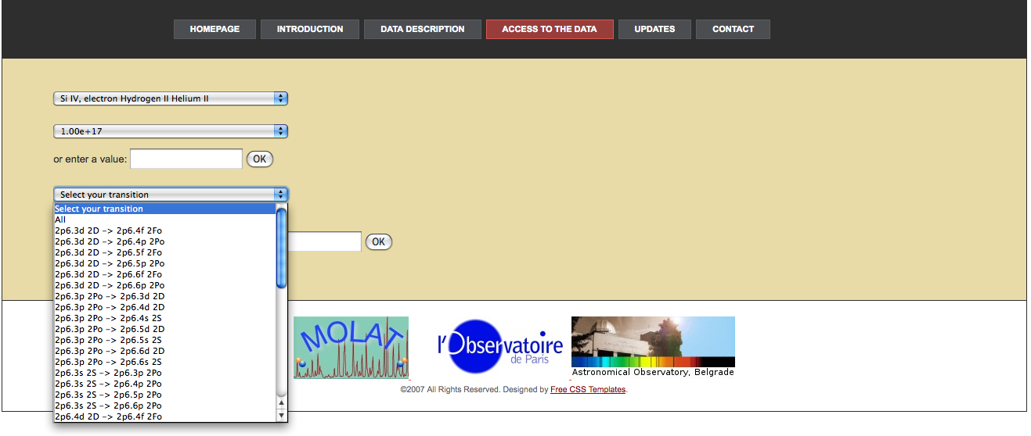

Slide 27
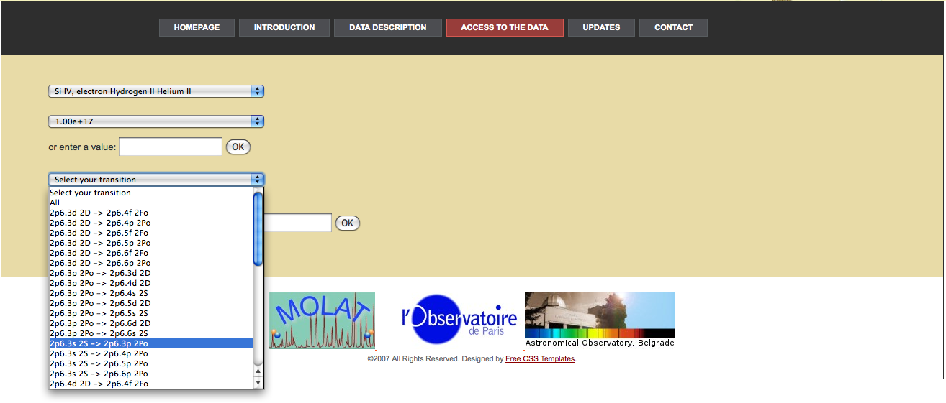

Slide 28
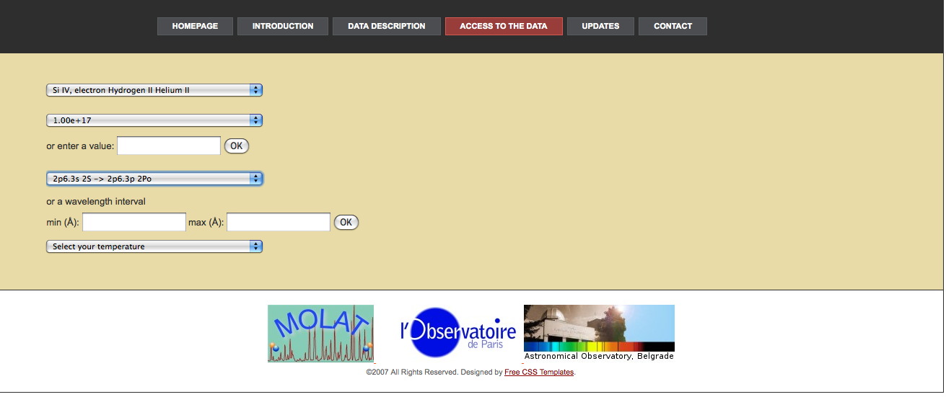

Slide 29
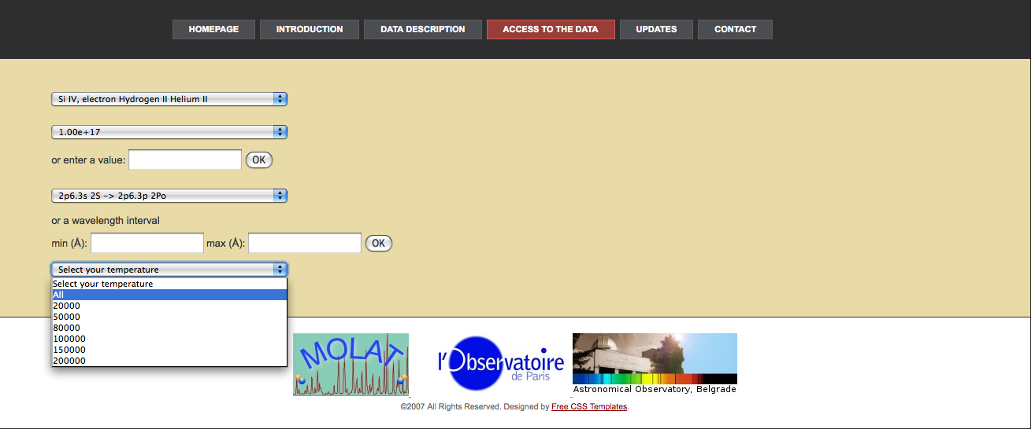

Slide 30
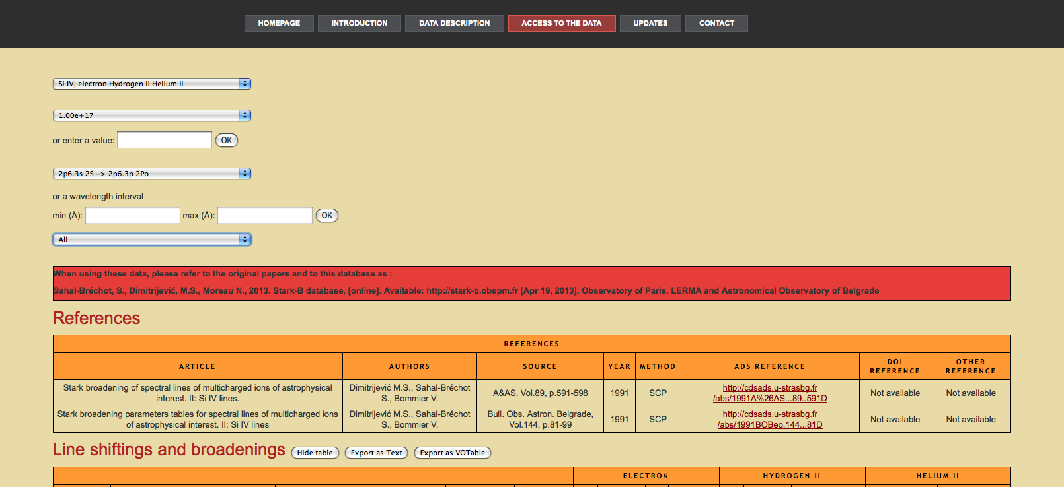
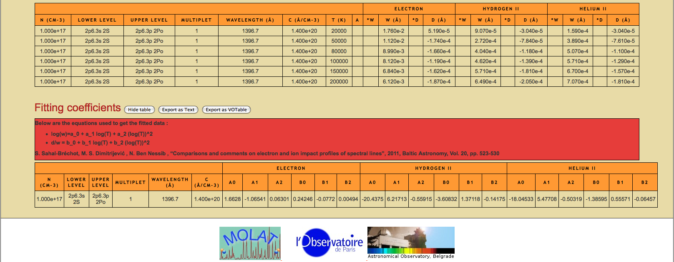

Slide 31
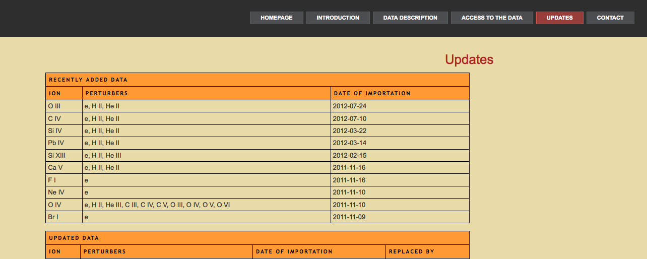
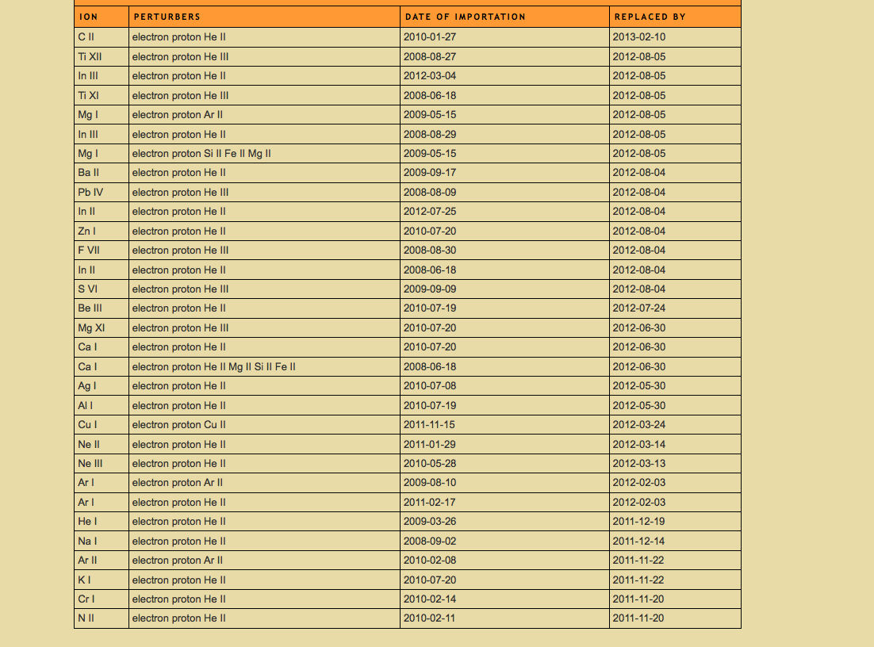

Slide 32
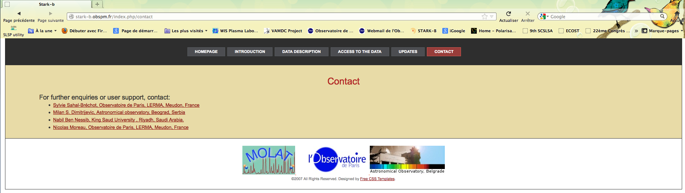

Slide 33
STARK-B: Next steps
Insertion of MSE data(in progress)
Insertion of little “applets” on line for users:
  extrapolation or interpolation
    along principal quantum numbers,
    charge of the radiating ions (isoelectronic sequences),
    homologous ions,
    charge of the ion collider
Future:
  SCP code on line: STARK-C project
      Insertion of quantum data in intermediate coupling: SST + DW, AS
      especially adapted to highly charged ions and resonance lines (Sahal-Bréchot with Elabidi & Ben Nessib (2004 and after, an also with Dubau and Cornille 2007 and after )

Slide 34
VAMDC Consortium
Virtual Atomic and Molecular Data Center
European project FP7 "Research Infrastructures
summer 2009 - end of 2012
Interoperable e-Infrastructure
for exchange of atomic and molecular data
15 administrative partners: 24 teams
from 6 European Union member states,
Serbia, Russian Federation and Venezuela
strong coupling
to the users (astrochemistry, atmospheric physics, plasmas)
scientists and engineers from the ICT community (Information and Communication Technologies)
used to deal with deploying interoperable e-infrastructure
e.g. Europlanet IDIS
IVOA (International Virtual Observatory Alliance)
Members: Euro-VO , AstroGrid…
http://www.vamdc.org
http://www.vamdc.eu

Slide 35
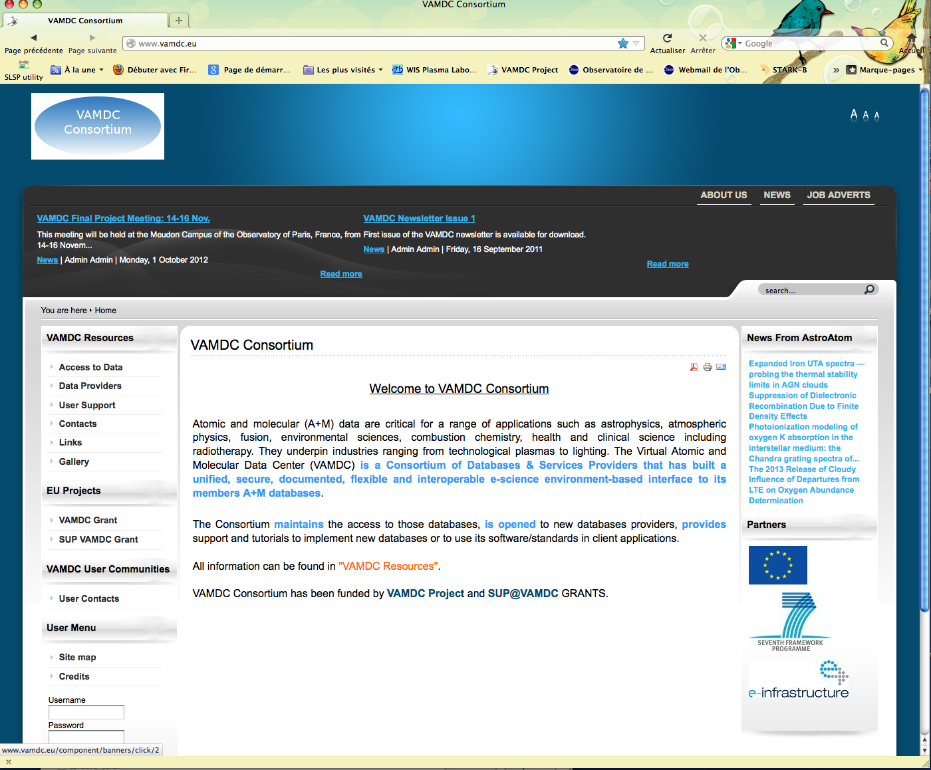
http://www.vamdc.eu

Slide 36
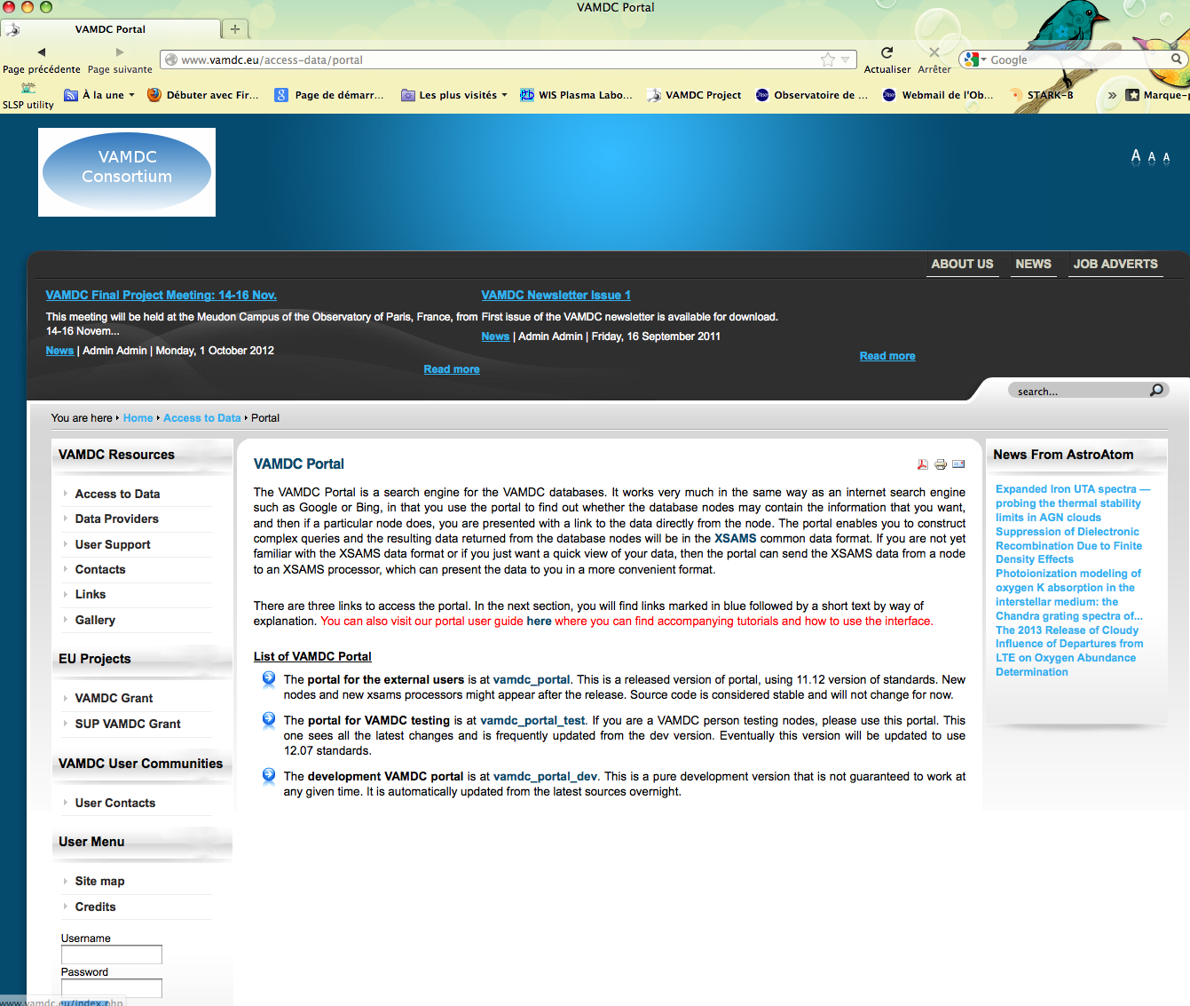

Slide 37
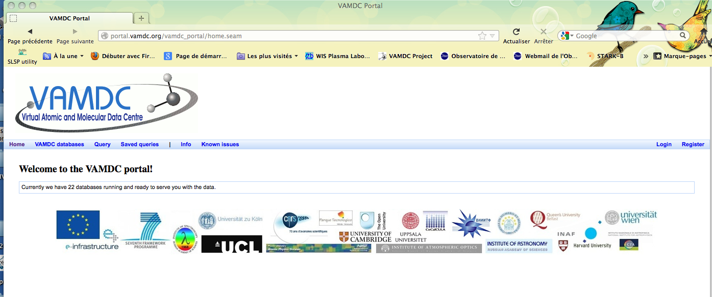
VAMDC: portal user

Slide 39
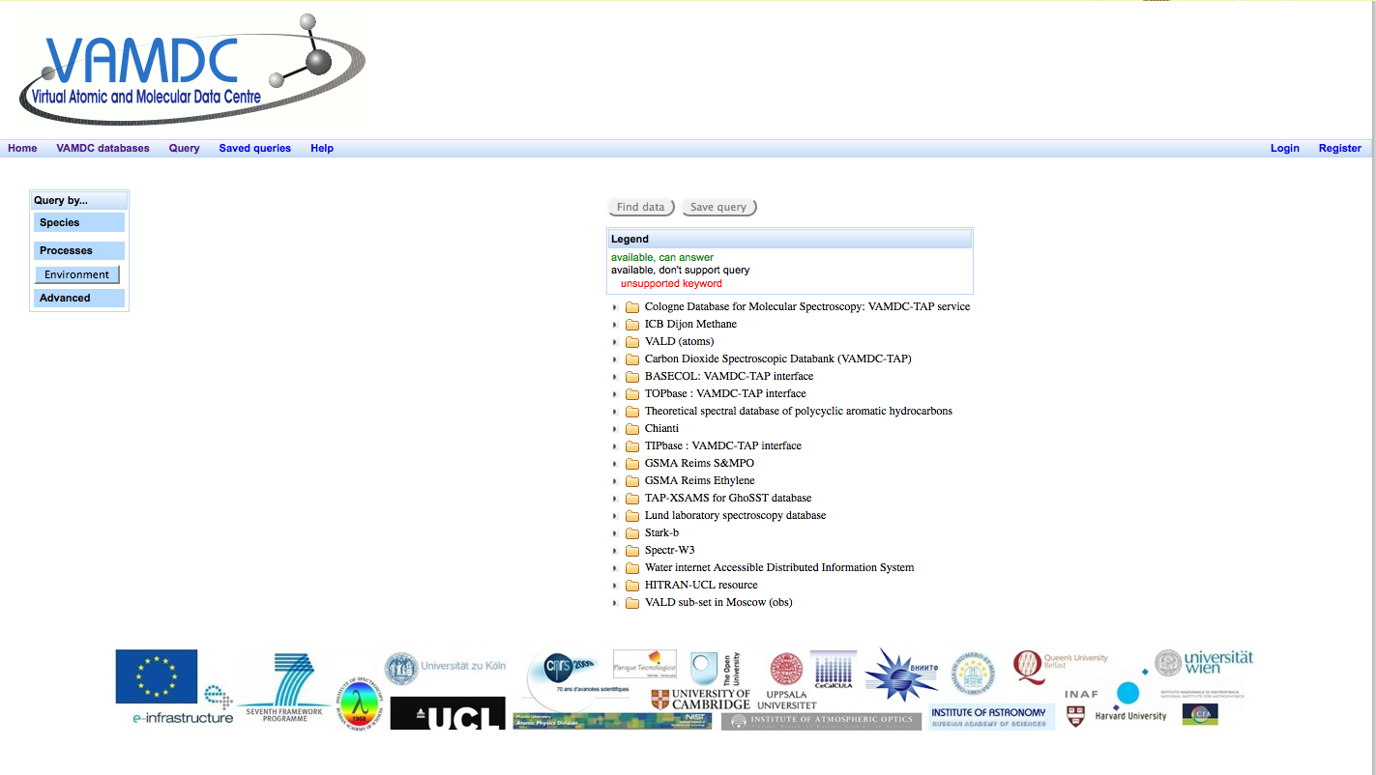
Query

Slide 40
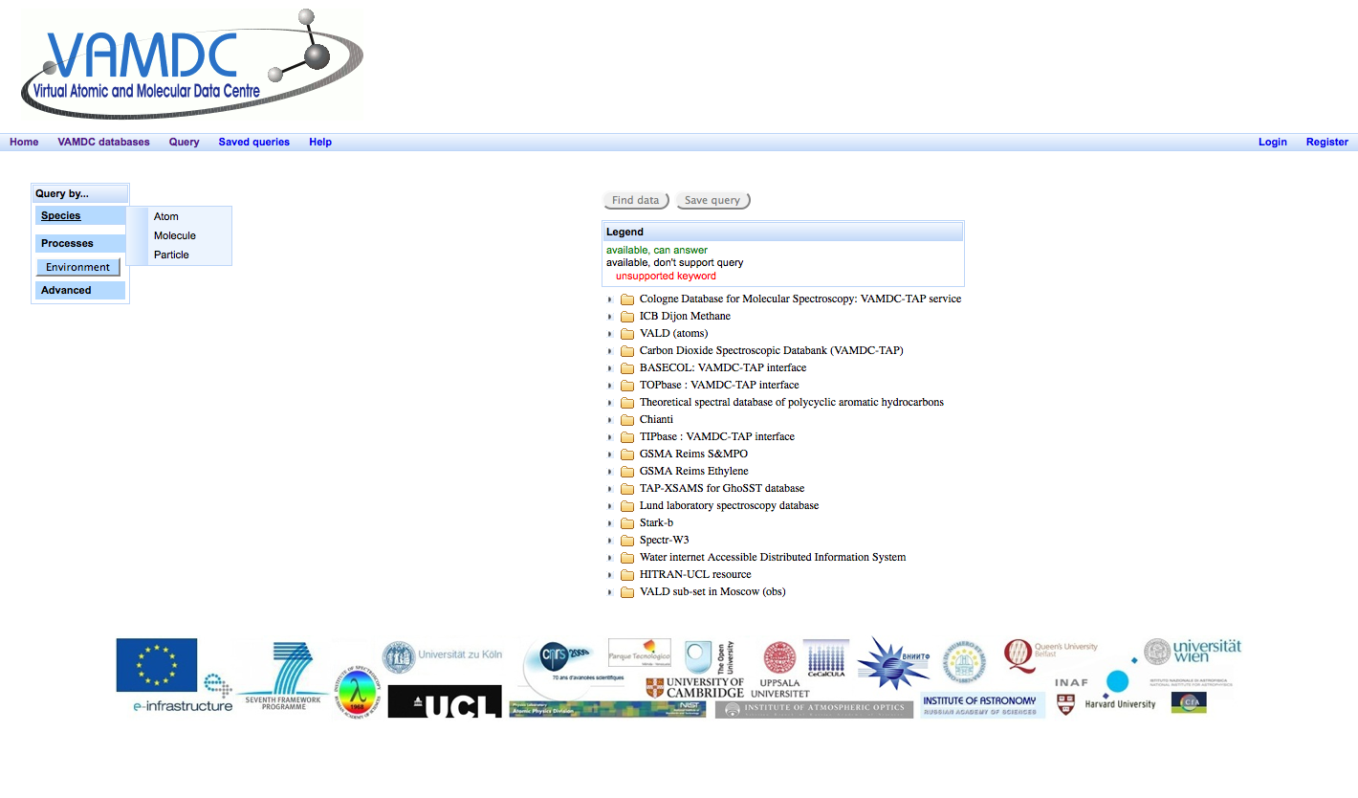
Query by species

Slide 41
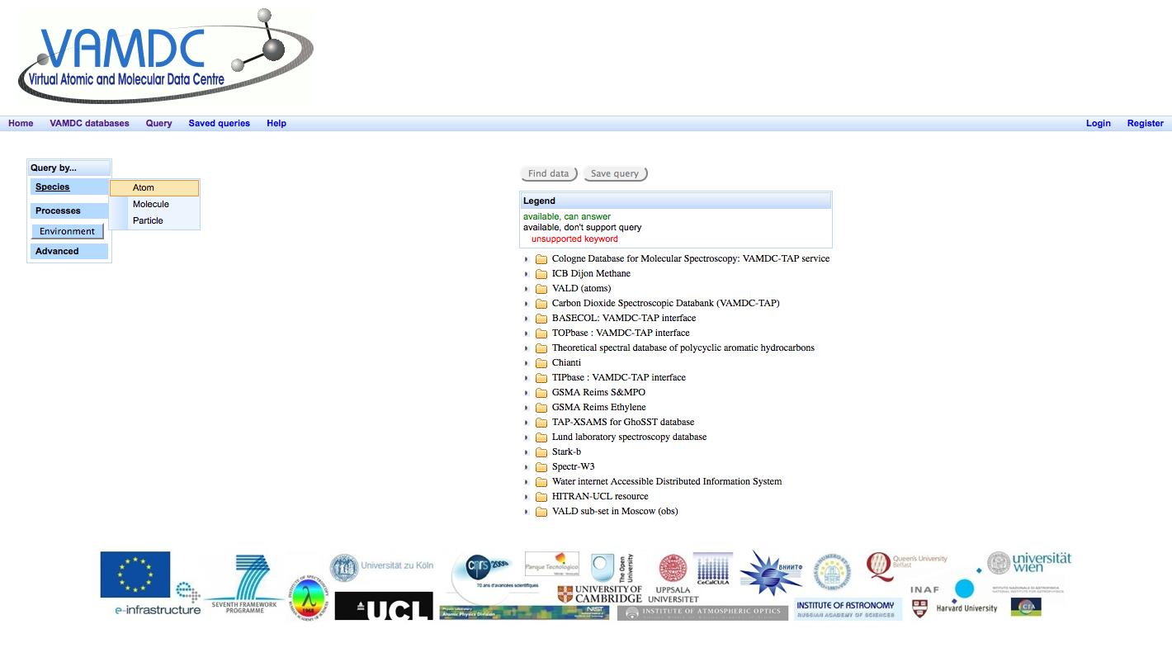
Query by species: atom

Slide 42
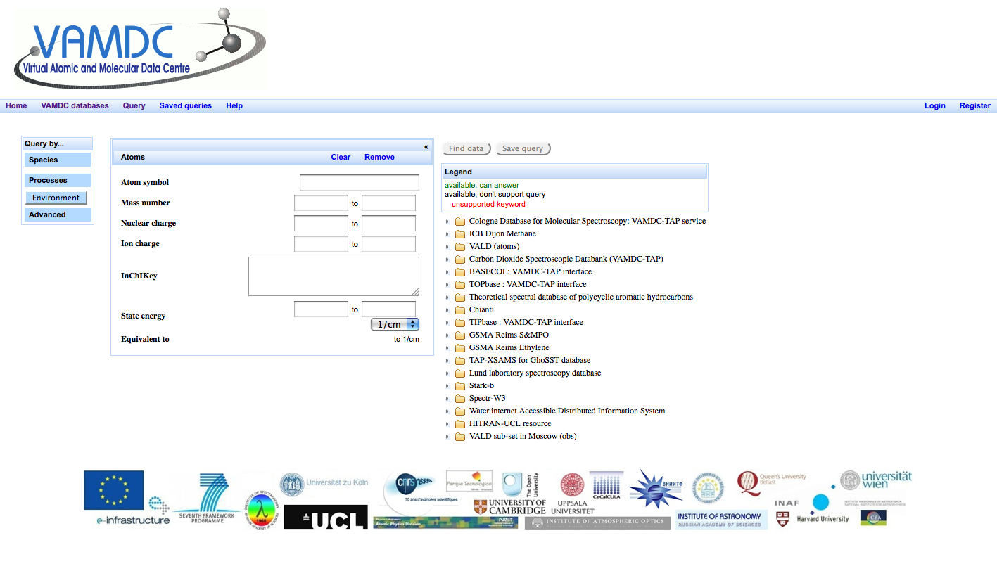
Query by species: atom (following)

Slide 43
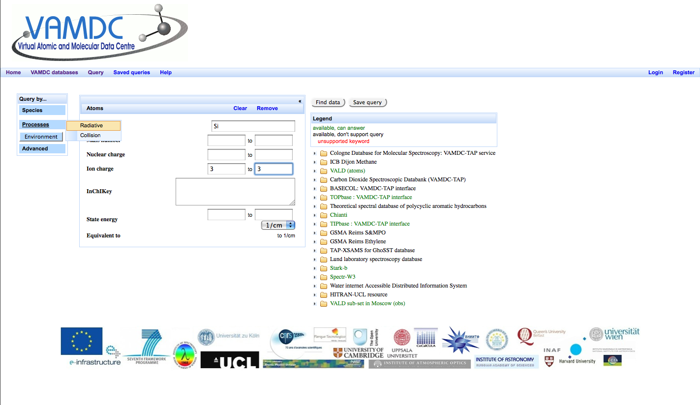
Query by species: atom, processes

Slide 44
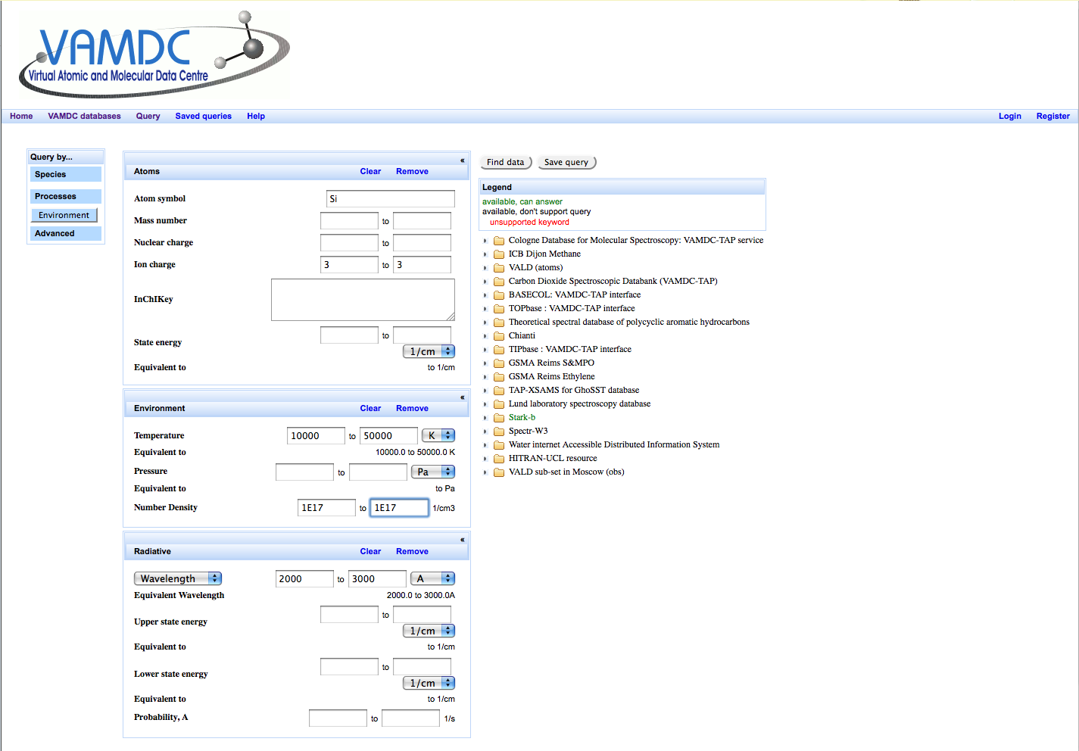
Query by species: atom, processes (following)

Slide 45
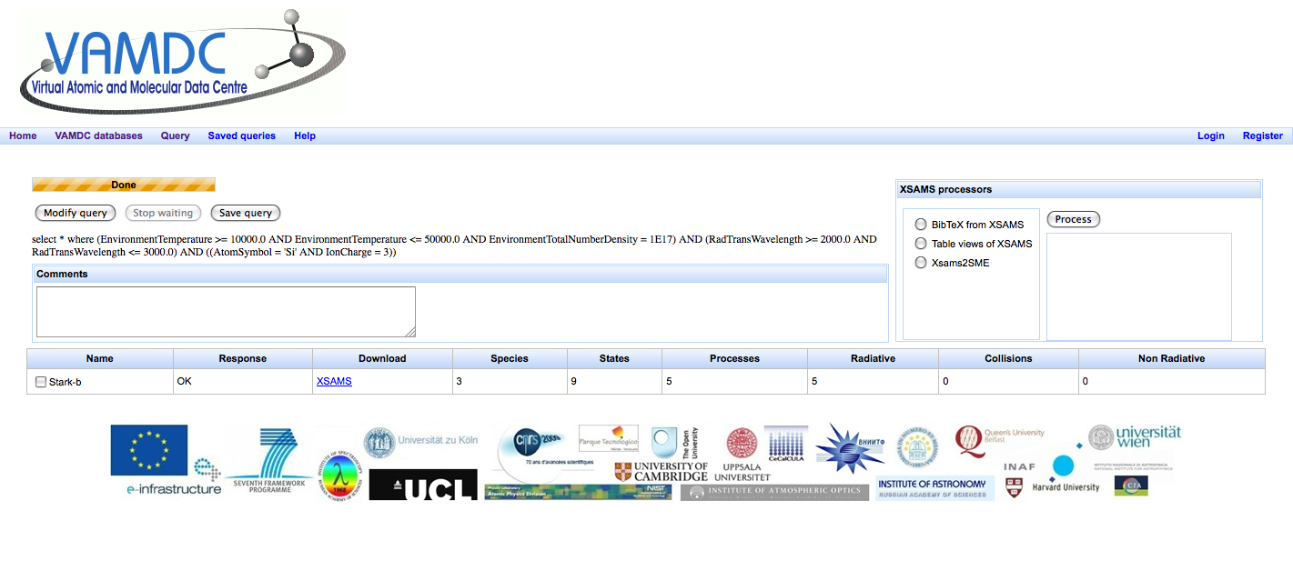
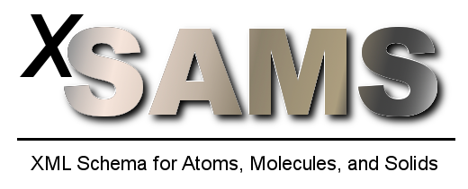

Query : result, click on download
Xsams: XML Schema for Atoms, Molecules and Solids
XML: Extensible Markup Language
Xsams2SME: converts XML document into the CSV-format wanted by Spectroscopy Made Easy (SME)
Notes:
XML : Extensible Markup Language, « langage de balisage extensible ») mettre en forme des documents grâce à des balises (markup) faciliter l'échange automatisé de contenus complexes (arbres, texte riche…) entre systèmes d'informations hétérogènes (interopérabilité).
XSAMS: XML-based standard for exchange of atomic, molecular, and particle-solid-interaction data was proposed at the IAEA

Slide 46
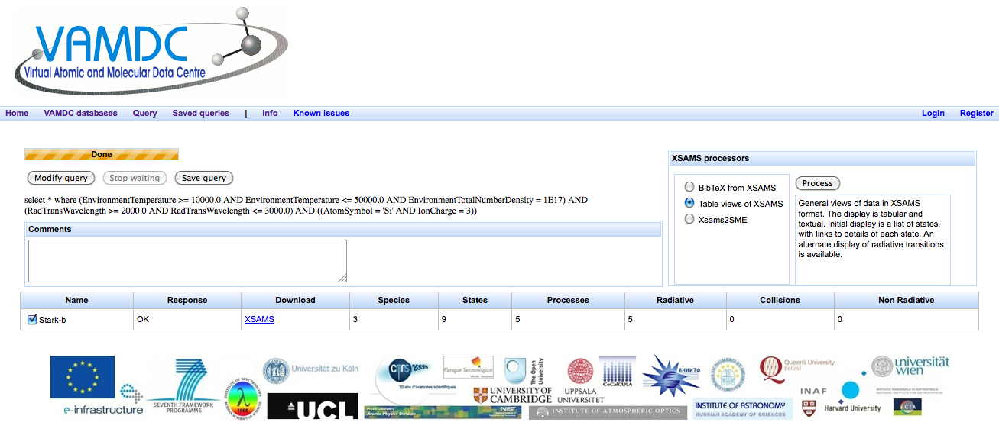

Slide 47
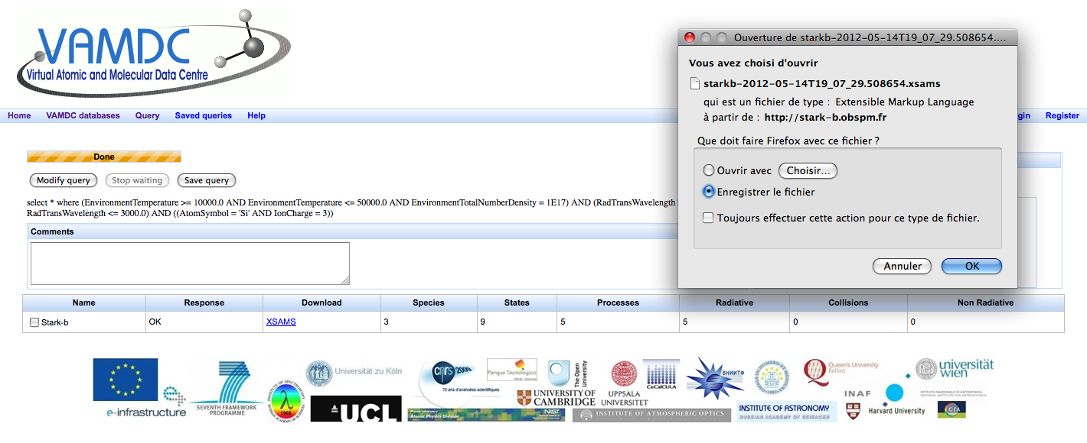
Result of the download: code in XML language for users
Xsams
XML Schema for Atoms, Molecules and Solids

Slide 48
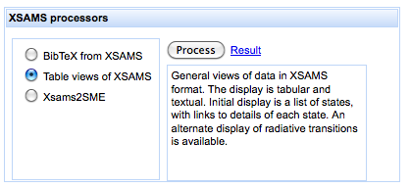

Slide 49
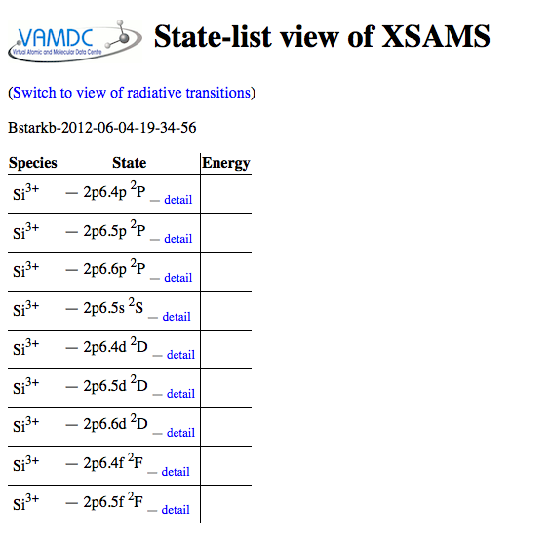

Slide 50
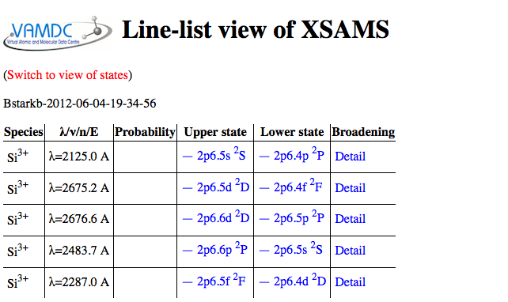

Slide 51
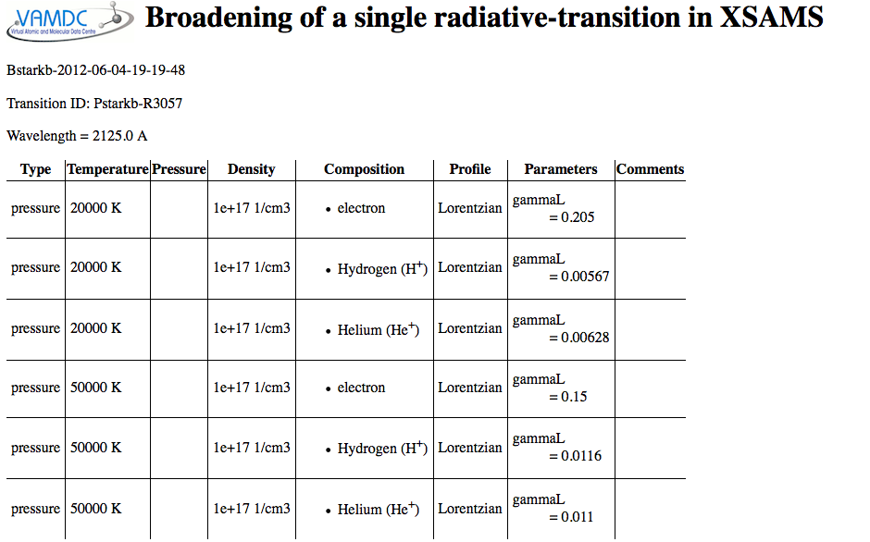

Slide 52
Thank you for your attention

