Slide 1
Exoplanery searches with gravitational microlensing: polarization issues
А.Ф.Захаров (Alexander F. Zakharov)
Institute of Theoretical and Experimental Physics, Moscow,
e-mail: zakharov@itep.ru
Main references: G. Ingrosso , F. De Paolis, P. Jetzer, S. Calchi Novati , A.A. Nucita, A.F. Zakharov (MNRAS, 2009); (GRG, 2010), (MNRAS, 2012)
9th SCSLSA, Banja Koviljaca, 16 May 2013

Slide 2
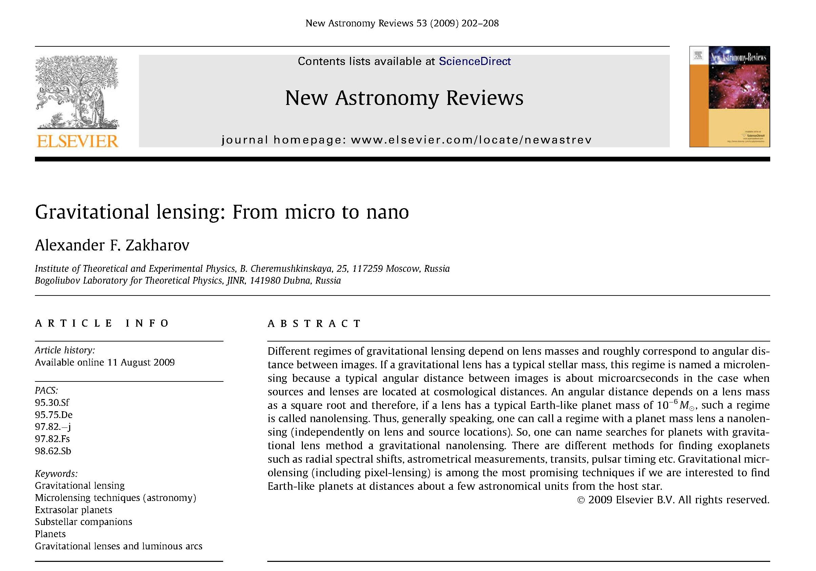

Slide 3
1 nano angular second
2.5 cm coin from the Neptune orbit (4.5* 10^{9} km) (about 30 AU).
Millimetron is a future mission for space–ground interferometry. 12 m radio antenna has to be placed at the L2 point

Slide 4
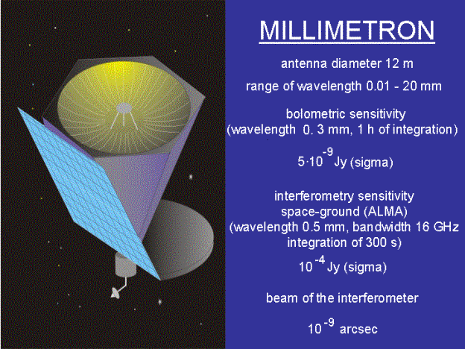

Slide 5
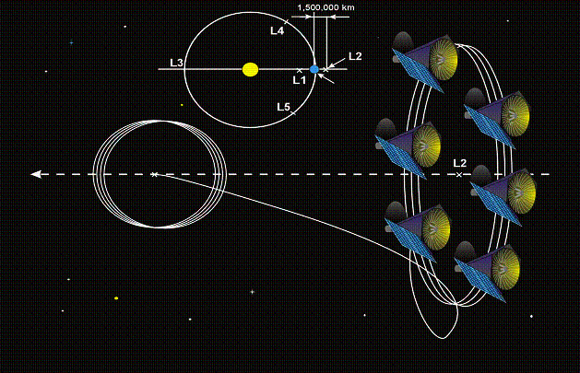

Slide 6
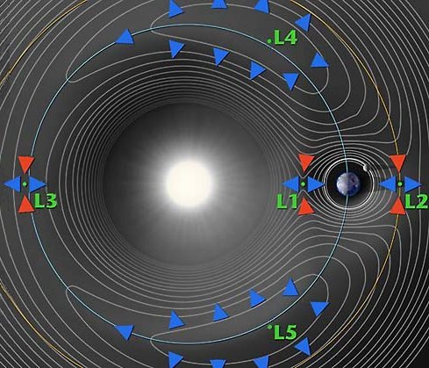

Slide 7
Outline
History (GL, ML, local ML)
Binary lenses (planets)
Pixel microlensing
Polarization issues for exoplanetary searches
Conclusions

Slide 8
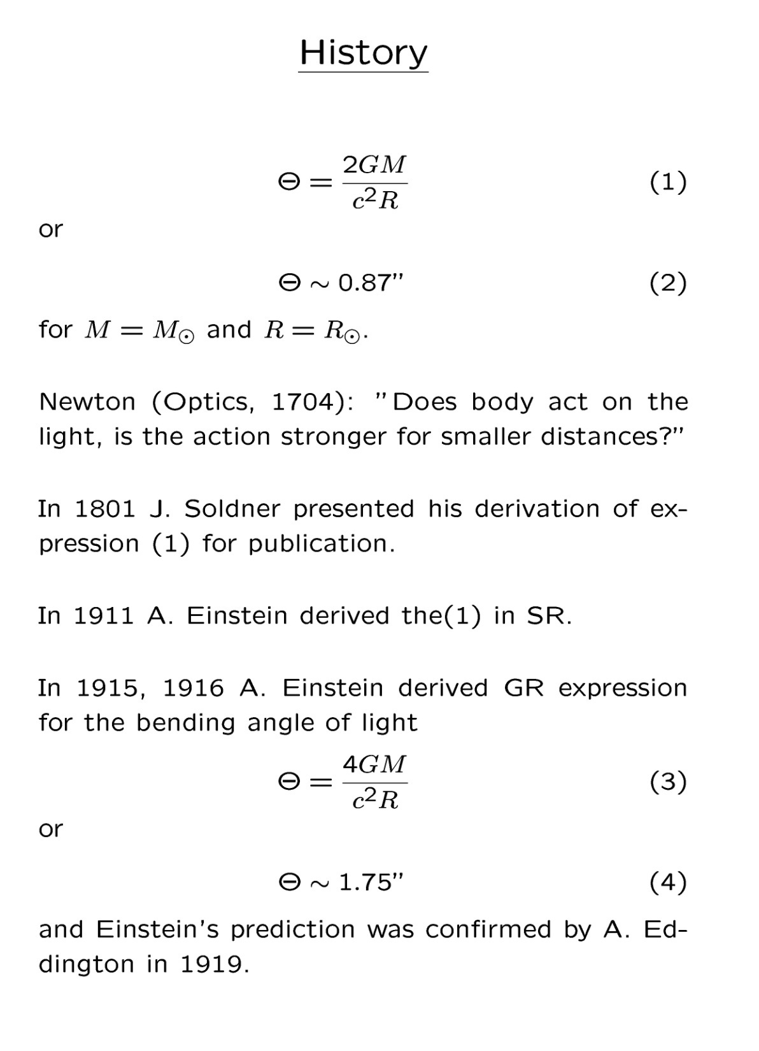

Slide 9
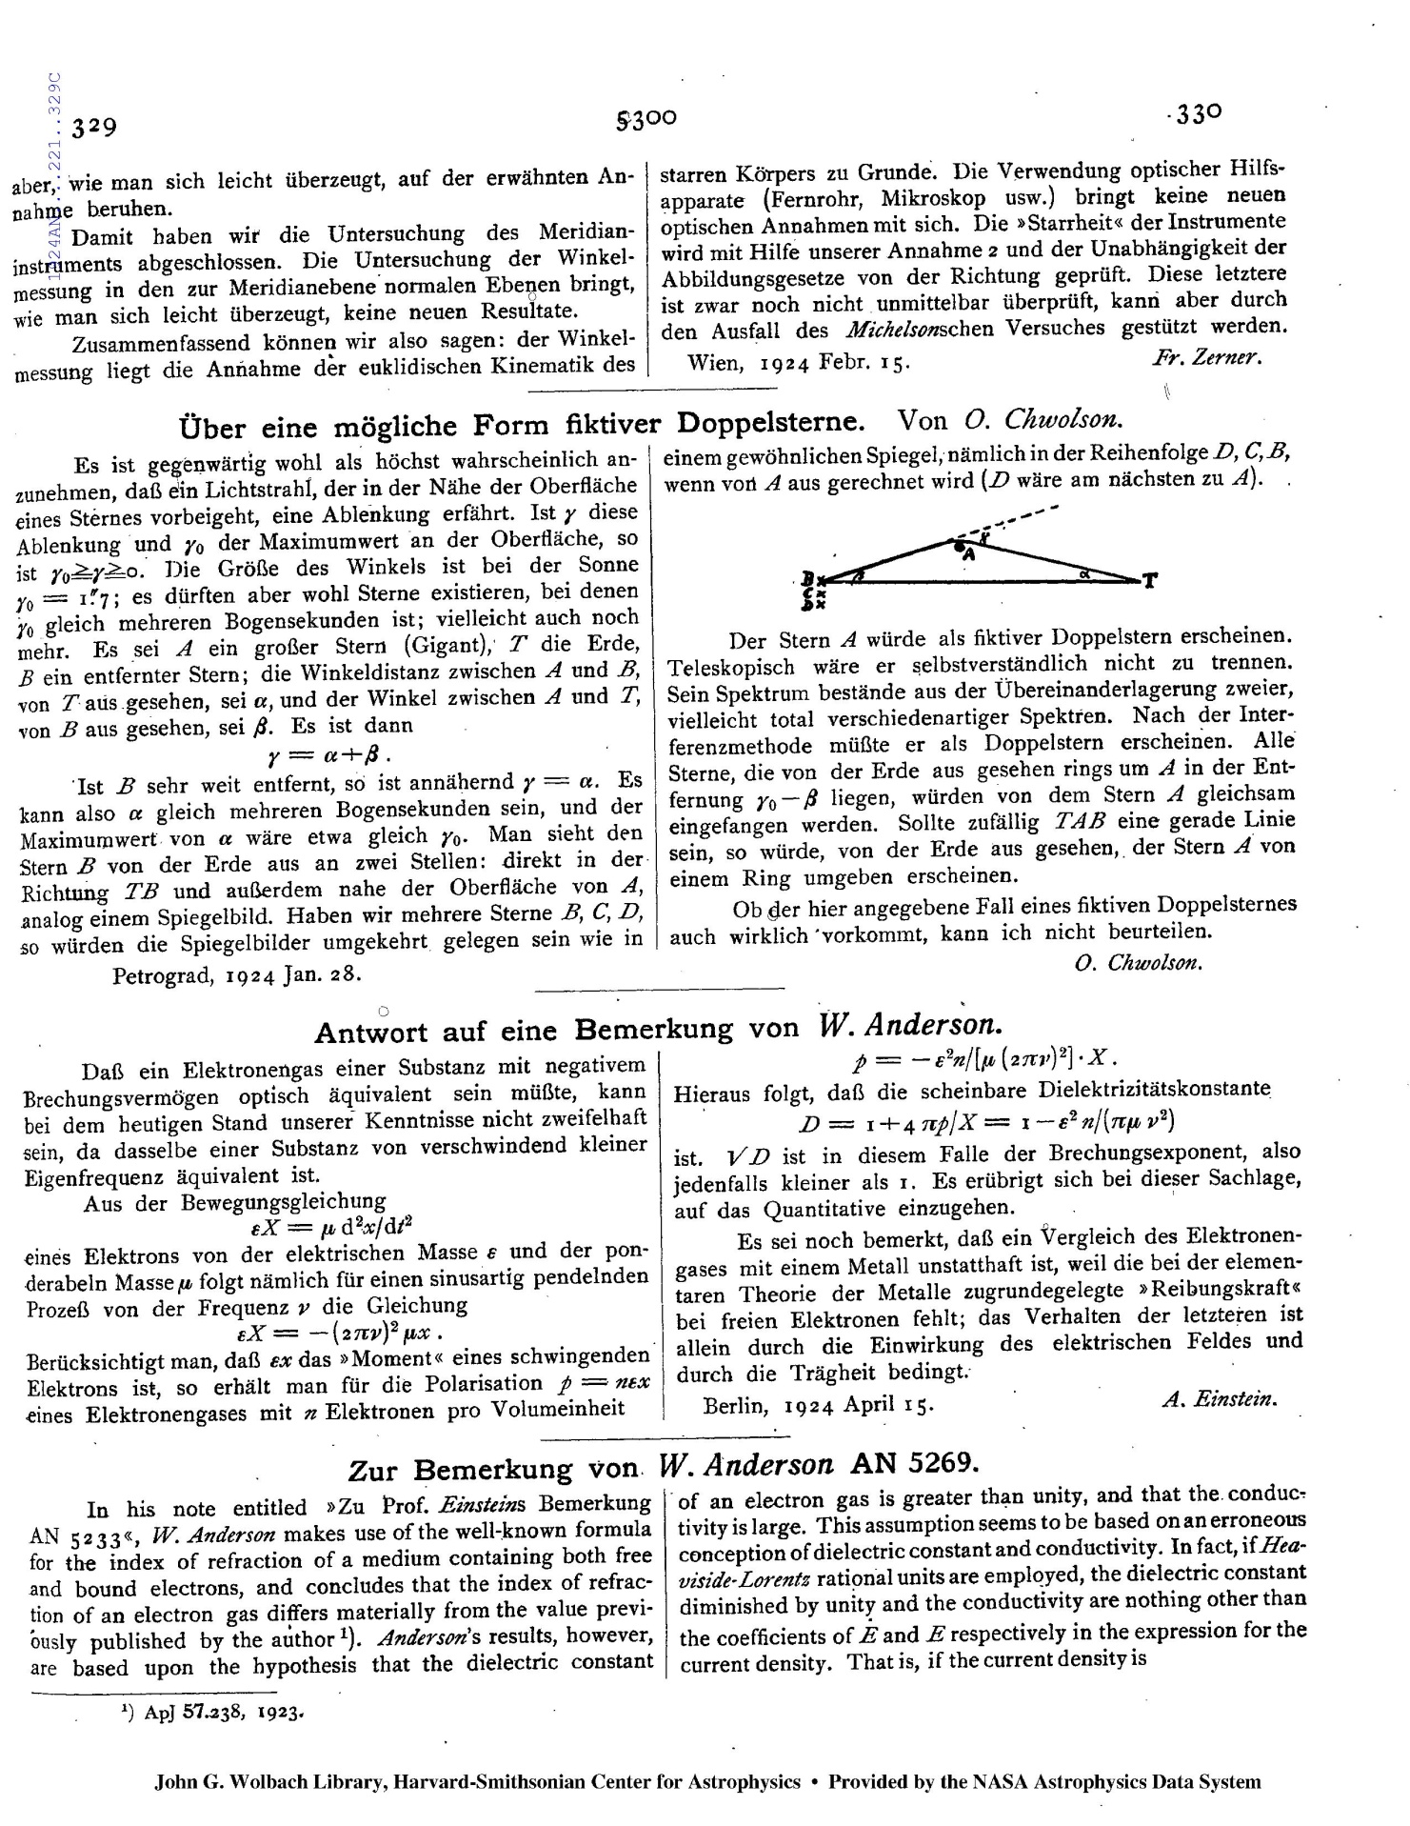

Slide 10
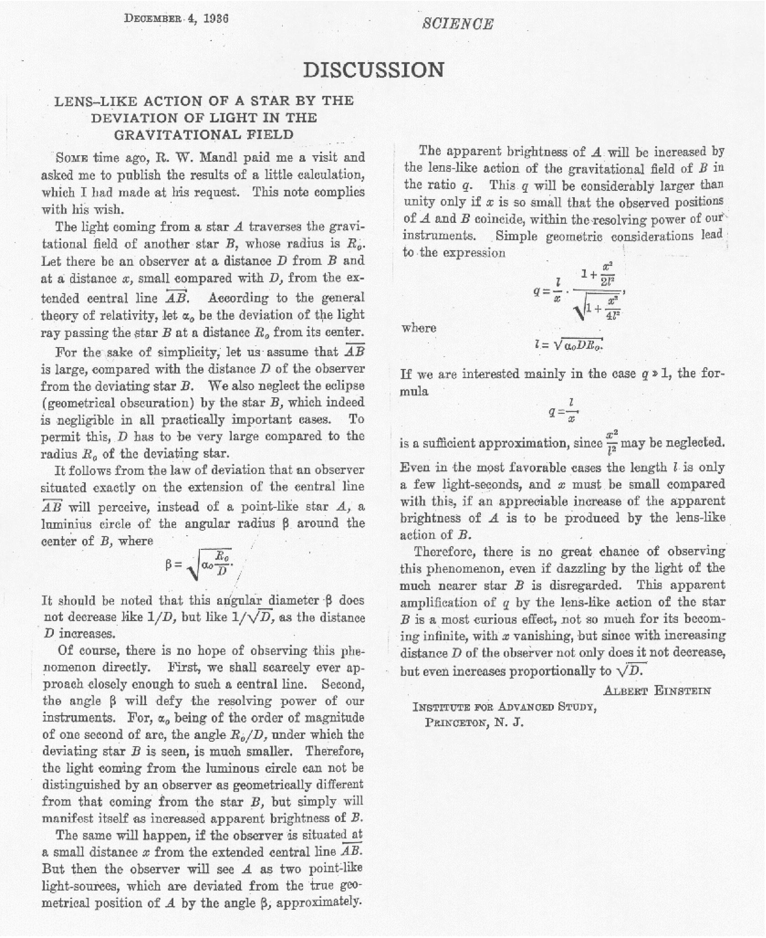

Slide 11
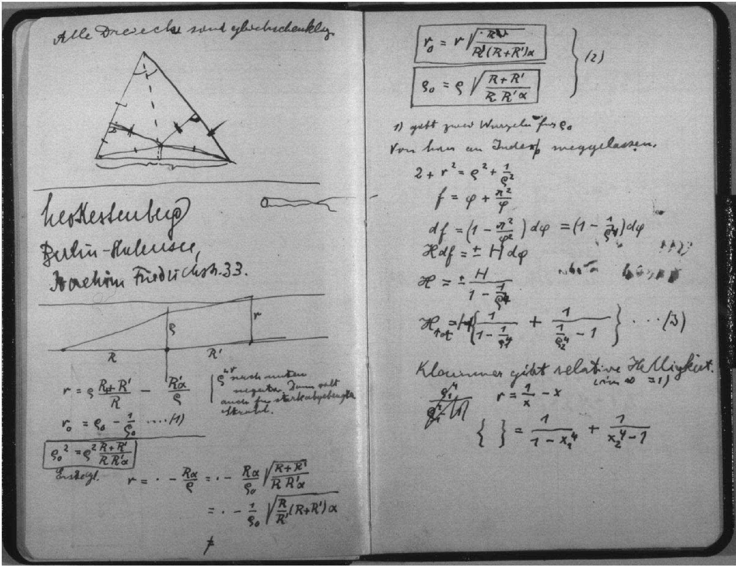

Slide 12
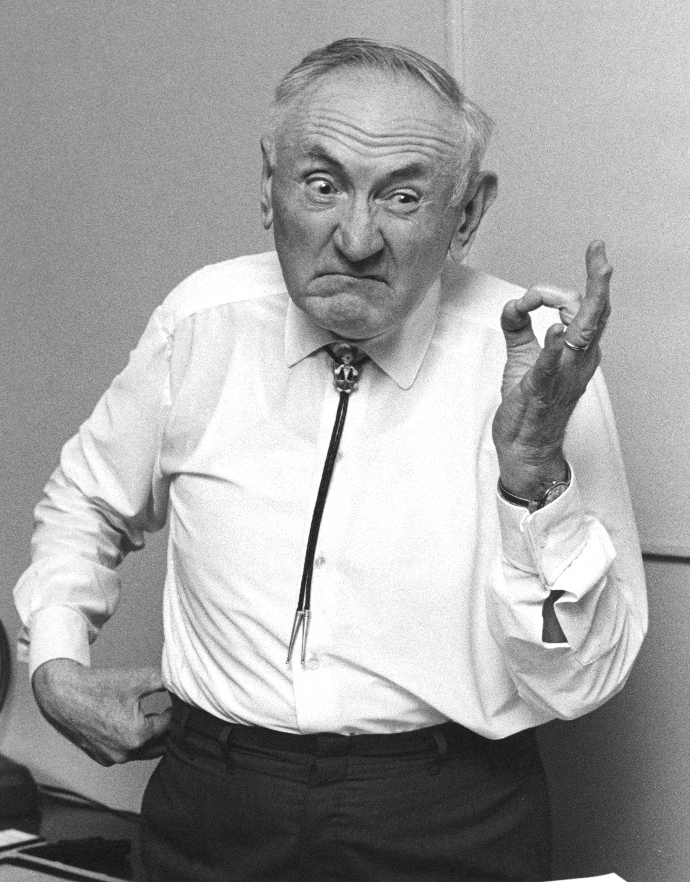
Fritz Zwicky → GL+DM

Slide 13
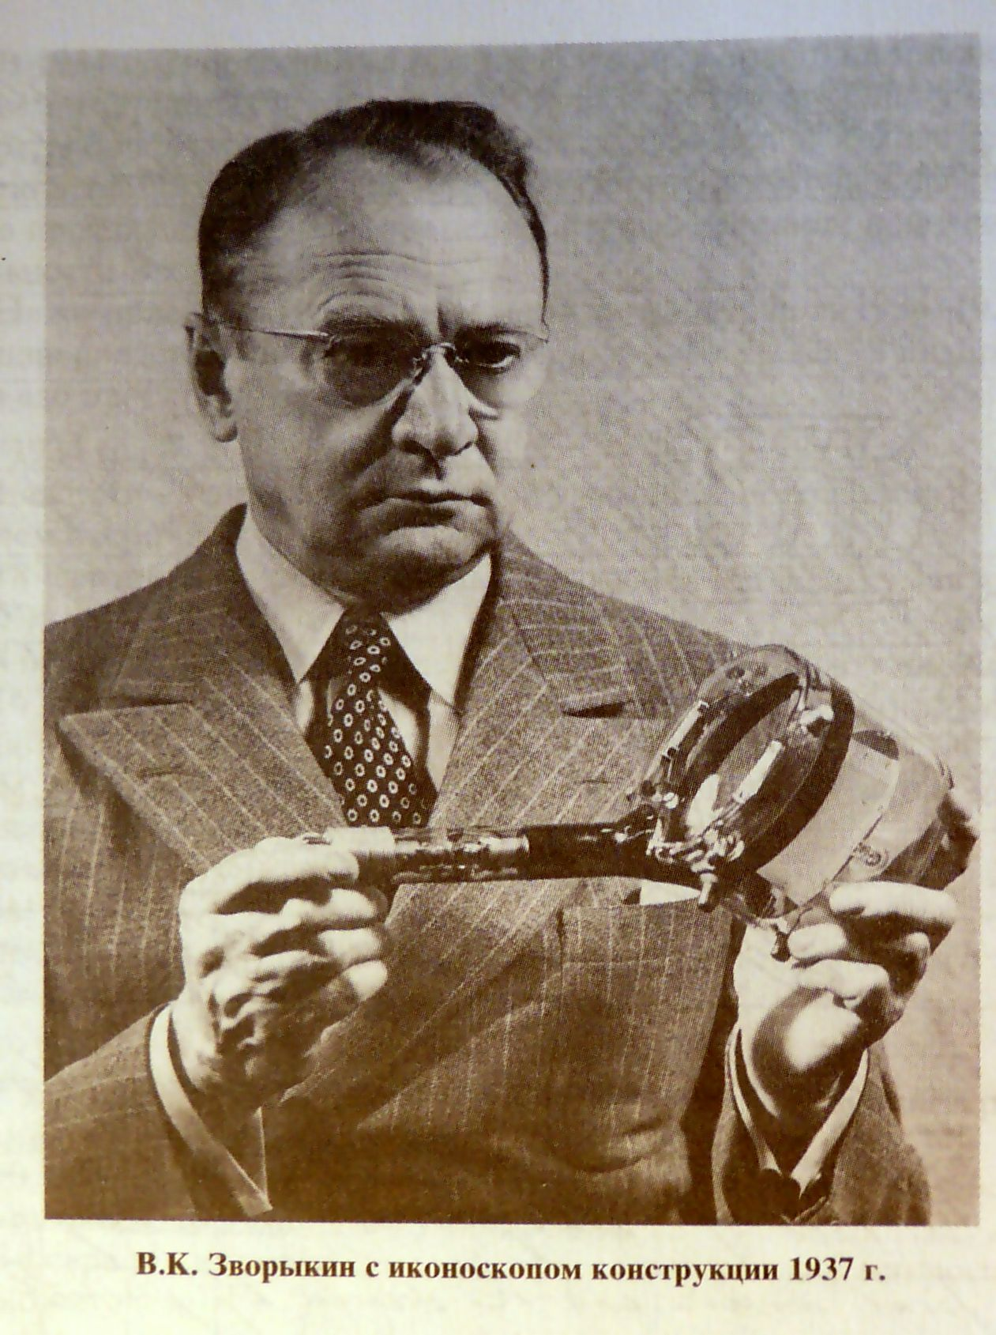

Slide 14
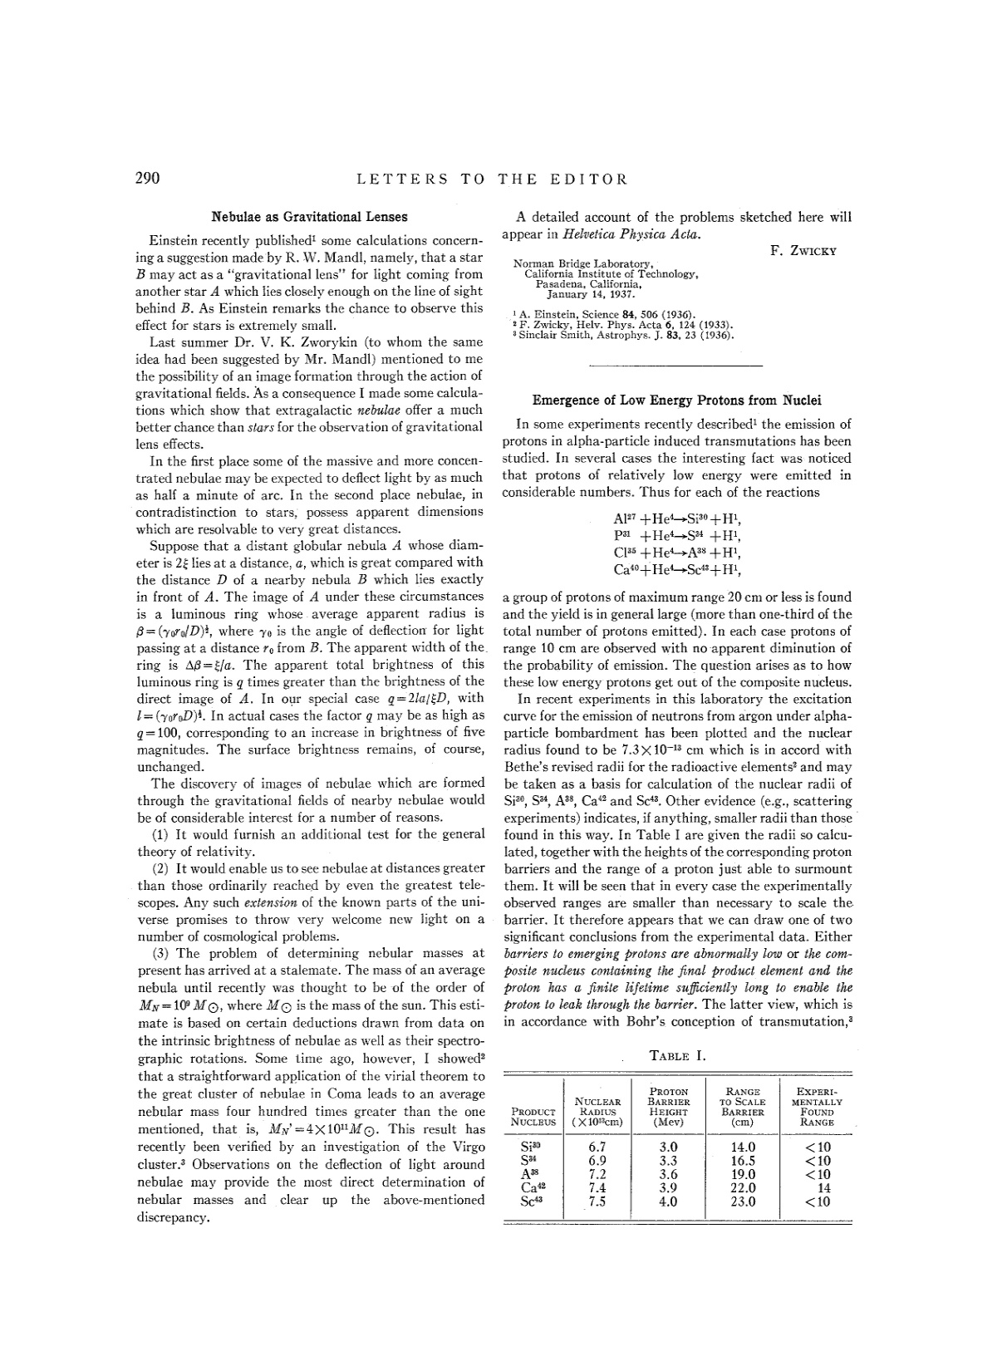

Slide 15
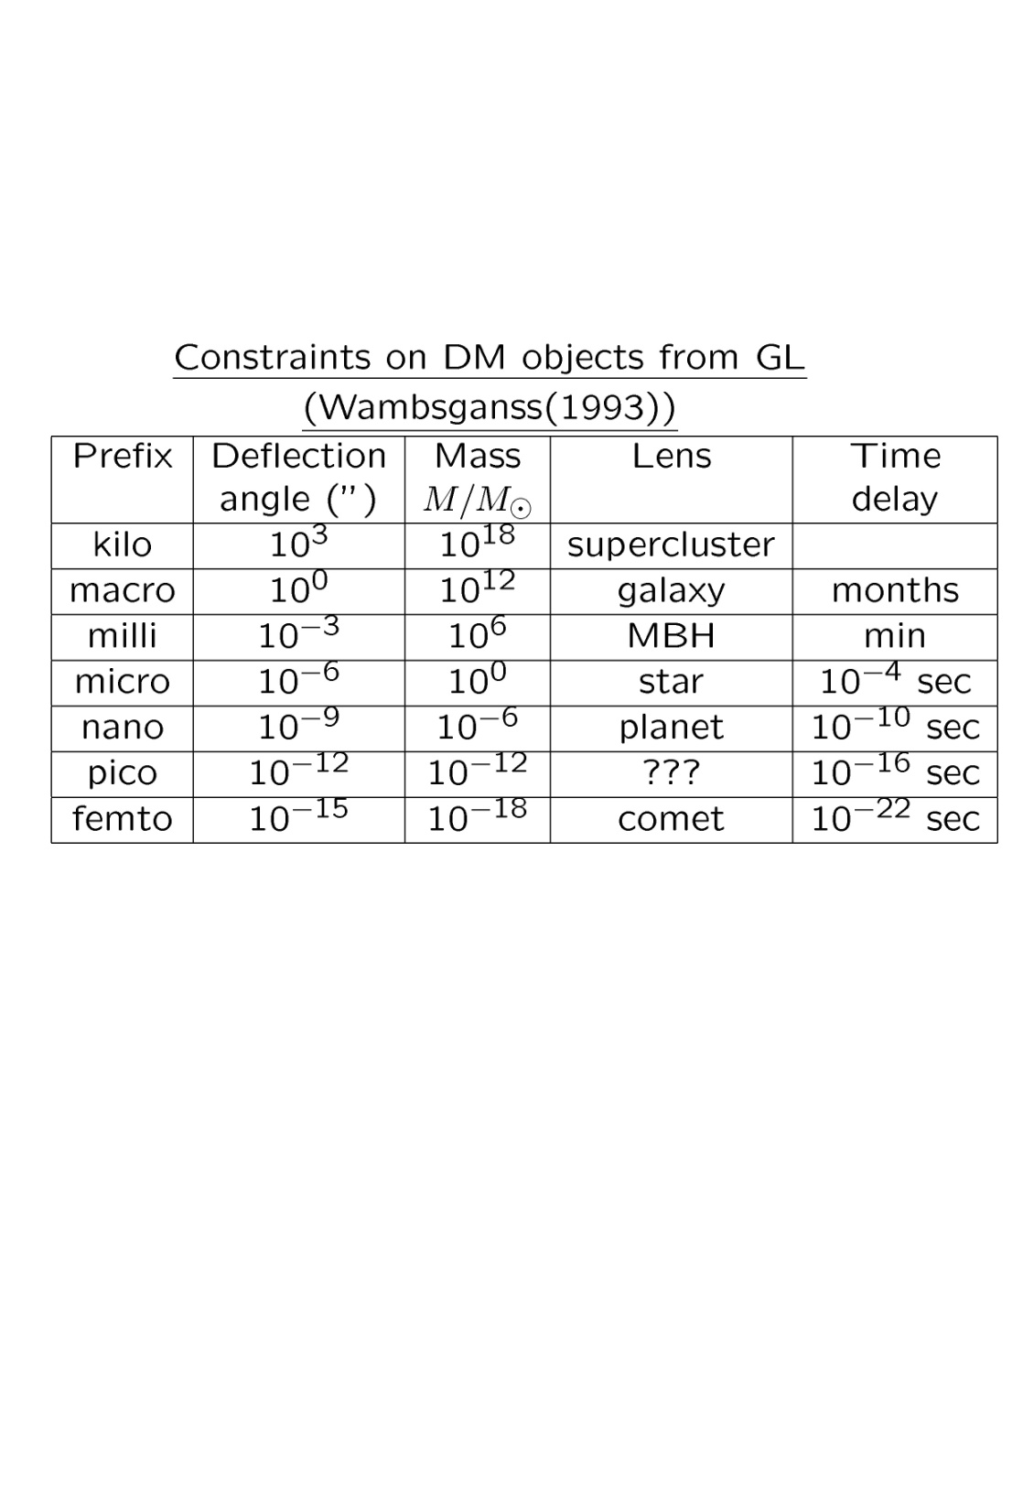

Slide 16
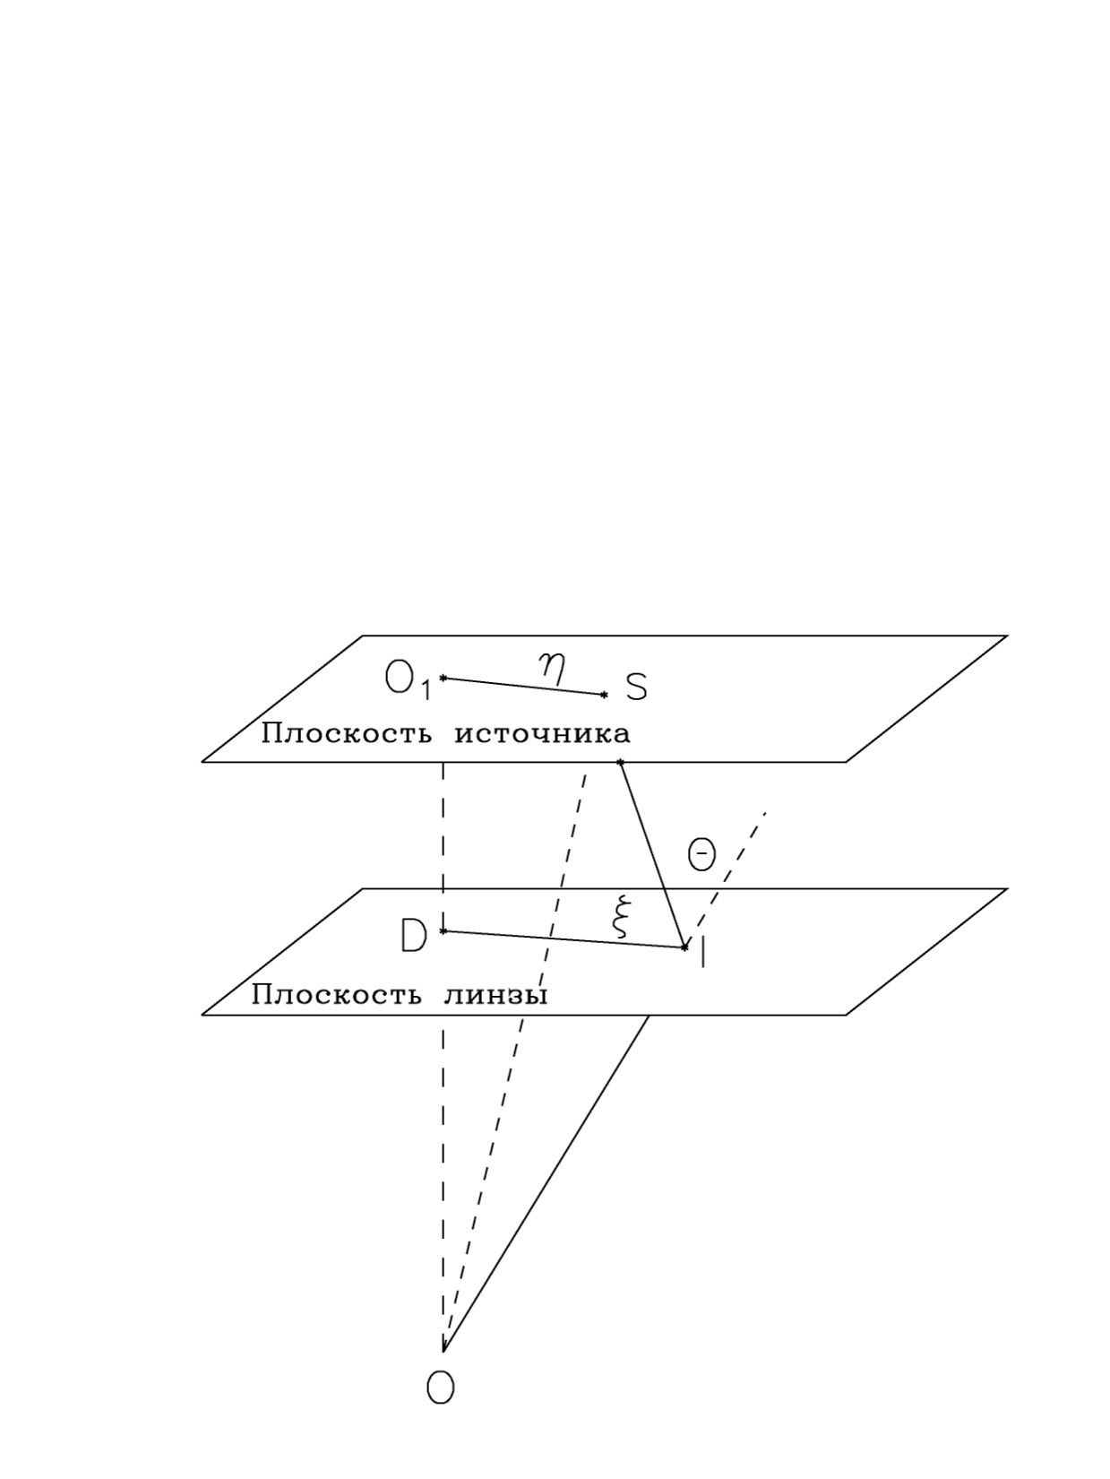

Slide 17
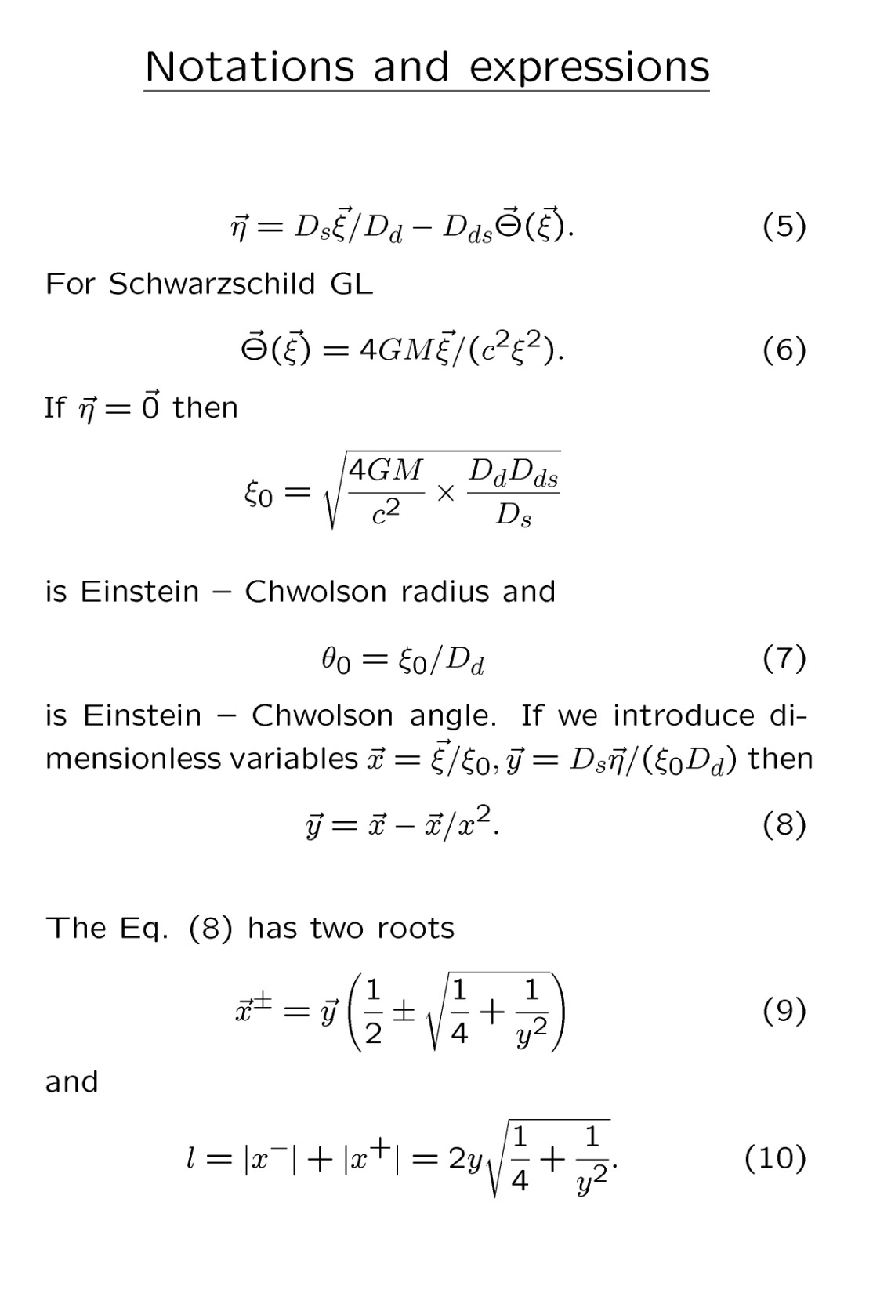

Slide 18
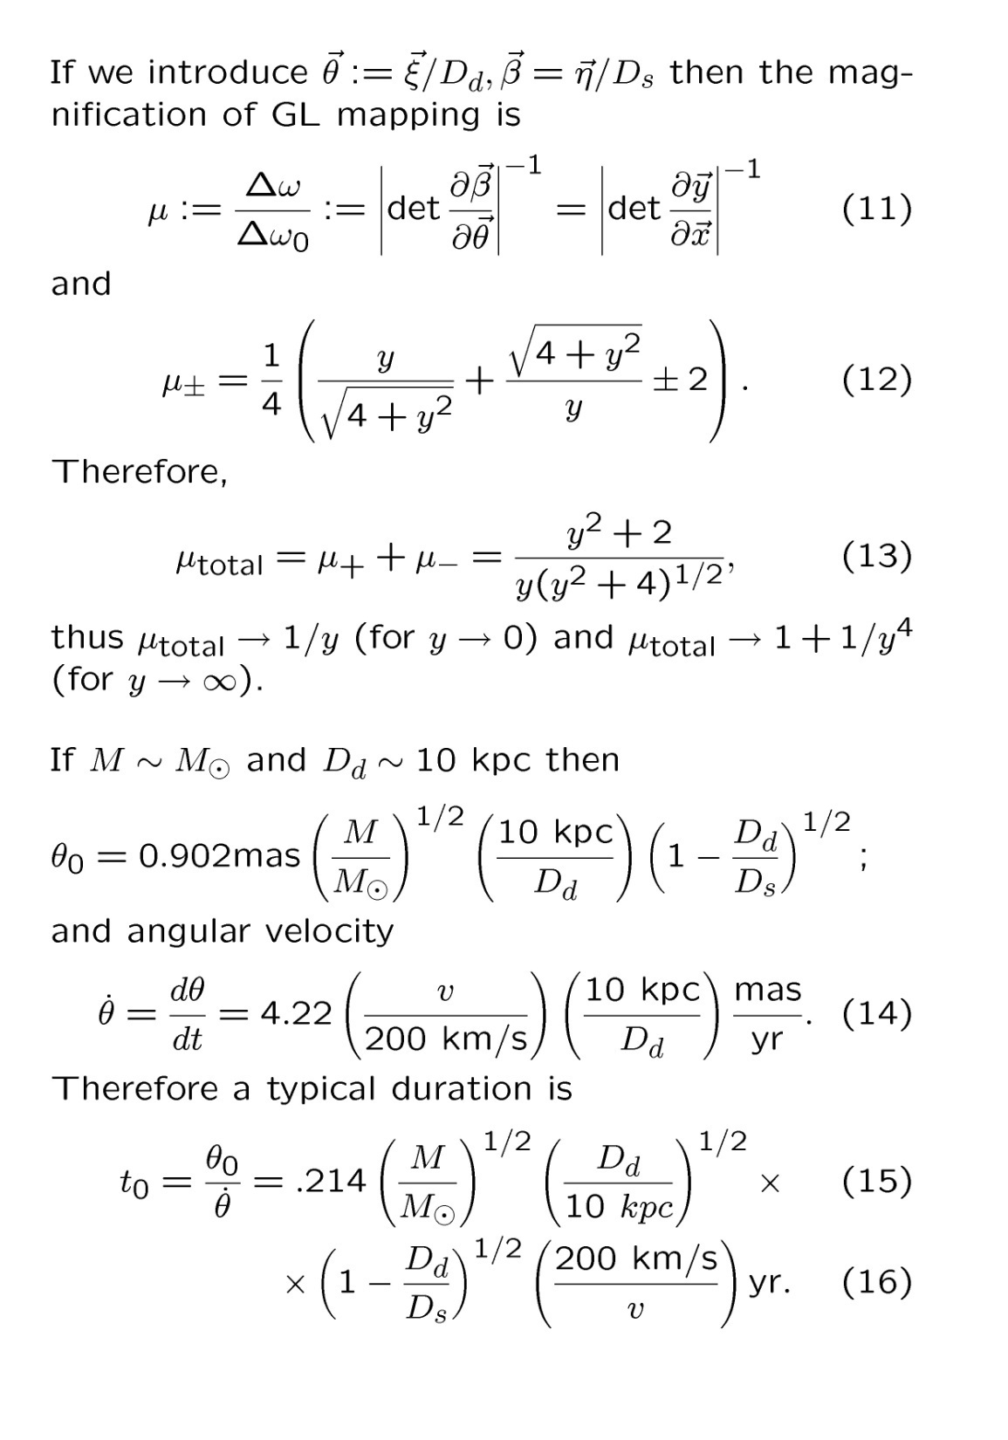

Slide 19
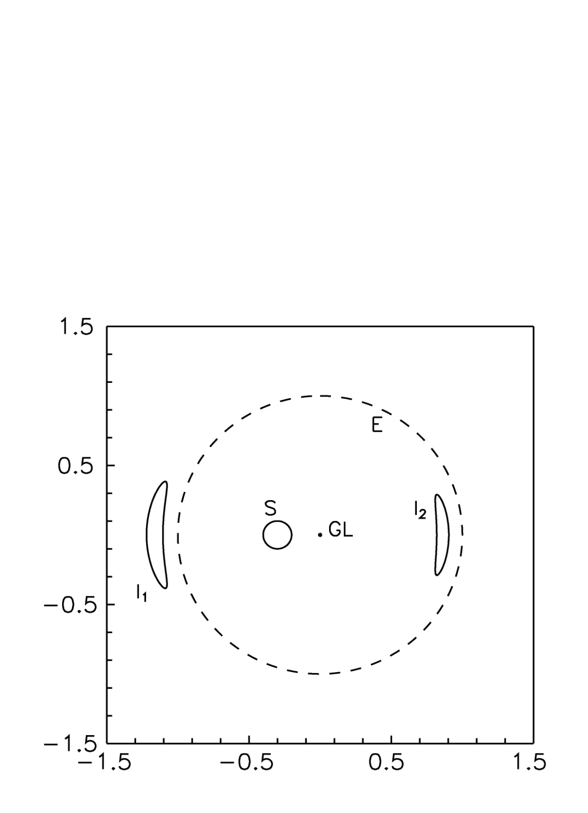

Slide 20
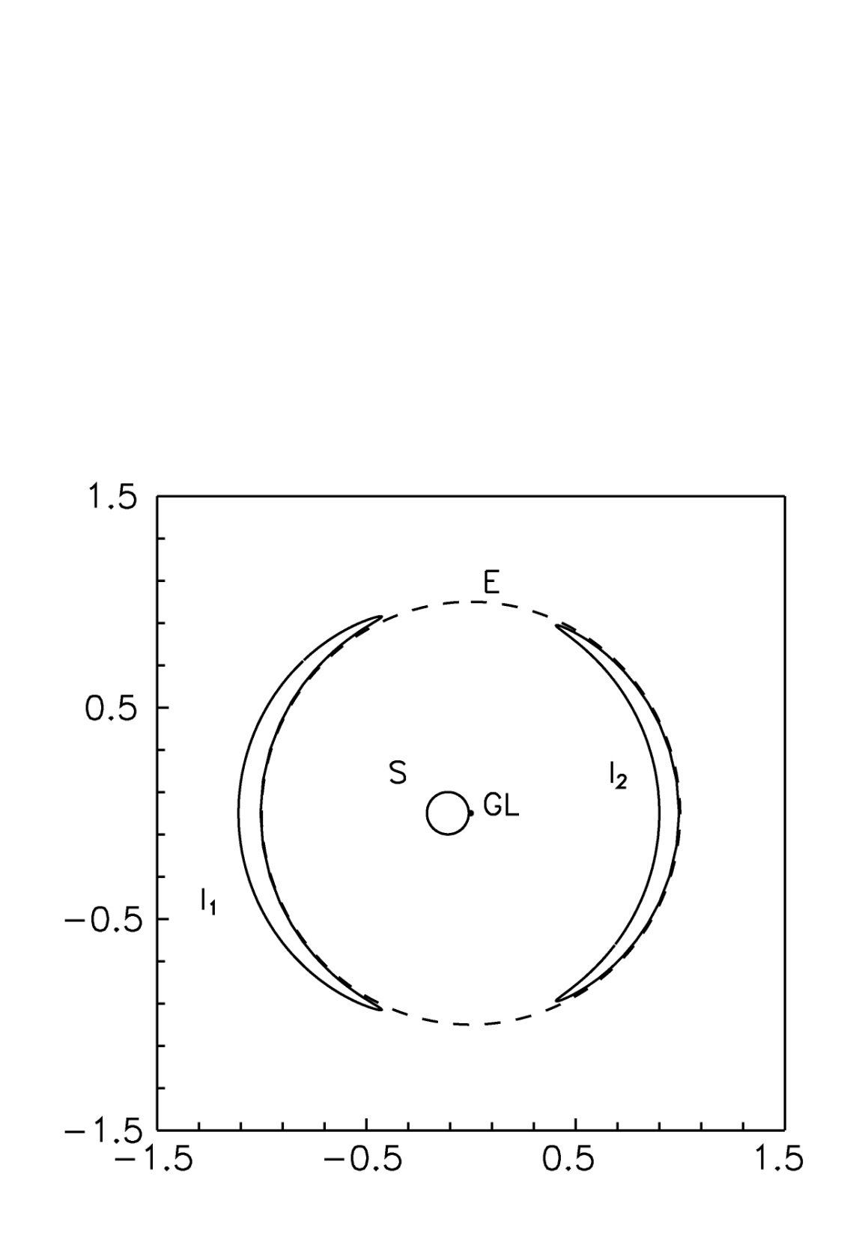

Slide 21
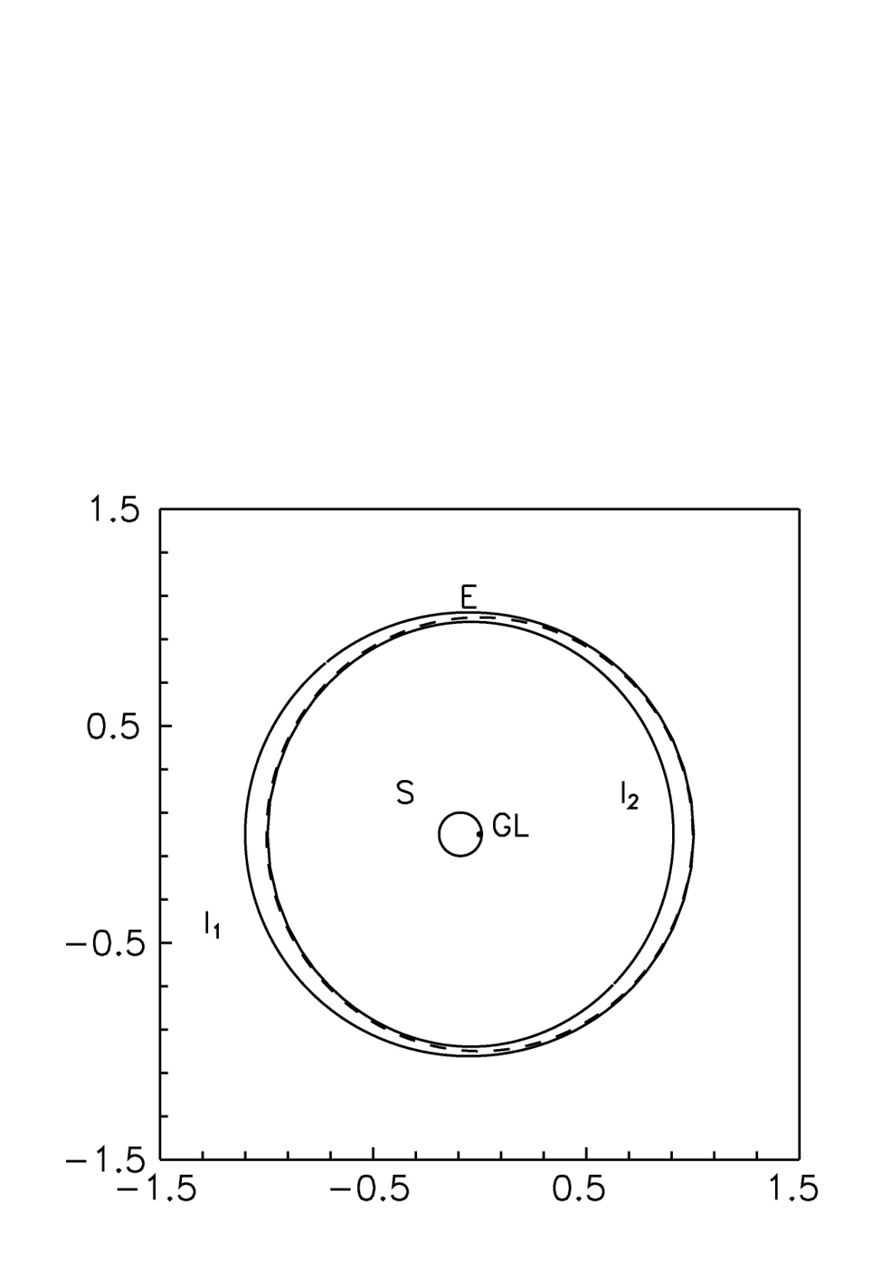

Slide 22
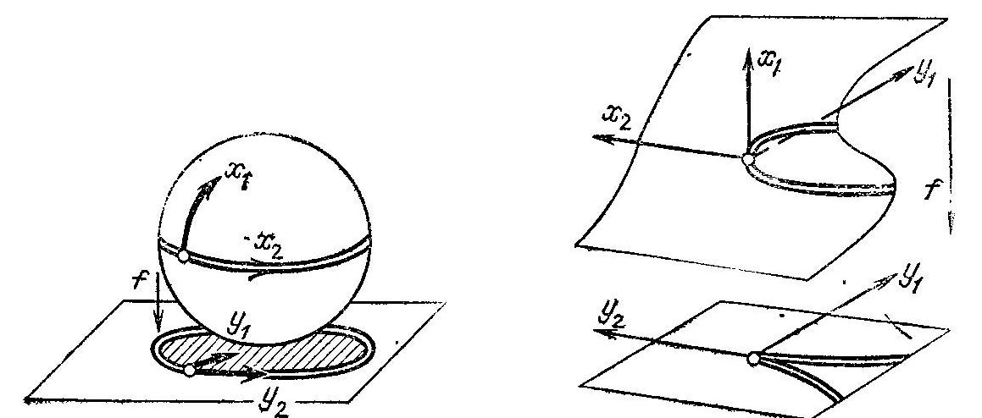

Slide 23
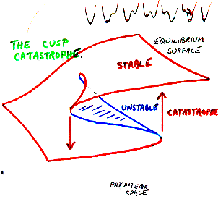

Slide 24
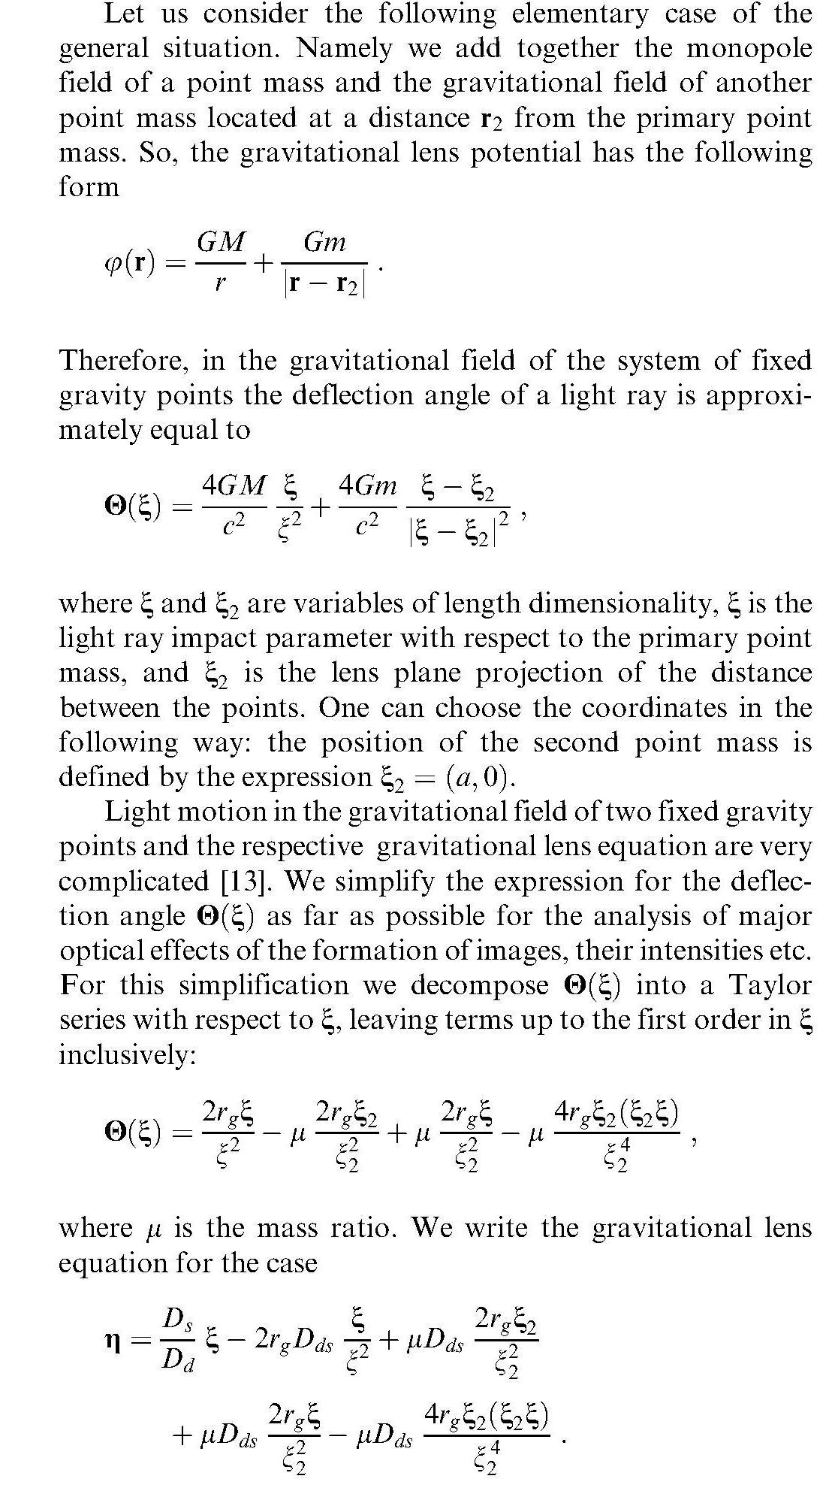

Slide 25
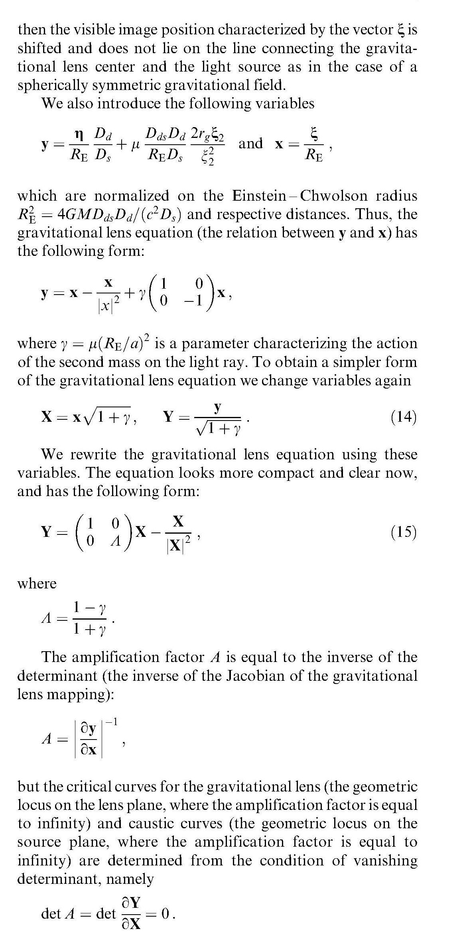

Slide 26
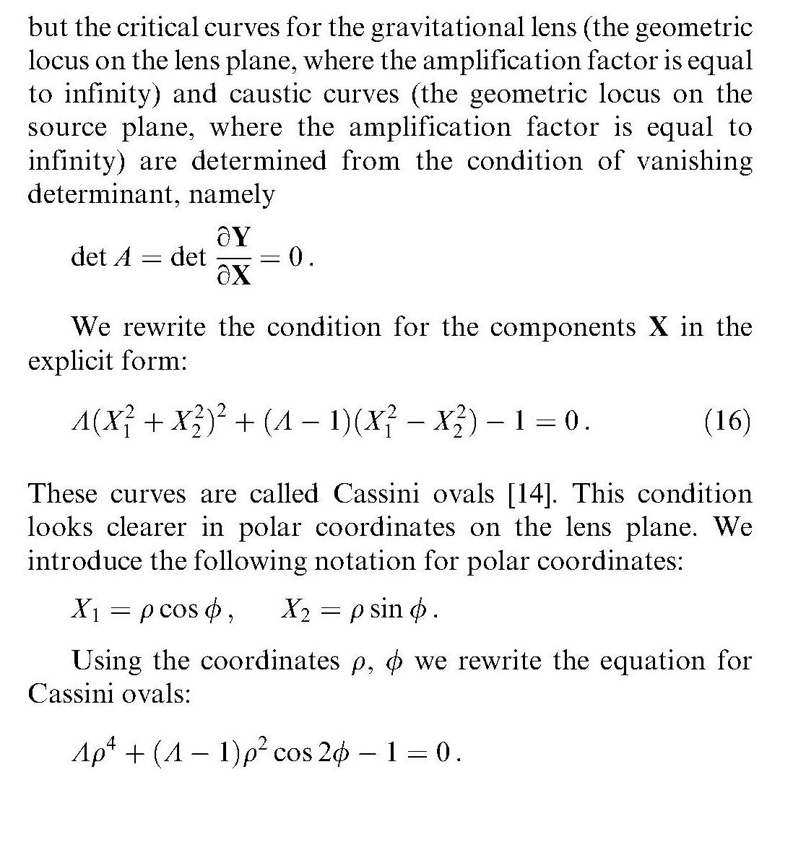

Slide 27
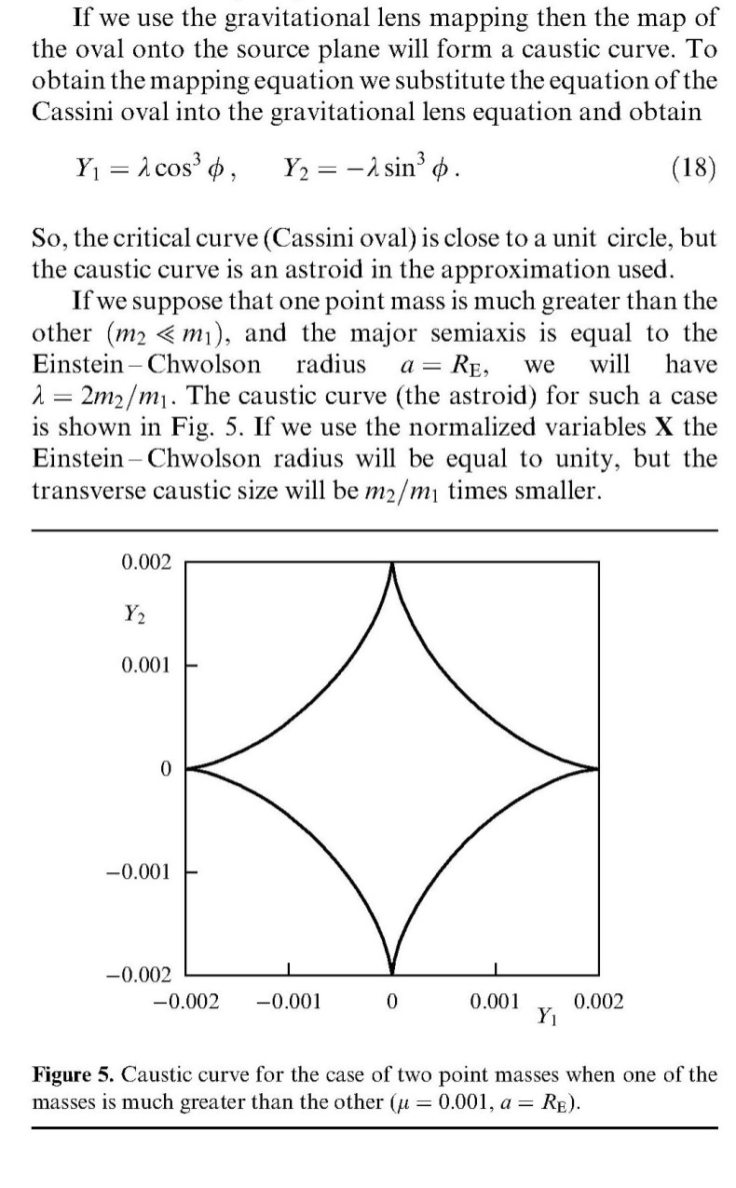

Slide 28
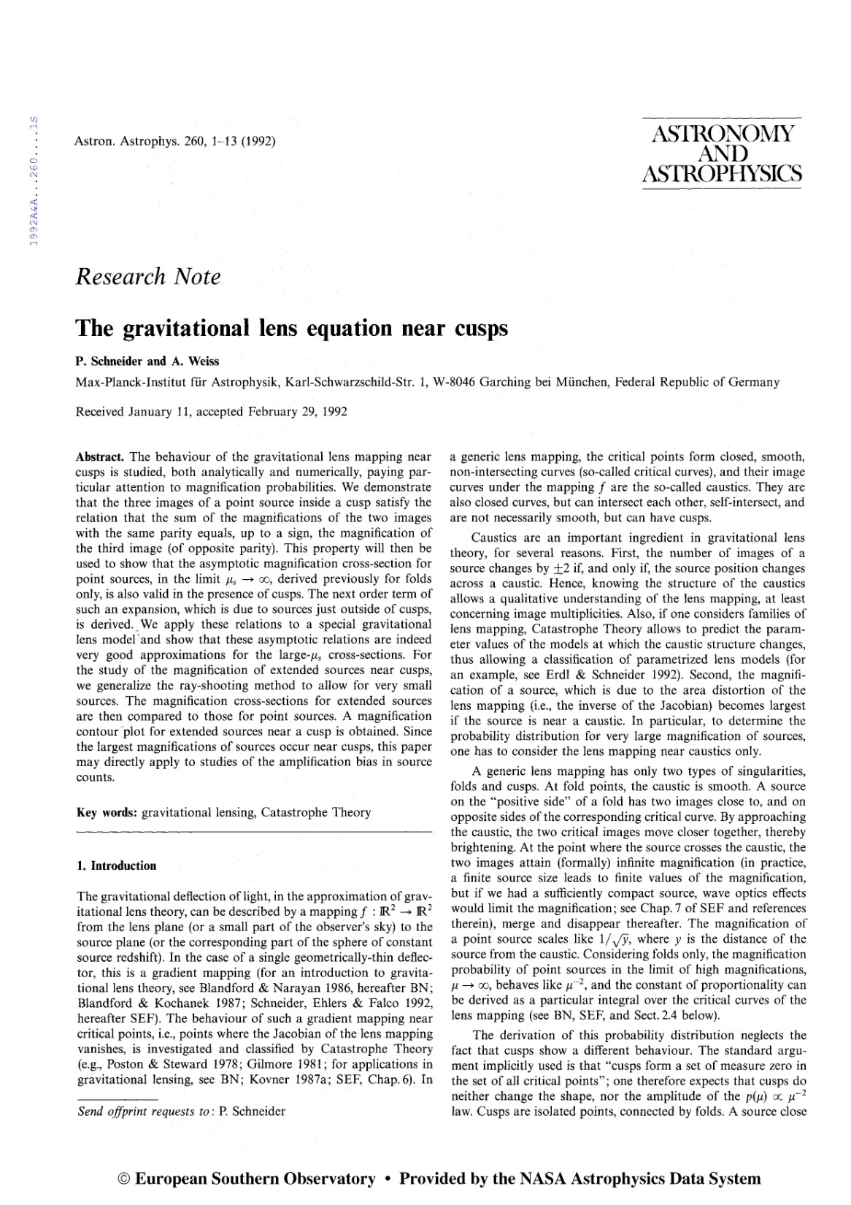

Slide 29
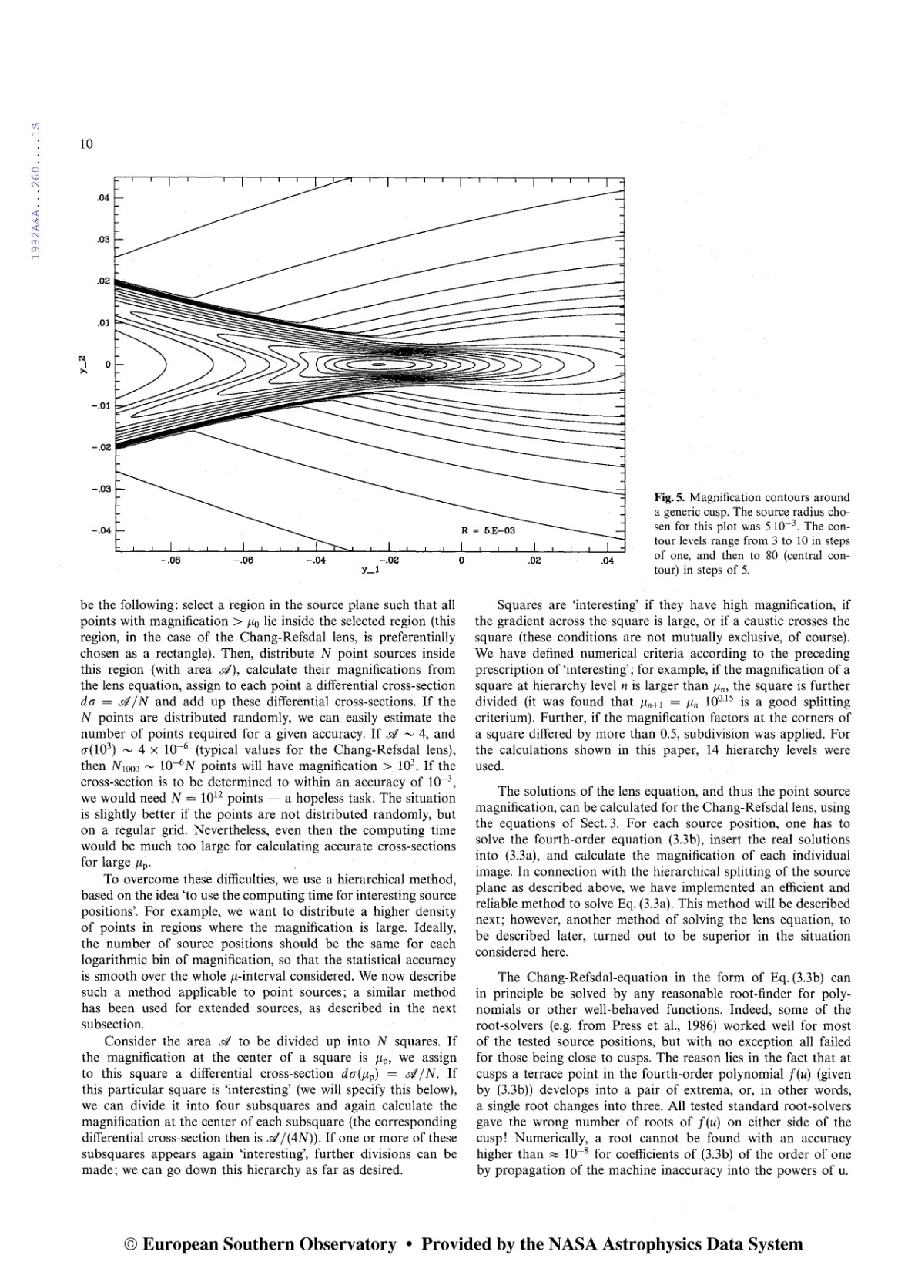

Slide 30
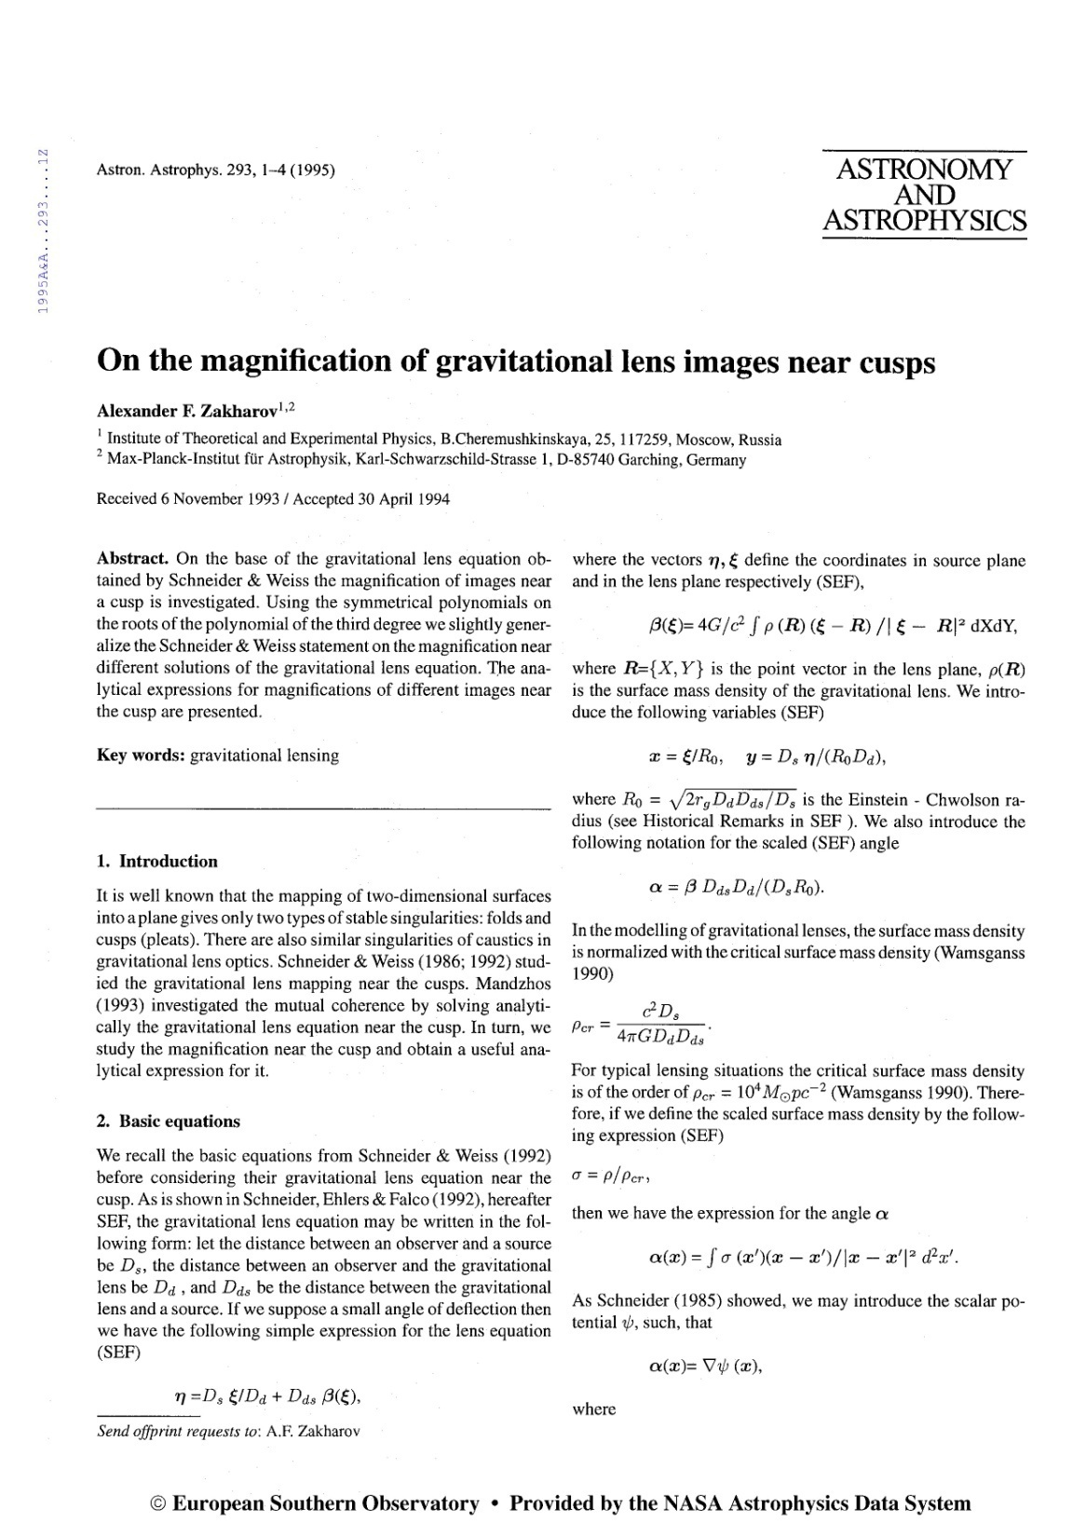

Slide 31
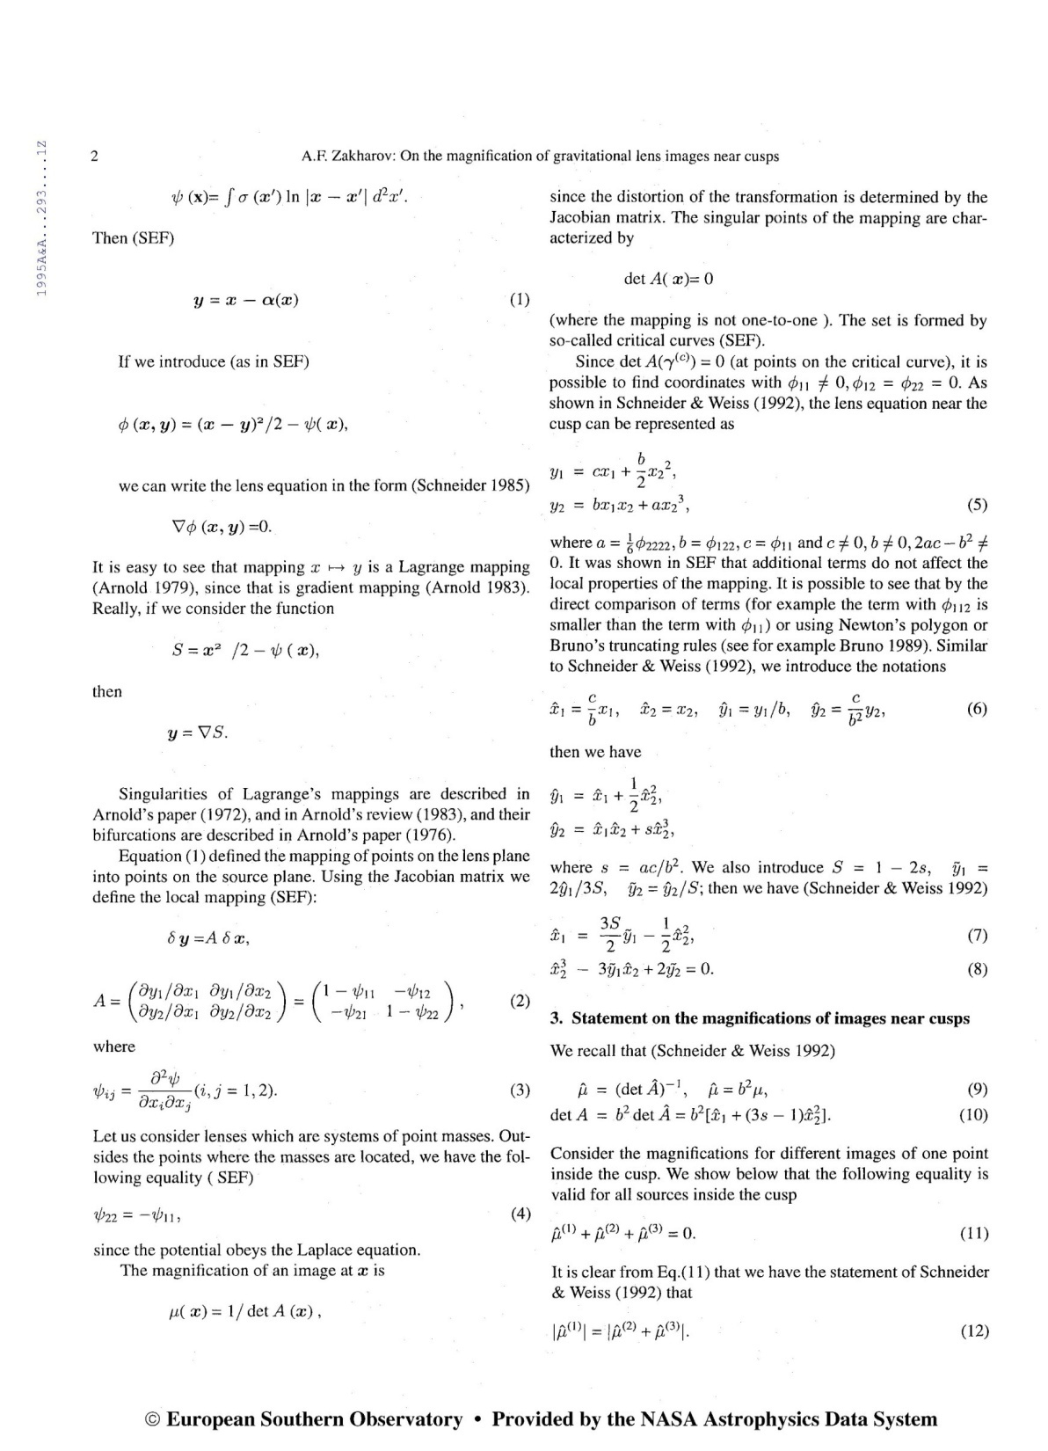

Slide 32
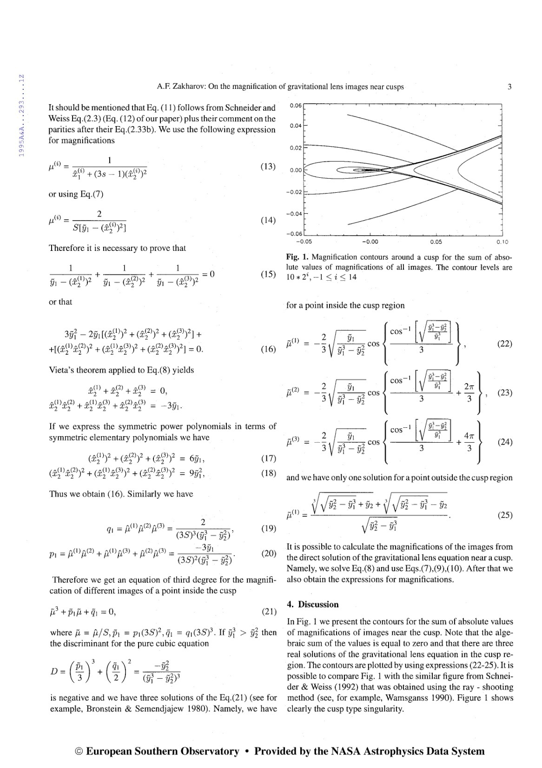

Slide 33
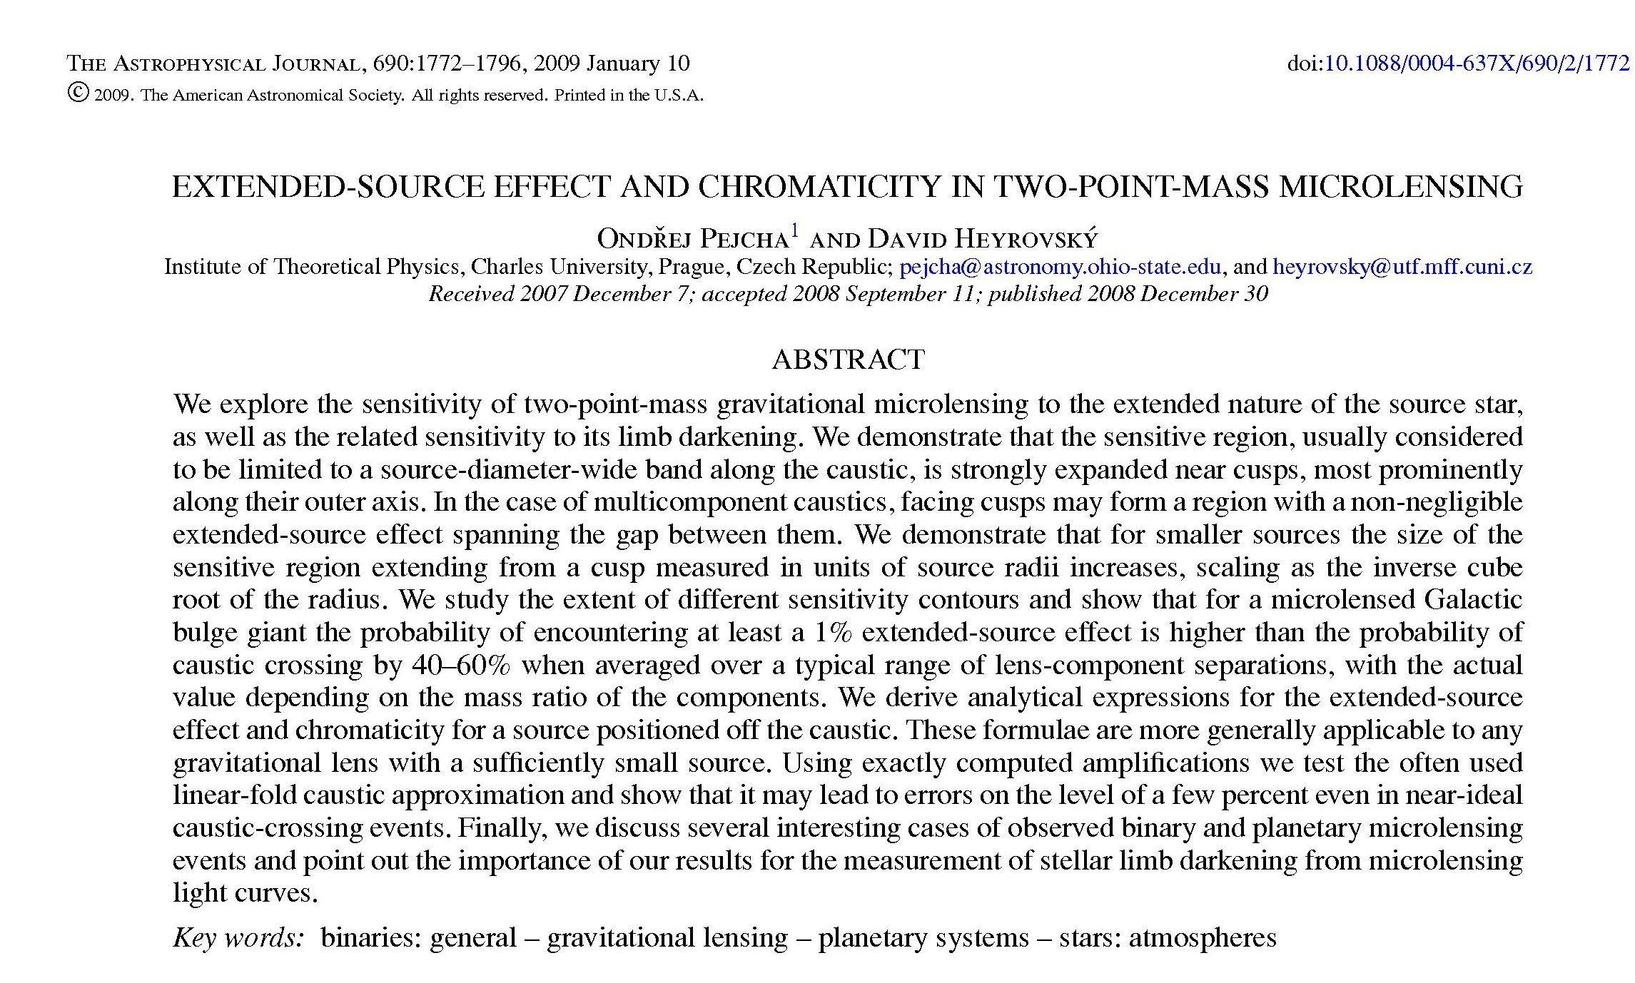

Slide 34
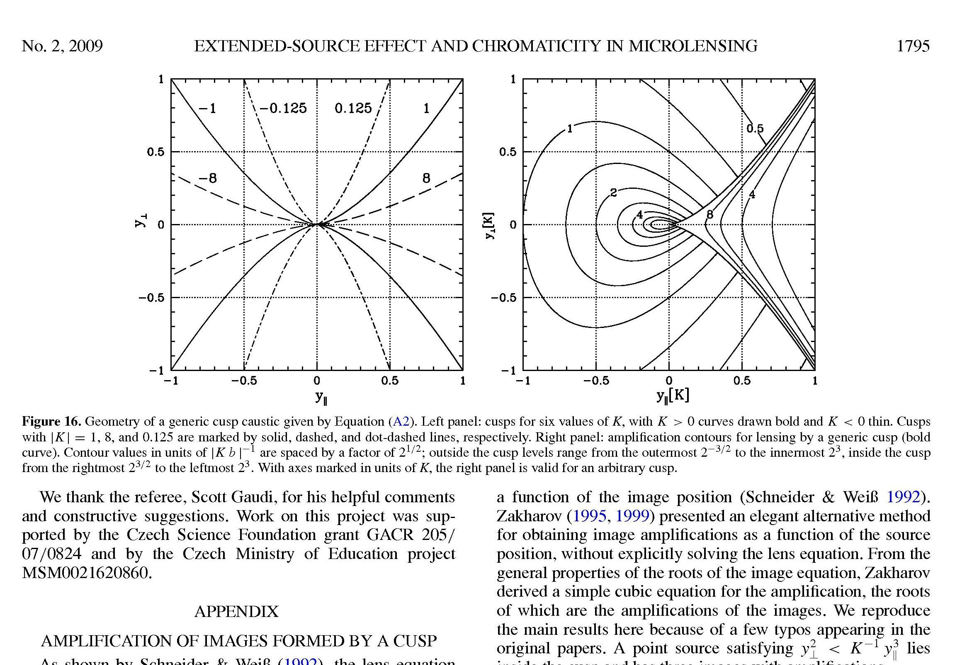

Slide 35
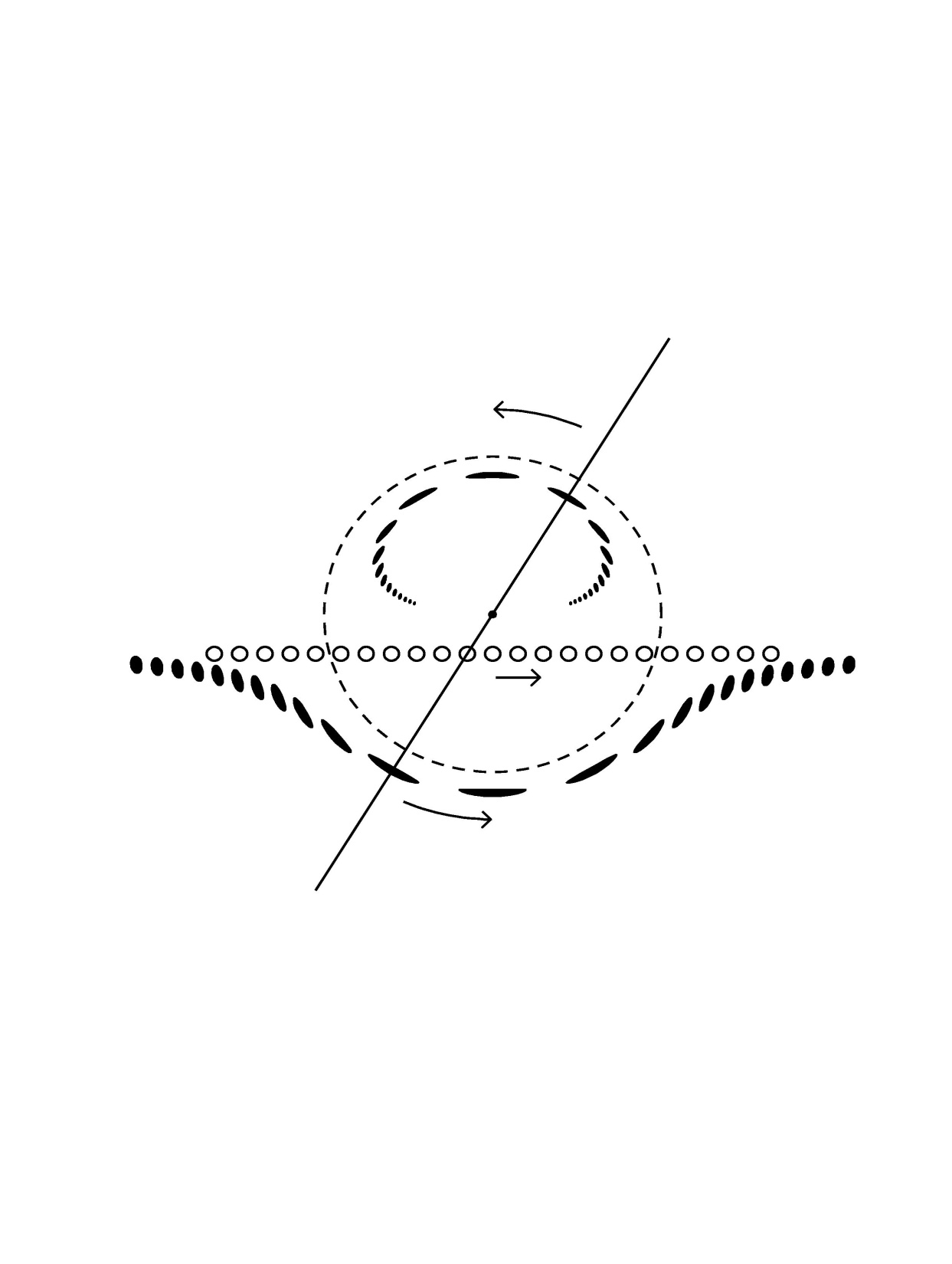

Slide 36
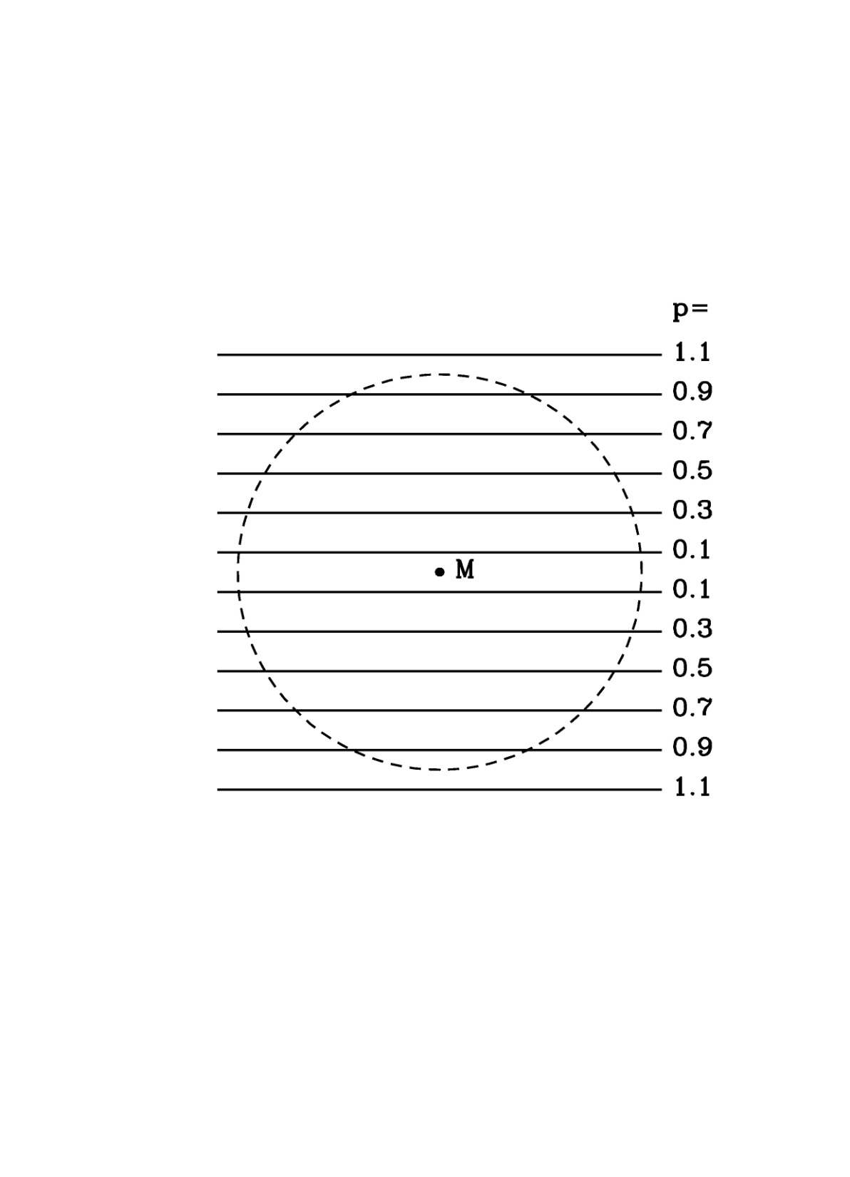

Slide 37
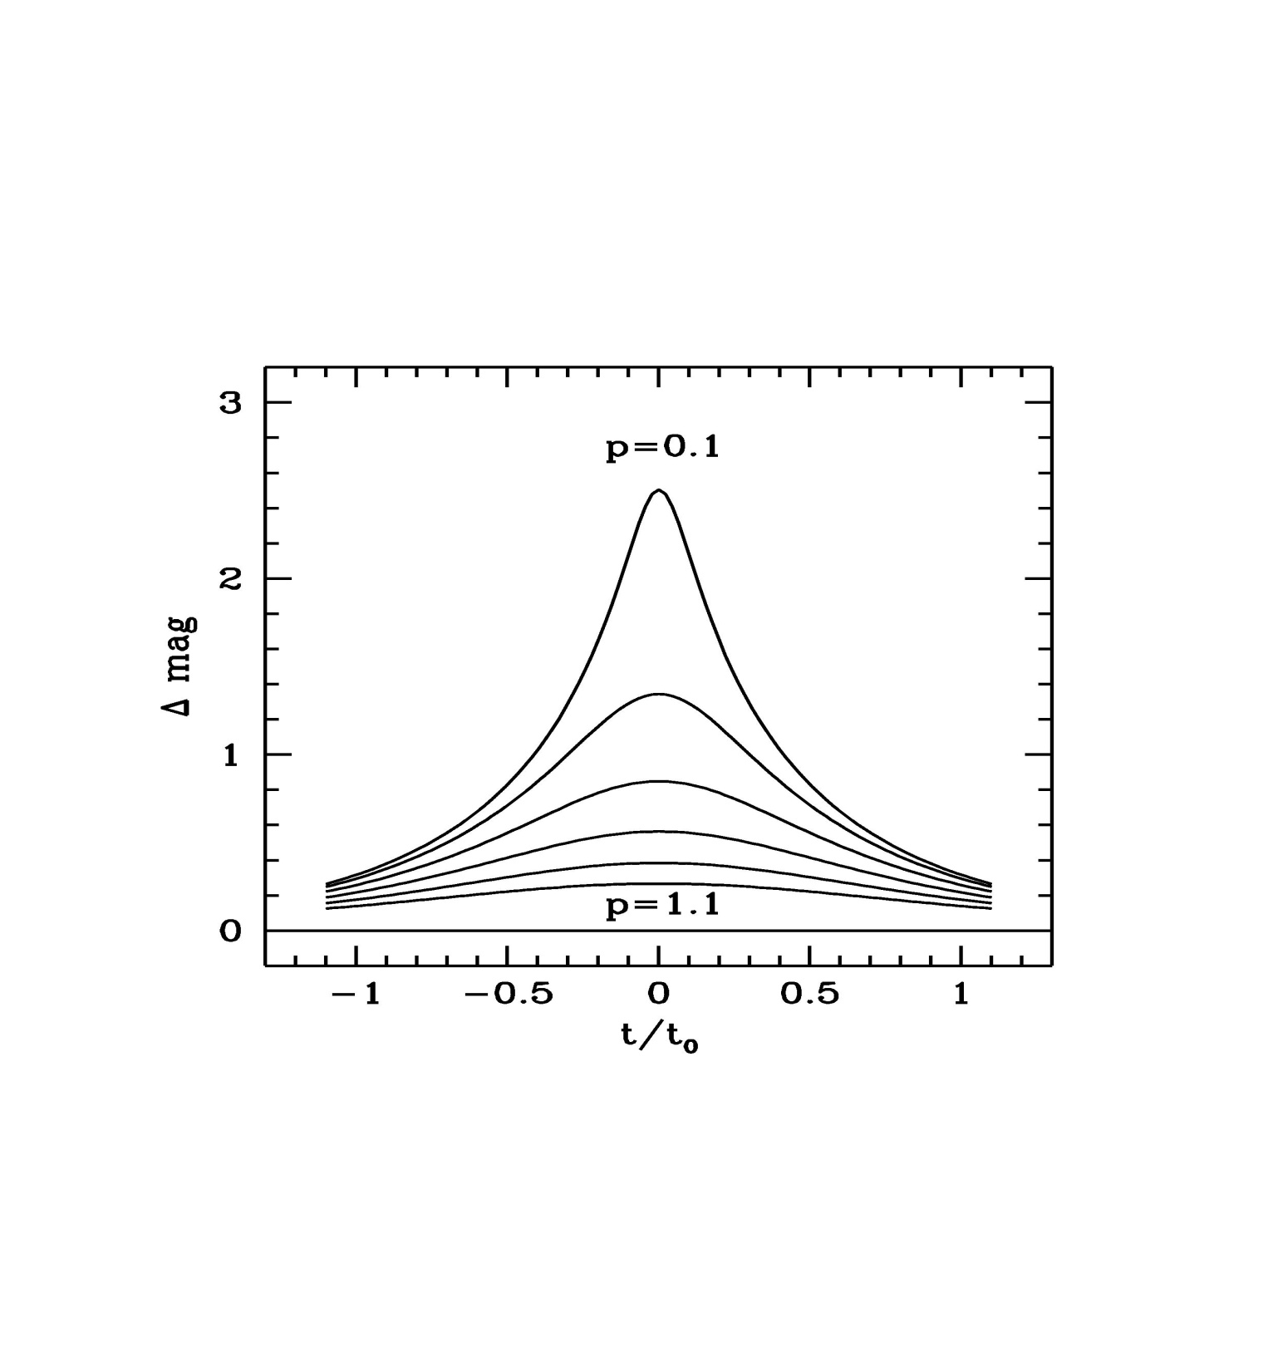

Slide 38
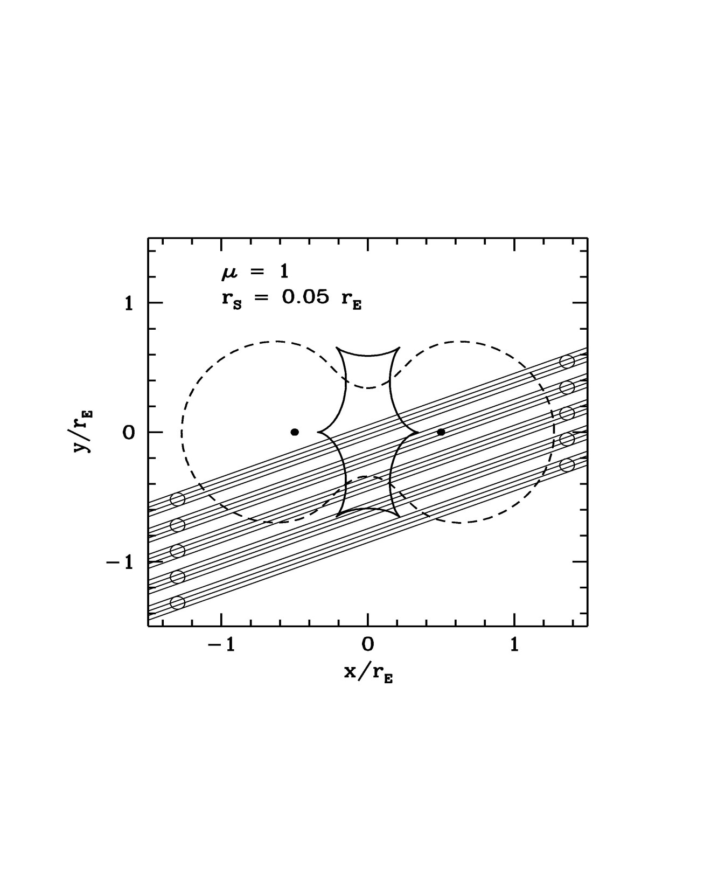

Slide 39
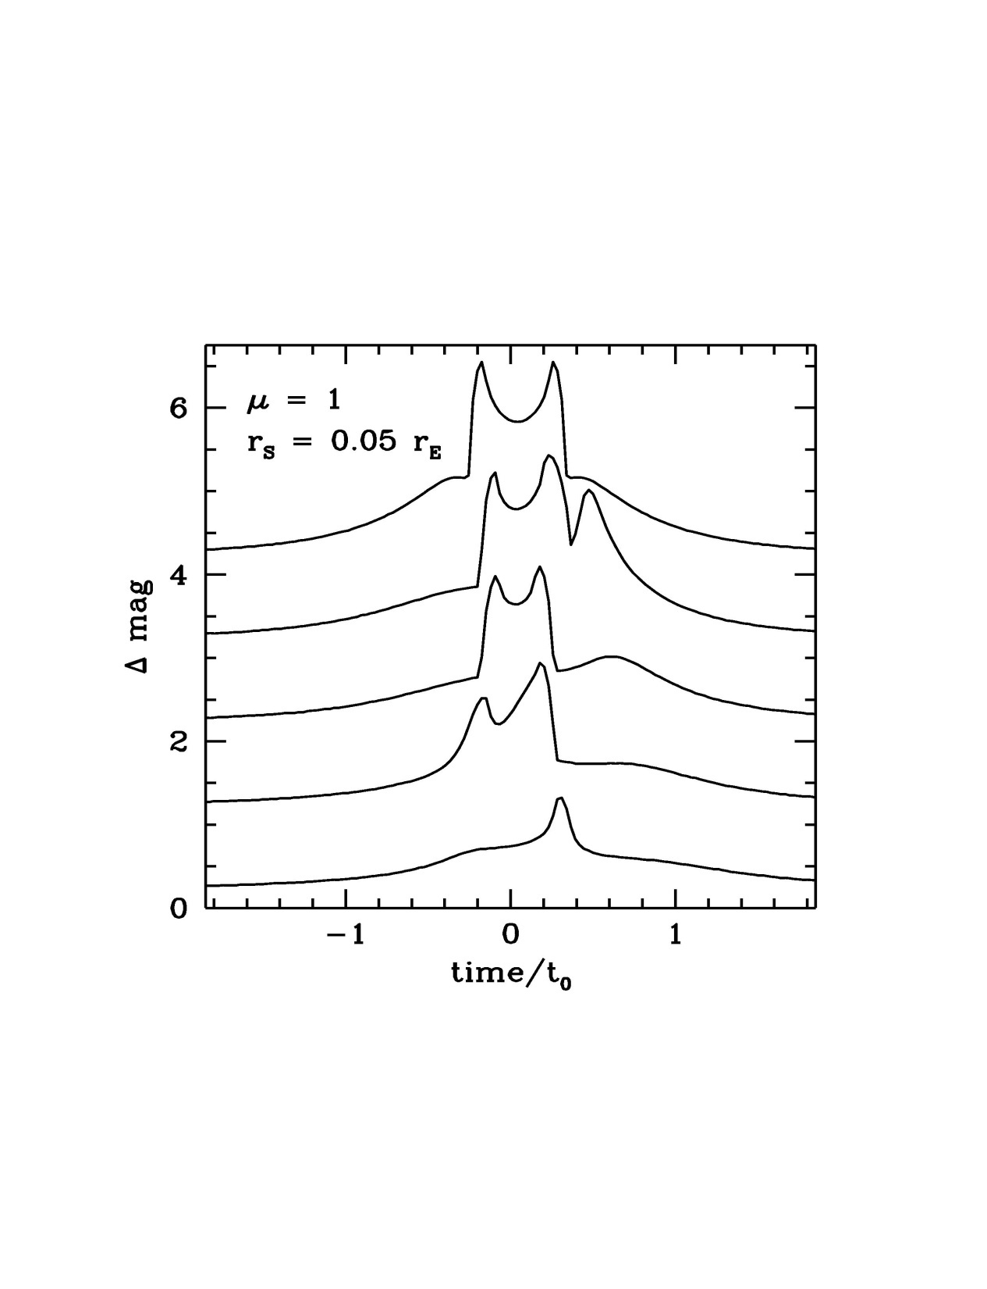

Slide 40
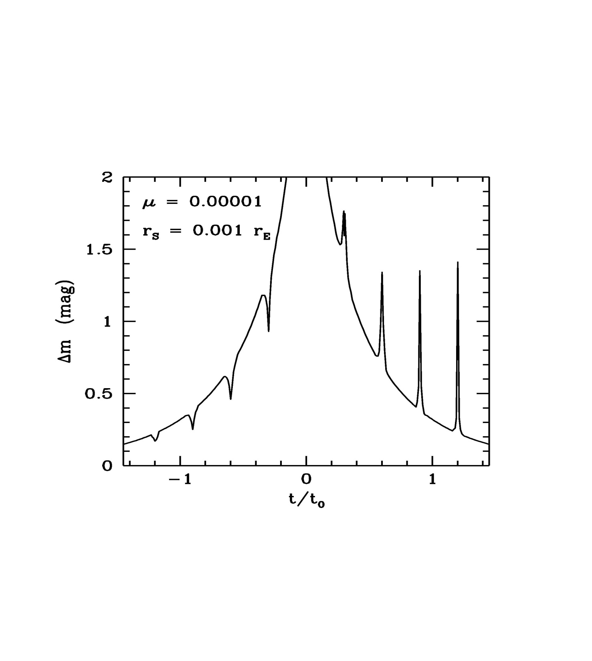

Slide 41
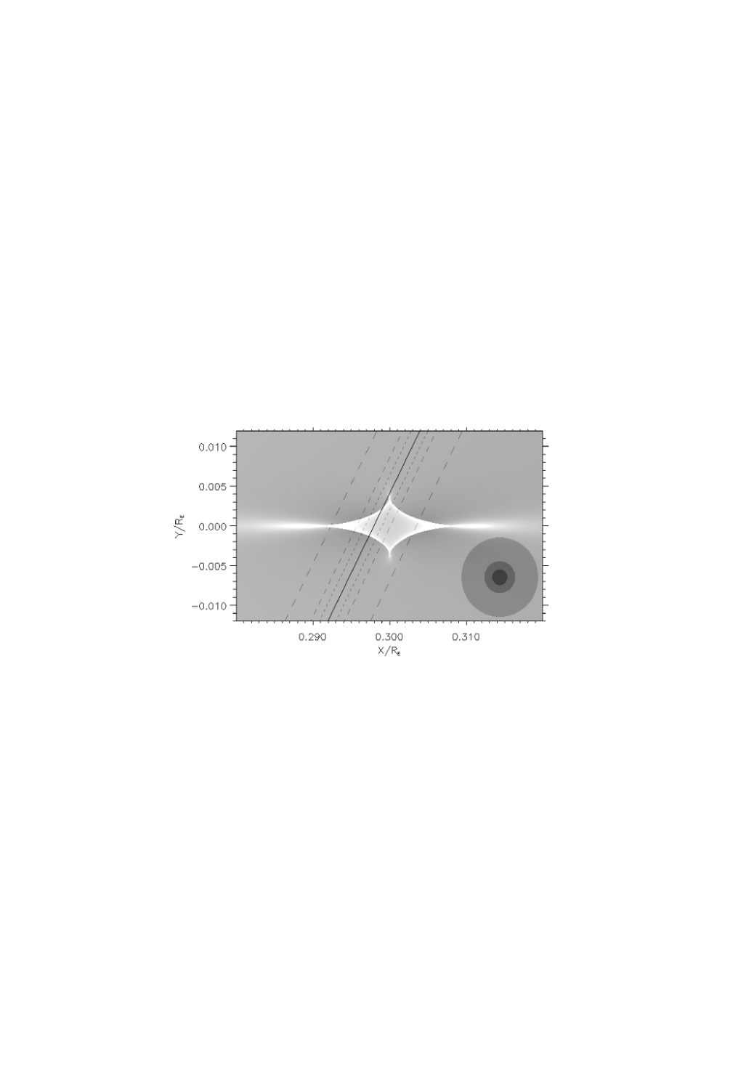

Slide 42
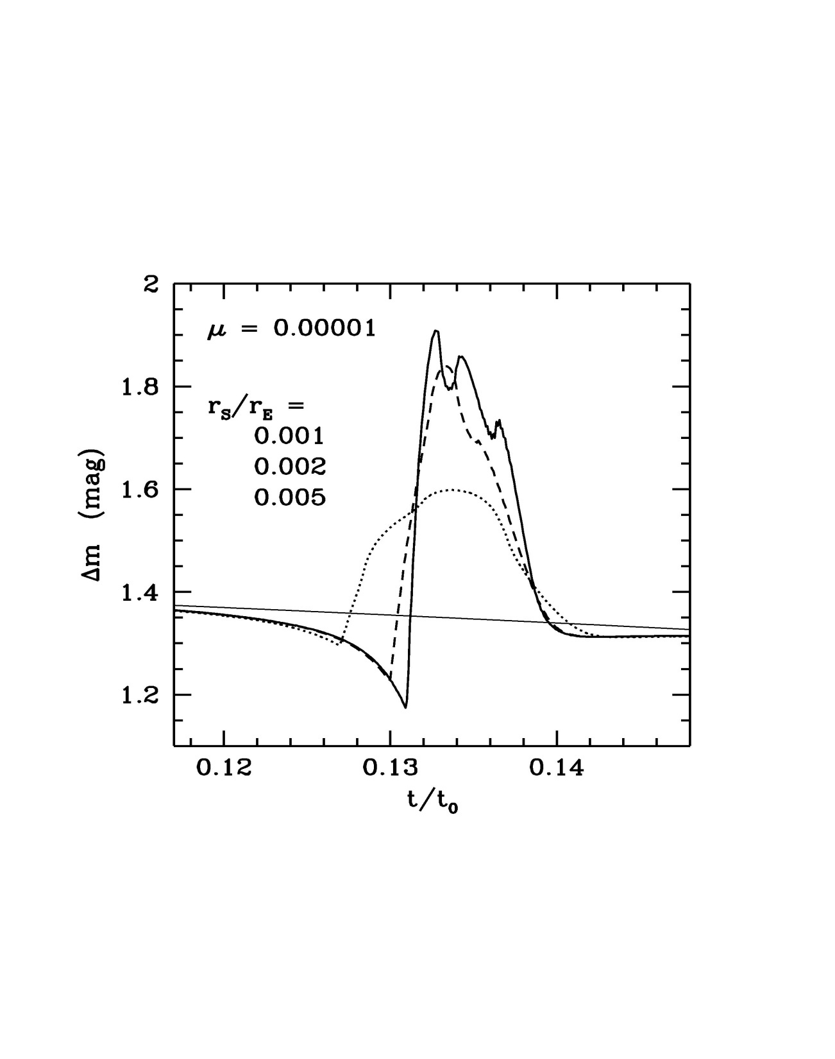

Slide 43
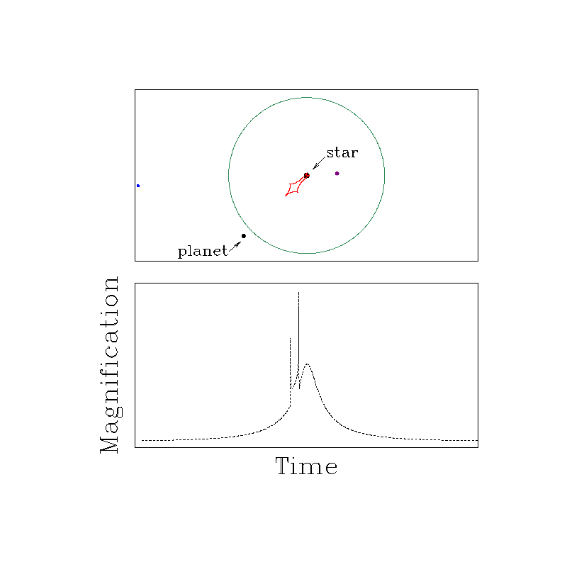

Slide 44
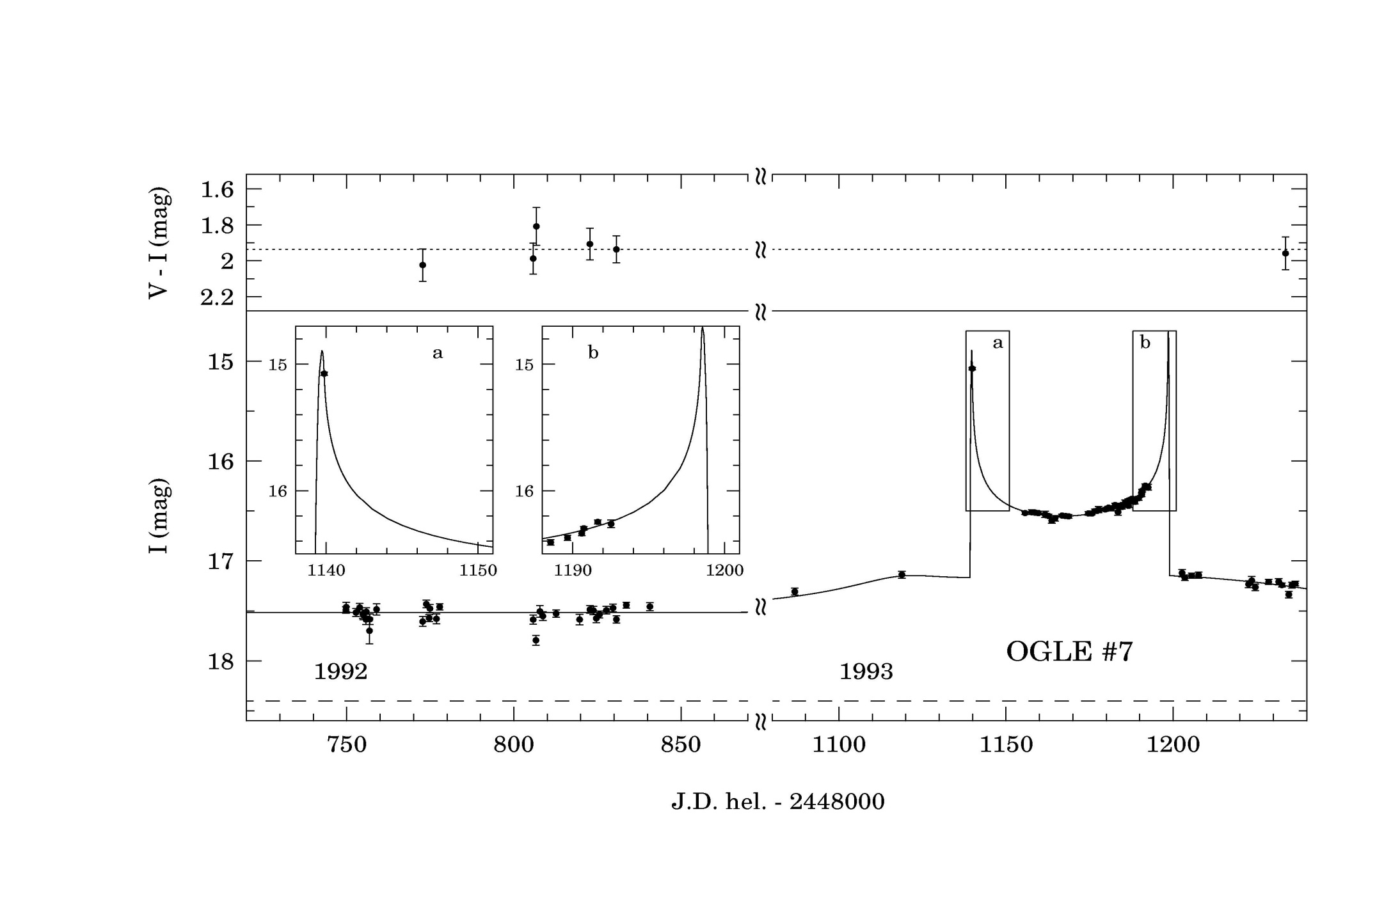

Slide 45
Planet discovery with ML with the lowest mass
(J.-P. Beaulieu et al. Nature, 2006)

Slide 46
Planet discovery with ML with the lowest mass in 2006 (now people find a planet with a mass about 2 Earth masses, see Mayor et al.)
(J.-P. Beaulieu et al. Nature, 2006)

Slide 47
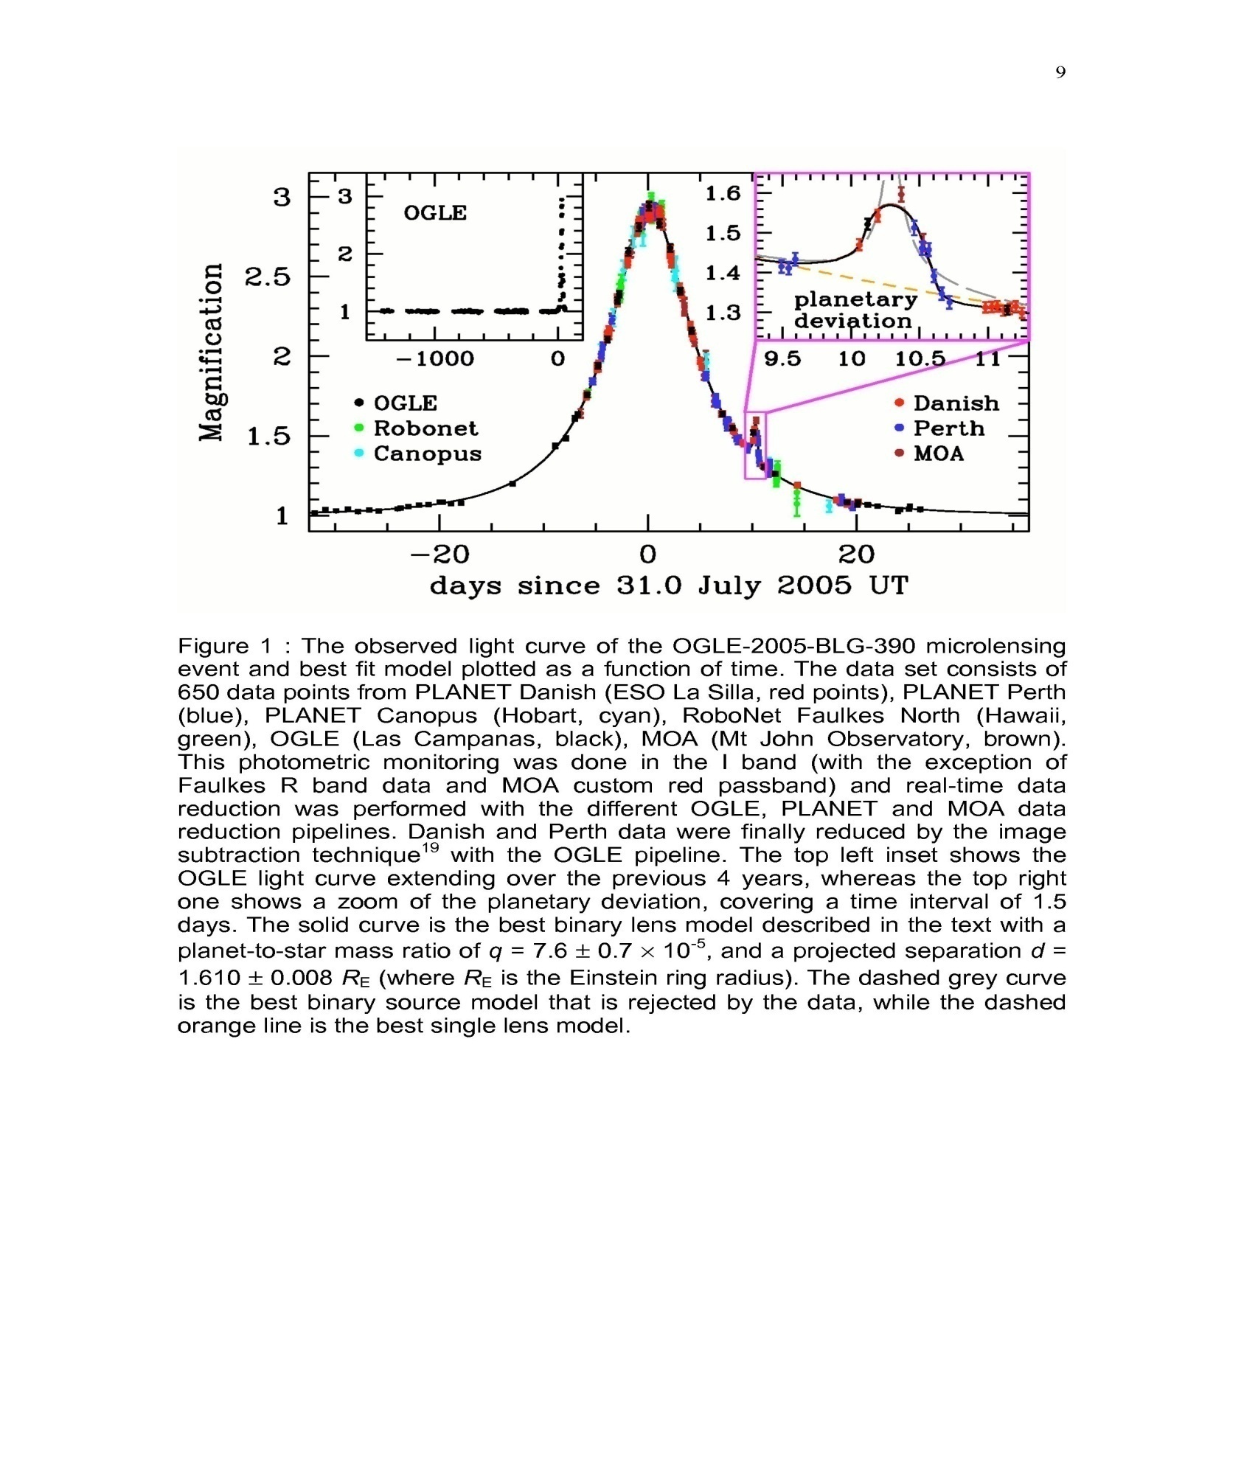

Slide 48
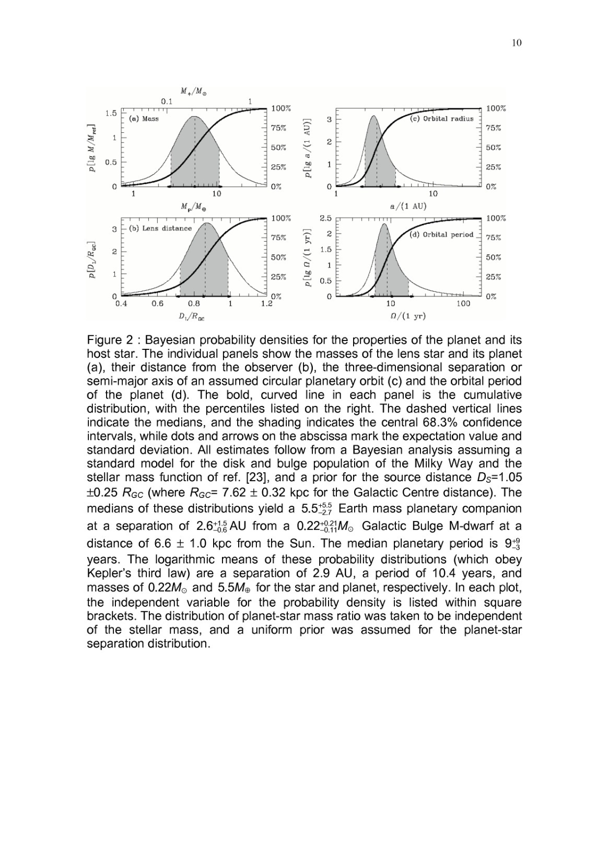

Slide 49
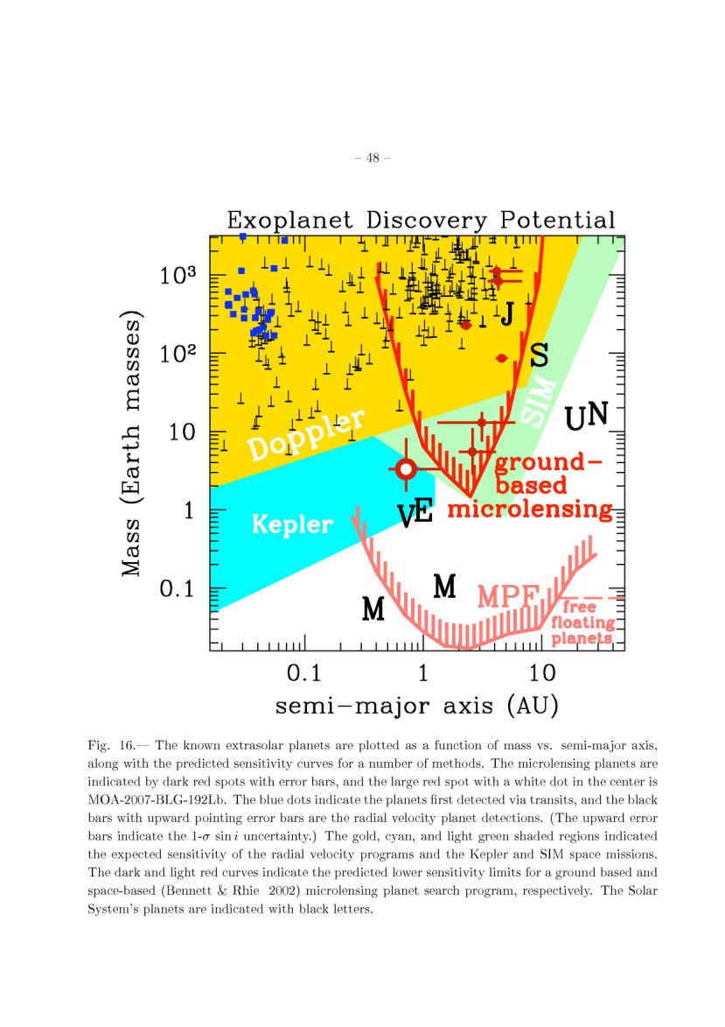
D.P. Bennett et al. A Low-Mass Planet with a Possible Sub-Stellar-Mass Host in Microlensing Event MOA-2007-BLG-192
Arxive:0806.0025[astro-ph] .

Slide 50
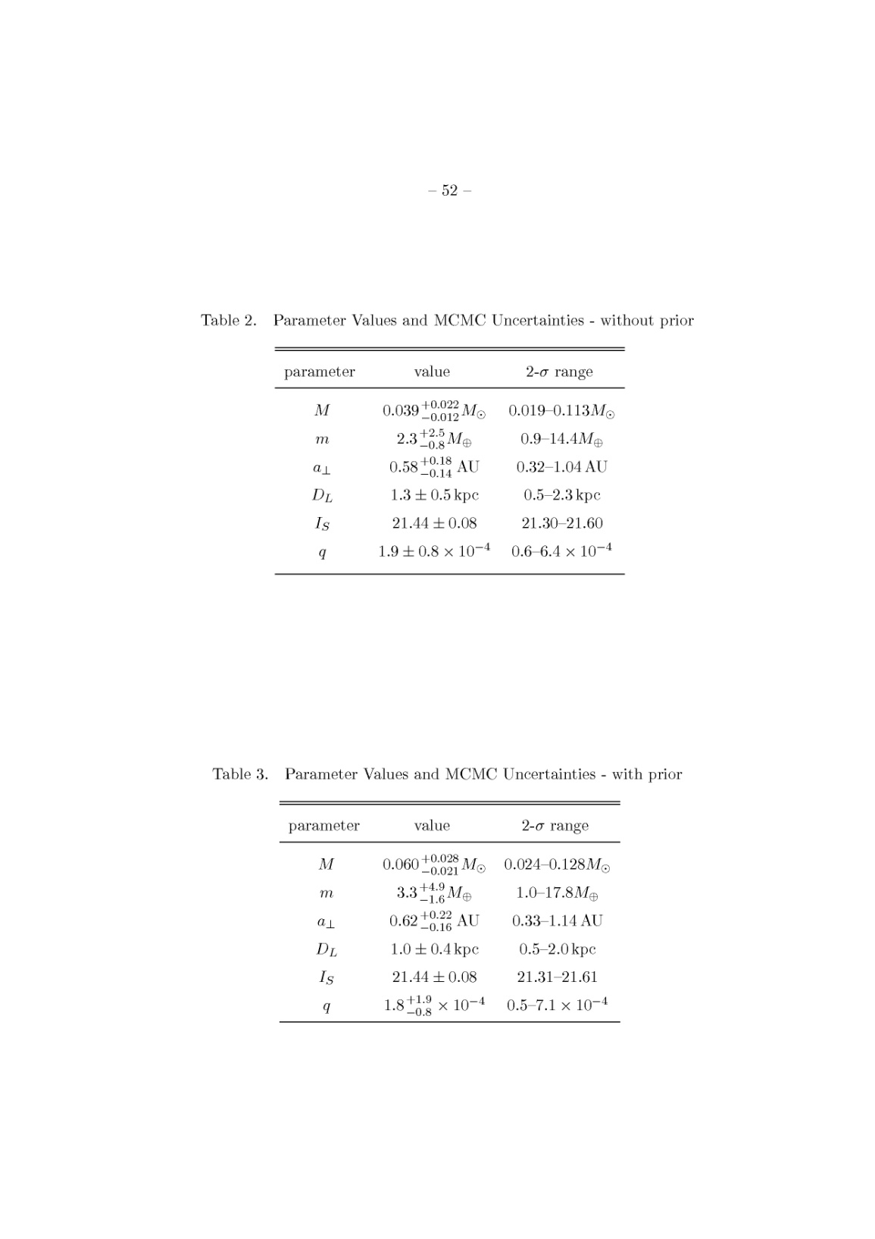

Slide 51
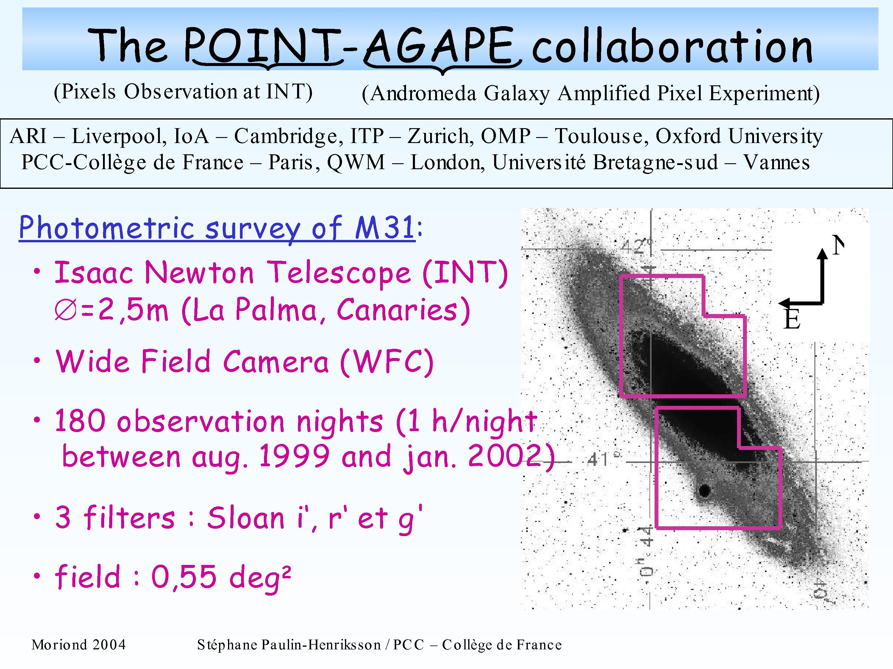

Slide 52
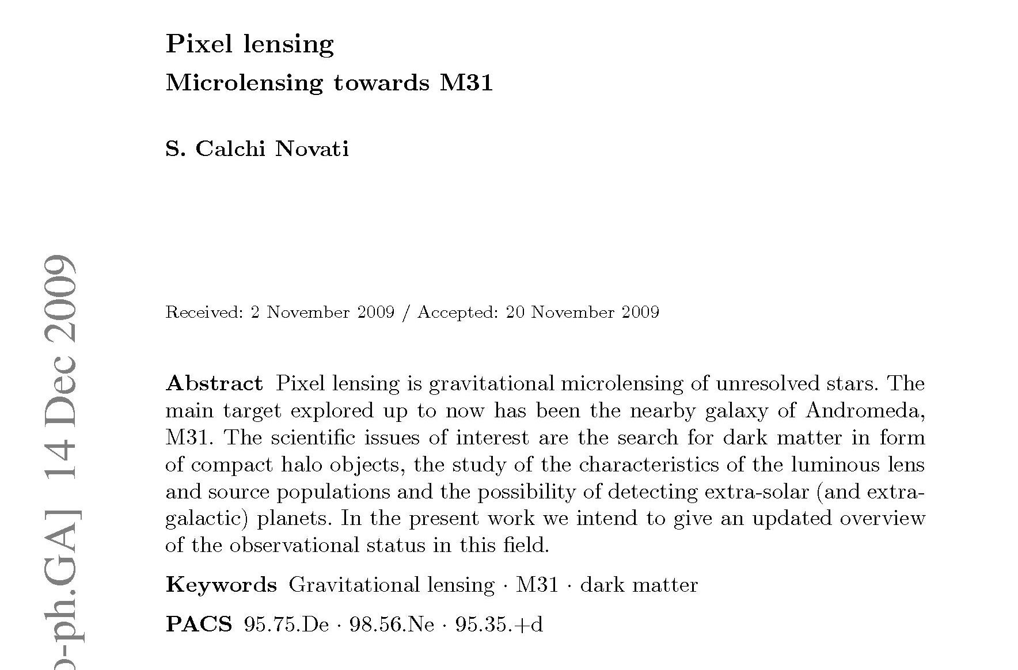

Slide 53
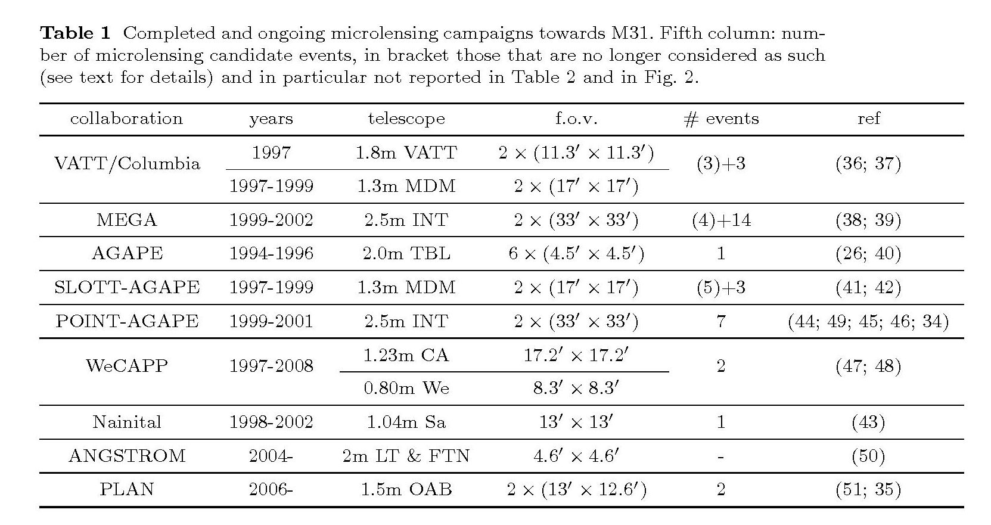

Slide 54
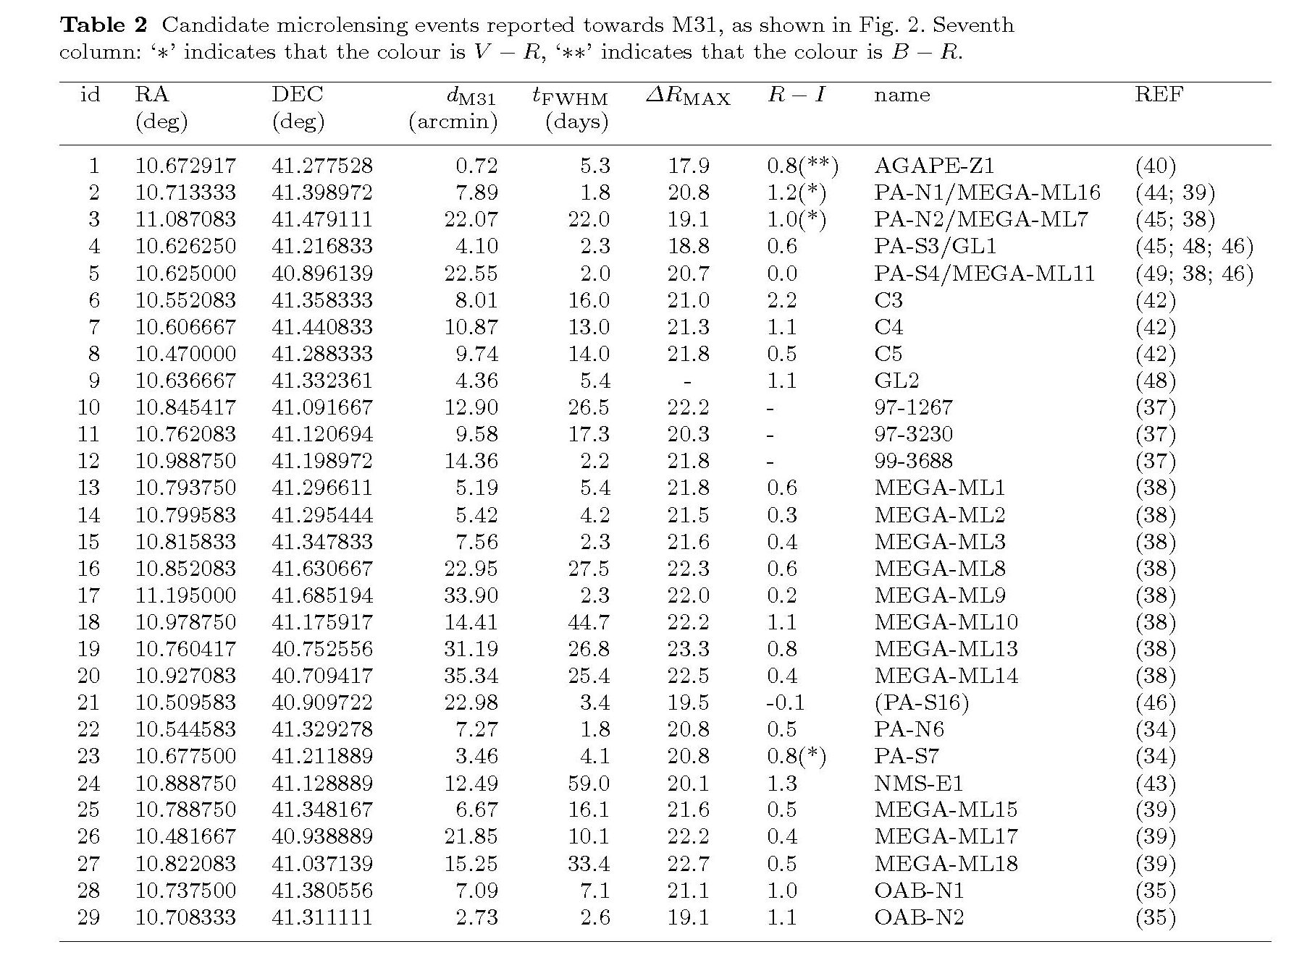

Slide 55
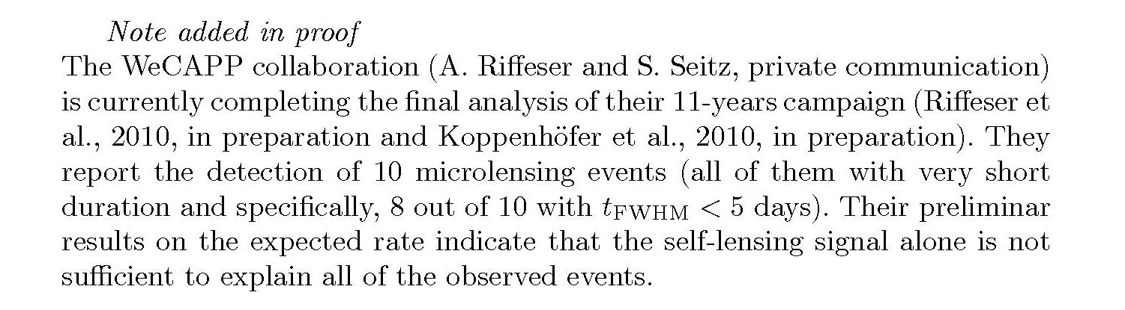

Slide 56


Slide 57


Slide 58


Slide 59


Slide 60
Pixel-lensing and extra-solar searches
G. Ingrosso, S. Calchi-Novati, F. De Paolis, P. Jetzer, A. Nucita, AFZ (MNRAS, 399, 219)
Planets with masses 0.1 Earth masses may be detected in M31

Slide 61
There were two claims in the article.
Exoplanets with masses less than Earth mass may be detected with pixel lensing using present observational facilities.
The pixel lensing event candidate observed by PLANET—AGAPE collaboration in 1999 may be fitted by a planetary system in Andromeda galaxy with a mass exoplanet about 5—7 Jupiter masses.

Slide 62
New Scientist
http://www.newscientist.com/article/dn17287-first-extragalactic-exoplanet-may-have-been-found.html
http://www.newscientist.com/section/science-news
Technology Review (Published by MIT)
http://www.technologyreview.com/blog/arxiv/23619/
FOX News
http://www.foxnews.com/story/0,2933,525886,00.html
BBC
http://news.bbc.co.uk/2/hi/science/nature/8097141.stm
Universe Today
http://www.universetoday.com/2009/06/10/first-extra-galactic-planet-may-have-been-detected/

Slide 63
Scientific American
http://www.scientificamerican.com/article.cfm?id=planet-spotted-in-andromeda-galaxy-2009-06
Daily Telegraph
http://www.telegraph.co.uk/science/science-news/5534891/Planet-six-times-the-mass-of-Jupiter-spotted-by-astronomers.html
World News
http://article.wn.com/view/2009/06/14/Hint_of_planet_outside_our_galaxy/
Russian Press
http://www.gazeta.ru/science/2009/06/10_a_3209024.shtml?lj2
http://www.rian.ru/science/20090618/174737604.html
(with an interview to Alexander Zakharov)
http://rian.ru/science/20090609/173875820.html
Intervista con il Prof. Jetzer (University of Zurich)
http://www.spektrum.de/artikel/1008445

Slide 64
Spanish Press
http://www.terra.cl/actualidad/index.cfm?id_cat=1167&id_reg=1199230
ANSA Italia
http://ansa.it/opencms/export/site/visualizza_fdg.html_989646565.html
Le Stelle
http://www.lestelle-astronomia.it/news.asp
Le Stelle (articolo apparso sul Numero di Agosto 2009 e qui riprodotto)
http://www.fisica.unisalento.it/tagroup/download/LeStelle2009.pdf
Thaindian News
http://www.thaindian.com/newsportal/health/first-extragalactic-exoplanet-may-have-been-found-by-gravitational-microlensing_100203542.html
Wired
http://www.wired.it/news/archivio/2009-06/15/i-misteri-fuori-dalla-nostra-galassia.aspx

Slide 65
Il Corriere del Mezzogiorno
http://corrieredelmezzogiorno.corriere.it/lecce/notizie/universita/2009/15-giugno-2009/astrofisici-salentini-osservano-primo-pianeta-fuori-nostra-galassia--1601467322460.shtml
La Repubblica
http://www.repubblica.it/2008/12/gallerie/scienze/pianeta-extragalattico/1.html
Il Mattino
http://www.ilmattino.it/articolo.php?id=62260&sez=SCIENZA
La Gazzetta di Parma
http://www.gazzettadiparma.it/primapagina/dettaglio/7/22044/Astronomia:_italiani_scoprono_prima_pianeta_extragalattico.html
Quotidiano di Lecce
http://www.lecceprima.it/articolo.asp?articolo=14980
Quotidiano di Puglia
http://www.quotidianopuglia.it/leggi_notizia.asp?ID=8034
http://www.fisica.unisalento.it/tagroup/images/Quotidiano160609.jpg

Slide 66
http://blogs.discovermagazine.com/80beats/2009/06/16/have-astronomers-spotted-the-first-exoplanet-in-another-galaxy/
http://www.lifeinitaly.com/node/6145
http://news.webindia123.com/news/printer.asp?story=/news/Articles/India/20090615/1275300.html
RAI
http://www.radio.rai.it/grr/grcontinua.cfm?GR=1&L_DATA=2009-06-15&L_ORA=19:00#
Il nostro paper e' attualmente disponibile al link:
http://arxiv.org/PS_cache/arxiv/pdf/0906/0906.1050v1.pdf
Il pianeta possibilmente identificato (PA-99-N2) e' stato aggiunto alla ben nota "extrasolar planet encyclopedia" con i dati riportati nel nostro paper.
Per maggiori informazioni:
http://exoplanet.eu/planet.php?p1=PA-99-N2&p2=b&showPubli=yes&sortByDate

Slide 67
JPL (Pasadena, USA)
http://planetquest.jpl.nasa.gov/news/roundUp.cfm
(Indian Top News)
http://www.topnews.in/first-planet-spotted-outside-milky-way-may-lie-andromeda-galaxy-2177884
http://www.ask.com/wiki/Extragalactic_planet
European Association for Astronomical Education
http://eaae-astronomy.org/blog/?p=508

Slide 68
SOFTPEDIA
http://news.softpedia.com/news/First-Exoplanet-in-Another-Galaxy-Found-113678.shtml
ASTRONOMIND
http://www.astronomind.com/faces-of-exoplanets
EXOPLANETZ
http://exoplanetz.com/exoplanet-discovered-in-another-galaxy
FRESHNEWS (INDIA)
http://www.freshnews.in/first-planet-spotted-outside-the-milky-way-may-lie-in-andromeda-galaxy-149525

Slide 69


Slide 70



Slide 71
Hint of planet outside our galaxy
By Jason Palmer
Science and technology reporter, BBC News
Astronomers believe they have seen hints of the first planet to be spotted outside of our galaxy.
Situated in the Andromeda galaxy, the planet appears to be about six times the mass of Jupiter.
The method hinges on gravitational lensing, whereby a nearer object can bend the light of a distant star when the two align with an observer.
The results will be published in Monthly Notices of the Royal Astronomical Society (MNRAS).
The team, made up of researchers from the National Institute of Nuclear Physics (INFN) in Italy and collaborators in Switzerland, Spain, and Russia, exploited a type of gravitational lensing called microlensing.
The effect of large, massive objects between an observer and a distant planet or star can cause distortion or multiple images as the

Slide 72
AP/NASA
First Planet in Another Galaxy Possibly Found
Friday, June 12, 2009
The Andromeda galaxy in a NASA composite image.
Astronomers may have found the first planet in another galaxy,
according to New Scientist magazine.

Slide 73

SkyMania - June 14, 2009
Planet 'spotted' in Andromeda galaxy
Astronomers believe they may have discovered the first planet ever detected in another galaxy. The new world was apparently glimpsed in the closest giant spiral galaxy to the Milky Way, Messier 31 in the constellation of Andromeda. It lies an incredible 2.5 million light-years away - too far normally to be seen. But it revealed itself thanks to a phenomenon called microlensing where the gravitational field of an object closer to Earth acts like a magnifying glass.
Astronomers believe they may have discovered the first planet ever detected in another galaxy. The new world was apparently glimpsed in the closest giant spiral galaxy to the Milky Way, Messier 31 in the constellation of Andromeda.
It lies an incredible 2.5 million light-years away - too far normally to be seen.
But it revealed itself thanks to a phenomenon called microlensing where the gravitational field of an object closer to Earth acts like a magnifying glass.
Amazingly, it has taken the astronomers five years to realise that they probably netted an extra-galactic planet. They observed a peculiar microlensing event while studying the Andromeda galaxy - which can be seen as a dim blur with the unaided eye - in 2004.
The international team, using the UK's Isaac Newton Telescope on the Canary Island of La Palma, thought at the time that they had recorded a pair of stars orbiting each other.
But computer simulations and other calculations have persuaded them that they actually observed a star with a smaller, planet sized companion about six times bigger than Jupiter.
More than 300 so-called exoplanets have been found orbiting other stars in our own galaxy. And NASA has launched a $595 million spaceprobe called Kepler to watch 100,000 stars for signs of world like Earth.
Picture: A photo of the galaxy M31 in visible light. (Photo: John Lanoue).
• Discover space for yourself and do fun science with a telescope. Here is Skymania's advice on how to choose a telescope. We also have a guide to the different types of telescope available.
©PAUL SUTHERLAND, Skymania.com

Slide 74


Slide 75
Planet : PA-99-N2 b
THE PLANET
Basic data :
Name | PA-99-N2 b
Discovered in | 2009
M.sin i | 6.34 M_{J} | ref.
Update | 16/06/09
http://exoplanet.eu/planet.php?p1=PA-99-N2&p2=b&showPubli=yes&sortByDate

Slide 76
Remarks :
 | Reanalysis of data by An et al 2004
4 related publications : (sort by author) (sort by date)
AN J., EVANS N., KERINS E., BAILLON P., CALCHI NOVATI S., CARR J., CREZE M., GIRAUD-HERAUD Y., GOULD A., HEWETT P., JETZER Ph., KAPLAN J., PAULIN-HENRIKSSON S., SMARTT S., TSAPRAS Y. & VALLS-GABAUD D. (The POINT-AGAPE Collaboration) , 2004
The anomaly in the candidate microlensing event PA-99-N2
ApJ. , 601 , 845
paper
INGROSSO G., CALCHI NOVATI S., DE PAOLIS F., JETZER Ph., NUCITA A. & ZAKHAROV A. , 2009
Pixel-lensing as a way to detect extrasolar planets in M31
MNRAS , 399 , 219
accepted
preprint

Slide 77
WRIGHT J., MARCY G. & the California Planet Survey consortium , 2010
Exoplanet Data Explorer
web page
INGROSSO G., CALCHI NOVATI S., DE PAOLIS F., JETZER Ph., NUCITA A. & ZAKHAROV A. , 2010
Search for exoplanets in M31 with pixel-lensing and the PA-99-N2 event revisited
in II Italian-Pakistani Workshop on Relativistic Astrophysics, Pescara 2009
Paper: arXiv:1001.4342

Slide 78
THE STAR in M31
Name | PA-99N2
Distance | 670000 pc | ref.
Mass | 0.5 M_{sun} | ref.

Slide 79
Andromeda Galaxy
From Wikipedia, the free encyclopedia
In 2009, the first planet may have been discovered in the Andromeda Galaxy. This candidate was detected using a technique called microlensing, which is caused by the deflection of light by a massive object.^{[26]}
26. Ingrosso, G.; Calchi Novati, S.; De Paolis, F.; Jetzer, Ph.; Nucita, A. A.; Zakharov, A. F.. "Pixel-lensing as a way to detect extrasolar planets in M31". arXiv. http://arxiv.org/abs/0906.1050.

Slide 80


Slide 81


Slide 82


Slide 83


Slide 84


Slide 85


Slide 86


Slide 87


Slide 88


Slide 89


Slide 90


Slide 91


Slide 92
"A Giant Planet Around a Metal-Poor Star of Extragalactic
Origin" by Setiawan et al at
http://www.sciencemag.org/content/early/2010/11/17/science.1193342
M = 1.25 M_Jup
P = 16.3 days:
http://exoplanet.eu/planet.php?p1=HIP+13044&p2=b
Personal note (JS): the extra-galactic origin of the star does not prove
that the planet b is also of extragalactic origin.

Slide 93


Slide 94


Slide 95


Slide 96


Slide 97


Slide 98
Polarization for pixel microlensing
G. Ingrosso, S. Calchi-Novati, F. De Paolis, P. Jetzer, A. Nucita, F. Strafella, AFZ (MNRAS, 2012)

Slide 99


Slide 100


Slide 101


Slide 102


Slide 103


Slide 104


Slide 105


Slide 106


Slide 107


Slide 108


Slide 109


Slide 110


Slide 111
S. Mao & B. Paczynski (1991), Paczynski (1996) claimed that the most efficient technique to find light exoplanets at large distances (near the so-called snow line) from host stars is microlensing.

Slide 112
Conclusions
Polarization is a very important tool to verify of binary ML model (or star+planet as a microlens) for detected candidates
Model parameters could be clarified (including information about a proper motion of a source in respect of gravitational microlens system) with the technique

Slide 113
Thanks for your kind attention!

