Slide 1
On the role of density and Eddington ratio in the correlation space of NLS1 galaxies
Dawei Xu
National Astronomical Observatories, Beijing
In coll. With
S. Komossa, H. Zhou, H. Lu, C. Li, D. Grupe, J. Wang, W. Yuan
the M - σ relation
[OIII] blue outliers: large scale outflows
a zone of avoidance in density
correlation space
May 14, 2013
Notes:
We have systematically studied the physical properties of a sample of NLS1s. I will briefly review previous results, including (1)the locus of NLS1s on the M—sigma relation, (2) the presence of OIII blue outliers which hint at large scale outflows, (3) the detection of a ZOA. And then I will present our new results on correlation space.

Slide 2
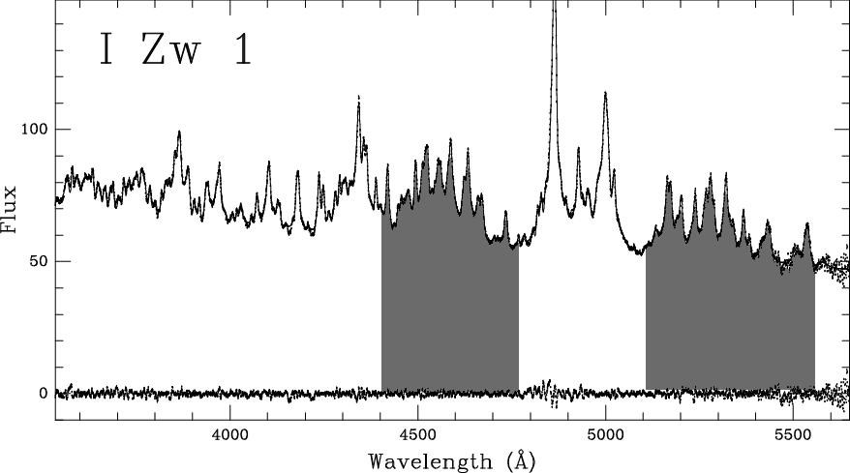
Intro: Narrow-line Seyfert 1 Galaxies
defi: via optical
spectral properties
Hβ
[OIII]
FeII
FeII
FWHM_{Hβ} < 2000 km/s [OIII]/Hβ < 3 strong FeII/Hβ
[e.g., Osterbrock & Pogge 85, Goodrich 89, Veron-Cetty+ 01]
NLS1s cluster at one “extreme end“ of correlations (‘EV1‘) between line/conti properties of AGNs
- small FWHM(Hβ)
- strong FeII/Hβ
- weak [OIII]/Hβ
- strong CIV blueshifts, Hβ asym.
- sometimes: steep X-spectra;
some samples show Γx-FWHM(Hβ)
corr., others not at all
[e.g., Boroson & Green 92, Boroson 02, Boller & 96 , Brandt & 97, Grupe & 04, 11, Laor 97, Marziani & 01, 03, Sulentic & 00, 02, 03,08, Williams & 02, 04, Puchnarewicz & 02, Shemmer & Netzer 02, Xu & 03, 07,12, Netzer & 04, Fields & 04, Zhou & 06, Ai & 11; review by Komossa 08, Pogge 11]
Notes:
NLS1s are important objects when addressing the issues of black hole growth and evolution, and of feeding and feedback.

Slide 3
Intro: Narrow-line Seyfert 1 Galaxies
models: what drives the correlations ??
- high Eddington-scaled accretion rate and/or
- low BH mass
- density effect
- orientation
- young age
- different host galaxies
- different NLR/BLR (abundances), ionized
absorption
[e.g. review by Komossa 08]

Slide 4
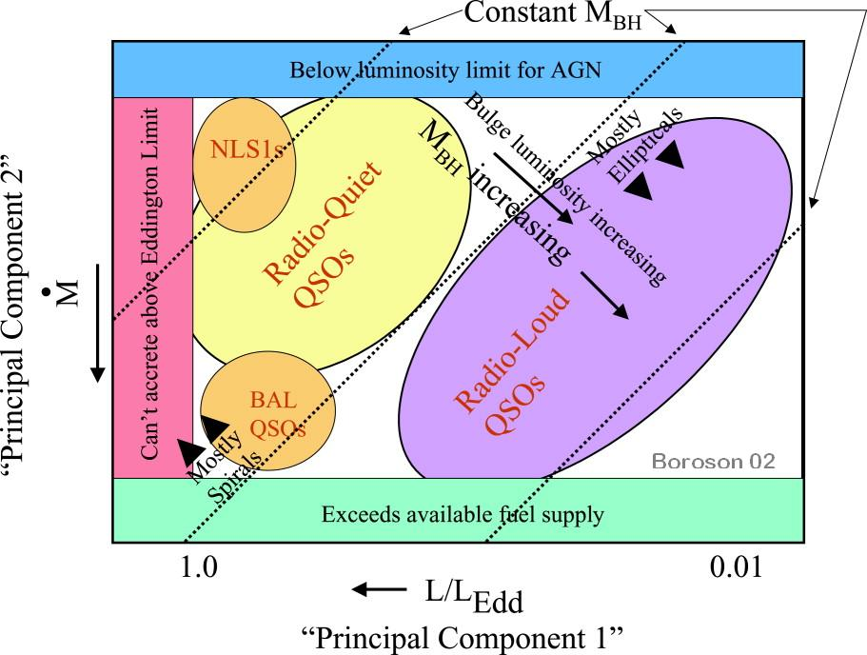
Intro: Narrow-line Seyfert 1 Galaxies
Links with other types of sources
ULIRGs: share strong FeII, weak [OIII] trends. High-z QSOs: share super-solar metallicities, high L/L_{Edd}
BAL quasars: NLS1-ness and BAL-ness at same end of EV1 (but opposite end of EV2 - diff. L)
radio-sources: NLS1-ness and (steep-spectrum) RLness at opposite ends of EV1 – but recent studies have revealed a number of radio-loud NLS1s

Slide 5
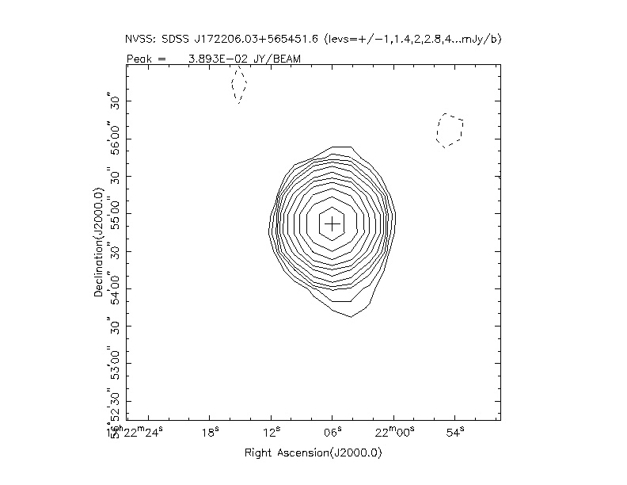
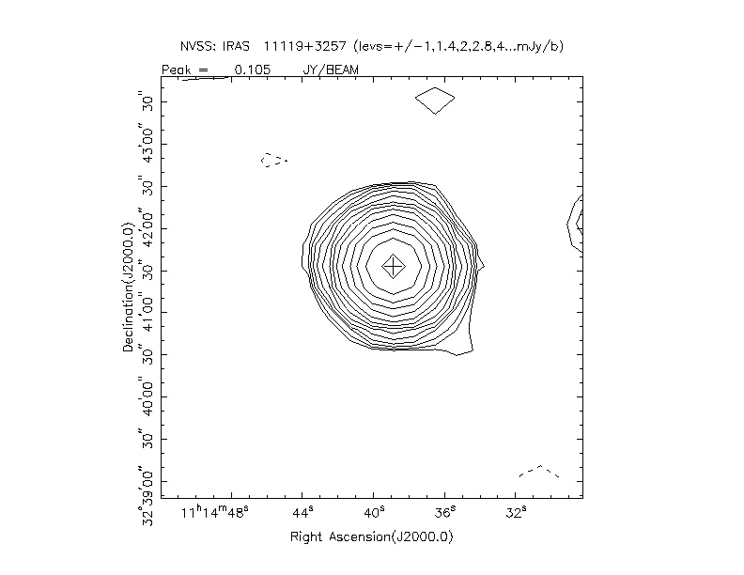
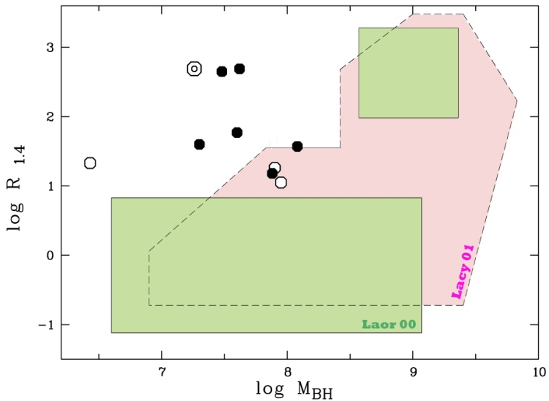
Intro: Narrow-line Seyfert 1 Galaxies
Systematic radio study (Komossa & 06) showed that:
- NLS1s, as a class, are much less radio-loud than BLS1s.
- RL-NLS1s show similarity with compact steep-spectrum sources (CSS),
which might be young radio sources in dense environment.
- BH masses in prev. rarely populated regime of M_{BH}-radio-loudness diagram
Among the radio-loudest NLS1s, several cases for beaming have emerged, and they share similarities with blazars (e.g., Zhou& 03, Komossa& 06, Yuan& 08).
Some of the beamed radio-NLS1s have now also been detected in the gamma-ray regime. (e.g., Foschini & 11,12)

Slide 6
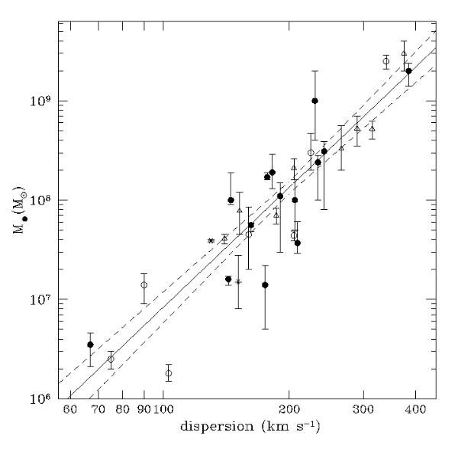
The M_{BH} - σ Relation
correlation between black hole mass, M_{BH}, and bulge stellar velocity dispersion,σ∗,
M_{BH}/(10⁸ Μ_{sun}) = 1.7 (σ∗/σ₀)^{4.9} (FF05)
implies close link between BH and galaxy formation/evolution
models: regulation of bulge-
growth due to feedback from
active BH / star formation
do all types of galaxies, at all
times, follow the M-σ∗ relation ?
how do objects ‚move onto‘
the relation ?
where do NLS1s locate ?
[M-σ: Ferrarese & Merritt 00, Gebhardt & 00, MF01, Tremaine & 02, Ferrarese & Ford 05]
[models: e.g., Silk & Rees 98, Burkert & Silk 01, Haehnelt+ 03, Springel+ 05, Hopkins+ 06,11 .........]

Slide 7
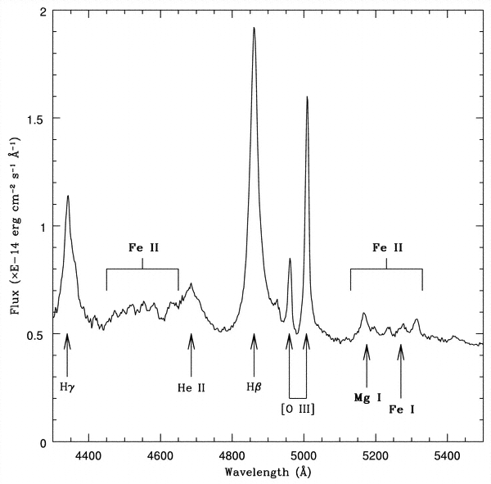
M_{BH} and σ measurements in AGNs
in AGNs, an independent way to estimate BH masses from “reverberation mapping“ of the BLR,
→ R_{BLR}-L relation
[e.g., Kaspi et al. 2005, Peterson 2007]
do we also have a way to measure σ∗ ?
Not really, AGN conti bright; stellar absorption features often superposed by bright conti & emission-complexes
nearby ‘normal‘ AGNs:
agree with M_{BH}–σ∗ relation if
σ_{[ΟΙΙΙ]} is used as substitue for
σ∗
use gaseous kinematics, traced by emission-lines, instead.
[Nelson & Whittle 96, Nelson 2000]

Slide 8
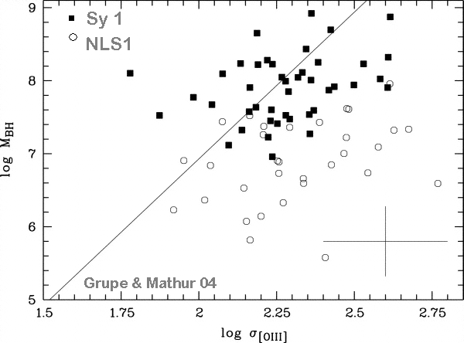
NLS1s on the M_{BH} – σ_{[OIII]} planes
original trend: NLS1s are OFF M_{BH} – σ_{[ΟΙΙΙ]} relation(Mathur+ 01)，but “on“ in Wang & Lu (2001)
few real σ∗ measurements
(Botte+ 05, Xiao+ 11: “on“; Zhou+ 06: “off“; Bian+ 08 “on“ or “off“)
few L_{bulge} measurements
(Botte+ 04: “on“; Ryan+ 07, Mathur+ 12: “off“; based on ~10 objects each)
[Mathur & 01, Wang & Lu 01, Wandel 02, Grupe & Mathur 04, Bian & Zhao 04,06, Botte & 04, 05, Barth & 05, Mathur & Grupe 05a,b, Greene & Ho 05, Zhou & 06, Ryan & 07, Watson & 07, Komossa & Xu 07, Xiao+ 11, Mathur &12]
Notes:
Orban &? On or off?

Slide 9
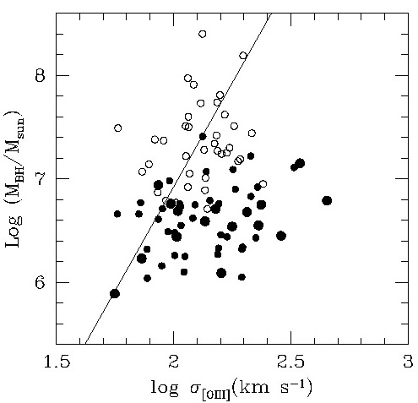
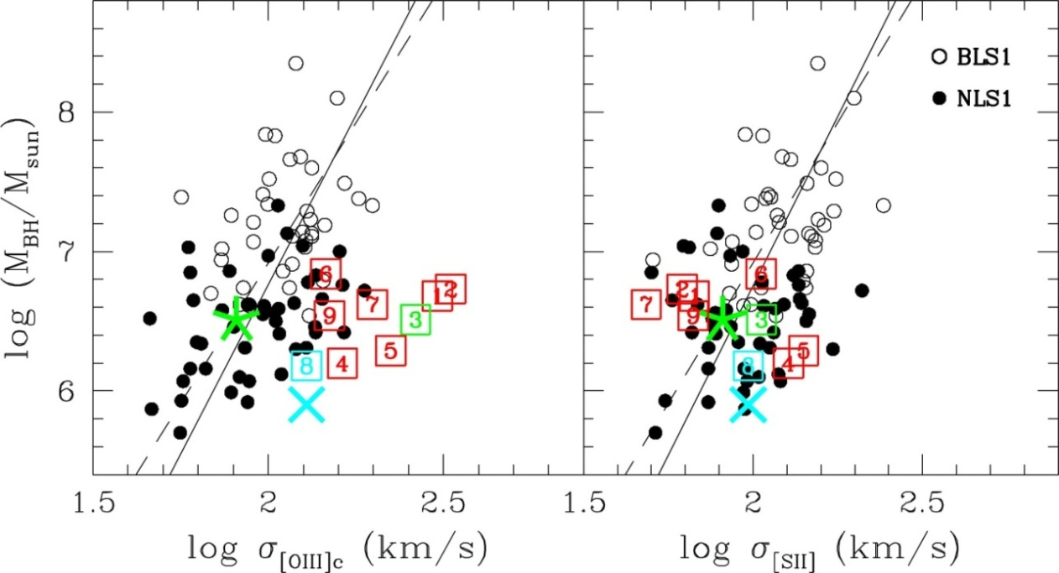
NLS1s on the M_{BH} - σ Relation
- how reliable is [OIII] as substitute for stellar velocity dispersion ?
[OIII] often affected by blueshifts (→ outflows)
we used [SII] instead:
NLS1s no longer off-set !
and they do follow M-σ_{ΙΙΙ} relation of BLS1s & normal galaxies if sources with [OIII] core blueshifts are removed, in which velocity fields are not dominated by the bulge potential
Komossa & Xu 07
Notes:
9
NLS1 host – BH scaling relations:
and NLS1s follow the MBH - s[OIII] relation, if objects with outflows in [OIII] are removed, in which velocity fields are not dominated by the bulge potential
Recent results: some of them controversial, almost all of them very surprising.
(1) OFF MBH-sigma_O3 relation, as defined by SEYFERT galaxies (which are on Tremaine et al. 2002 M –Sigma_*)

Slide 10
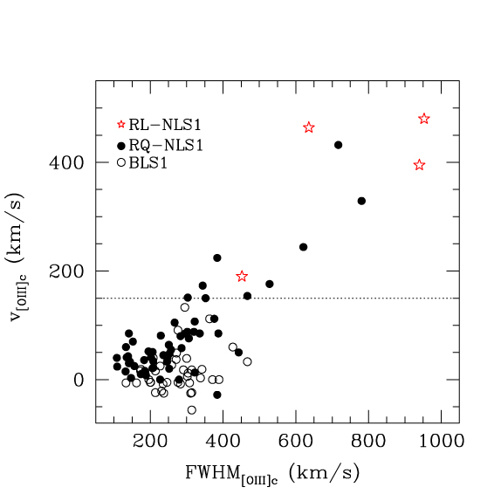
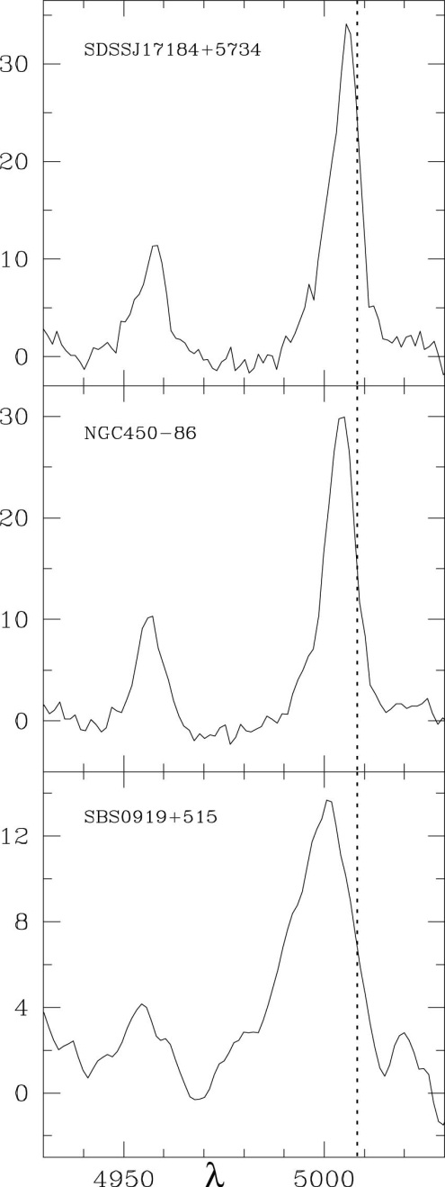
NLS1s with Strong [OIII] Outflows
Komossa, Xu+ 08, 13
16% of “blue outliers“ among NLS1s, which have their whole [OIII] core profile blueshifted, by up to several 100 km/s.
[e.g., Zamanov+ 02, Marziani+ 03, Bian+ 05, Aoki+ 05, Komossa,Xu+ 08, 13— in prep]
Notes:
NLS1s with strong [OIII] outflows
The independent question is raised as to what ….
10

Slide 11
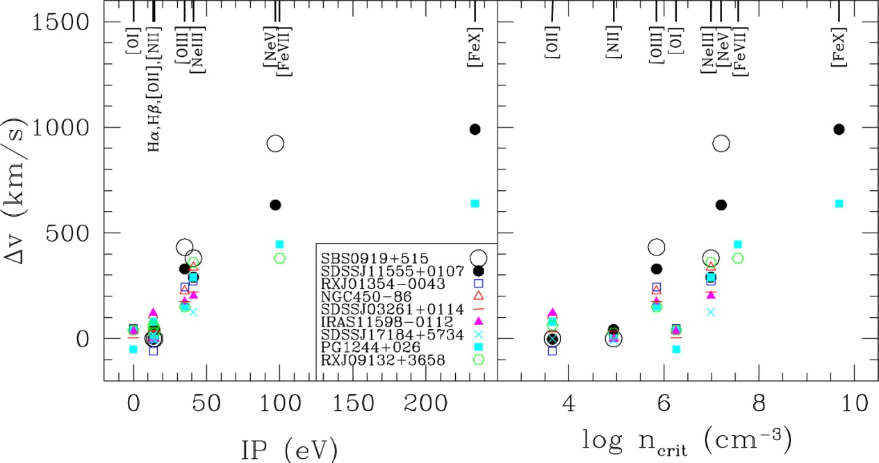
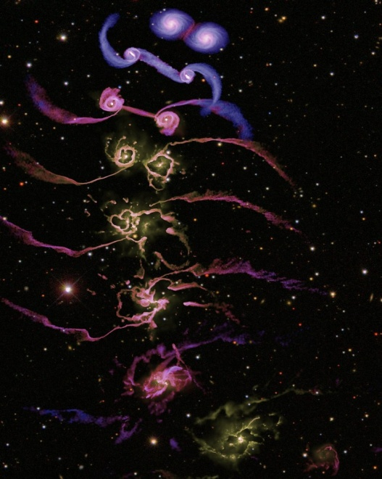
On the Nature of [OIII] “Blue Outliers“
[di Matteo+ 05]
[Komossa, Xu, Zhou, Storchi-Bergmann, Binette 08]
other emi-lines show evidence for extreme outflows up to 1000 km/s; affecting the CLR, and large parts of the NLR - while the outer NLR is quiescent
high L/Ledd, & pole-on view into an outflow?
is feedback due to outflows at work ? follow-up HST imaging: search for mergers a la Springel et al. / or bars
Notes:
1. Near face-on orientation allow us look more down the flow in blue outliers, thereby enhancing the stratification,
broadening, and blueshift effect.
2.galaxy merger simulations predict strong outflows in the final merger phase (e.g.,
Springel et al. 2005). Imaging will allow us to test whether blue outliers are in such a phase.

Slide 12
Density Effects in NLS1s
Density measurements: conflicting results
High density BLR based on the large Si III]1892/C III]1909 ratios from UV spectra (e.g. Kuraszkiewicz et al. 2000; Wills et al. 2000; Marzianie et al. 2001, Bachev et al. 2004) and high density NLR of I ZW 1 (Laor 1997; Veron-Cetty, Joly & Veron 2004).
Low density BLR from UV spectroscopy (e.g., Rodriguez-Pacual et al. 1997) and low average density in NLR using optical and near-IR spectroscopy (Rodriguez-Ardila et al. 2000).
Moreover, there are indications that the density of [OIII]5007 decreases with steeper soft X-ray slope (Baskin & Laor 2005)
Is the density low or high in NLS1s?

Slide 13
The NLR Density
We had a systematic study of the NLR density for a large homogeneously analyzed NLS1 sample and compared it with that of BLS1s, by using the density diagnostic [S II] line ratio: i.e., [S II]6716/6731.
We attempted to answer the following key questions:
Is there any difference in the NLR density between NLS1s and BLS1s?
If so, do trends in density correlate with other parameters?
What are the key physical drivers of the trends in density?

Slide 14
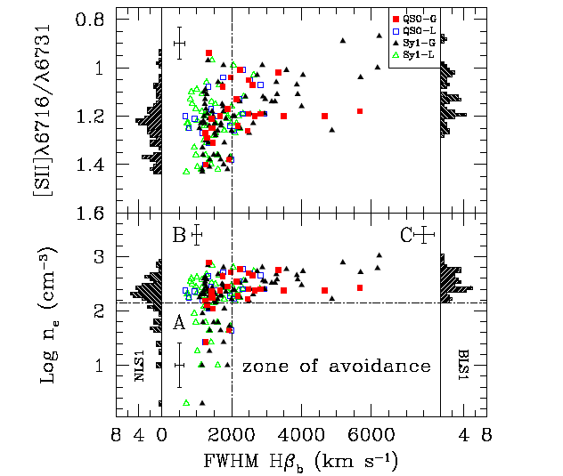
A Zone of Avoidance in Density
a systematic study of the NLR density of NLS1s and compared it with that of BLS1s, by using the density diagnostic [SII] line ratio.
The Key detection : a ’zone of avoidance’ in the density—FWHM (Hβb) diagram: BLS1s avoid low densities, while NLS1s show a larger scatter in densities, including a significant number of objects with low density.
Xu et al. 2007

Slide 15
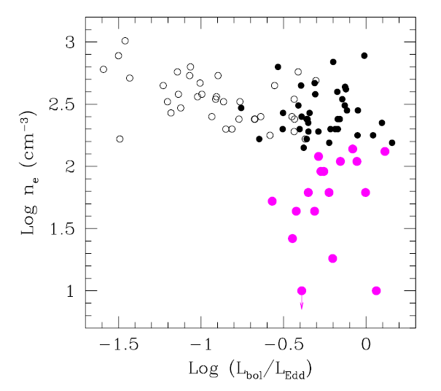
On the Origion of the ZOA - Outflows
Higher Eddington ratios likely drive stronger outflows
→ more tenuous, low-density NLR in objects with higher L/LEdd
L/LEdd vs. density: decreasing density with increasing L/L_{Edd}
The [OIII] peak blueshift strongly
correlates with L/L_{Edd}
outflows are more common in
objects with high accretion rates
The density correlates with the
blueshift of the [OIII] bluewing
outflows are stronger in the low-
density objects
Notes:
We found several lines of evidence that outflows play a significant role in driving the difference in the NLR density between NLS1s and BLS1s. …
If these still propagate up into the NLR, we may expect more tenuous,…

Slide 16
Why Correlation Analyses
Cluster at one extreme end of AGN correlation space.
Such correlations provide some of the strongest constraints on, and new insights in, the physical conditions in the centers of AGNs and the prime drivers of activity.
Independent samples are of importance when assessing the robustness of correlation analyses and when increasing correlation space.

Slide 17
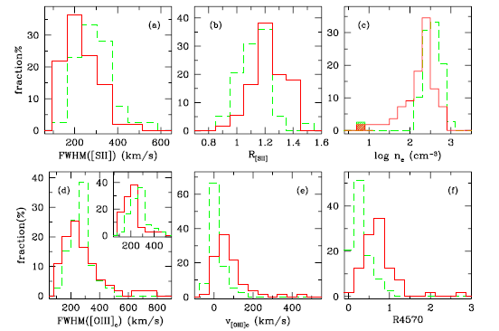
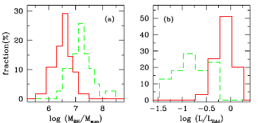
Sample Properties
new analyses and a statistical study of a homogeneously analyzed NLS1 sample in comparison with a BLS1 sample based on SDSS spectra
Xu et al. 2012
Notes:
NLS1s are shown as solid line, BLS1s as dashed line. For comparison, we also show histograms of other properties, like the width … Some of these reflecting trends we reported previously.

Slide 18
Correlations for Key Parameters
Xu et al. 2012
Notes:
I now focus on studying trends across our sample. First, we performed a Spearman rank order correlation analysis to determine which parameters are correlated and to derive the significance of the correlations. In addition to confirm previously well-known correlations involving the width of Hbeta, strength of feII and OIII emission lines, new trends including the SII line ratio and the velocity shift of OIII core lines are identified.

Slide 19
PCA and Eigenvetor Space
aimed at identifying the strongest correlations and the underlying drivers of the correlation space
New key element of Eigenvector 1 (EV1)：the density of the NLR
as important as L/L_{Edd}
Xu et al. 2012
Notes:
The PCA is a commonly applied method aimed at identifying the strongest correlations and the underlying parameters. For the first time, we have established that the density of the NLR as a key ….

Slide 20
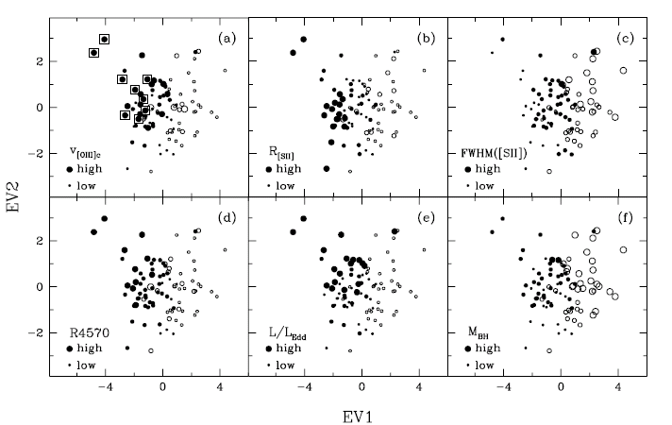
PCA and Eigenvector Space
Several [OIII] blue outliers are located in the high Eddington ratio and high-luminosity corner, possibly sharing these properties with BAL QSOs.
Xu et al. 2012
Notes:
This figure shows the distribution of our objects in the EV1-EV2 space, in dependence on different parameters. …The objects marked with an extra square. Possiblly, they bridge a gap between NLS1s and BAL quasars.

Slide 21
Links between Central Engine and Host Properties
The NLR density is representative of the ISM of the host galaxy, and this study thus links the central engine properties with the host galaxy.
Scenarios may account for the strong dependence of EV1 on ISM density:
accretion-driven winds & bar-driven inflows
particularly seen in NLS1s an excess of bars in NLS1s
Eddington driven winds more likely bars can transport gas inward
merger simulation predict large-scale outflows secular processes in NLS1s
Distinguishing between the two scenarios:
HST images & correlation analyses combining other host properties
Notes:
Adding the NLR density to EV1 is of great importance, because it is representative….

Slide 22
Future follow-up studies
Selection of larger NLS1 samples from the latest SDSS/LAMOST data releases which, in particular, have all their classical emission lines detected. This ensures that emission-line diagnostics can be performed the same way as it was done for our current sample.
Nearest-neighbor analyses of larger NLS1 samples, in order to investigate if NLS1 and BLS1 galaxies reside in similar large-scale environments.
Obtaining high-quality host images of the galaxies of our sample, in order to measure their host type, and host properties, and ultimately add host properties to the correlation analyses.

Slide 23
Summary
NLS1s do follow the M–σrelation of BLS1s and normal galaxies, if [SII] is used to measure σ ; and and they do follow M- σ_{III} relation if sources with [OIII] core blueshifts are removed;
these [OIII] ‘blue outliers‘ are of independent interest because of their strong large–scale outflows (→ constraints on mechanisms to drive AGN winds on large scales );
We detected a ’zone of avoidance’ in the density—FWHM (Hβ_{b}) diagram. Outflows may play a significant role in driving the difference in the NLR density between NLS1s and BLS1s;
the NLR density is added as a new key element to the EV1 space, as important as L/L_{Edd};
Accretion-driven winds on the one hand, or bar-driven inflows on the other hand, may play a role in explaing the links between the central engine and the host properties;
Several [OIII] blue outliers lie in the high Eddington ratio and high-L regime in the EV1-EV2 space, possibly sharing these properties with BAL QSOs.

Slide 24
Thank you for your attention!

