Slide 1
Stark-width regularities within spectral series of neutral atoms

Slide 2
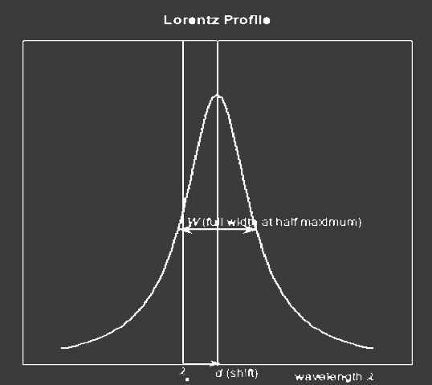
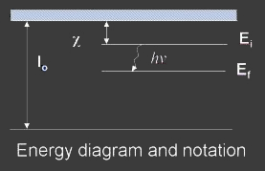
  Stark broadening influence
  Spectral line broadening is proportional with electron density
  Temperature dependence for 95% of spectral lines ω=A+BT^{C}
  Influence of lower level ionization potential
  Influence of effective charge
  Broadening dependence on upper level ionization potential

Slide 3
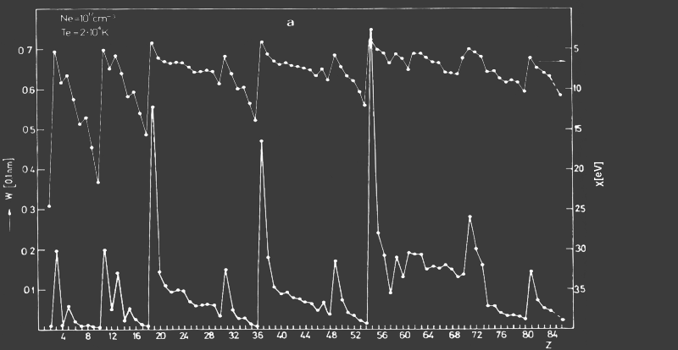
Upper level ionization potential and Stark broadening

Slide 4
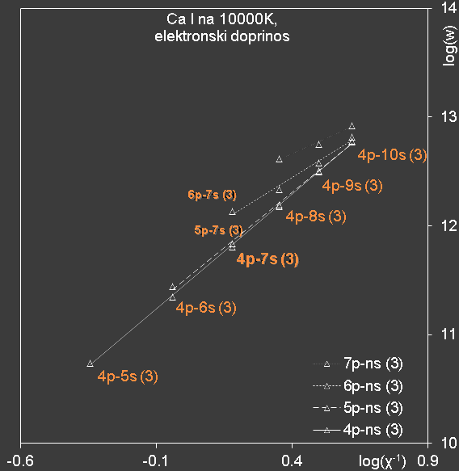
Influence of lower level ionization potential
electron contribution

Slide 5
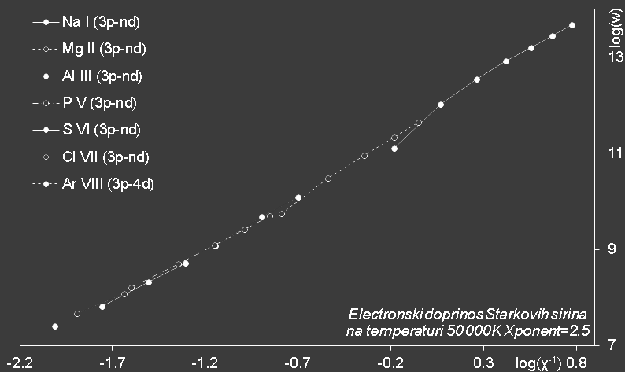
Effective charge influence

Slide 6
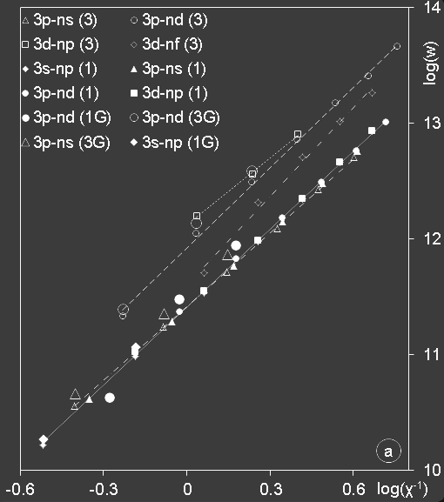
Stark broadening of neutral magnesium

Slide 7
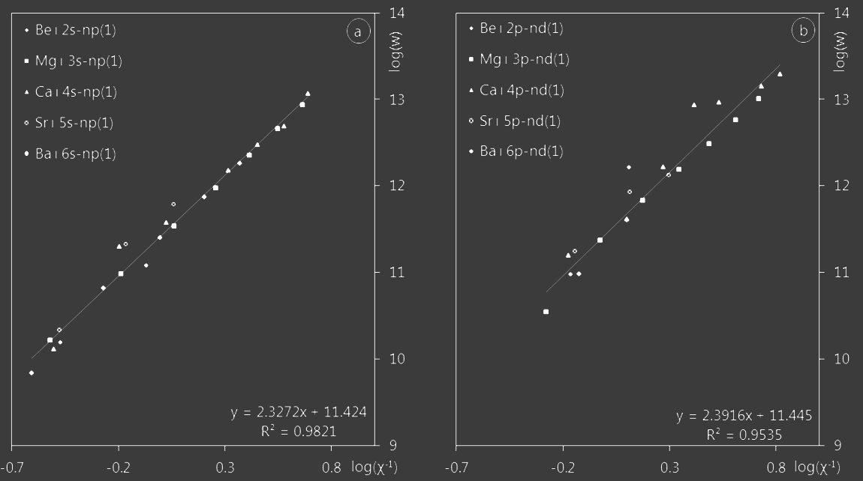
- Singlet resonant spectral series (initial p level, final s level)
- Singlet diffuse spectral series (initial d level, final lowest p level)

Slide 8
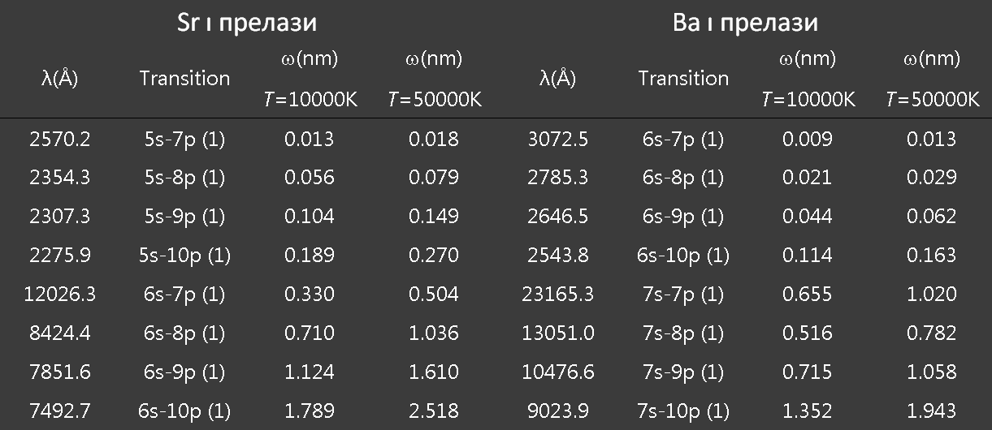
Calculated values of Stark broadening (FWHM)
transition
transition

Slide 9
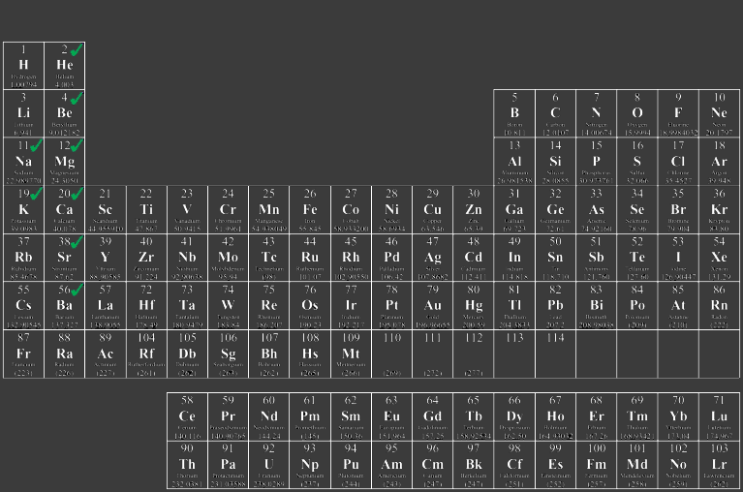
Резултатиати и планови

