Slide 1
Comparing
Hβ and MgIIλ2800
for Estimating
Black hole Mass
J. Sulentic -- IAA - CSIC
P. Marziani -- OA Padova – INAF
A. Del Olmo – IAA - CSIC
I. Plauchu-Frayn – UNAM, Ensenada

Slide 2
Broad Emission Lines as virial estimators
FWHM Hβ >>>>>>> virial v
Single epoch FWHM measures? rms? Composites? Or sigma?

Slide 3
Notes:
F~~~root 3/2 randomly oriented velocities along los

Slide 4
The f factor?
BLR geometry and kinematics
Strong inclination dependence
Of order ~~1-2 (or 5.5 Onken et al. 2009 using sigma)
Same for Pop. A and B?

Slide 5
(Kaspi et al., 2000; 2005)

Slide 6
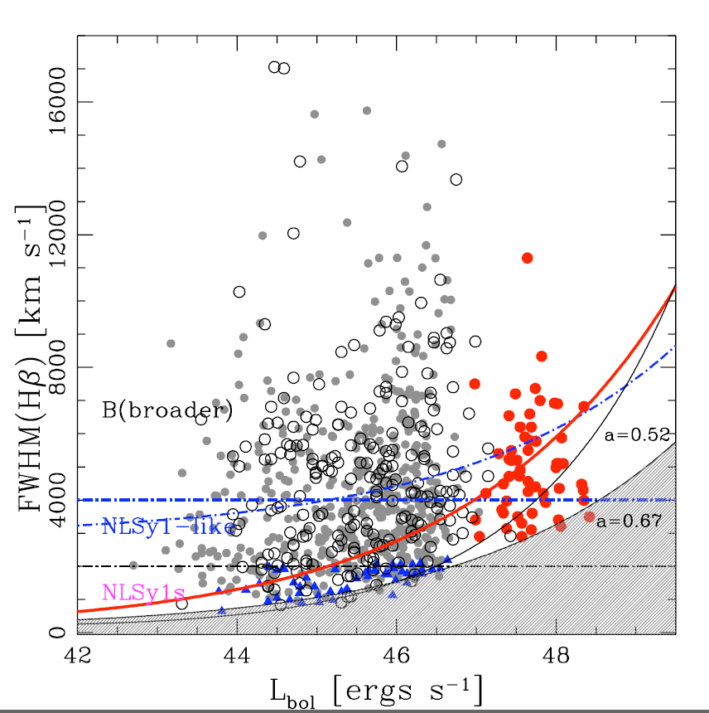
Notes:
Assumes fixed/stable BC 5100A X10

Slide 8
Not all FWHM Hbeta are the same
Sources above and below FWHM Hbeta=4000kms show different
structure (Sulentic et al. 2000)
Relationship between FWHM and sigma changes -- reflecting multiple components
(Collin et al. 2006)

Slide 9
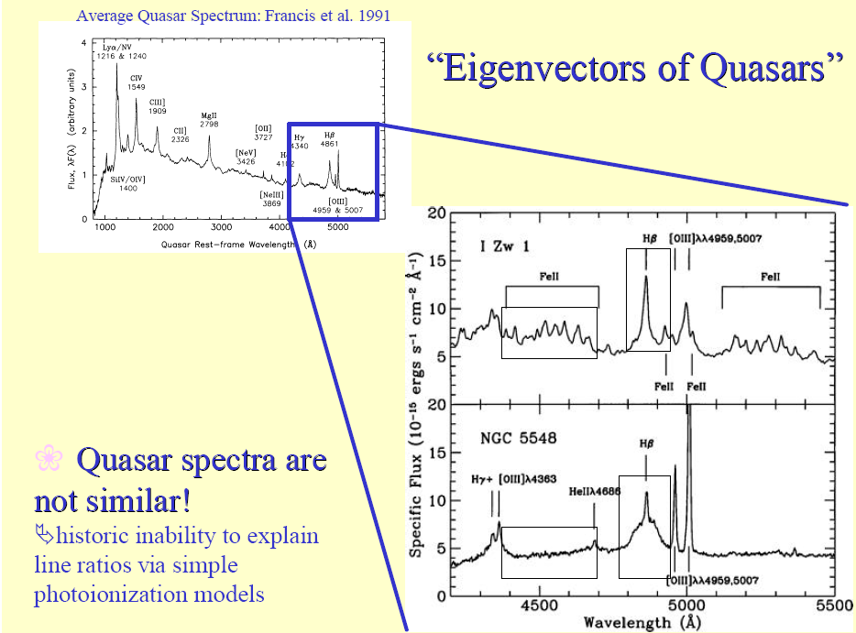

Slide 11
OUTLIERS
FWHM Hβ
R_{FeII}

Slide 12
B
FWHM Hβ
FWHM Hβ_{BC} 4000 km/s
A
R_{FeII}

Slide 14
WHY correct FWHM Hβ?

Slide 15
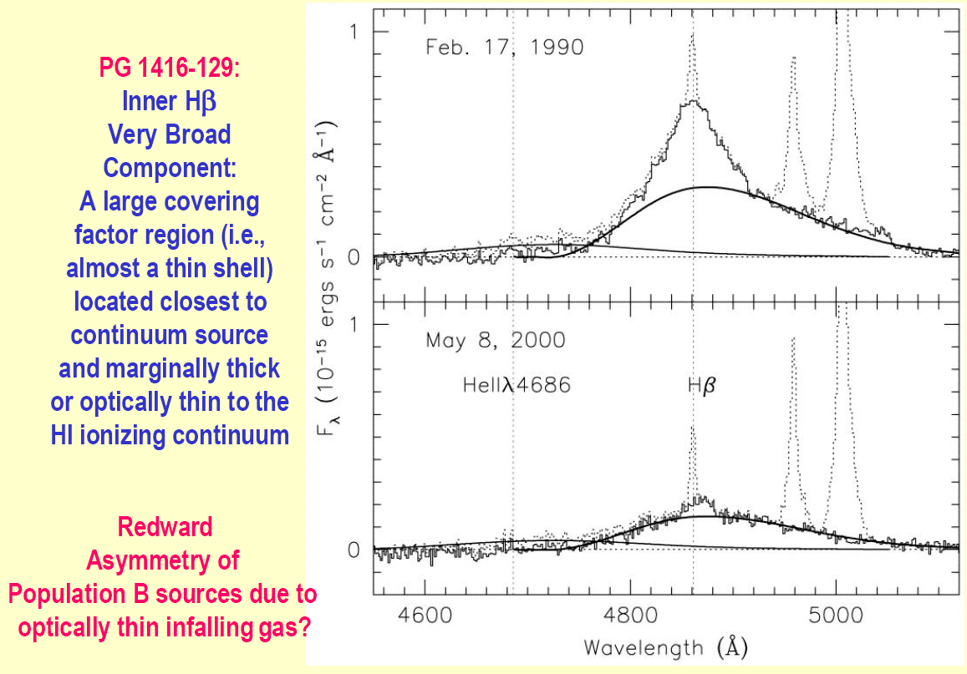

Slide 16
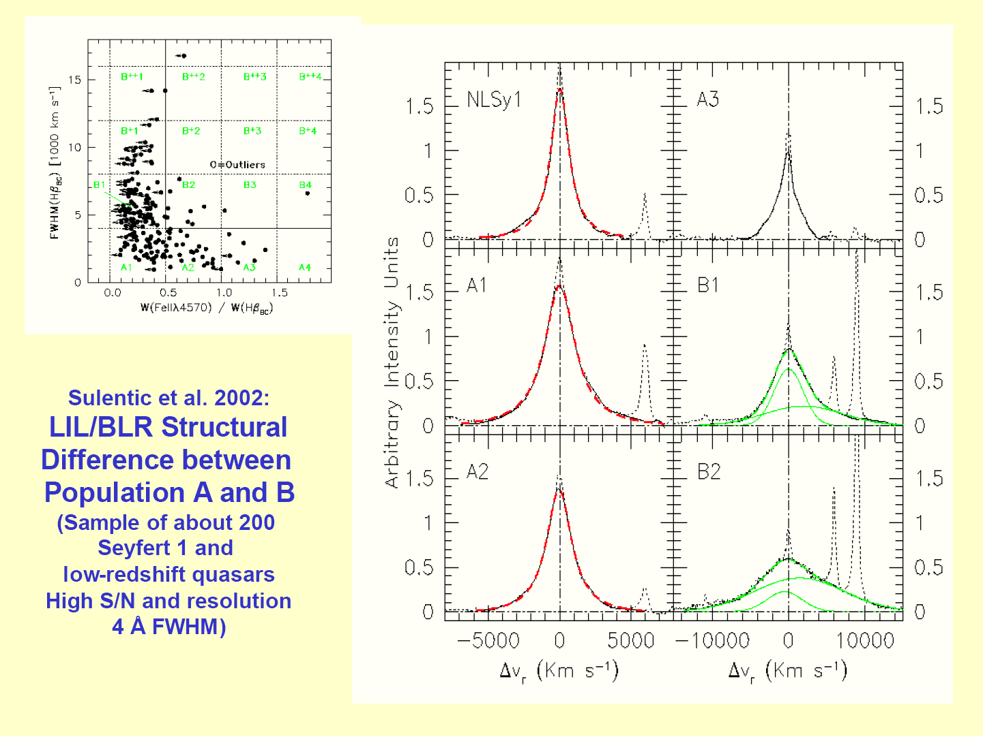

Slide 17
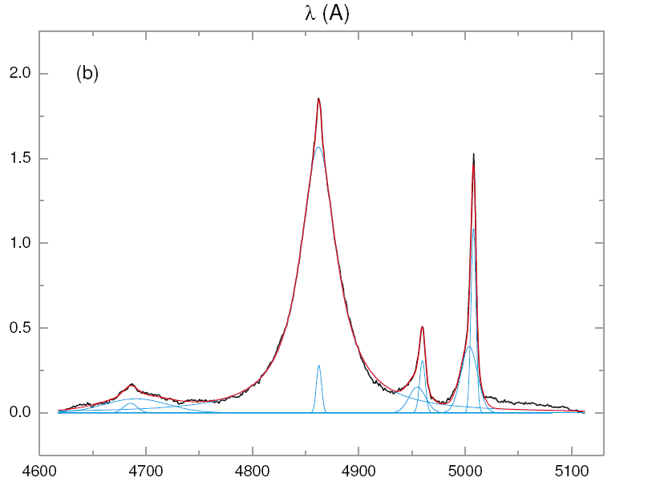
BIN A1 MEDIAN

Slide 18
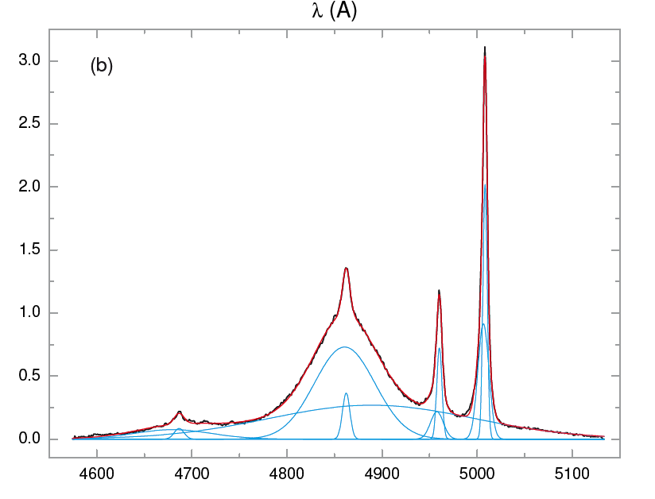
BIN B1 MEDIAN

Slide 19
FWHM Hb as virial estimator
Pop A: FWHM full profile
Pop B: FWHM of VBC corrected profile

Slide 20
Above z~0.7???
Follow Hbeta into the IR to z=3.8
MgII2798 with suitable corrections to z=7
CIV1549 dangerous (maybe Pop B)

Slide 21
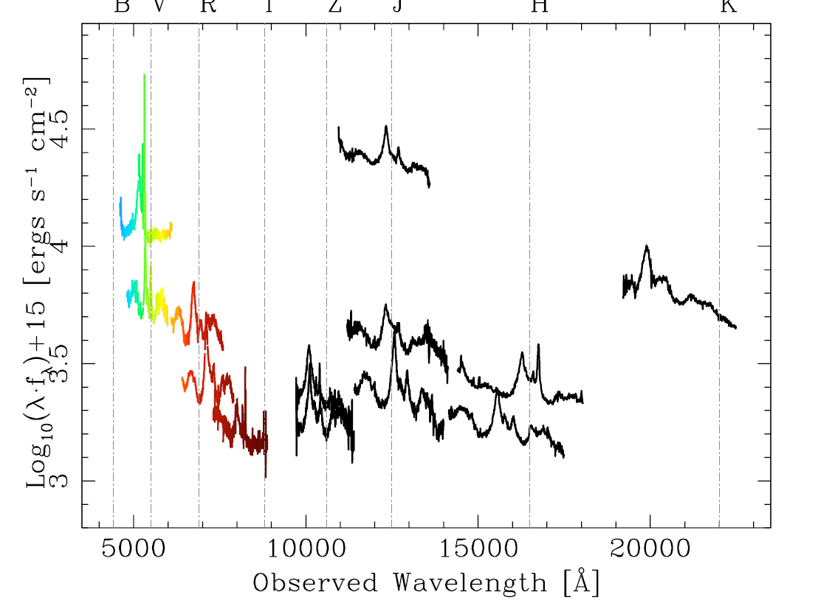

Slide 22
MgII 2798
A low ionization line (LIL)
A doublet 2796/2803
A resonance line
A virial estimator to z=7!?

Slide 23
Comparing MgII and Hb
600+ SDSS quasars (z=0.4-0.75) have spectra with both Hb and MgII recorded
(many with s/n < 10)
Recent studies Wang et al. 2009; Trachtenbrot &
Netzer 2012)
Binning is perhaps a better way?
Binned spectra are much higher S/N and essentially rms
Binning context – 4DE1?

Slide 24
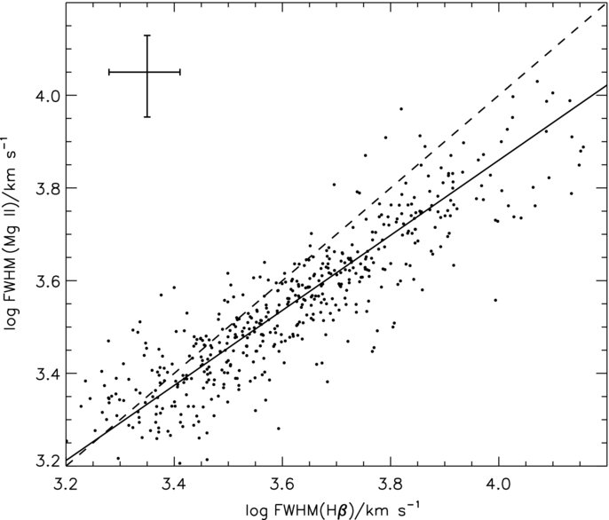
Wang et al. 2009
Notes:
Wang et al. 2009

Slide 25
Population A
Four median composite spectra for bins
A1, A2, A3, A4
increasing in intervals of RFE=0.5 with 1dex range in log L_bol=46
Lines, line components, FeII blends and continuum modeled using IRAF SPECFIT
Hb and MgII regions fit independently with single broad components

Slide 26
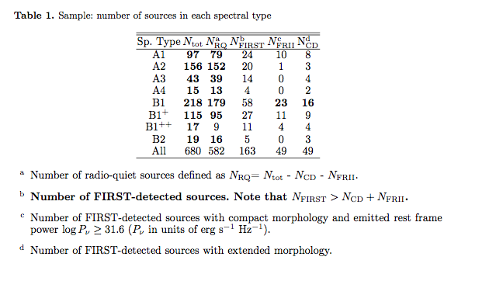

Slide 27
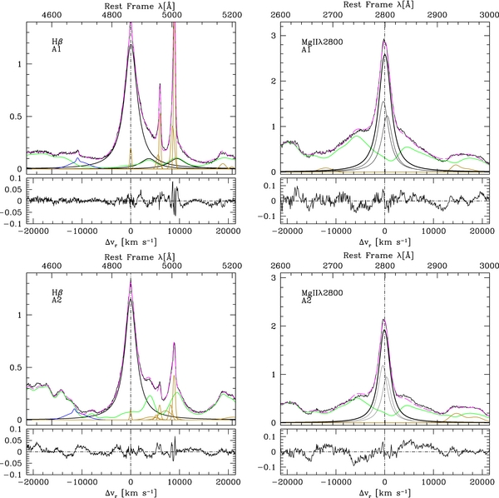

Slide 28
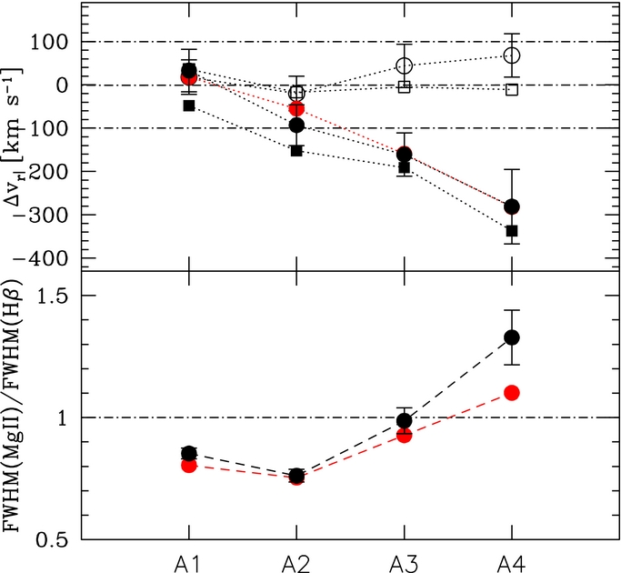

Slide 29
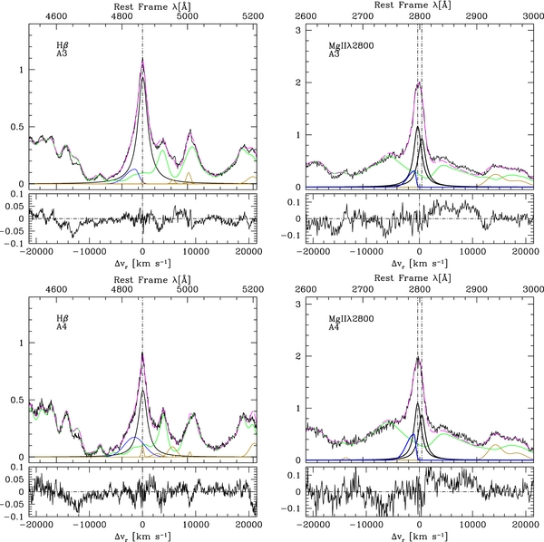

Slide 30
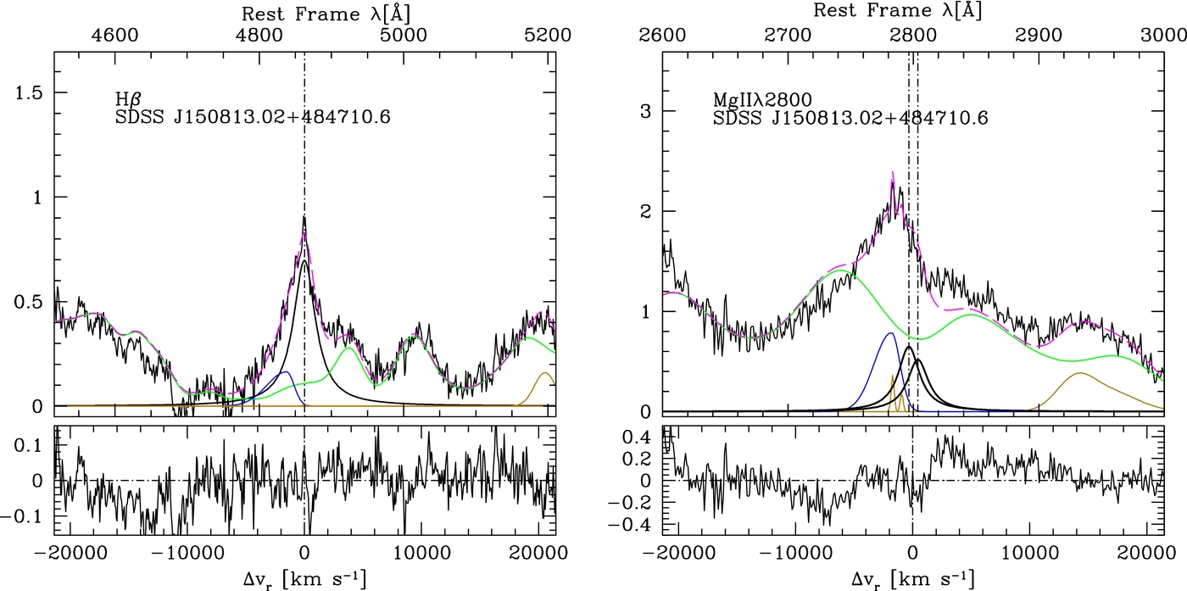

Slide 31
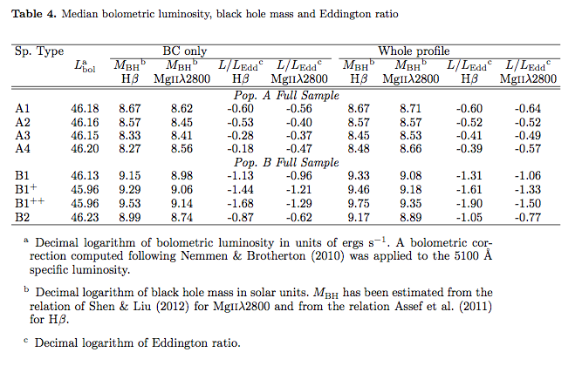

Slide 32
Bin A3 and A4 sources are different
FWHM MgII not valid virial estimator
MgII profiles are blueshifted
Hb is safer virial estimator
Why?
Bins A3 and A4 likely involve the highest accretors

Slide 33
PHYSICAL TRENDS
Γ - Ionization parameter
m - Dimensionless accretion rate
M - BH mass
n_{e} - Electron density
m
n_{e}
FWHM Hβ
Γ
M
R_{FeII}

Slide 34
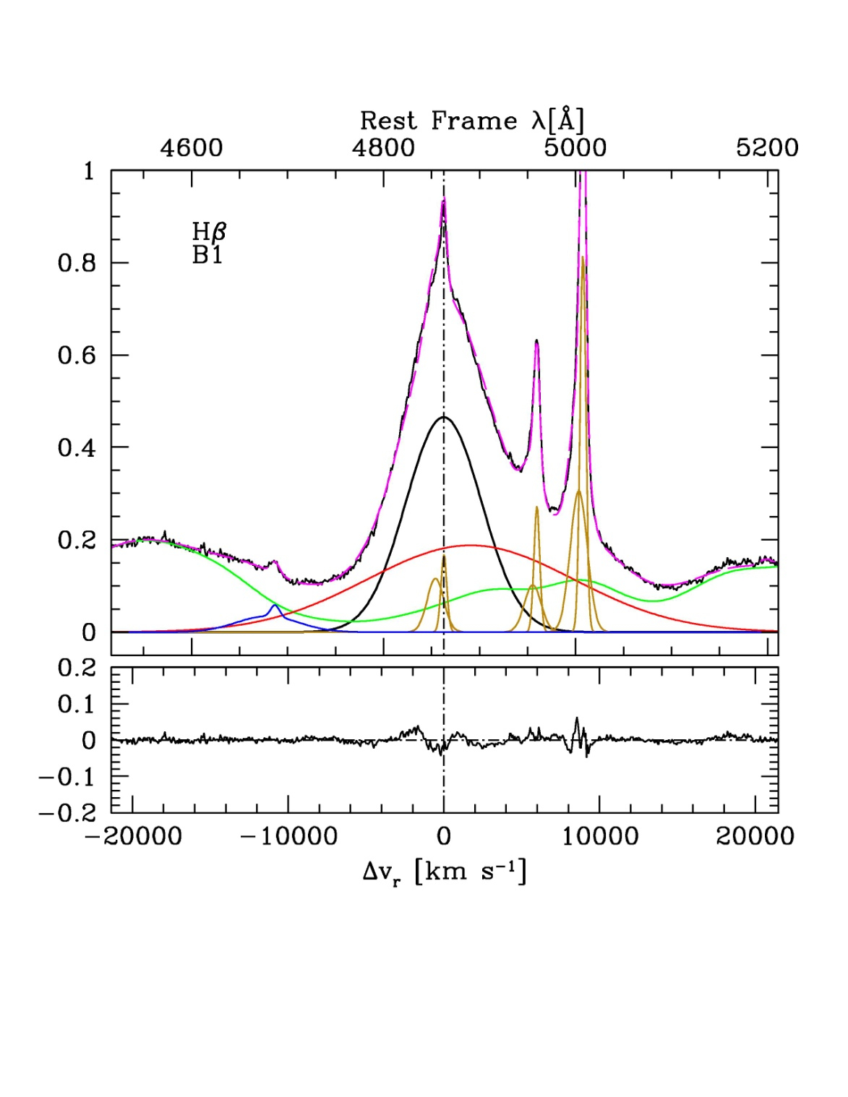

Slide 35
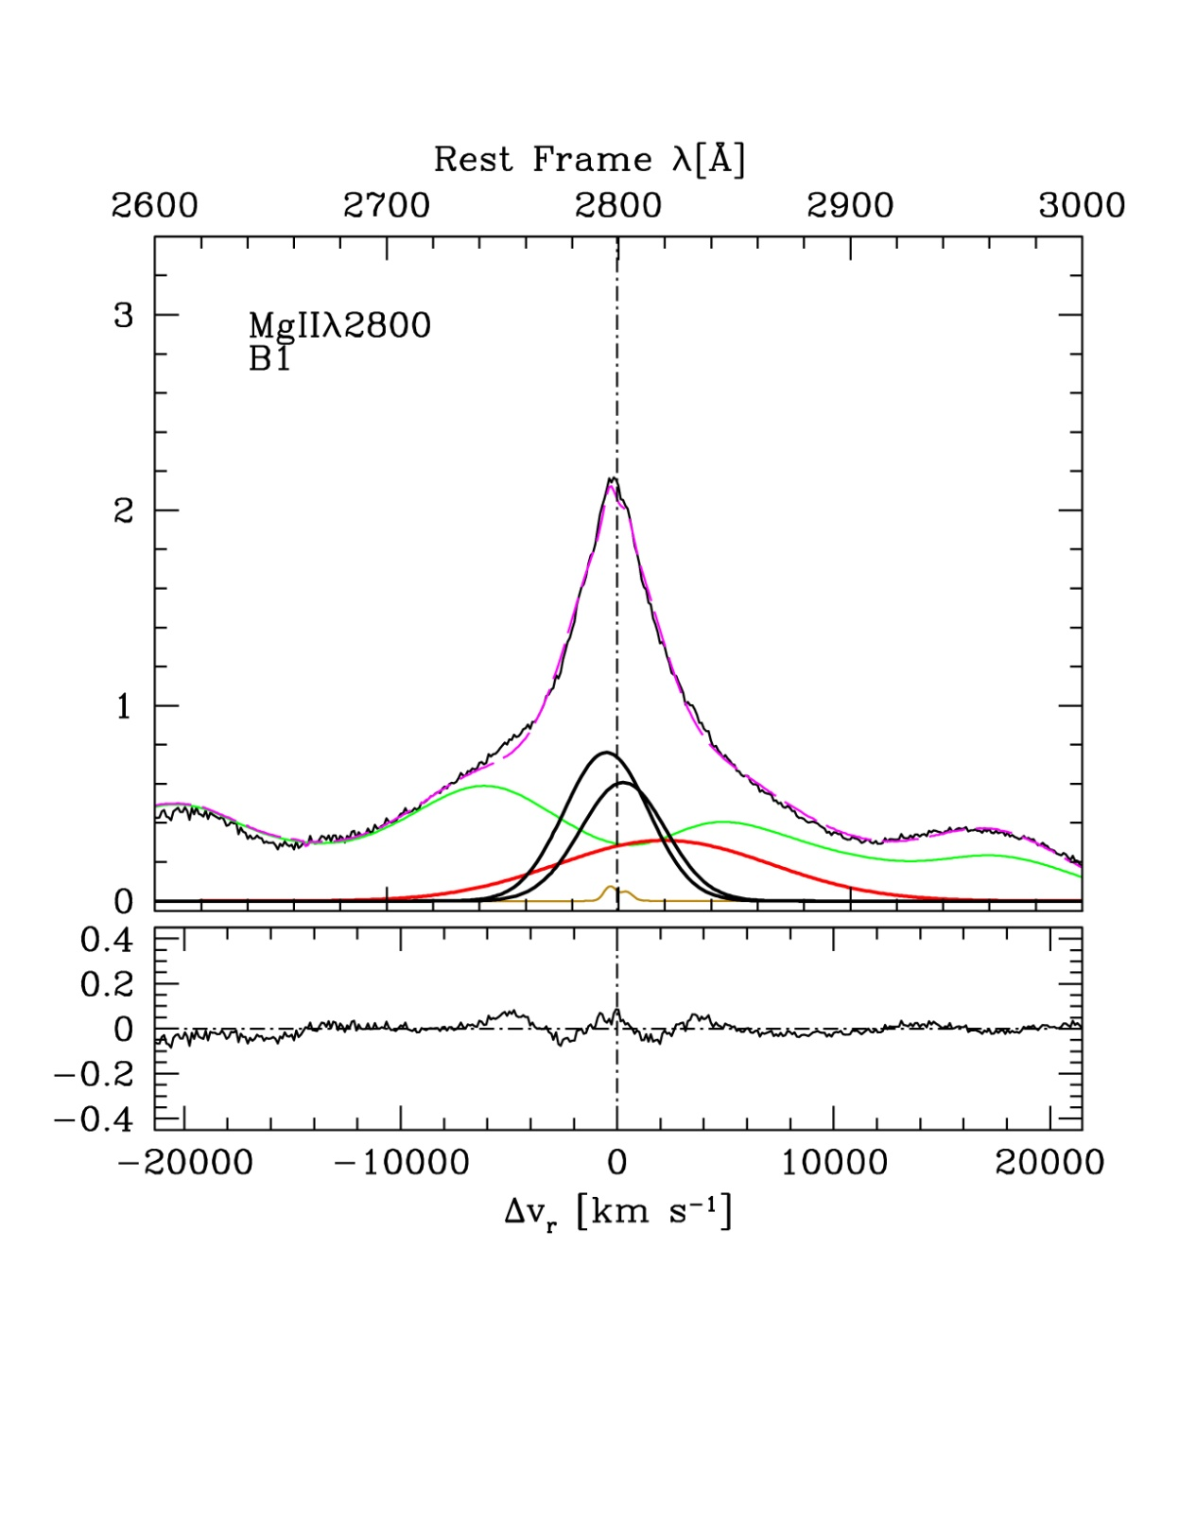

Slide 36
Pop B virial estimators
Both Hβ and MgII require correction for (nonvirial) VBC
FWHM Hb = 1.2 FWHM MgII

Slide 37
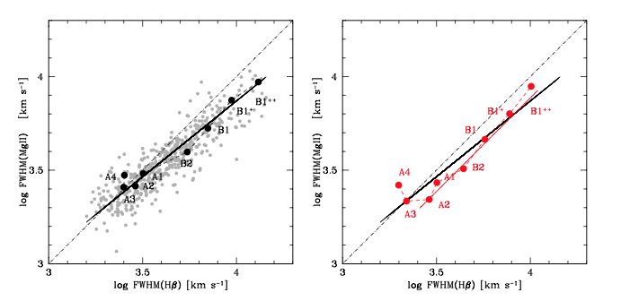

Slide 39
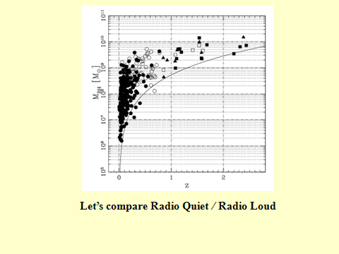

Slide 40
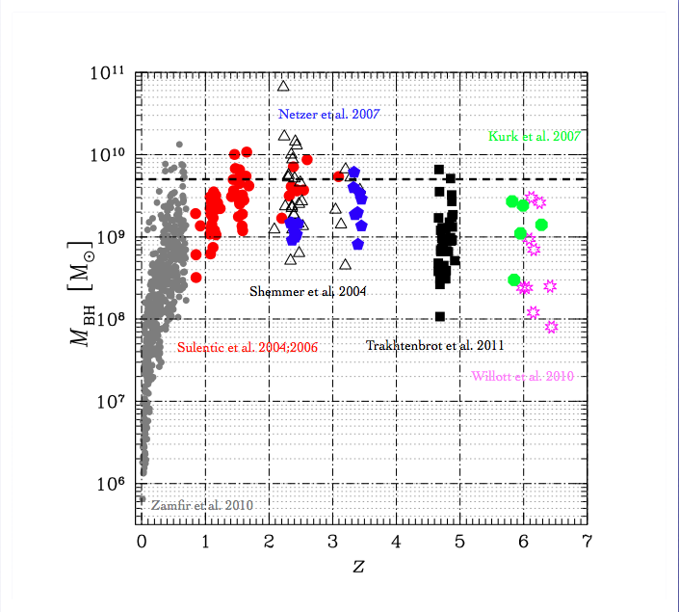

Slide 41
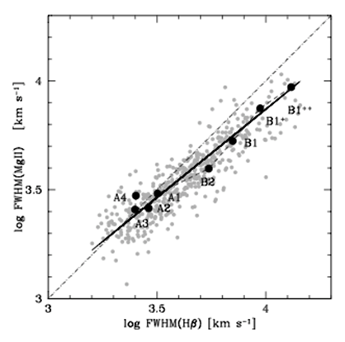

Slide 42
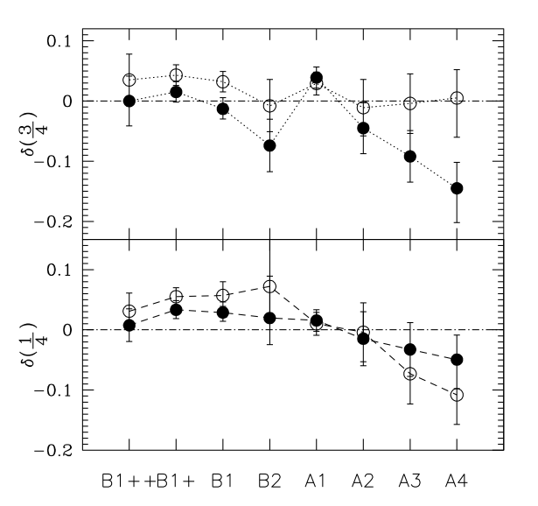

Slide 43
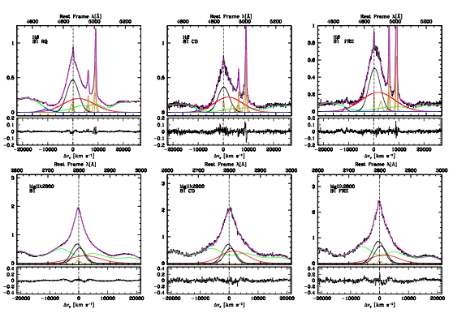

Slide 44
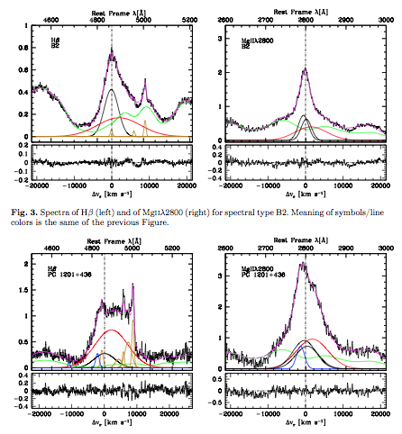

Slide 45
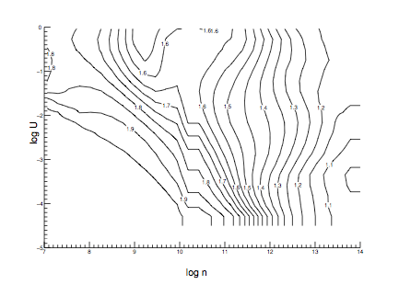

Slide 47
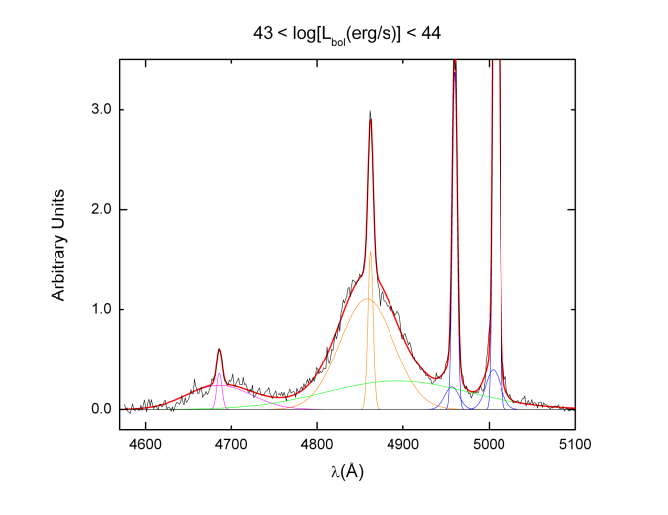
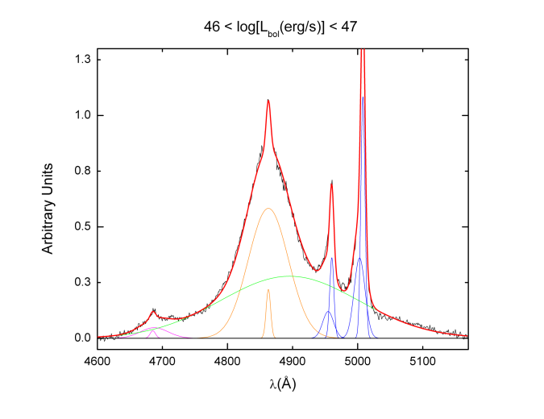
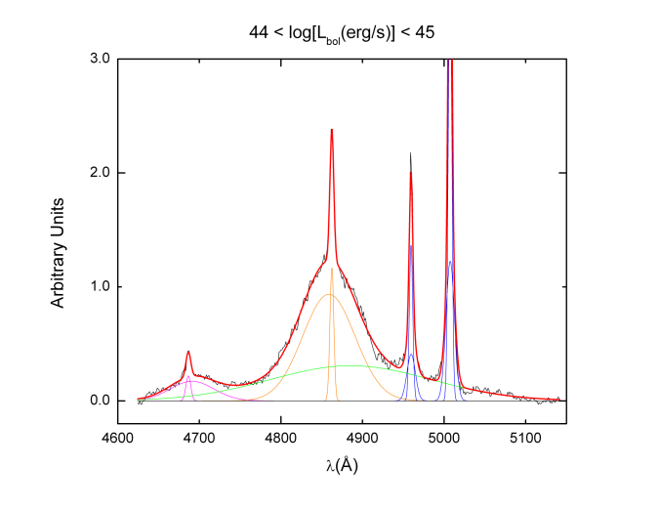
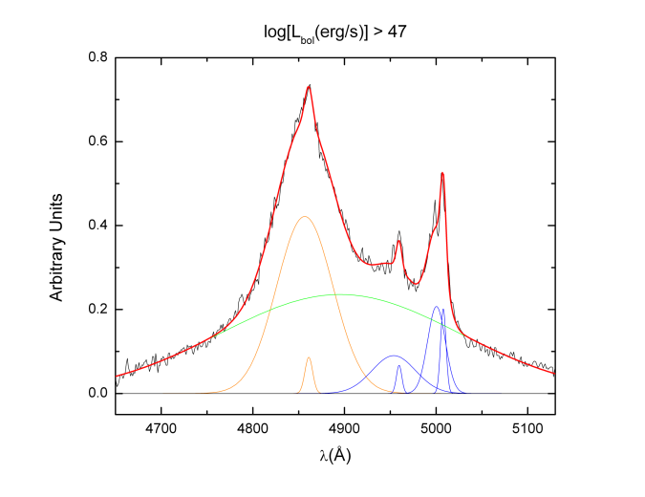
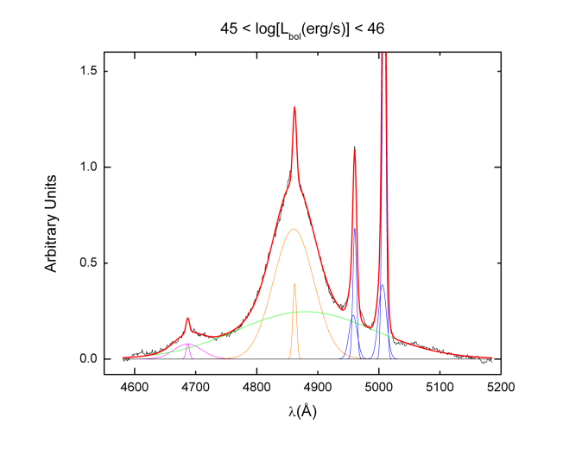
BC
VBC

Slide 48
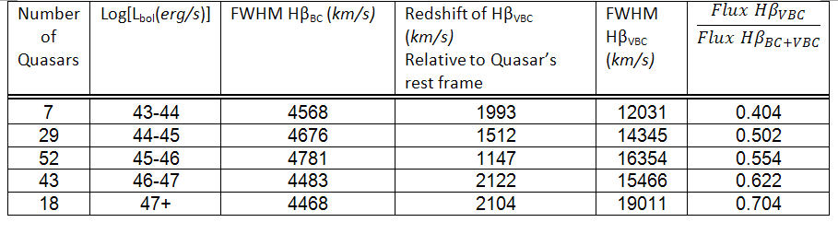

Slide 49
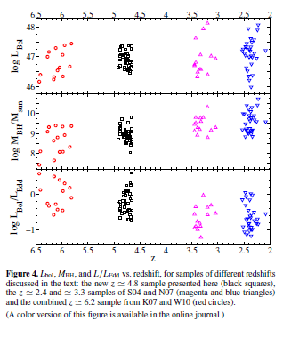

Slide 51
Why Spectra of the Hbeta Region?
Uniform BH mass and L/L_EDD estimation
FeII strength at high z
Hbeta and [OIII]5007 as BLR/NLR templates

Slide 52
Notes:
Assumes fixed/stable BC

Slide 55
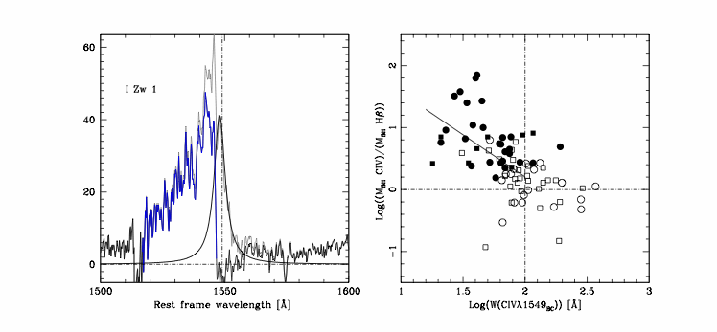

Slide 57
So we have “v” -- ways to estimate BLR size
Directly: reverberation mapping
(Peterson & Horne 2006)
Using r_BLR vs. Luminosity relation
(Marziani et al. 2009: Trachtenbrot et al. 2011)
Photoionization Method
(Dibai 1984; Wandel & Yahil 1985; Padovani & Rafanelli 1989; Wandel et al. 1999; Negrete et al. 2011)

Slide 58
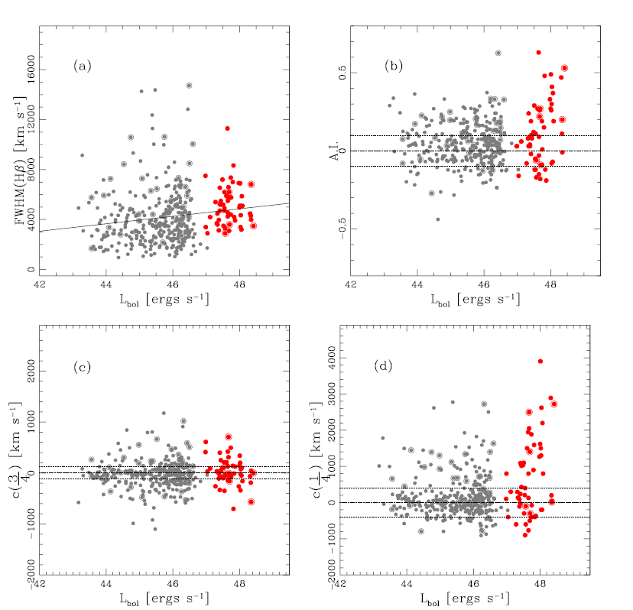

Slide 59
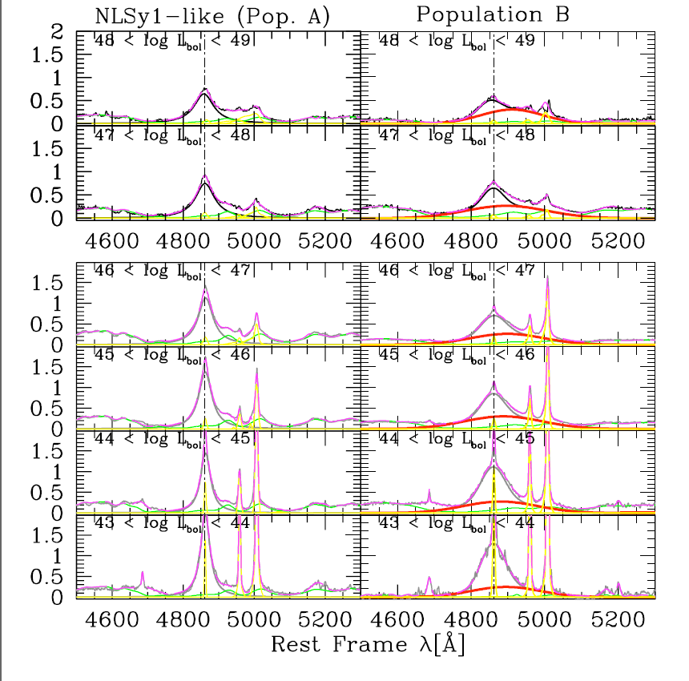

Slide 60
(Kaspi et al., 2000; 2005)

Slide 61
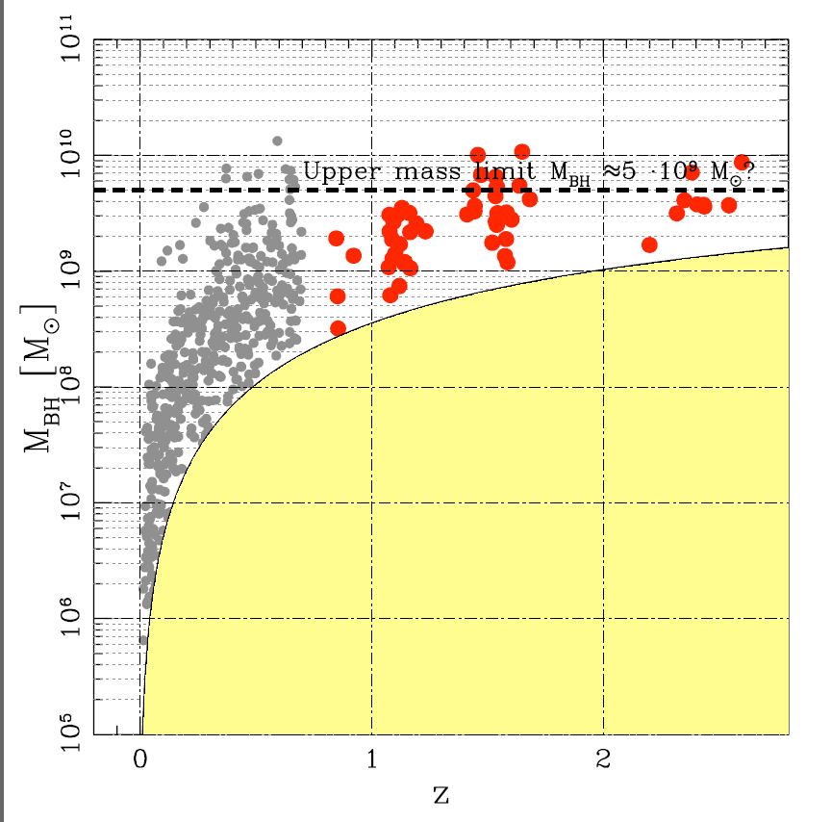

Slide 62
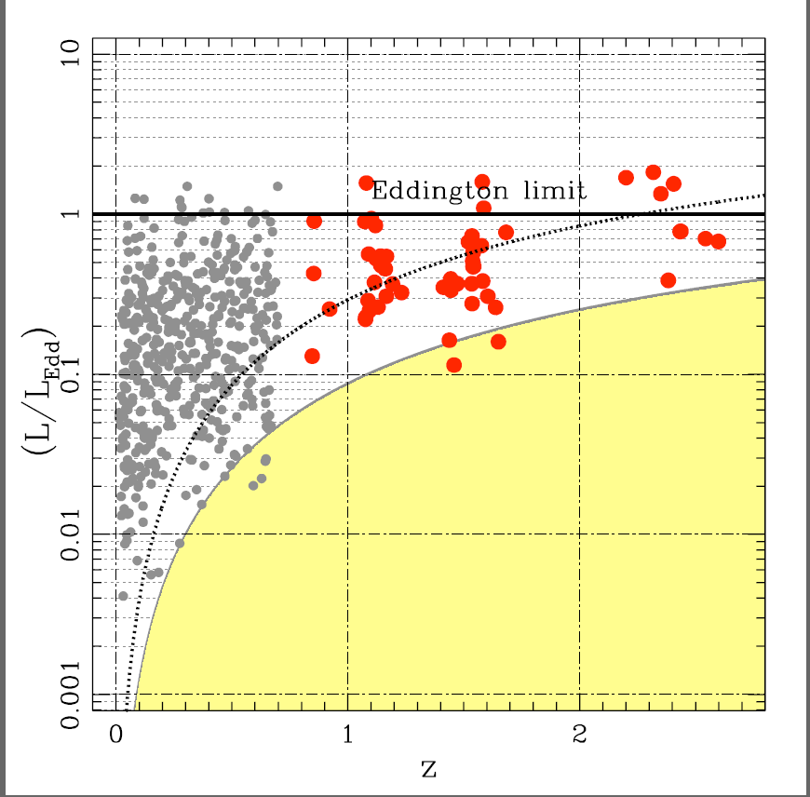
Notes:
Limit curves B~~16.5 and 17.5 surveys

Slide 63
BC
VBC

Slide 67
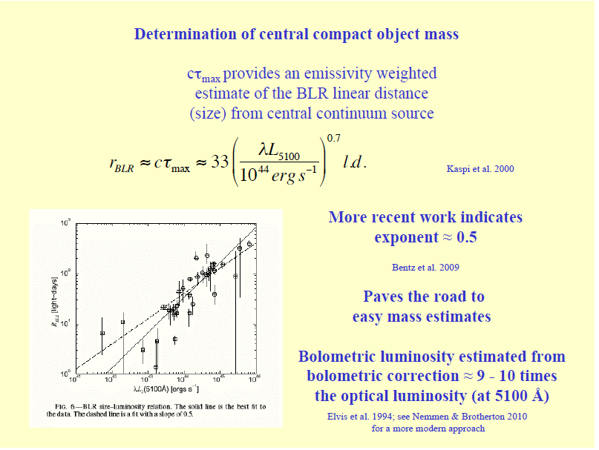

Slide 68
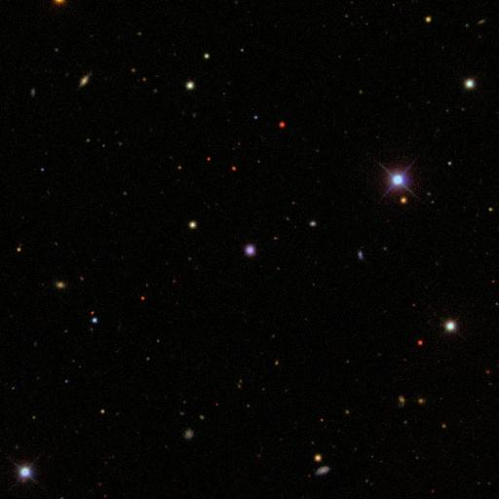

Slide 69
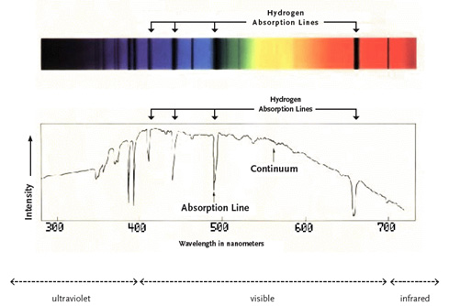

Slide 70
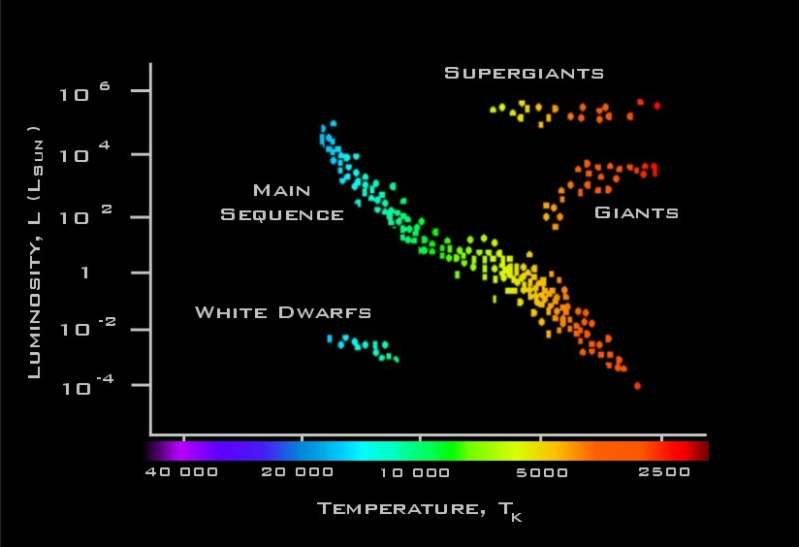

Slide 72
BEFORE AVERAGING SPECTRA
A CONTEXT THAT UNIFIES SPECTROSCOPIC DIVERSITY
MULTI-WAVELENGTH
MULTI-DIMENSIONAL
TO REMOVE DEGENERACY BETWEEN PHYSICS AND ORIENTATION

Slide 73
EIGENVECTOR 1 PARAMETER SPACE
FWHM H_{β}
_{velocity dispersion of LIL}
EW (FeII Optical) / EW (Broad H_{β}) (R_{FeII})
ratio of LIL with opposite density dependences
Soft X-ray Photon Index (Γ_{soft})
_{thermal emission signature}
CIV λ1549 Broad Line Shift
_{systematic motions of HIL}
Precursors:
Boroson & Green (1992); Boller et al. (1996); Marziani et al. (1996); Wang et al. (1996);Laor et al. (1997)

Slide 74
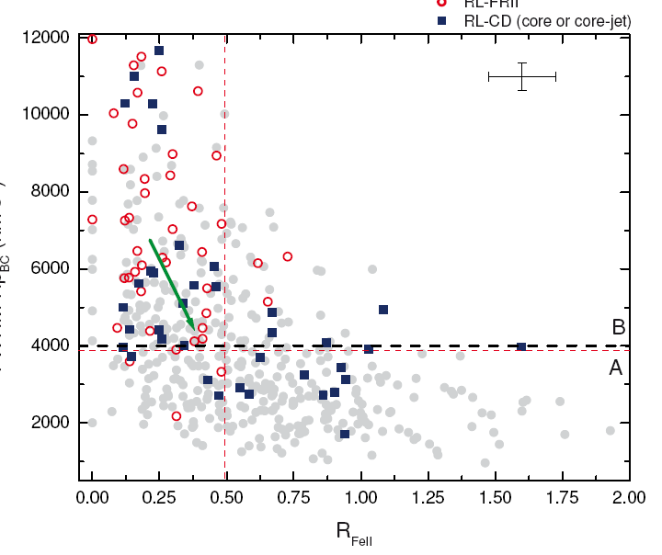
Notes:
CD—blue spillover due to face-on orientation?
LD—red A few misaligned jets

Slide 75
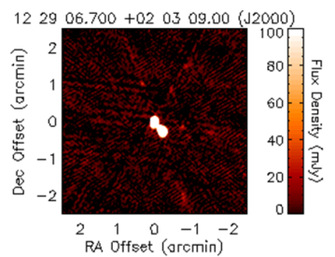

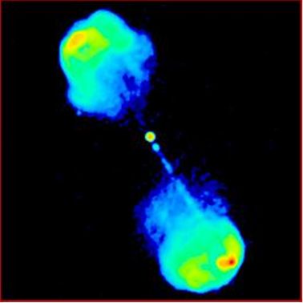

Slide 76
DICHOTOMY
Population A: strong/moderate FeII, HIL blueshift/asymmetry, soft X-ray excess, radio quiet, symmetric Lorentzian LILs
Population B: weak/moderate FeII, no HIL blueshift or soft X-ray excess, mixed RL-RQ, double Gausssian LILs

Slide 78
(Kaspi et al., 2000; 2005)

Slide 82
Notes:
Limit curves B~~16.5 and 17.5 surveys

Slide 85
POPULATION A
LIL FWHM~~600—4000km/s
Lorentzian profile—AD—virial estimator?
HIL blueshift/asymmetry – disk wind?
Soft X-ray excess – thermal disk signature?
Strong/moderate FeII –dense BLR?
Small M_BH
High L/L_Edd

Slide 86
BIN A1 MEDIAN

Slide 87
POPULATION B
LIL FWHM~~4-8000km/s
Double Gaussian LIL profile—no virial?
No HIL blueshift—no AD wind—no AD?
Weak/moderate FeII—lower n_e BLR?
No soft X-ray excess—no AD?
Larger M_BH
Smaller L/L_Edd

Slide 88
BIN B1 MEDIAN

Slide 89
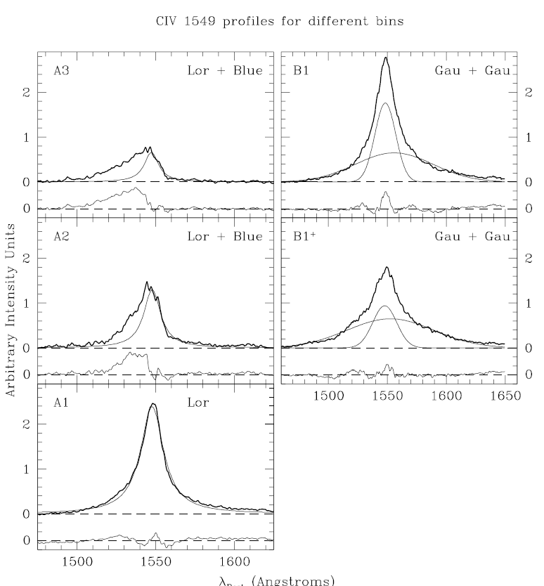
AVG. CIV PROFILES

Slide 91
Notes:
Assumes fixed/stable BC

Slide 93
Notes:
Limit curves B~~16.5 and 17.5 surveys

Slide 94
BIG QUESTIONS?
Why a Pop. A-B dichotomy?
A rather abrupt change in most observed properties.
A critical Eddington ratio that drives BLR structure?

Slide 95
BIG QUESTIONS?
What is the VBLR emission component?
Redshifted ~~10^3km/s
Very broad ~~10^4km/s
Grav z? or infall? or scattering?

Slide 96
AMIGA COUNTERPOINT:
QUASARS
ESO VLT ISAAC Spectroscopy
Estimating BLACK HOLE Masses
Out to z~~3.0
An upper limit at log M_BH~9.5?

