Slide 1
LYMAN-ALPHA BLOBS COMOVING NUMBER DENSITY AND COLD GAS ACCRETION MODE
9th SCSLSA
Marijana Smailagić¹,
Milan Bogosavljević²,
Miroslav Mićić²
¹ Belgrade University, Faculty of Mathematics,
² Astronomical Observatory, Belgrade

Slide 2
LYMAN ALPHA BLOBS
COLD ACCRETION
MODE
L_{Lyα}~10⁴³-10⁴⁴ erg/s
d ~100 kpc
z ~ 2-3 (1-6.6)
T < 2.5x10⁵ K
n < 0.13 cm⁻³

Slide 3
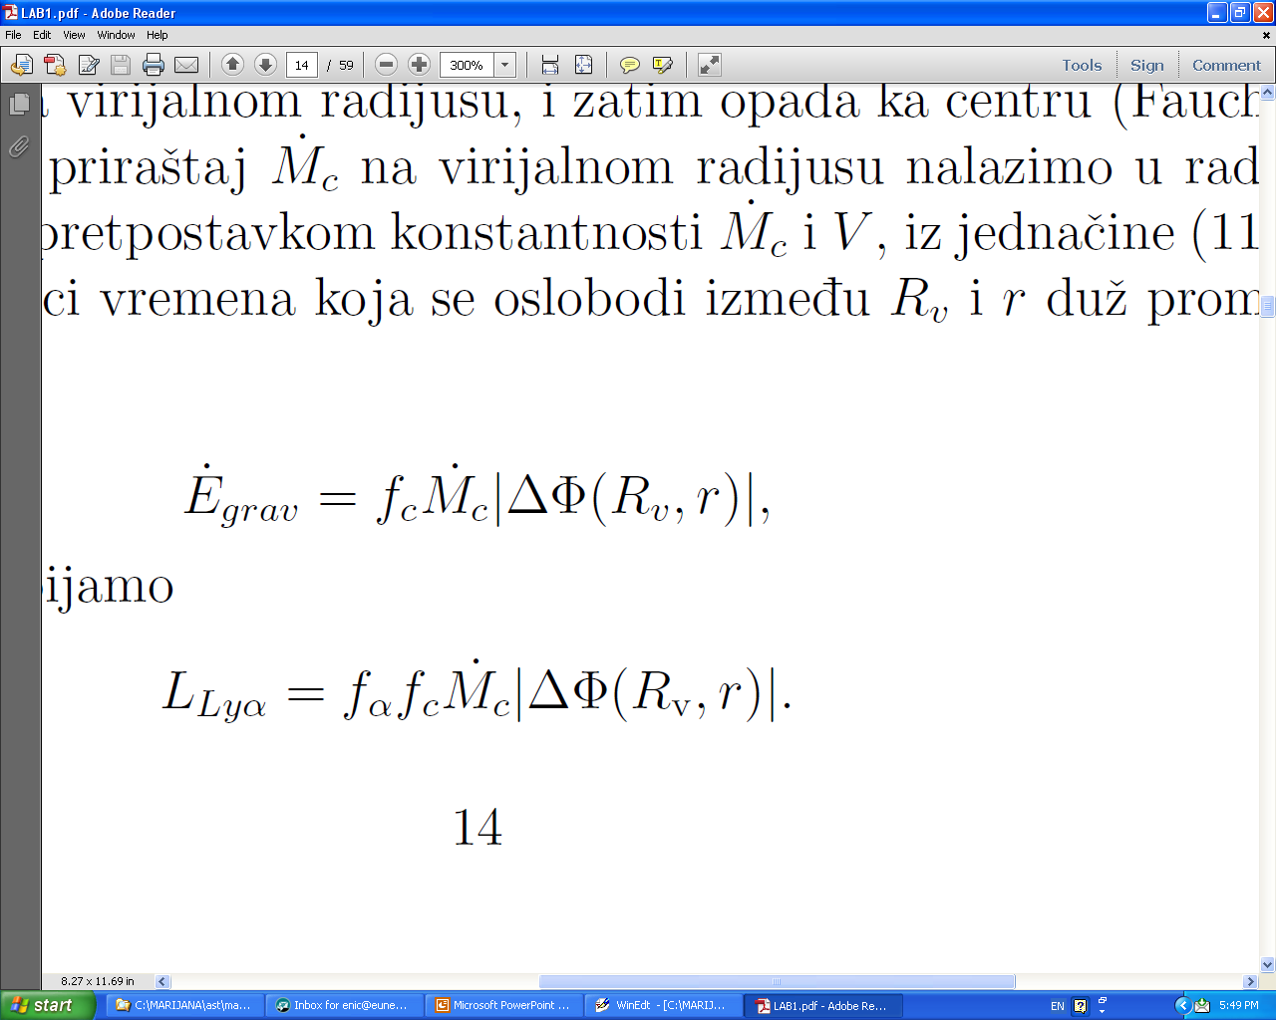
OUR MODEL
Source of energy: cold gas accretion
LAB: L > 10⁴³ erg/s, d >100 kpc
Cold gas accretion rate:
From simulation
Faucher-Giguere et al. 2011
% radiated energy that we see at Lyα
% of energy that goes to
heating the cold streams of gas
Potential difference between
virial radius and radius r
Luminosity for 4 cases:
r = 0 or 0.2R_{v} , and
f_{α}f_{c} = 0.34 or 0.10
r
R_{v}
halo

Slide 4
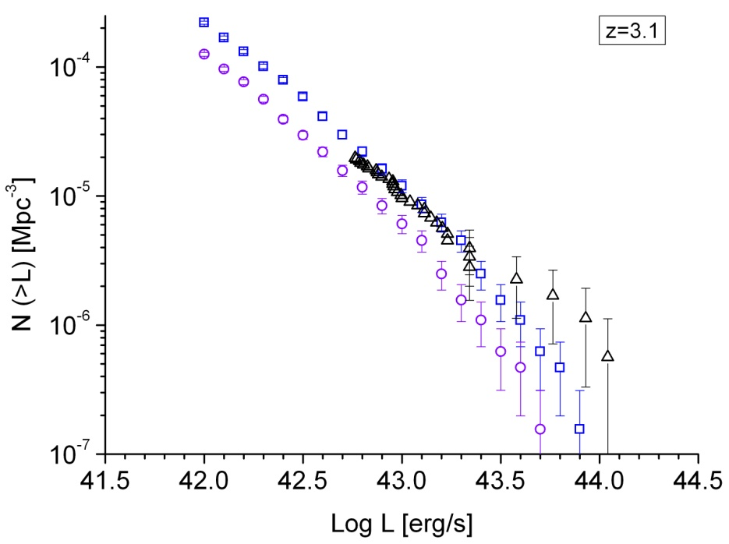
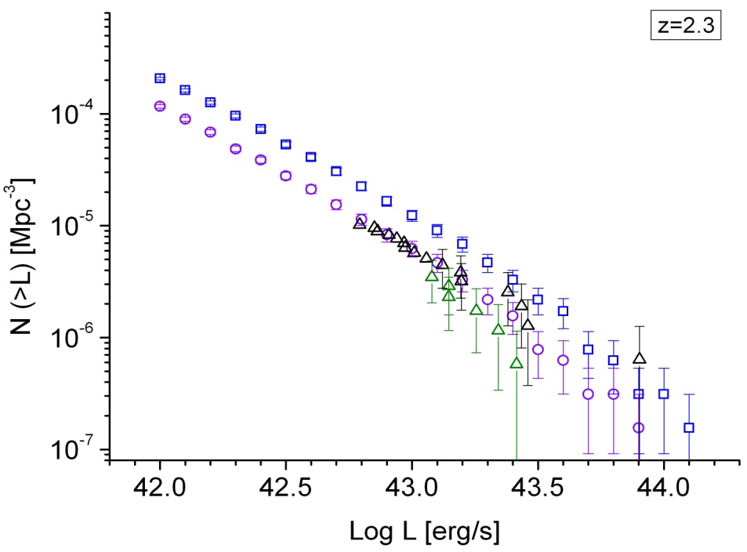
LUMINOSITY FUNCTIONS
fαfc=0.34, r=0
fαfc=0.34, r=0
fαfc=0.34, r=0.2
fαfc=0.34, r=0.2
Z=3.1
Z=2.3
observations
observations
Agreement between the slopes of luminosity functions -> could indicate that
CAM has an important role in luminosity of LABs, or that source of energy
is related to mass of halo in similar way
Agreement for different parameters -> role of other effects: dust absorption near
galaxy, different accretion rate through the radius of halo… ,
or different main source of energy

Slide 5
COMOVING NUMBER DENSITY
fαfc=0.34, r=0
fαfc=0.34, r=0.2
observations
The comoving number density of LABs in our model is in agreement with observations at z=2 to z=4, but falls below observed density at high redshift and above at lower redshifts. This could indicates that CAM is not the main source of energy of LAB at all redshifts and masses.

