Slide 1
Stark broadening data for spectral lines of rare-earth elements: Nb III
Z. Simić¹, M. S. Dimitrijević^{1,2},
L. Č. Popović¹
¹Astronomical Observatory, Volgina 7, 11060 Belgrade, Serbia
²Observatoire de Paris-Meudon, 92195 Meudon, France

Slide 2
Due to the lack of known energy levels as well as of reliable
transition probabilities for rare-earth elements, the
approximate methods are adequate for Stark broadening
calculations. Consequently the modified semiempirical
approach will be applied.

Slide 3
MODIFIED SEMIEMPIRICAL THEORY
(Dimitrijević & Konjević, 1980; Dimitrijević & Kršljanin, 1986)

Slide 4
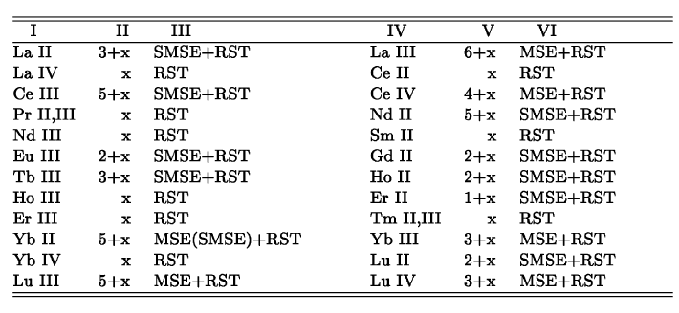
List of the ions for which we are going to calculate the electron impact broadening parameters (Popović and Dimitrijević, 1998)
Added: Nb II and Nb III

Slide 5
Energy levels are taken from:
Physica Scripta. Vol. 57, 45-65, 1998
Spectrum of Doubly Ionized Niobium (Nb III)
R. R. Gayazov, A. N. Ryabtsev and S. S. Churilov
“The spectrum of doubly ionized Nb is recorded in the region 900-2512 Å”
Here, we calculated Stark widths for 20 Nb III spectral lines, for example:
5s (3F) ⁴Fº_{5/2} - 5p (3F) ⁴Dº_{7/2} 2228.832 Å
5s (3F) ⁴Fº_{5/2} - 5p (3F) ⁴Dº_{5/2} 2244.216 Å
5s (3F) ⁴Fº_{5/2} - 5p (3F) ⁴Dº_{3/2} 2275.236 Å

Slide 6
N=10+17cm-3
Transition (2275.9, 2244.9, 2229.5) Å
T(K) w_{2275.9}(Å) w_{2244.9}(Å) w_{2229.5}(Å)
10000 0.7334D-01 0.7145D-01 0.7051D-01
20000 0.5186D-01 0.5053D-01 0.4986D-01
50000 0.3280D-01 0.3196D-01 0.3153D-01
100000 0.2374D-01 0.2312D-01 0.2282D-01
200000 0.1947D-01 0.1896D-01 0.1872D-01
300000 0.1872D-01 0.1823D-01 0.1801D-01

Slide 7
Thank you
for
attention!

