Slide 1
Relative deviation of QSO spectra induced by microlensing on diffusive massive substructure
Saša Simić¹ and Luka Č. Popović^{2,3}
Faculty of Science, University of Kragujevac, Radoja Domanovića 12, 34000 Kragujevac
Astronomical Observatory, Volgina 7, 11000 Belgrade
Faculty of Mathematics, University of Belgrade, Studentski trg 16, 11000 Belgrade

Slide 2
Outline
  To estimate the influence of microlensing of star clusters on the QSO objects. To see whether this effect can be measurable.
  Source
    Extended source
    Spectral energy distribution
    Define the observational band
  Constructing the lens – basics of ray tracing/shooting method
  Results:
    Magnification maps, source image
    Influence as a curves of magnification and centroid shift
  Prospects for testing the influence on the spectral lines – future work.

Slide 3
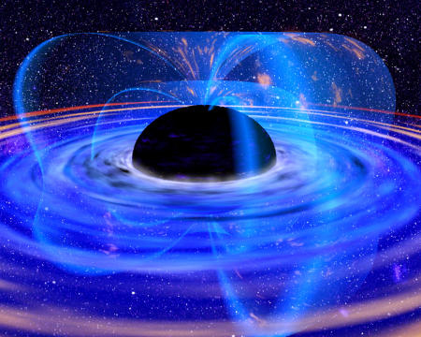
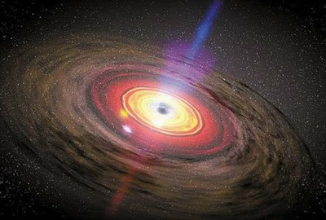
Source model
AGN core – accretion disc – jets formation
Accelerated material radiate in wide energy band

Slide 4
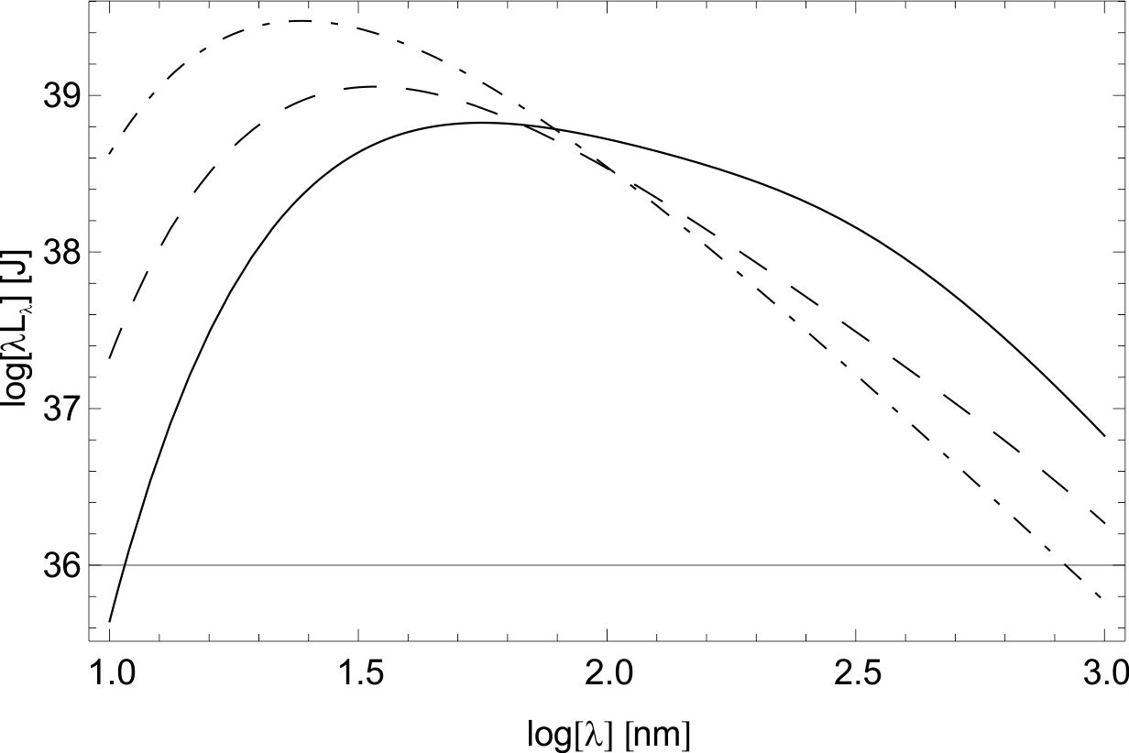
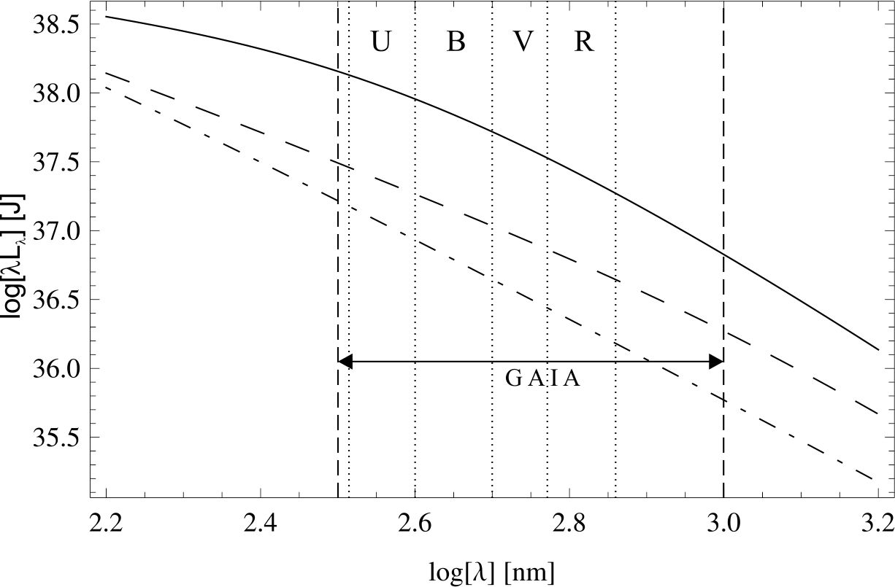
Source model
Disc properties (Pringle & Rees 1972; Shakura & Sunyaev 1973; Novikov & Thorne 1973):
  standard relativistic
  opticaly thick
  geometrically thin
  black body disc

Slide 5
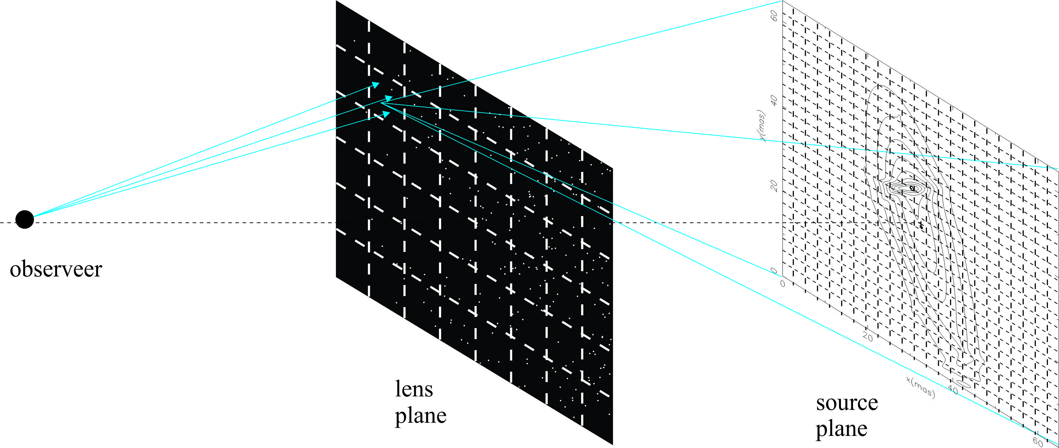
Lens model
Sun like stars – uniformly distributed
Compact star clusters
Ray shooting method
Extended source – divide source plane
  any point of source has omnidirectional emission and particular SED
  we sum all of those which fall on the observer point.

Slide 6
Parameters of source and lens
Accretion disc – R_{in}=10¹⁵cm, R_{out}=10¹⁷cm.
Disc temperature – T = 20000K at R = 10¹⁵cm. (Blackburne et al., 2011)
Source plane around 40ERRs.
Lens – source system: z_{d} = 0.5 and z_{s} = 2.0
Lens dimension ~ 0.3pc
Number of stars in lens: 40 – 240 Solar mass.

Slide 7
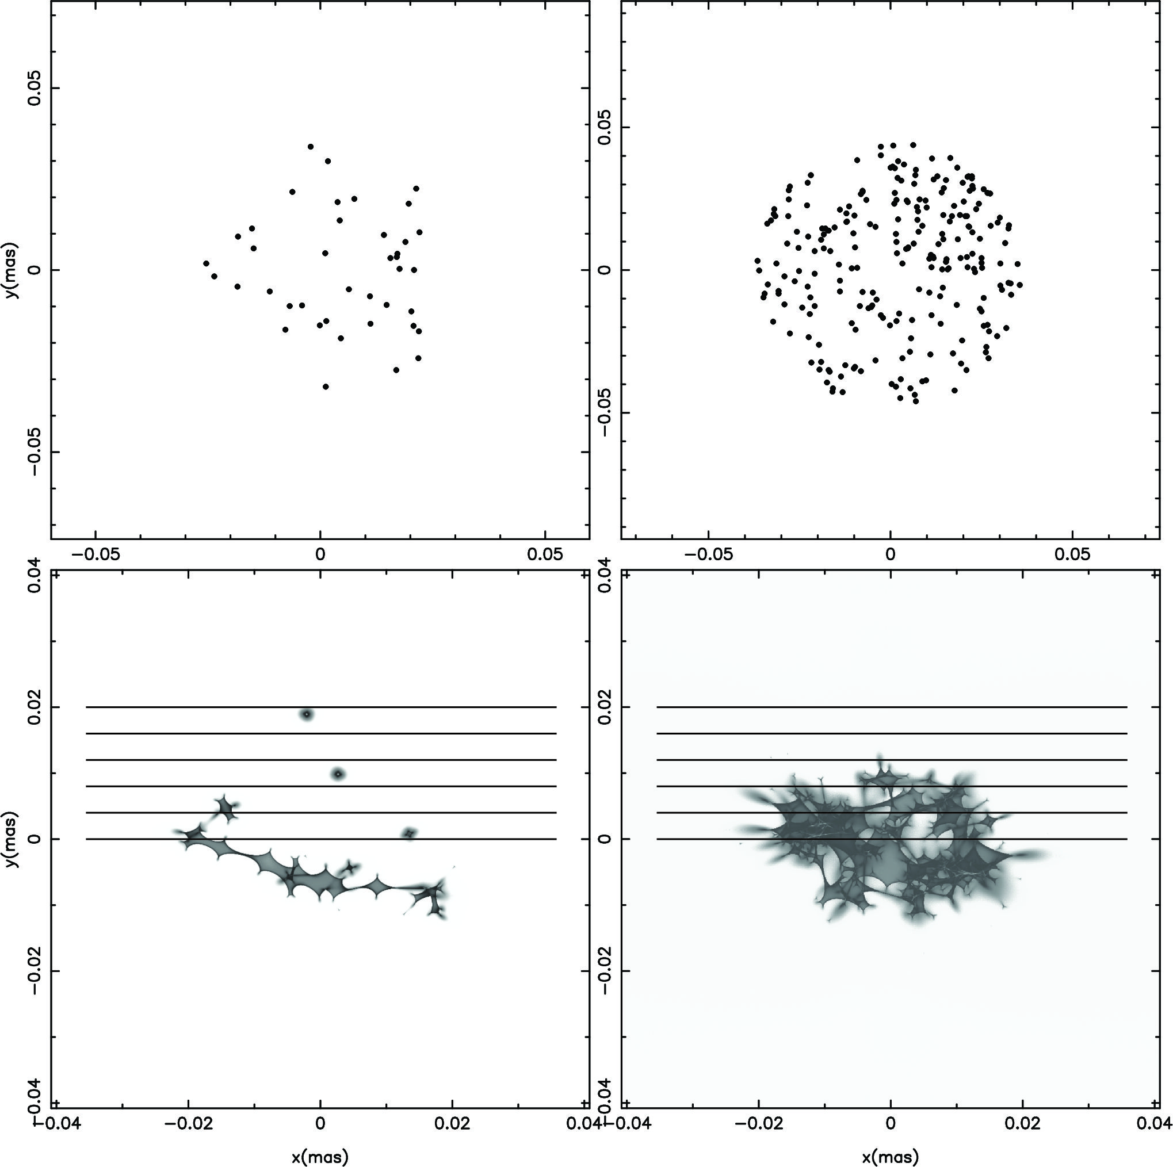
Results
Two different cases of lens population with 40 ond 240 stars (top row).
Their appropriate magnification maps (below).
Horizontal lines show the trajectories during the microlensing event of source over the lens.
Why do we choose given star number range?

Slide 8
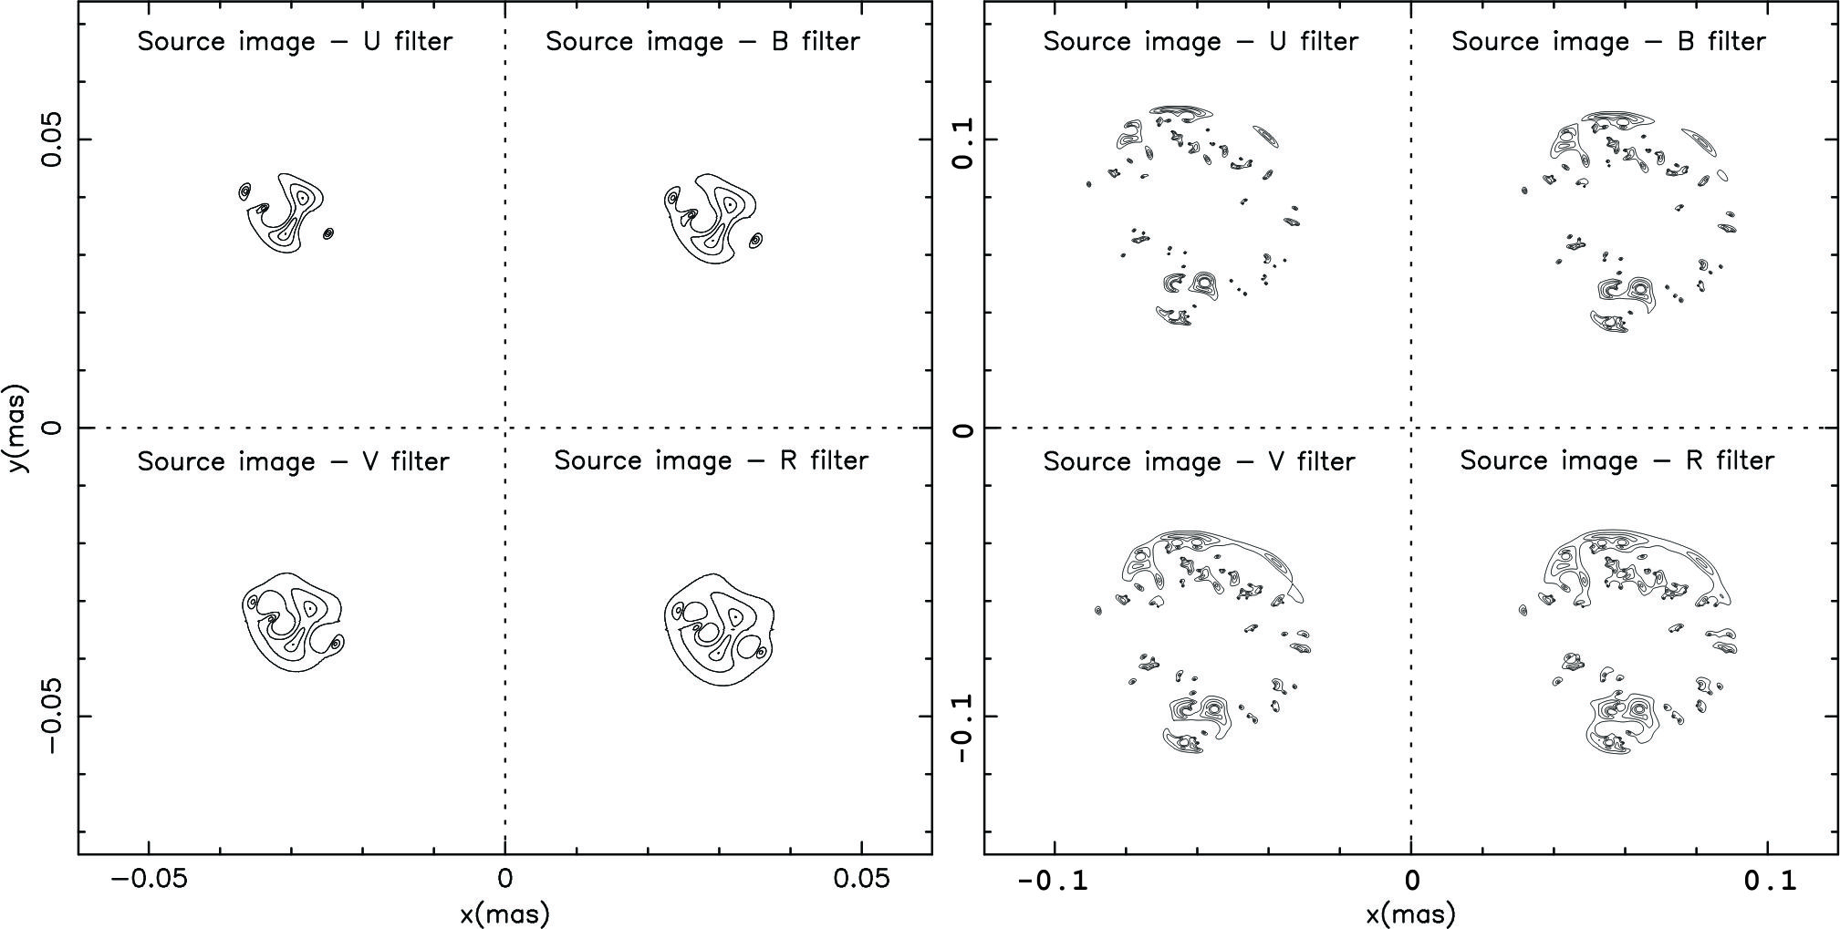
Results
Images of source in UBVR energy channels. Left panels are for n_{stars} = 40 and right is for n_{stars} = 240. At arbitrary position during the passing.

Slide 9
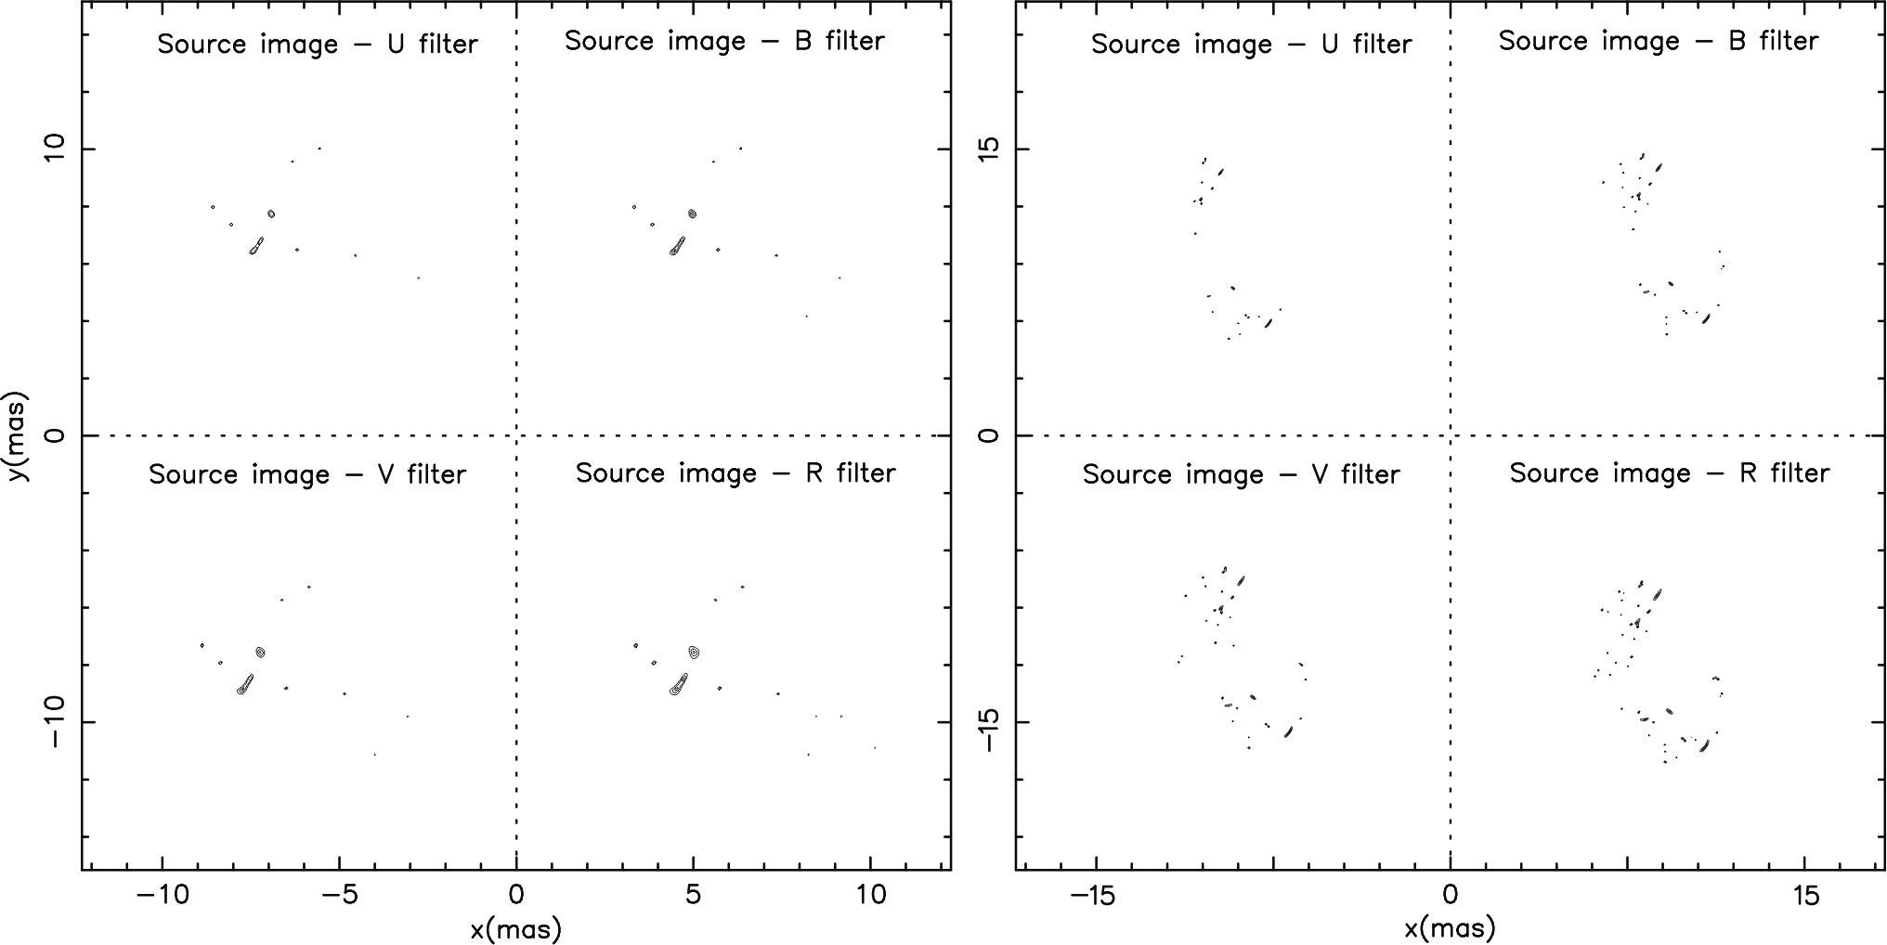
Results
Same, but for the closser lens at z_{d} = 0.01.
Dispersion of components is more expressed.

Slide 10
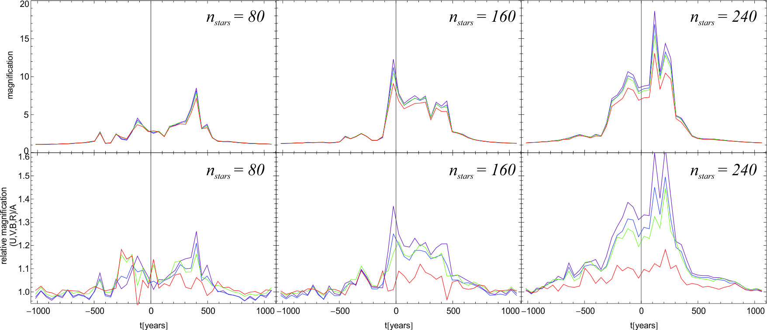
Results
Curves of magnification during the event for different cluster population.
U band – highest, then B, V and R – lowest magnification.
Calculations are made for the lens – source on the line of sight.

Slide 11
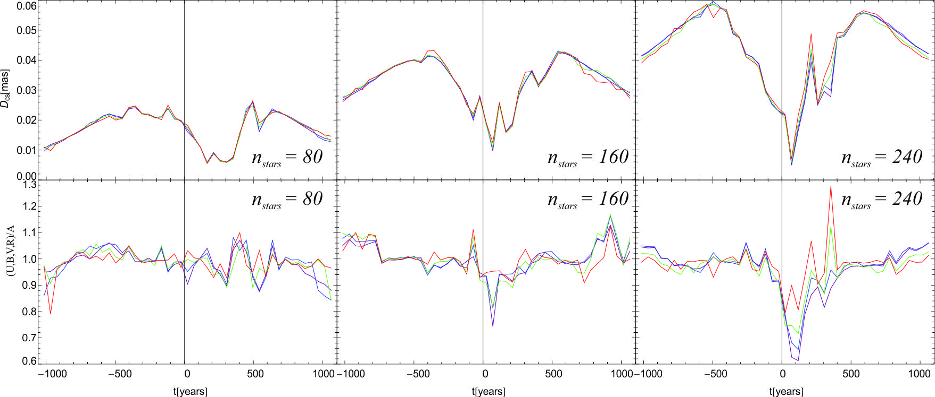
Results
Same as in previous slide but for photo-center displacement.
First row absolute, second relative to entire observational band.
Displacement present almost equally in all bands.

Slide 12
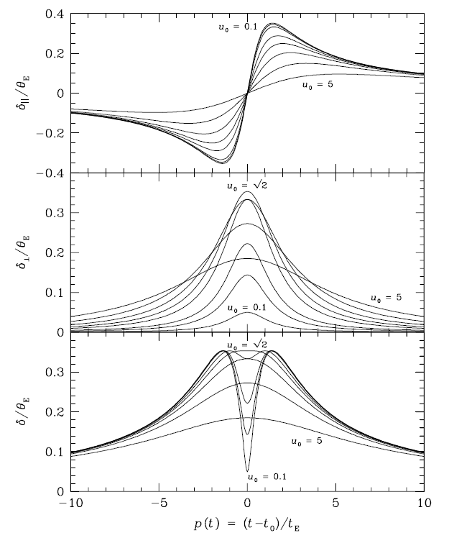
Results
Same as in previous slide but for photo-center displacement.
First row absolute, second relative to entire observational band.
Displacement present almost equally in all bands.
Dominik & Sahu, 2000.

Slide 13
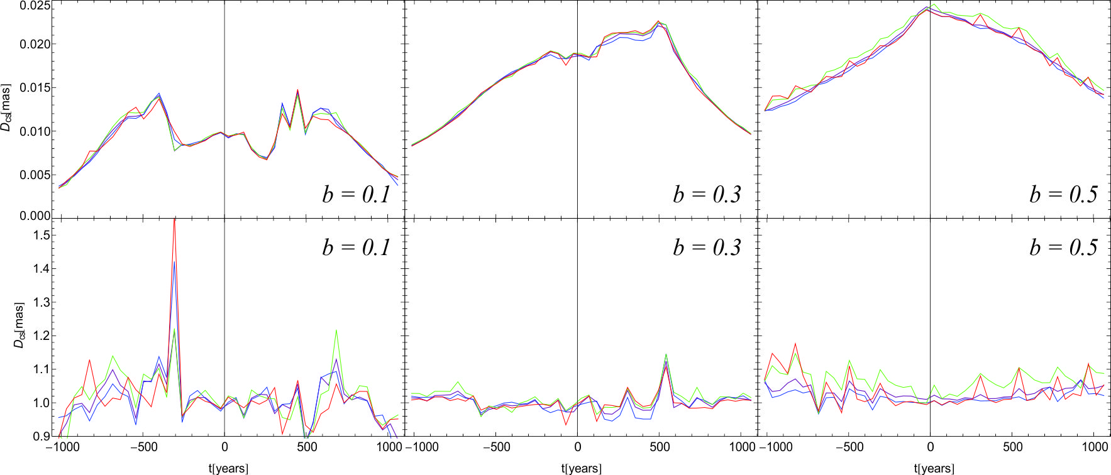
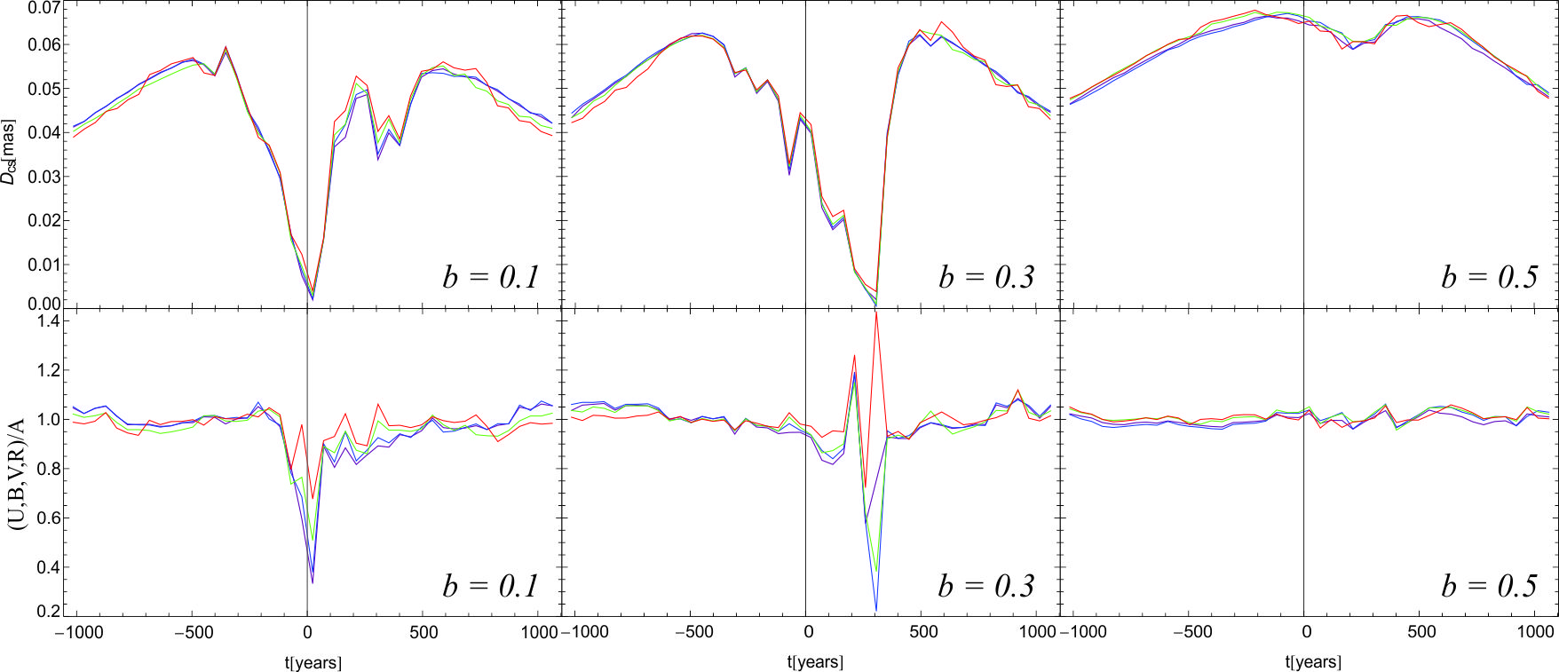
Results
Centroid shift for the case of 40 (up) and 240 (down) stars in the cluster.
Impact parameter b

Slide 14
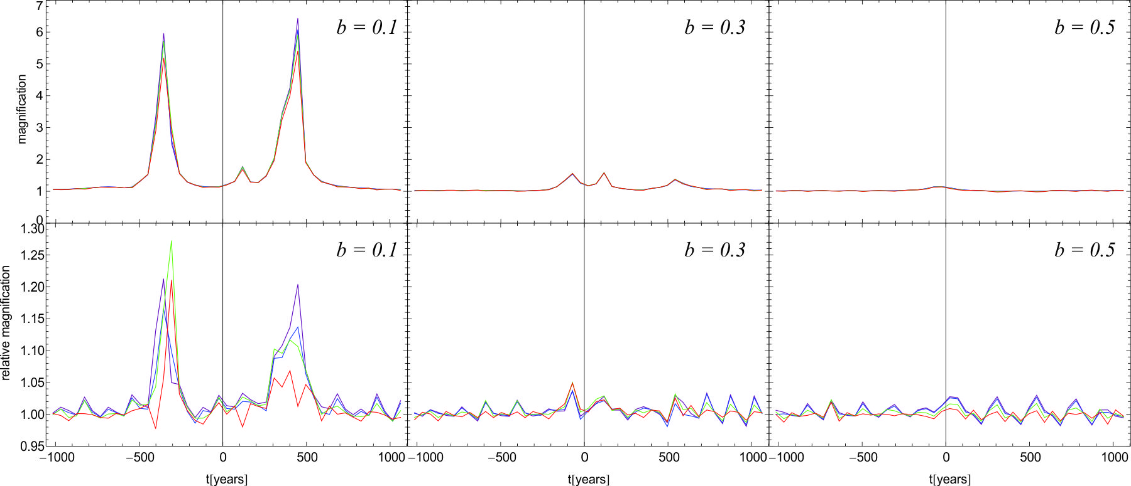
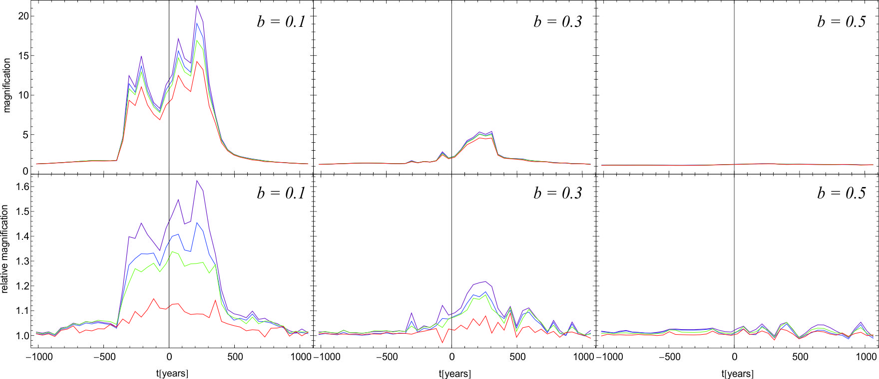
Results
Magnification for the case of 40 (up) and 240 (down) stars in the cluster.
Variability is lower for the more offcenter transitions.

Slide 15
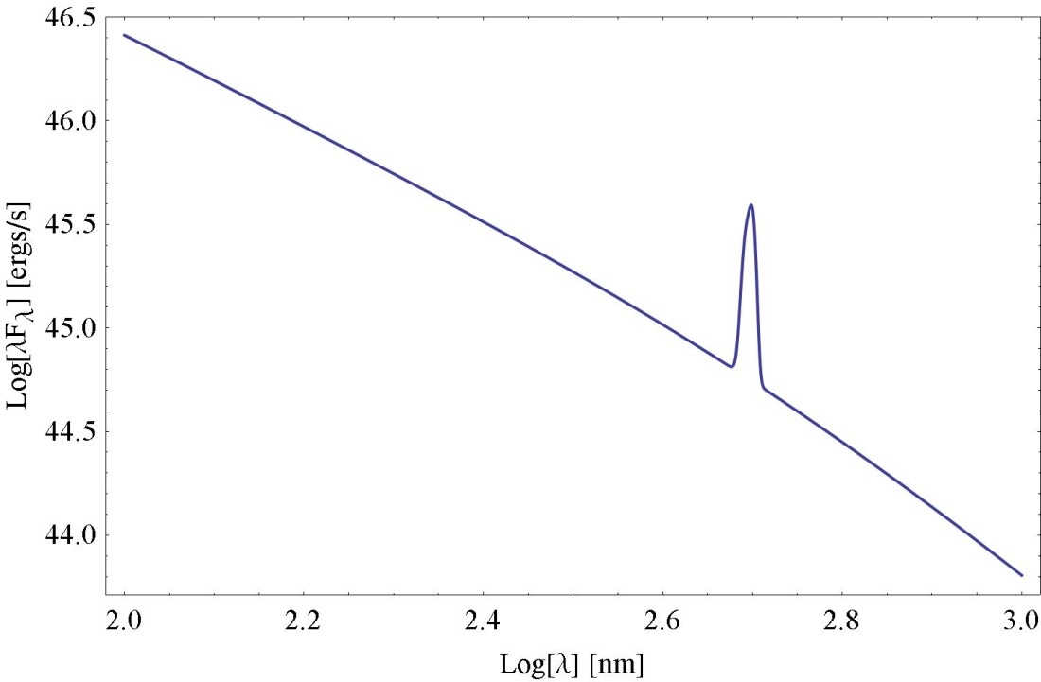
Effect on spectral lines
We assume that spectral lines are generated in BLR around the AGN.
We use the Gaussian line shape with intensity L_{line} and Doppler width W.
We expect change in intensity and different from continuum emission.
Kaspi et al., 2005. Bentz et al., 2006.

Slide 16
Thank you!
Novikov, I. D., Thorne, K. S., 1973, in DeWitt, C., DeWitt, B., eds, Black Holes. Gordon and Breach, Paris, p. 343
Shakura, N. I., Sunyaev, R. A., 1973, A&A, 24, 337
Pringle, J. E., Rees, M. J., 1972, A&A, 21, 1
Blackburne, J. A., 2011, astroph 1007.1665.v2
Simić, S. & Popović, L.Č., 2013, MNRAS, doi:10.1093/mnras/stt498
Dominik, M. & Sahu, K.C., 2000, ApJ, 534, 213
Kaspi , S., 2005, ApJ, 629,61.
Bentz, M.C., 2006, ApJ, 644,133.

