Slide 1
9th SCSLSA
Study of the Si IV emission lines in the UV spectra of 21 HiBALQSOs
E. Lyratzi*, E. Danezis*, D. Stathopoulos*,
L. Č. Popović**, A. Antoniou*, M. S. Dimitrijević**,
D. Tzimeas*
* University of Athens, ** Astronomical Observatory of Belgrade

Slide 2
Active Galactic Nuclei - AGN
An Active Galactic Nucleus is defined as a compact region in the center of a galaxy, characterized by particularly high brightness in all the regions of the electromagnetic spectrum, from radio waves up to gamma rays. The galaxies hosting active galactic nuclei are called active galaxies.
It is considered that an AGN is the product of mass accumulation around a super massive black hole.
The general “group” of Active Galactic Nuclei (AGNs) includes different types of galaxies, such as Seyfert, Radiogalaxies, Quasars, Blazars etc.

Slide 3
HiBALs
High Ionization BALs (C IV, Si IV, N V)
Seyfert
Radio
galaxies
BALQSOs
(Broad Absorption Line QSOs)
LoBALS
Low Ionization BALs (MgII)
Blazars
Active Galactic Nuclei
A.G.N.
Quasars
FeLoBALs
(Absorption from Fe)
ULIRGs
Non -BALQSOs
LINERs
Markarian

Slide 4
Spectral classification of BALQSOs
HiBALs (High Ionization BALs): BALQSOs that contain strong, broad absorption troughs short-ward of high-ionization emission lines (such as C IV, Si IV, N V) and are typically identified through the presence of C IV absorption troughs.
LoBALs (Low Ionization BALs): BALQSOs that contain HiBAL features but also have absorption lines from low-ionization ions such as Mg II.
FeLoBALs: BALQSOs with excited iron absorption features (Fe II).
Non – BALs: BALQSOs with no broad absorption troughs just blueward of the C IV and Mg II emission lines.
Notes:
4

Slide 5
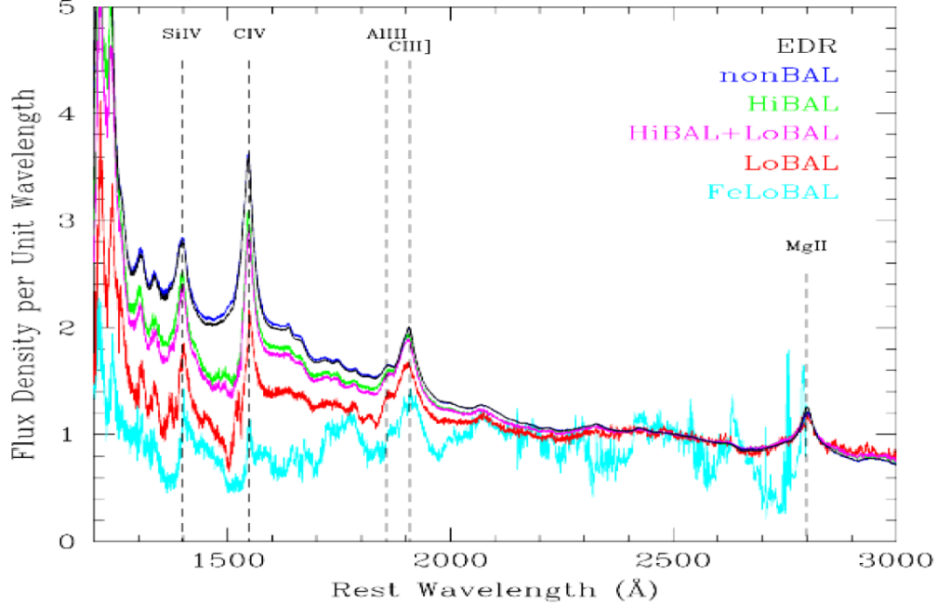
Spectral classification of QSOs (Reichard et al. 2003)

Slide 6
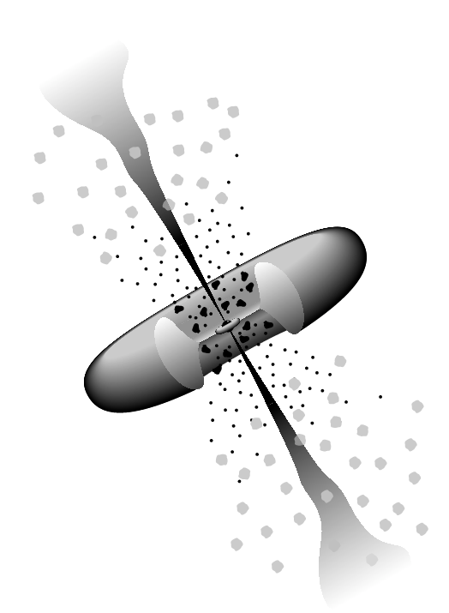
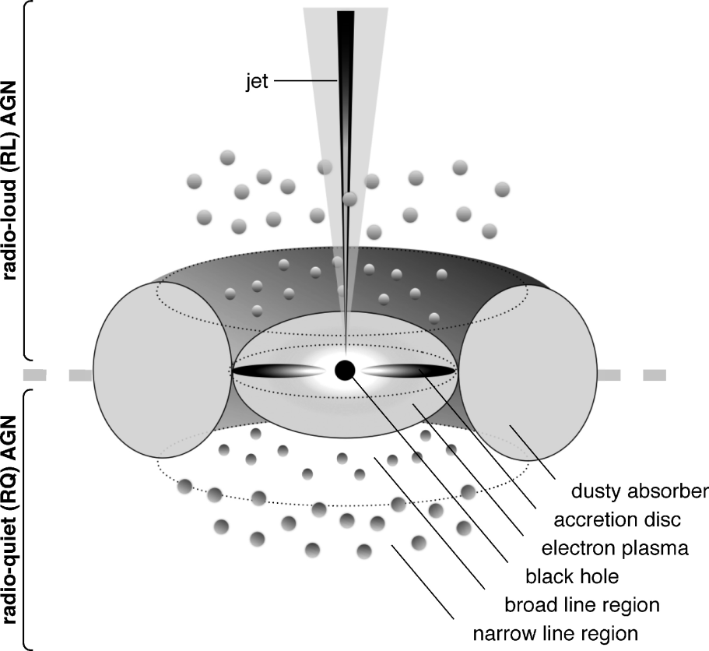
6. Narrow Line
Region Clouds
Structure
1. Black Hole
3. Jet
Black Hole
Accretion Disk
Jet
Broad Line Region Clouds
Torus
Narrow Line Region Clouds
5. Torus
4. Broad Line
Region Clouds
2. Accretion Disk

Slide 7
The broad emission lines
The broad emission lines that we observe in the optical and UV spectra of AGNs are produced in partially ionized gaseous clouds (Broad Line Clouds), which move rapidly (v>10.000 Km/sec) in the gravitation field of the black hole. This means that the broad emission lines are created in a region which is not homogeneous. [Caroll, B. and Ostllie, D. 2006, An Introduction to Modern Astrophysics (2nd Edition)]. This region, which is formed by the Broad Line Clouds is called Broad Line Region (BLR) and is relatively close to the nucleus.
Broad Line
Clouds
Broad Line
Region

Slide 8
Subgroups of Emission lines
In the spectra of HiBAL QSOs we detect emission lines separated in two subgroups.
Simple Emission lines (disk model or a classical distribution, such as Gauss, Lorentz and Voigt )
Multi-component emission lines

Slide 9
Simple Emission lines
The first subgroup of emission lines includes lines with simple profiles that we can fit using the accretion disk model or a classical distribution, such as Gauss, Lorentz or Voigt.

Slide 10
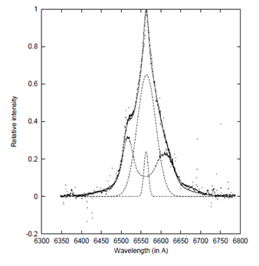
Multi-component Emission Lines
The second subgroup of emission lines includes complex lines that cannot be simulated using only the accretion disk model. This means that the line profiles are not due to the accretion disk only, but there are other regions (clouds) apart from the disk that play a significant role too.
The observed Hα line (dots) fitted with multi-component model (solid line) given by Popović et al. (2002). The disk, the broad and the narrow spherical components are presented with dashed lines.

Slide 11
For the purpose of computational modeling, the BLR is divided in two layers. These layers are the regions of HIL (High Ionization Lines) and LIL (Low Ionization Lines).
The first layer is located closer to the central source and corresponds to electron density n_{e}≈10¹⁵ m⁻³.
This layer is surrounded by a second layer, which is partially ionized and has much greater electron density.
The high ionization spectral lines (C IV, Si IV, Lyα, C III, He I, He II and Ν V) arise from the inner layer, whereas the low ionization spectral lines, such as the lines of Balmer series and the lines of Mg II, C II and Fe II, arise from the outer layer.

Slide 12
Problems of BAL profiles in QSOs spectra
In the bibliography we cannot find a mathematical distribution or a physical model that can fit the observed complex profiles in the QSOs spectra.
So, we solved the radiative transfer equations for a complex plasma environment having independent successive clouds and we concluded to the line function that can describe accurately each complex spectral line.

Slide 13
Problems of BAL profiles in QSOs spectra
Another problem is that the classical distributions (Gauss, Lorentz and Voigt) are not efficient enough in describing the BALQSO’s spectra and as a result we need some new distributions, in order to give a more accurate description to the complex spectra.
What was missing, was a distribution able to describe the rotation of plasma clouds (around their centers) or a distribution that could describe the rotation of clouds as well as the thermal motions of the ions simultaneously.

Slide 14
Solution for the BAL profiles in QSOs spectra
We created two new distributions, the Rotation distribution (Danezis et al. 2003) that describes the rotation of the plasma clouds and the Gauss-Rotation (GR) distribution (Danezis et al. 2006b, Danezis et al. 2007a, Lyratzi et al. 2009) which describes the combination of the random motions of the clouds’ ions and the self-rotation of the clouds.

Slide 15
Using the GR model
We can calculate some important parameters of the plasma clouds that construct the components of the observed spectral feature, such as:
Direct calculations
The apparent rotational velocities of absorbing or emitting clouds (V_{rot})
The apparent radial velocities of absorbing or emitting clouds (V_{rad})
The Gaussian typical deviation of the ions’ random motions (σ)
The optical depth in the center of the absorption or emission components (ξ_{i})
Indirect calculations
The random velocities of the ions (V_{random})
The FWHM
The absorbed or emitted energy (Εa, Ee)
The column density (CD)

Slide 16
Data
Our data were the spectra of 21 broad absorption line quasars (BALQSOs) taken from the Sloan Digital Sky Survey’s Data Release 7. The SDSS imaging survey uses a wide-field multi-CCD camera (Gunn et al. 1998). The spectra cover the optical range 3800–9200 Å at a resolution of 1800–2100.
For the UV continuum we used the 0.5 power law index.
In the following Table, column 1 lists the name of the QSOs, using the SDSS format of J2000.0 right ascension (hhmmss.ss) and declination (±ddmmss.s), columns 2 lists the modified Julian date-plate-fiber, column 3 lists the redshift and column 4 lists the dates of observation.

Slide 17
Table 1
Object Name (SDSS) | MJD-Plate-Fiber | Redshift | Date
J004323.43-001552.4 | 51794‐0393‐181 | 2,81671 | 7/9/2000, 8:10
J104109.86+001051.76 | 51913‐0274‐482 | 2,25924 | 4/1/2001, 11:00
J001502.26+001212.4 | 51795‐0389‐465 | 2,85152 | 7/9/2000, 6:08
J104841.03+000042.81 | 51909‐0276‐310 | 2,03044 | 31/12/2000, 11:08
J015048.83+004126.29 | 51793‐0402‐505 | 3,70225 | 6/9/2000, 10:06
J102517.58+003422.17 | 51941‐0272‐501 | 1,88842 | 1/2/2001, 9:30
J031828.91-001523.17 | 51929‐0413‐170 | 1,98447 | 20/1/2001, 4:23
J010336.40-005508.7 | 51816‐0396‐297 | 2,44295 | 29/9/2000, 8:28
J005419.99+002727.9 | 51876‐0394‐514 | 2,51946 | 21/11/2000, 2:17
J004732.73+002111.3 | 51794‐0393‐588 | 2,87768 | 7/9/2000, 8:10
J023908.99-002121.42 | 51821‐0408‐179 | 3,74 | 4/10/2000, 9:38
J004041.39-005537.3 | 51794‐0393‐298 | 2,09094 | 7/9/2000, 8:10
J001438.28-010750.1 | 51795‐0389‐211 | 1,81564 | 7/9/2000, 6:08
J023252.80-001351.17 | 51820‐0407‐158 | 2,03289 | 3/10/2000, 9:41
J001025.90+005447.6 | 51795‐0389‐332 | 2,84727 | 7/9/2000, 6:08
J110041.20+003631.98 | 51908‐0277‐437 | 2,01143 | 30/12/2000, 11:19
J000056.89-010409.7 | 51791‐0387‐098 | 2,12325 | 4/9/2000, 7:08
J003551.98+005726.4 | 51793‐0392‐449 | 1,90110 | 6/9/2000, 8:20
J015024.44+004432.99 | 51793‐0402‐485 | 2,00596 | 6/9/2000, 10:06
J000103.85-104630.2 | 52143-650-133 | 2.081 | 28/2/2000 5:52
J000913.77-095754.5 | 52141-651-519 | 2.076 | 28/2/2000 5:52

Slide 18
In order to reproduce the Si IV resonance lines (λλ 1393.755, 1402.77 Å), we applied the GR model to the studied spectra of the 21 broad absorption line quasars (BALQSOs).
The best fit results when in the line function we use the Voigt distribution for the emission lines and the GR (Gauss-Rotation) distribution for the absorption lines.
GR
Voigt
GR

Slide 19
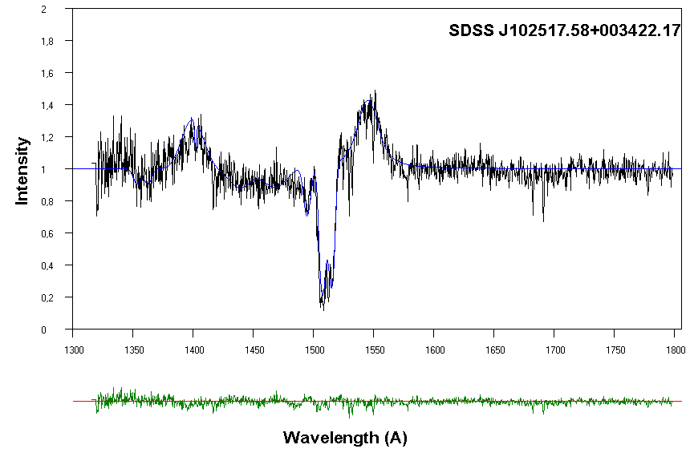
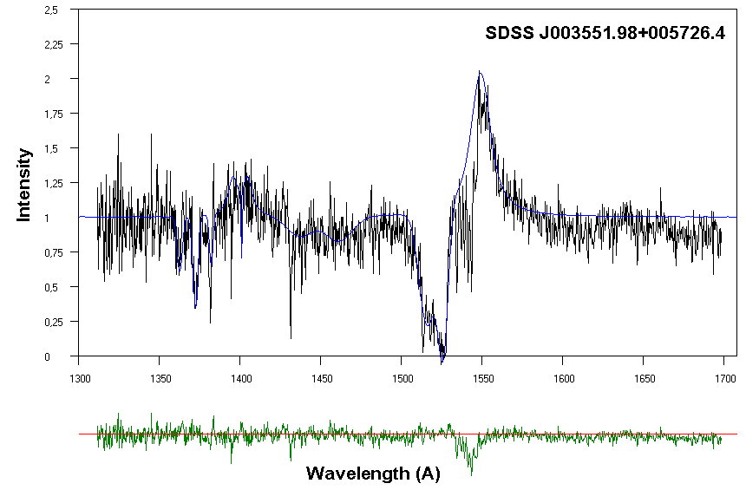
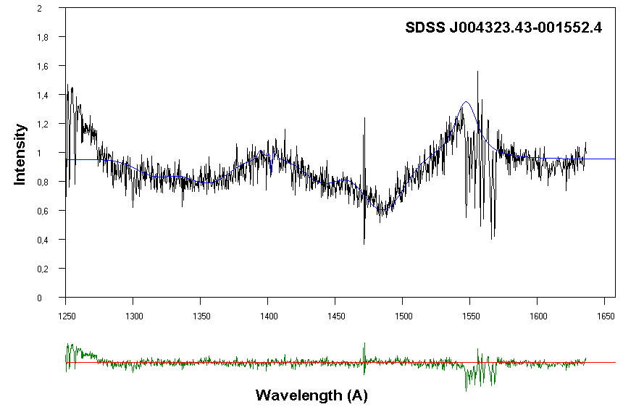
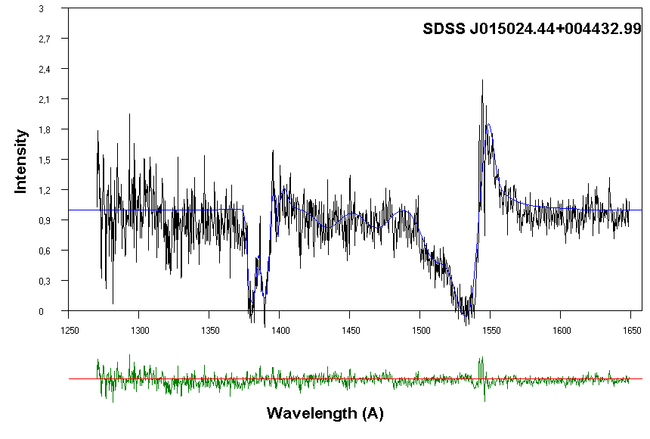
Si IV
Si IV
Si IV
Si IV

Slide 20
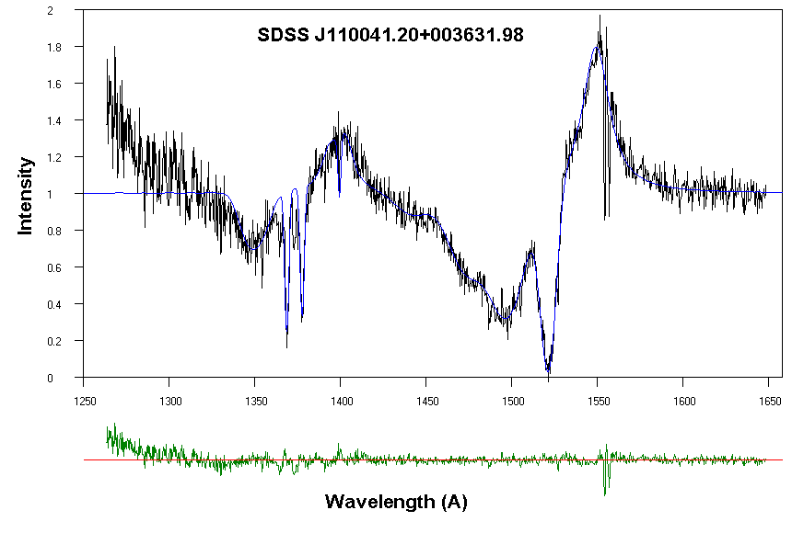
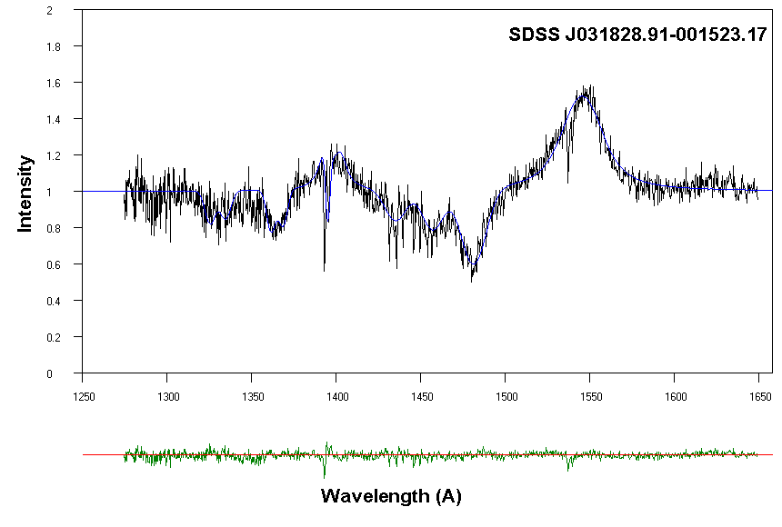
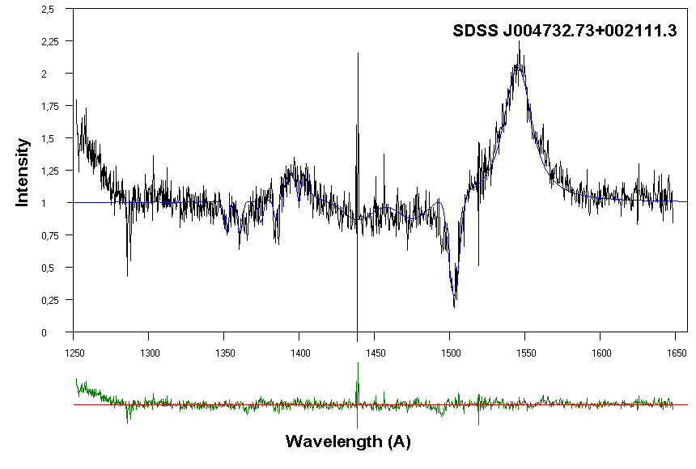
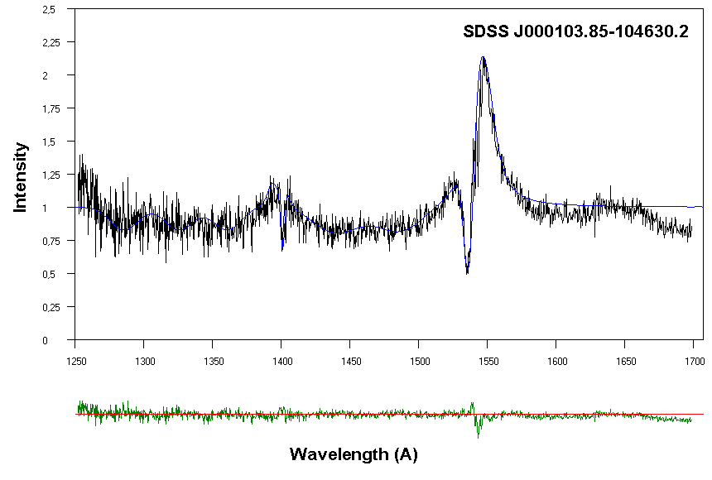
Si IV
Si IV
Si IV
Si IV

Slide 21
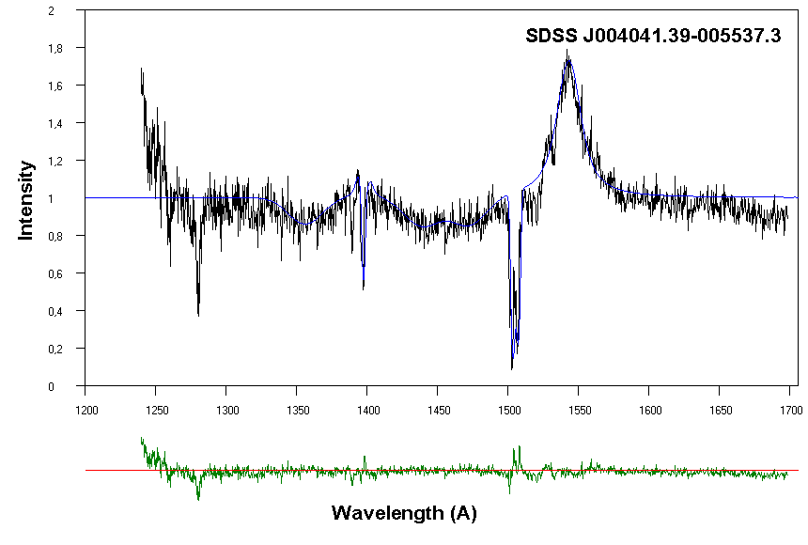
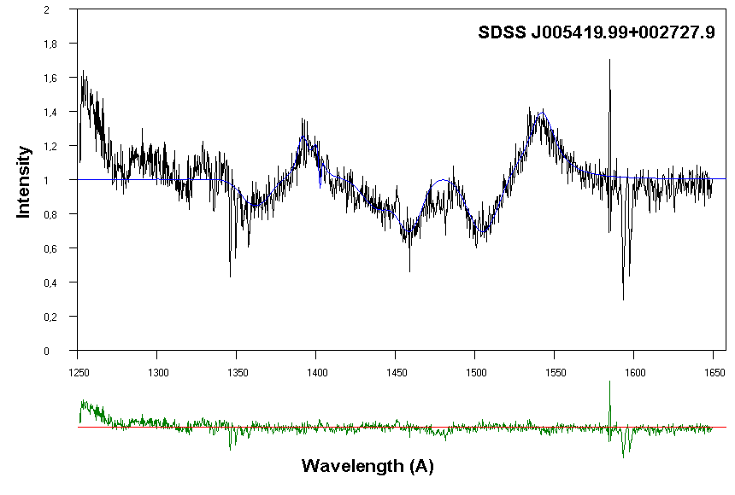
Si IV
Si IV
Si IV
Si IV

Slide 22
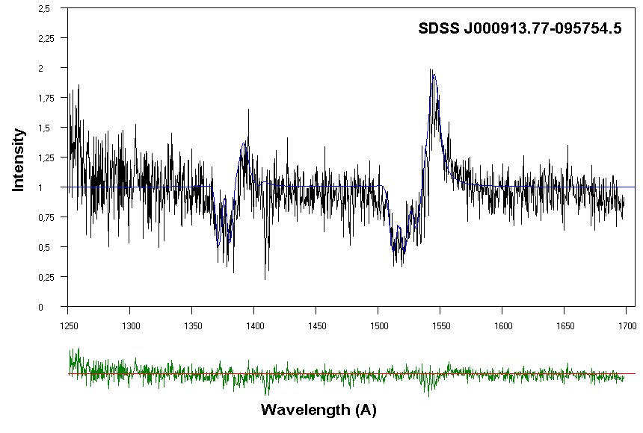
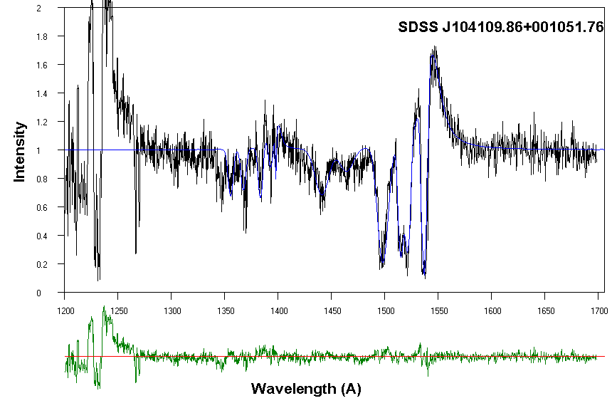
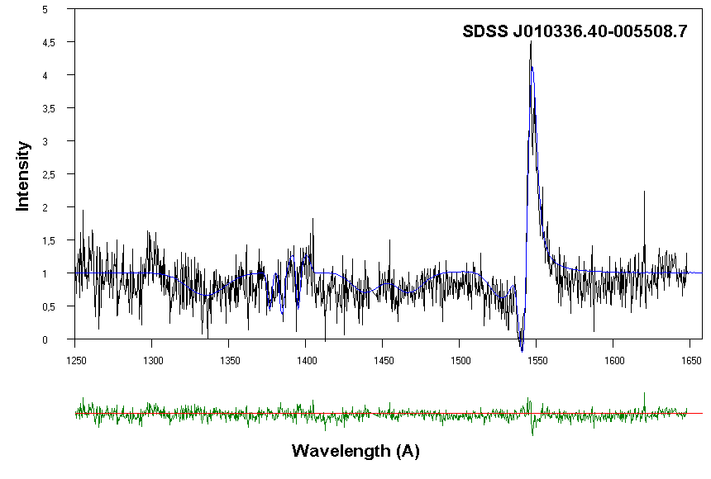
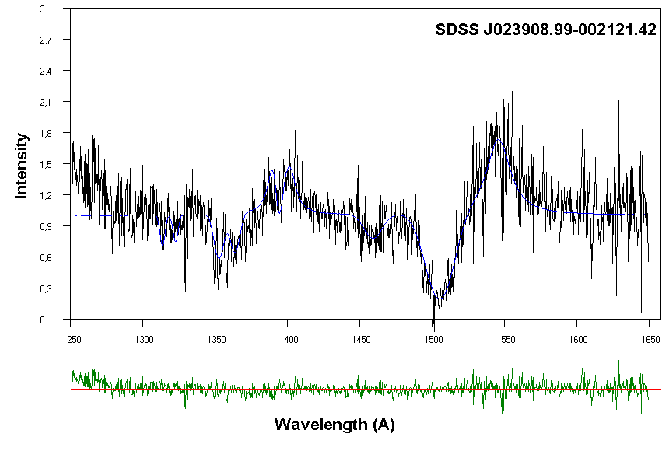
Si IV
Si IV
Si IV
Si IV

Slide 23
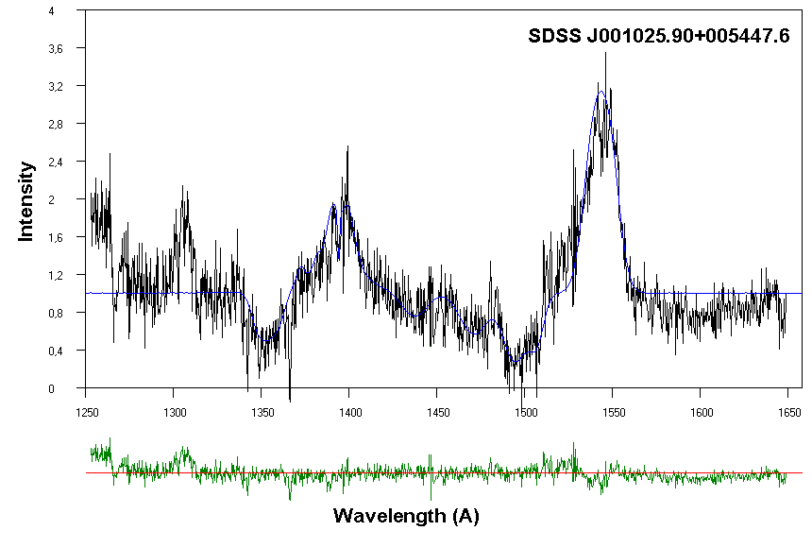
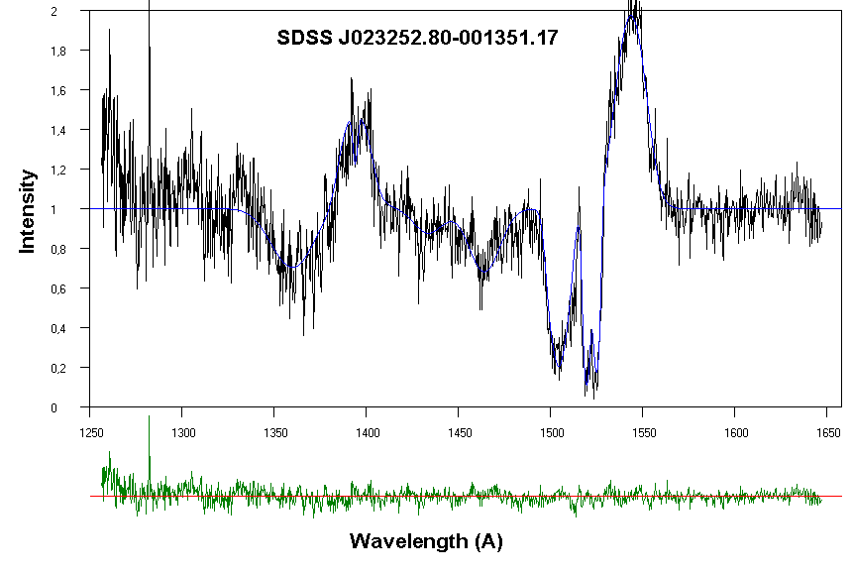
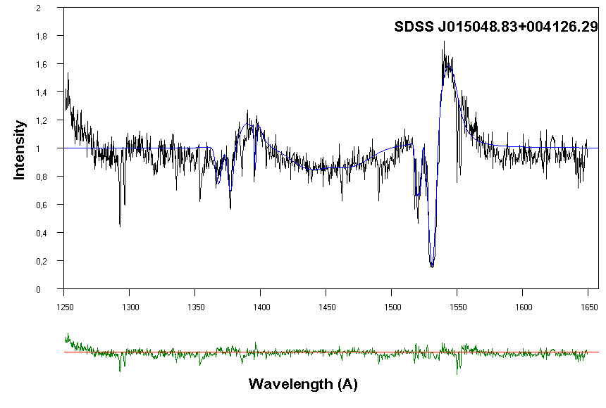
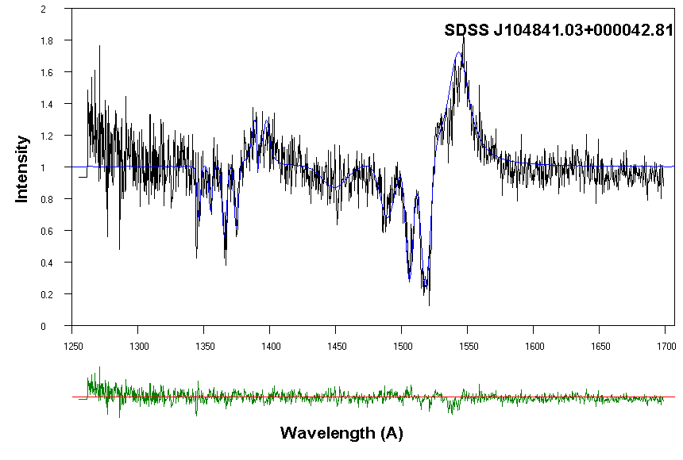
Si IV
Si IV
Si IV
Si IV

Slide 24
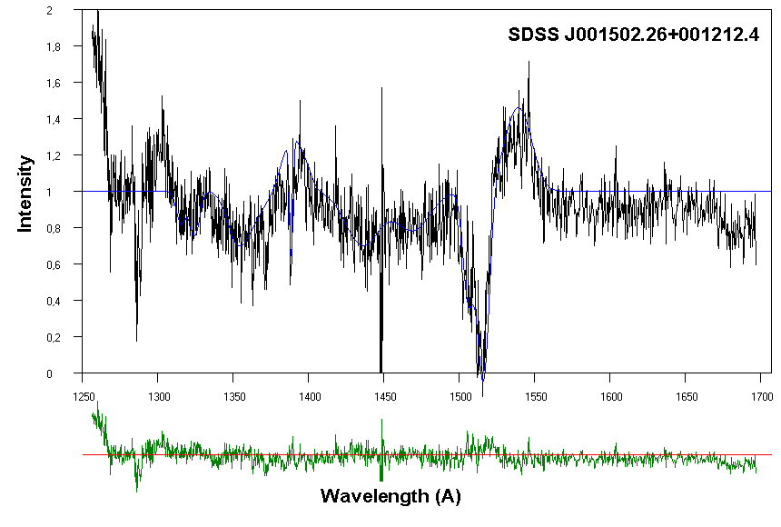
Si IV

Slide 25
Results
The 21 HiBALQSOs were sorted in descending order of the clouds’ radial velocities, beginning with the QSO that had the cloud with the highest radial velocity.
Object Name (SDSS) | Red Shift | Vrad (km/s) | Vrand (km/s) | ξ | σ | γ | FWHM (Å) | CD (cm⁻²) | E (eV)
J102517.58+003422.17 | 1.88842 | 428.81 | 1768.33 | 0.450 | 7.0 |  | 17.835 | 8.42E+09 | 3.36
J003551.98+005726.4 | 1.9011 | 428.81 | 1009.03 | 0.300 | 4.0 | 0.6 | 7.026 | 6.93E+09 | 2.76
J004323.43-001552.4 | 2.81671 | 214.41 | 757.31 | 0.270 | 3.0 | 0.7 | 5.345 | 1.27E+09 | 0.51
J015024.44+004432.99 | 2.00596 | 214.41 | 757.31 | 0.500 | 3.0 | 1.0 | 5.992 | 4.06E+09 | 1.62
J110041.20+003631.98 | 2.01143 | 0.00 | 1515.71 | 0.550 | 6.0 | 0.7 | 11.392 | 9.89E+09 | 3.94
J031828.91-001523.17 | 1.98447 | 0.00 | 1263.09 | 0.463 | 5.0 | 0.6 | 9.128 | 6.42E+09 | 2.56
J004732.73+002111.3 | 2.87768 | 0.00 | 1010.47 | 0.500 | 4.0 | 0.7 | 7.509 | 5.50E+09 | 2.19
J000103.85-104630.2 | 2.081 | 0.00 | 1010.47 | 0.426 | 4.0 | 1.4 | 8.558 | 3.96E+09 | 1.58
J004041.39-005537.3 | 2.09094 | 0.00 | 757.85 | 0.325 | 3.0 | 0.6 | 5.343 | 1.83E+09 | 0.73
J000056.89-010409.7 | 2.12325 | 0.00 | 593.94 | 0.800 | 2.4 | 1.0 | 4.985 | 9.47E+09 | 3.78
J001438.28-010750.1 | 1.81564 | 0.00 | 227.36 | 0.925 | 0.9 | 1.6 | 2.158 | 1.97E+09 | 0.79
J005419.99+002727.9 | 2.51946 | -428.81 | 1011.92 | 0.509 | 4.0 | 1.0 | 8.004 | 5.62E+09 | 2.24
J000913.77-095754.5 | 2.076 | -428.81 | 1011.92 | 0.629 | 4.0 | 1.0 | 8.201 | 8.34E+09 | 3.32
J104109.86+001051.76 | 2.25924 | -428.81 | 885.43 | 0.463 | 3.5 | 0.8 | 6.658 | 4.15E+09 | 1.66
J010336.40-005508.7 | 2.44295 | -428.81 | 505.24 | 0.600 | 2.0 |  | 5.225 | 3.71E+09 | 1.48
J023908.99-002121.42 | 3.74 | -429.50 | 1264.91 | 0.740 | 5.0 | 0.7 | 9.905 | 1.54E+10 | 6.12
J001025.90+005447.6 | 2.84727 | -643.22 | 1265.81 | 1.100 | 5.0 | 0.4 | 10.484 | 2.94E+10 | 11.73
J023252.80-001351.17 | 2.03289 | -857.63 | 1266.72 | 0.700 | 5.0 | 2.2 | 12.246 | 1.22E+10 | 4.86
J015048.83+004126.29 | 3.70225 | -1072.03 | 1267.62 | 0.450 | 5.0 | 1.0 | 9.885 | 4.93E+09 | 1.96
J104841.03+000042.81 | 2.03044 | -1072.03 | 760.57 | 0.600 | 3.0 | 0.6 | 5.656 | 5.84E+09 | 2.33
J001502.26+001212.4 | 2.85152 | -1500.84 | 1263.09 | 0.463 | 5.0 |  | 12.766 | 6.60E+09 | 2.63

Slide 26
In the following diagrams we present the calculated parameters as a function of radial velocity, that is an expression of the distance from the galactic center.

Slide 30
C IV/Si IV Intensity and Energy ratios
An important factor in the study of QSOs is the ratio of C IV/Si IV intensity. We also calculated the C IV/Si IV energy ratio. We do that in order to include all the parameters that contribute to the emitted energy, such as the σ, γ, ξ.

Slide 32
Conclusions
Besides the Si IV emission lines, we have also studied the Si IV absorption lines. We found that probably, all the Si IV resonance lines present p Cyg profiles. This means that in a future work we should try to calculate the mass loss from the regions that create these emission lines.

Slide 33
We simulated the Si IV emission lines with a Voigt distribution, i.e. with a distribution with one pick.
In the case that the emission lines arise from an emission disc (Holt et al. 1992 (Collin-Souffrin 1987, Collin & Hure 2001), we know that the disc model indicates such a shape only when the observation line and the rotational axis of the disc form a small angle (between 0-5 degrees) (see Antonucci, R. 1993).

Slide 34
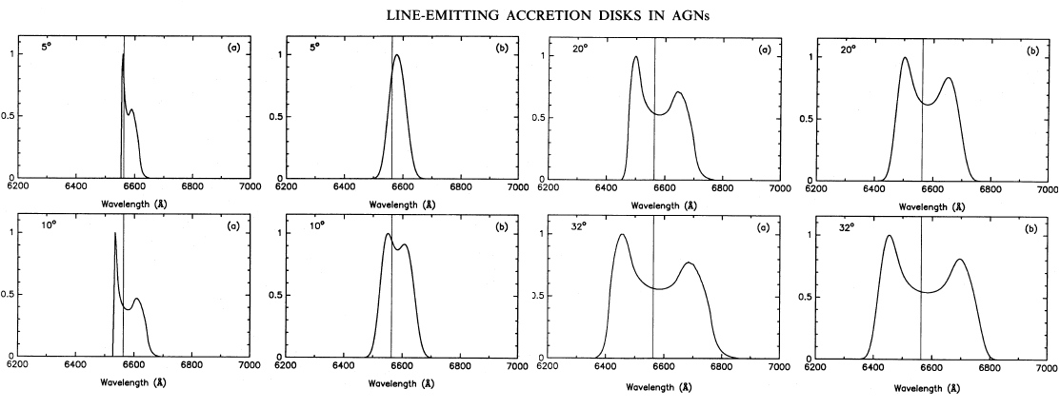
Here we see the theoretical emission profiles that arise from the disc model as a function of the inclination angles (Chen, K. & Halpern, J. P. 1989)

Slide 35
We simulated all the resonance Si IV emission lines with a Voigt distribution. This means that in the region (disc or cloud) that produces the Si IV resonance lines, pressure exists, which might be able to create a shock (Fromerth & Melia 2001), due to great decrease of the kinematic energy and that is the reason of the radiant energy.
Notes:
35

Slide 36
Thank you !

