Slide 1
Quantum Stark broadening for Ar XV lines
Haykel Elabidi^{1,2,a}, Sylvie Sahal-Bréchot³ and Milan S. Dimitrijevic^{3,4}
¹Deanship of the Foundation Year, Umm Al-Qura University, Makkah, Saudi Arabia
²GREPAA, Faculté des Sciences de Bizerte, Université de Carthage, Tunisia
³LERMA, UMR 8112 CNRS, Observatoire de Paris-Meudon, F-92195 Meudon, France
⁴Astronomical Observatory, Volgina 7, 11060 Belgrade 38, Serbia
ªhaelabidi@uqu.edu.sa

Slide 2
We calculate in the present paper, quantum (Q) and semiclassical (SCP) widths for some Ar XV lines.
An extensive comparison between the results of the two formalisms is presented.
Except few SCP results, the present quantum results are the first ones to be published.

Slide 3
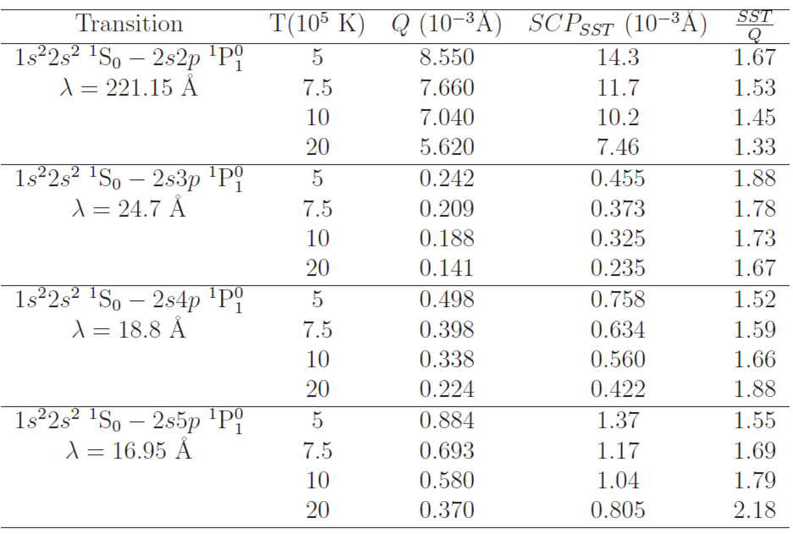
All the SCP widths for lines involving the ground level are overestimated compared to the quantum ones.

Slide 4
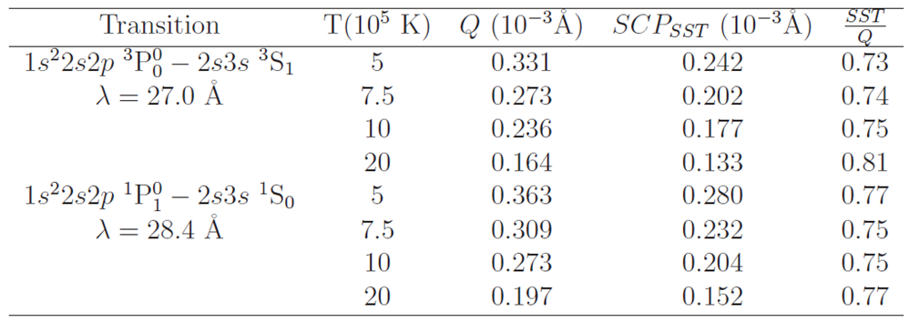
The two results (Q and SCP) become close to each others for lines involving excited levels.
The SCP results are no longer overestimated compared to the quantum ones.

Slide 5
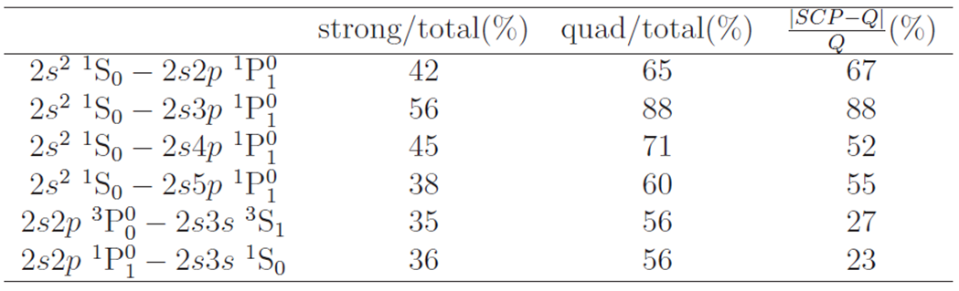
The disagreement between Q and SCP results is important when the strong and close collisions and thus the elastic collisions due to the quadrupolar potential are dominant.
The contributions of strong collisions and those of the quadrupolar potential are important for transitions involving levels with low principal quantum number.
Probably, the SCP method overestimates the contributions of strong close collisions.
This may be due to the hydrogenoid approximation used in the evaluation of these contribution.

Slide 6
THANK YOU FOR YOUR ATTENTION

