Slide 1
RADIATIVE TRANSITIONS IN FEW ELECTRON QUASY-MOLECULES
A.Devdariani
V.A.Fock Institute of Physics, St.Petersburg University
9th Serbian Conference on Spectral Line Shapes in Astrophysics, ^{May 13-17, 2013}

Slide 2
CONTENTS
List of Definitions
Intoduction
One-Electron-Two-Center Problem, Motivations
Features of Dipole Transition Moments
Asymptotically Forbidden Transitions
Radiative Transition in the He⁺(n=3)+H⁺ Collisions Followed by Charge Transfer
H+H⁻ Collision Induced Radiative Transitions
Conclusions

Slide 3
Definitions
Quasi-molecules (QM)
Temporary molecules formed by colliding atoms/ions
Potential energy curves (U,E)
Potential energies of interactions in specific QM states
Dipole moments (D,d)
Dipole moments of optical transitions between two QM states
Spectral profiles (J)
Wings of spectral lines produced by QM transitions, excluding the central parts of the lines

Slide 4
Spectral Profile Calculations
close-coupling approach
semi-classical approach:
quasy-static appr:
Condon Point→

Slide 5
Spectral Profiles Calculations, J()
Input Data:
Potential energy curves, U_{i,f}(R)
Dipole moment, d(R)
The variation of the dipole has to be taken into account to obtain reliable results to be used as a diagnostic tool
The first step:
binary collisions of multi-charged ions with only one
bound electron, Z₁eZ₂

Slide 6
MOTIVATION
The two Coulomb centres - one electron compound Z₁eZ₂ is a unique system:
The Z₁eZ₂ problem plays the same role for (quasi)-molecules as the problem of a hydrogen atom for atoms
The prototype of all the features in the spectral profiles
Input data for spectral profile calculations can be obtained straightforwardly, avoiding typical quantum- chemical approximations.
Practical applications for plasma spectroscopy, including hot dense plasmas
Notes:
Why? Because for this system all static quantities like energy terms can be calculated without.. And at the same time it’s a prototaype
‘Ku:lom ‘kompaund proutetaip

Slide 7
Historical Note
Homopolar case
H₂⁺ problem
W Pauli, PhD thesis (1922)
E Teller 1930
H A Bethe
Quantum Mechanics, 1st Edition(~1930)
R S Mulliken, J Chem Phys 7 14 (1939)
Dipole moment for the g-u transitions ~R/2
D R Bates 1956
D E Remaker and J M Peek (1973)
20 states with principal quantumnumber n=1,2, or 3
H₂⁺ radiative transitions
Lyman-α, β, γ transitions broadened by collisions with H⁺
I.I.Sobel‘man et al, JETP Letters 2000, PHYSICS-USPEKHI 2003
Radiative transitions in the molecular ion H₂⁺
Heteropolar case
X-ray radiation under inner-shell excitation in ion-atom collisions.
Hot dense plasma physics.
In hot dense plasma experiments the typical densities are about 10²⁴cm⁻³ now, therefore ‹R›~1a₀ and quasi-molecular description is applicable.
Notes:
Following the work by great physisits
Until recently the most intensive study has been devoted to the

Slide 8
A novel feature is dependence on a new parameter Z₁/Z₂
Scaling Rule
Z₁eZ₂
Devdariani et al
Phys Rev a 71 022512 (2005)
Z₁ =1.5, 2, 2.5, and 3 , Z₂ =1, n_{u}=1,2,3, and 4
Notes:
Little is known about DTM, In contrast to PEC, which can be regarded as a combination ...and we know how they can be described. Allowed transiton and forbidden transitions
The most complete results (Bates) Nonsymmetrical case
In computation 1.determine the separation constant and calculate the terms 2. for quasiradial – well-known jaffe expansion, for quasiangular expansion fromKOMAROV. The expansion coefficient can be calculated from the three-term recurrence relations. The accuracy of the matrix elements can be estimated at 10-8.
Conditions for zeros in the generalized oscillator strengh:
one electron atom and diatomic molecul example
They are important,similar to zeros in oscillator strengh for fotoionization lead to to dips in cross sections
Fastrup, 1975, PR12 2325 for energies
Kereselidze,2001 Absracts 22 IPEAC

Slide 9
Results and Discussion
The most prominent features of the dipole matrix elements:
The dipole moments strongly depend on the inter-nuclear distance R;
The limiting values of some matrix elements, at large R, tend in pairs to the same values or to values of equal moduli and opposite signs, and some of them are equal to zero;
Some dipole moments have zeros at intermediate R.

Slide 10
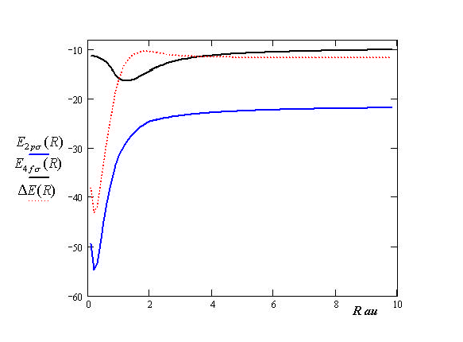
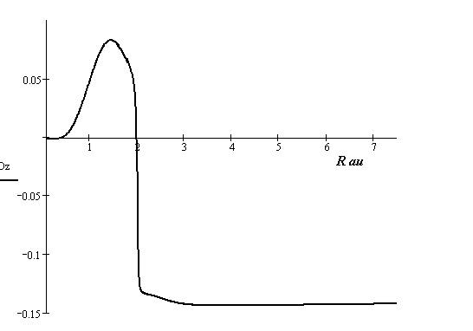
Example: 2pσ – 4fσ, Z₁/Z₂=1.5
E(R)
D(R)
D(R~2)=0
Devdariani, Dalimier
Phys Rev A 78 (2008)

Slide 11
Asymptotically forbidden-transitions
D(R➔∞)=0
  Two cases:
  1. A limiting value of D(R) in a single ion is equal to zero
  ⟨3pσ|d_{z}| 1sσ ⟩ → ⟨110|d_{z}| 000 ⟩ = 0
  2. Charge exchange when the initial and final states belong to different ions at R → ∞.
Strong dependence of D(R)
Notes:
Corresponding wave-functions do not overlap and therefore, the matrix element is equal to zero.
At smaller R, the interaction between two different ions will allow optical transitions corresponding to the transition of one electron from one ion to the other.

Slide 12
The specific example of the exothermic charge transfer which includes an initial excited state and leads to the formation of neutral hydrogen
He⁺(n=3)+H⁺→He²⁺+H(n=1)+7.6eV/hν through the 4𝑓𝜎→2𝑝𝜎 transitions
Radiative Transition in He⁺(n=3)+H⁺ Collisions Followed by Charge Transfer
Notes:
More specifically I’’ll deal with… Eksou’the:mik
that leads to

Slide 13
He⁺(n=3)+H⁺
He²⁺+H(n=1)
He⁺(n=3)+H⁺→He²⁺+H(n=1)+7.6eV
He⁺(n=3)+H⁺→He²⁺+H(n=1)+hν

Slide 14
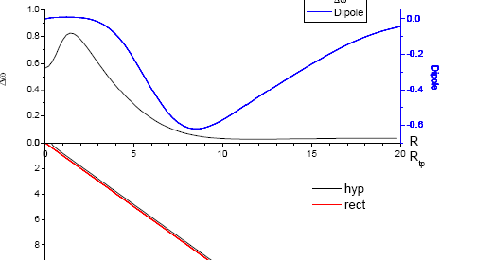
He⁺(n=3)+H⁺→He²⁺+H(n=1)+hν

Slide 15
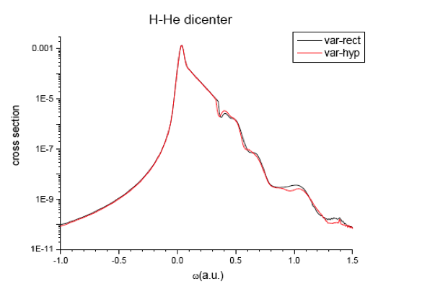
Spectral Profile Summed over Impact Parameters
The total cross section is scaling as Z²
Charge exchange through quasi-molecular optical transitions can be the main channel for low energy collisions of multiply charged ions

Slide 16
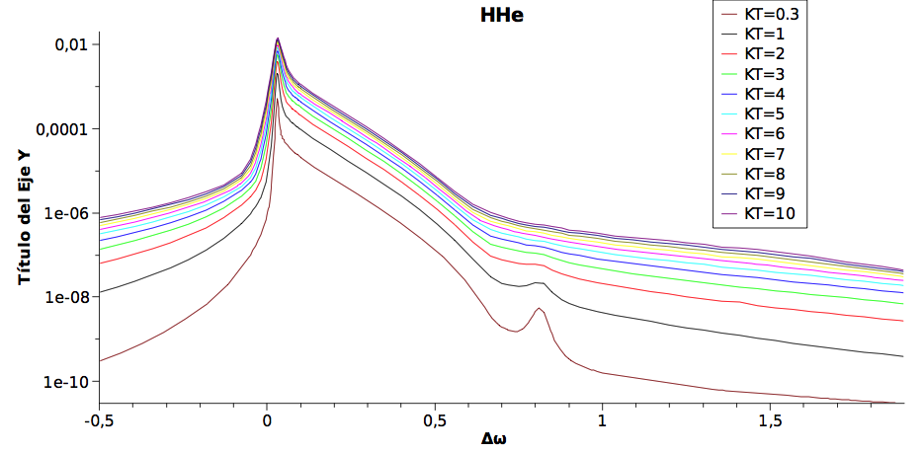
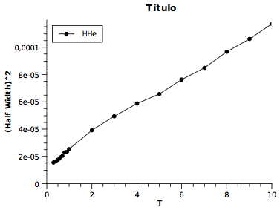
Temperature Dependences
Spectral Profiles
Half-Width Squared

Slide 17
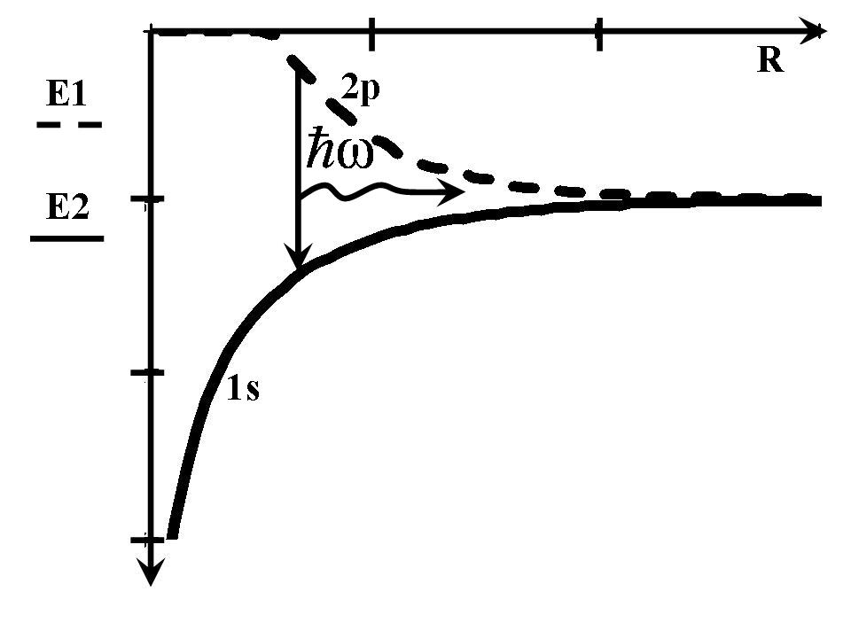
Another Example of Asymptotically Forbidden Transition: Radiating Transitions Followed by Resonance Charge Exchange
Notes:
Another example

Slide 18
Zero-Range Potential Method
The mathematical image of the model is:
: is the bound energy of the extra
electron in a negative ion
Notes:
[X]-hai

Slide 19
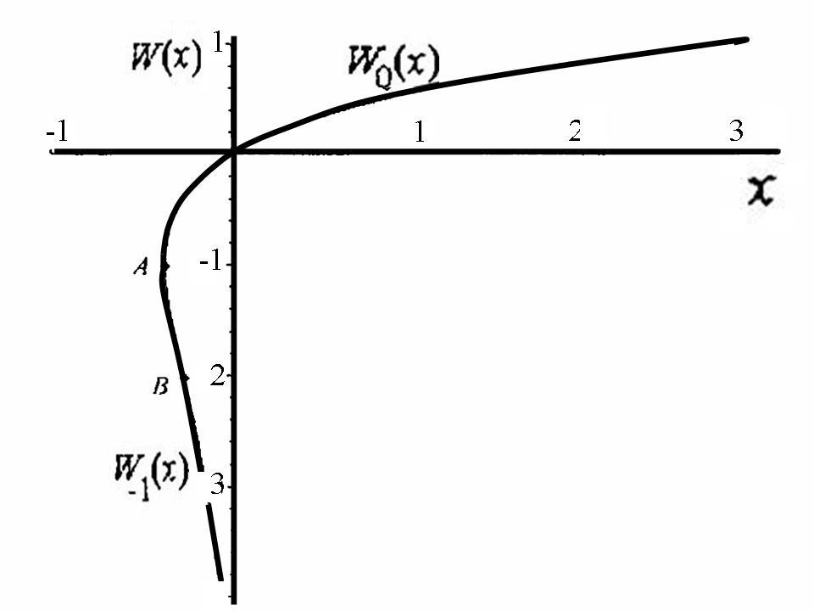
Quasi-Molecular Gerade and Ungerade Energies
In Terms of Lambert W Function
D Knuth (1996)
On the Lambert function, Adv Comput Math 5
The Lambert function W is defined as a solution of the equation:

Slide 20
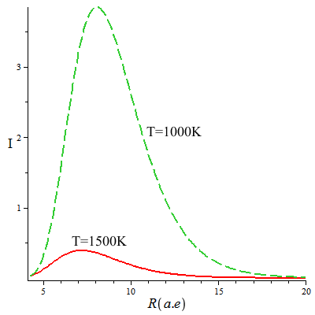
Spectral Profiles Averaged over Maxwell’s Distributions as a Function of Distance between the Nuclei
The maximum of intensity is formed by transitions in the region of 7-10 a.u. It means that the radiating transitions can be followed by the formation of unstable molecules in high rotational states.

Slide 21
Long-Lived Anionic States of H₂

Slide 22
Conclusions
The two problems involving radiative transitions in one/three quasi-molecules have been considered.
Charge exchange is related to the asymptotically forbidden radiative transitions.
The dependence of the transition dipole moment is, likely, more important then the differential potential function.

Slide 23


COLLABORATORS
T. M. Kereselidze and I. L. Noselidze
Department of Physics, Tbilisi State University, Chavchavadze Avenue 3, 380028 Tbilisi, Georgia
E.Dalimier, P.Sauvan*, P.Angelo and R.Schott
Université Pierre et Marie Curie, PAPD/LULI, 4, place Jussieu, 75252 Paris cedex 05, France
LULI, Ecole Polytechnique, Route de Saclay, 91 128 Palaiseau cedex, France
*Departamento de Ingenieria Energetica, UNED, Juan del Rosal 12, 28040 Madrid, Spain
Thank you for your attention

Slide 24
The Relative Accuracy:
10⁻¹² - for the energy terms;
10⁻⁸-10⁻¹⁰ - for the corresponding quasi-radial and quasi-angular wavefunctions;
10⁻⁸ - for the calculated matrix elements.

Slide 25
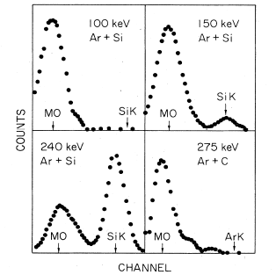
Heavy-Ion—Atom Collisions
X rays due to vacancy production
Ar-Ar
L MO x-ray production
as a result of promotion
swapping at Z₂~Z₁ or Z₁ /2
F W Saris et al, Phys Rev Lett 28 717 (1972)
Notes:
Due to promotion

Slide 26
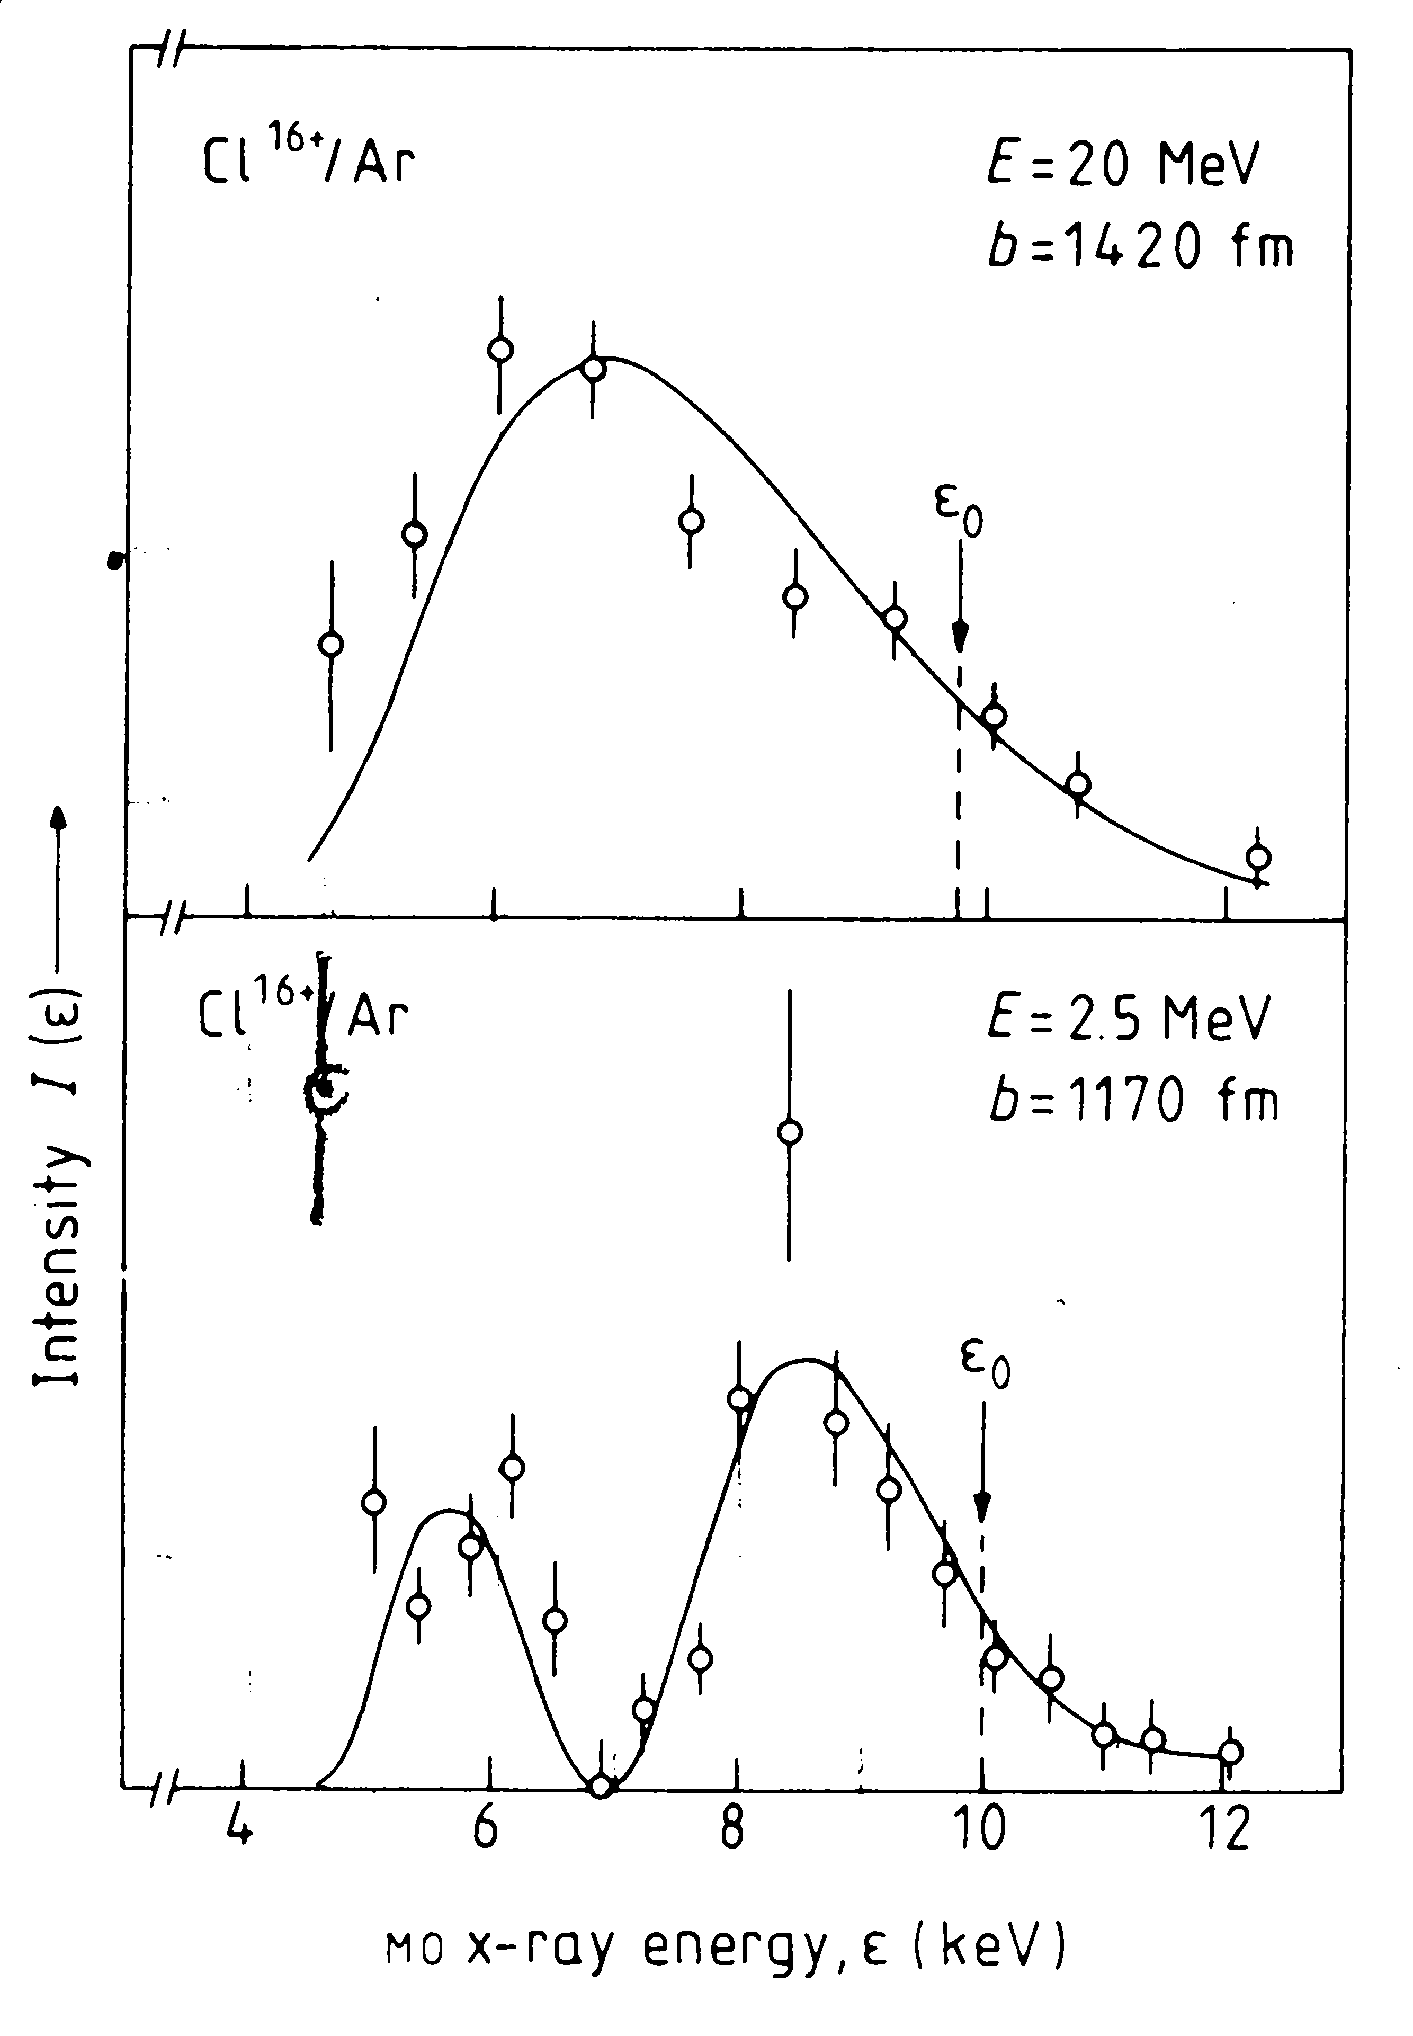
Cl¹⁶⁺-Ar
b=1420fm
b=1170fm
A Z Devdariani, V N Ostrovskij, and A Niehaus
J Phys B: At.Mol.Phys. 18 L161 (1985)
Notes:
1fm=10-13cm. The arrows indicate the transition energy at the turning point

