Slide 1
Strong distortions of line shapes in periodic electric fields
Roland Stamm ¹ , Ibtissem Hannachi ^{1,2}, Joël Rosato ¹,
and Yannick Marandet ¹
1 Aix-Marseille Université, CNRS, PIIM UMR 7345, 13397 Marseille Cedex 20, France
2 LRPRIM, Faculty of Sciences, University of Batna 1, Batna, Algeria

Slide 2
Simulation calculation of the line shape
Schrödinger equation for the emitter submitted to electric fields
$$iℏ\frac{dU(t)}{dt}=\left(H_{0}−\vec{D} . {\vec{E}}_{S}\left(t\right)−\vec{D}.{\vec{E}}_{W}\cos{(ω_{p}t+φ}\right)U(t)$$
U(t) atomic evolution operator, D dipole operator.
${\vec{E}}_{S}$ thermal Stark microfield, ${\vec{E}}_{W}$ wave field.
Calculation of the dipole autocorrelation function (DAF)
$$C\left(t\right)=Tr\left\langle \vec{D}(0)\vec{D}(t)ρ\right\rangle$$
The line shape is obtained by a Fourier transform of C(t)

Slide 3
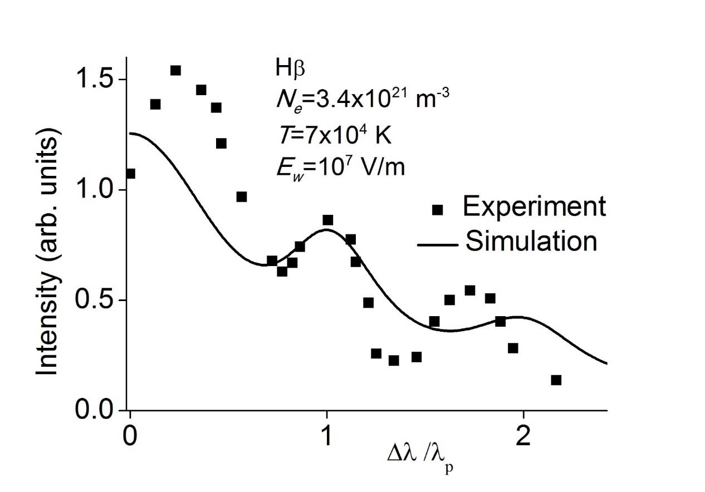
Effect of oscillating fields on line shapes
Early experiments (Rutgers, Gallagher, Ramette) : observation of satellites on Balmer lines at multiples of the electronic plasma frequency ω_{p}
Gallagher C C, Levine M A 1971 Phys. Rev. Lett. 1971, 27 1693
Notes:
Early theories in the sixties and seventies : Mozer and Baranger, Oks and Sholin
Early experiments in the seventies : Rutgers, Gallagher, Ramette show such satellites
No real quantitative agreement between experiments and models! It is worth revisiting this field

Slide 4
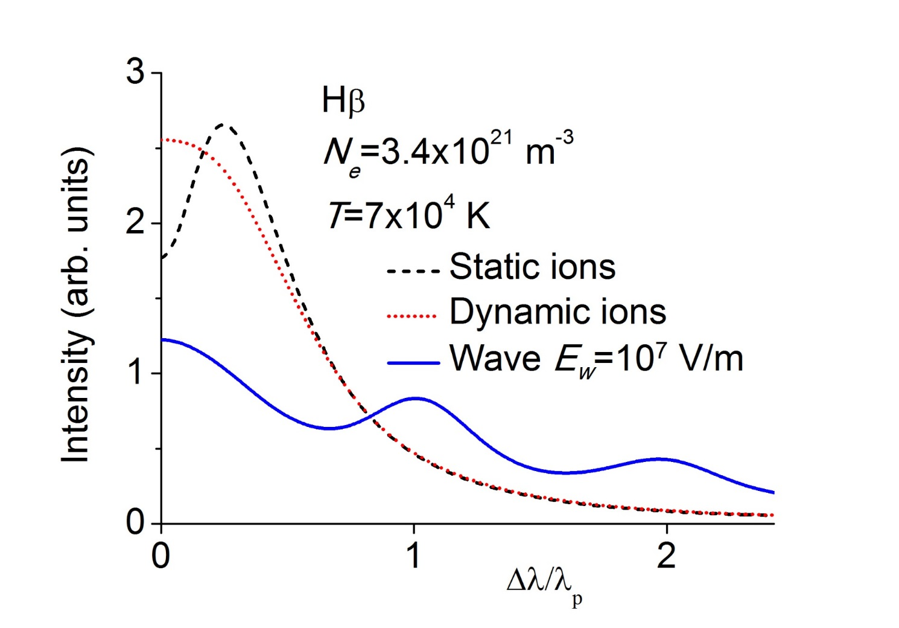
Simulation calculation of oscillating fields on line shapes
A static ion line shape was used for obtaining the density, but the line shape has no central dip for such plasma conditions (ion dynamics)
Notes:
Early theories in the sixties and seventies : Mozer and Baranger, Oks and Sholin
Early experiments in the seventies : Rutgers, Gallagher, Ramette show such satellites
No real quantitative agreement between experiments and models! It is worth revisiting this field

Slide 5
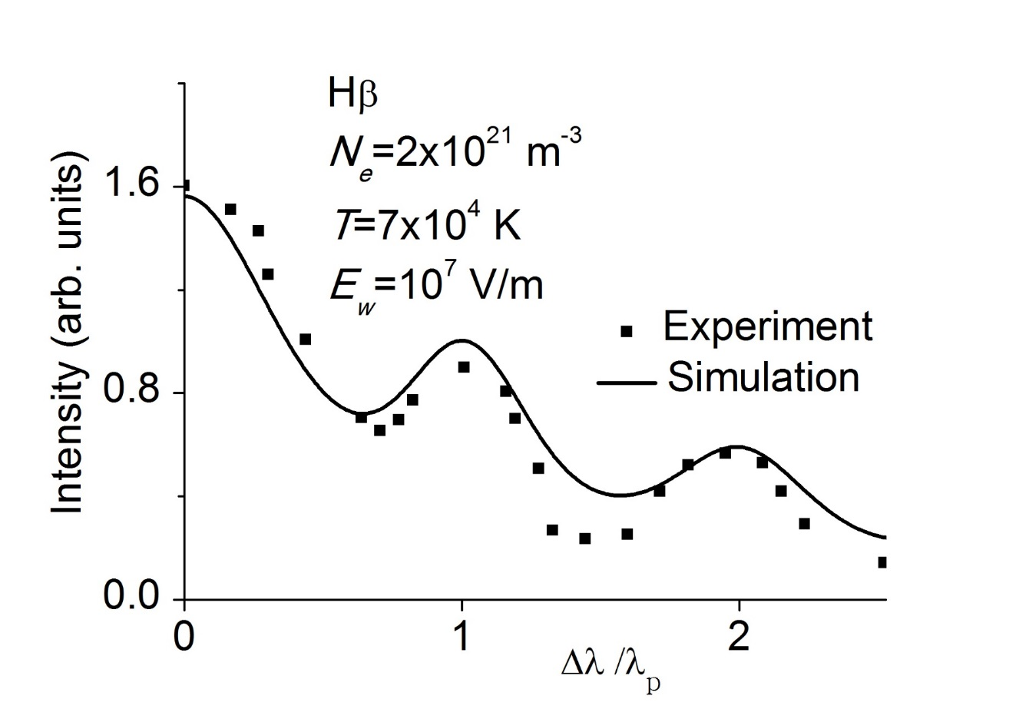
Shifting the center of the line to the central peak value
The density is changed to 2x10²¹ m⁻³, but now the two satellites are located at one and two plasma frequencies
Strong changes of the line shape are explained
Notes:
Early theories in the sixties and seventies : Mozer and Baranger, Oks and Sholin
Early experiments in the seventies : Rutgers, Gallagher, Ramette show such satellites
No real quantitative agreement between experiments and models! It is worth revisiting this field

Slide 6
Effect of oscillating fields on line shapes
Theory
- Studies can be traced back to Schrödinger and Blokhintsev (1932-1933)
In presence of a field E cos(Ωt) , there is a possibility of observing satellites of the main line separated by ± Ω, ± 2Ω, … ± jΩ
- Mozer and Baranger, Oks and Sholin,..
Waves can broaden, create satellites, holes on the lines, depending on plasma and wave conditions
Experiments (Rutgers, Gallagher, Ramette) : observation of satellites on Balmer lines at multiples of the electronic plasma frequency ω_{p}
Notes:
Early theories in the sixties and seventies : Mozer and Baranger, Oks and Sholin
Early experiments in the seventies : Rutgers, Gallagher, Ramette show such satellites
No real quantitative agreement between experiments and models! It is worth revisiting this field

Slide 7
Modeling of plasma radiative properties
Numerical simulation of the microfield
We use simulations of electric fields, coupled to a numerical integration of the Schrödinger equation
Not a molecular dynamics simulation:
particles move on straight lines
Cubic box
Periodic boundary conditions
Screened ion field

Slide 8
Plane waves
Field created by an external generator or Langmuir waves
$$\vec{E }\left(t\right)={\vec{E}}_{w}cos⁡(Ωt+φ)$$
Different kinds of simulations
- Convolution of a Stark profile with a profile affected by oscillating field
Ab initio simulation of the dynamic ion field plus the oscillating field
E_{w} with a random direction and sampled magnitude (Gaussian?)
Fixed direction and magnitude: partial polarization
We compare E_{w} or < E_{w}> to the mean plasma microfield E_{m}≈3.4 E₀ with E₀=(1/(4πε₀))1/r₀² , with r₀ the mean interparticle distance
Notes:
We can simulate the effect of electrons, however we most often use an electronic impact operator, since the line shape structures are mainly determined by ion dynamics and the wave.
The effect of the electric field (both particles and oscillating field) on the particles trajectories is not taken into account!

Slide 9
Plasmas and oscillating electric fields
Different situations
Fields created by an external source (microwave generator, laser radiation)
Plasma oscillations : collective phenomena favor the development of fluctuations and oscillation. A wave may be amplified by an instability (e.g. beam-plasma instability) which increases the electric field magnitude
-High amplitude oscillating fields are also present in astrophysical plasmas:
Magnetospheres, star surfaces, interaction of black hole with matter
-In fusion plasmas : Tokamak plasmas strongly affected by waves
Klepper et al., Phys. Rev. Lett. 110, 215005 (2013)
Notes:
Diagnostic of plasma and diagnostic of radio frequency field (waves are used in a tokamak for heating the plasma
And for a steady state operation (current drive),Klepper et al

