Slide 1
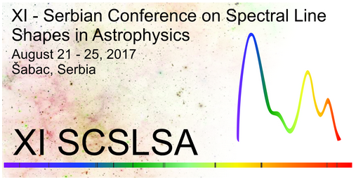
Atom-Atom and Ion-Atom collisional processes: Modeling of stellar atmospheres
V. A. Srećković, LJ. M. IGNJAtovIć and M. S. Dimitrijević
11th Serbian Conference on Spectral Line Shapes in Astrophysics, Šabac, Serbia, August 21-25, 2017

Slide 2
This lecture is devoted to the topic, thematic we (A. A. Mihajlov, LJ.M. Ignjatovic, myself and others from IF) have been working on, for a long time with prof. Milan Dimitrijevic and which started ‘80 by deceased prof. A. A. Mihajlov and prof. Milan Dimitrijevic.

Slide 3
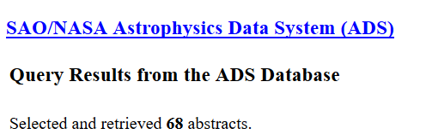
First of all, the cooperation with Milan (mainly between originator Tolja & Milan) has resulted in more than hundreds collaboration papers.
Looking at the SAO / NASA Astrophysics Data System (ADS) more than 70 of them in the referred journals:
Most of us knew the deceased prof. Mihailov. He participated in almost all SCSLSA conferences and was in the scientific committee of this conference (I think) from the beginning.

Slide 4

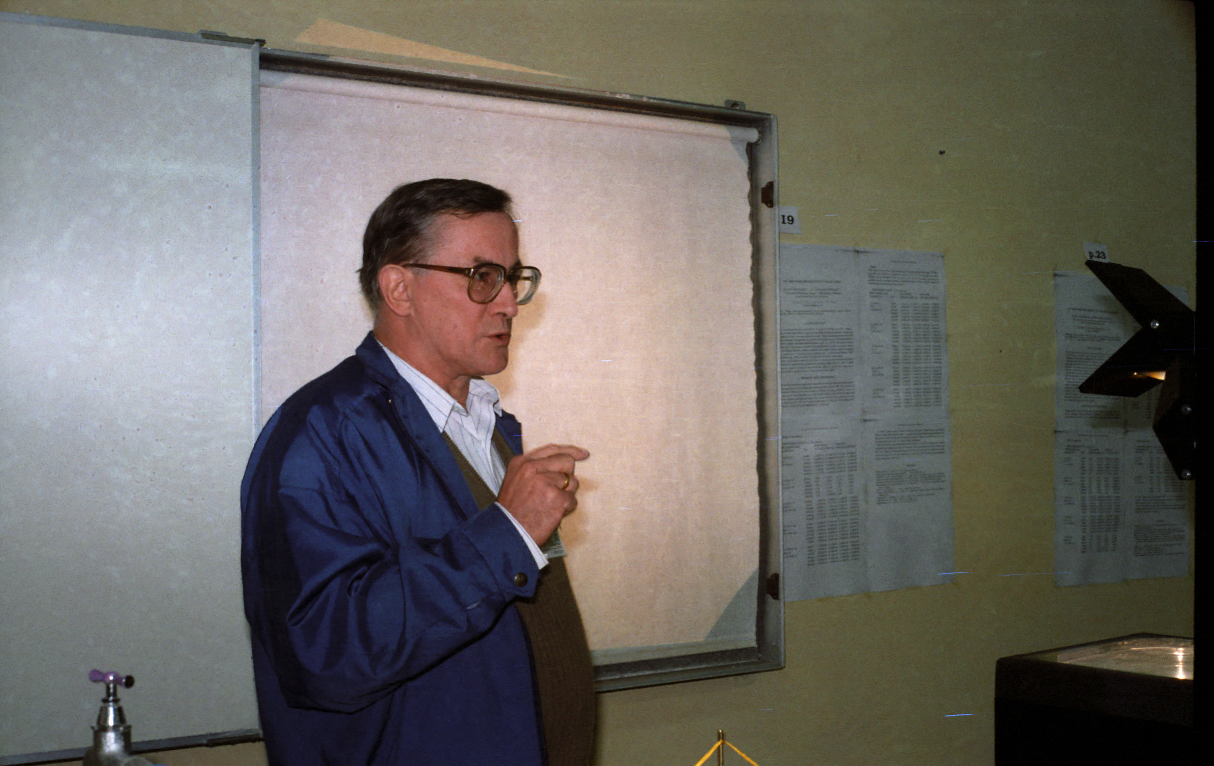
Photos from
II CONFERENCE ON SPECTRAL LINE SHAPES
September 29 - October 2, 1997, Bela Crkva

Slide 5
Cooperation and work on atomic processes with Milan Dimitrijevic has been ongoing since 1985. and the first paper was presented on the conference,
XVII International Conference on Phenomena in Ionized Gases, held July 8-12, 1985, in Budapest, Hungary. Contributed Papers, Volume 1. Organizing Committee ICPIG-XVII. 1985. p. 357
Initial cooperation papers
- 1985pig1.conf..357M
Mihajlov, A. A.; Dimitrijevic, M. S.; Popovic, M. M.
Determination of Electrical Conductivity of Plasma on the Basis of the Cut-Off Coulomb Potential Model
- 1986A&A...155..319M
Mihajlov, A. A.; Dimitrijevic, M. S.
Influence of ion-atom collisions on the absorption of radiation
- 1987A&AS...70...57D
Dimitrijevic, M. S.; Mihajlov, A. A.; Popovic, M. M.
Stark Broadening Trends Along Homologous Sequences
- 1989JPhB...22.3845D
Dimitrijevic, M. S.; Mihajlov, A. A.; Djuric, Z.; Grabowski, B.
On the influence of Debye shielding on the Stark broadening of ion lines within the classical model

Slide 6
And cooperation continued in various fields of astrophysics
1.ion-atom
-Symmetric ion-atom radiative processes in the: solar and DB white-dwarf atmospheres, quiet Sun and sunspots
-Non-symmetric ion-atom absorption processes: solar and DB white-dwarf atmospheres, quiet Sun and sunspots
2.Atom-Rydberg atom processes
-Excitation and deexcitation processes i.e. mixing: solar and DB white-dwarf atmospheres
- Chemi-Ionization and Chemi-Recombination: sodium- and other alkali-metal geocosmical plasmas, solar and DB white-dwarf atmospheres
3.Electric & transport properties astrophysical plasma
- Electrical Conductivity: DB white-dwarf atmospheres
4.VAMDC: development of atomic & molecular databases

Slide 7
Recently we started a new project of inserting these results (of investigated atomic processes) into the databases.
http://portal.vamdc.org/vamdc_portal/home.seam
http://servo.aob.rs/mold/

Slide 8
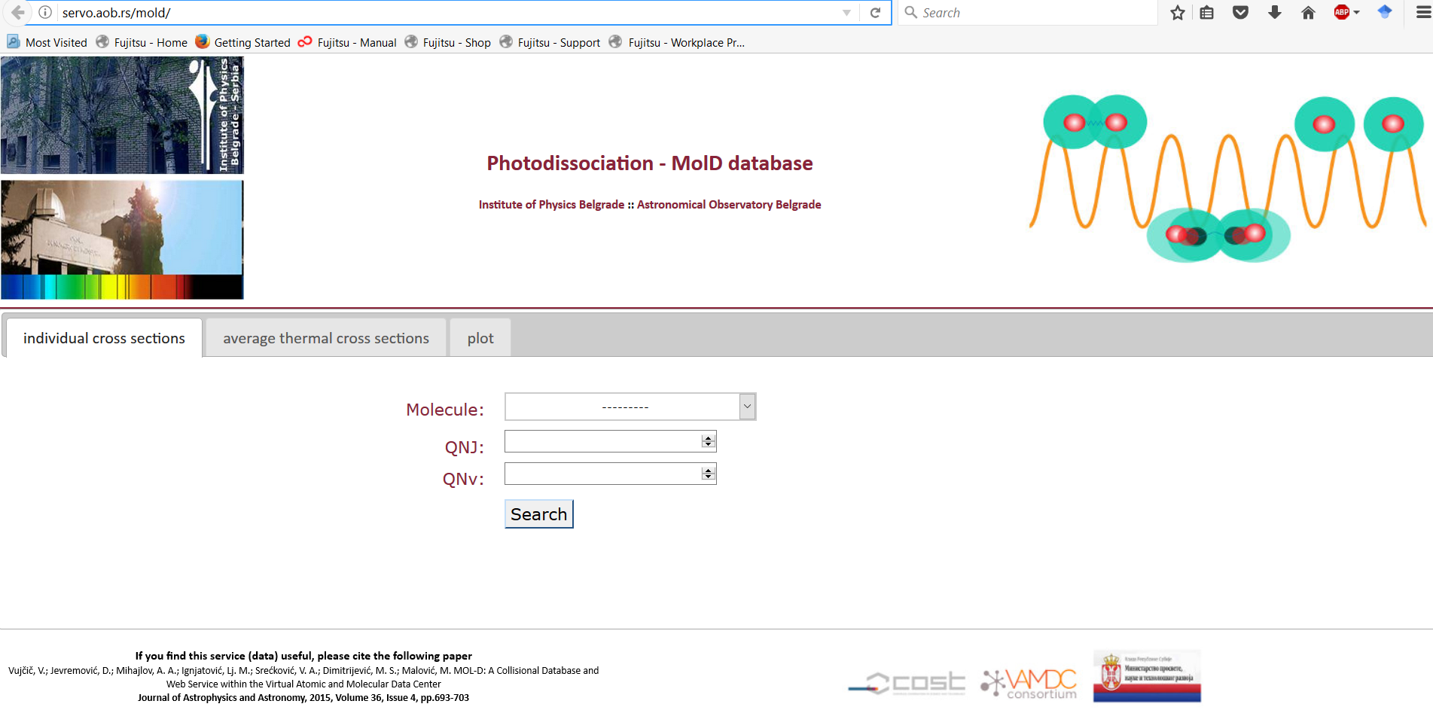
Homepage of our database MolD on SerVO

Slide 9
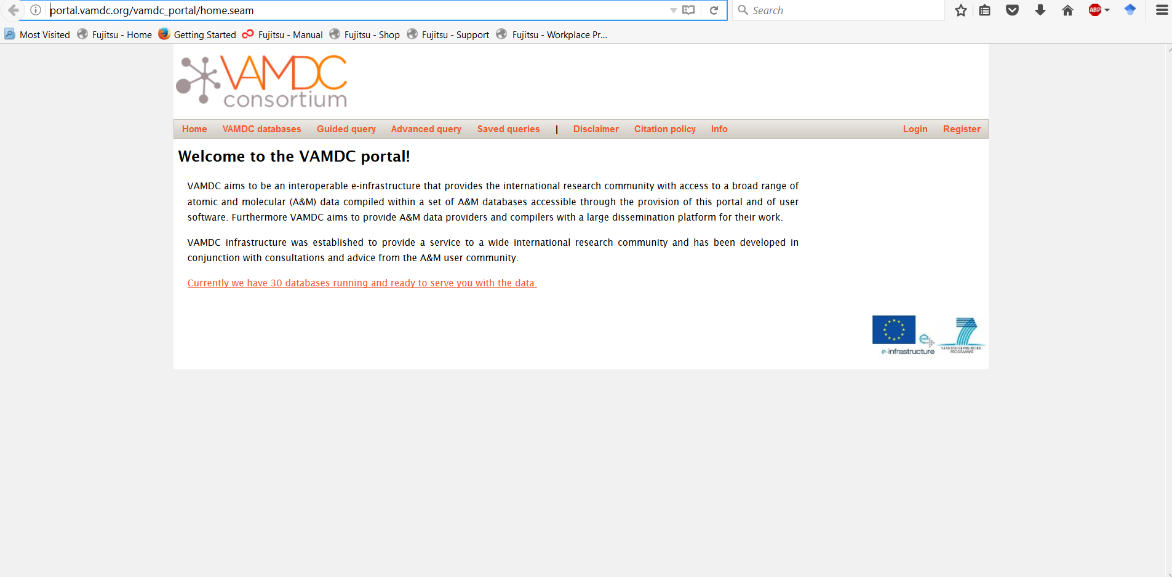
We are members of VAMDC consortium. It is Like Google but for atomic & molecular data as Milan said.

Slide 10
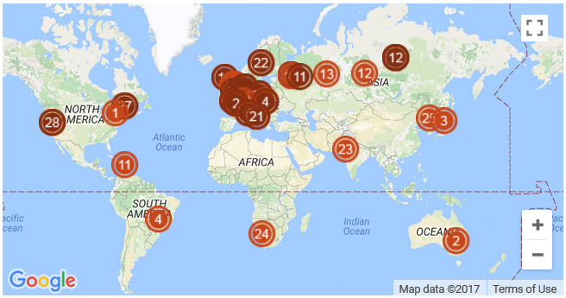
Countries VAMDC

Slide 11
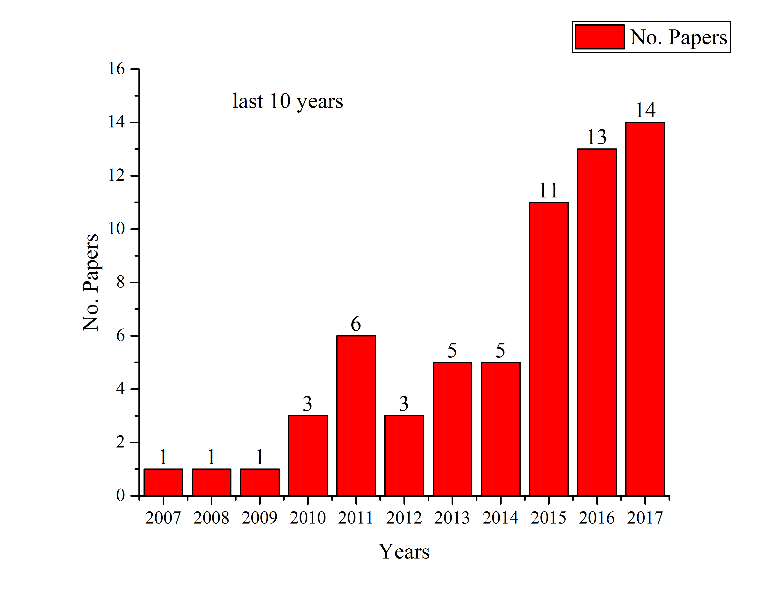
Lets back to my collaboration with Milan
My long-standing scientific cooperation with Milan Dimitrijevic lasts since 2000.
We have over 70 joint papers published in int. journals and presented on the conferences.
During the preparing of this lecture, I counted and analyzed our papers.
Still not the end of the year. You can see growing tendency
Fig: Papers with M.Dimitrijevic last 10 years

Slide 12
And this time I really thank Milan for the many years of successful cooperation.

Slide 13
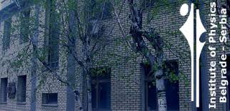
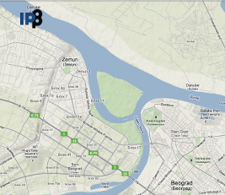
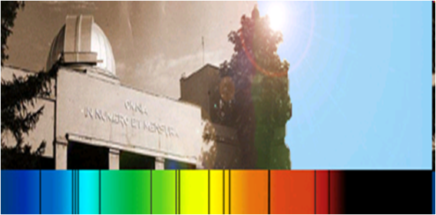
The team
Team: M.S. Dimitrijević
mdimitrijevic@aob.rs
Astronomical Observatory, Belgrade, Serbia
research interest: stark broadening; line profiles; stellar spectra; atomic and ionic collisions with formation of quasimolecules; atomic processes in white dwarfs and solar type stars; astroinformatics; databases; history and philosophy of science
Sreckovic Vladimir vlada@ipb.ac.rs
Institute of Physics Belgrade, University of Belgrade, Serbia
research interest: Solar and stellar astrophysics; High energy astrophysics; Atomic and ionic collisions with formation of quasimolecules; Atomic processes in white dwarfs and solar type stars; Astroinformatics; Databases; Space Weather studies of Upper Atmosphere; Ionospheric plasma Irregularities using VLF .
Also, people from the team:
Prof. dr. Lj.M. Ignjatović,
….dr. N. Sakan, …
Collaborators all over the world: Prof.Klucharev, Prof. Bezuglov …
and extended research with Jevremovic, Vujcic on databases and virtual astrophys.

Slide 14
In this talk, I will present the overview of our many years research:
Elementary processes in astrophysics traditionally attract researchers attention.
The first can be attributed to a group of ion-atom collision processes
The second can be attributed to a group of atom-atom i.e. chemi-ionization processes in Rydberg atom collisions with ground state parent atoms and inverse chemi-recombination processes.

Slide 15
COLLISIONAL PROCESSES
In a series of previous papers, two groups of ion-atom and atom-atom collisional processes have been studied from the point of view of their effect on the optical and kinetic properties of weakly ionized laboratory and astrophysical plasmas
ion-atom collisional processes
photodissociation / association,
and radiative charge exchange
1)
atom–(Rydberg)-atom collisional processes
chemi-ionization processes
2)
chemi-recombination processes

Slide 16
Here A and A⁺ are atoms and their positive ions in their ground states, A∗(n, l) is the atom in a highly excited (Rydberg) state with the principal quantum number n > 1 and orbital quantum number l, A₂⁺ is the corresponding molecular ion in the ground electronic state, and e is a free electron.
schematic a-i
schematic a-a
Fig. schematically shows the geometry of A*(n) + A collision
Potential curves of a symmetric atom–Rydberg atom system, A*(n) + A, as functions of the internuclear distance R

Slide 17
Here, we consider the most significant astrophysical cases where:
and
or
and
i.e. we investigate influence of these processes in the atmospheres of: DB, M red dwarfs, Solar

Slide 18
The influence of i-a processes (1) is estimated by comparing their intensities with the intensities of known concurrent radiative processes, namely:
(3)
(4)
(5)
Creation of negative ion
Effect of chemi-ionization and hemi - recombination processes (2) is evaluated by comparing their intensities with intensities of known concurrent ionization and recombination processes, namely:
(6)
(7)

Slide 19
Atmosphere of the Sun: visible spectral region
The contribution of ion-atom radiative collision to the opacity of the solar atmosphere in region >350nm
(1)
In the hydrogen case, the processes (1) are considered with reference to the photosphere and the lower solar chronosphere and are characterized by their spectral emissivity i.e. the spectral density of the radiation energy, which these processes generate from a unit volume per unit time, into a solid angle . The emissions that characterize the processes (3), (4), and (5) in the hydrogen case are denoted here by. In accordance with this, the influence of the processes (1) is estimated by the values ​​of the following parameters which are defined as functions of the height of the considered layer of the solar atmosphere on the basis of standard models
The spectral emissivity correspond to proc. (1)
Emission spectral coefficient
(3)
(4)
(5)
the influence of the processes (1) is estimated by the values ​​of the following parameters. Ratio of sp.emissivity of proc. (1)/(3;4;5) characterize the relative contribution of processes (1) in comparison with proc. (2),(3),(4)

Slide 20
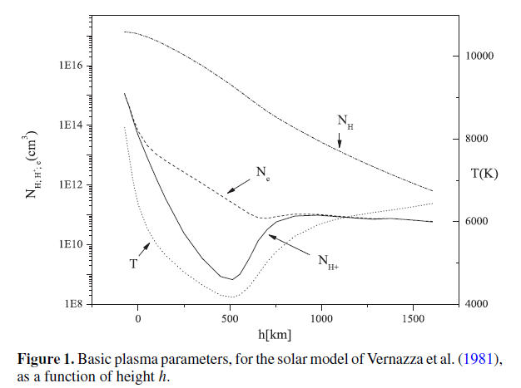
is > (3) and (4)
in some parts i.e. layers of
Solar atm.
Ne>N_{H+}
In some layers up to 10%
In some layers up to 10%
is up to 10%
of proc (5) in some parts
i.e. layers of
Solar atm.
These figures show that the overall contribution of processes (1) to the opacity of the solar atmosphere in the visible region must be taken into account, despite the presence of exceptionally intensive processes (5).

Slide 21
In Visible spectral region we conclude that:
We investigate the contribution to the opacity of the solar atmosphere of some processes other than formation and photodissociation of the H⁻ ion. We show that positive-ion-atom radiative collision processes are not negligible at certain layers of the photosphere and of the chromosphere.

Slide 22
Atmosphere of the sun: UV and VUV region.
In the far UV region processes emission channels (1) stop to play a role, while the role of absorption channels in this area is growing very rapidly. Accordingly, in the UV and VUV region effect of processes (1) is estimated by the parameter i.e. the ratio of the absorption coefficient of these processes and the absorption coefficient determined by the concurrent processes (3), (4) and (5) taken together. The results obtained are illustrated by the two figures below.
=(1)/(3;4;5)
(5)
(2a)
(4)
(3)
(2b)
κ is Spectr.abs.coeff
K abs rate.coeff

Slide 23
10%-90%
dominant

Slide 24
these processes are already included in some solar atmosphere models (Fontenla et al. 2009).

Slide 25
Helium – rich DB white dwarf atmospheres: the visible spectral region
In the case of helium processes (1) considered in relation to the photosphere DB white dwarfs with effective temperatures T_{eff} ≤ 16000K. The influence of these processes is estimated only by values ​​of the 2 parameters since in the helium case there is no stable negative ion
Ion-atom
concurrent
(4)
(3)
(5)
We will determine the relative contribution of the processes 1a,b in comparison with electron-atom processes and electron-ion processes using the quantities
The contribution of processes to the plasma absorption and emission continuous spectra is characterized by the absorption coefficients and the spectral emissivities

Slide 26
dominant
In some layers from 10% - 40%

Slide 27
contribution of the ion-atom processes in DB white dwarf atmospheres: the UV and VUV regions
In the far UV region processes emission channels (1) stop to play a role, while the role of absorption
channels in this area is growing very rapidly.
Ion-atom
concurrent
(4)
(1)
(3)

Slide 28
From 80nm to 250nm our dominant
From 80nm to 250nm our dominant
<80nm H phi dominant
According to the model of Koester the ratio of hydrogen and helium abundances for the considered DB wd atmosphere is 10⁻⁵ and H photoionization should be treated as important abs.process < H ionization boundary 91.13nm
The ion-atom processes in the region 80nm≤λ≤200nm dominate in comparison with the concurrent processes (3) and (4) while in the region λ > 200nm the He⁻ absorption process (4) have the principal role.

Slide 29
NON-Symmetric ion-atom
Next time
Solar
DB
where X is metal atom

Slide 30
Atom – atom coll. Proc.

Slide 31
atom–(Rydberg)-atom collisional processes: Solar atmosphere
Effect of chemi-ionization and hemi - recombination processes (2) is evaluated by comparing their intensities with intensities of known concurrent ionization and recombination processes, namely:
chemi-ionization processes
2)
chemi-recombination processes
(6)
(7)
In this study the chemi-ionization and chemi-recombination processes (2) considered first in terms of their effect on the populations of the excited states of the hydrogen atom in the solar atmospheres and colder stars, as in the population of the excited states of the helium atom DB white dwarfs. Comparative estimates of the influence of these and competing processes (6) and (7) are given, which are given by the values ​​of the following parameters:
RECOMBINATION PROCESSES
Samo recomb.proc.

Slide 32
RECOMBINATION PROCESSES
The results obtained in the case of the photosphere and the lower chromosphere of the sun are presented in the following two figures. These figures show that in this case processes (2) dominate with respect to the photo-recombination process (6) and that their intensity is close to the intensity of triple electron-electron-ion recombination processes (7).

Slide 33
ApJS2011
Extend for chemi recomb. n=2,3
+ chemi –ion
We compare with concurrent ioniz./ recomb. processes
The results demonstrate considered chemi-ionization /recombination have significant influence on the optical properties of the solar photosphere in comparison with the concurrent electron-atom impact ionization and electron-ion recomb. processes.

Slide 34
Partial parameter F(n) ioniz.

Slide 35
MNRAS 2016 correction by including mixing

Slide 36
ATOM-ATOM PROCESSES IN LOW-TEMPERATURE LAYERS OF HELIUM-RICH DB WHITE DWARF ATMOSPHERES
Concurrent processes
Partial parameter F(n)

Slide 37
Rate coeff.

Slide 38
partial parameter F(n)

Slide 39
MNRAS 2016 correction by including mix

Slide 40
Atmosphere M red dwarfs (PHOENIX Program)
1. Influence of chemi-ionization and chemi-recombination processes on the population of higher states of hydrogen in the layers of a stellar atmosphere.
In Figs. 1 and 2 is shown that the chemi-ioniz./recombination processes in the region n from 4 to 8 influence to the population of all hydrogen exited states with n>3. In figs is presented the ratio of the exited states population calculated with and without these processes. ζ≠1
Excited state population ratio

Slide 41
Also, chemi-ioniz/recomb. processes in the whole region of n>1 influence to the free electron density. Fig shows the behavior of free electron density calculated with these processes (solid curve) and without them(dashed).
2. Influence of chemi-ionization and chemi-recombination processes on hydrogen line shapes in M red dwarfs
The presented results suggest that the chemi-ioniz/recomb. processes due to their influence on the excited state population and free electron density should influence on the atomic spectral line shapes. This assumption is confirmed by following figures which show the profiles of some hydrogen spectral lines calculated with and without these processes.

Slide 44
Thank you for your attention

Slide 46
references
1. Mihajlov A.A., M.S. Dimitrijevic, Ignjatovic Lj.M., A&A, 276, p. 187-192, (1993)
2. Mihajlov A.A., Dimitrijevic M.S., Ignjatovic Lj.M., and Djuric Z., A&AS, 103, p. 57-66, (1993)
3. Mihajlov A.A., Dimitrijevic M.S., Ignjatovic Lj.M., A&A, 287, p. 1026-1028, (1994)
5. Mihajlov A.A., Dimitrijevic M.S., Ignjatovic Lj.M., and Djuric Z., Astrophys. J., 454, p.420-428, (1995)
6. Mihajlov A.A., Ignjatović Lj.M., Sakan N.M. and Dimitrijević M.S., A&A, Volume 469, Issue 2, pp.749-754 (2007)
7. Mihajlov A A, Ljepojevic N N, Dimitrijevic M S., J. Phys. B, 25, 5121, 1992
8. Mihajlov A A, Dimitrijevic M S, Djuric Z., Physica Scripta, 53, 159--166, 1996
9. Mihajlov A A, Dimitrijevic A A, Ignjatovic Lj M, Vasilijevic M.M., Astronomical and Astrophysical Transactions, 18,145--149, 1999
10. Mihajlov A A, Jevremovic D, Hauschildt P, Dimitrijevic M S, Ignjatovic Lj. M, Alard F., A&A, 403, 787--791, 2003.
11. Mihajlov A.A., Ignjatovic Lj.M., Dimitrijevic M.S., and Djuric Z., ApJSS, 147, p.369-377, (2003)
12. Ignjatovic Lj M, Mihajlov A A, Phys. Rev. A, 72, 022715, 2005
13. Mihajlov A. A., N. N. Ljepojevic, M. S. Dimitrijevic, M. S., J. Phys. B 25, 5121 (1992).
14. Mihajlov A. A., M. S. Dimitrijevic, Z. Djuric, Phys. Scr. 53, 159 (1996).
15. Mihajlov A. A., Lj. M. Ignjatovic, M. M. Vasiljevic, M. S. Dimitrijevic, A&A 324, 1206 (1997).
16. Mihajlov A. A., D. Jevremovic, P. Hauschildt, M. S. Dimitrijevic, Lj. M. Ignjatovic, F. Alard, A&A 403, 787 (2003).
17. Mihajlov A. A., Z. Djuric, M. S. Dimitrijevic, N. N. Ljepojevic, Phys. Scr. 56, 631 (1997).
18. Vernazza, J. E., Avrett, E. H., Loeser, R., 1981, ApJS 45, 635
19. Maltby, P., Avrett, E.H., Carlsson, M., Kjeldseth-Moe, O., Kurucz, R.L., Loeser, R., 1986, ApJ 306, 284]
20. Koester, D. A&AS, 39, 401 (1980).
Mihajlov A.A., Jevremovic D., Hauschildt P., Dimitrijevic M.S., Ignjatovic Lj.M., and Alard F., A&A, Volume 471, Issue 2, pp.671-673 (2007).
Lj.M. Ignjatovic, A.A. Mihajlov, V.A. Sreckovic, M.S. Dimitrijevic, MNRAS 441, 1504 (2014)
Lj.M. Ignjatovic, A.A. Mihajlov, A.V. Sreckovic, M.S.Dimitrijevic, MNRAS 439, 2342 (2014)
V.A. Sreckovic, A.A. Mihajlov, Lj.M. Ignjatovic, M.S. Dimitrijevic, Adv. Space Res. 54, 1264 (2014)
V. Vujcic, D. Jevremovic, A.A. Mihajlov, Lj.M. Ignjatovic, V.A. Sreckovic, M.S. Dimitrijevic, M. Malovic, JA&A 36, 693 (2015) Mihajlov, A. A., Ignjatovic, L. M., Sreckovic, V. A., & Dimitri-
jevic, M. S. 2011, ApJS, 193, 2
Mihajlov, A. A., Ignjatovic, L. M., Sreckovic, V. A., & Dimitri-
jevic, M. S. 2011b, Baltic Astronomy, 20, 566
Mihajlov, A. A., Sreckovic, V. A., Ignjatovic, L. M., & Klyucharev
A.N. 2012, Journal of Cluster Science, 23 ,47
O'Kee
e, P., Bolognesi, P., Avaldi, L., et al. 2012, Phys. Rev. A,
85, 052705

