Slide 1
Line shifts in laboratory plasma
B. Obradović¹, M.Ivković², N. Cvetanović¹, S. Ivković¹,
I. Krstić¹, G. Sretenović¹, V. Kovačević¹, M. Kuraica¹
¹University of Belgrade, Faculty of Physics, Belgrade, Serbia
²University of Belgrade, Institute of Physics, Belgrade, Serbia

Slide 2
Line shifts in electrical discharges
- Stark shift (macroscopic field)
- Stark shift (microscopic field)
- Doppler shift
Stark polarization spectroscopy
Stark spectroscopy

Slide 3
Stark shifts in electrical discharges
Stark shift (microscopic field)
Stark shift (macroscopic field)
Stark spectroscopy
Stark polarization spectroscopy
Measurement of electron number density
Testing theoretical models
Measurement of electric field
Investigating of discharge characteristics

Slide 4
Hydrogen Balmer alpha line
low pressure discharge in Townsend mode
to spectrometer
end-on observation
to spectrometer
side-on observation
d =1mm
H₂ 6mbar

Slide 5
Hydrogen Balmer alpha line – end on
to spectrometer
end-on observation

Slide 6
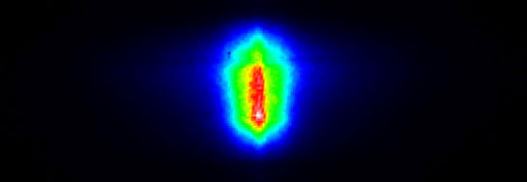
Hydrogen Balmer alpha line - unpolarized
to spectrometer
side-on observation
Cathode
Anode

Slide 7
Hydrogen Balmer alpha line – π polarized
to spectrometer
side-on observation
Cathode
Anode

Slide 8
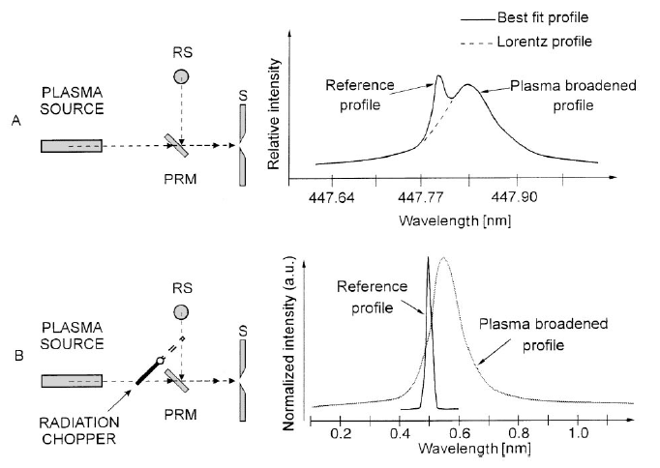
Procedure for line shift measurement
N. Konjevic, Physics Reports 316 (1999) 339

Slide 9
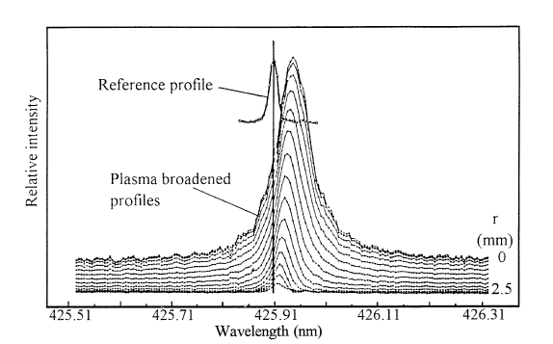
Line shift measurement
S. Djurovic, Z. Mijatovic, R. Kobilarov, N. Konjevic, J. Quant. Spectrosc. Radiat. Transfer 57 (1997) 695

Slide 10
How to obtain reference (unshifted) line?
Low pressure plasma source (pen lights, HCD lamps…) - great difference in optical intensity, different optical paths
Spectra of well studied element - e.g. Fe I lines
Lines at late times during plasma decay - low accuracy
Plasma jet (low Ne) from same source

Slide 11
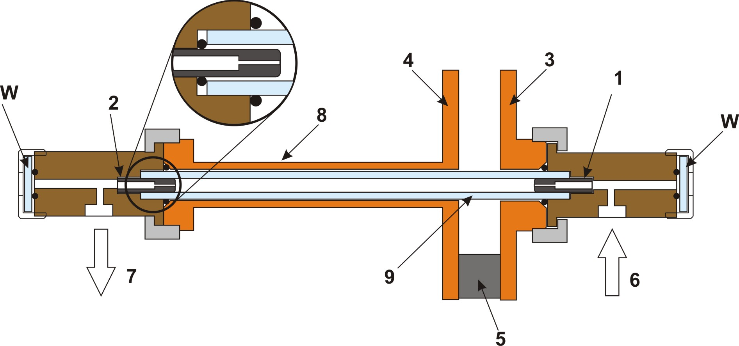
Nouniform plasma – foe or friend
in line shift measurement?
Discharge tube: 1) cathode, 2) anode, 3) and 4) cathode and anode electric connection with capacitor, 5) insulator, 6) gas inlet, 7) gas outlet, 8) coaxial current connector with the cathode made of brass tubing, 9) glass tube and W - window

Slide 12
Spectra recording of the Hα line together with several neutral helium lines
Lines emitted
from plasma jet
M Ivković, T Gajo, I Savić, N Konjević, JQSTR 161 (2015) 197–202

Slide 13
Examples of measured Stark shifts – He I 706.522 nm
M Ivković, T Gajo, I Savić, N Konjević, JQSTR 161 (2015) 197–202

Slide 14
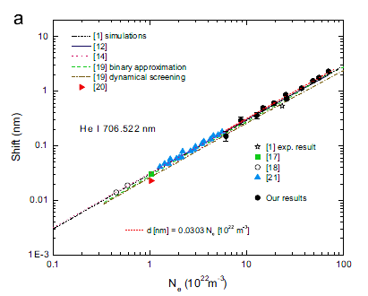
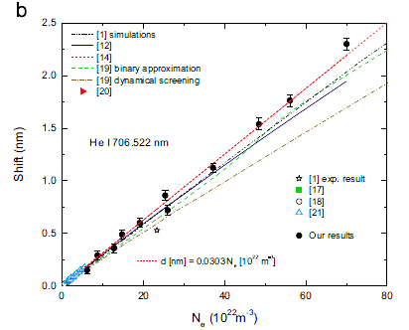
Comparison of measured Stark shifts – He I 706.522 nm
M Ivković, T Gajo, I Savić, N Konjević, JQSTR 161 (2015) 197–202

Slide 15
Examples of measured Stark shifts - HeI 728.1 nm

Slide 16
Separation between F and A component of He I 447.1 nm line

Slide 17
Examples of measured Stark shifts – He I 492.19 nm

Slide 18
Examples of measured Stark shifts – He I 492.19 nm

Slide 19
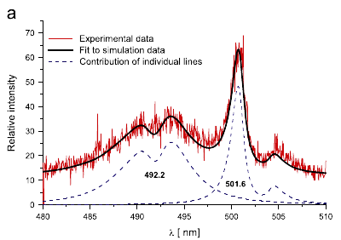
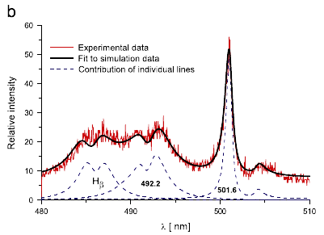
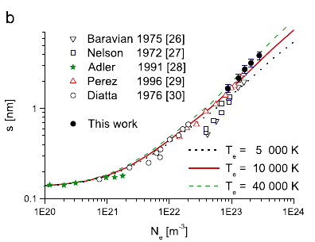
Examples of line profiles and fitting – He I 492.19 nm
M. Ivković, M. A. Gonzalez, N. Lara, M. A. Gigosos, N. Konjević, JQSRT 127(2013) 82 – 89

Slide 20
Examples of line profiles and fitting – He I 492.19 nm

Slide 21
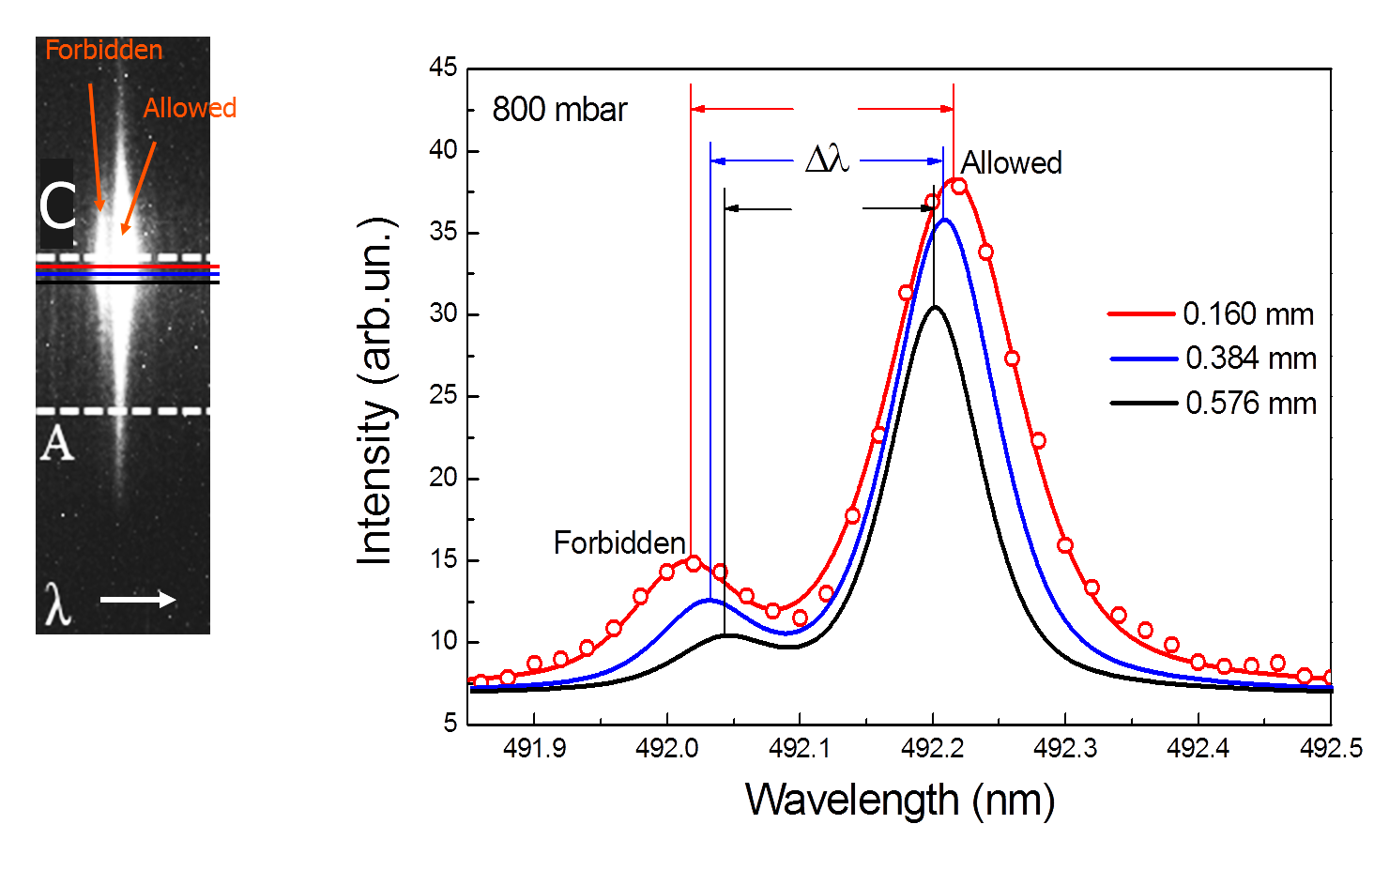
He I 492.19 nm in macroscopic electric field in DBD
S S Ivković, B M Obradović, N Cvetanović, M M Kuraica and J Purić, J. Phys. D: Appl. Phys. 42 (2009) 225206

Slide 22
Influence of the pressure on He I 492.2 nm line

Slide 23
Influence of the pressure on He I 492.2 nm line

Slide 24
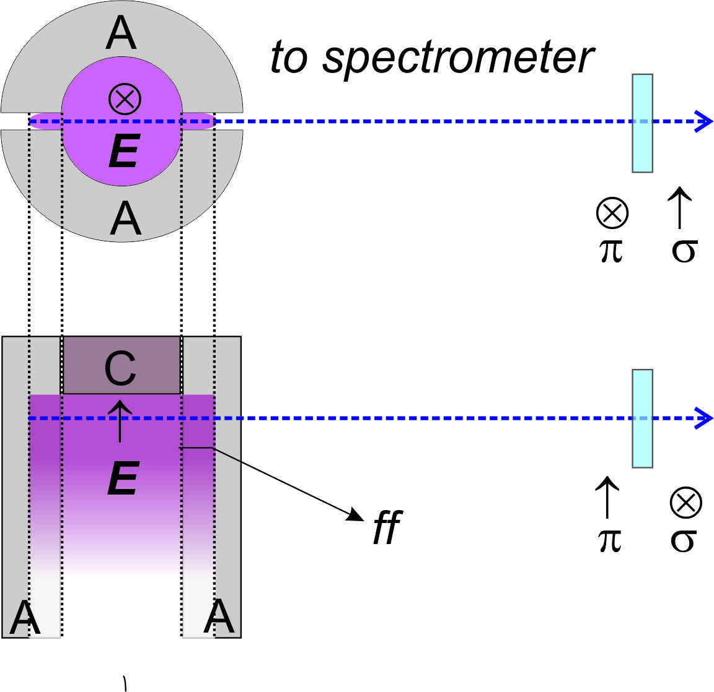
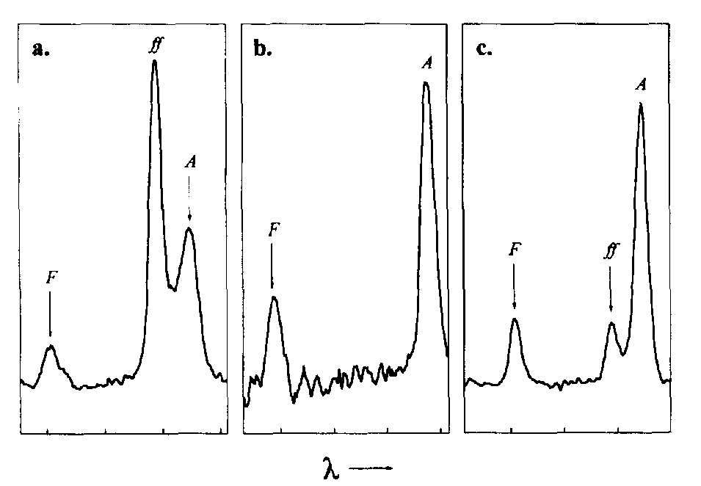
Nouniform plasma – foe or friend
in line shift measurement?
M.M. Kuraica, N. Konjević, I.R. Videnović, Spectrochim. Acta B 52 (1997) 745

Slide 25
Nouniform plasma – foe or friend
in line shift measurement?
B.M. Obradović, M.M. Kuraica, Physics Letters A 372 (2008) 137–140

Slide 26
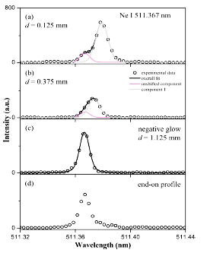
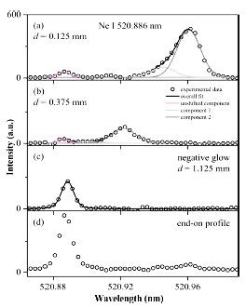
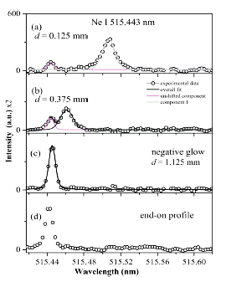
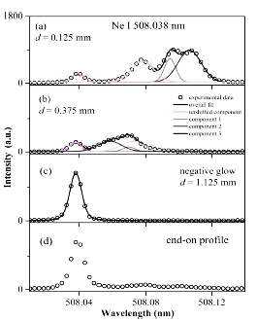
Nouniform plasma – foe or friend
in line shift measurement?
N. M. Šišović,et al, J. Anal. At. Spectrom., 29 (2014) 2058–2063

Slide 27
Nouniform plasma – foe or friend
in line shift measurement?
Dielectric Barrier Discharge at 1000 mbar

Slide 28
Nouniform plasma – foe or friend
in line shift measurement?
DBD plasma jet
“plasma bullet”
to spectrometer
Carbone E and Nijdam S 2014 Plasma Sources Sci. Technol. 23 012001
G.B. Sretenović , I.B. Krstić, V.V. Kovačević , B.M. Obradović and M.M. Kuraica, Appl. Phys. Lett. 99, 161502 (2011)

Slide 29
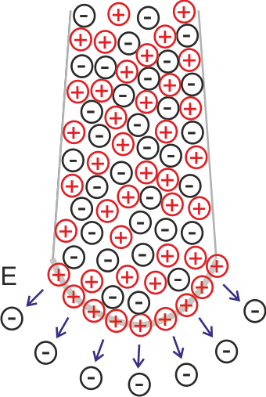
“plasma bullet”
or guided streamer
d = 0.03 mm
Notes:
This is an illustration of the origin of line components in the measured overall profile. The shifted forbidden and allowed components come from the front of the streamer head where nearly directed electric field is present.

Slide 30
“plasma bullet”
or guided streamer
d = 0.03 mm
Notes:
We presume that the most intensity of the FF component comes from plasma streamer tail.

Slide 31
Doppler shift in hollow cathode discharge
H⁺ _{fast} + H_{2 slow} → H _{fast} + H₂⁺_{slow}

Slide 32
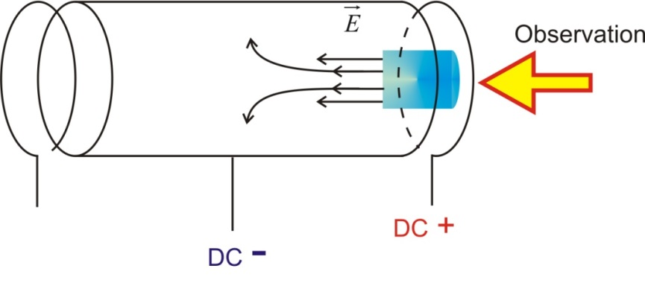
Doppler shift of hydrogen Balmer lines

Slide 33
Doppler shift of hydrogen Balmer lines

Slide 34
N⁺ _{fast} + N_{2 slow} → N _{fast} + N₂⁺_{slow}

Slide 37
O⁺ _{fast} + O_{2 slow} → O _{fast} + O₂⁺_{slow}

Slide 40
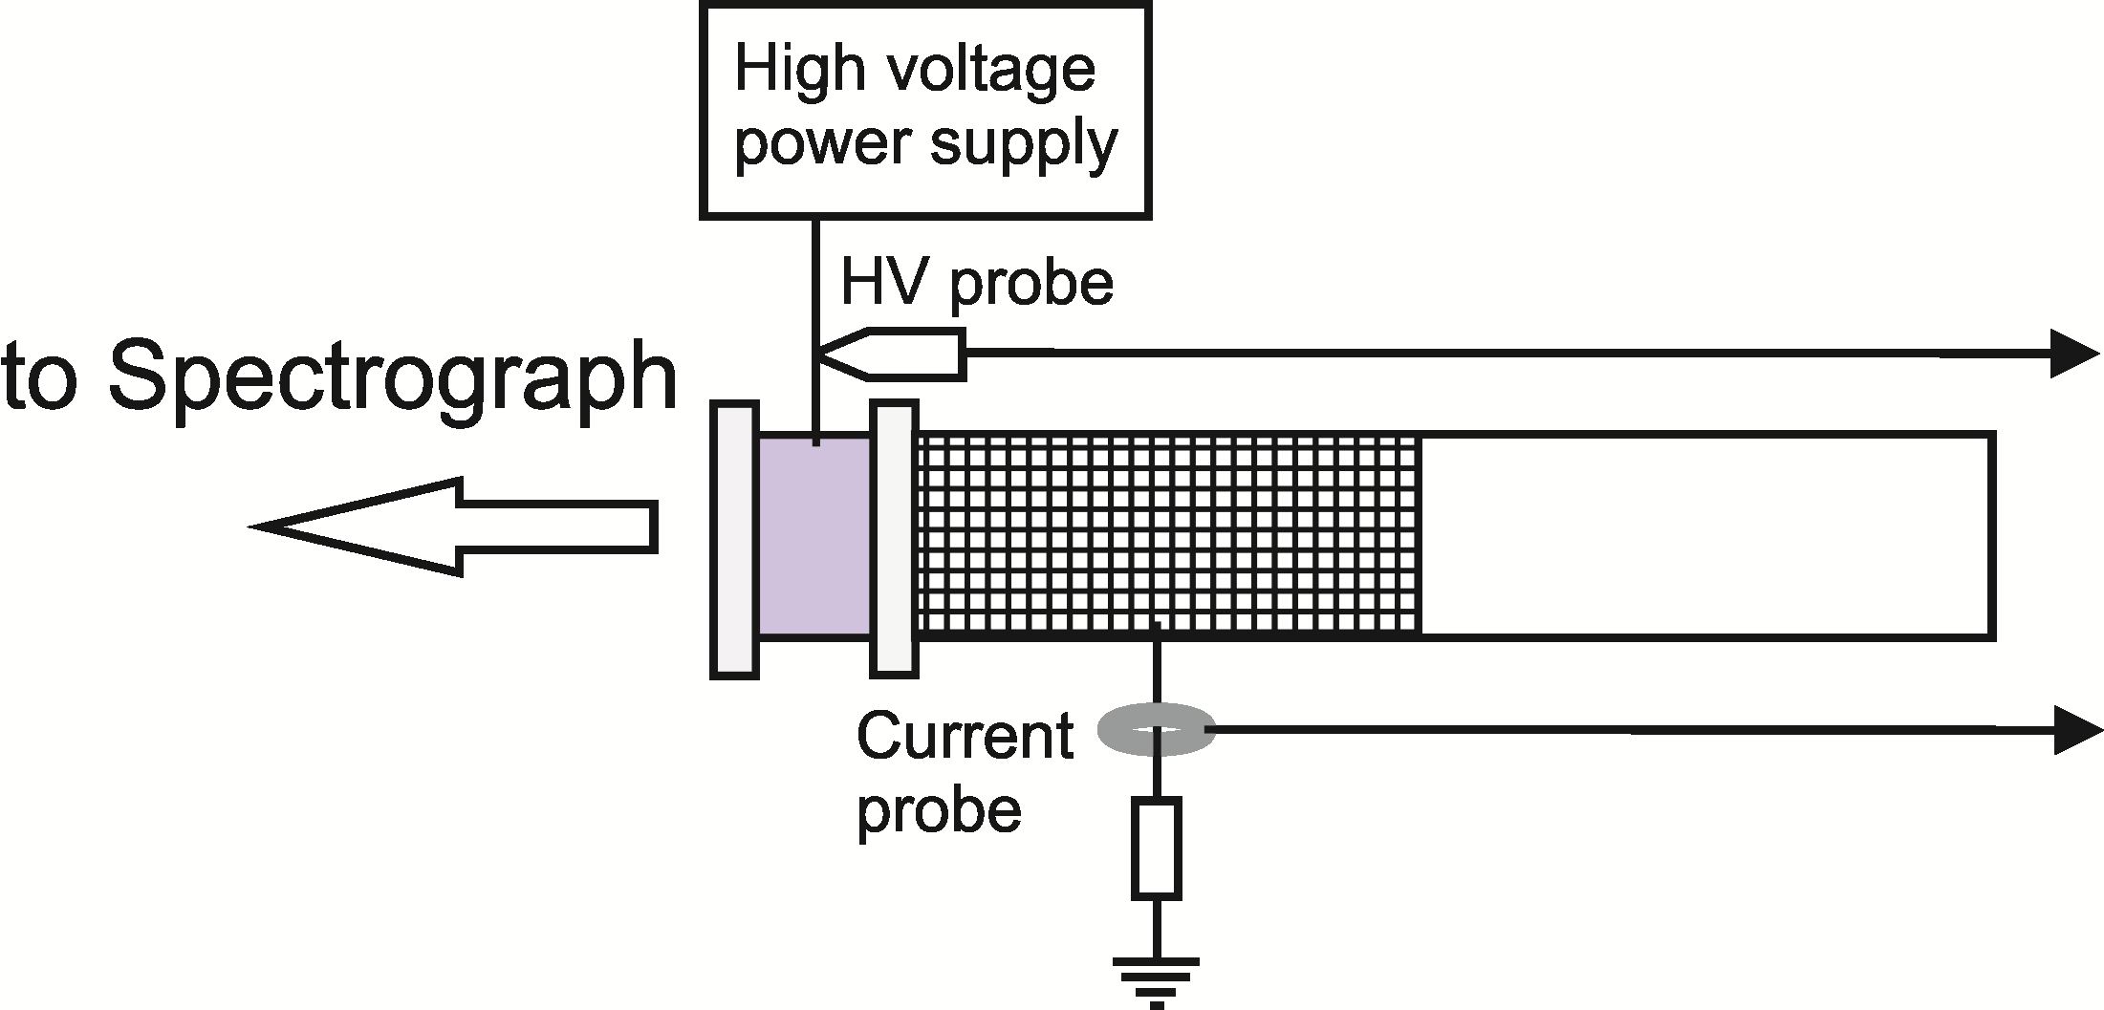
Study of the dynamics of a barrier hollow-cathode discharge using a broadened Hα line
E

Slide 41
C
A
-
+
+
H⁺ _{fast} + H_{2 slow} → H _{fast} + H₂⁺_{slow}
+
H⁺
H₂⁺
+
-
+
C
E

Slide 42
C
e⁻+ H₂ → H*+ H + e⁻
A
-
+
-
+
-
+
C
E

Slide 43
C
e⁻+ H → H*+ e⁻
A
-
+
-
+
-
+
C
E

Slide 44
Study of the dynamics of a barrier hollow-cathode discharge using a broadened Hα line

Slide 45
Study of the dynamics of a barrier hollow-cathode discharge using a broadened Hα line

Slide 46
Study of the dynamics of a barrier hollow-cathode discharge using a broadened Hα line

Slide 47
Study of the dynamics of a barrier hollow-cathode discharge using a broadened Hα line

Slide 48
Study of the dynamics of a barrier hollow-cathode discharge using a broadened Hα line

Slide 49
Study of the dynamics of a barrier hollow-cathode discharge using a broadened Hα line

Slide 50
Study of the dynamics of a barrier hollow-cathode discharge using a broadened Hα line
B M Obradović, S S Ivković, N Cvetanović and M M Kuraica, Plasma Sources Sci. Technol. 23 (2014) 015021

Slide 51
Study of the dynamics of a barrier hollow-cathode discharge using a broadened Hα line

Slide 52
Thank you for your attention!

