Slide 1
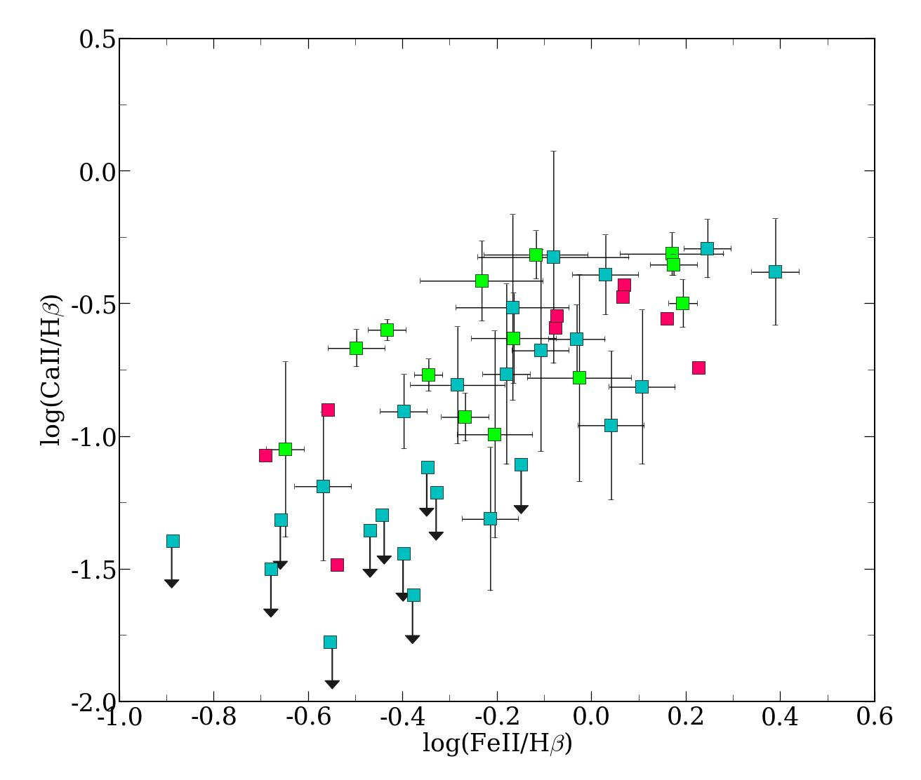
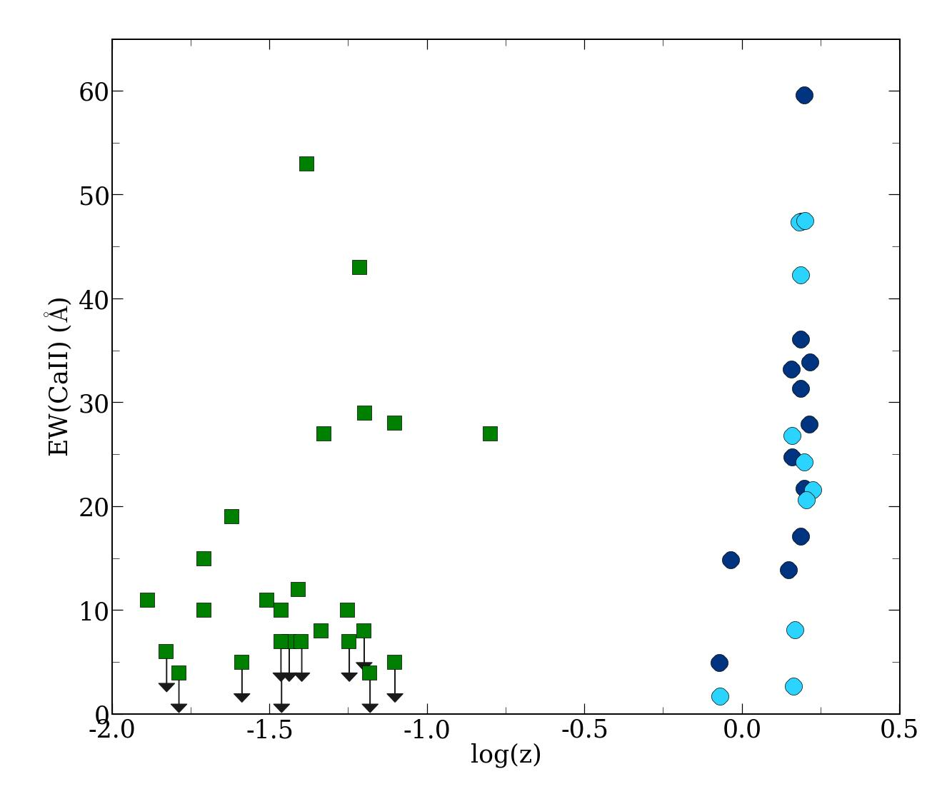
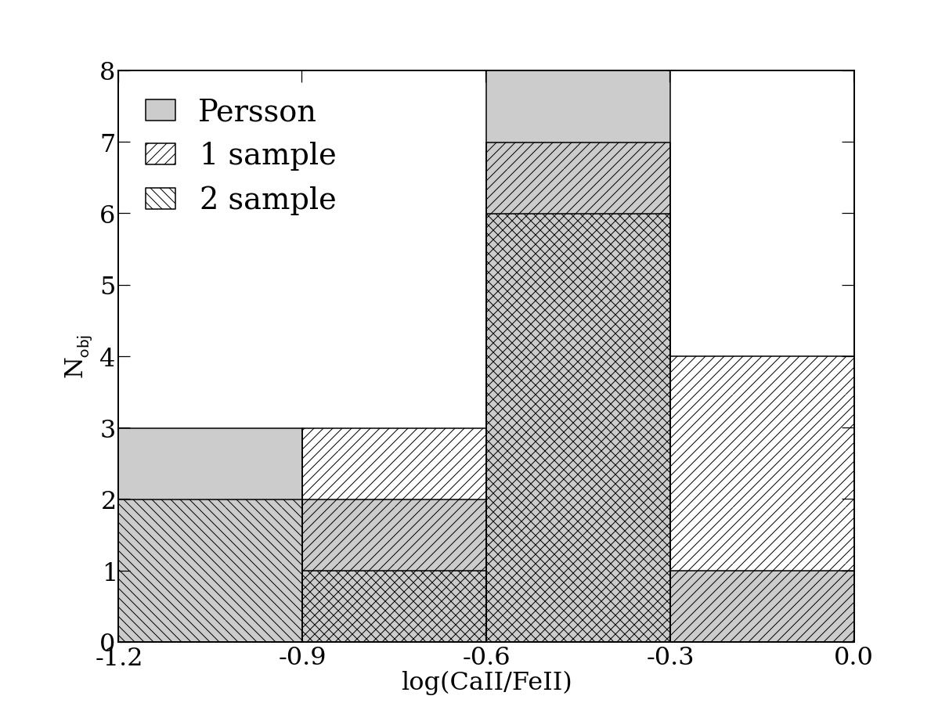
Observations of the Ca II IR triplet in high luminosity Quasars: Expanding the sample
Mary Loli Martínez-Aldama et al.
VLT ISAAC data: sample of 30 sources from HE survey at z>0.9; CaII covered in the IR
Correlation between CaII IR/Hβ and FeII/Hβ:
supports photoionization as emission mechanism for FeII
Larger CaII/FeII ratio and CaII EW at high z: enrichment by recent SF?

