Slide 1




NewCompStar
http://compstar.uni-frankfurt.de/
Previously ESF funded RTN CompStar has been relaunched through a COST Action on physics and astrophysics of compact stars.
Official kick-off was on 25.11.13, and will run till 25.11.2017
29 countries have joined so far: Austria, Belgium, Bulgaria, Croatia, Czech Republic, Denmark, Finland, France, Germany, Greece, Hungary, Iceland, Ireland, Isreal, Italy, Malta, Netherlands, Norway, Poland, Portugal, Romania, Serbia, Slovakia, Slovenia, Spain, Sweden, Switzerland, Turkey, United Kingdom.
Participating near neighbouring countries: The Russian Federation and Armenia, with Australia being an international partner.

Slide 2

Driven by science to exploit synergies
The Action wants to address a few fundamental but challenging questions concerning the physics and astrophysics of compact stars.
astrophysics
The Action brings together leading European experts in astrophysics, nuclear physics and gravitational physics through interdisciplinary approach.
compact stars
The Action has three working groups (WGs), one for thematic area. WGs are open to anyone wishing to join.
gravitational
physics
nuclear physics

Slide 3
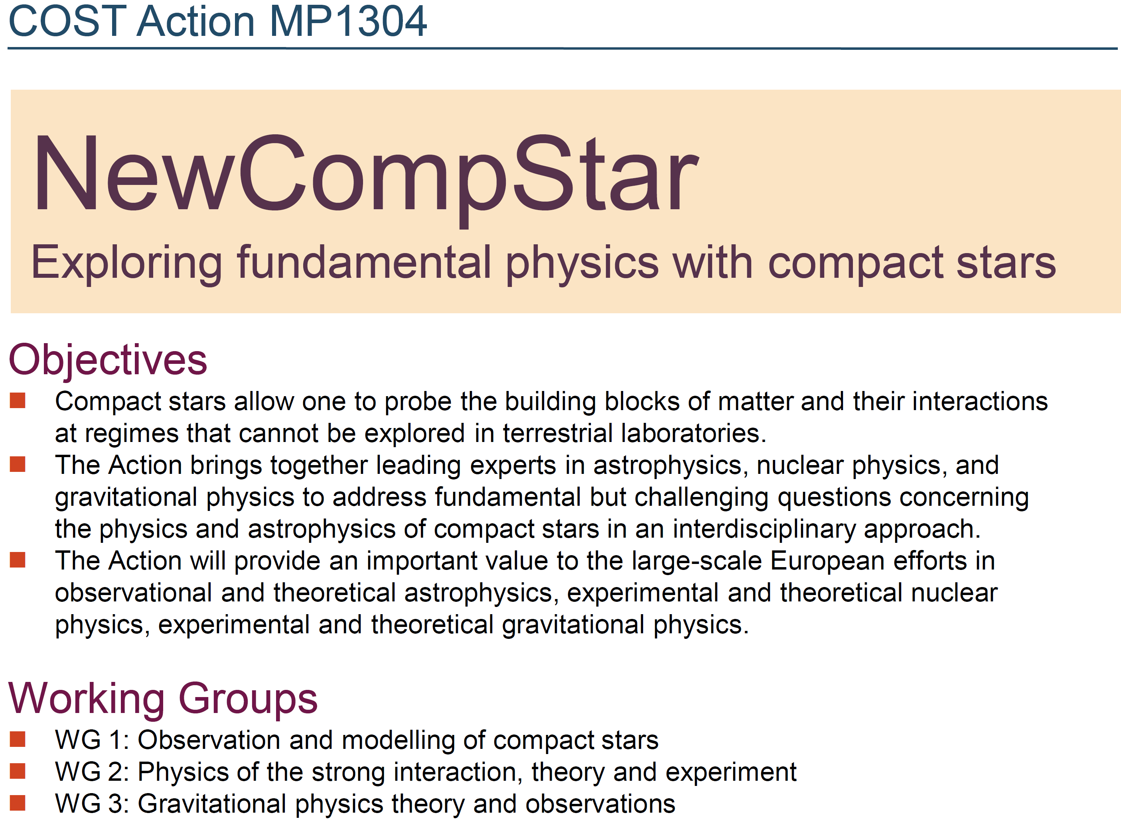

Slide 4
Organization
NewCompStar is chaired by L. Rezzolla (Frankfurt) and by P. Pizzochero (deputy, Milano)
WG1
WGL1
Each working group has a leader (WGL), ensuring that the scientific goals are met:
J. Pons for astrophysics
I. Jones for gravitational physics
J. Margueron for nuclear physics.
SA-13
SA-12
WGL3
WGL2
SA-23
Synergy Agents (SAs): responsible for the synergy between two or more WGs and provide recommendations to the WGLs.
WG3
WG2

Slide 5
Short Scientific Missions STSMs
Very important are also the short-term scientific missions, to which a substantial part of the yearly budget is allocated.
STSMs are a great opportunity for all scientists within the Action to exchange visits, nurture collaborations, or develop new ones.
In 2014 more than 25 such missions were granted
In 2015 a similar number is expected in 2015, with three different calls for applications will be made.
Any scientist in working in an institute of the 29 participating countries can apply; success rate is usually very high: ~ 80%.

Slide 6
Activities: 2014
Compact Stars in the QCD Phase Diagram IV. 26-30 September, 2014, Prerow, Baltic coast (Germany).
Pulsars and their environments.19-21 May 2014, Institute de Physique Nucleaire de Lyon (INPL), Lyon (France).
The Structure and Signals of Neutron Stars, from Birth to Death. 24-28 March 2014. The Galileo Galilei Institute for Theoretical Physics, Arcetri, Florence (Italy).
Working Groups (WG2/WG3) and CompOSE meeting. 17-19 November, Lyon (France).
Working Group Meeting (WG1) in coincidence with the NewCompStar School. 23 September, 2014, Barcelona (Spain).

Slide 7
Activities: 2015
Annual NewCompStar Conference. June 15-19, 2015, Budapest (Hungary).
Modern Physics of Compact Stars (WG2 Meeting), Sept. 30 – Oct. 3, 2015, Yerevan (Armenia)
(Non-)Universal Properties of Neutron Stars (WG3 Meeting), 18-20 May, 2015, Bremen (Germany).
Observations & theory in the dynamics of neutron stars (WG2 Meeting), 26-30 January, 2015, Trento (Italy).

