Slide 1
Binarity in AGN and Microquasars
Edi Bon

Slide 2
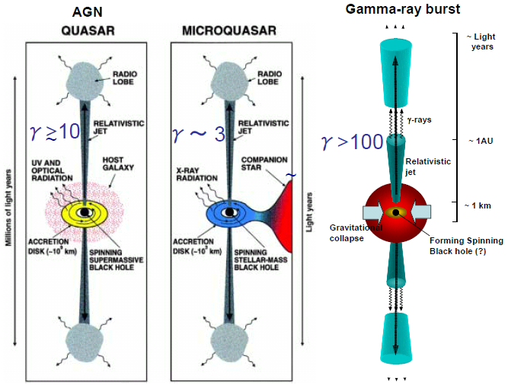

Slide 4
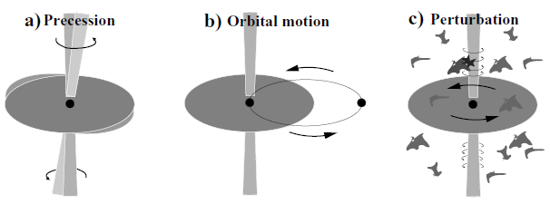
Jet Wobbling
15 GHz VLBI image of 4C+12.50
High resolution VLBI observations of some AGN jets show regular or irregular swings of innermost jet structural position angle (jet wobbling).
Parsec scale AGN jet curvatures and helical-like structures (inner parsec or large scale) are believed to be triggered by changes in direction at the jet nozzle.
Physical origin of jet wobbling (Agudo 2009)
  Accretion disk precession
  Orbital motion of accretion system (binary BH?)
  Jet instabilities
Position angle oscillation of 3C273
P.A.
year
Notes:
<number>

Slide 5
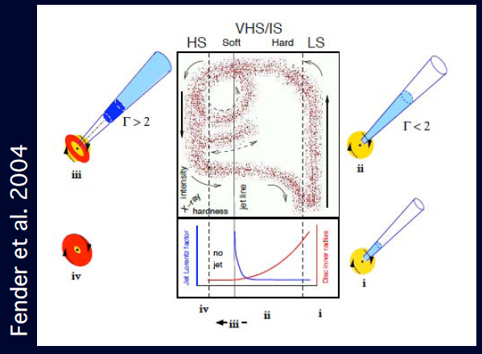
State changes and ejection
Conjecture: spectral state change are associated with
major relativistic ejections (Fender & collaborators).

Slide 6
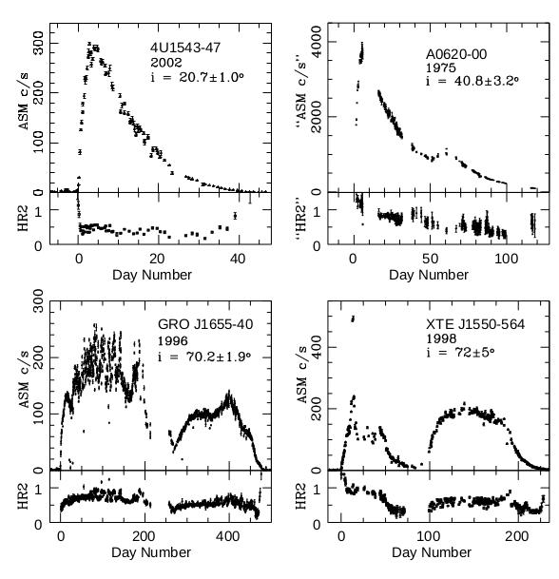
Narayan, Ramesh; McClintock, Jeffrey E.
2005ApJ...623.1017N

Slide 7
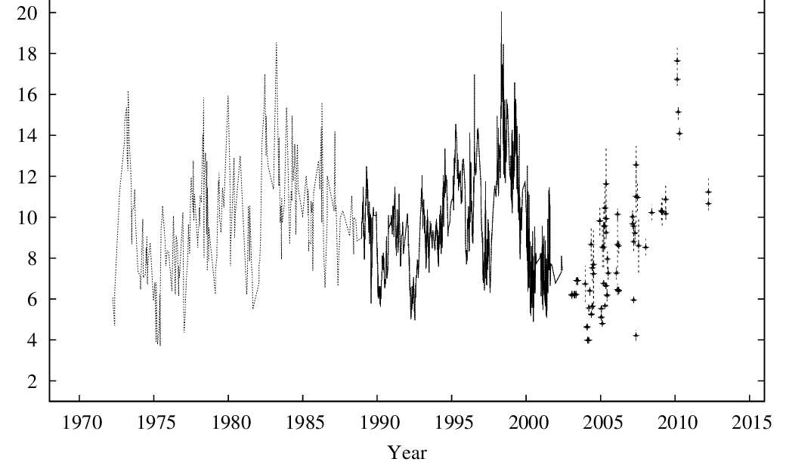
NGC5548

Slide 8
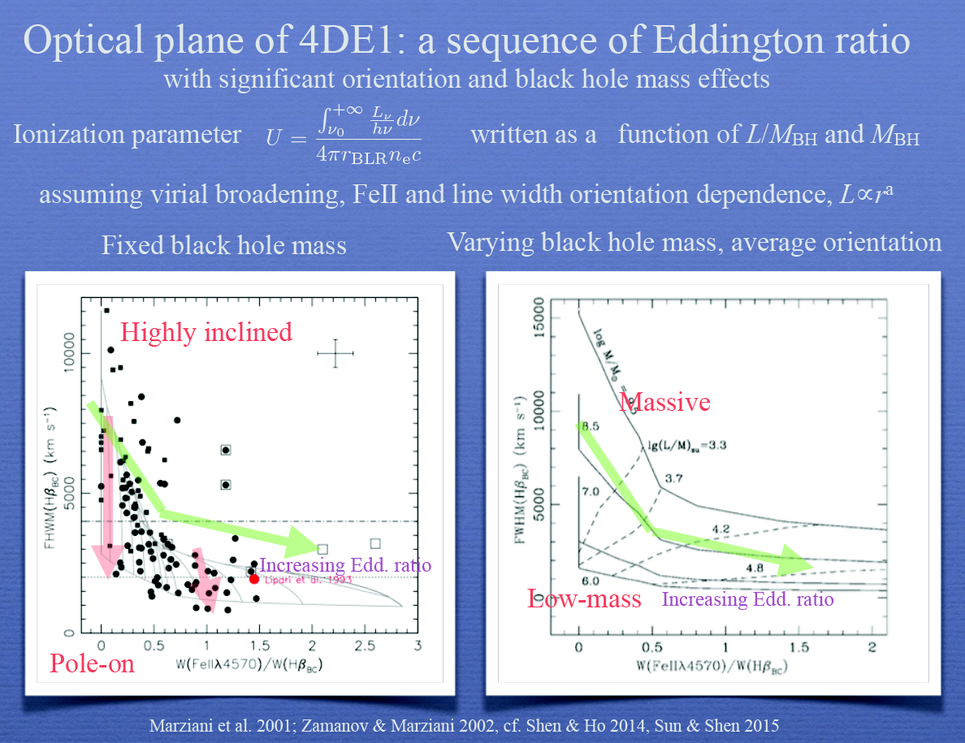

Slide 9
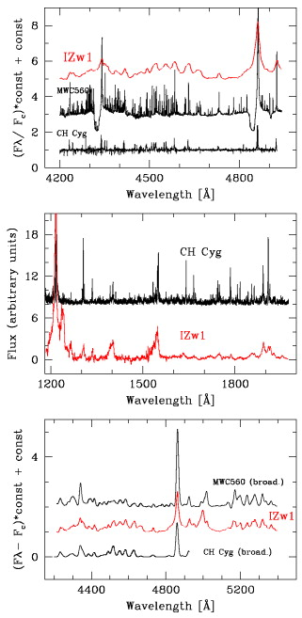

Slide 10

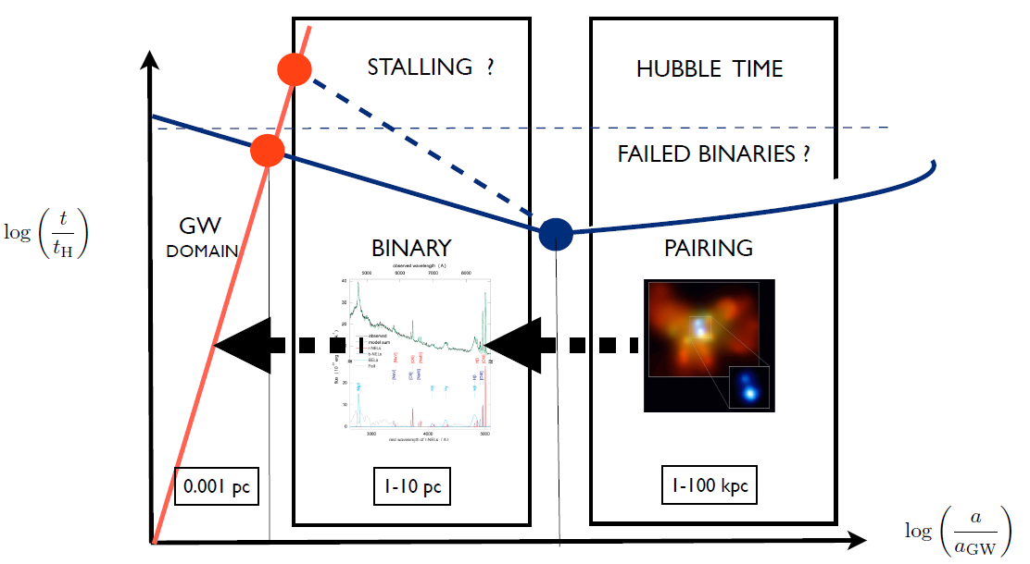
We see many merging galaxies and traces of mergers =>
  Where do SMBHs after merging end up?
From many simulations =>
  we expect to find traces of coalescing BHS in Hubble time
  Where are they?
See more in Mirosavljevic & Meritt 2001

Slide 11
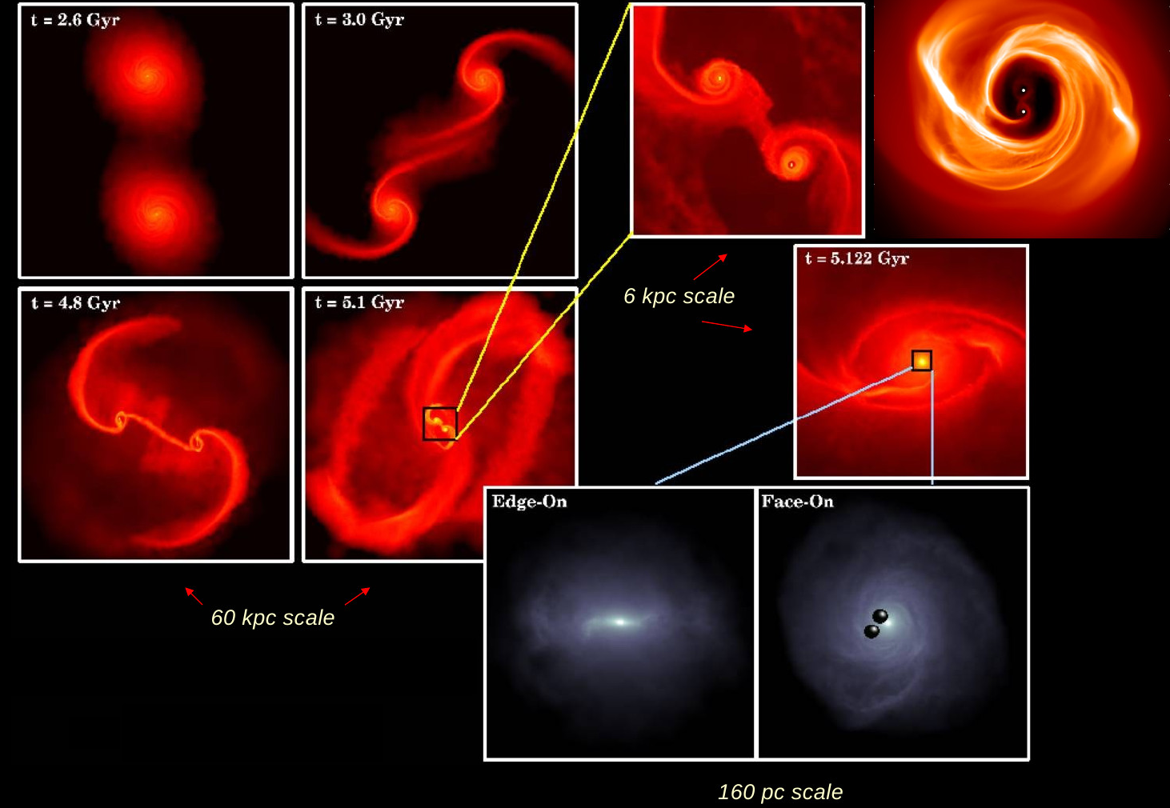

Slide 12
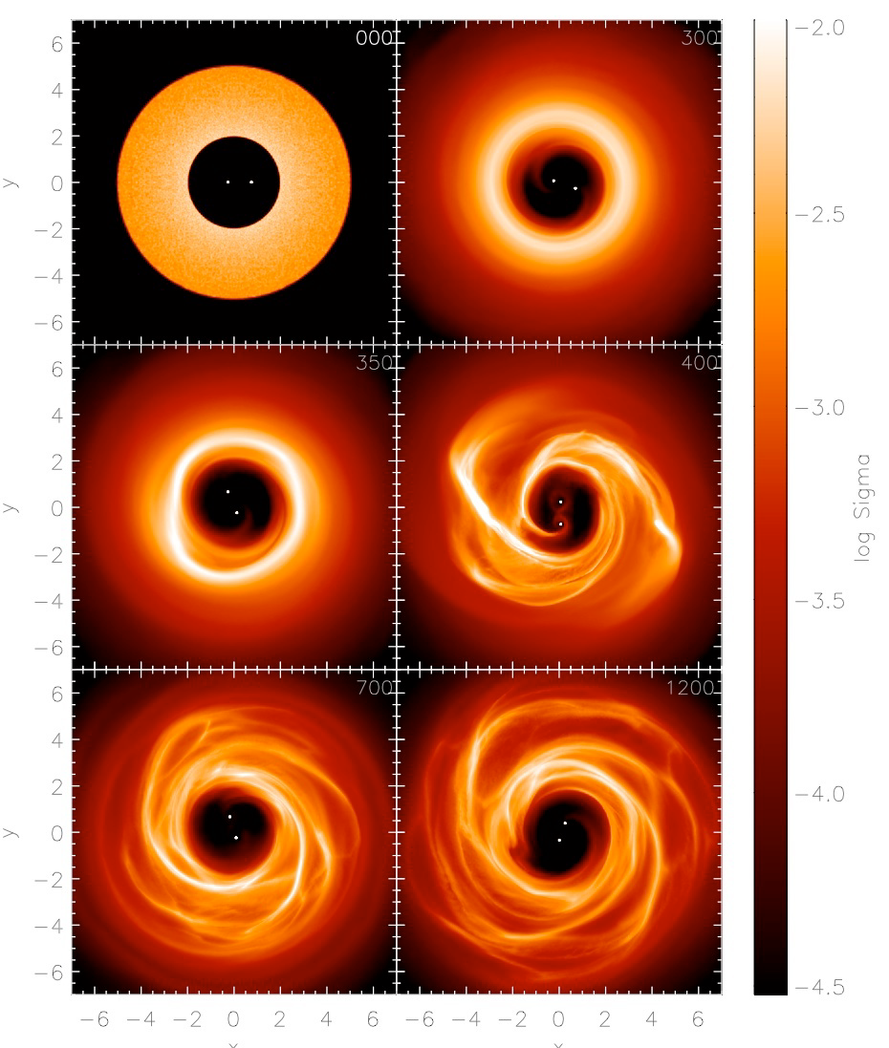
BINARY HARDENING IN CIRCUM-BINARY DISC
GAP OPENING
I. THE BLACK HOLES DEPOSIT ORBITAL ANGULAR MOMENTUM IN THE DISC AFTER EXCITING A TRAILING SPIRAL WAVE OPENING A GAP
II. TURBULENCE & VISCOSITY REDISTRIBUTE THE DISC ANGULAR MOMENTUM CAUSING INFLOWS THAT MAINTAIN THE CONTACT OF THE BINARY WITH THE DISC
EQUILIBRIUM BETWEEN GRAVITATIONAL TORQUE FROM THE BINARY AND VISCOUS TORQUE IN THE DISC LEADS TO BLACK HOLE MIGRATION
CUADRA et al. ,2009, ROEDIG, MC et al. 2011
ARMITAGE & NATARAJAN 2002
GOULD 1990

Slide 13
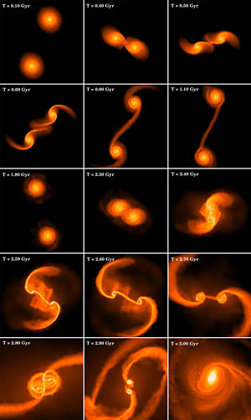
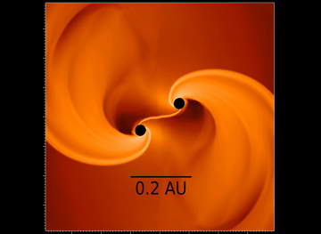
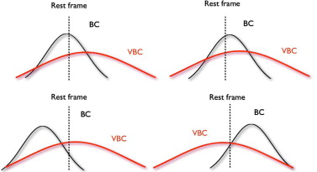
(Marziani & Sulentic,2012,NewAR,56,49)

Slide 14
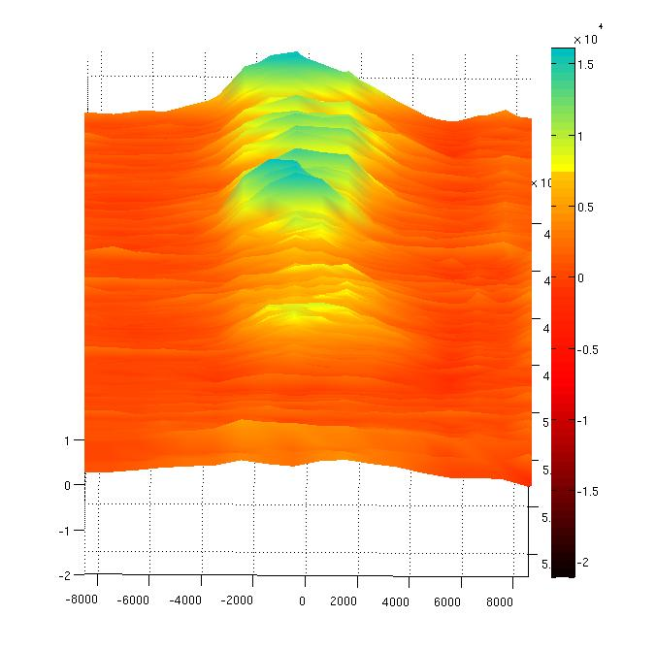
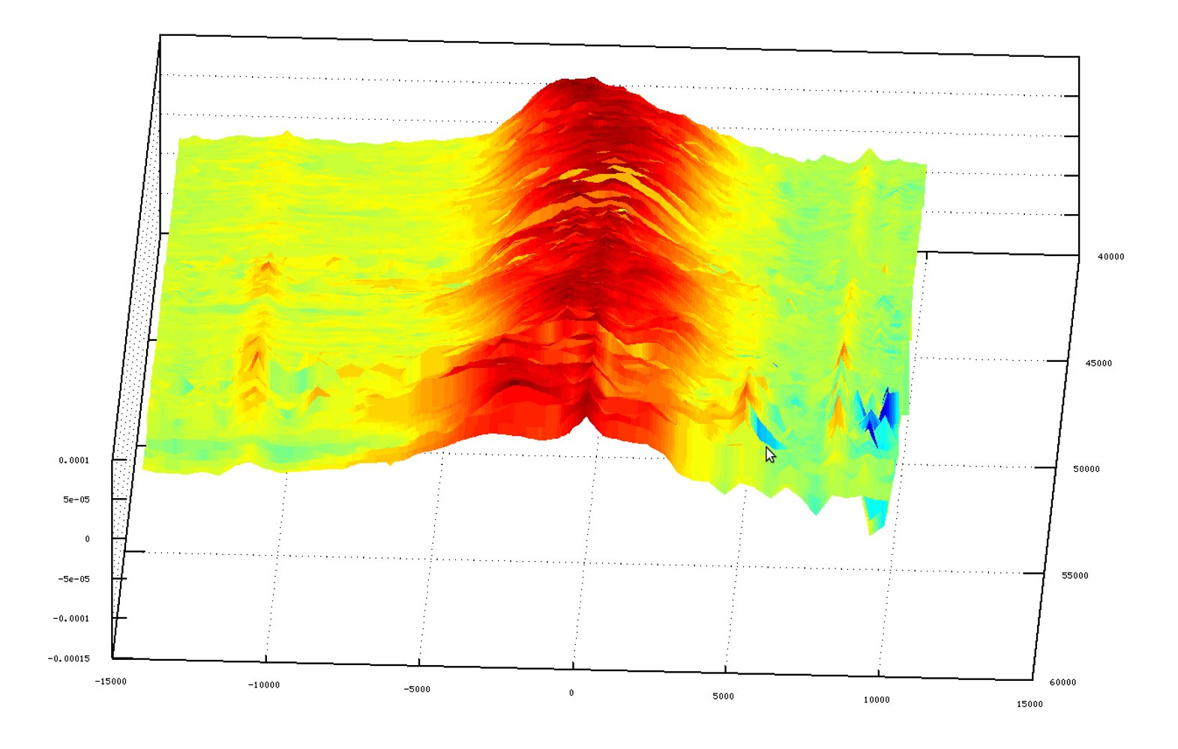
NGC5548

Slide 15
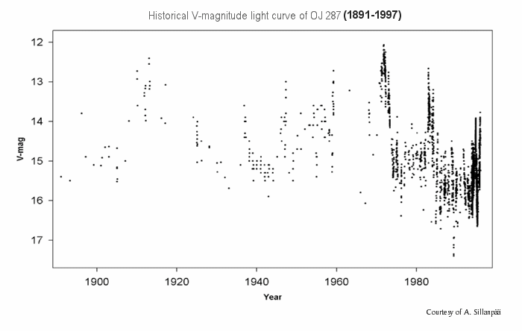
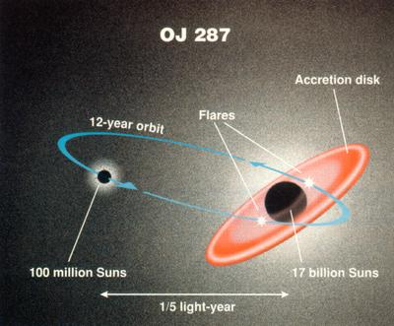
OJ287
Mauri Valtonen

Slide 16
“A possible close supermassive black-hole binary in a quasar with optical periodicity”
Matthew J. Graham, S. G. Djorgovski, Daniel Stern
Nature, 2015.
PKS 1302-102

Slide 17
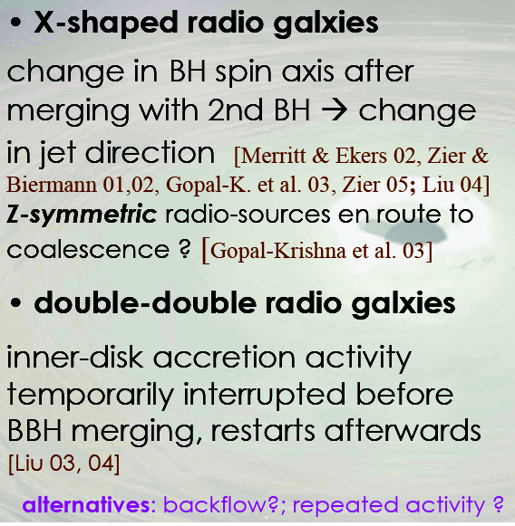


Slide 18
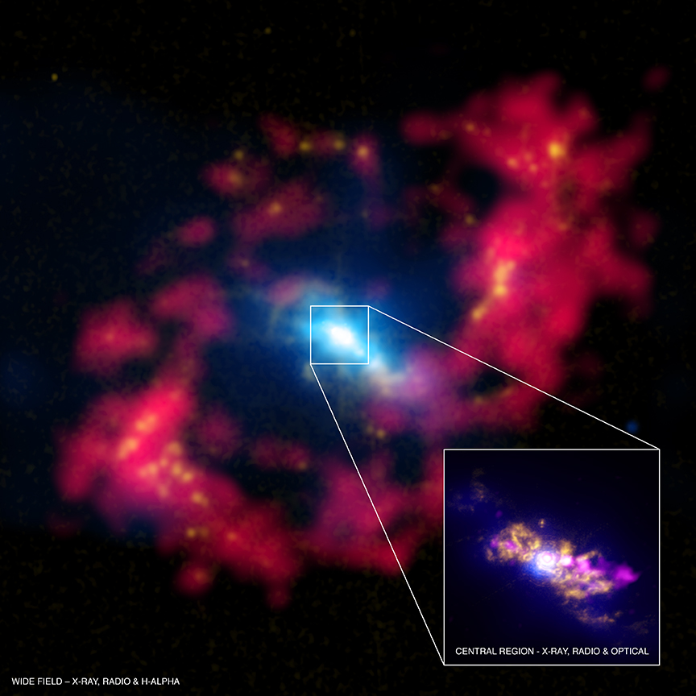
NGC4151
NGC 4151

Slide 19
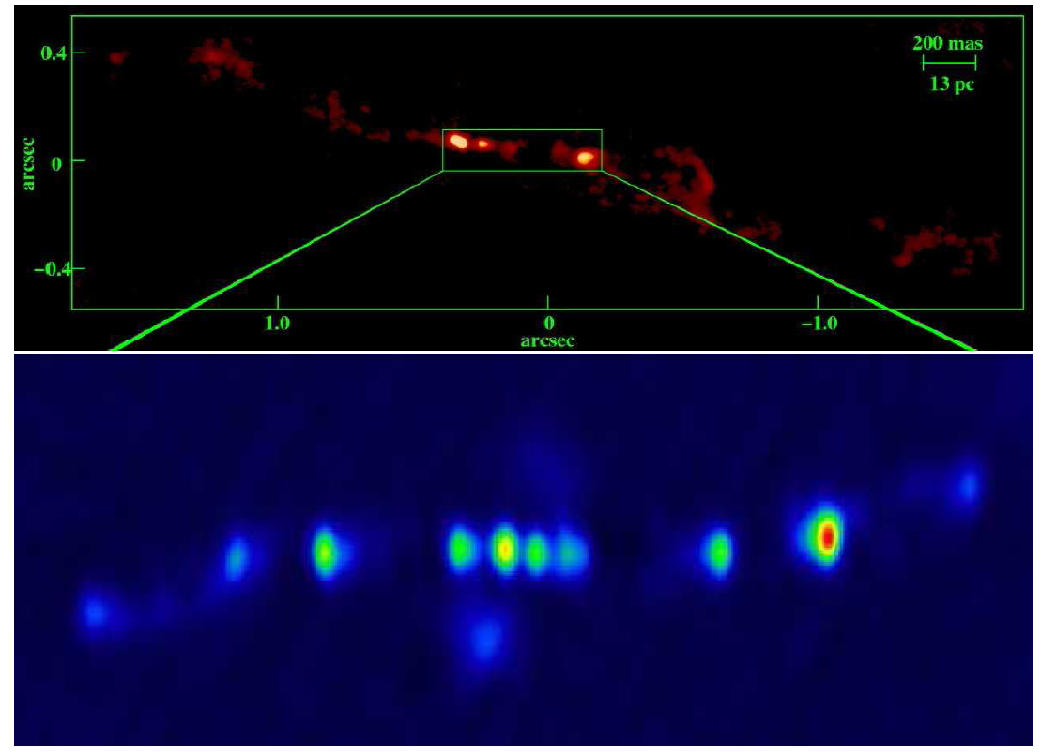
NGC4151

Slide 20
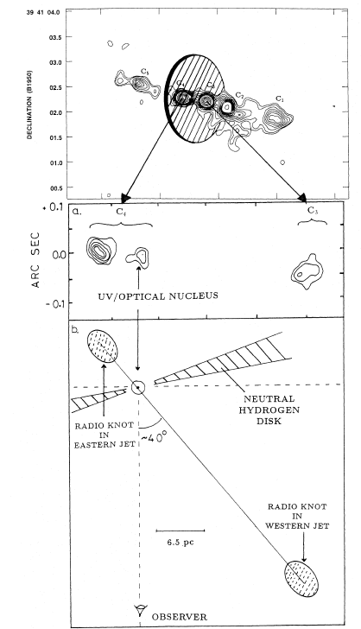
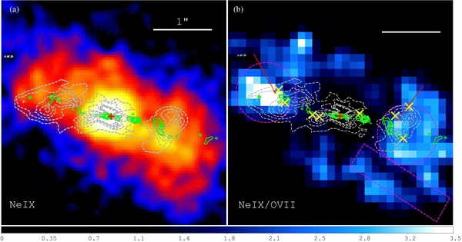
NGC 4151 –
2.2 μm dust emission lags λ5500
≈ 50d
(Minezaki et al. 2006)

Slide 21
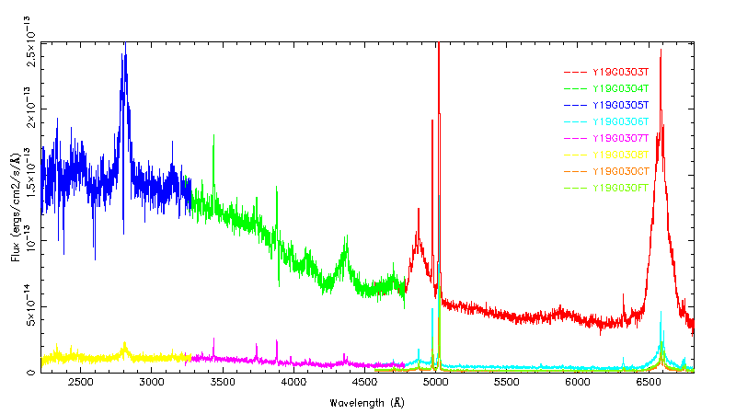
PROMENLJIVOST SPEKTARA

Slide 22
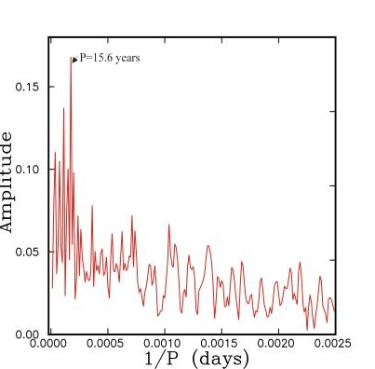
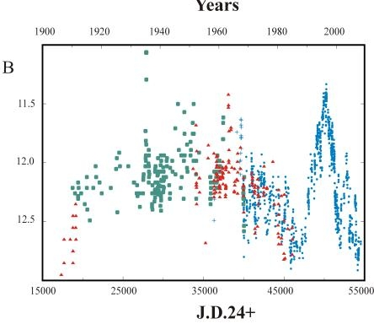
NGC 4151 promenljivost u 100 godina
V. Lyuty V. Oknyanskij, SAI, 2007
"PeremennyeZvezdy", Prilozhenie, vol. 7, N 28 (2007)

Slide 23
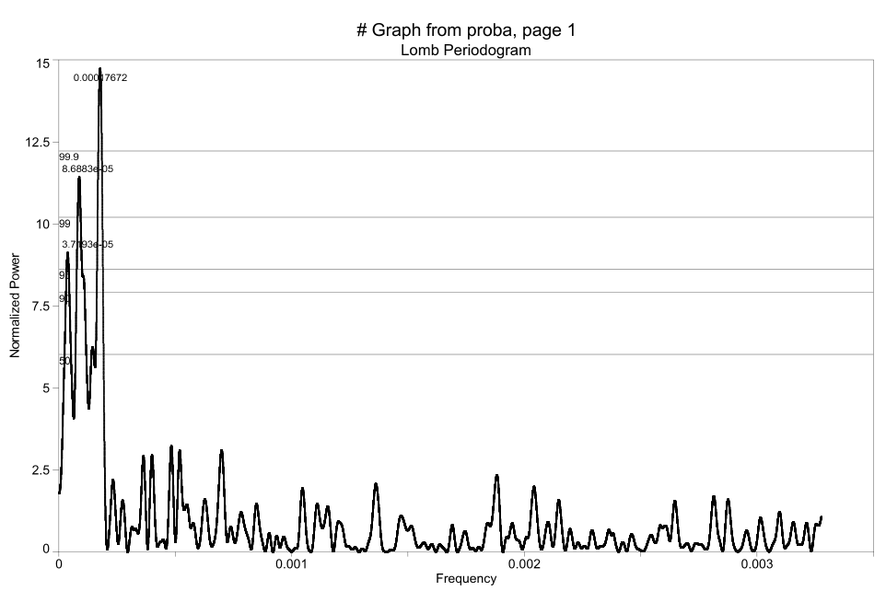
Lomb-Scargle Periodogram of 100 year data
1 / 0.000176=15.6 years

Slide 24
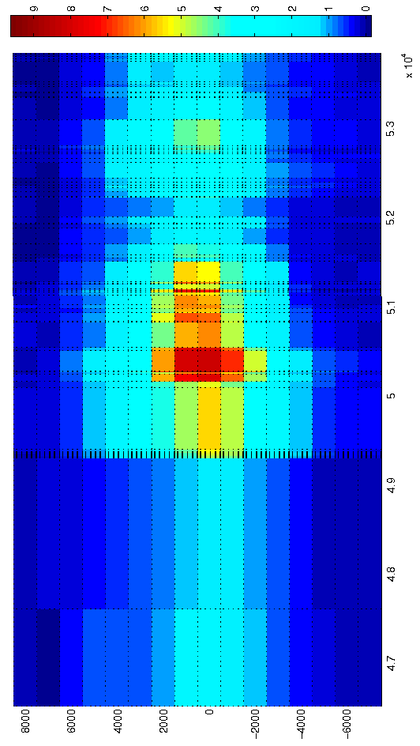
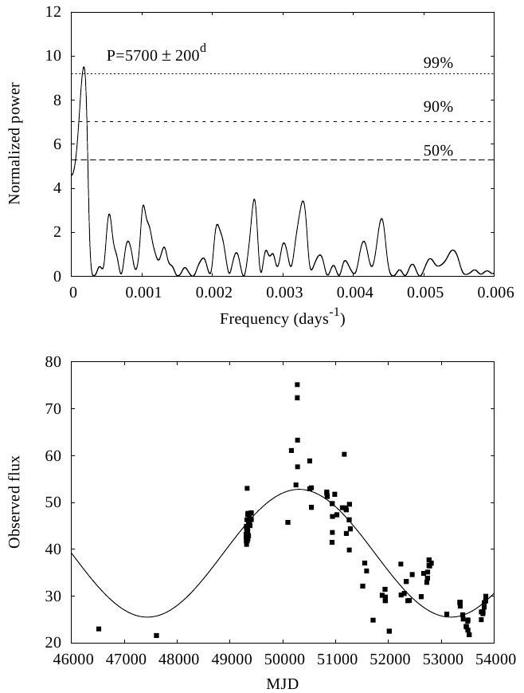
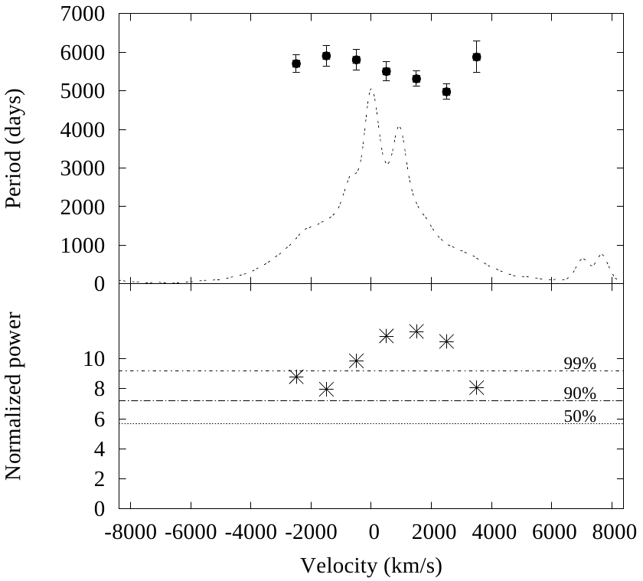
Periodogram of the Hα line variations
Total Hα flux
MJD
1000 km/s bins
Fit sine function
P=5700 d
Lomb Scargle periodogram
of 1000km/s lightcurve bins
Partial Hα flux

Slide 25
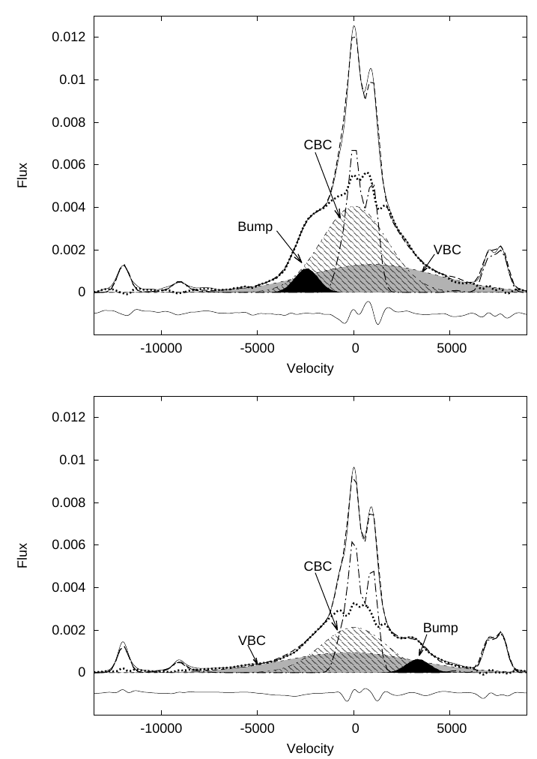
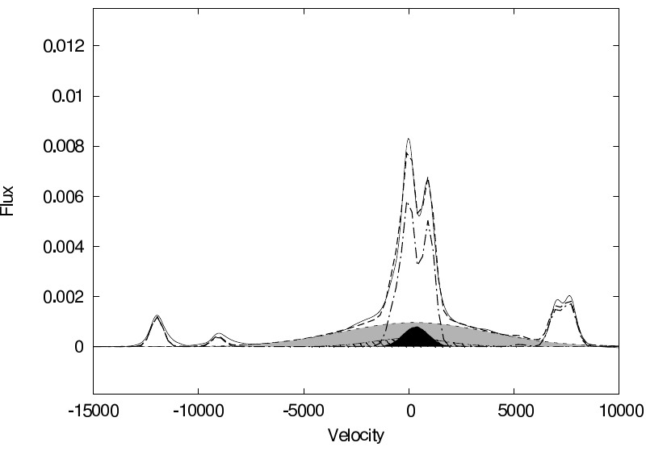
THE MODEL
Suma Gausiana:
σVBC = 3400 km/s
σCBC = 1700 km/s
σBump = 600 km/s
+ Narrow line template

Slide 26
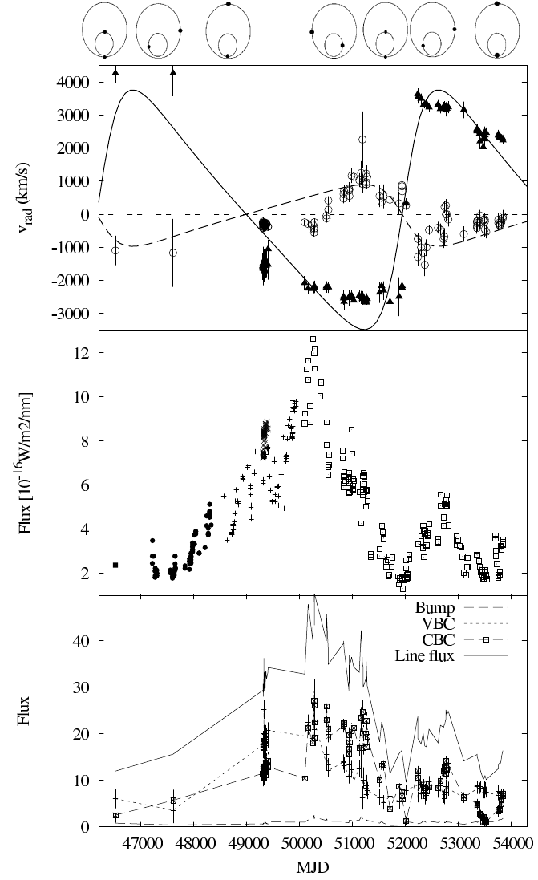
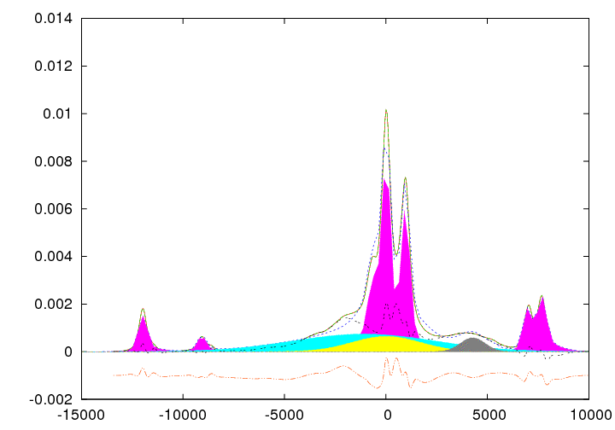
The flux maximum in the lightcurve correspond to the approaching phase of a secondary component towards the observer.
According to the obtained results we speculate that the periodic variations in the observed Hα line shape and flux are due to shock waves generated by the supersonic motion of the components through the surrounding medium.
VBC=prim BH
Bump = sec BH
a1 sin i = 0.002 pc
a2 sin i = 0.008 pc
m1sin3 i=3·107M⊙
m2sin3 i=8.5·106M⊙

Slide 27
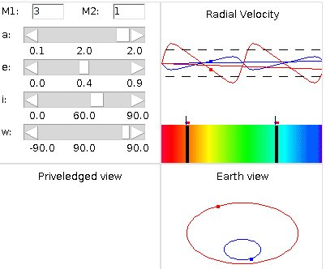
Nova posmatranja:
K1 = 690 km/s
e = 0.42
ω = 5
P = 5790
K1/K2 = 0.23
a1 sin i = 0.002 pc
a2 sin i = 0.008 pc
m1sin3 i=3·107M⊙
m2sin3 i=8.5·106M⊙
More details in: E. Bon et al. 2012 ApJ 759 118

Slide 28
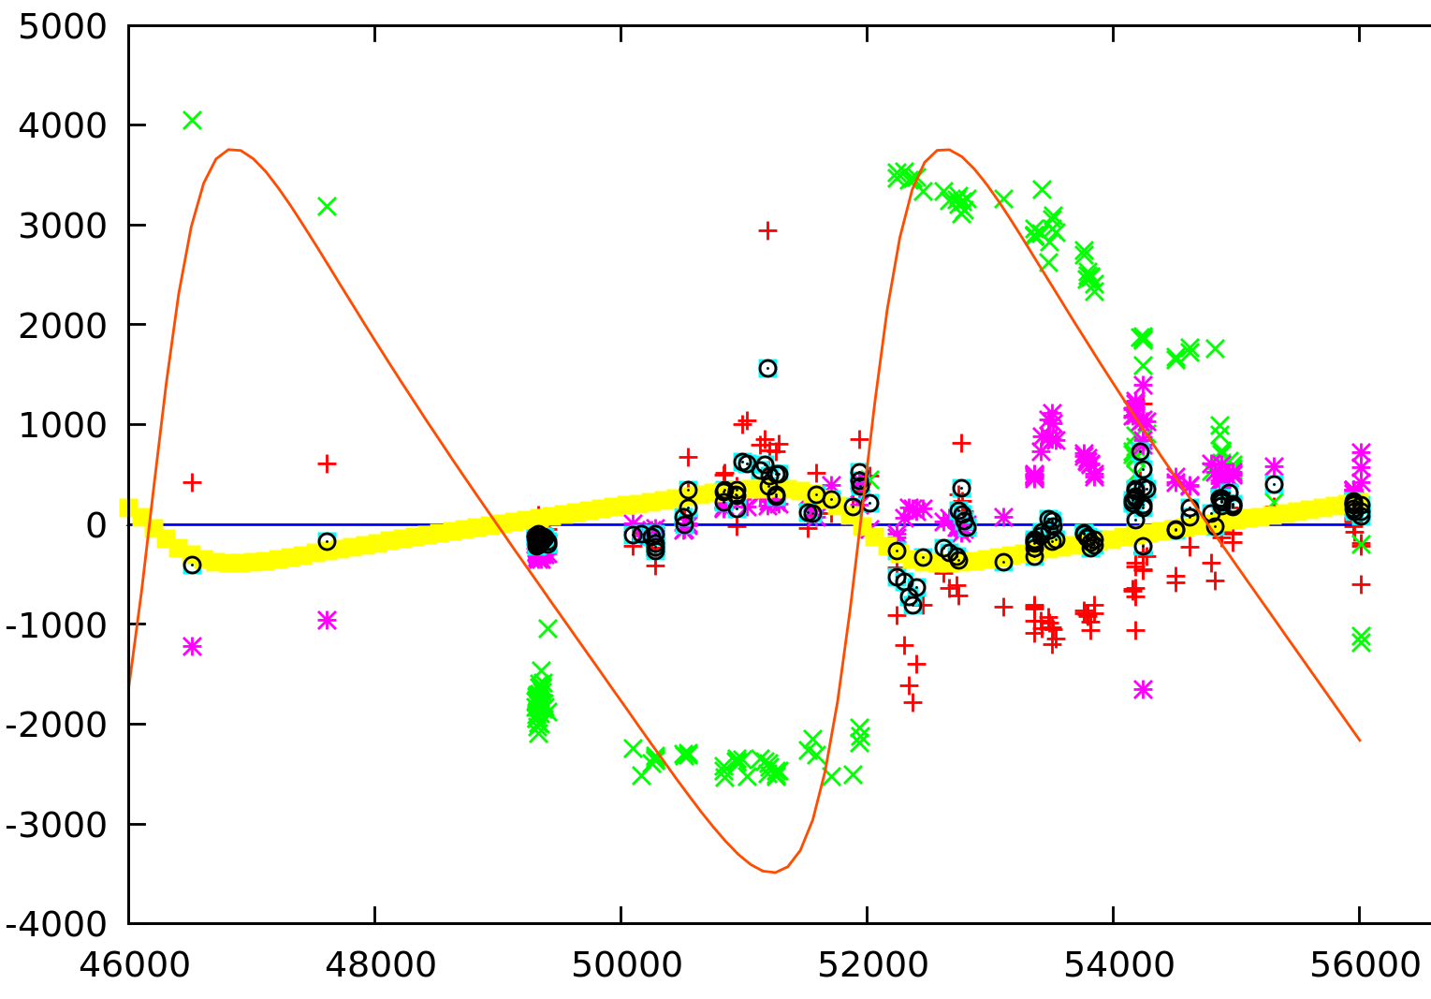

Slide 29
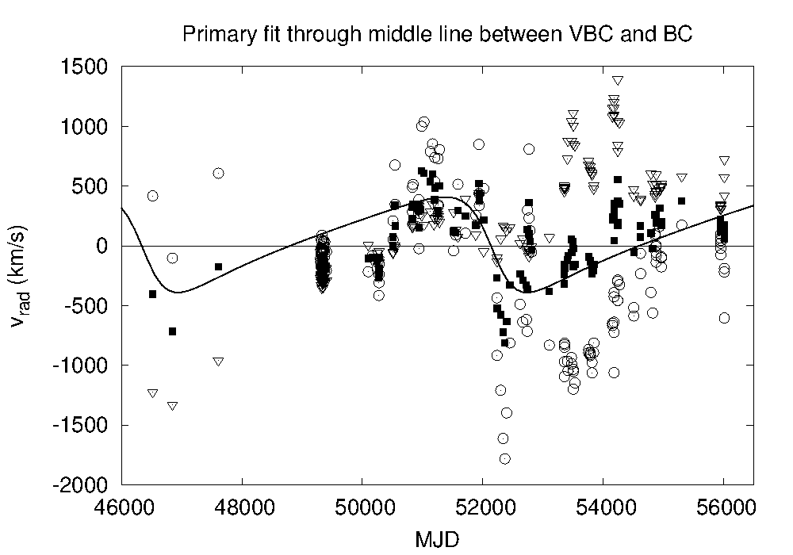

Slide 30
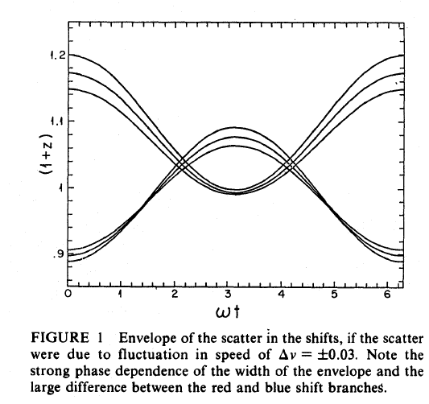

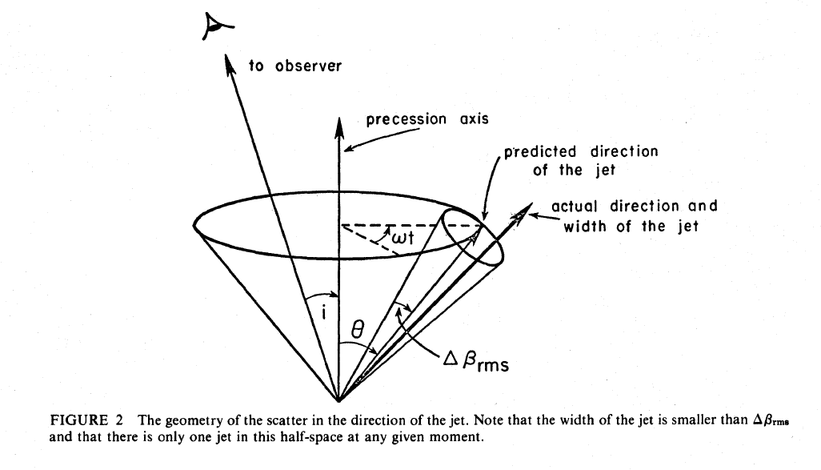

Jitter model used for SS 433-A
Katz, J. I.; Piran, T. Astrophysical Letters, vol. 23, no. 1, 1982, p. 11-15.

Slide 31
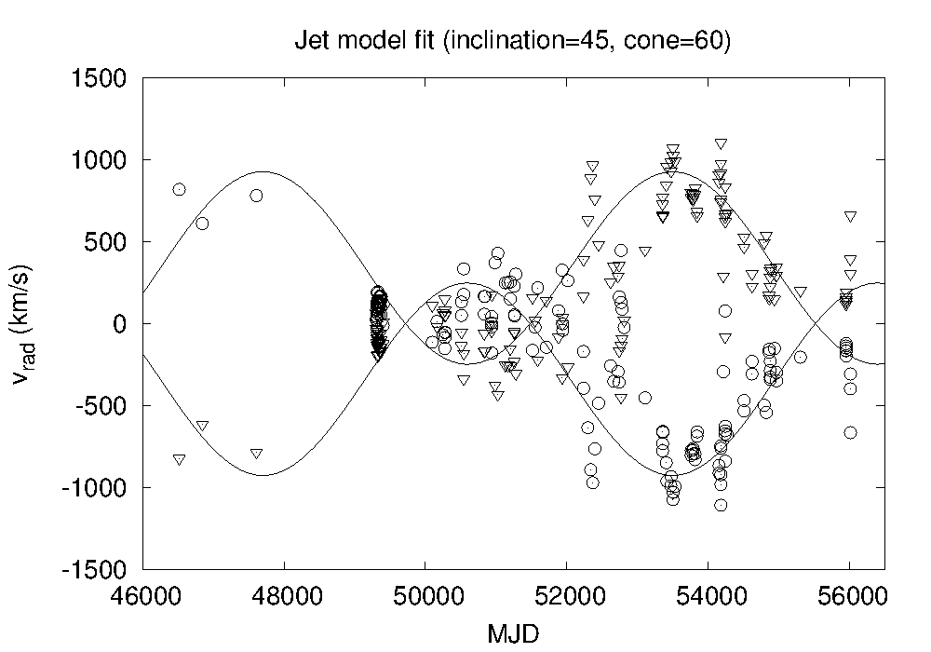
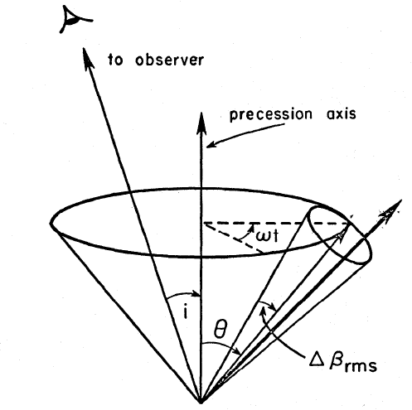
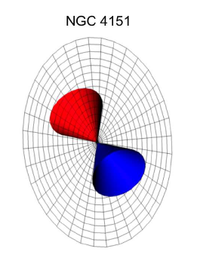
BC & VBC after subtracting the radial velocity curve of the primary
BH component
...or inclination of 60 and cone of 45
BC
VBC
This result is the same as the one obtained using OIII line from HST data (Das 2005, Apj)

Slide 32
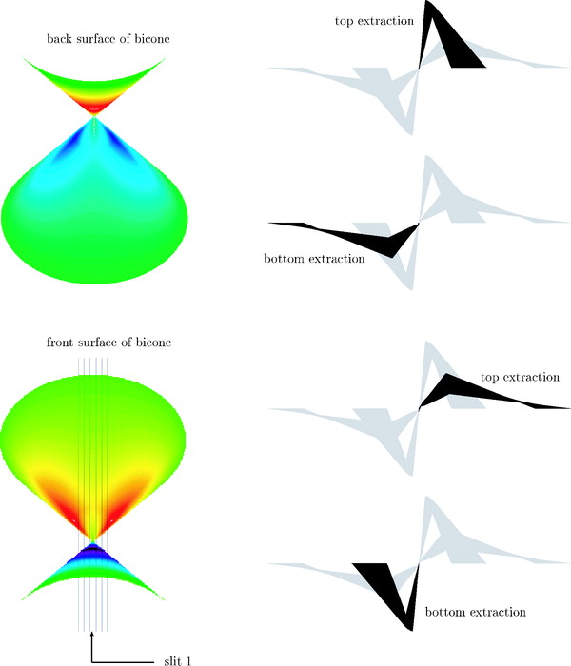
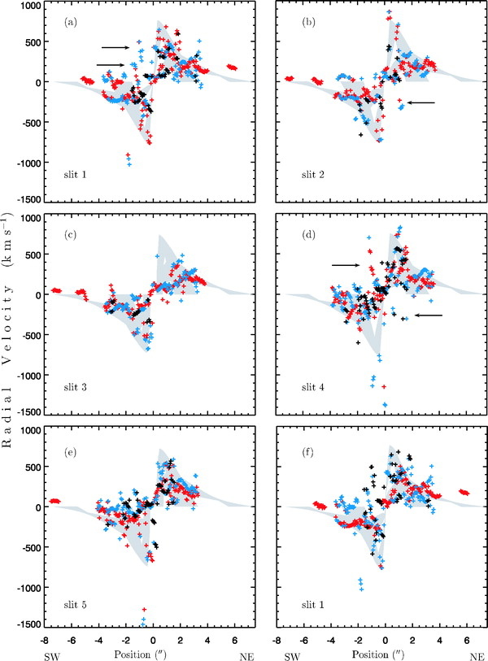
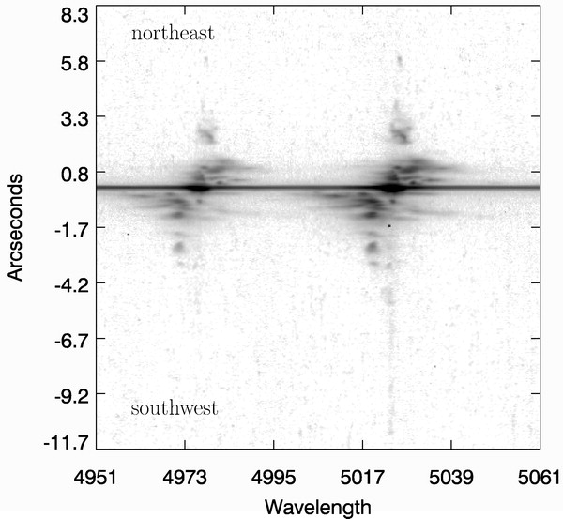
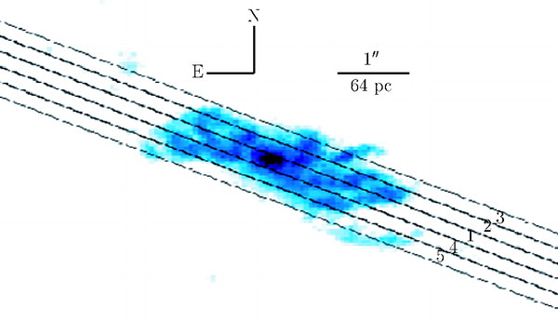

Slide 33
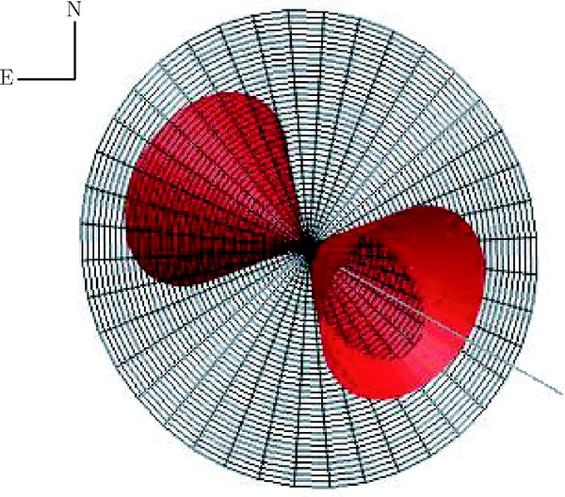
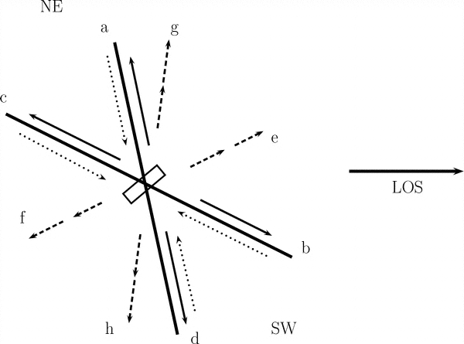
(LOS) is to the right, and the bottom of the bicone is tilted out of the plane of the sky, corresponding to 45° in our model. The rectangle in the middle of the figure represents the torus. The largest opening angle is shown here (cartoon not drawn to scale).
The position angle of the galaxy is 22°, with an inclination of 20° to the line of sight, the southwest side being closer to us. The position angle of the bicone is 60°, and its inclination is 45°. The maximum half-opening angle of the bicone is shown here to be 33°. Note that our line of sight is outside of the bicone, at an angle of 12° with respect to the nearest part of the bicone. The angle, which is the angle between the bicone axis and the normal to the galactic disk, is 36°.

Slide 34
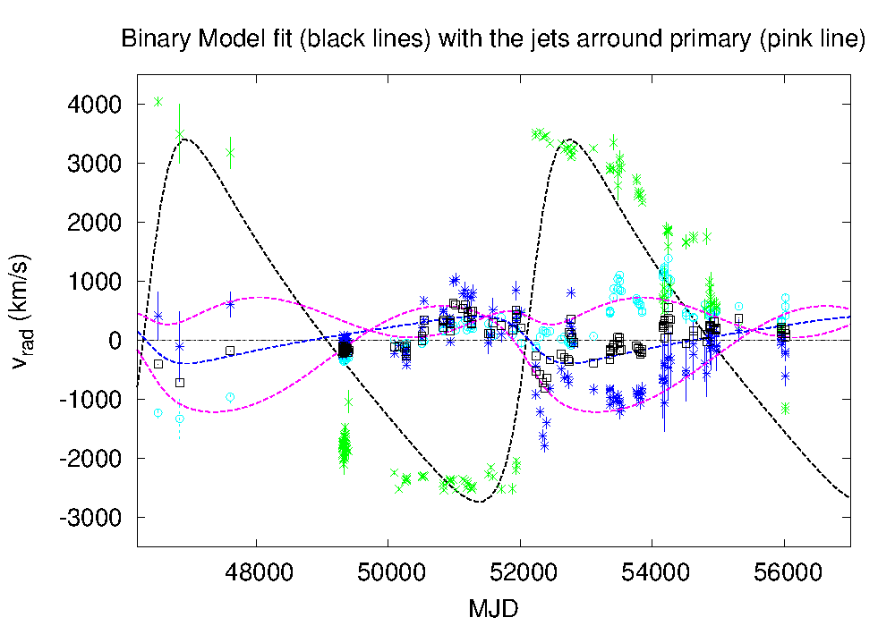
e = 0.42
P = 5780 days (~16y)
i=45◦ =>
  0.003 pc
  0.01 pc,
  4· 107 M⊙
  1· 107 M⊙

Slide 35
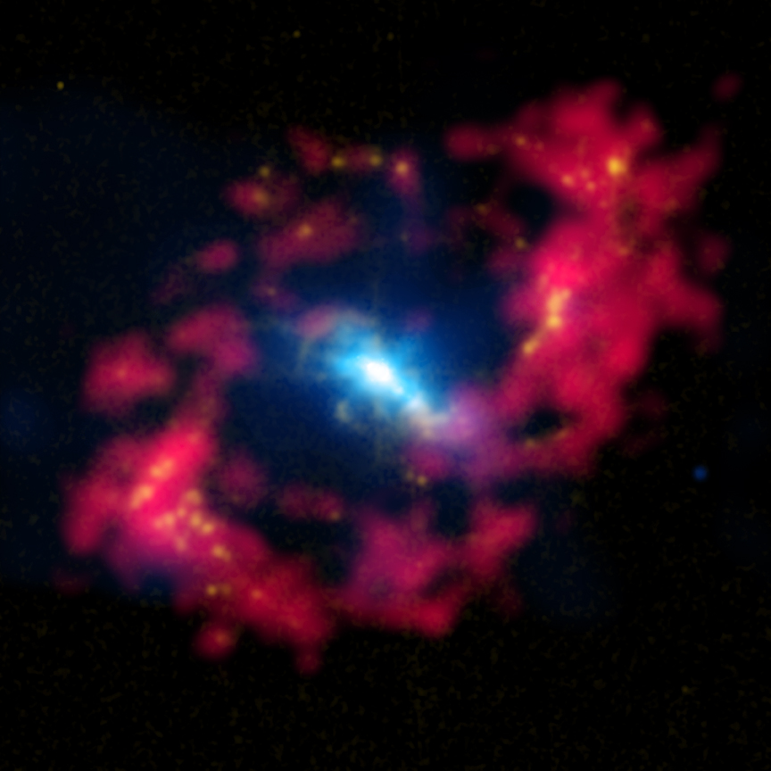
Thank you for attention
Thank you for attention

